Slide 1

SUMMER TRAINING
Seven Weeks at Tasheel Information Technology
Aldana Ashraf Felemban — Computer Science
5 July – 20 August 2026

Slide 2
Training Roadmap
Seven weeks, from onboarding to full system integration
1
2
3
4
5
6
7
Onboarding
System
Analysis
EmployeeForm
Development
Collaborative
Development
AVS Database
Design
AVS Coding & Testing
System
Integration
Two systems built end-to-end: EmployeeForm (EFS) and the Airport Visit Management System (AVS) — designed, developed, tested, and integrated into a single connected platform.
Tasheel Information Technology • Training
Overview

Slide 3

WEEK 1
Onboarding & Git Fundamentals
5 – 9 July 2026
Introduced to Tasheel IT, its tools, and services
Set up Git and GitHub environment
Practiced commits, branching, and merging
Reviewed the company's Project Tracking System
Tasheel Information Technology • Training
Week 1 of 7

Slide 4

WEEK 2
System Analysis — Project Tracking System
12 – 16 July 2026
Analyzed PTS modules, users, and stakeholders
Interviewed a Project Manager on real usage
Wrote functional & non-functional requirements
Built use case and activity diagrams
Tasheel Information Technology • Training
Week 2 of 7

Slide 5

WEEK 3
EmployeeForm — Architecture & Delete Feature
19 – 23 July 2026
Reviewed EmployeeForm's MVC architecture
Designed the DeleteEmployee feature
Built admin safeguards and validation
Resolved a nested Git merge conflict
Tasheel Information Technology • Training
Week 3 of 7

Slide 6

WEEK 4
Collaborative Software Development
26 – 30 July 2026
Studied feature branches, PRs, and code review
Opened a pull request on GitHub
Worked through review conflicts
Merged DeleteEmployee into main
Tasheel Information Technology • Training
Week 4 of 7

Slide 7
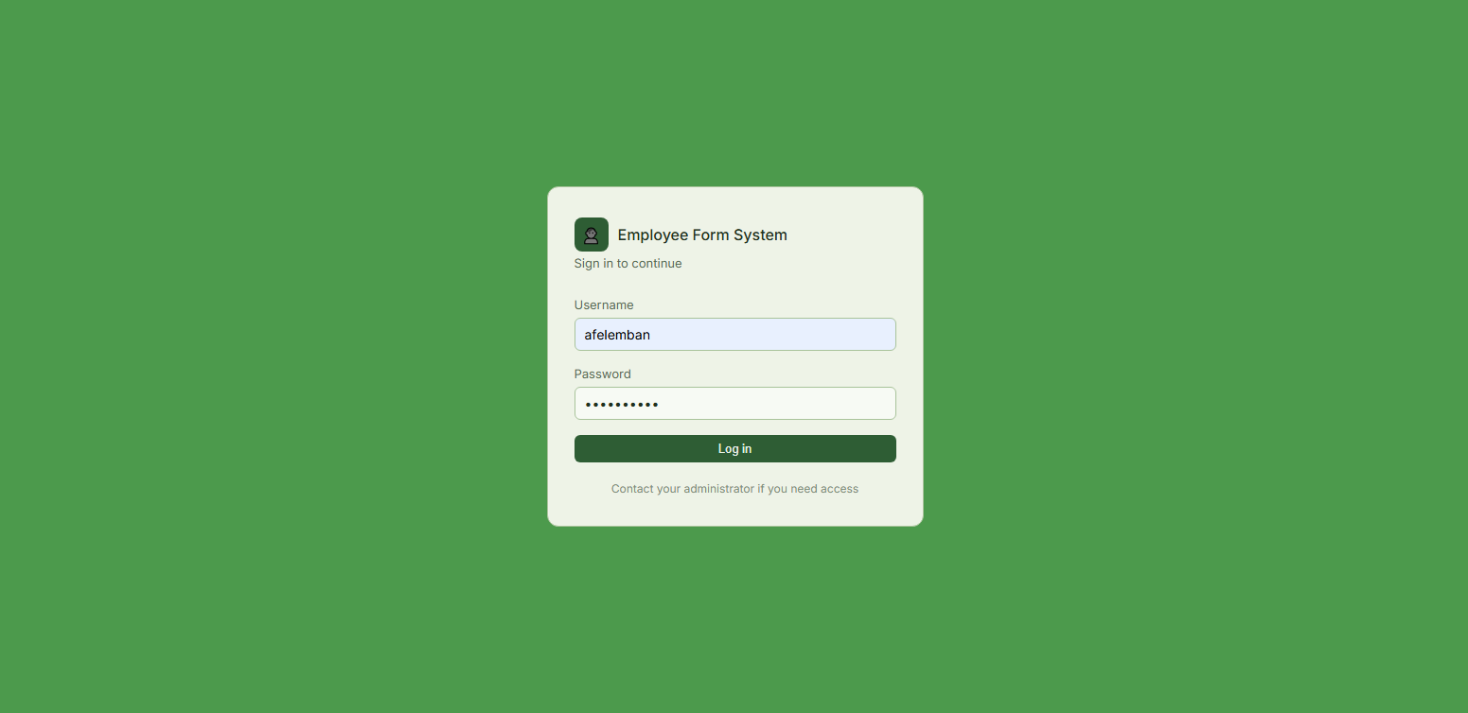
SYSTEM WALKTHROUGH
EmployeeForm (EFS)
Page: Login
Process in action: Logging in as Admin
https://efs.tasheelinfotech.local/Login
Tasheel Information Technology • Training
EmployeeForm

Slide 8
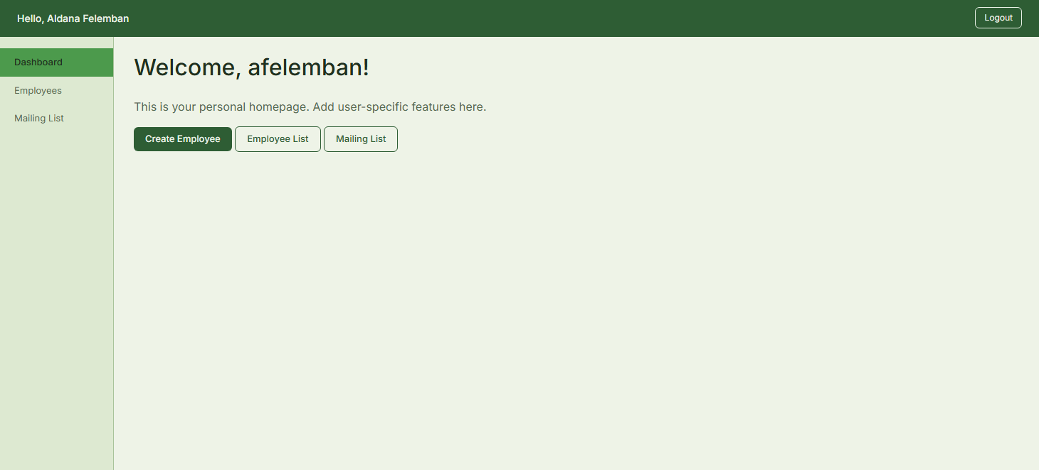
SYSTEM WALKTHROUGH
EmployeeForm (EFS)
Page: Dashboard
Process in action: Access to the systems modules.
https://efs.tasheelinfotech.local/...
Tasheel Information Technology • Training
EmployeeForm

Slide 9
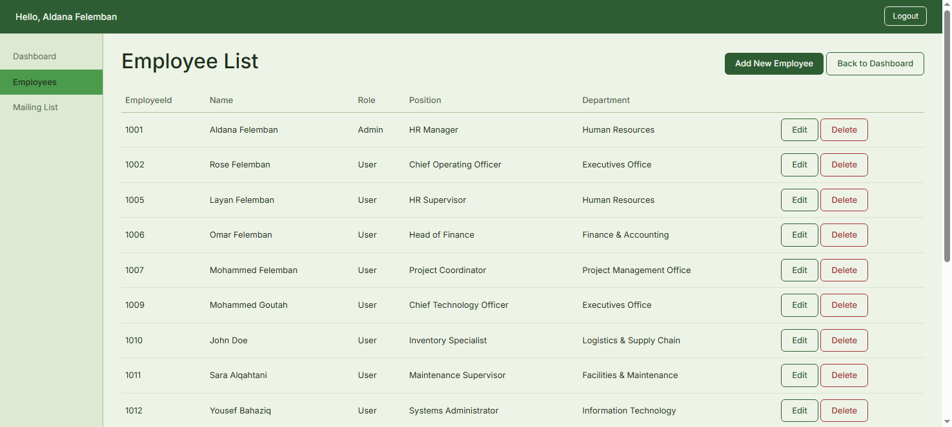
SYSTEM WALKTHROUGH
EmployeeForm (EFS)
Page: Employee List
Process in action: View, Add, and Edit employees.
https://efs.tasheelinfotech.local/...
Tasheel Information Technology • Training
EmployeeForm

Slide 10
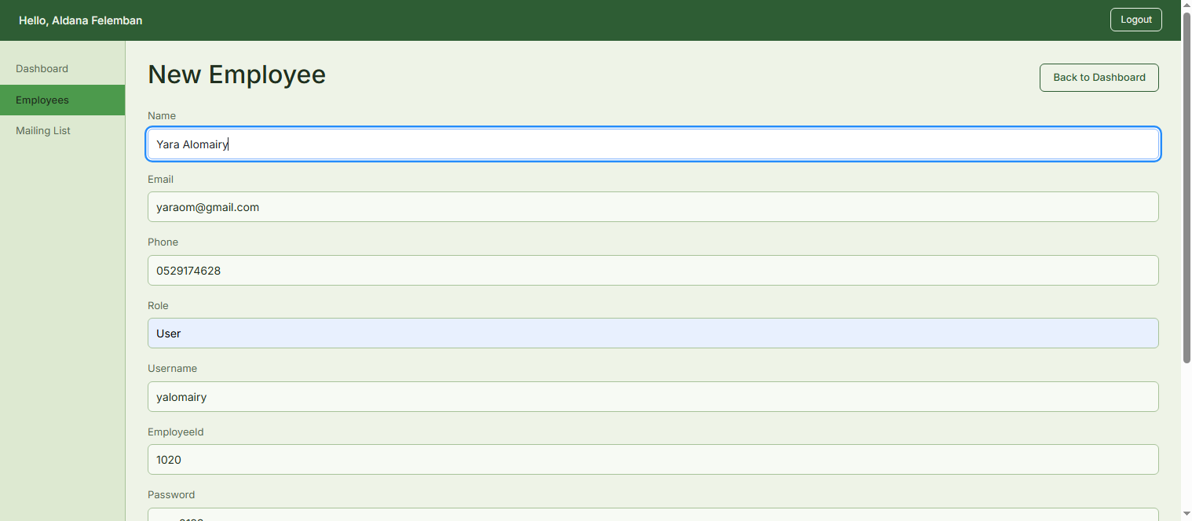
SYSTEM WALKTHROUGH
EmployeeForm (EFS)
Page: New Employee
Process in action: Registering a new Employe to the system.
https://efs.tasheelinfotech.local/...
Tasheel Information Technology • Training
EmployeeForm

Slide 11
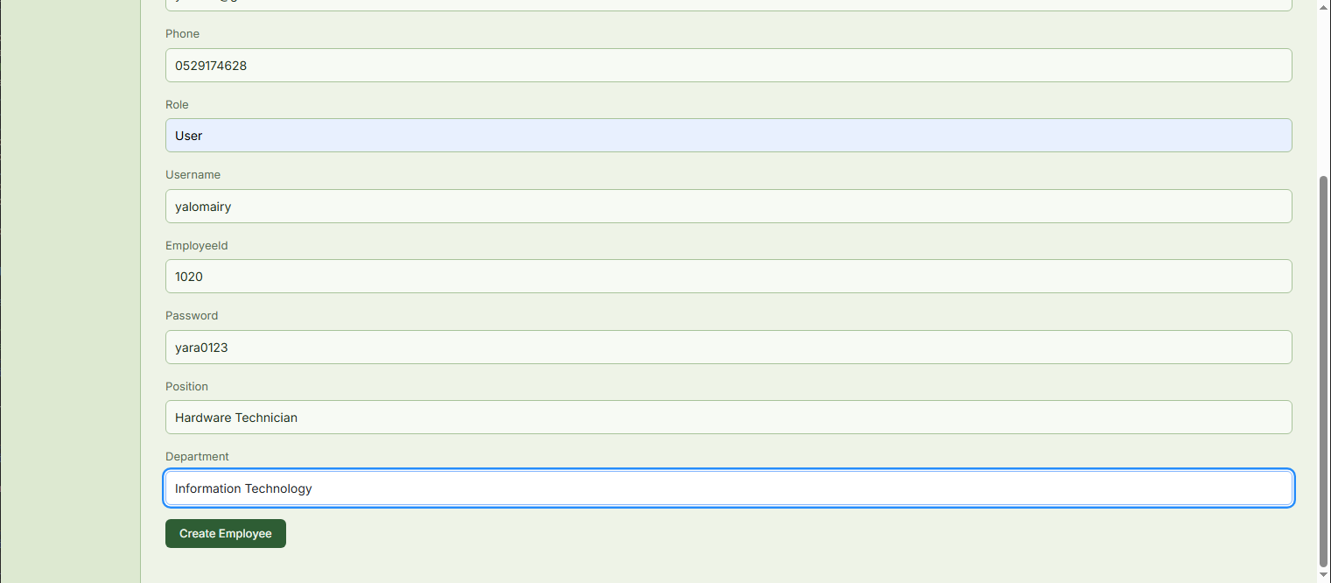
SYSTEM WALKTHROUGH
EmployeeForm (EFS)
Page: New Employee (continued)
Process in action: Registering a new Employe to the system.
https://efs.tasheelinfotech.local/...
Tasheel Information Technology • Training
EmployeeForm

Slide 12
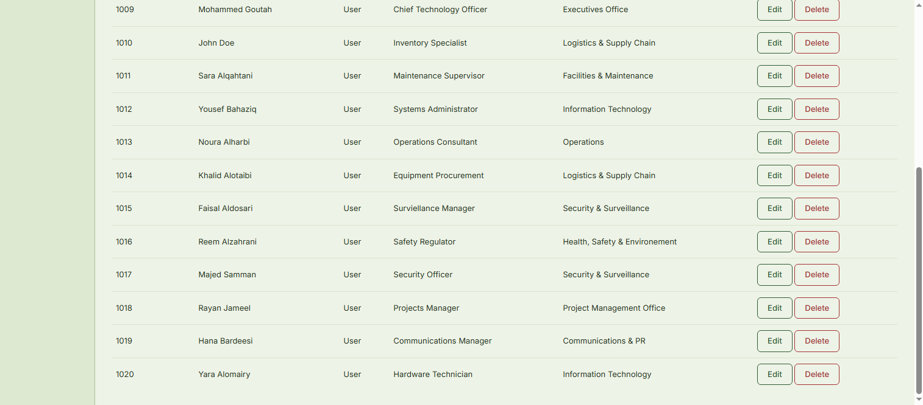
SYSTEM WALKTHROUGH
EmployeeForm (EFS)
Page: Employee List
Process in action: Adding new employee complete.
https://efs.tasheelinfotech.local/...
Tasheel Information Technology • Training
EmployeeForm

Slide 13
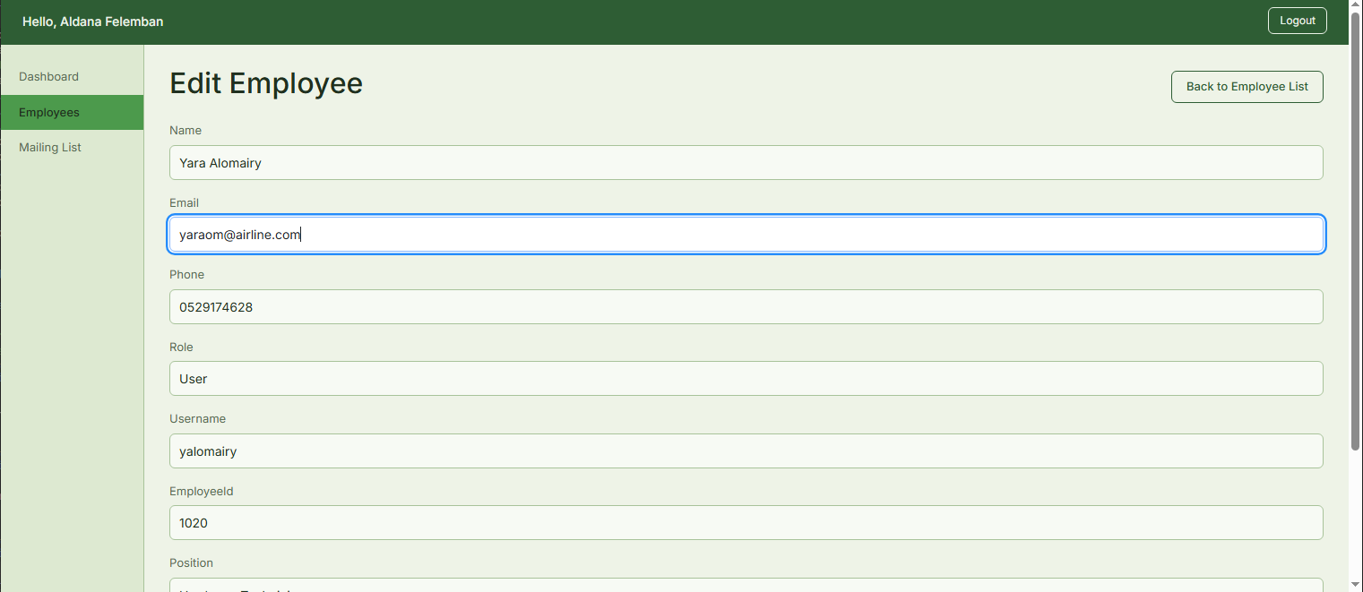
SYSTEM WALKTHROUGH
EmployeeForm (EFS)
Page: Edit Employee
Process in action: Editing employee details (Email).
https://efs.tasheelinfotech.local/...
Tasheel Information Technology • Training
EmployeeForm

Slide 14
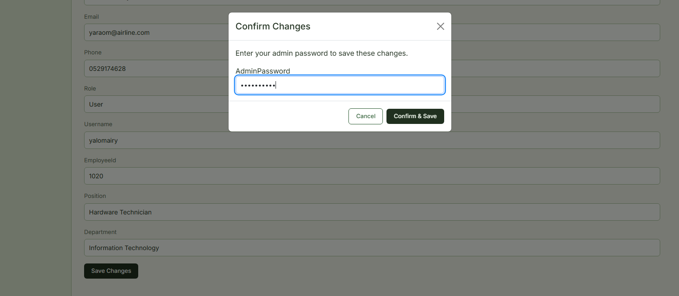
SYSTEM WALKTHROUGH
EmployeeForm (EFS)
Page: Edit Employee Confirmation
Process in action: Entering password to save changes.
https://efs.tasheelinfotech.local/...
Tasheel Information Technology • Training
EmployeeForm

Slide 15
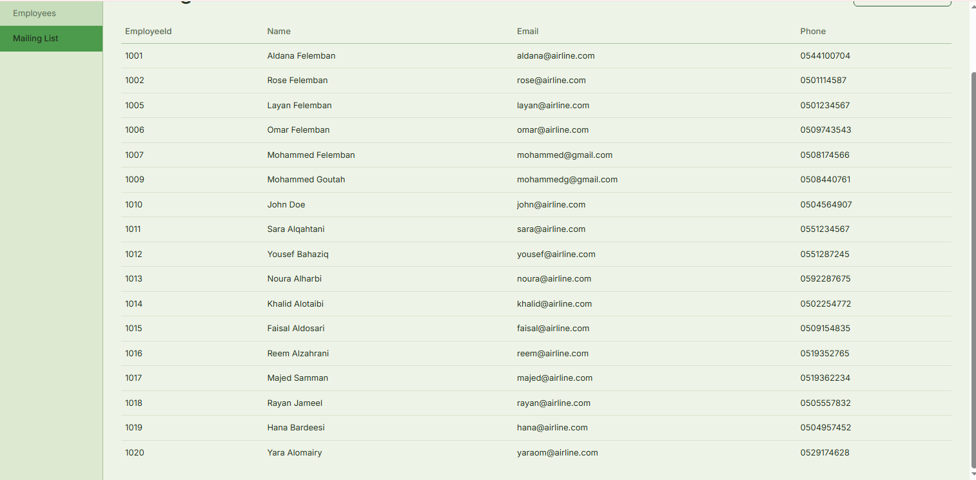
SYSTEM WALKTHROUGH
EmployeeForm (EFS)
Page: Mailing List
Process in action: Changes to Email were saved.
https://efs.tasheelinfotech.local/...
Tasheel Information Technology • Training
EmployeeForm

Slide 16
SYSTEM WALKTHROUGH
EmployeeForm (EFS)
Page: Employee List
Process in action: Deleting employee from the system.
https://efs.tasheelinfotech.local/...
Tasheel Information Technology • Training
EmployeeForm

Slide 17
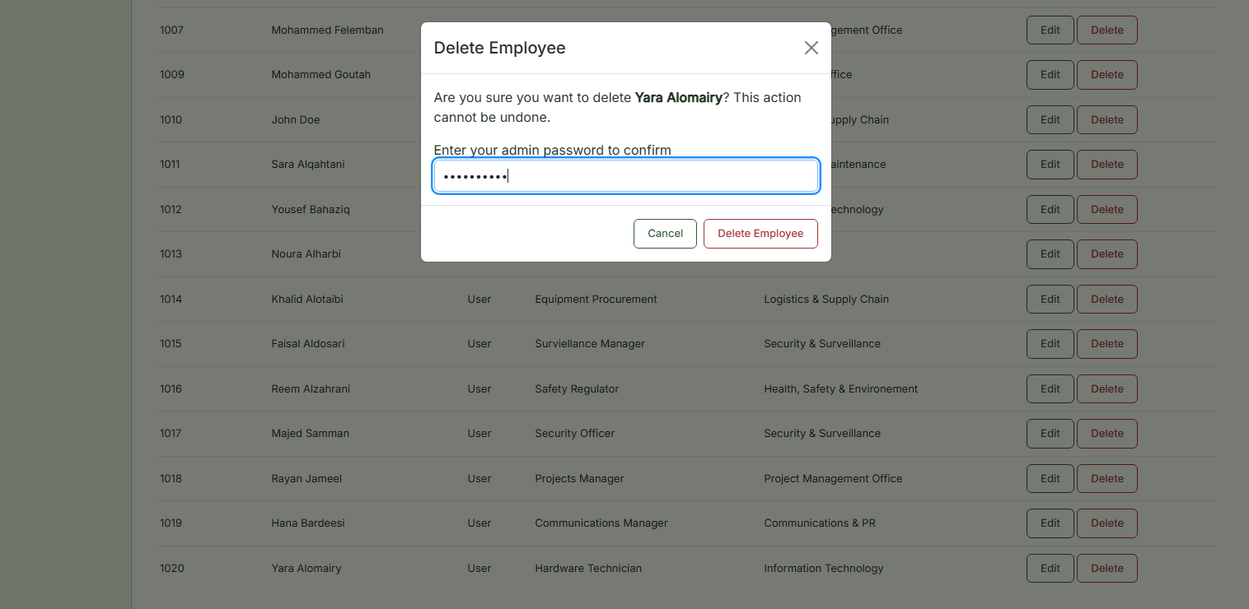
SYSTEM WALKTHROUGH
EmployeeForm (EFS)
Page: Employee List (Delete Employee Pop-Up Window)
Process in action: Authorization and validation step before committing deletion.
https://efs.tasheelinfotech.local/...
Tasheel Information Technology • Training
EmployeeForm

Slide 18

WEEK 5
Airport Visit Management — Database Design
2 – 6 August 2026
Documented AVS scenario and business rules
Normalized schema through 1NF → 3NF
Implemented a 10-table schema in SQL Server
Wrote the first stored procedures
10
normalized database tables
Tasheel Information Technology • Training
Week 5 of 7

Slide 19

WEEK 6
Airport Visit Management — Development & Testing
9 – 13 August 2026
Built the application's remaining views
Implemented role-based login
Executed a full test case suite
Logged and resolved three defects
11
test cases executed
Tasheel Information Technology • Training
Week 6 of 7

Slide 20

WEEK 7
EFS + AVS Integration
16 – 20 August 2026
Connected EFS and AVS through an API
Unified employee login through EFS
Built AVS's registration flow & Admin role
Matched AVS's UI design across both systems
2
systems merged into one platform
Tasheel Information Technology • Training
Week 7 of 7

Slide 21
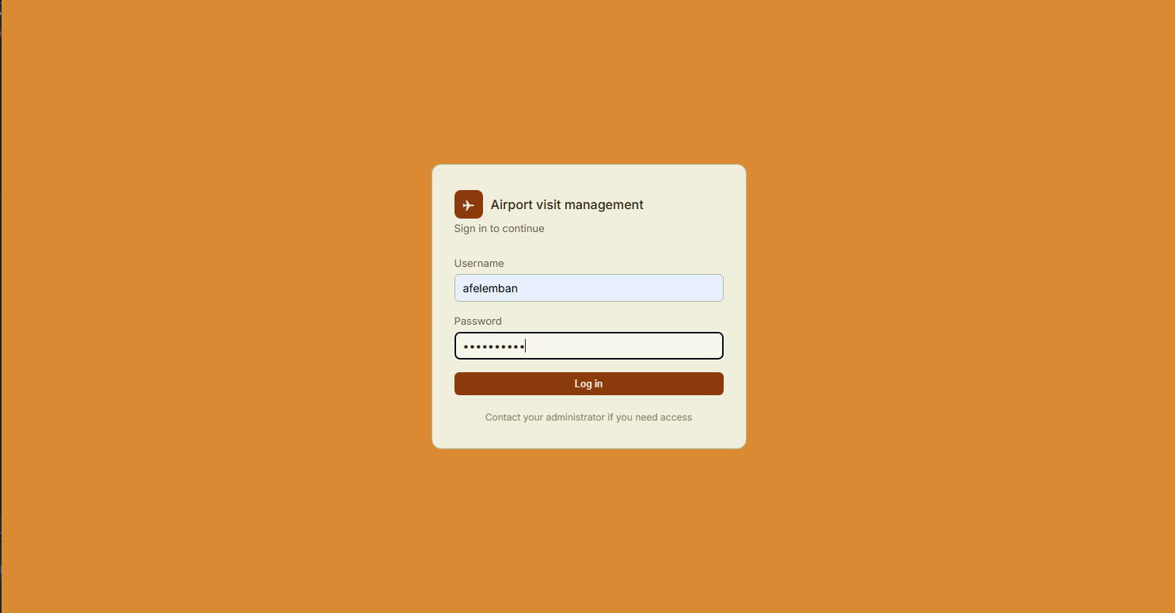
SYSTEM WALKTHROUGH
Airport Visit Management System (AVS + EFS Integration)
Page: Login
Process in action: Logging in as Admin.
https://efs.tasheelinfotech.local/...
Tasheel Information Technology • Training
Airport

Slide 22
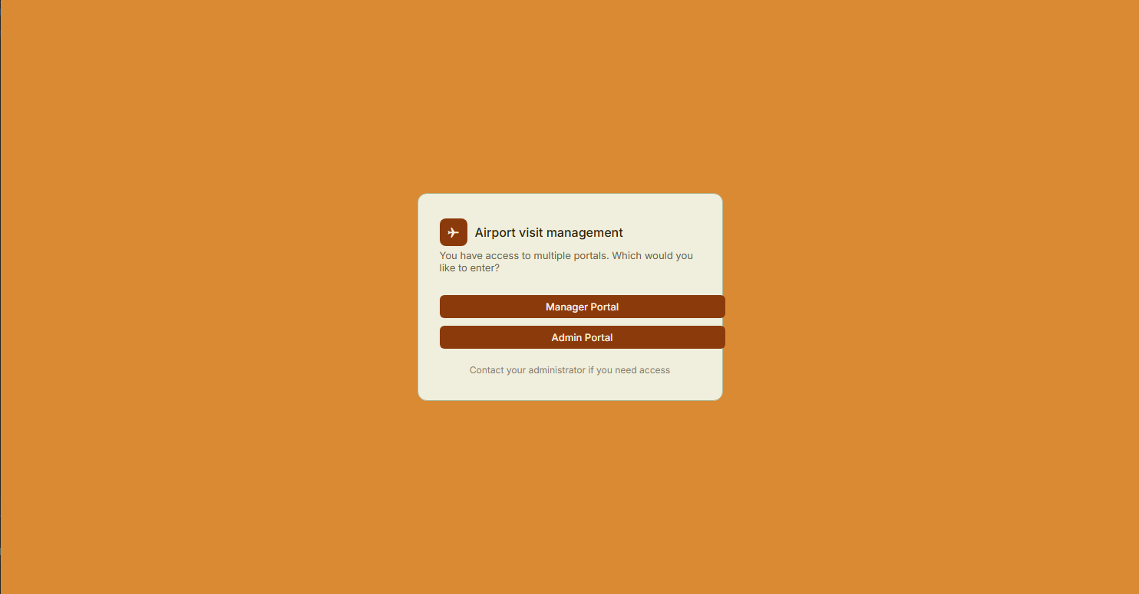
SYSTEM WALKTHROUGH
Airport Visit Management System (AVS + EFS Integration)
Page: Choose Portal
Process in action: Can choose to login as Admin or Manager.
https://efs.tasheelinfotech.local/...
Tasheel Information Technology • Training
Airport

Slide 23
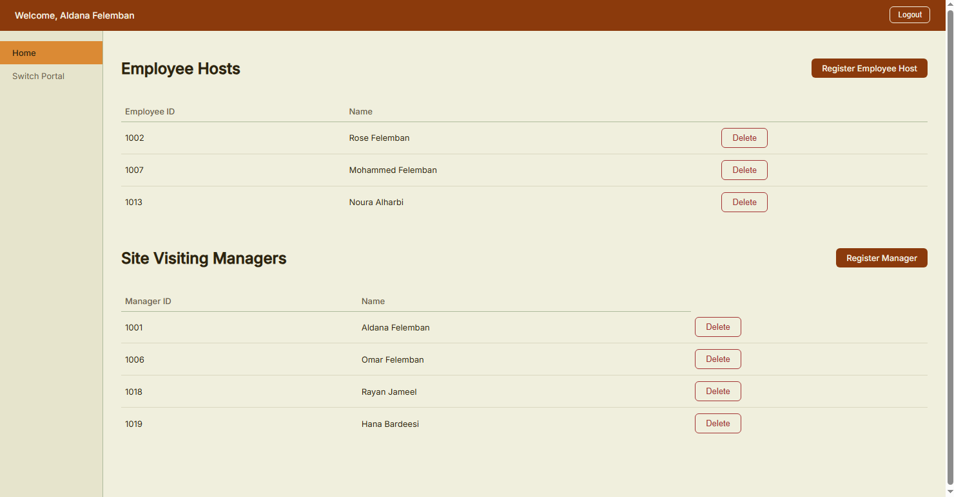
SYSTEM WALKTHROUGH
Airport Visit Management System (AVS + EFS Integration)
Page: Admin Dashboard
Process in action: Register new employee hosts and site visiting managers from existing employees in EFS.
https://efs.tasheelinfotech.local/...
Tasheel Information Technology • Training
Airport

Slide 24
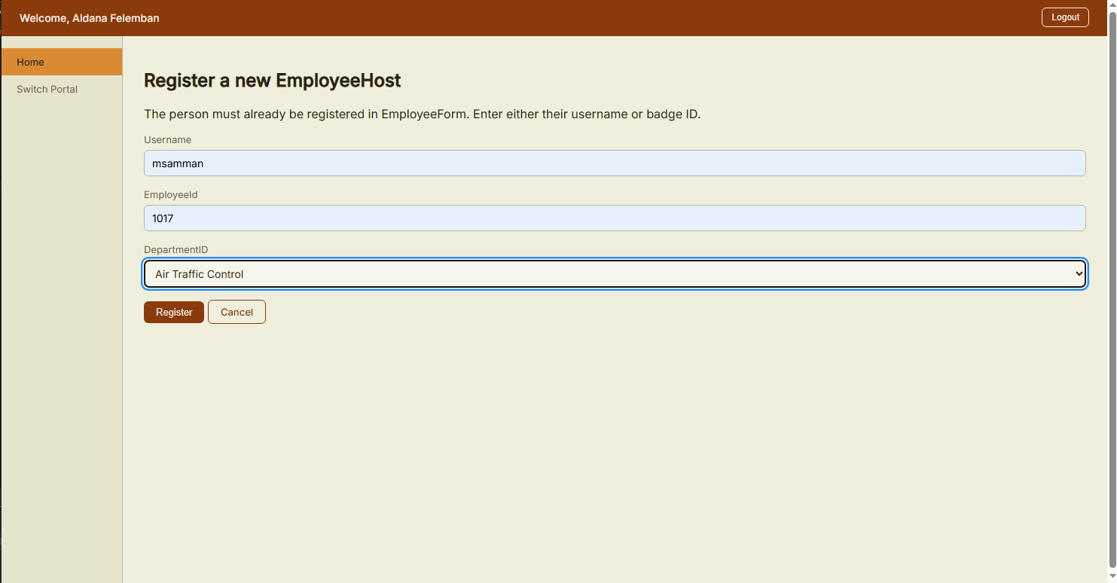
SYSTEM WALKTHROUGH
Airport Visit Management System (AVS + EFS Integration)
Page: Register Employee Host
Process in action: Register new employee host to system. Look up from EFS helps fill in username and link new employee host user to their employee record.
https://efs.tasheelinfotech.local/...
Tasheel Information Technology • Training
Airport

Slide 25
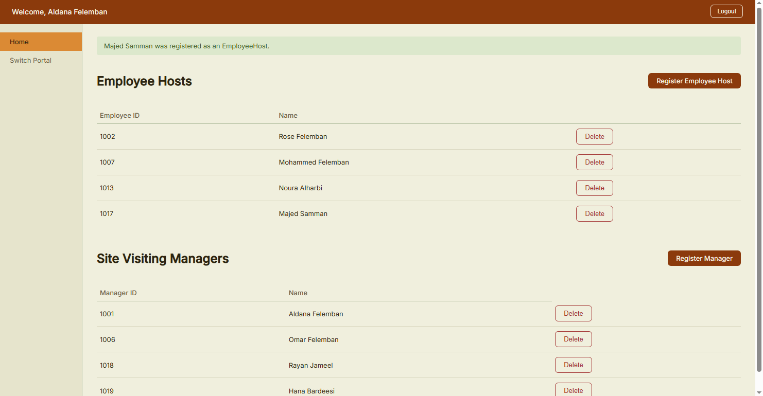
SYSTEM WALKTHROUGH
Airport Visit Management System (AVS + EFS Integration)
Page: Dashboard (register Employee Host complete)
Process in action: Successfully added employee host message.
https://efs.tasheelinfotech.local/...
Tasheel Information Technology • Training
Airport

Slide 26
SYSTEM WALKTHROUGH
Airport Visit Management System (AVS + EFS Integration)
Page: Choose Portal
Process in action: Switching to Manager portal.
https://efs.tasheelinfotech.local/...
Tasheel Information Technology • Training
Airport

Slide 27
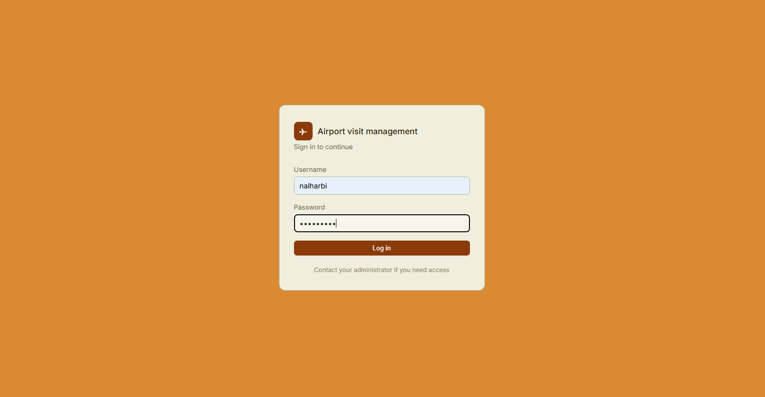
SYSTEM WALKTHROUGH
Airport Visit Management System (AVS + EFS Integration)
Page: Login
Process in action: Logging in as employee host.
https://efs.tasheelinfotech.local/...
Tasheel Information Technology • Training
Airport

Slide 28
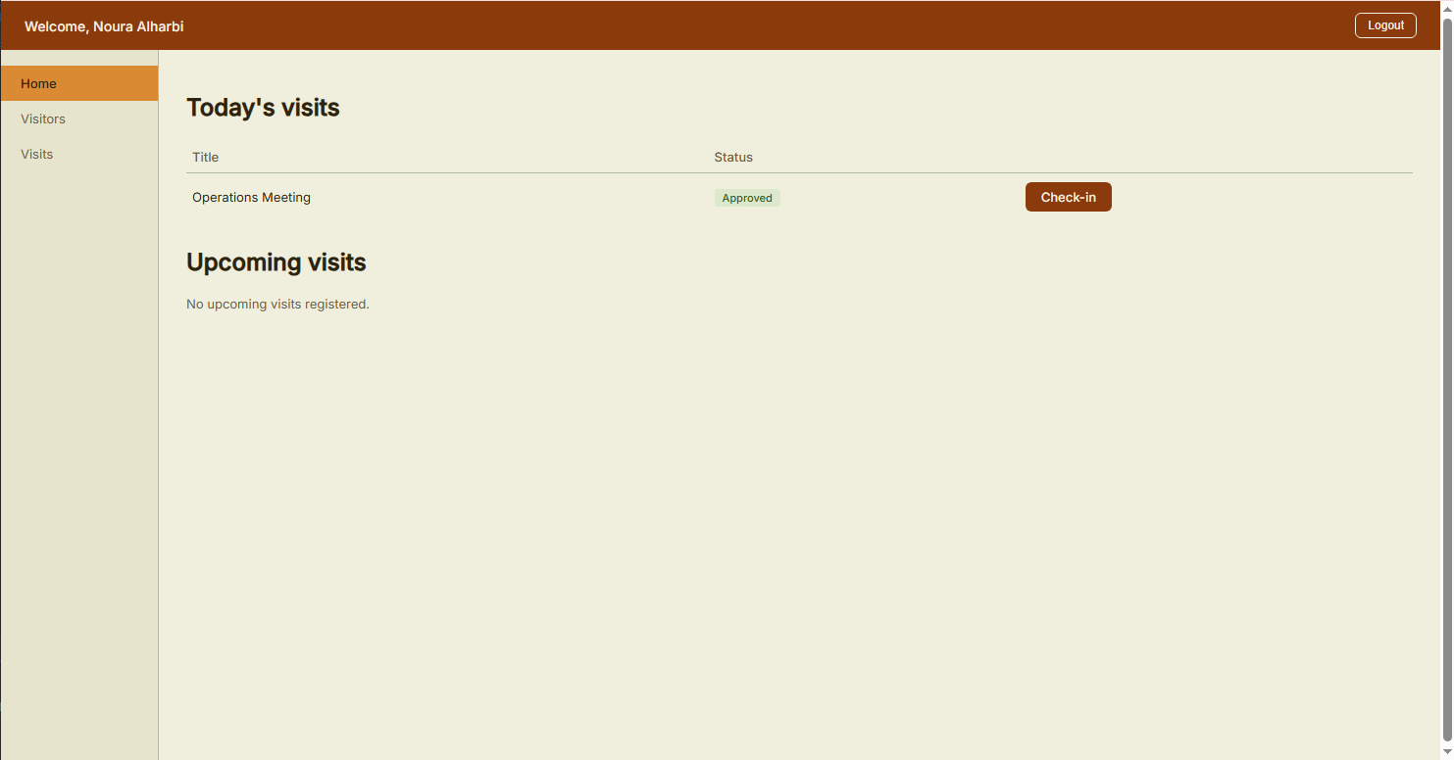
SYSTEM WALKTHROUGH
Airport Visit Management System (AVS + EFS Integration)
Page: Employee Host Home
Process in action: Employee can view only their upcoming visits.
https://efs.tasheelinfotech.local/...
Tasheel Information Technology • Training
Airport

Slide 29
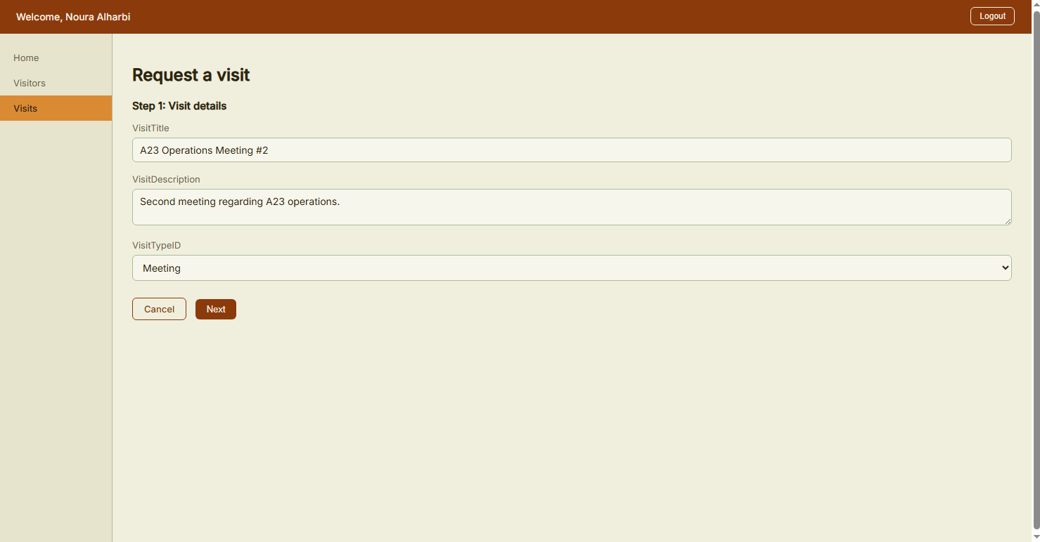
SYSTEM WALKTHROUGH
Airport Visit Management System (AVS + EFS Integration)
Page: Request Visit
Process in action: Step 1 of entering Visit request details.
https://efs.tasheelinfotech.local/...
Tasheel Information Technology • Training
Airport

Slide 30
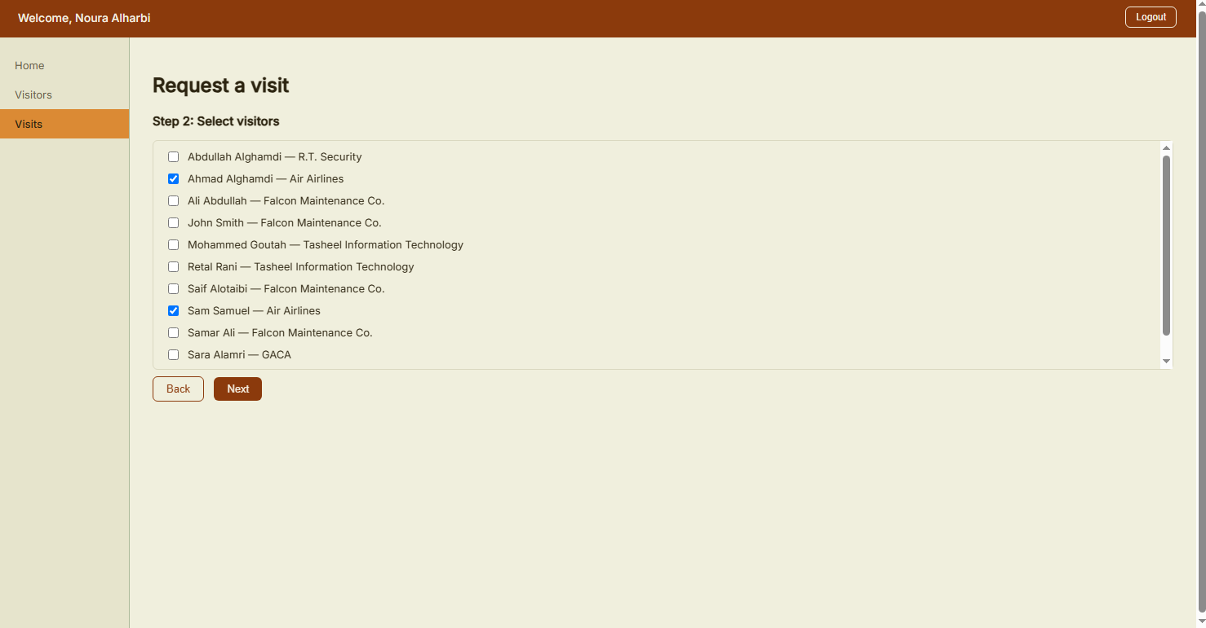
SYSTEM WALKTHROUGH
Airport Visit Management System (AVS + EFS Integration)
Page: Request Visit
Process in action: Step 2 of entering Visit request details.
https://efs.tasheelinfotech.local/...
Tasheel Information Technology • Training
Airport

Slide 31
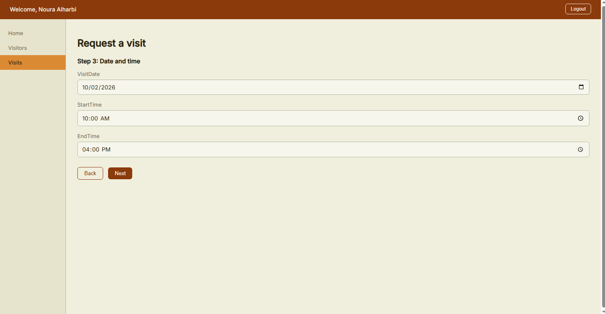
SYSTEM WALKTHROUGH
Airport Visit Management System (AVS + EFS Integration)
Page: Request Visit
Process in action: Step 3 of entering Visit request details.
https://efs.tasheelinfotech.local/...
Tasheel Information Technology • Training
Airport

Slide 32
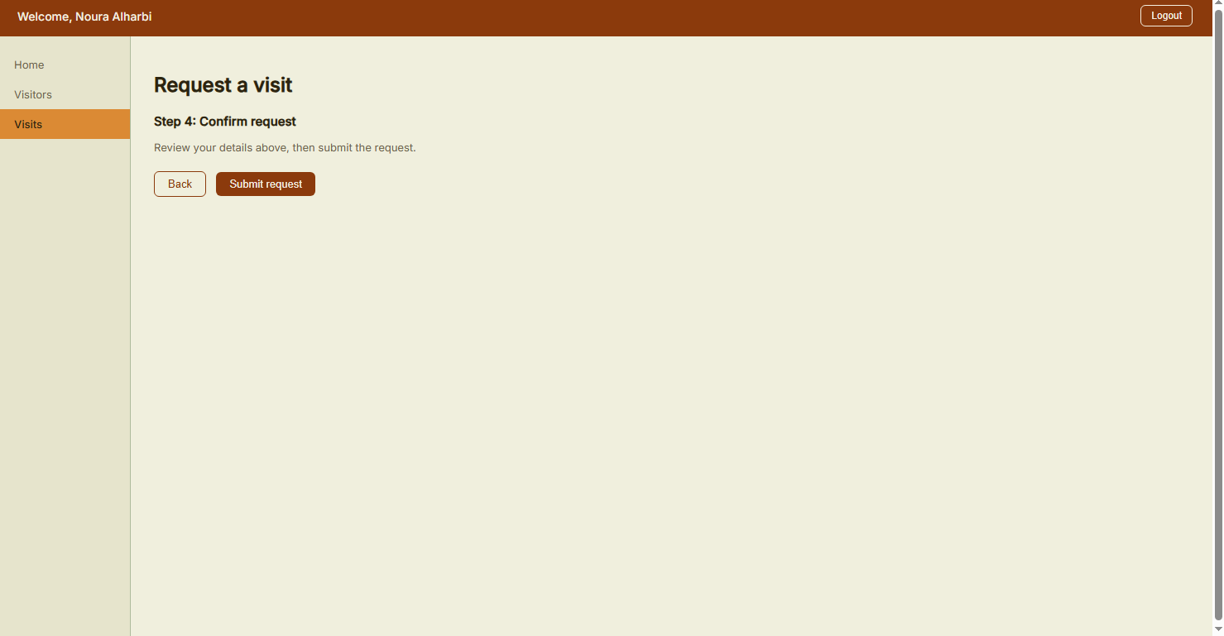
SYSTEM WALKTHROUGH
Airport Visit Management System (AVS + EFS Integration)
Page: Request Visit
Process in action: Step 4 of entering Visit request details.
https://efs.tasheelinfotech.local/...
Tasheel Information Technology • Training
Airport

Slide 33
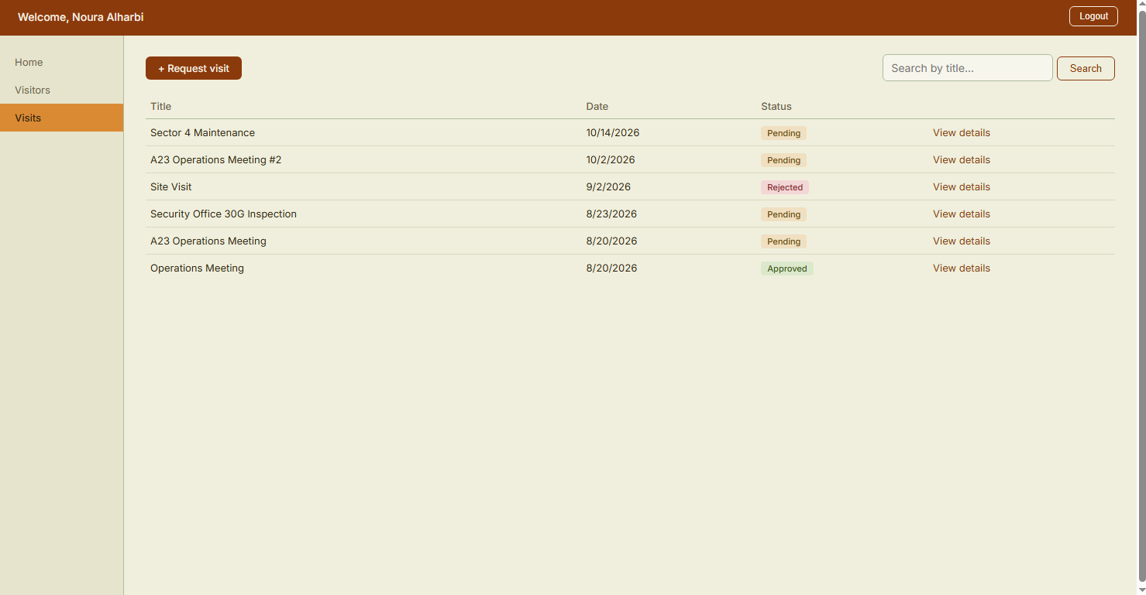
SYSTEM WALKTHROUGH
Airport Visit Management System (AVS + EFS Integration)
Page: Visits
Process in action: Visit request complete.
https://efs.tasheelinfotech.local/...
Tasheel Information Technology • Training
Airport

Slide 34
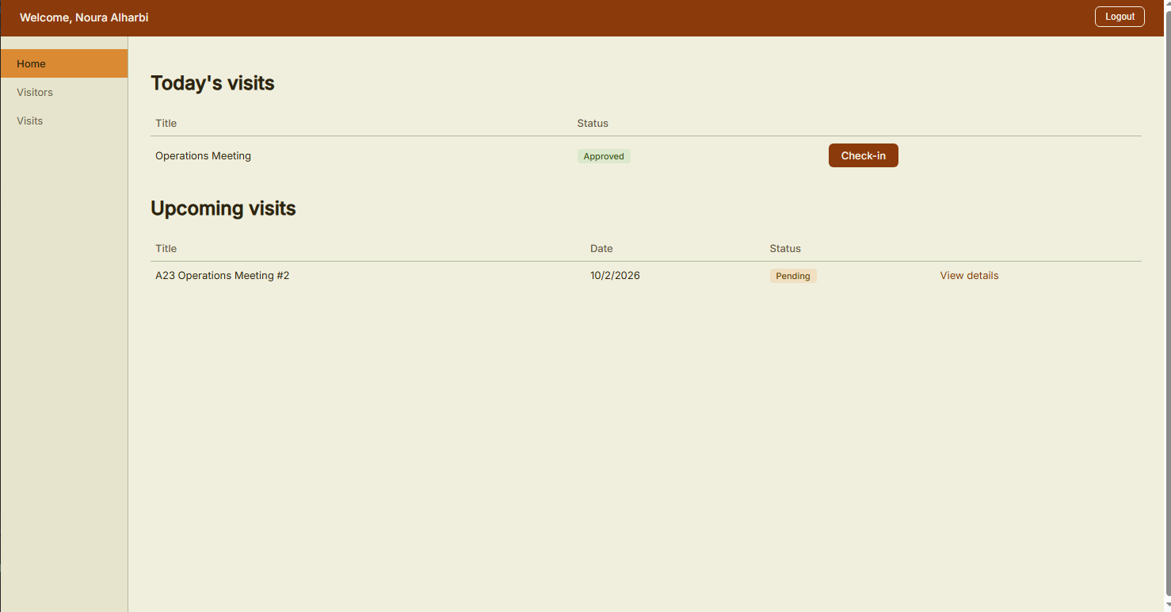
SYSTEM WALKTHROUGH
Airport Visit Management System (AVS + EFS Integration)
Page: Employee Host Home
Process in action: Check-in todays visit.
https://efs.tasheelinfotech.local/...
Tasheel Information Technology • Training
Airport

Slide 35
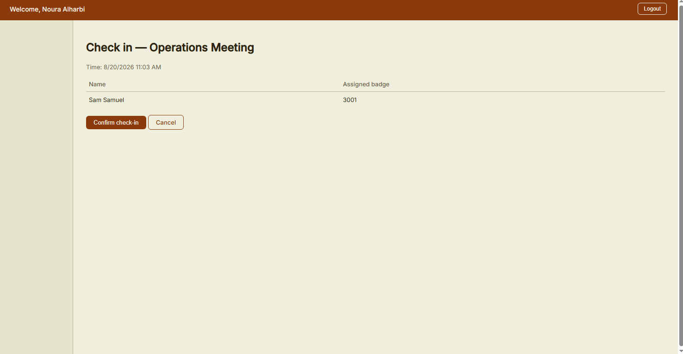
SYSTEM WALKTHROUGH
Airport Visit Management System (AVS + EFS Integration)
Page: Check In
Process in action: Confirming visitor check in.
https://efs.tasheelinfotech.local/...
Tasheel Information Technology • Training
Airport

Slide 36
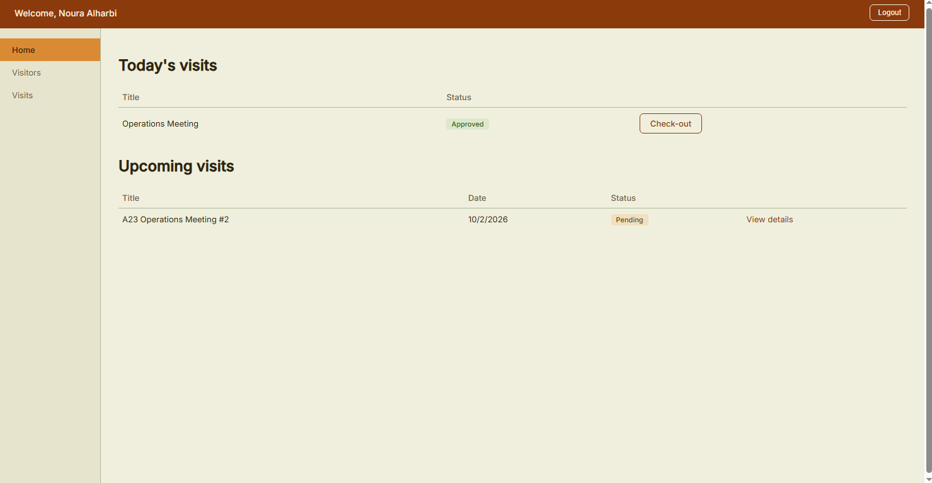
SYSTEM WALKTHROUGH
Airport Visit Management System (AVS + EFS Integration)
Page: Employee Host Home
Process in action: Check out visitor after visit is complete.
https://efs.tasheelinfotech.local/...
Tasheel Information Technology • Training
Airport

Slide 37
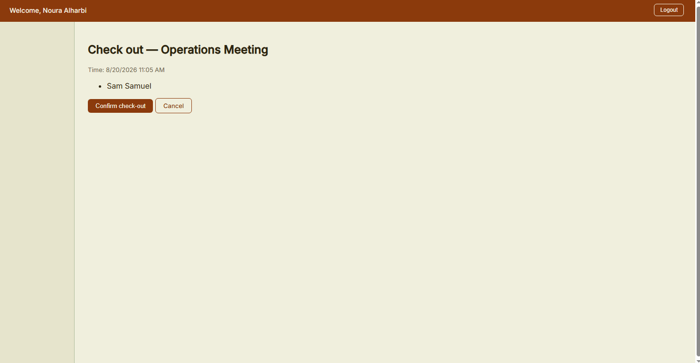
SYSTEM WALKTHROUGH
Airport Visit Management System (AVS + EFS Integration)
Page: Check Out
Process in action: Confirming visitor check out.
https://efs.tasheelinfotech.local/...
Tasheel Information Technology • Training
Airport

Slide 38
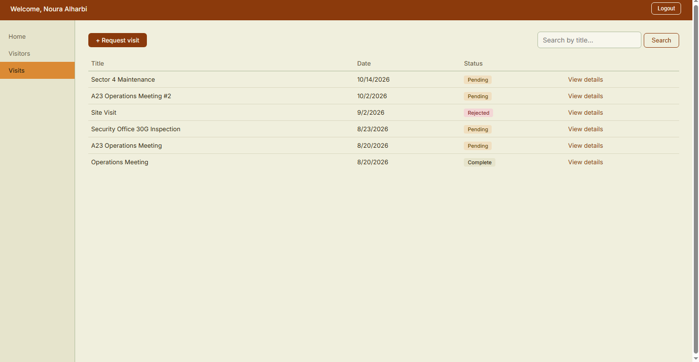
SYSTEM WALKTHROUGH
Airport Visit Management System (AVS + EFS Integration)
Page: Visits
Process in action: View visit status changed to ‘Complete’.
https://efs.tasheelinfotech.local/...
Tasheel Information Technology • Training
Airport

Slide 39
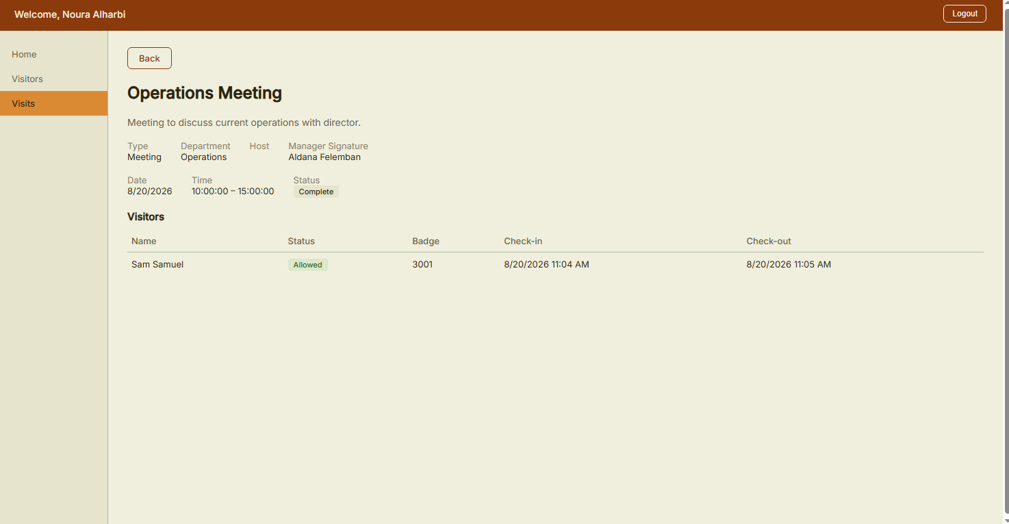
SYSTEM WALKTHROUGH
Airport Visit Management System (AVS + EFS Integration)
Page: Visit Details
Process in action: View all Visit details.
https://efs.tasheelinfotech.local/...
Tasheel Information Technology • Training
Airport

Slide 40
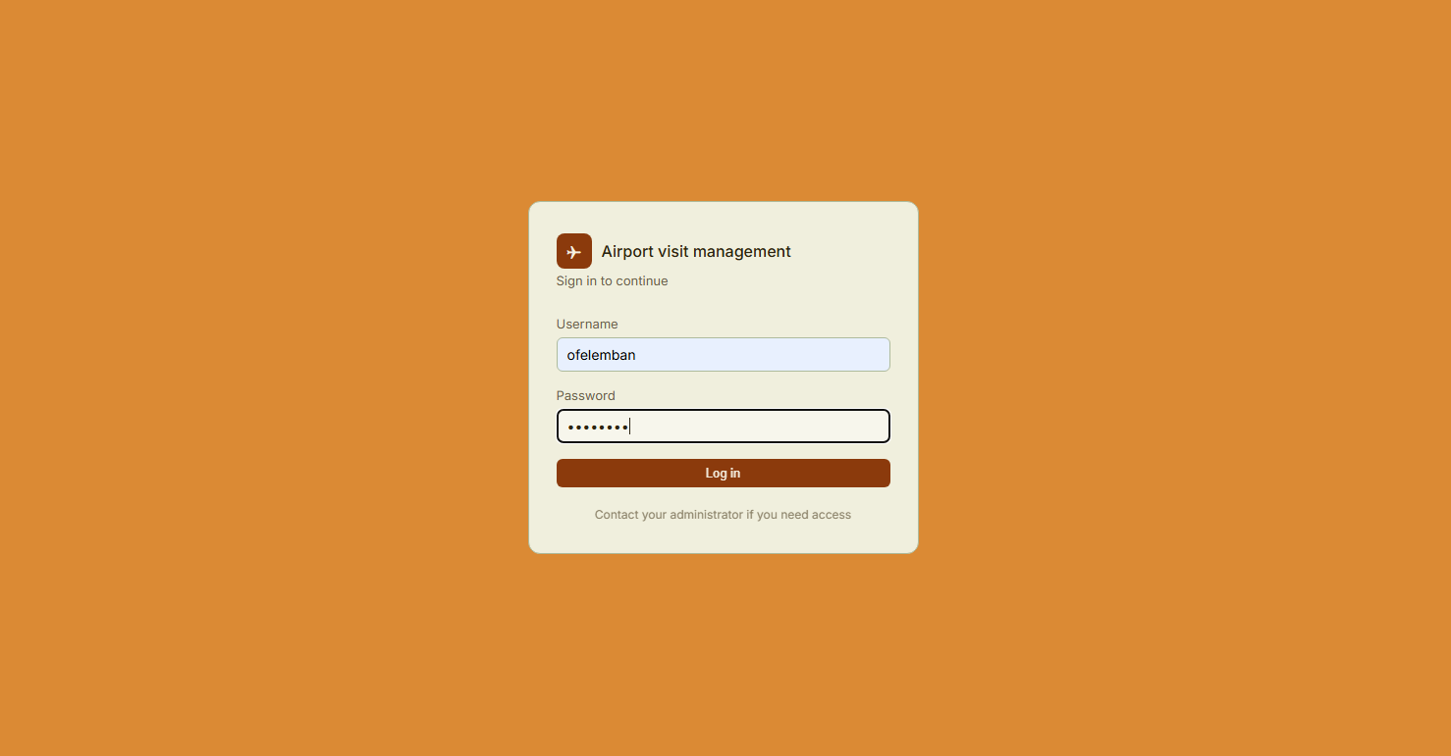
SYSTEM WALKTHROUGH
Airport Visit Management System (AVS + EFS Integration)
Page: Login
Process in action: Logging in as Site Visiting Manager.
https://efs.tasheelinfotech.local/...
Tasheel Information Technology • Training
Airport

Slide 41
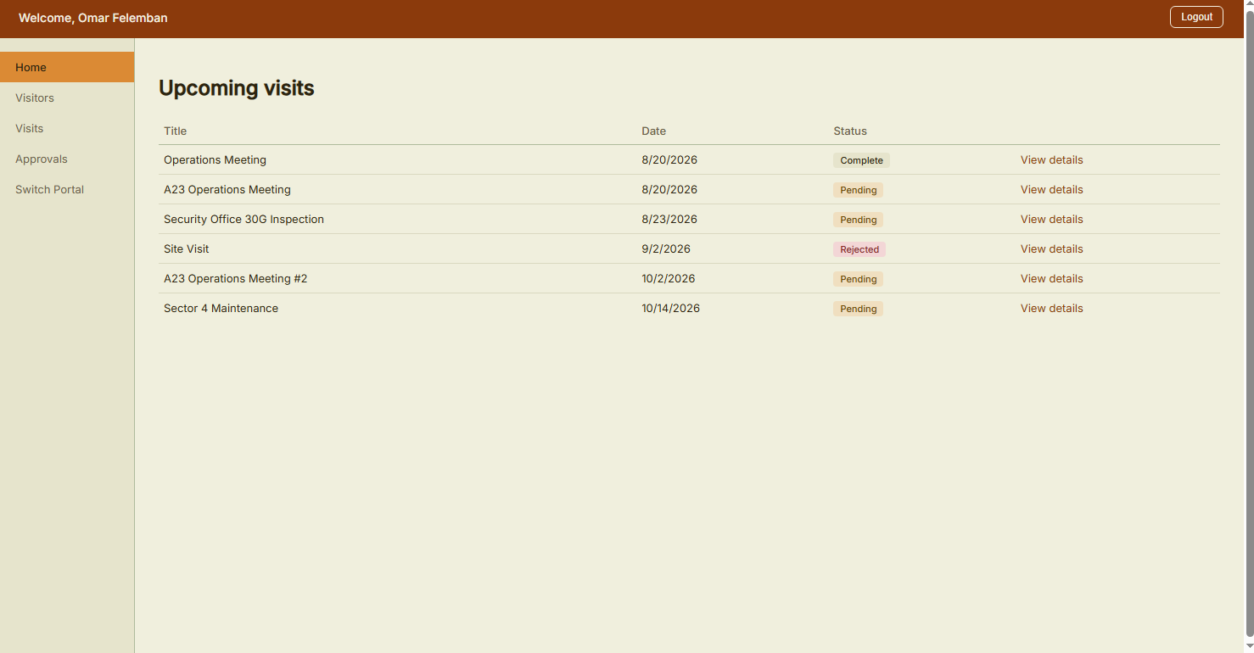
SYSTEM WALKTHROUGH
Airport Visit Management System (AVS + EFS Integration)
Page: Manager Home
Process in action: Manager can view all upcoming visits.
https://efs.tasheelinfotech.local/...
Tasheel Information Technology • Training
Airport

Slide 42
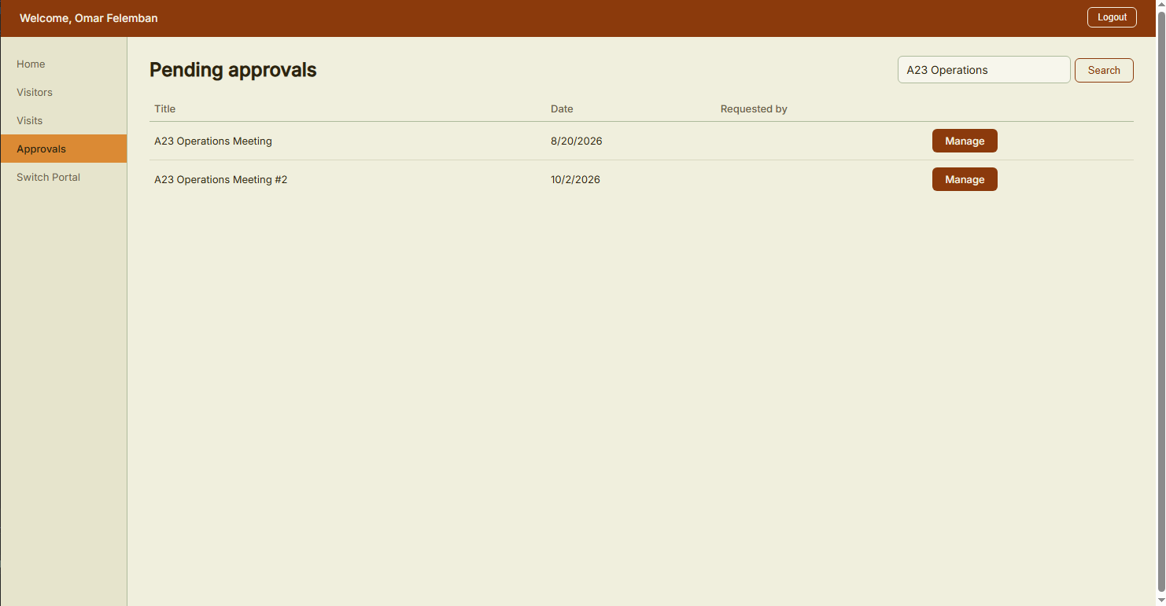
SYSTEM WALKTHROUGH
Airport Visit Management System (AVS + EFS Integration)
Page: Approvals
Process in action: Search through pending visit requests to manage them.
https://efs.tasheelinfotech.local/...
Tasheel Information Technology • Training
Airport

Slide 43
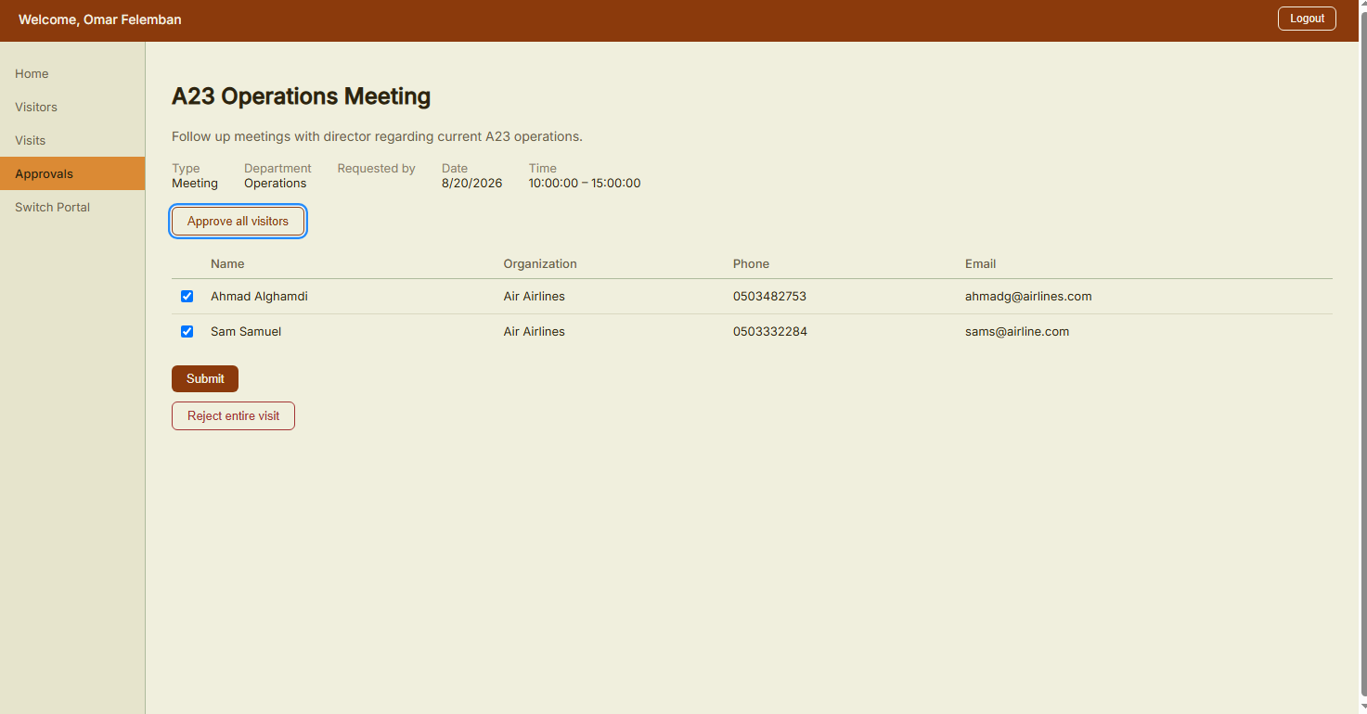
SYSTEM WALKTHROUGH
Airport Visit Management System (AVS + EFS Integration)
Page: Approvals
Process in action: Approving all visitors at once and submitting.
https://efs.tasheelinfotech.local/...
Tasheel Information Technology • Training
Airport

Slide 44
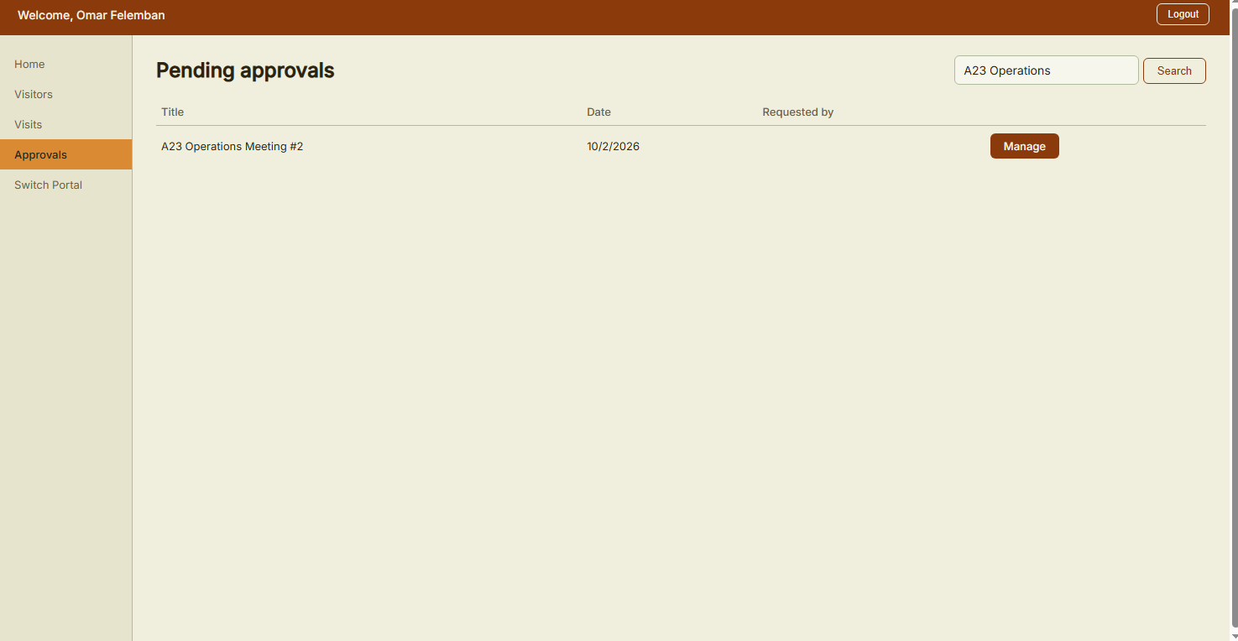
SYSTEM WALKTHROUGH
Airport Visit Management System (AVS + EFS Integration)
Page: Approvals
Process in action: Search through pending visit requests to manage them.
https://efs.tasheelinfotech.local/...
Tasheel Information Technology • Training
Airport

Slide 45

SYSTEM WALKTHROUGH
Airport Visit Management System (AVS + EFS Integration)
Page: Approvals
Process in action: Rejecting visit with all its visitors.
https://efs.tasheelinfotech.local/...
Tasheel Information Technology • Training
Airport

Slide 46
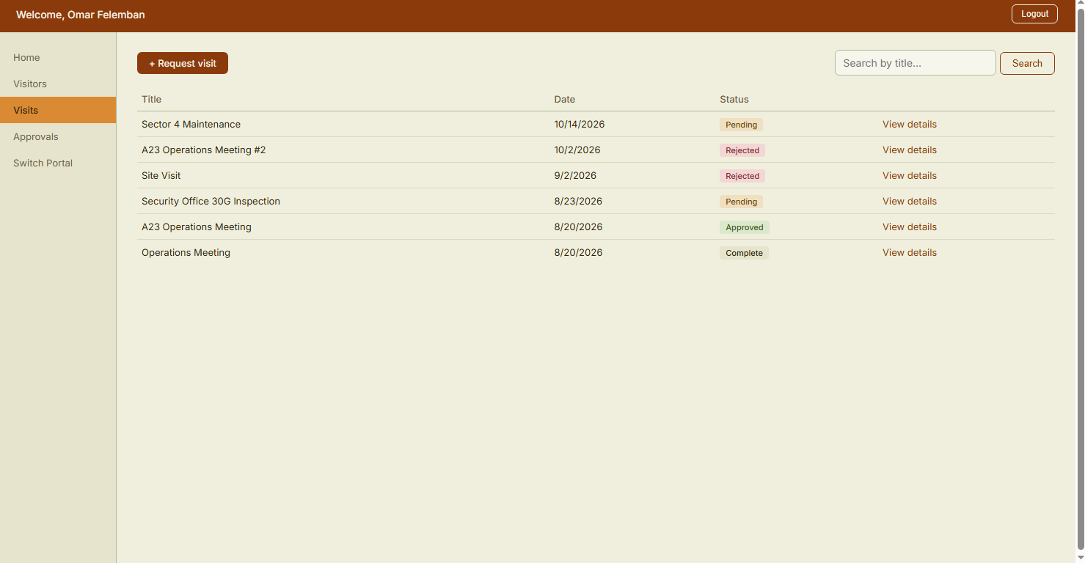
SYSTEM WALKTHROUGH
Airport Visit Management System (AVS + EFS Integration)
Page: Visits
Process in action: View status of managed visits.
https://efs.tasheelinfotech.local/...
Tasheel Information Technology • Training
Airport

Slide 47

Thank You
Aldana Ashraf Felemban • Tasheel Information Technology

