Slide 1
PANDAA Software
ReFocus Assistant and EpiFocus Assistant: automated qualitative results analysis tools

Slide 2
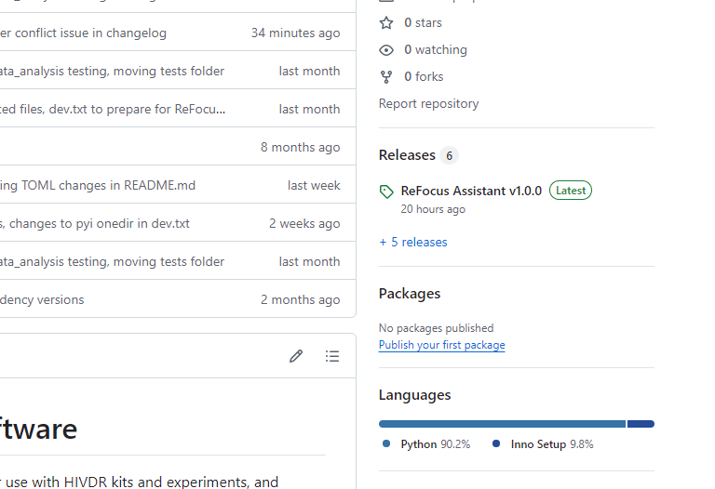
Where to get the software
GitHub
aldatubio/PANDAA-qPCR-Results: Development of a script to auto-analyze qPCR results from tsv / csv files. (github.com)
Visit “Releases” for downloads

Slide 3






Workflow Overview
Choose tool based on product family:
PANDAA Assay
CSV summary
ReFocus Assistant
HIV drug resistance
EpiFocus Assistant
Viral hemorrhagic fevers
qPCR Machine
PANDAA Software
PDF summary
Raw results file (XLSX, CSV, text)

Slide 4
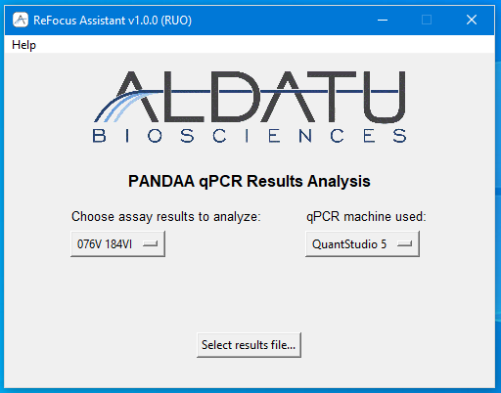
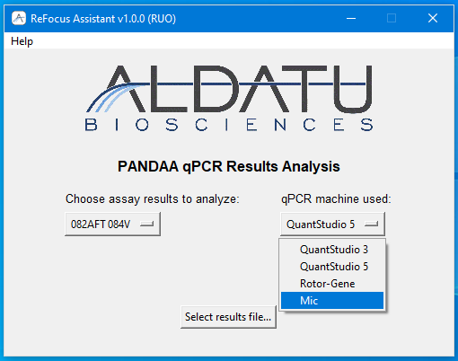
Workflow
Double-click icon to start app and open main window
Choose assay and qPCR machine from menus

Slide 5
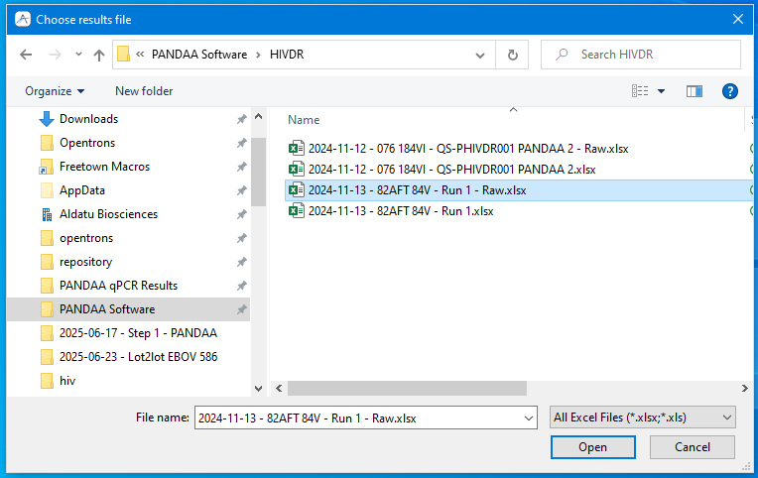
Workflow
Choose raw, unedited results file from file selection menu (can be Excel file, CSV, or text file)

Slide 6
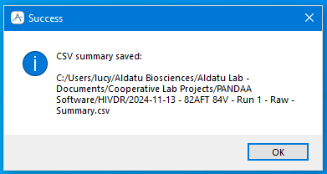
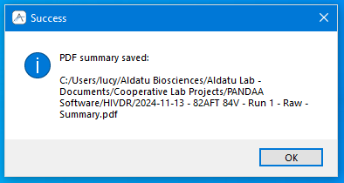
Workflow
Dialog box shows location of analyzed results files (CSV and optional PDF), then program closes

Slide 7
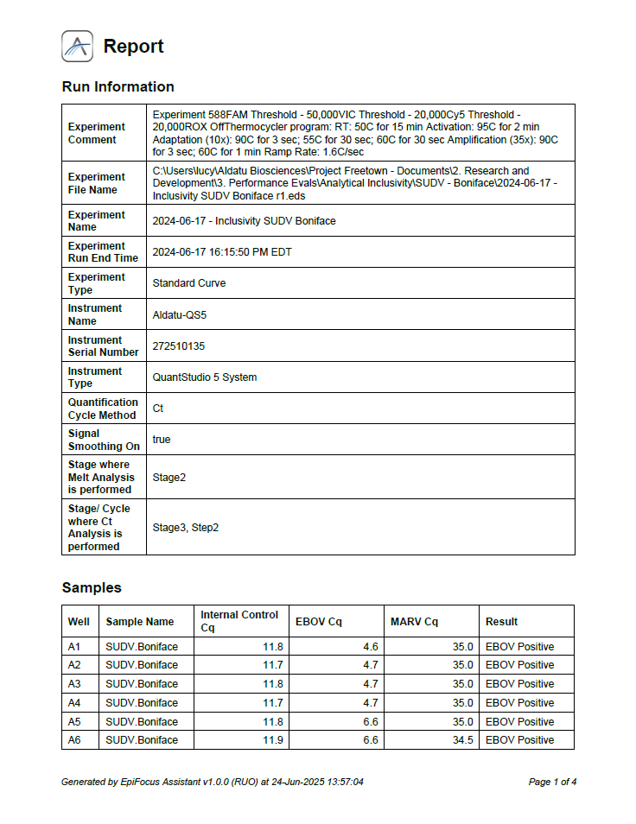
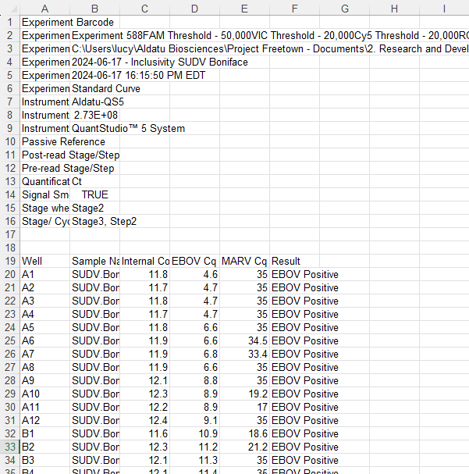
Workflow
Results files

Slide 8
ReFocus Assistant vs EpiFocus Assistant
ReFocus Assistant
EpiFocus Assistant
For HIVDR assays
Builds standard curve based on wells with specified input quantity
Cq values in unknown wells are compared to the standard curve to calculate quantity in unknowns
Qualitative results are given as a percentage of DRM present in a well, compared to the amount of VQ detected
For VHF assays
No standard curve required; well quantities ignored
Qualitative results (positive or negative) are given based on Cq value, and whether it is above or below specified cutoffs

Slide 9
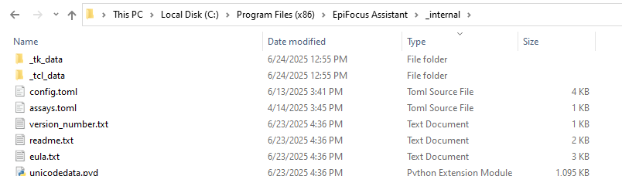
How to configure settings using TOML files
Navigate to the Program Files folder

Slide 10
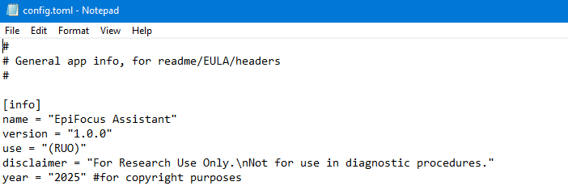
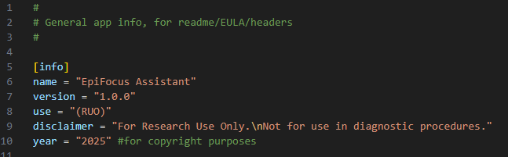
How to configure settings using TOML files
TOMLs can be opened in any text editor, although they can be color-coded in VSCode for easier reading
Notepad
VSCode

Slide 11
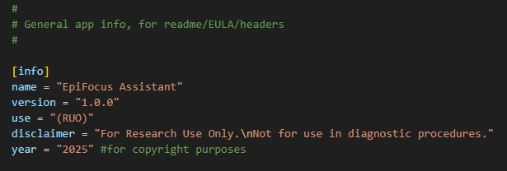
How to configure settings using TOML files
Anatomy of a TOML
Comments – not read by software
Table name – do not edit
Values of keys – edit these to configure
Key names – subunits of table. Do not edit
TOML: Tom's Obvious Minimal Language

Slide 12
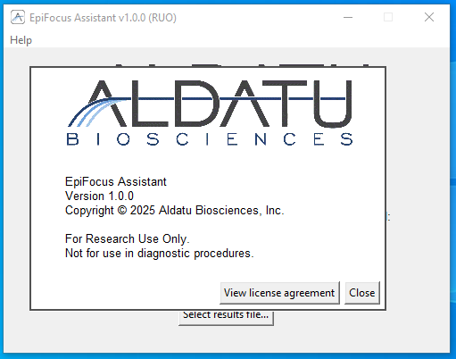
How to configure settings using TOML files
How TOML settings show up in the software

Slide 13
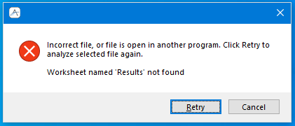
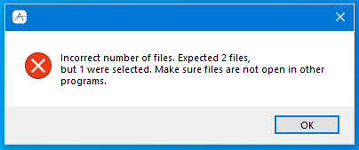
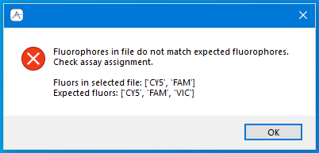
Troubleshooting
In general, errors should be caught and should show up as an error dialog box for the user. Feel free to let me know if I’ve missed anything!

