Slide 1
A WEB-BASED DIAGNOSIS OF COVID-19 BASED ON CHEST X-RAY USING DEEP LEARNING
SUPERVISOR : Dr. Abir Elfakki

Slide 2
WHO ARE WE !
NOURAH ABDULLAH, AFNAN ABDULLAH , WARD DAHEM
We present this Project Report Submitted in Partial Fulfillment of the Requirements for the Degree of BACHELOR
in
(COMPUTER SCIENCE )

Slide 3
CONTENTS OF THIS PRESENTATION
Abstract | Summary for all project (interpreting facts, identifying the problems).
Introduction | Explain the overview ,goal, importance, limits and boundaries of the project
Theoretical section | You must keep it so that proper credits for our design are given
SYSTEM STUDY AND ANLAYSIS | Show system diagrams , decomposition of a system into its components and the concept of this system in Theoretical way

Slide 4
Abstract
COVID-19 global pandemic affects health care and lifestyle worldwide, and its early detection is critical to control cases’ spreading and mortality. The actual diagnosis test is the Reverse transcription Polymerase chain reaction (RT-PCR), result times and cost of these tests are high, so other fast and accessible diagnostic tools are needed to allow people accessing it freely . the idea is inspired by recent project that correlates the presence of COVID-19 to findings in Chest X-ray images, The aim of this project is to use existing deep learning models (VGG19 and U-Net) to process these images and classify them as positive or negative for COVID-19. A web based application has been developed, to make this process seamless and efficient. The trained neural network is used to process the given image. This will be done in the back-end of the web application. If the person is infected with COVID, the application makes use of an advanced AI searching algorithm to find the most suitable physician based on the requirements of the user.

Slide 5
TABLE OF CONTENTS
01
02
03
04
OVERVIEW
Theoretical section
SYSTEM STUDY AND ANLYSIS
Conclusion

Slide 6
01
OVERVIEW

Slide 7
INTRODUCTION
The proposed system involves a preprocessing stage with lung segmentation, removing the surroundings which does not offer relevant information for the task and may produce biased results; after this initial stage comes the classification model trained under the transfer learning scheme; and finally, results analysis and interpretation via heat maps visualization. The proposed system models must achieve the best detection accuracy of COVID-19 .

Slide 8
DIFFERENCES BETWEEN LABS
OFFICIAL LAB
AT-HOME using SYSTEM
Done in hospital
Take a lot time
Need more effort
Done anywhere
Take a few minutes only
less effort for this process

Slide 9
ADVANTAGES OF SYSTEM
LOW-COST
FAST RESULTS
SIMPLE USE
FLEXIBLE
EFFECTIVE
REPEATABLE

Slide 10
GOAL
Providing an automated health system capable of diagnosing infection with high accuracy
Work to reduce the effort exerted to obtain a medical diagnosis
Saving the material cost of making the same diagnosis in the health center
Benefit from cognitive concepts and turn them into a useful service to society
1
2
3
4

Slide 11
Project importance
the importance of the project lies in the extent to which people need alternative solutions to the traditional diagnostic process in addition to the speed in completing the process as the result of the diagnosis may appear within a few minutes compared to the normal diagnostic process

Slide 12
02
Theoretical section

Slide 13
EFFECT OF COVID-19 IN BODY
45%
30%
15%
LUNGS
BLOOD
HEAD

Slide 14
6,000
THE NUMBER OF CASES IN SUADIA ARABIA LAST MONTHS

Slide 15
COVID-19 SYMPTOMS
1
2
3
4
Hard breath
cough
fever
headache

Slide 16
Personal protection
2
4
1
3
5
Wash
hands
mask
Don’t let it
Long while
Remove mask
New mask

Slide 17

The x-ray has been in the place of traditional test and it has been used very widely we choose it because it’s the best choice

Slide 18
Related works
Resent Work | Techniques Used | Number of Classification | Accuracy
[Khan, A.I.; Shah, J.L.; Bhat, M.M , 2020] A deep neural network for detection and diagnosis of COVID-19 from chest X-ray | CoroNet | 4 | 89.6%
[Apostolopoulos, I.D.; Aznaouridis, S.I.; Tzani, M.A , 2021] Extracting possibly representative COVID-19 biomarkers from X-ray images with deep learning approach and image data related to pulmonary diseases | VGG-19 | 3 | 93.48%
[Sahinbas, K.; Catak, F.O , 2021] Transfer learning-based convolutional neural network for COVID-19 detection with X-ray images. In Data Science for COVID-19 | VGG-16, VGG-19, ResNet, DenseNet, InceptionV3 | 2 | 80%
Our proposed system | (VGG19 and U-Net) | 4 | In the capstone project (2), this will be accomplished

Slide 19
03
SYSTEM STUDY AND ANLAYSIS

Slide 20
Project idea
Quite simply, the idea of ​​the project is to work on implementing a website built in Python and using machine learning. This site makes a classification out of two classifications of the Coronavirus, which is whether a person is infected with the Coronavirus or not infected with the virus.

Slide 21
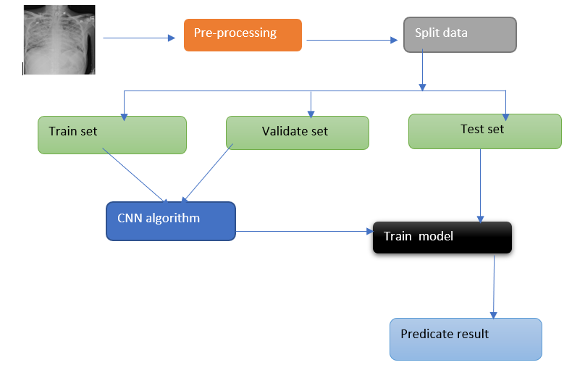
SYSTEM ARCHITECTURE

Slide 22
METHODOLOGY
1
2
preprocessing
classification
is used to improve the overall contrast of the image in order to reduce inconsistencies between images obtained from various X-ray devices. The image is also resized and normalized to suit the size of the training model throughout that process
involves a variety of classifiers, and the most effective classifier are chosen based on the classification target in each case.

Slide 23
PROPOSED SYSTEM FILTERS
Filter | Tasks
Median | Median filtering is a nonlinear method used to remove noise from images. The median is calculated by first sorting all the pixel values from the window into numerical order, and then replacing the pixel being considered with the middle (median) pixel value.
Sharpening | Sharpening, which can help emphasize details and enhance the edges of objects in an image, is critical when post-processing many types of images. However, you should be aware of the following whenever you sharpen an image
Histogram equalization | Histogram equalization is used to enhance the contrast of the image, it spreads the intensity values over full rang

Slide 24
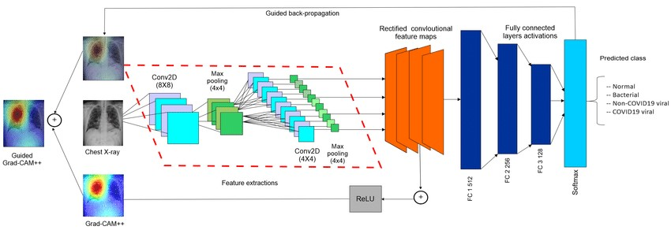
ARCHITECTURE OF CNN ALGORITHM

Slide 25
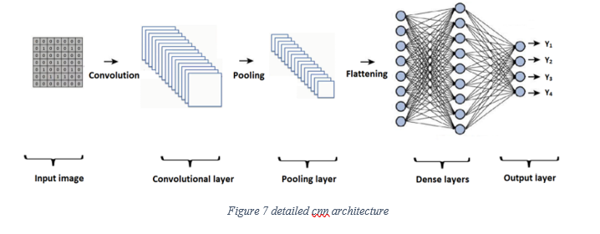
ARCHITECTURE OF CNN ALGORITHM

Slide 26
CNN layers
01
02
03
04
Convolutional layer
Pooling layer
creates a feature map by applying a filter that scans the image several pixels at a time
scales down the information generated by the convolutional layer to effectively store it
Fully connected layer
flatten layer
applies weights over the inputs generated by the feature analysis
flattens the outputs into a single vector

Slide 27
Dataset
We have a dataset containing 2000 chest x-ray images (1000 infected with COVID-19 and 1000 non-infected images) This dataset is uploaded to google Drive, where when we run the code on Colab, we will first connect with google drive in order to access the dataset folder.

Slide 28
We propose an algorithm that combines deep learning and CNN algorithms to detect and diagnose covid-19, and also allows the use of this system across websites. The functional requirements can be described as the following:-
Functional Requirements
After data collection admin should train and test the model and set before publishing
1
2
The proposed system first allows users to register on the website to make the diagnosis
After login, a website user should insert an x-ray chest for the lungs
3
This system will provide a statistical report on registered users and how many Coronavirus cases were detected and not detected
4

Slide 29
NON-FUNCTIONAL REQUIREMENTS
Functionality | System has accomplished 90% of its expected functions.
Reliability | Reliability is calculated by calculating the proportion of failures per hours, the value of reliability is 95%.
Correctness | 98% this value of correctness was obtained by testing the results of reports of this system.
Usability | 90% this value of usability was obtained after presenting the system to a group of customers to experiment and then hear their views about it and monitor the ability to use and carry out operations.
Availability | Availability is the percentage of how much time data is available and in this system since it is not connected to the internet. Data is available 100%.
Efficiency | Efficiency was measured by examining the size and space taken from the RAM memory of the device, and also by monitoring the speed of completion of operations (Speed 95%, space 4 M)
Accuracy | accuracy means that almost all resulted, expected outputs were accurate

Slide 30
IMPLEMENTATION TOOLS AND TECHNOLOGY
Python
01
Python is an interpreted, object-oriented, high-level programming language with dynamic semantics.
neural networks
02
a subset of machine learning and are at the heart of deep learning algorithms.
Deep Learning
03
is a subset of machine learning in artificial intelligence that can mimic the computing capabilities of the human brain and create patterns
flask
04
Flask is also a Python-based microframework that is used for web application development

Slide 31
Diagrams
1
— flowchart
2
— use case
3
— class
4
— sequence

Slide 32
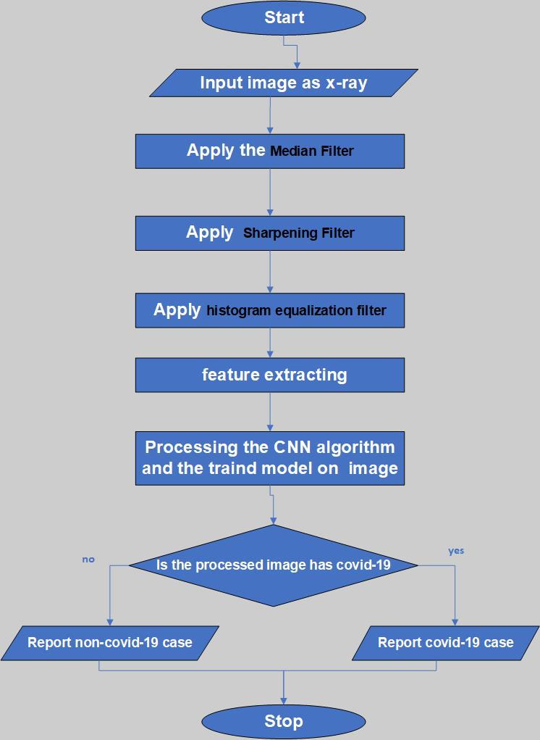
Flowchart

Slide 33
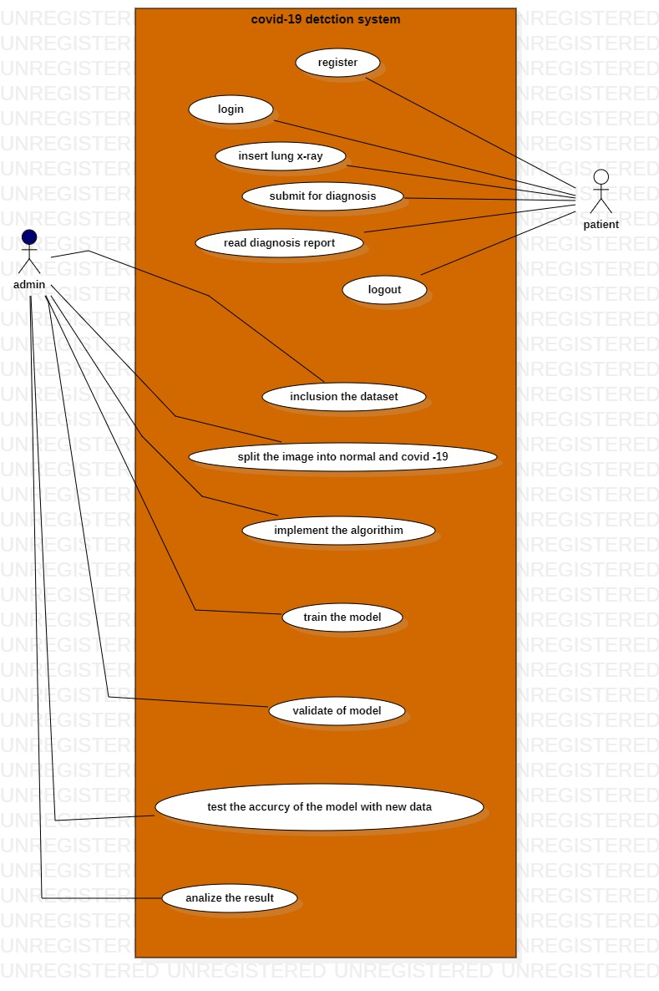
Use case
link the dataset
Split the image into train /validata

Slide 34
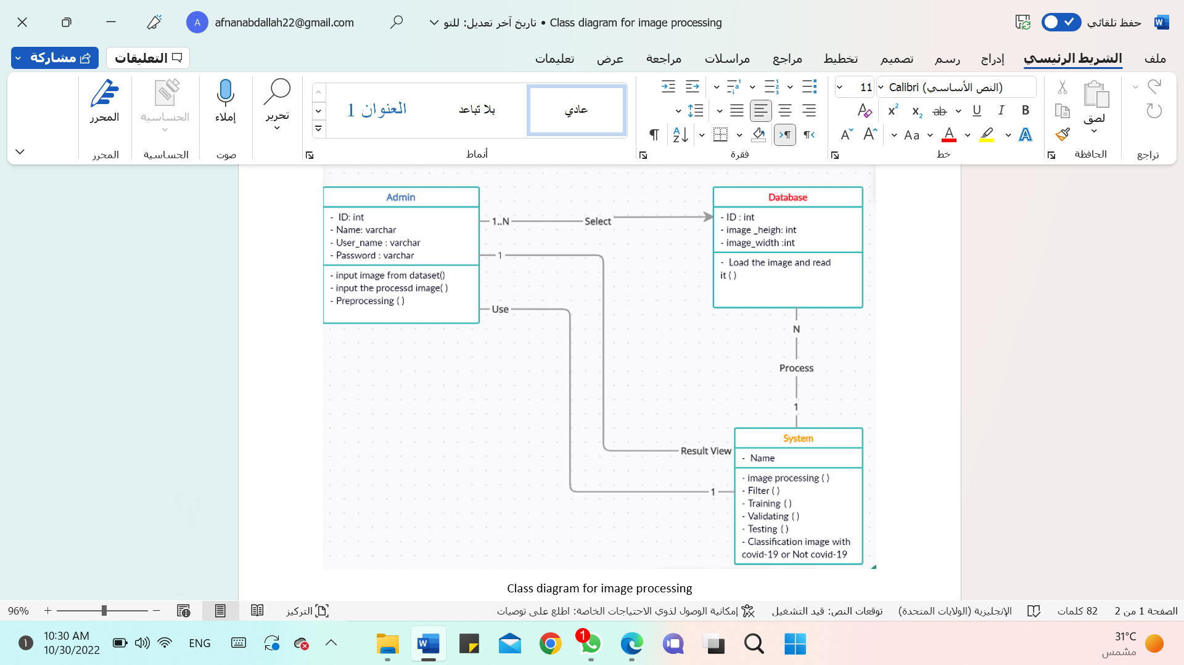

Class diagram
dataset

Slide 35
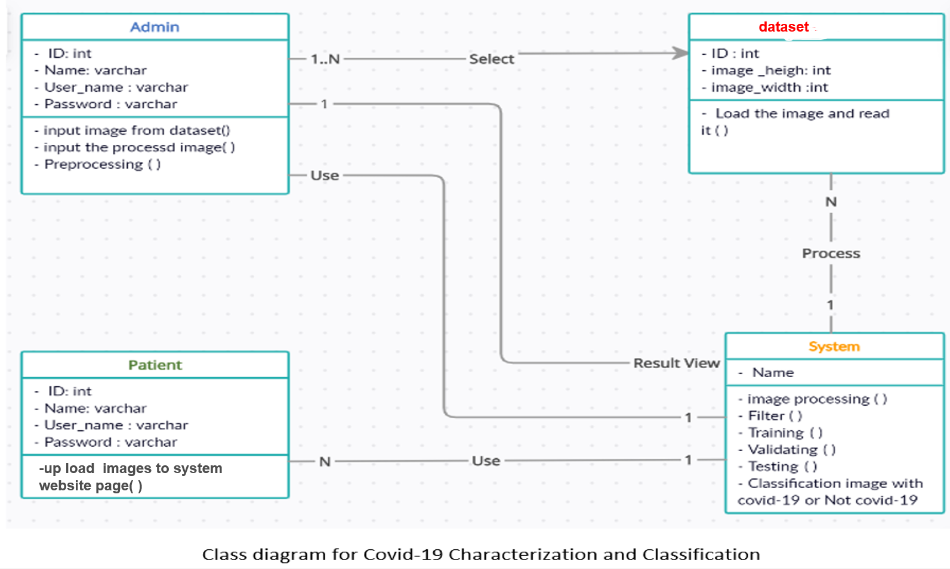
Class diagram

Slide 36
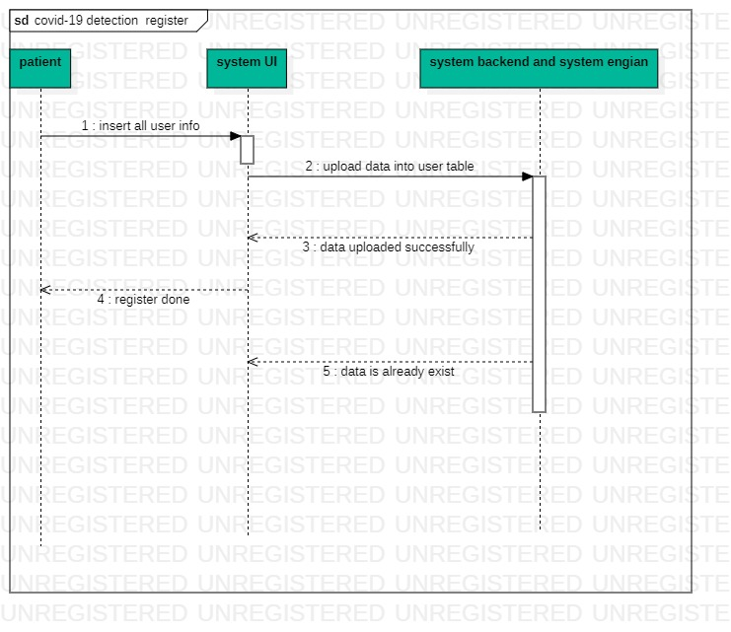
Sequence for register

Slide 37
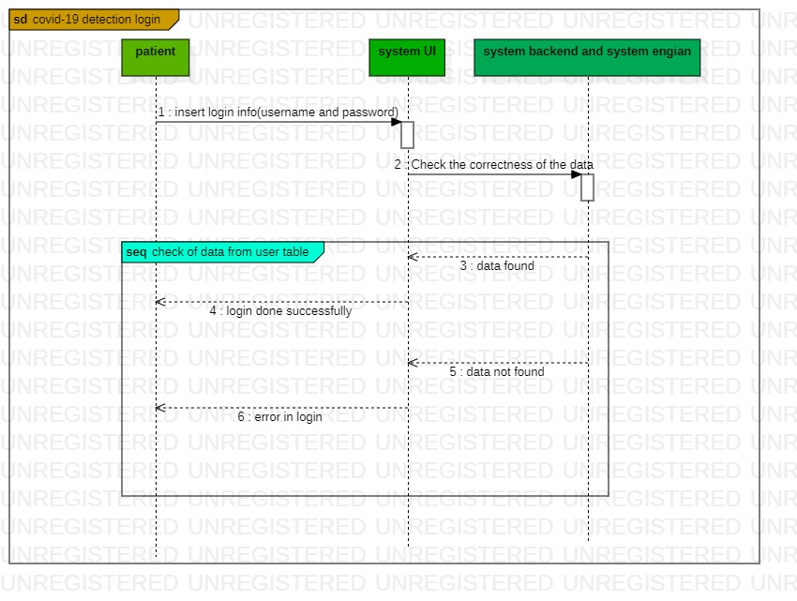
Sequence for login

Slide 38
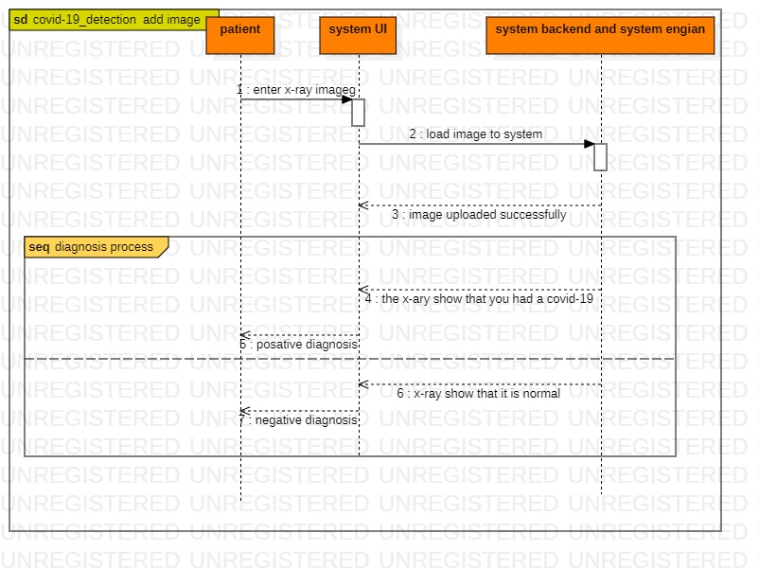
Sequence for adding image

Slide 39
conclusion
04
In the end, our project aims to use technology,especially artificial intelligence, to deal with the current diseases, and we hope that our project helps, even with a small thing, in building a safe world free of deadly diseases, asking God to protect us and you from it.

Slide 40
THANKS!

