Slide 1
Binary Hackathon
Squat
IT
Right
Count it precisely!
Powered by ciucasLaPet Team®

Slide 2



🆂🆀🆄🅰🆃 🅸🆃 🆁🅸🅶🅷🆃
Gabriel-David Rosu
Raluca-Elena Aldea
Andrei Onea
Developer
Developer
Developer

Slide 3




Flow/Components
01
02
03
04
Hardware
Software
Server
Android Terminal
Arduino NANO
6050 Gyroscope
HC-05 Bluetooth Module
Python
JAVA
Arduino IDE
MySQL
Rest API (Flask)
Samsung Galaxy A5
Android 7.0 Nougat

Slide 4
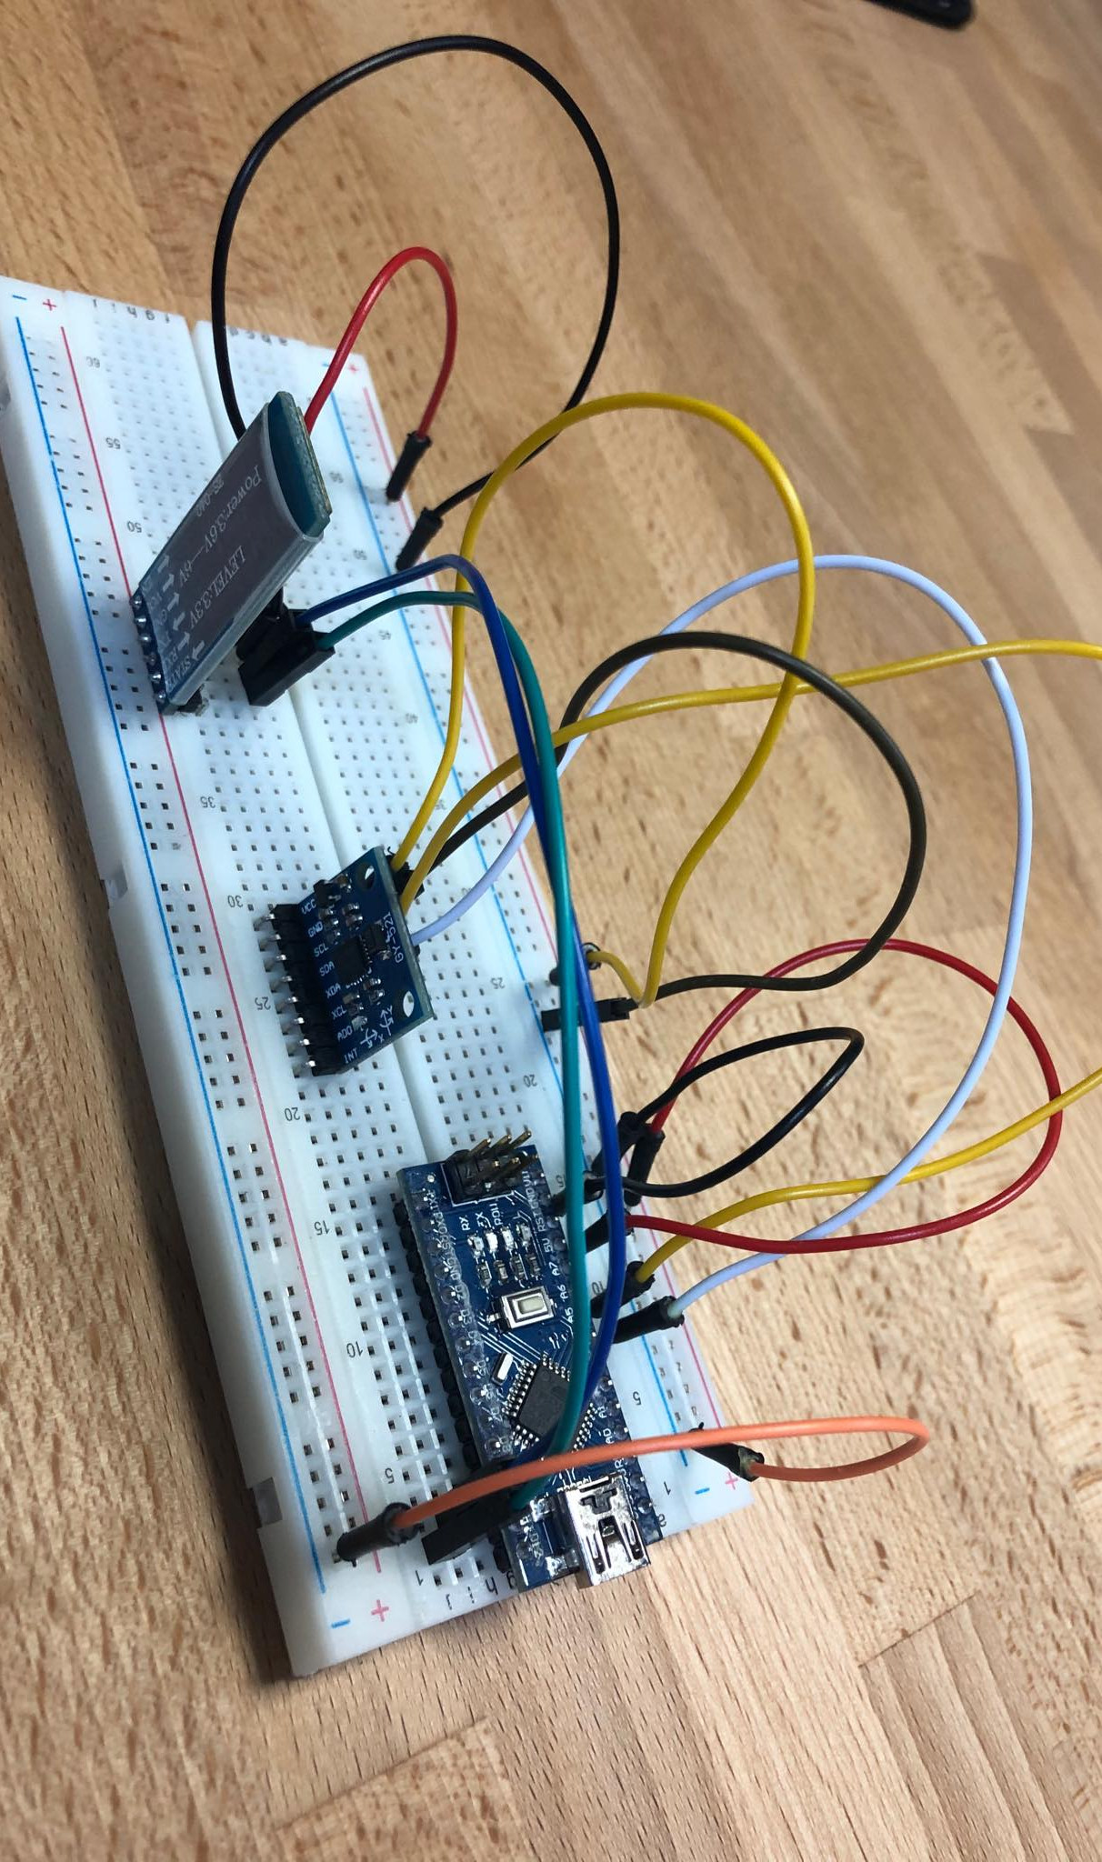
HC-05 Bluetooth Module
HARDWARE
Gyroscope
Arduino NANO

Slide 5
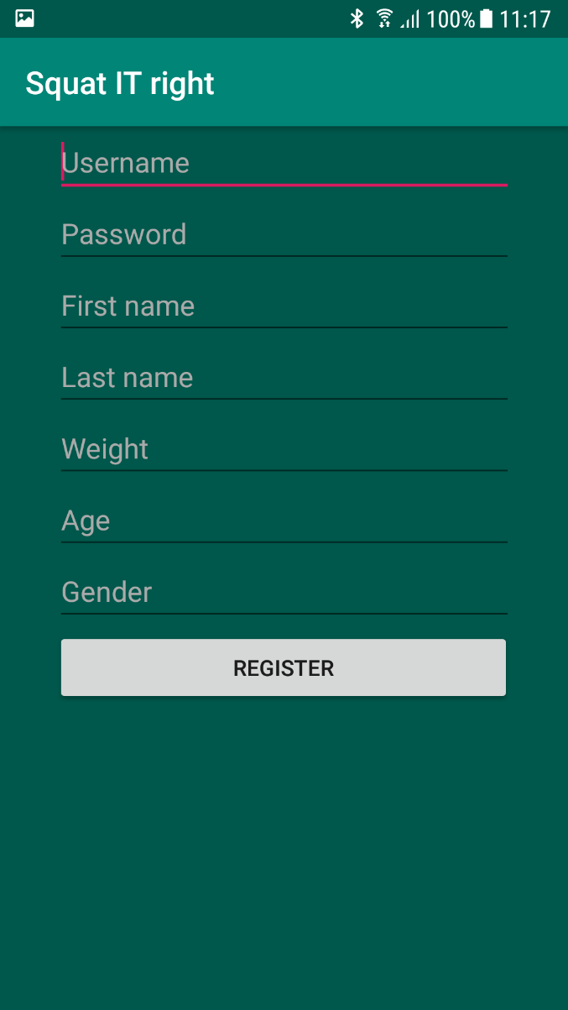
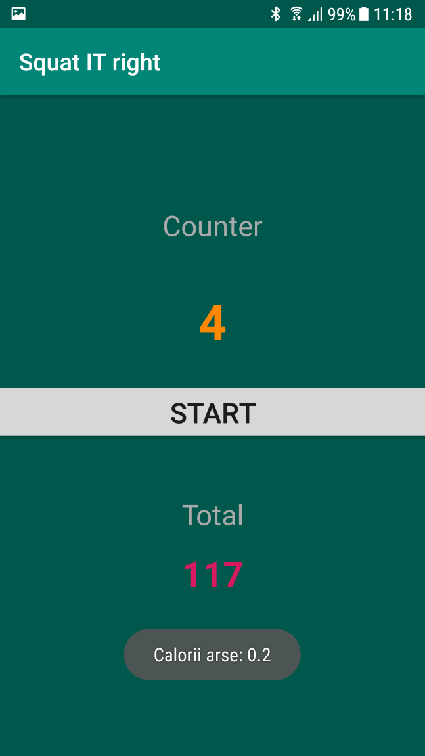
UI
REGISTER
PAGE
The account information is stored in a SQL Database
🆂🆀🆄🅰🆃 🅸🆃 🆁🅸🅶🅷🆃
COUNTER
First Number – Current session count
Second Number – Total number of squats

Slide 6
Binary Hackathon
Thank You

