Slide 1
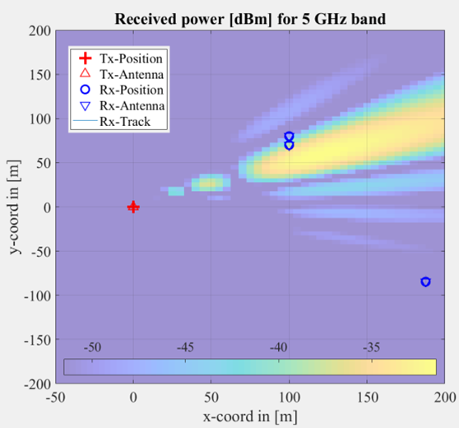
Toy example: user scheduling
There are 3 users: one at cell edge, two closer to BS and closer to each other
For each TTI, can serve 2 users with 2 frequency bands: low and high
u0 and 1 can send 2 packets or 1 if selected together
u0, u1
Edge u2 sends 2 only if no interference and low freq.
If same frequency is used, throughput decreases by 1
“Full buffer” traffic, users have buffers for one packet
u2
Interference impacts edge user, all if unexpected
Resource allocation must protect edge user u2

Slide 2

Detailing the example (optional)
Interference Bernoulli(α)
Tx
Channel
User 0
Each user can send 0, 1 or 2 packets:
...
Example: current buffers are all empty (b₀,b₁,b₂) = (0,0,0) with no interference
(‘N’ instead of ‘I’). We choose to serve u0 and u1 with high and low freqs, respectively: (0, 1, 'H', 'L'). The two transmit packets per user are (d₀,d₁) or alternatively (1, 1, 0). The buffers on next time instant are (0, 0, 1). Packets are decoded 1-α (‘I’),
User 1
...
$$∅$$
or
d_{n,}, b_{n}
b_{n}
d_{n}
User 2
...
d_{n} = 1
b_{n}

Slide 3
Modeling as finite MDP
Stochastic and stationary due to how we are modeling intercell interference
State is the buffers occupancy and interference occurrence, ex: ((0,1,1), ‘N’)
Action is to select two users and two frequencies, ex: (u0, u1, H, L)
Reward takes in account throughput, dropout and outage: (0, 1, 2, 3, 4, -10, -20, -30, -5)
There are 16 states, 12 actions and 9 rewards. We assume discount = 0.9
Distribution p(s’, r / s, a) and expected value r(s’, s, a) define the MDP. Agent executes policy π(s, a)

Slide 4
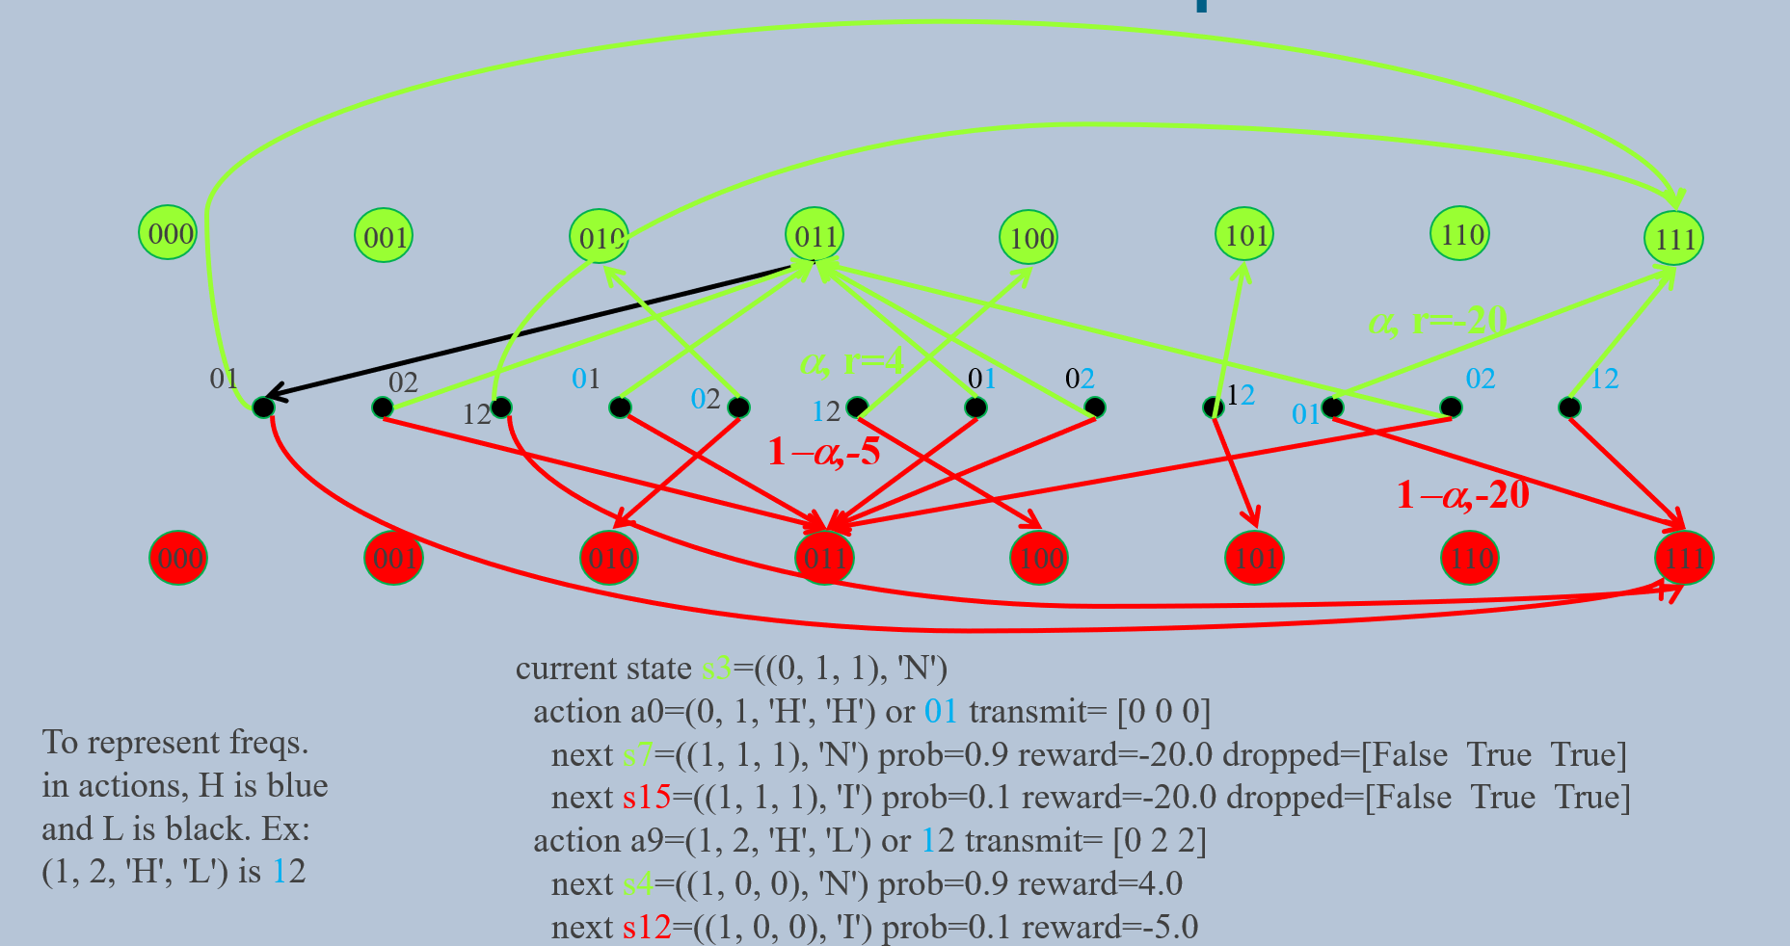
MDP Transition Graph

Slide 5
MDP Transition Graph (repeated, but not image – decrease the size of the circles for finding the arrow)
000
001
010
011
100
101
110
111
α, r=-20
α, r=4
01
02
01
02
01
02
12
02
12
12
12
01
1−α,-5
1−α,-20
000
001
010
011
100
101
110
111
current state s3=((0, 1, 1), 'N')
action a0=(0, 1, 'H', 'H') or 01 transmit= [0 0 0]
next s7=((1, 1, 1), 'N') prob=0.9 reward=-20.0 dropped=[False True True]
next s15=((1, 1, 1), 'I') prob=0.1 reward=-20.0 dropped=[False True True]
action a9=(1, 2, 'H', 'L') or 12 transmit= [0 2 2]
next s4=((1, 0, 0), 'N') prob=0.9 reward=4.0
next s12=((1, 0, 0), 'I') prob=0.1 reward=-5.0
To represent freqs. in actions, H is blue and L is black. Ex:
(1, 2, 'H', 'L') is 12
Notes:
current state s3=((0, 1, 1), 'N')
action a0=(0, 1, 'H', 'H') transmit= [0 0 0]
next s7=((1, 1, 1), 'N') prob=0.9 reward=-20.0 dropped=[False True True]
next s15=((1, 1, 1), 'I') prob=0.1 reward=-20.0 dropped=[False True True]
action a1=(0, 1, 'H', 'L') transmit= [1 1 0]
next s3=((0, 1, 1), 'N') prob=0.9 reward=-10.0 dropped=[False False True]
next s11=((0, 1, 1), 'I') prob=0.1 reward=-10.0 dropped=[False False True]
action a2=(0, 1, 'L', 'H') transmit= [1 1 0]
next s3=((0, 1, 1), 'N') prob=0.9 reward=-10.0 dropped=[False False True]
next s11=((0, 1, 1), 'I') prob=0.1 reward=-10.0 dropped=[False False True]
action a3=(0, 1, 'L', 'L') transmit= [0 0 0]
next s7=((1, 1, 1), 'N') prob=0.9 reward=-20.0 dropped=[False True True]
next s15=((1, 1, 1), 'I') prob=0.1 reward=-20.0 dropped=[False True True]
action a4=(0, 2, 'H', 'H') transmit= [1 0 0]
next s3=((0, 1, 1), 'N') prob=0.9 reward=-20.0 dropped=[False True True]
next s11=((0, 1, 1), 'I') prob=0.1 reward=-20.0 dropped=[False True True]
action a5=(0, 2, 'H', 'L') transmit= [1 0 2]
next s2=((0, 1, 0), 'N') prob=0.9 reward=-10.0 dropped=[False True False]
next s10=((0, 1, 0), 'I') prob=0.1 reward=-10.0 dropped=[False True False]
action a6=(0, 2, 'L', 'H') transmit= [1 0 1]
next s3=((0, 1, 1), 'N') prob=0.9 reward=-10.0 dropped=[False True False]
next s11=((0, 1, 1), 'I') prob=0.1 reward=-10.0 dropped=[False True False]
action a7=(0, 2, 'L', 'L') transmit= [1 0 1]
next s3=((0, 1, 1), 'N') prob=0.9 reward=-10.0 dropped=[False True False]
next s11=((0, 1, 1), 'I') prob=0.1 reward=-10.0 dropped=[False True False]
action a8=(1, 2, 'H', 'H') transmit= [0 1 0]
next s7=((1, 1, 1), 'N') prob=0.9 reward=-10.0 dropped=[False False True]
next s15=((1, 1, 1), 'I') prob=0.1 reward=-10.0 dropped=[False False True]
action a9=(1, 2, 'H', 'L') transmit= [0 2 2]
next s4=((1, 0, 0), 'N') prob=0.9 reward=4.0
next s12=((1, 0, 0), 'I') prob=0.1 reward=-5.0
action a10=(1, 2, 'L', 'H') transmit= [0 2 1]
next s5=((1, 0, 1), 'N') prob=0.9 reward=3.0
next s13=((1, 0, 1), 'I') prob=0.1 reward=-5.0
action a11=(1, 2, 'L', 'L') transmit= [0 1 1]
next s7=((1, 1, 1), 'N') prob=0.9 reward=2.0
next s15=((1, 1, 1), 'I') prob=0.1 reward=-5.0

Slide 6
Learning (training) evaluation
Q-learning algorithm with data from generative MDP
Vary step size α with ε = 0.01
“Exploration” prob. ε with α = 0.5
Better convergence with α = 0.5
Stationary MDP: no need to explore

Slide 7
Policy (test stage) evaluation
Compare Q-learning trained with 300 iterations, α = 0.5, ε = 0.01 and optimal policy. Take averages over 10⁴ episodes with 100 iterations
Optimal policy eventually drops packets in first 2 iterations whenever initial buffers are full

Slide 8
Optimal policy protecting edge user u2
s= 0 = ((0, 0, 0), 'N')
| a= 5 = (0, 2, 'H', 'L') | a= 6 = (0, 2, 'L', 'H') | a= 7 = (0, 2, 'L', 'L') | a= 9 = (1, 2, 'H', 'L') | a= 10 = (1, 2, 'L', 'H') | a= 11 = (1, 2, 'L', 'L')
s= 1 = ((0, 0, 1), 'N')
| a= 5 = (0, 2, 'H', 'L') | a= 9 = (1, 2, 'H', 'L')
s= 2 = ((0, 1, 0), 'N')
| a= 9 = (1, 2, 'H', 'L') | a= 10 = (1, 2, 'L', 'H')
s= 3 = ((0, 1, 1), 'N')
| a= 9 = (1, 2, 'H', 'L')
s= 4 = ((1, 0, 0), 'N')
| a= 5 = (0, 2, 'H', 'L') | a= 6 = (0, 2, 'L', 'H')
s= 5 = ((1, 0, 1), 'N')
| a= 5 = (0, 2, 'H', 'L')
s= 6 = ((1, 1, 0), 'N')
| a= 1 = (0, 1, 'H', 'L') | a= 2 = (0, 1, 'L', 'H')
s= 7 = ((1, 1, 1), 'N')
| a= 6 = (0, 2, 'L', 'H') | a= 10 = (1, 2, 'L', 'H')
s= 8 = ((0, 0, 0), 'I')
| a= 5 = (0, 2, 'H', 'L') | a= 6 = (0, 2, 'L', 'H') | a= 9 = (1, 2, 'H', 'L') | a= 10 = (1, 2, 'L', 'H')
s= 9 = ((0, 0, 1), 'I')
| a= 5 = (0, 2, 'H', 'L') | a= 6 = (0, 2, 'L', 'H') | a= 9 = (1, 2, 'H', 'L') | a= 10 = (1, 2, 'L', 'H')
s= 10 = ((0, 1, 0), 'I')
| a= 9 = (1, 2, 'H', 'L') | a= 10 = (1, 2, 'L', 'H')
s= 11 = ((0, 1, 1), 'I')
| a= 9 = (1, 2, 'H', 'L') | a= 10 = (1, 2, 'L', 'H')
s= 12 = ((1, 0, 0), 'I')
| a= 5 = (0, 2, 'H', 'L') | a= 6 = (0, 2, 'L', 'H')
s= 13 = ((1, 0, 1), 'I')
| a= 5 = (0, 2, 'H', 'L') | a= 6 = (0, 2, 'L', 'H')
s= 14 = ((1, 1, 0), 'I')
| a= 1 = (0, 1, 'H', 'L') | a= 2 = (0, 1, 'L', 'H')
s= 15 = ((1, 1, 1), 'I')
| a= 5 = (0, 2, 'H', 'L') | a= 6 = (0, 2, 'L', 'H') | a= 9 = (1, 2, 'H', 'L') | a= 10 = (1, 2, 'L', 'H')

