Slide 1
Environment multiband_scheduling_env.py

Slide 2
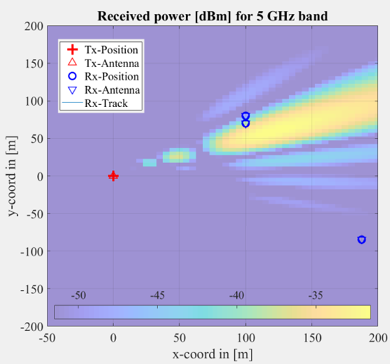
Multiband example: user scheduling in downlink
There are 3 users: one at cell edge, two closer to BS and closer to each other
At each TTI, BS serves 2 users using two frequency bands: low and high. Example: user u0 served using high and u2 using high, or u2 using low
System can be suffering intercell interference or not
u0 and u1 can receive 2 packets each, but only 1 if u0 and u1 are selected together because they are close
u0, u1
Edge u2 receives 2 packets if no intercell interference and if it is served in low frequency. Otherwise u2 receives only one packet
u2
If same frequency is used twice at a given TTI, the throughput of each user decreases by 1
Resource allocation must protect edge user u2

Slide 3
Modeling as finite MDP
Stochastic and stationary due to how we are modeling intercell interference
State is the buffers occupancy and interference state, ex: ((0,1,1), ‘N’)
Action is to select two users and two frequencies, ex: (u0, u1, H, L)
Reward takes in account throughput and dropout. Values are: (0, 1, 2, 3, 4, -10, -20, -30)
There are 16 states, 12 actions and 8 rewards
Distribution p(s’, r / s, a) and expected value r(s’, s, a) define the MDP. Agent executes policy π(s, a)

Slide 4
Action space
All 12 possible actions are organized as tuples with 4 elements each:
The agent action consists on choosing the two users to be served at the given time (in other words, to exclude one of the three users from the list of 2 to be served)
Besides, the agent chooses the frequency bands ‘H’ and ‘L’ for serving each user. The same band can be ueventually sed for both users
For example: the action
a3=(0, 1, 'L', 'L’)
indicates the agent chose users u0 and u1, serving both with the low-frequency band, while
a9=(1, 2, 'H', 'L')
indicates the agent chose users u1 and u2, serving them with high and low-frequency bands, respectively
a0=(0, 1, 'H', 'H')
a1=(0, 1, 'H', 'L')
a2=(0, 1, 'L', 'H')
a3=(0, 1, 'L', 'L')
a4=(0, 2, 'H', 'H')
a5=(0, 2, 'H', 'L')
a6=(0, 2, 'L', 'H')
a7=(0, 2, 'L', 'L')
a8=(1, 2, 'H', 'H')
a9=(1, 2, 'H', 'L')
a10=(1, 2, 'L', 'H')
a11=(1, 2, 'L', 'L')

Slide 5
State space
The buffer occupancies are the first part of the MDP state. Example: (0, 1, 1) indicates that users u1 and u2 have one packet in their buffers, while u0 has an empty buffer. Each buffer has a size of a single packet.
Hence, the MDP state is a tuple with two elements: a tuple with the buffers occupancies and a Character indicating whether interference occurred When transmitting at this TTI
All 16 states are listed below:
The second part of the state indicates whether or not intercell interference occurred, represented as ‘I’ and ‘N’, respectively. This interference decreases the system throughput and impacts the reward. It does not impact the buffers in the next state. The interference itself is an independent two-states random process, with the following probabilities:
s0=((0, 0, 0), 'N')
s1=((0, 0, 1), 'N')
s2=((0, 1, 0), 'N')
s3=((0, 1, 1), 'N')
s4=((1, 0, 0), 'N')
s5=((1, 0, 1), 'N')
s6=((1, 1, 0), 'N')
s7=((1, 1, 1), 'N')
s8=((0, 0, 0), 'I')
s9=((0, 0, 1), 'I')
s10=((0, 1, 0), 'I')
s11=((0, 1, 1), 'I')
s12=((1, 0, 0), 'I')
s13=((1, 0, 1), 'I')
s14=((1, 1, 0), 'I')
s15=((1, 1, 1), 'I')
β
1−β
I
N
1−α
α
We have S=16 states, A=12 possible actions and R=8 rewards

Slide 6
Rewards
We have S=16 states, A=12 possible actions and R=8 possible reward values:
possibleRewards = [0, 1, 2, 3, 4, -10, -20, -30]
The reward is the “sum rate” if no packets were dropped, or the sum of dropped packets multiplied by -10 in case there are dropped packets.
Code:
# calculate reward value
sumDrops = np.sum(drop) # drop is array with number of dropped packets per user
if sumDrops > 0:
r = -10 * sumDrops
else:
r = np.sum(transmitRate) # transmitRate is array with number of successfully transmitted packets per user

Slide 7
Defining number of packets that can be transmitted by BS
# start assuming maximum throughput of 2 packets per user
t1 = 2
t2 = 2
if u2 == 2 and f2 == 'H':
t2 = 1 # user 2 is far from BS and transmits only 1 packet if higher freq. is used
if currentInterference == True: # in this case 'I' there is intercell interference
# check whether u2 is scheduled in this TTI
if u2 == 2: # user 2 is never scheduled as u1, so we can check if u2==2
t2 = 1 # when system is experiencing intercell interference, user 2 can only transmit 1 packet
if u1 == 0 and u2 == 1: # If U0 and U1 are scheduled simultaneously, they transmit only 1 packet each
t1 = 1
t2 = 1
if f1 == f2: # If two frequencies are the same, the rate per MS decreases by 1
t1 = np.max(t1 - 1, 0)
t2 = np.max(t2 - 1, 0)
# need to reduce the rate in case there are fewer packets to send
# the +1 below represents the new packet that arrives at each new time instant
if t1 > buffersTuple[u1] + 1:
t1 = buffersTuple[u1] + 1
if t2 > buffersTuple[u2] + 1:
t2 = buffersTuple[u2] + 1
Note that
a0=(0, 1, 'H', 'H’)
leads to a tuple representing transmitted packets:
transmit= [0 0 0]

Slide 8
“Full buffer” traffic: One new packet per user at each time, and the buffer size is one single packet
At BS
Example: current buffers are all empty (b₀,b₁,b₂) = (0,0,0) and the system is experiencing no intercell interference (‘N’ instead of ‘I’). The agent chooses to serve u0 and u1 with high and low freqs, respectively: (0, 1, 'H', 'L'). The number of packets that can be transmitted per user are (d₀,d₁)=(1,1) or alternatively, to take in account we have always three users, we can represent the transmit packets as a tupe (1, 1, 0). The buffers on next time instant are (0, 0, 1). There are no dropped packets
User 0
...
User 1
...
Another example: buffers are full (b₀,b₁,b₂) = (1,1,1). The system is experiencing intercell interference (‘I’ state), which decreases to 1 the maximum number of packets that can be transmitted for u2. The agent chooses the action (1, 2, 'H', ‘L’). With the extra packets arriving at the current moment, the BS is capable of transmitting 2 packets for u1 and 1 packet for u2, and the tuple of transmitted packages is (0, 2, 1). The buffers on next time instant are represented as (1, 0, 1), with 1 packet of u0 being dropped given that the buffer cannot store more than 1 packet
User 2
...
Depending on interference state, the BS can transmit for each user 0, 1 or 2 packets

Slide 9
In summary:
At each time t (new TTI):
three packets arrive, one for each user
the agent chooses its action, scheduling two users for downlink and choosing their frequency bands
the BS calculates the number of packets that can be successfully transmitted for each user, based on the buffers status and intercell interference state
the BS can combine the packets that just arrived at time t with the ones that are buffered, such that the maximum number of packets that can be transmitted by user is 2
after BS transmits the packets, it updates the buffers, which have size of 1 packet. Eventually, packets are dropped
the reward is then computed based on dropped and transmitted packets

Slide 10
Special cases
Cases in which the reward is maximum: r = 4 (in these cases there are no dropped packets)
current state s3=((0, 1, 1), 'N')
action a9=(1, 2, 'H', 'L') transmit= [0 2 2]
next s4=((1, 0, 0), 'N') prob=0.9 reward=4.0
next s12=((1, 0, 0), 'I') prob=0.1 reward=4.0
current state s5=((1, 0, 1), 'N')
action a5=(0, 2, 'H', 'L') transmit= [2 0 2]
next s2=((0, 1, 0), 'N') prob=0.9 reward=4.0
next s10=((0, 1, 0), 'I') prob=0.1 reward=4.0
Cases in which the reward is r = 0 (in these cases there are no dropped packets)
current state s0=((0, 0, 0), 'N')
action a0=(0, 1, 'H', 'H') transmit= [0 0 0]
next s7=((1, 1, 1), 'N') prob=0.9 reward=0.0
next s15=((1, 1, 1), 'I') prob=0.1 reward=0.0
action a3=(0, 1, 'L', 'L') transmit= [0 0 0]
next s7=((1, 1, 1), 'N') prob=0.9 reward=0.0
next s15=((1, 1, 1), 'I') prob=0.1 reward=0.0
current state s8=((0, 0, 0), 'I')
action a0=(0, 1, 'H', 'H') transmit= [0 0 0]
next s7=((1, 1, 1), 'N') prob=0.4 reward=0.0
next s15=((1, 1, 1), 'I') prob=0.6 reward=0.0
action a3=(0, 1, 'L', 'L') transmit= [0 0 0]
next s7=((1, 1, 1), 'N') prob=0.4 reward=0.0
next s15=((1, 1, 1), 'I') prob=0.6 reward=0.0

Slide 11
Histogram of rewards
There are 16 x 12 = 192 state-action (s, a) pairs
x=[0 1 2 3 4 -10 -20 -30]
y=[4 12 38 16 2 92 24 4]
bar(x,y)
xlabel('rewards')
ylabel('number of pairs (s,a)')
Obs:
sum(y) = 192
as expected

Slide 12
Optimal policy (protecting edge user u2)
s0=((0, 0, 0), 'N')
| a5=(0, 2, 'H', 'L') or a6=(0, 2, 'L', 'H') or a7=(0, 2, 'L', 'L') or a9=(1, 2, 'H', 'L') or a10=(1, 2, 'L', 'H') or a11=(1, 2, 'L', 'L')
s1=((0, 0, 1), 'N')
| a5=(0, 2, 'H', 'L') or a9=(1, 2, 'H', 'L')
s2=((0, 1, 0), 'N')
| a9=(1, 2, 'H', 'L') or a10=(1, 2, 'L', 'H')
s3=((0, 1, 1), 'N')
| a9=(1, 2, 'H', 'L')
s4=((1, 0, 0), 'N')
| a5=(0, 2, 'H', 'L') or a6=(0, 2, 'L', 'H')
s5=((1, 0, 1), 'N')
| a5=(0, 2, 'H', 'L')
s6=((1, 1, 0), 'N')
| a1=(0, 1, 'H', 'L') or a2=(0, 1, 'L', 'H')
s7=((1, 1, 1), 'N')
| a6=(0, 2, 'L', 'H') or a10=(1, 2, 'L', 'H')
s8=((0, 0, 0), 'I')
| a5=(0, 2, 'H', 'L') or a6=(0, 2, 'L', 'H') or a9=(1, 2, 'H', 'L') or a10=(1, 2, 'L', 'H')
s9=((0, 0, 1), 'I')
| a5=(0, 2, 'H', 'L') or a6=(0, 2, 'L', 'H') or a9=(1, 2, 'H', 'L') or a10=(1, 2, 'L', 'H')
s10=((0, 1, 0), 'I')
| a9=(1, 2, 'H', 'L') or a10=(1, 2, 'L', 'H')
s11=((0, 1, 1), 'I')
| a9=(1, 2, 'H', 'L') or a10=(1, 2, 'L', 'H')
s12=((1, 0, 0), 'I')
| a5=(0, 2, 'H', 'L') or a6=(0, 2, 'L', 'H')
s13=((1, 0, 1), 'I')
| a5=(0, 2, 'H', 'L') or a6=(0, 2, 'L', 'H')
s14=((1, 1, 0), 'I')
| a1=(0, 1, 'H', 'L') or a2=(0, 1, 'L', 'H')
s15=((1, 1, 1), 'I')
| a5=(0, 2, 'H', 'L') or a6=(0, 2, 'L', 'H') or a9=(1, 2, 'H', 'L') or a10=(1, 2, 'L', 'H')

Slide 13
Optimal policy protecting edge user u2 (same as previous slide)
s= 0 = ((0, 0, 0), 'N')
| a= 5 = (0, 2, 'H', 'L') | a= 6 = (0, 2, 'L', 'H') | a= 7 = (0, 2, 'L', 'L') | a= 9 = (1, 2, 'H', 'L') | a= 10 = (1, 2, 'L', 'H') | a= 11 = (1, 2, 'L', 'L')
s= 1 = ((0, 0, 1), 'N')
| a= 5 = (0, 2, 'H', 'L') | a= 9 = (1, 2, 'H', 'L')
s= 2 = ((0, 1, 0), 'N')
| a= 9 = (1, 2, 'H', 'L') | a= 10 = (1, 2, 'L', 'H')
s= 3 = ((0, 1, 1), 'N')
| a= 9 = (1, 2, 'H', 'L')
s= 4 = ((1, 0, 0), 'N')
| a= 5 = (0, 2, 'H', 'L') | a= 6 = (0, 2, 'L', 'H')
s= 5 = ((1, 0, 1), 'N')
| a= 5 = (0, 2, 'H', 'L')
s= 6 = ((1, 1, 0), 'N')
| a= 1 = (0, 1, 'H', 'L') | a= 2 = (0, 1, 'L', 'H')
s= 7 = ((1, 1, 1), 'N')
| a= 6 = (0, 2, 'L', 'H') | a= 10 = (1, 2, 'L', 'H')
s= 8 = ((0, 0, 0), 'I')
| a= 5 = (0, 2, 'H', 'L') | a= 6 = (0, 2, 'L', 'H') | a= 9 = (1, 2, 'H', 'L') | a= 10 = (1, 2, 'L', 'H')
s= 9 = ((0, 0, 1), 'I')
| a= 5 = (0, 2, 'H', 'L') | a= 6 = (0, 2, 'L', 'H') | a= 9 = (1, 2, 'H', 'L') | a= 10 = (1, 2, 'L', 'H')
s= 10 = ((0, 1, 0), 'I')
| a= 9 = (1, 2, 'H', 'L') | a= 10 = (1, 2, 'L', 'H')
s= 11 = ((0, 1, 1), 'I')
| a= 9 = (1, 2, 'H', 'L') | a= 10 = (1, 2, 'L', 'H')
s= 12 = ((1, 0, 0), 'I')
| a= 5 = (0, 2, 'H', 'L') | a= 6 = (0, 2, 'L', 'H')
s= 13 = ((1, 0, 1), 'I')
| a= 5 = (0, 2, 'H', 'L') | a= 6 = (0, 2, 'L', 'H')
s= 14 = ((1, 1, 0), 'I')
| a= 1 = (0, 1, 'H', 'L') | a= 2 = (0, 1, 'L', 'H')
s= 15 = ((1, 1, 1), 'I')
| a= 5 = (0, 2, 'H', 'L') | a= 6 = (0, 2, 'L', 'H') | a= 9 = (1, 2, 'H', 'L') | a= 10 = (1, 2, 'L', 'H')

Slide 14
Convergence
Zoom
y=x';
semilogy(y(:))
xlabel('iterations')
ylabel('stopping criterion')
Converged with 335 iterations with final stopping criterion= 0.0

Slide 15
Part II
In this case, one needs to enable use_fancy_reward_definition

Slide 16
Case of reward depending on (s, a, s’)
We had R=8 possible reward values and it depended only on (s, a). Then we wanted to model a MDP in which the reward depends on (s, a, s’) and has 9 values:
possibleRewards = [0, 1, 2, 3, 4, -10, -20, -30, -5]
(obs: self.reward_due_transition_N_to_I = -5)
The reward continues to be basically the “sum rate” if no packets were dropped, or the sum of dropped packets multiplied by -10. But a transition from ‘N’ to ‘I’ may be a surprise to the user. So, the reward is -5, instead of -10, -20 or -30
# calculate initial reward value (it may change in case of transition from 'N' to 'I')
sumDrops = np.sum(drop) # drop is array with number of dropped packets per user
if sumDrops > 0:
r = -10 * sumDrops
else:
r = np.sum(transmitRate) # transmitRate is array with number of successfully transmitted packets per user
if transition_from_N_to_I:
# in this case the reward is the minimum between the "drop" penalty and outage value
r = np.minimum(r, self.reward_due_transition_N_to_I)

Slide 17
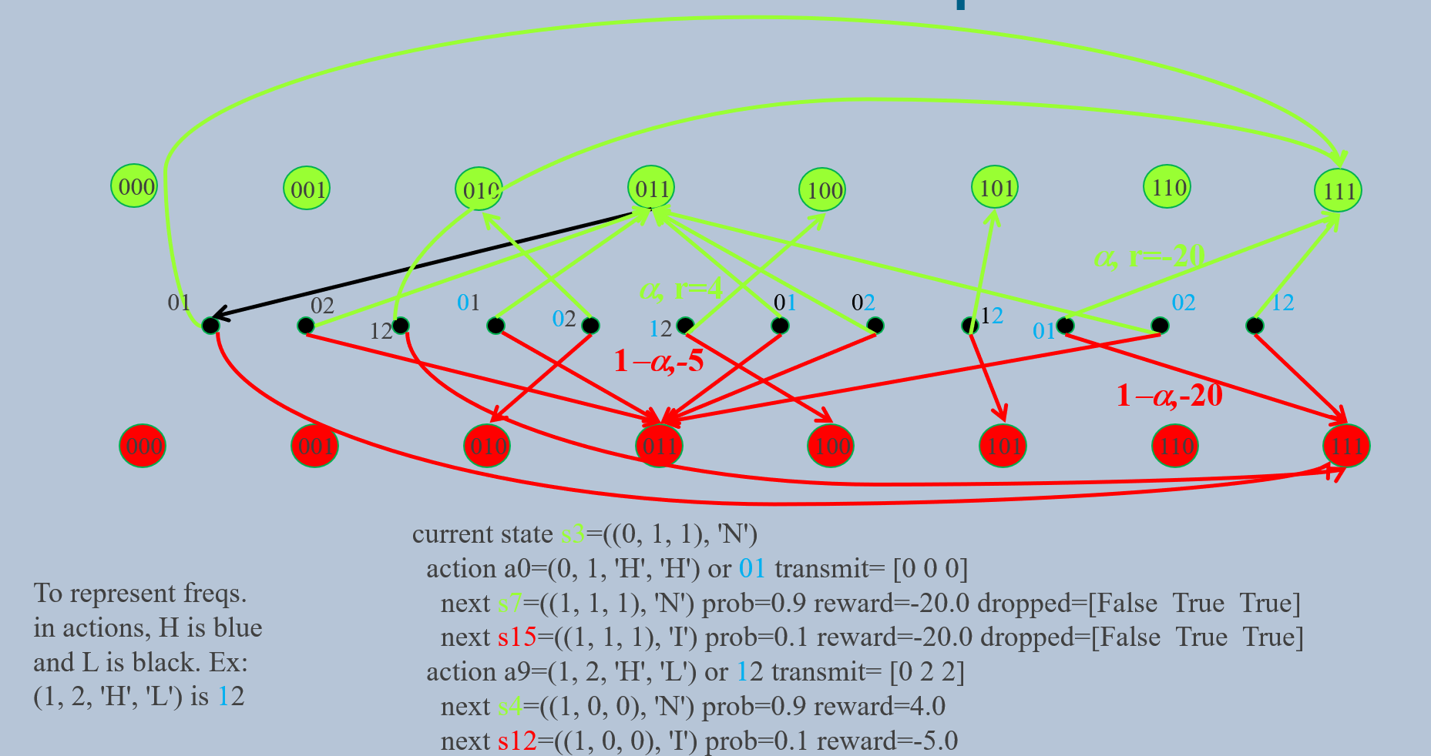
MDP Transition Graph
To avoid many edges, we are not showing the ones from state s3 to actions (black circles)
s3
In this example : α=0.1

Slide 18
MDP Transition Graph (repeated, but not image – decrease the size of the circles for finding the arrow)
000
001
010
011
100
101
110
111
α, r=-20
α, r=4
01
02
01
02
01
02
12
02
12
12
12
01
1−α,-5
1−α,-20
000
001
010
011
100
101
110
111
current state s3=((0, 1, 1), 'N')
action a0=(0, 1, 'H', 'H') or 01 transmit= [0 0 0]
next s7=((1, 1, 1), 'N') prob=0.9 reward=-20.0 dropped=[False True True]
next s15=((1, 1, 1), 'I') prob=0.1 reward=-20.0 dropped=[False True True]
action a9=(1, 2, 'H', 'L') or 12 transmit= [0 2 2]
next s4=((1, 0, 0), 'N') prob=0.9 reward=4.0
next s12=((1, 0, 0), 'I') prob=0.1 reward=-5.0
To represent freqs. in actions, H is blue and L is black. Ex:
(1, 2, 'H', 'L') is 12
Notes:
current state s3=((0, 1, 1), 'N')
action a0=(0, 1, 'H', 'H') transmit= [0 0 0]
next s7=((1, 1, 1), 'N') prob=0.9 reward=-20.0 dropped=[False True True]
next s15=((1, 1, 1), 'I') prob=0.1 reward=-20.0 dropped=[False True True]
action a1=(0, 1, 'H', 'L') transmit= [1 1 0]
next s3=((0, 1, 1), 'N') prob=0.9 reward=-10.0 dropped=[False False True]
next s11=((0, 1, 1), 'I') prob=0.1 reward=-10.0 dropped=[False False True]
action a2=(0, 1, 'L', 'H') transmit= [1 1 0]
next s3=((0, 1, 1), 'N') prob=0.9 reward=-10.0 dropped=[False False True]
next s11=((0, 1, 1), 'I') prob=0.1 reward=-10.0 dropped=[False False True]
action a3=(0, 1, 'L', 'L') transmit= [0 0 0]
next s7=((1, 1, 1), 'N') prob=0.9 reward=-20.0 dropped=[False True True]
next s15=((1, 1, 1), 'I') prob=0.1 reward=-20.0 dropped=[False True True]
action a4=(0, 2, 'H', 'H') transmit= [1 0 0]
next s3=((0, 1, 1), 'N') prob=0.9 reward=-20.0 dropped=[False True True]
next s11=((0, 1, 1), 'I') prob=0.1 reward=-20.0 dropped=[False True True]
action a5=(0, 2, 'H', 'L') transmit= [1 0 2]
next s2=((0, 1, 0), 'N') prob=0.9 reward=-10.0 dropped=[False True False]
next s10=((0, 1, 0), 'I') prob=0.1 reward=-10.0 dropped=[False True False]
action a6=(0, 2, 'L', 'H') transmit= [1 0 1]
next s3=((0, 1, 1), 'N') prob=0.9 reward=-10.0 dropped=[False True False]
next s11=((0, 1, 1), 'I') prob=0.1 reward=-10.0 dropped=[False True False]
action a7=(0, 2, 'L', 'L') transmit= [1 0 1]
next s3=((0, 1, 1), 'N') prob=0.9 reward=-10.0 dropped=[False True False]
next s11=((0, 1, 1), 'I') prob=0.1 reward=-10.0 dropped=[False True False]
action a8=(1, 2, 'H', 'H') transmit= [0 1 0]
next s7=((1, 1, 1), 'N') prob=0.9 reward=-10.0 dropped=[False False True]
next s15=((1, 1, 1), 'I') prob=0.1 reward=-10.0 dropped=[False False True]
action a9=(1, 2, 'H', 'L') transmit= [0 2 2]
next s4=((1, 0, 0), 'N') prob=0.9 reward=4.0
next s12=((1, 0, 0), 'I') prob=0.1 reward=-5.0
action a10=(1, 2, 'L', 'H') transmit= [0 2 1]
next s5=((1, 0, 1), 'N') prob=0.9 reward=3.0
next s13=((1, 0, 1), 'I') prob=0.1 reward=-5.0
action a11=(1, 2, 'L', 'L') transmit= [0 1 1]
next s7=((1, 1, 1), 'N') prob=0.9 reward=2.0
next s15=((1, 1, 1), 'I') prob=0.1 reward=-5.0

Slide 19
Learning (training) evaluation
Q-learning algorithm with data from generative MDP
Vary step size α with ε = 0.01
“Exploration” prob. ε with α = 0.5
Better convergence with α = 0.5
Stationary MDP: no need to explore

Slide 20
Policy (test stage) evaluation
Compare Q-learning trained with 300 iterations, α = 0.5, ε = 0.01 and optimal policy. Take averages over 10⁴ episodes with 100 iterations
Optimal policy eventually drops packets in first 2 iterations whenever initial buffers are full

