Slide 1

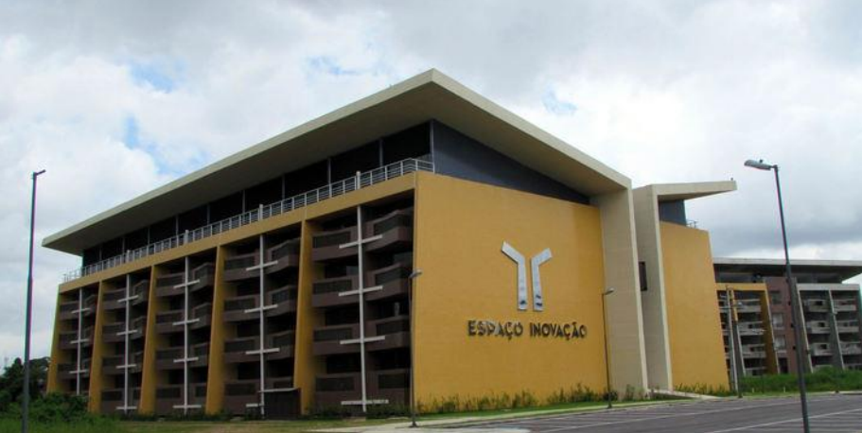
Introduction to Pattern Recognition: Classification
Aldebaro Klautau
Sensors and Embedded Systems (LASSE)
Federal University of Para (UFPA)
Feb. 02, 2017

Slide 2
Agenda
Pattern recognition
Data organized as tables and files
Classification as a machine learning task
Others that we will not discuss: regression, association rules, feature selection, etc
Simple classifiers
Decision stump
Decision tree
K-Nearest Neighbors
Bayes’
Decision regions
Weka: machine learning package in Java

Slide 3
What is “pattern recognition”?
Pattern recognition is a branch of machine learning that focuses on the recognition of patterns and regularities in data, although it is in some cases considered to be nearly synonymous with machine learning [Wikipedia]
See e.g. IEEE Transactions on Pattern Analysis and Machine Intelligence (PAMI)
publishes articles on all traditional areas of computer vision and image understanding, all traditional areas of pattern analysis and recognition, and selected areas of machine intelligence, with a particular emphasis on machine learning for pattern analysis.

Slide 4
“Raw” data can often be organized as a table
Example:
Name | Phone | Weight (kg) | Country
Trump | 1 43 22885998 | 87 | USA
Temer | 55 23 591927 | 72 | Brazil
Castro | 34 95 499402 | 82 | Cuba
... | ... | ... | ...
Each column is a “field”, “parameter”, “feature” or attribute
Each row is a “register”, “example” or “instance”

Slide 5
Attributes or parameters
Categories:
A) Nominal or Discrete, K possible values (K is an integer)
Binary, K=2. Example: Brazilian? Yes or No
Multiclass, K>2. Example: Seven rainbow colors? red, orange, yellow, green, blue, indigo and violet
B) Numeric
Real numbers. Example: weight 80.7, 23.2, 56.4, ...
Integer numbers. Example: age in years 1, 2, 3, ...
C) Strings
Example: Name John, Paul, Laura, etc.
D) Others: date, etc.
The non-numeric attributes can be mapped to numbers
Example: The seven rainbow colors are mapped to integers from 1 to 7
Similar to the mapping of a random variable, from an “outcome” (e.g. head or tail) into a number

Slide 6
Classification
Problem:
Given a vector x with N parameters, find its class y among Y possible labels
Fish classifier:
Evaluation: misclassification (or error) rate
x₁
classifier
vector
x
classifier
y
or
x₂
y
x_{N}
...
or
?
Length | Weight | Class y
12 | 3.2
10 | 0.5
14 | 2.8
Test stage uses “unseen” examples:
x = (13, 4.2)
y = ?
Training set
used during ➔
the training stage

Slide 7
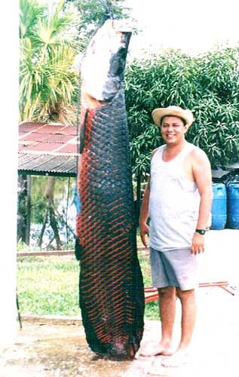
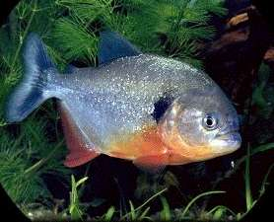
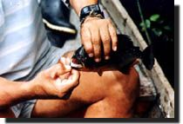
Piranha or Pirarucu?
(fishing in the Amazon rivers)
Piranha
Pirarucu

Slide 8
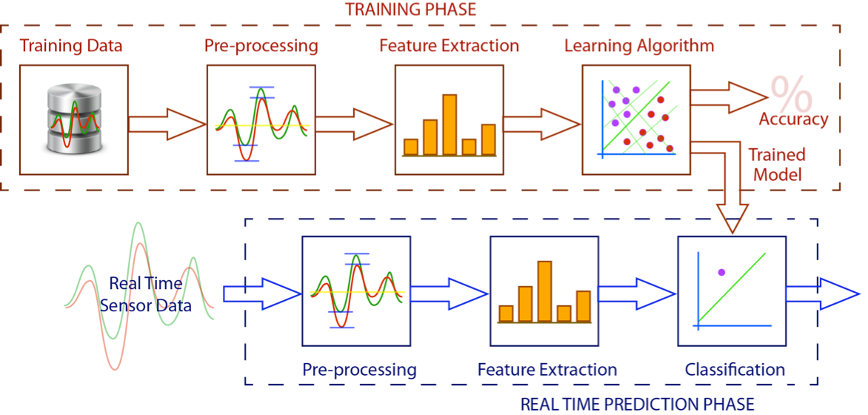
Stages in training and testing
http://www.nickgillian.com/wiki/pmwiki.php/GRT/GettingStarted

Slide 9
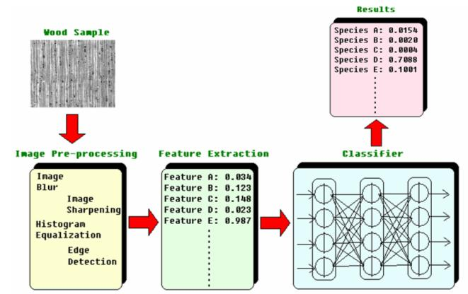
Stages in training and testing: variant for wood species recognition system
http://www.utar.edu.my/contentRandD.jsp?catid=9&contentid=417&2ndcontentid=1500

Slide 10
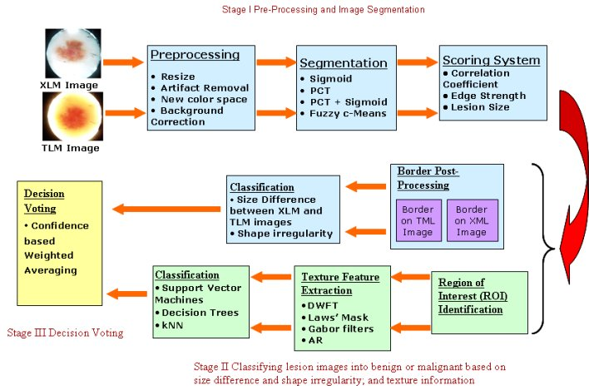
Stages in training and testing: variant for skin lesion detection and classification
http://sites.tech.uh.edu/isgrin/research-projects/biomedical-signal-and-image-processing/skin-lesion-project/

Slide 11
How classifiers are built (trained)?
There are many automatic classifiers. Examples:
If / else rules and thresholds forming a “decision tree”
A single if/else rule with a threshold, called “decision stump”
K-nearest neighbors (KNN)
Artificial neural networks (ANN)
Support vector machines (SVM)
Naïve Bayes classifiers
... and many others
Each classifier has one or more training algorithms
Recall: during the supervised training stage, both the parameters x and the correct label y is available. During test, the classifier has x as input and outputs its guess y₀ for the correct value of y

Slide 12
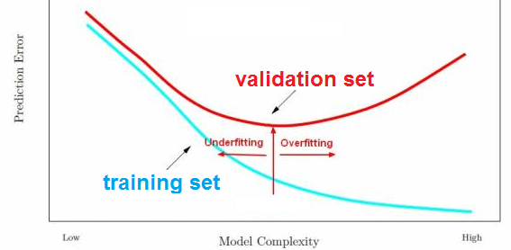
Model selection and overfitting
Model selection: obtain the parameters that define the classifier
Need to avoid overftting, use a validation set

Slide 13
Evaluation methods
Never obtain the misclassification error using the training set iteself and then use this value as indication of the classifier performance
Evaluate the classifier using an unseen test set
To be strict, use a validation set to “tune” the classifier. This stage of “model selection”, or selecting the parameters of the classifier, is sometimes done with a “test” set (in Weka nomenclature) but then a disjoint test set should be used to infer about the classifier generalization capability
Cross-validation
Split the training set in N subsets (“folds”)
Repeat for all subsets i=1:N
Consider the specific subsets i as the test set and compose the training set with the N-1 reamaining
Obtain the i-th error rate
The final error rate is the average among the N error rate values
Leave-one-out
Extreme case of cross-validation: only 1 example is the test “set” while all other examples are the training set
Confusion-matrix

Slide 14
Simple classifiers (for two simple sets)
Instead of using an automatic training method, let us design simple classifiers ourselves using the two simple sets below:
Training set
Test set
Length | Weight | Class y
12 | 3.2 | 0
10 | 0.5 | 1
14 | 2.8 | 0
14 | 2.4 | 0
13 | 1.8 | 1
13.8 | 1.5 | 0
11 | 1 | 1
Length | Weight | Class y
13 | 3.1 | 0
9 | 0.8 | 0
12.3 | 1.4 | 1
10 | 2.3 | 1

Slide 15
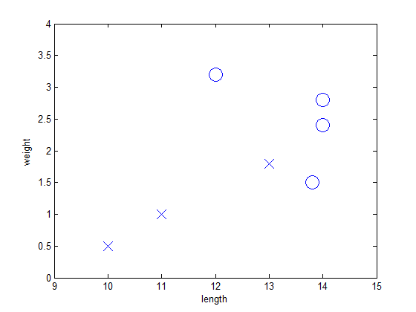
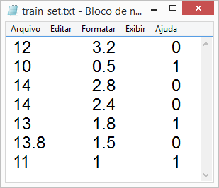
Getting familiar with the given data
Because there are (only) two features, it is easy to visualize the training set
Training set
Length | Weight | Class y
12 | 3.2 | 0
10 | 0.5 | 1
14 | 2.8 | 0
14 | 2.4 | 0
13 | 1.8 | 1
13.8 | 1.5 | 0
11 | 1 | 1
Text (ASCII) file

Slide 16
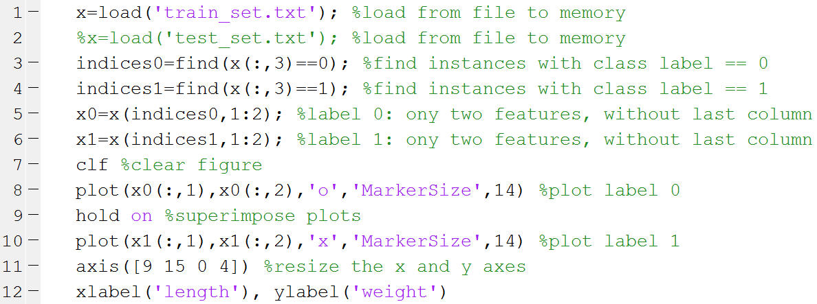
Manipulating the data
Matlab / Octave code showSets.m to plot the data:
x is a 7x3 array

Slide 17
First classifier: decision stump
Decision stump is a single if / else rule based on a chosen threshold value of a chosen feature
First example:
if weight > 1
then class label is 0
This gives one error in training set!
Another example:
if length < 12
then class label is 1
This also gives one error in training set!

Slide 18
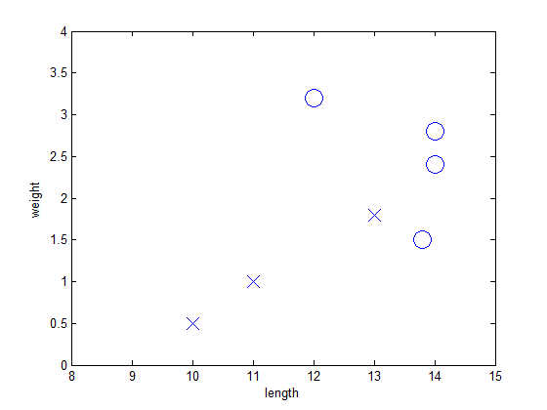
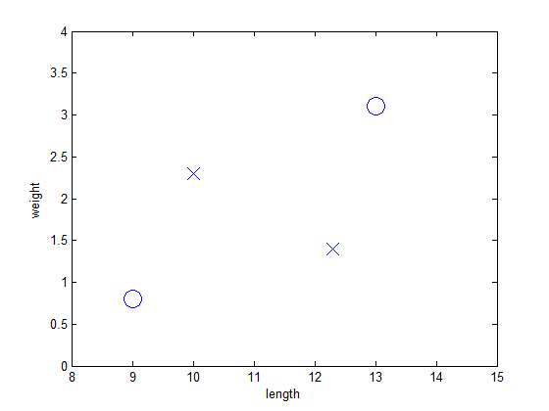
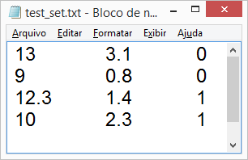
Test our decision stump
Example:
if weight > 1
then class label is 0
This gives one error in training set!
But gives three errors in this (strange) test set!

Slide 19
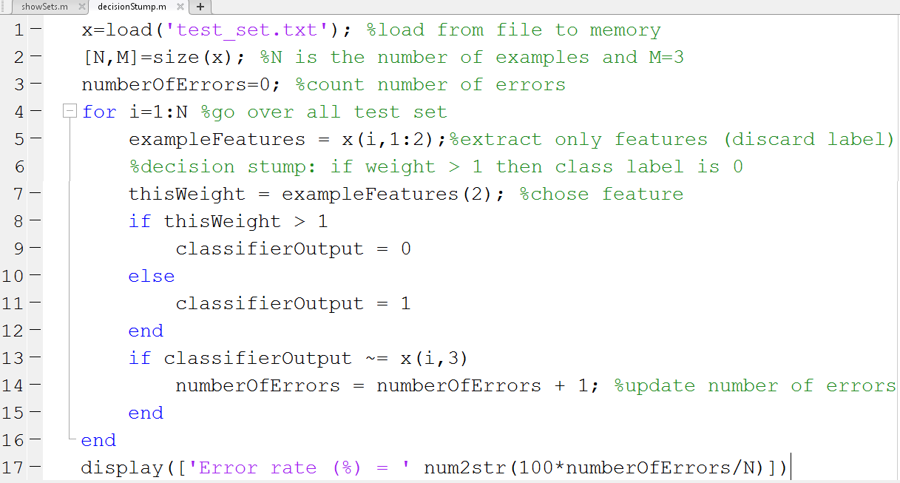
Implement (and test): decisionStump.m

Slide 20
Second classifier: decision tree
Decision tree is a set of more than one decision stumps (if / else’s) organized as a tree. Example with two stumps that gives no errors in the training set:
length > 13 ?
weight > 2.5 ?
class is 0
class is 1
class is 0

Slide 21
Third classifier: nearest neighbor
The nearest neighbor (NN) classifier simply stores the whole training sequence and, according to the adopted distance measure (e.g. Euclidean distance) assigns to the test example the same class of its nearest (smallest distance) neighbor (example of the stored training sequence
The Euclidean distance corresponds to the squared value of the error vector norm
y represents the test vector
z represents a training example
Euclidean: distance(y, z) = || y – z ||²

Slide 22
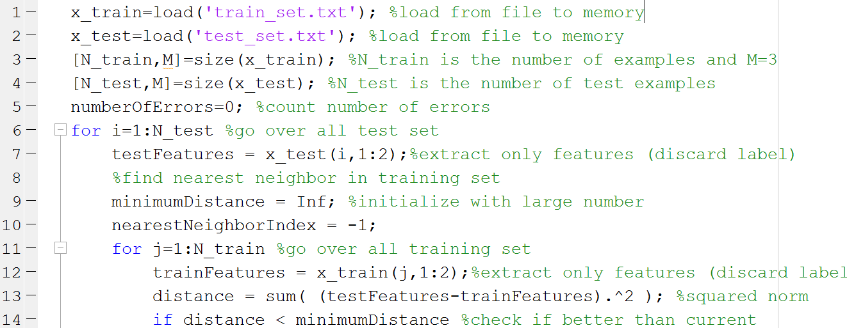
NN classifier implementation

Slide 23
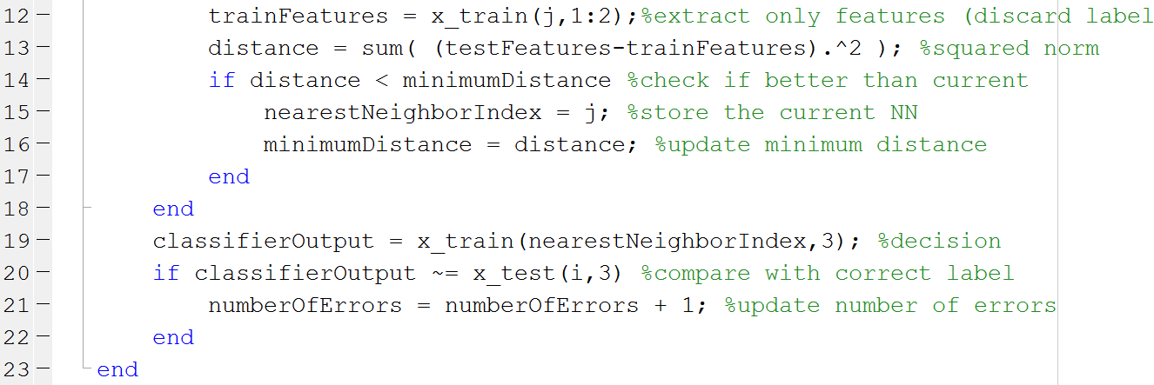
NN classifier implementation

Slide 24
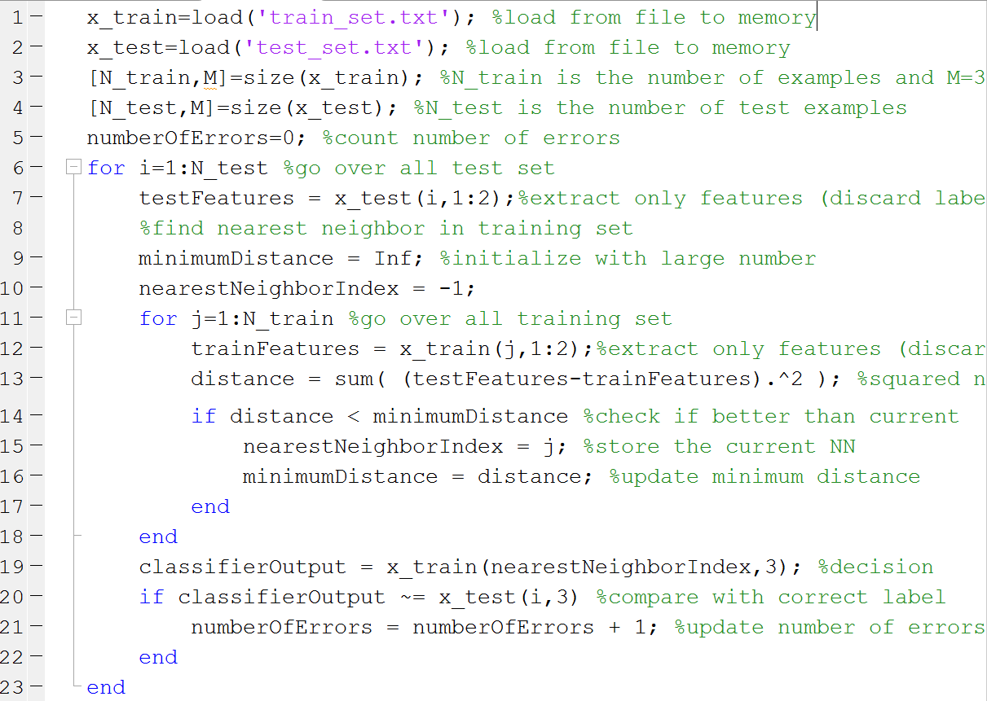
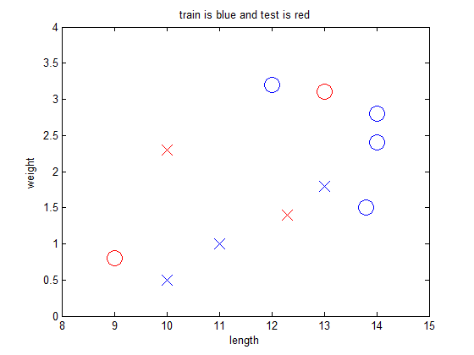
NN classifier implementation
Error rate on test set = 25 %
(error on training set is always 0)

Slide 25
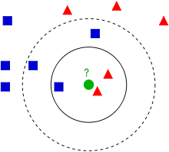
Fourth classifier: K-nearest neighbors
KNN classifier: choose K as an integer odd number (e.g. K=3 or 5 is widely adopted) and make the classifier to output the most popular label among the K nearest neighbor as final decision
The previous NN classifier is equivalent to using K=1, which may be less robust to outliers than K > 1
Example: assume that all red and blue examples compose a new training sequence. Note the outlier!
Example from Wikipedia en.wikipedia.org/wiki/K-nearest_neighbors_algorithm

Slide 26
Controling number of examples in KNN
KNN is called “lazy” classifier because “training” corresponds to storing the whole training sequence. But this can lead to a prohibitive computational cost
To decrease the number of examples stored per class, a “clustering” algorithm such as K-means can be used (the meaning for K in K-means is not same as K in K-NN)
Example, running K-means with K=2 for the 4 examples of label 0 would return 2 new vectors to represent the class 0
K-means is an iterative algorithm, but in the special case of K=1 with Euclidean distance, its outputs is simply the average of the input vectors
➔ Adopting K-means with K=1 “mean” (1 example per class), would lead to a simple KNN with K=1 (IB1 in Weka)

Slide 27
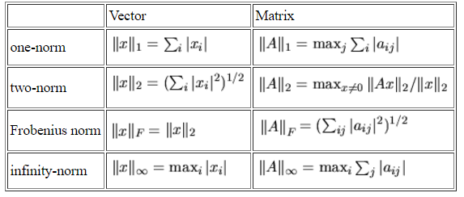

Norms
Besides the Euclidean distance, there are several norms that can be used to compare (error) vectors and matrices. Norms are used to define distances: d(x,y) = || x-y ||
norm([3 4],1)=7
norm([3 4]) = 5
norm([3 4],'fro')=5
norm([3 4],Inf) = 4
http://www.netlib.org/lapack/lug/node75.html

Slide 28
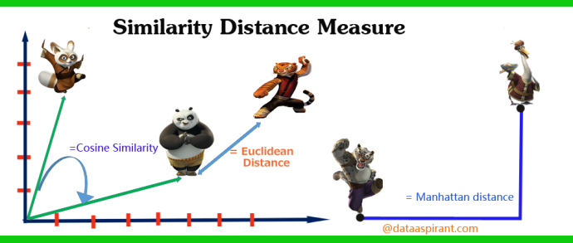
There are several similarity measures for features organized as vectors
http://dataaspirant.com/2015/04/11/five-most-popular-similarity-measures-implementation-in-python/

Slide 29
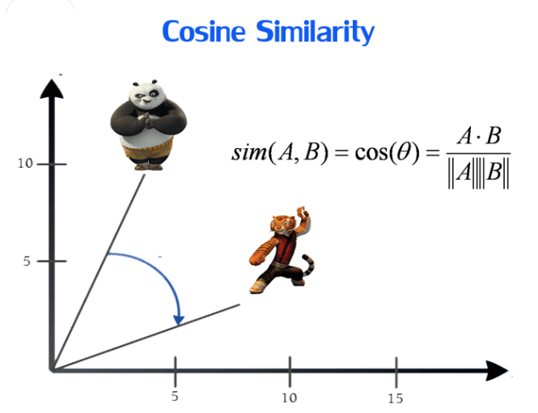
Similarity based on inner product
http://dataaspirant.com/2015/04/11/five-most-popular-similarity-measures-implementation-in-python/

Slide 30
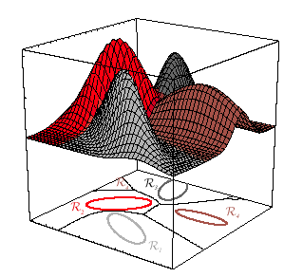
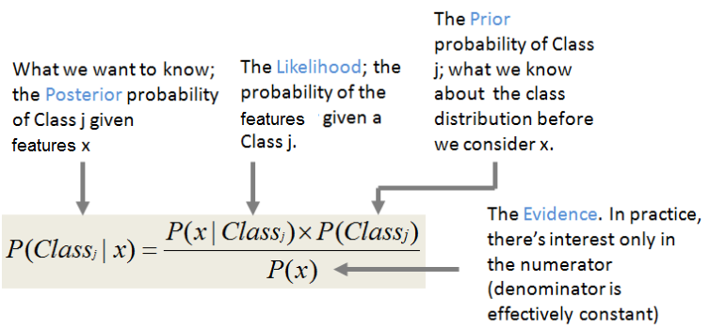
Statistical Bayes classifiers
Based on Bayes’ theorem, requires the estimation of likelihoods and priors for each class:
If the estimation of likelihoods and priors is perfect, the Bayes classifier is optimum and its error is the minimum possible, called “Bayes error”
http://shatterline.com/blog/2013/09/12/not-so-naive-classification-with-the-naive-bayes-classifier/

Slide 31

Example of a Bayes classifier
Example: 4 classes
“Nature” dictated that in this case each likelihood is a Gaussian distribution
Assume the priors are uniformly distributed P(Class_{j})=1/4
Given a test vector x, calculate posteriors for j=1, 2, 3, 4 and choose the largest:

Slide 32
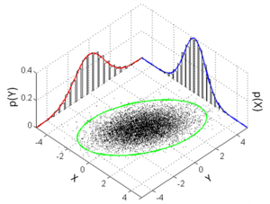
Naïve Bayes classifier
Use the naïve (ingenuous) assumption that the parameters of each class are statistically independent, such that all joint distributions are equivalent to the multiplication of the marginal distributions
Example, for a parameter vector z = [x, y] of a classe C, it corresponds to P(z|C) = P(x|C) P(y|C)

Slide 33
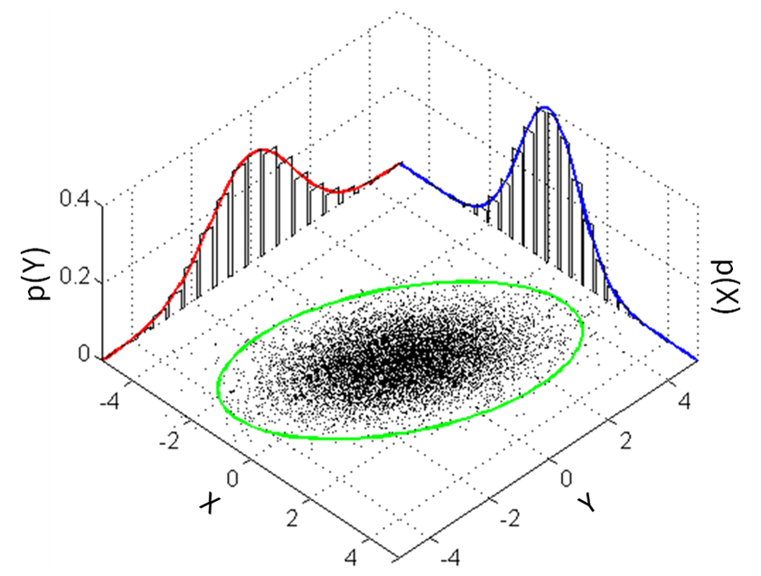
Naïve classifier using Gaussians for real-valued features
For each class, estimate the needed statistics, priors and likelihoods
Class 0:
prior0=4/7
m0l=mean([12 14 14 13.8]) %13.450
m0w=mean([3.2 2.8 2.4 1.5]) %2.4750
s0l=std([12 14 14 13.8]) %0.97125
s0w=std([3.2 2.8 2.4 1.5]) %0.72744
Class 1:
prior1=3/7
m1l=mean([10 13 11]) %11.333
m1w=mean([0.5 1.8 1]) %1.1000
s1l=std([10 13 11]) %1.5275
s1w=std([0.5 1.8 1]) %0.65574
Test example: x=[13 3.2]; xl=x(1); xw=x(2);
num0=normpdf(xl,m0l,s0l)*normpdf(xw,m0w,s0w)*prior0
num1=normpdf(xl,m1l,s1l)*normpdf(xw,m1w,s1w)*prior1
Px=num0+num1; %denominator, just a scale factor
posterior0=num0/Px %0.99685
posterior1=num1/Px %0.0031541

Slide 34
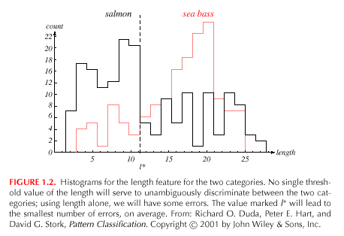
Classification based on histograms for discrete features
Piranha: black curve
Pirarucu:
red curve
Histogram of the discretized “length” feature

Slide 35
Decision regions
Examples with different classifiers using Peterson & Barney’s vowel dataset

Slide 36
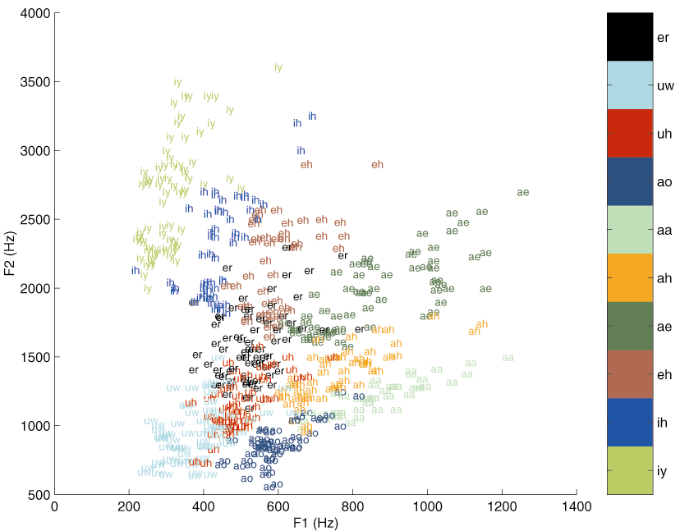
P&B vowel dataset
⇦ back “which part of the tongue is raised” front ⇨
⇦ close “how far the tongue is raised” open ⇨

Slide 37
Decision tree C4.5 (J4.8 in Weka)
F2 <= 1600
| F1 <= 586
| | F2 <= 990: UW (92.0/47.0)
| | F2 > 990
| | | F2 <= 1200: UH (50.0/17.0)
| | | F2 > 1200: ER (63.0/23.0)
| F1 > 586
| | F2 <= 1250: AA (59.0/33.0)
| | F2 > 1250: AH (56.0/24.0)
F2 > 1600
| F1 <= 490
| | F1 <= 350: IY (68.0/5.0)
| | F1 > 350: IH (61.0/21.0)
| F1 > 490
| | F1 <= 652: EH (71.0/34.0)
| | F1 > 652: AE (79.0/19.0)
Size: 17 nodes and 9 leaf nodes

Slide 38
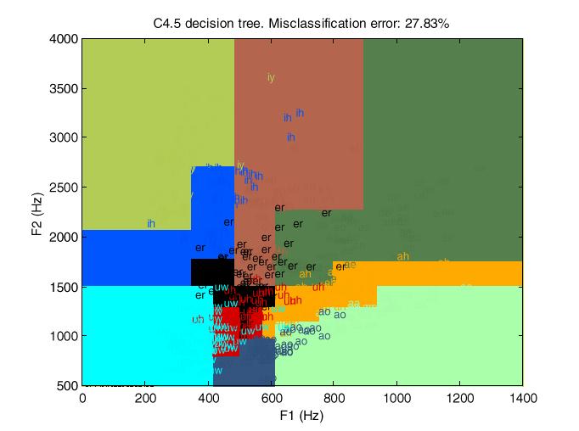
Decision region for the decision tree

Slide 39
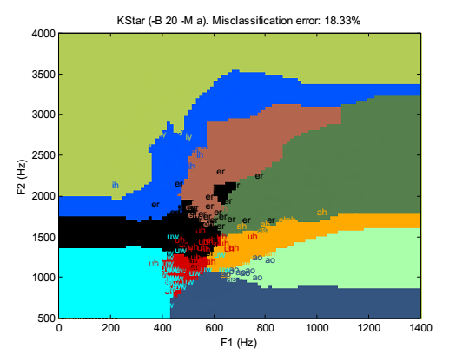
Decision region for “KStar” classifier

Slide 40

Weka machine learning software
Popular, open-souce package, written in Java
Site: http://www.cs.waikato.ac.nz/ml/weka/
Limitation: does not
Many other alternatives for “big data”:
http://www.kdnuggets.com/2016/04/top-15-frameworks-machine-learning-experts.html
We are going to use here the Explorer module
Weka supports the ARFF file format
ASCII text with simple header

Slide 41
Example: Weka ARFF format
@relation car
@attribute buying {vhigh, high, med, low}
@attribute maint {vhigh, high, med, low}
@attribute doors {2, 3, 4, 5more}
@attribute persons {2, 4, more}
@attribute lug_boot {small, med, big}
@attribute safety {low, med, high}
@attribute class {unacc, acc, good, vgood}
@data
vhigh,vhigh,2,2,small,low,unacc
vhigh,vhigh,2,2,small,med,unacc
...
Obs: Comma-separated values (CSV) ASCII file with a header

Slide 42
Thanks!
Contact: lasse@ufpa.br
www.lasse.ufpa.br

