Slide 1

OpenCV on MS Visual Studio
Installing and debugging OpenCV on Windows with Microsoft Visual C++ Express 2010
Aldebaro Klautau – www.lasse.ufpa.br
Belém, Brazil – Feb. 07, 2016
Federal University of Para (UFPA)

Slide 2
Agenda
Install a C++ compiler (for Windows)
Download OpenCV
Create your own “project” and prepare files to later have CMake adding it to the OpenCV compiler projetct (or “solution”)
Download CMake and use it to create the “solution” that will compile your project
Compile, link and debug your project code

Slide 3
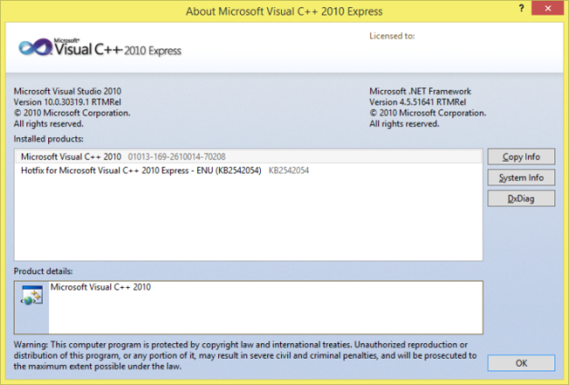
Install a C++ compiler
The free Microsoft Visual Studio “Express” version is enough. Other versions (e.g. 2015 for Windows Desktop) may work but we will assume 2010. You can google:
download and install microsoft visual c++ 2010 express edition
Or go to:
https://www.visualstudio.com/products/visual-studio-express-vs
The “About” window is ➔

Slide 4
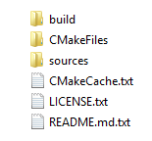
Download OpenCV
Go to
http://opencv.org
We will assume Version 3.1 of 2015-12-21, but the same should work for 3.2 or another
Within your main OpenCV folder, you should find:

Slide 5
Add 3 files the correspond to your new (face detection) project
Go to:
https://github.com/aldebaro/ufpa-face-detection/
and look for folder “opencv/sources/apps”, or go directly to
https://github.com/aldebaro/ufpa-face-detection/tree/master/opencv/sources/apps
Download the files (opencv_ufpafacedet.cpp and the two CMakeLists.txt fiels). We will use the three files that will be discussed in the sequel

Slide 6

Add your files to the “apps” folder in OpenCV
The goal is to add opencv_ufpafacedet.cpp and compile it as part of the OpenCV project
From OpenCV main folder, find and go to folder opencv\sources\apps, which may have the following contents:

Slide 7
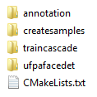
Add your own files to the “apps” folder
Create the folder ufpafacedet, such that the folder apps now has:
Subsitute the original CMakeLists.txt (seen above) by the one at
https://github.com/aldebaro/ufpa-face-detection/tree/master/opencv/sources/apps

Slide 8

Add your own files to the “apps” folder (cont.)
And copy to your folder opencv\sources\apps\ufpafacedet the two files opencv_ufpafacedet.cpp and CMakeLists.txt available at https://github.com/aldebaro/ufpa-face-detection/tree/master/opencv/sources/apps/ufpafacedet
Note the two files CMakeLists.txt from the github repository above are different!!!
Your folder opencv\sources\apps\ufpafacedet should then have:

Slide 9
Download CMake and use it to create a MS Visual Studio .sln “solution” file
We can follow the instructions at [1]: http://www.anlak.com/2013/02/build-debug-opencv-vs2010.html
First, download (https://cmake.org/download) and install CMake
Then configure (twice, as indicated in [1] above) and generate the MS Visual Studio .prj and .sln files

Slide 10
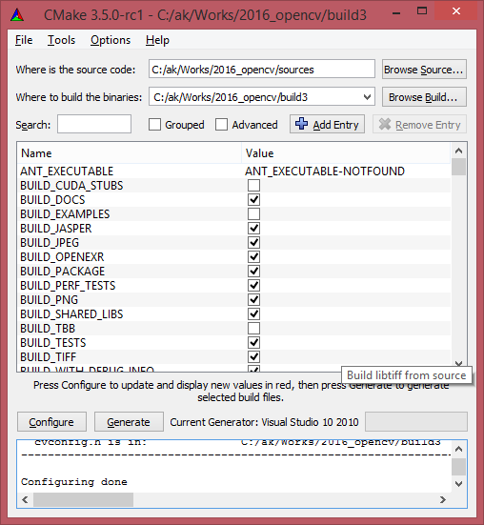
Run CMake GUI
Goal is to have CMake adding your “project” ufpafacedet to the Visual C++ “solution”
CMake GUI will allow to choose the source code folder and choose and output (build) file
After successfully running CMake, you can go to MS Visual Studio and open the OpenCV.sln created by CMake

Slide 11
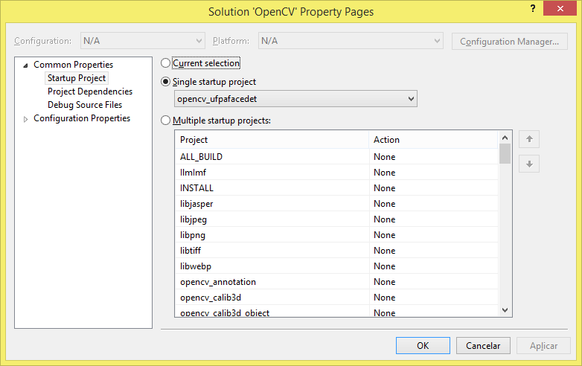
Compile, link and debug your code
Go to menu Project ➔ Set StartUp Projects and choose opencv_ufpafacedet as follows:

Slide 12
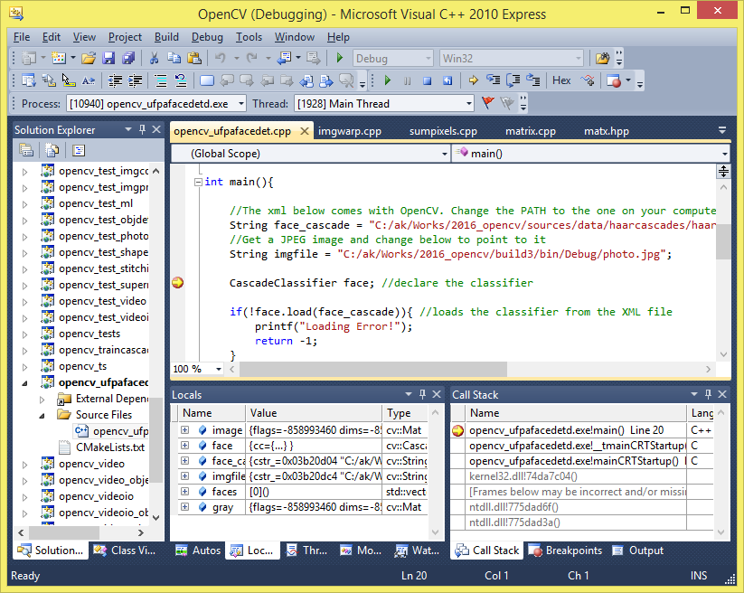
Set a breakpoint and debug the code

