Slide 1


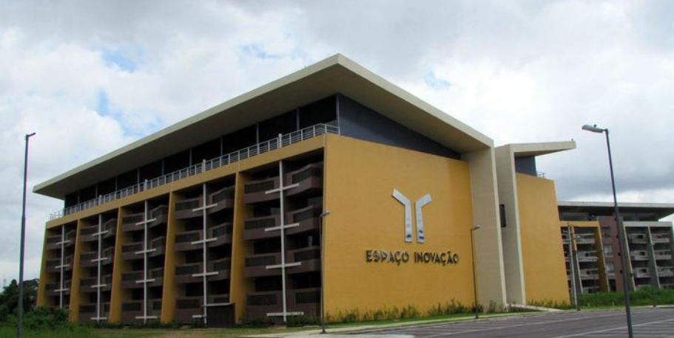
An Introduction to Boosting and AdaBoost using Weka
Aldebaro Klautau
LASSE - Federal University of Pará (UFPA)
Brazil, Jun. 30, 2017
Most slides from P. Viola and others

Slide 2
Boosting
Boosting is a “meta” learning scheme that works by combining weak learners. It can generate an accurate “ensemble classifier” and easily perform “feature selection”
  A weak learner need only do better than chance
Training consists of multiple boosting rounds
  During each boosting round, we select a weak learner that does well on examples that were hard for the previous weak learners
  “Hardness” is captured by weights attached to training examples
Y. Freund and R. Schapire, A short introduction to boosting, Journal of Japanese Society for Artificial Intelligence, 14(5):771-780, September, 1999.

Slide 3

Training
Choose a resolution (say, images with 24 x 24 pixels)
Use a large number of “positive” examples (faces)
And a large number of “negative” examples, (anything but a face)

Slide 4
Training procedure
Initially, weight each training example equally
In each boosting round:
  Find the weak learner (we assume it is a Decision Stump) that achieves the lowest weighted training error
  Raise the weights of training examples misclassified by current (partially trained) classifier, taking all weak learners already trained in account
Compute final classifier as linear combination of all weak learners (weight of each learner is directly proportional to its accuracy)
Exact formulas for re-weighting and combining weak learners depend on the particular boosting scheme (e.g., AdaBoost)
Y. Freund and R. Schapire, A short introduction to boosting, Journal of Japanese Society for Artificial Intelligence, 14(5):771-780, September, 1999.

Slide 5
Boosting illustration (perceptron as weak learner)
Weak
Classifier 1

Slide 6
Boosting illustration
Weights
Increased

Slide 7
Boosting illustration
Weak
Classifier 2

Slide 8
Boosting illustration
Weights
Increased

Slide 9
Boosting illustration
Weak
Classifier 3

Slide 10
Boosting illustration
Final classifier is
a combination of weak classifiers

Slide 11
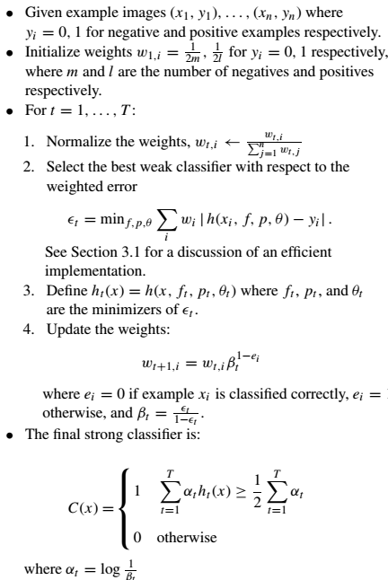

AdaBoost algorithm

Slide 12
AdaBoost algorithm (cont.)

Slide 13
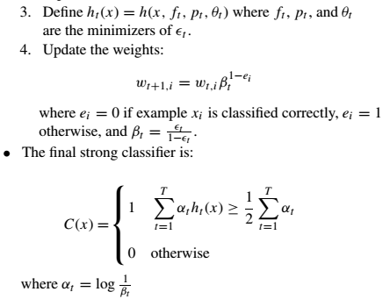
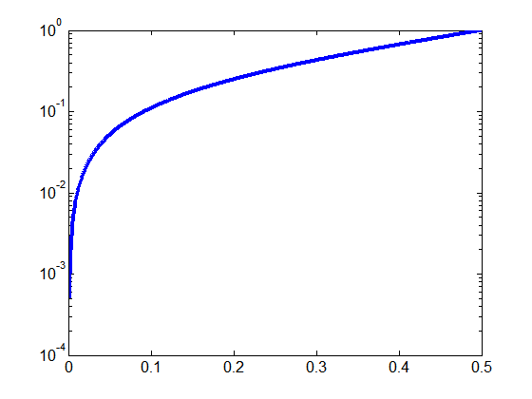
AdaBoost algorithm (cont. 2)
Case 1:
ε_{t} = 0.3
β_{t} = 0.43
α_{t} = 0.85
Case 2:
ε_{t} = 0.1
β_{t} = 0.11
α_{t} = 2.2
β_{t}=1
0
ε_{t}

Slide 14
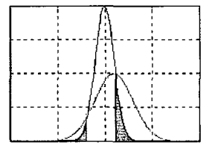
Faster boosting for binary problems
“Mining speech: automatic selection of heterogeneous features using boosting”, A. Klautau, ICASSP, 2003 (implemented as Weka class: FastBoostingFeatureSelector.java)
Fit two Gaussians and use the Bayes’ error:

