Slide 1


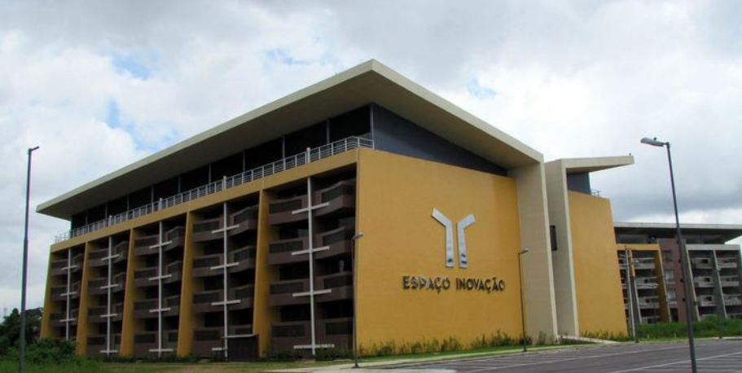
Face detection using boosted cascaded dectector [Viola & Jones]
Aldebaro Klautau
LASSE - Federal University of Pará (UFPA)
Brazil, Jul. 02, 2017
Most slides from P. Viola and others

Slide 2
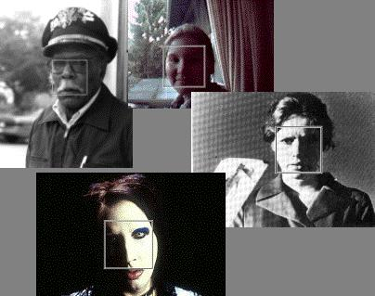
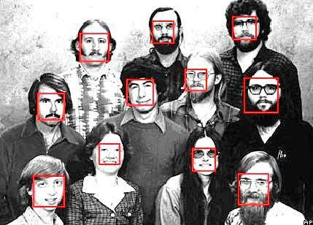
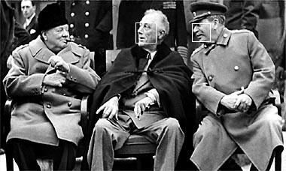
Face detection
Many slides adapted from P. Viola

Slide 3
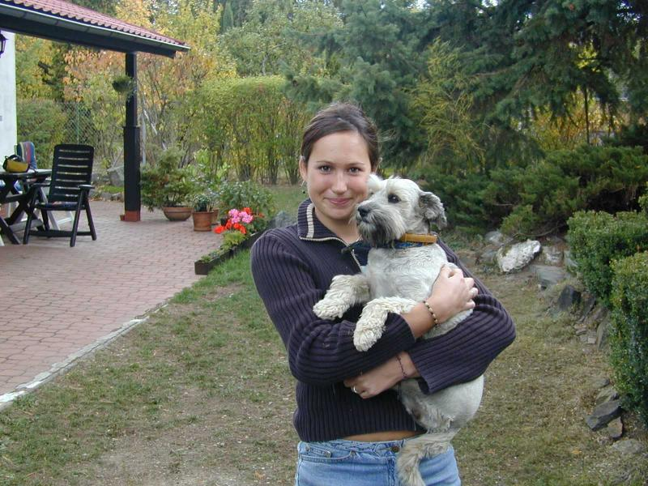
Face detection
Basic idea: slide a window across image and evaluate a face model at every location

Slide 4
Challenges of face detection
Sliding window detector must evaluate tens of thousands of location/scale combinations
Faces are rare: 0–10 per image
  For computational efficiency, we should try to spend as little time as possible on the non-face windows
  A megapixel image has ~10⁶ pixels and a comparable number of candidate face locations
  To avoid having a false positive in every image image, our false positive rate has to be less than 10⁻⁶

Slide 5
The Viola/Jones Face Detector
A seminal approach to real-time object detection
Training is slow, but detection is very fast
Key ideas
  Integral images for fast feature evaluation
  Boosting for feature selection
  Attentional cascade for fast rejection of non-face windows
P. Viola and M. Jones. Rapid object detection using a boosted cascade of simple features. CVPR 2001.
P. Viola and M. Jones. Robust real-time face detection. IJCV 57(2), 2004.

Slide 6
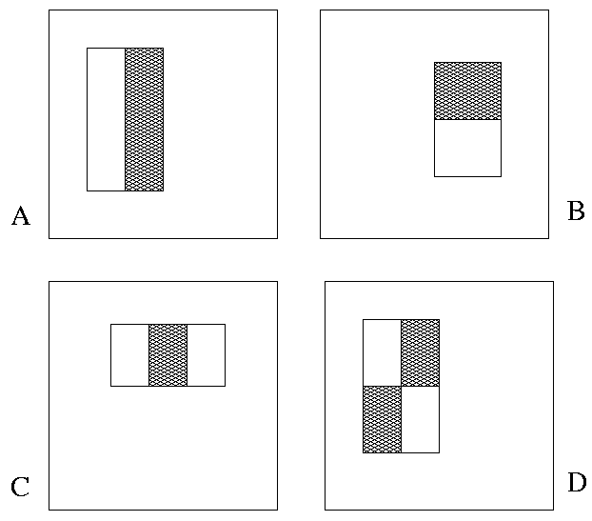
Image Features
“Rectangle filters”
Value =
∑ (pixels in white area) –
∑ (pixels in black area)
Notes:
For real problems results are only as good as the features used...
This is the main piece of ad-hoc (or domain) knowledge
Rather than the pixels, we have selected a very large set of simple functions
Sensitive to edges and other critcal features of the image
** At multiple scales
Since the final classifier is a perceptron it is important that the features be non-linear… otherwise the final classifier will be a simple perceptron.
We introduce a threshold to yield binary features

Slide 7
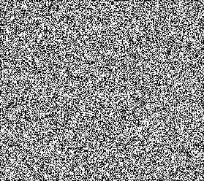



Example
Source
Result

Slide 8
Fast computation with integral images
The integral image computes a value at each pixel (x,y) that is the sum of the pixel values above and to the left of (x,y), inclusive
This can quickly be computed in one pass through the image
(x,y)

Slide 9
Computing the integral image

Slide 10
Computing the integral image
ii(x, y-1)
s(x-1, y)
i(x, y)
Cumulative row sum: s(x, y) = s(x–1, y) + i(x, y)
Integral image: ii(x, y) = ii(x, y−1) + s(x, y)
MATLAB: ii = cumsum(cumsum(double(i)), 2);

Slide 11
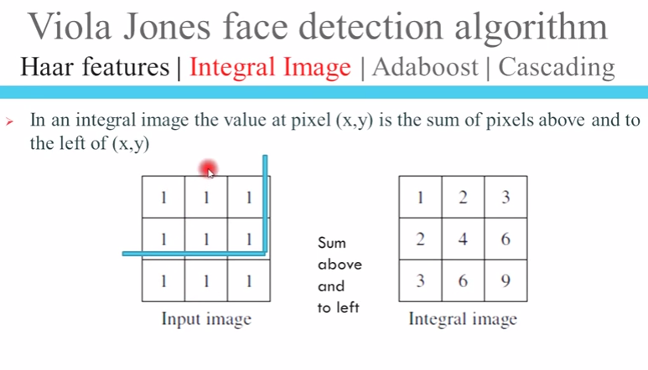

By http://ramsrigoutham.com/

Slide 12
Computing sum within a rectangle
Let A,B,C,D be the values of the integral image at the corners of a rectangle
Then the sum of original image values within the rectangle can be computed as:
  sum = A – B – C + D
Only 3 additions are required for any size of rectangle!
D
B
C
A

Slide 13
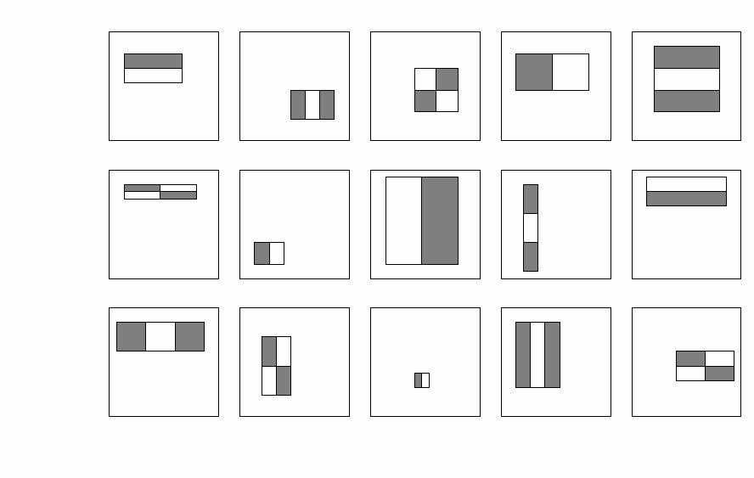
Features
For a 24x24 detection region, the number of possible rectangle features is ~160,000!

Slide 14
Scaling
Detector scans the input at many scales
The base (smallest) scale depends on the size of the images in the training set.
Then the scale (hence, the window) is consecutively enlarged by a factor of (for example) 1.25 until reaching the size of the image itself.

Slide 15
Scaling (cont.)
For example, assume the base scale is 24 x 24 pixels and the image has 384 x 288 pixels. The image is first searched using overlapping windows of 24 x 24 pixels (scale = 1). Then, the scale is multiplied by 1.25 and a window of 30 x 30 pixels (scale = 1.25) is used. The third scale is 1.5625 and so on, until reaching scale=12 with a window of 288 x 288 pixels.
Note that the conventional approach would be to compute a pyramid of 12 images, each 1.25 times smaller than the previous image. But in this detector, the image is not "resampled", and the resolution is adapted by using features of distinct sizes (resolutions), which is facilitated by the adotption of the integral image representation.

Slide 16

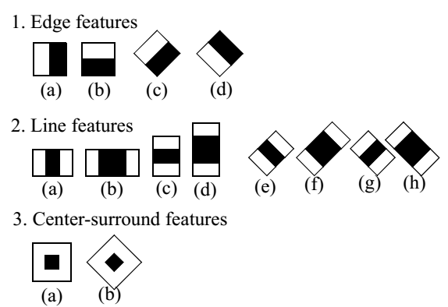
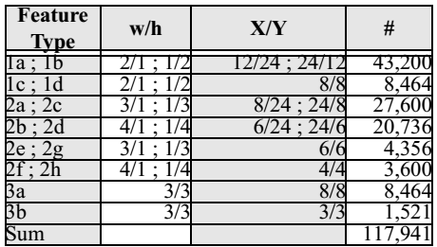
To calculate number of features
See: 2012 ICIP paper "An Extended Set of Haar-like Features for Rapid Object Detection", by Rainer Lienhart and Jochen Maydt (Intel)
Introduced “rotated” features

Slide 17
Feature selection
The number of possible rectangle features is huge!
At test time, it is impractical to evaluate the entire feature set
Can we create a good classifier using just a small subset of all possible features?
How to select such a subset?

Slide 18
An Introduction to Boosting and AdaBoost using Weka
Aldebaro Klautau
LASSE - Federal University of Pará (UFPA)
Brazil, Jun. 30, 2017
Most slides from P. Viola and others

Slide 19
Boosting
Boosting is a “meta” learning scheme that works by combining weak learners. It can generate an accurate “ensemble classifier” and easily perform “feature selection”
  A weak learner need only do better than chance
Training consists of multiple boosting rounds
  During each boosting round, we select a weak learner that does well on examples that were hard for the previous weak learners
  “Hardness” is captured by weights attached to training examples
Y. Freund and R. Schapire, A short introduction to boosting, Journal of Japanese Society for Artificial Intelligence, 14(5):771-780, September, 1999.

Slide 20
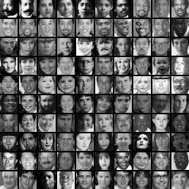
Training
Choose a resolution (say, images with 24 x 24 pixels)
Use a large number of “positive” examples (faces)
And a large number of “negative” examples, (anything but a face)

Slide 21
Training procedure
Initially, weight each training example equally
In each boosting round:
  Find the weak learner (we assume it is a Decision Stump) that achieves the lowest weighted training error
  Raise the weights of training examples misclassified by current (partially trained) classifier, taking all weak learners already trained in account
Compute final classifier as linear combination of all weak learners (weight of each learner is directly proportional to its accuracy)
Exact formulas for re-weighting and combining weak learners depend on the particular boosting scheme (e.g., AdaBoost)
Y. Freund and R. Schapire, A short introduction to boosting, Journal of Japanese Society for Artificial Intelligence, 14(5):771-780, September, 1999.

Slide 22
Boosting illustration (perceptron as weak learner)
Weak
Classifier 1

Slide 23
Boosting illustration
Weights
Increased

Slide 24
Boosting illustration
Weak
Classifier 2

Slide 25
Boosting illustration
Weights
Increased

Slide 26
Boosting illustration
Weak
Classifier 3

Slide 27
Boosting illustration
Final classifier is
a combination of weak classifiers

Slide 28
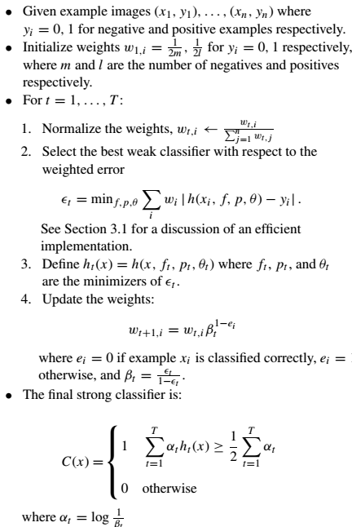
AdaBoost algorithm

Slide 29
AdaBoost algorithm (cont.)

Slide 30
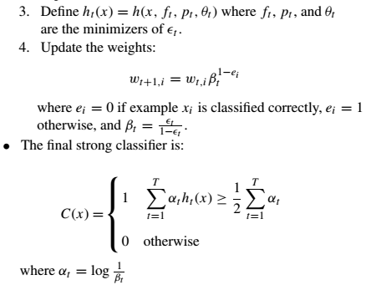
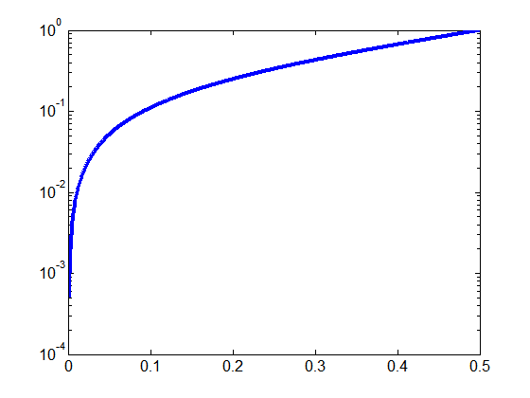
AdaBoost algorithm (cont. 2)
Case 1:
ε_{t} = 0.3
β_{t} = 0.43
α_{t} = 0.85
Case 2:
ε_{t} = 0.1
β_{t} = 0.11
α_{t} = 2.2
β_{t}=1
0
ε_{t}

Slide 31
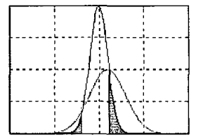
Faster boosting for binary problems
“Mining speech: automatic selection of heterogeneous features using boosting”, A. Klautau, ICASSP, 2003 (implemented as Weka class: FastBoostingFeatureSelector.java)
Fit two Gaussians and use the Bayes’ error:

Slide 32
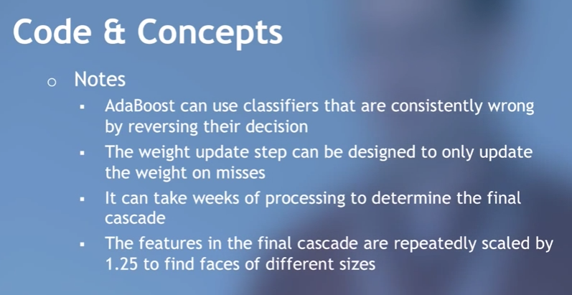
From Tom Neumark’s youtube presentation on Facial Detection

Slide 33
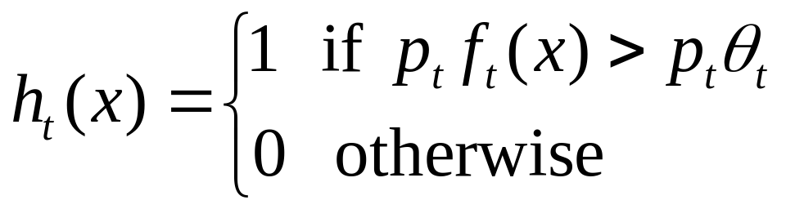
Boosting for face detection
Define weak learners based on rectangle features
value of rectangle feature
parity
threshold
window

Slide 34
Boosting for face detection
Define weak learners based on rectangle features
For each round of boosting:
  Evaluate each rectangle filter on each example
  Select best threshold for each filter
  Select best filter/threshold combination
  Reweight examples
Computational complexity of learning: O(MNK)
  M rounds, N examples, K features

Slide 35
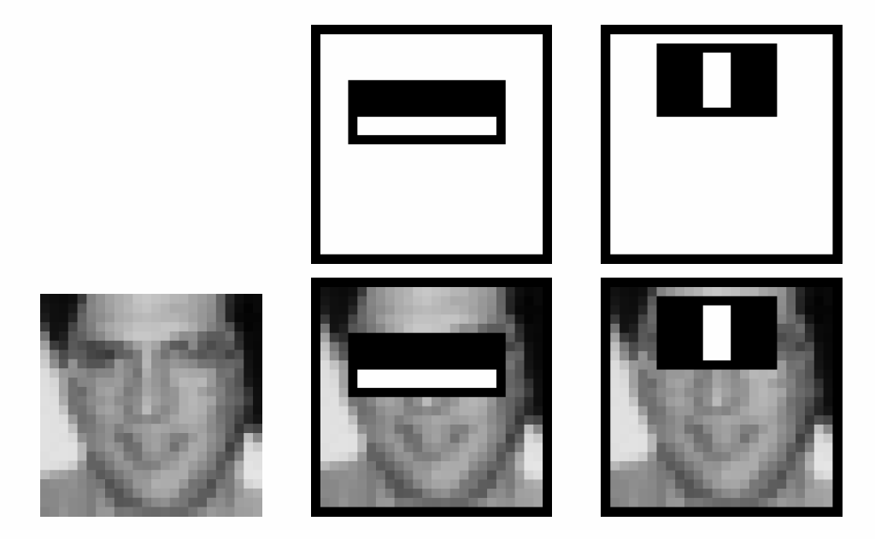
Boosting for face detection
First two features selected by boosting:
This feature combination can yield 100% detection rate and 50% false positive rate

Slide 36
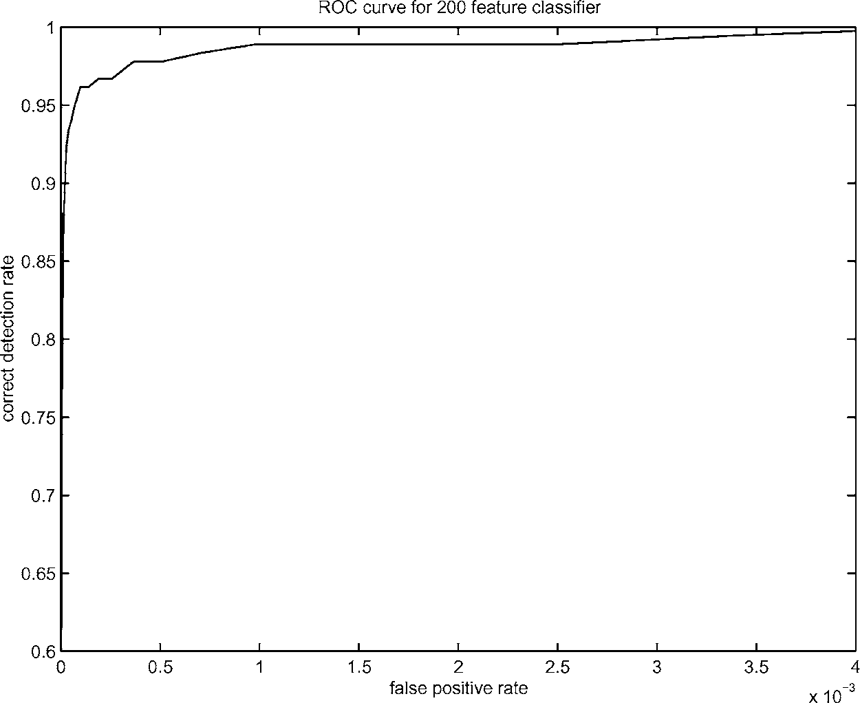
Boosting for face detection
A 200-feature classifier can yield 95% detection rate and a false positive rate of 1 in 14084
Not good enough!
Receiver operating characteristic (ROC) curve

Slide 37
Attentional cascade
We start with simple classifiers which reject many of the negative sub-windows while detecting almost all positive sub-windows
Positive response from the first classifier triggers the evaluation of a second (more complex) classifier, and so on
A negative outcome at any point leads to the immediate rejection of the sub-window
T
T
T
IMAGE
SUB-WINDOW
T
FACE
Classifier 1
Classifier 2
Classifier 3
F
F
F
NON-FACE
NON-FACE
NON-FACE

Slide 38
Attentional cascade
Chain classifiers that are progressively more complex and have lower false positive rates:
Receiver operating characteristic
% False Pos
0
50
vs
false
neg
determined by
0 100
% Detection
T
T
T
IMAGE
SUB-WINDOW
T
FACE
Classifier 1
Classifier 2
Classifier 3
F
F
F
NON-FACE
NON-FACE
NON-FACE
Notes:
In general simple classifiers, while they are more efficient, they are also weaker.
We could define a computational risk hierarchy (in analogy with structural risk minimization)…
A nested set of classifier classes
The training process is reminiscent of boosting…
- previous classifiers reweight the examples used to train subsequent classifiers
The goal of the training process is different
- instead of minimizing errors minimize false positives

Slide 39
Attentional cascade
The detection rate and the false positive rate of the cascade are found by multiplying the respective rates of the individual stages
A detection rate of 0.9 and a false positive rate on the order of 10⁻⁶ can be achieved by a
10-stage cascade if each stage has a detection rate of 0.99 (0.99¹⁰ ≈ 0.9) and a false positive rate of about 0.30 (0.3¹⁰ ≈ 6×10⁻⁶)
T
T
T
IMAGE
SUB-WINDOW
T
FACE
Classifier 1
Classifier 2
Classifier 3
F
F
F
NON-FACE
NON-FACE
NON-FACE

Slide 40
Training the cascade
Set target detection and false positive rates for each stage
Keep adding features to the current stage until its target rates have been met
  Need to lower AdaBoost threshold to maximize detection (as opposed to minimizing total classification error)
  Test on a validation set
If the overall false positive rate is not low enough, then add another stage
Use false positives from current stage as the negative training examples for the next stage

Slide 41
The implemented system
Training Data
  5000 faces
    All frontal, rescaled to
    24x24 pixels
  300 million non-faces
    9500 non-face images
  Faces are normalized
    Scale, translation
Many variations
  Across individuals
  Illumination
  Pose
Notes:
This situation with negative examples is actually quite common… where negative examples are free.

Slide 42
System performance
Training time: “weeks” on 466 MHz Sun workstation
38 layers, total of 6061 features
Average of 10 features evaluated per window on test set
“On a 700 Mhz Pentium III processor, the face detector can process a 384 by 288 pixel image in about .067 seconds”
  15 Hz
  15 times faster than previous detector of comparable accuracy (Rowley et al., 1998)

Slide 43
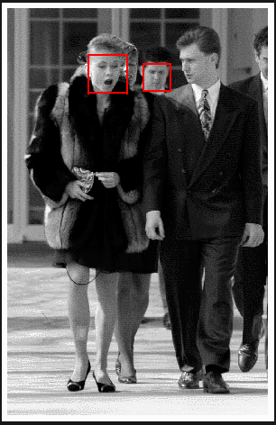
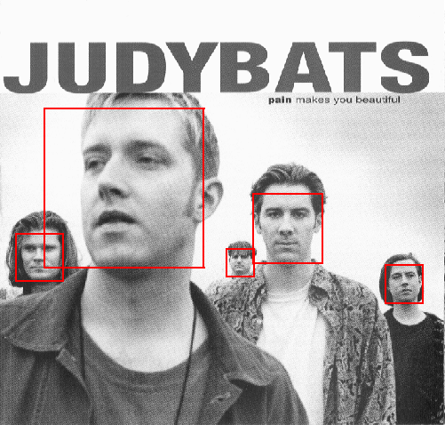
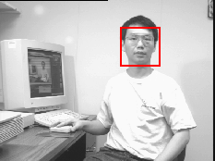
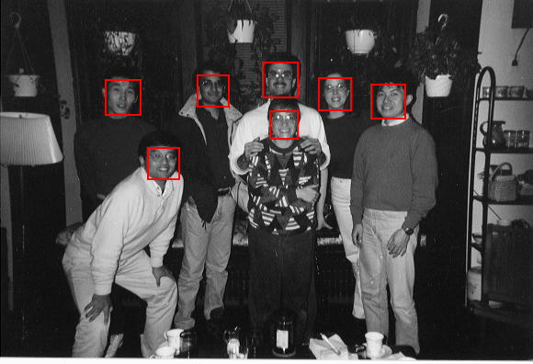
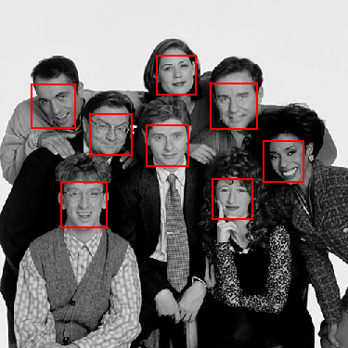
Output of Face Detector on Test Images

Slide 44
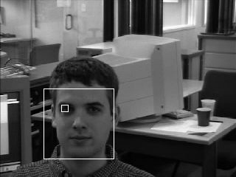
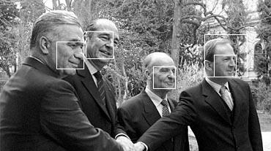
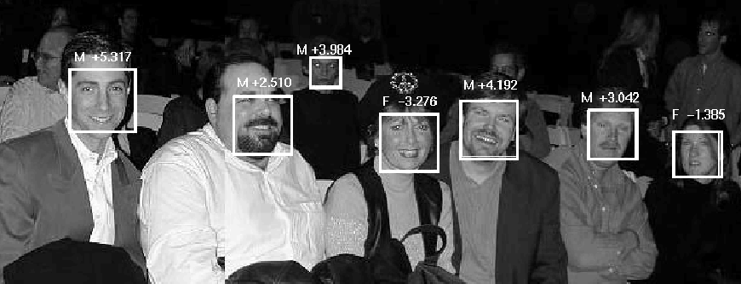
Other detection tasks
Facial Feature Localization
Profile Detection
Male vs.
female

Slide 45
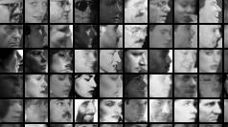
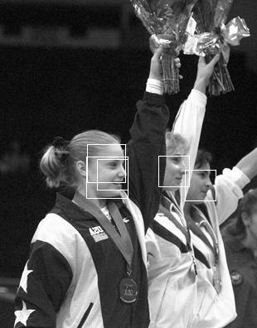
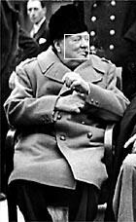
Profile Detection

Slide 46
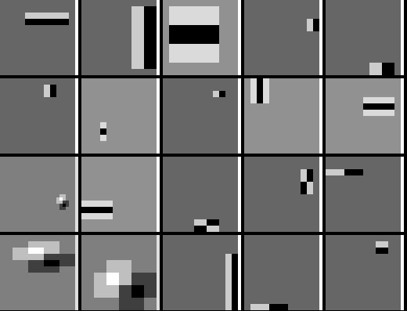
Profile Features

Slide 47
Summary: Viola/Jones detector
Rectangle features
Integral images for fast computation
Boosting for feature selection
Attentional cascade for fast rejection of negative windows

