Slide 1
FIR Digital Filter Design
Aldebaro Klautau
Federal University of Para (UFPA), Belém, Brazil
Sensors and Embedded Systems Laboratory (LASSE)
Source code at https://github.com/aldebaro/dsp-telecom-book-code

Slide 2
Finite impulse response (FIR) filter
Distinguish two properties of a filter
Recursive or non-recursive
Impulse response with infinite or finite duration
It is possible to have a recursive filter with a finite impulse response (e.g., when a pole cancels with a zero). Hence, FIR is not sinonymous of non-recursive but in practice a FIR filter is non-recursive
Poles of a FIR filter are located in z=0 or infinite (while an IIR filter has finite poles without this restriction). Examples:

Slide 3
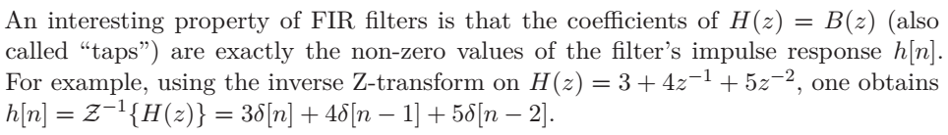
The coefficients of a FIR coincide with its impulse response
This may be very confusing! Say that Bz is an array in Octave/Matlab that represents the system function H(z) numerator while hn is an array that represents an impulse response. For a FIR, Bz and hn can be used interchangeably
For example: functions that have system functions H(z) as input parameter can be called using the “impulse response” array hn
freqz(hn) or freqz(hn,1) will give the DTFT of hn
y = filter(hn,1,x) will provide the ouput y to an input x through filter H(z) = Bz, which is equivalent to y=conv(hn,x) but filter eliminates the convolution tail, such that y has the same length of x

Slide 4
Algorithms for FIR filter design
Instead of using pre-defined functions such as Butterworth's, a FIR design is typically done with alternative methods, which seek to optimize a given criterion
The most common algorithm is the least-squares (firls in Matlab/Octave
Another algorithm is Parks-McClellan’s (firpm in Matlab, not available in Octave 3.2.3)
Windowing: fir1
Arbitrary frequency response magnitude: fir2

Slide 5
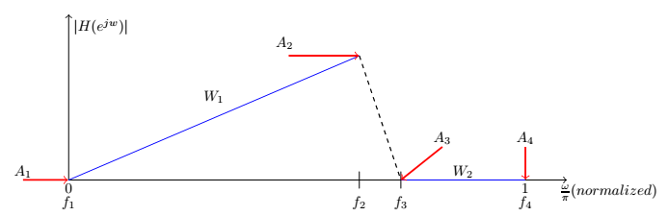
Arbitrary filter magnitude specification
An arbitrary function will be specified in N_{B} bands of interest. For each band b, four parameters are necessary: the start f_{b}^{s} and end f_{b}^{e} frequencies, the desired function values (the magnitude in this context) A_{b}^{s} and end A_{b}^{e} at the start and end frequencies. An optional parameter is the weight of each band (e.g., W₁ and W₂). The larger the weight, the higher the importance given to that band

Slide 6
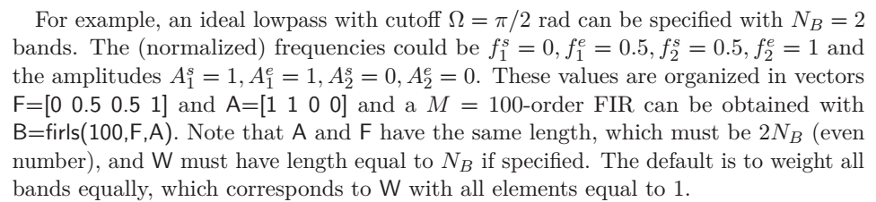
Example: FIR design via least-squares

Slide 7

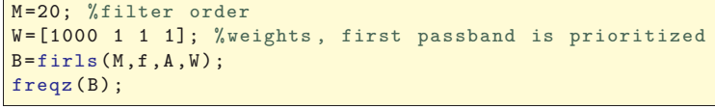
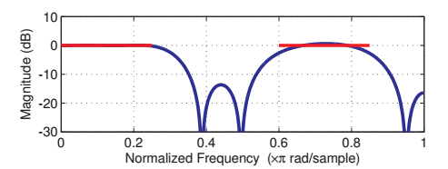
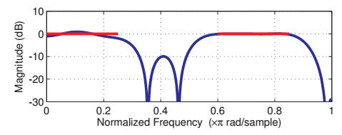
Another firls example
First band prioritized
Second band prioritized

Slide 8
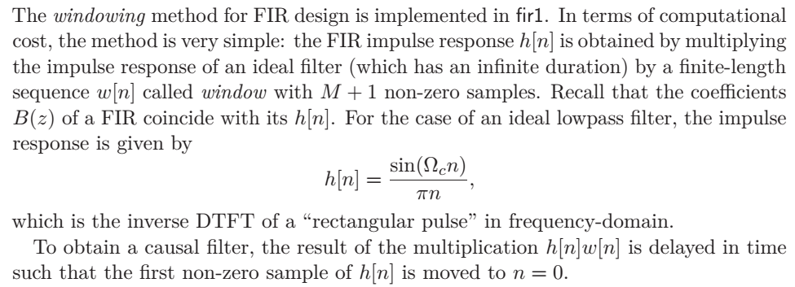


FIR design via windowing
Ideal lowpass
Ideal highpass

Slide 9
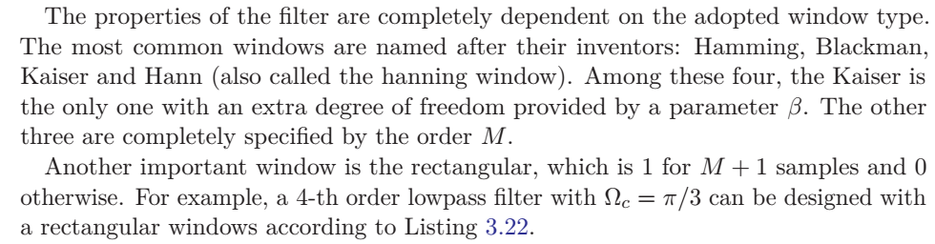
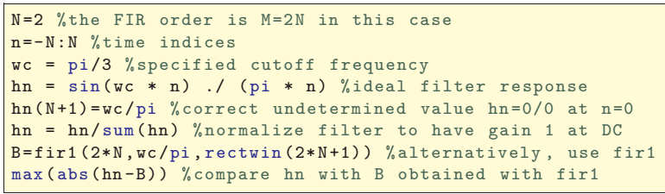
FIR design via windowing

Slide 10
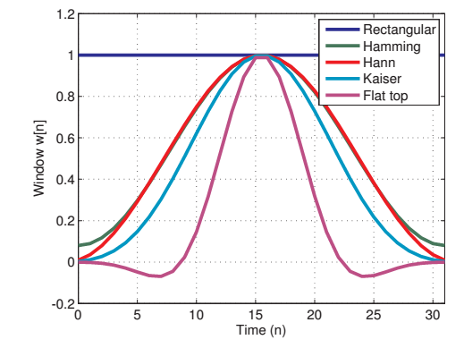
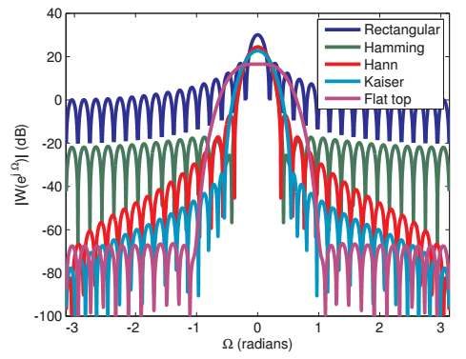
Windows

Slide 11
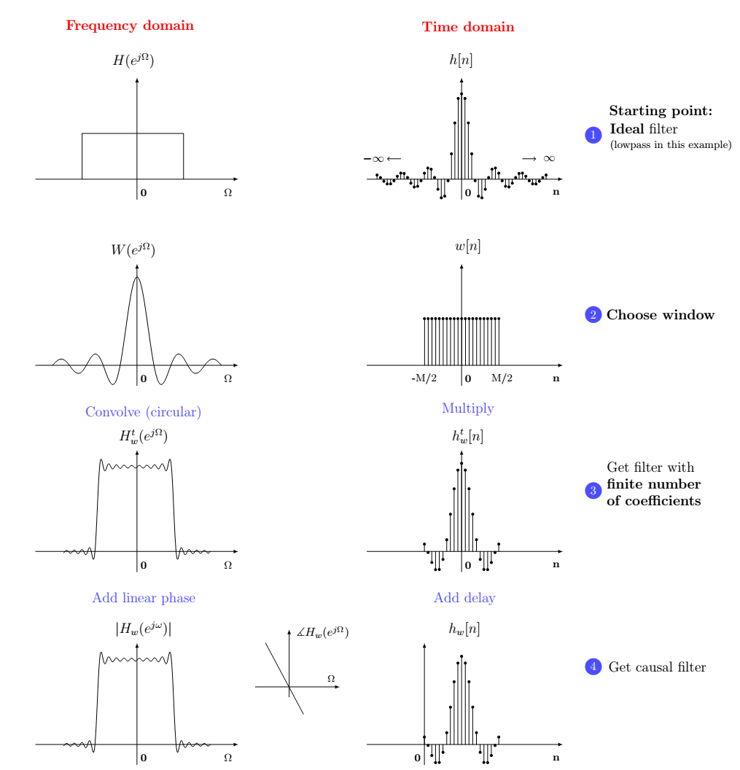

FIR design via windowing
Some window desired features:
Small main lobe width ➔ small transition band
Low amplitude of its sidelobes ➔ stronger attenuation at rejection band

Slide 12
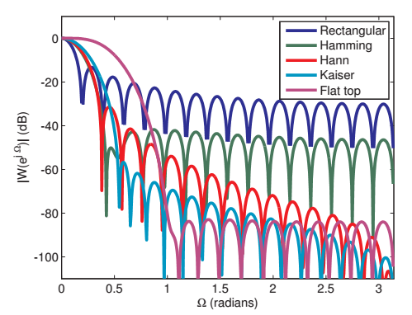
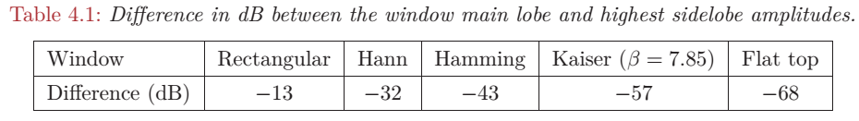
Main features of a window
width of its main lobe,
amplitude of its sidelobes,
rate of sidelobe decay as frequency increases,
and scallopping loss.

Slide 13
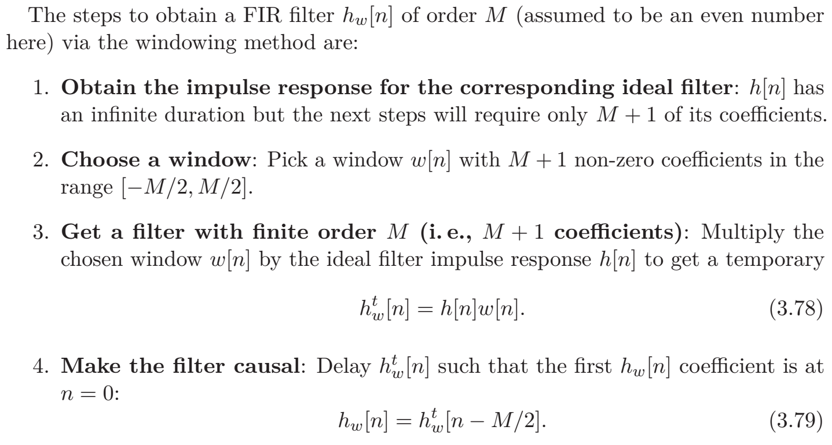
Window-based FIR design

Slide 14
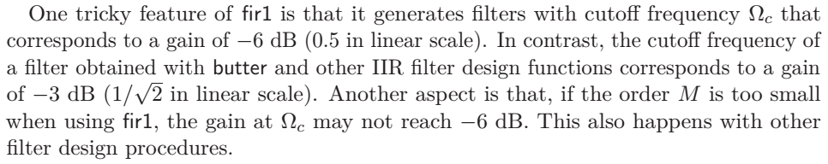
FIR design via windowing

Slide 15
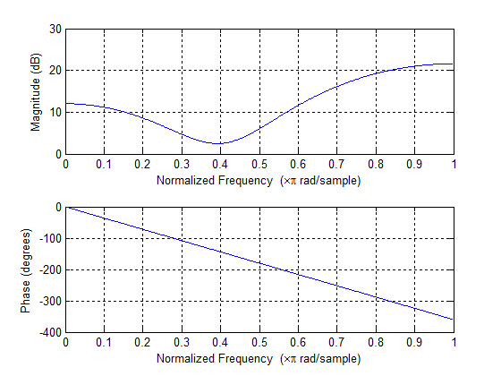
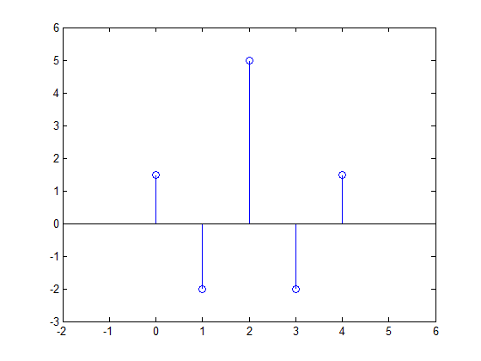
Two important characteristics of FIRs
FIRs are always stable
practical FIRs have all M+1 coefficients with finite values. Hence, they are stable in BIBO (bounded input, bounded output) sense
FIRs can have linear phase
It can be proved that the linear phase achieved if and only if there is symmetry in h[n] about some value n_{s}.
freqz(h)
h[n]

Slide 16

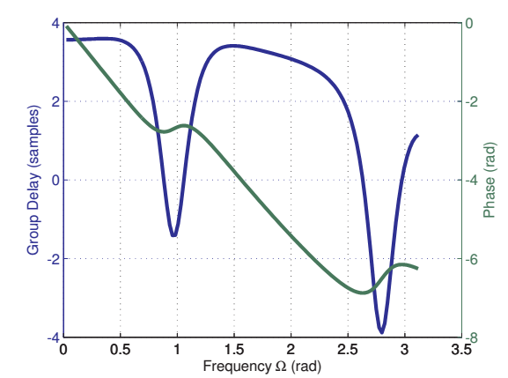
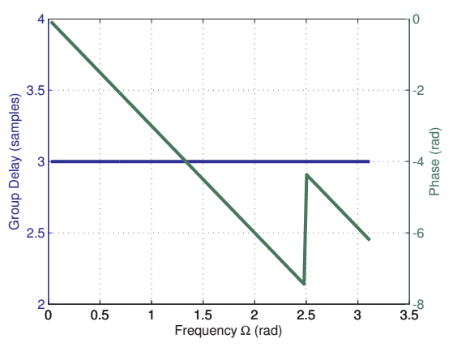
Why linear phase is important?
Recall group delay:
For a linear phase system (or filter), the group delay is constant: all frequency components delayed by this constant τ_{g}(ω) = τ_{g} and signal is not distorted but simply delayed by τ_{g} samples
Linear phase
Nonlinear phase

Slide 17
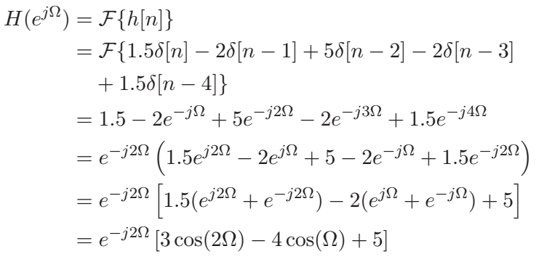


Mathematical relation between “symmetry” and “linear phase”
Example:
In general, a linear phase system can be decomposed as
where A(Ω) is a real function
Importance of
symmetry

Slide 18
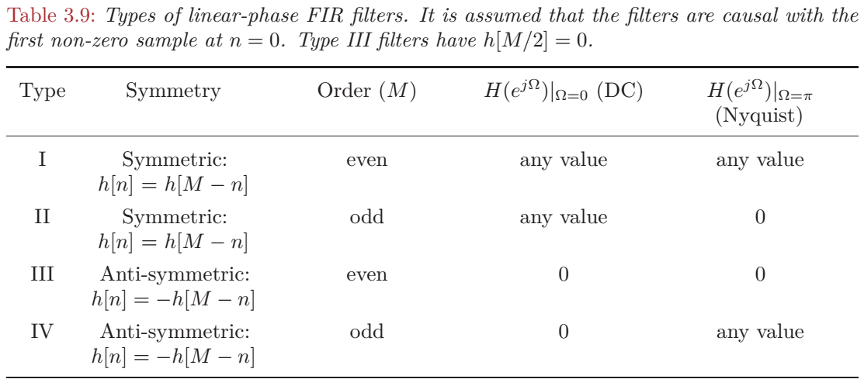
Four types of symmetric FIR filters

Slide 19
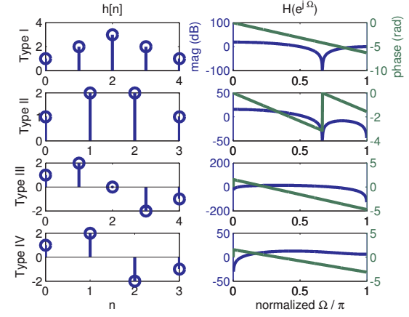
Impulse and frequency responses for the four types of symmetric FIR filters
Zeros close to the unit circle may impact phase linearity

