Slide 1
Multicarrier Modulation
DMT / OFDM
Aldebaro Klautau – www.laps.ufpa.br
Belém, Brazil – October 13, 2015
Federal University of Para (UFPA)

Slide 2
Multicarrier Modulation
What is the essence and motivation?
Partition the communication channel into several small “subchannels”
|H(f)|
sub-carrier

Slide 3
Multicarrier Modulation
The information at each “subchannel” is located in frequency by a “tone”, also called “bin” and “sub-carrier” (avoid calling “carrier”)
Example: DSL uses 4.3125 kHz as “tone spacing”
sub-carrier

Slide 4
Multicarrier Modulation
Discrete Multitone (DMT) ≈ Orthogonal Frequency-Division Multiplexing (OFDM)‏
OFDM is a “passband” modulation
Overall spectrum is centered at a carrier frequency (e.g. 2.4 GHz). It is adopted for wireless communications
Similar to a QAM, the OFDM signal (before frequency upconversion) is complex-valued
DMT is a “baseband” modulation
Overall spectrum is centered at DC (0 Hertz). It is adopted in DSL technologies (ADSL, VDSL, etc.)
Similar to a PAM, the signal is real-valued

Slide 5
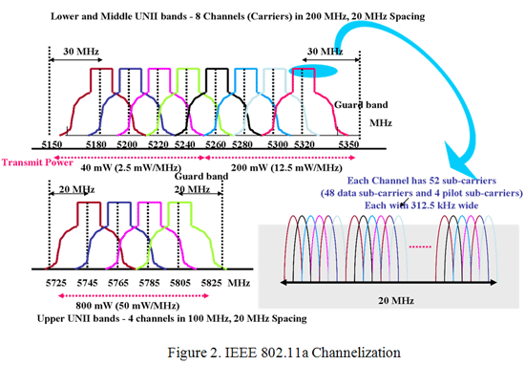
WiFi: Example of OFDM Spectrum
Notes:
From https://www.fcc.gov/help/public-safety-tech-topic-10-license-exempt-wireless-applications-public-safety

Slide 6
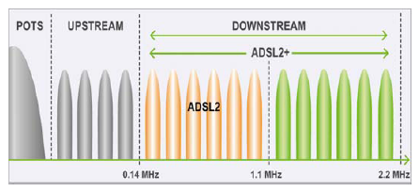
ADSL2+: Example of DMT Spectrum
POTS: Plain Old Telephony Service
Upstream: Transmission from customer to central office
Downstream: Transmission from central office to customer
Notes:
From https://www.fcc.gov/help/public-safety-tech-topic-10-license-exempt-wireless-applications-public-safety

Slide 7
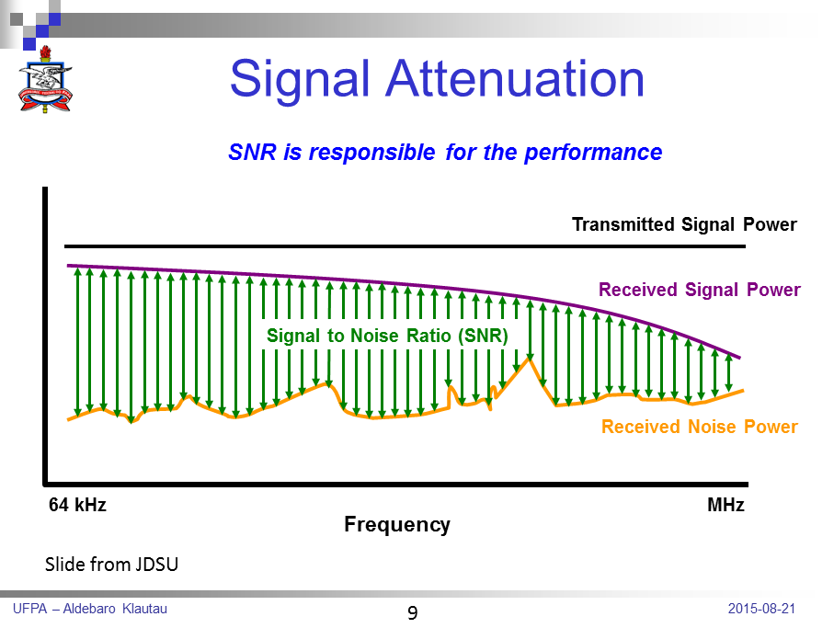
Signal Attenuation
Notes:
From http://www.atnf.csiro.au/people/atzioumi/jdsu/xDSL%20Overview%20Oct%2008.ppt

Slide 8
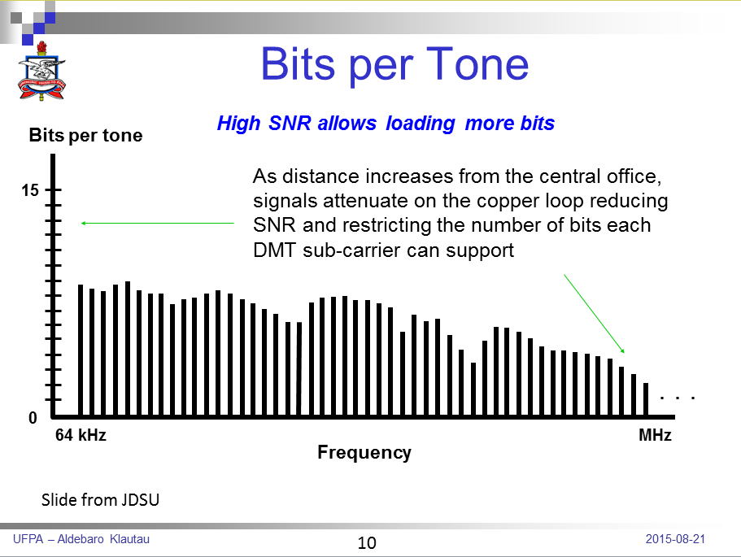
Bits per tone

Slide 9
DSL Standards
Family | ITU | Name | Ratified | Maximum Speed capabilities
ADSL | G.992.1 | G.dmt | 1999 | 8 Mbps down 800 kbps up
ADSL2 | G.992.3 | G.dmt.bis | 2002 | 8 Mb/s down 1 Mbps up
ADSL2plus | G.992.5 | ADSL2plus | 2003 | 24 Mbps down (Amend 1, 29Mbps) 1 Mbps up
ADSL2-RE | G.992.3 | Reach Extended | 2003 | 8 Mbps down 1 Mbps up
VDSL | G.993.1 | Very-high-data-rate DSL | 2004 | 55 Mbps down 15 Mbps up
VDSL1 -12 MHz long reach | G.993.2 | Very-high-data-rate DSL 2 | 2005 | 55 Mbps down 30 Mbps up
VDSL2 - 30 MHz Short reach | G.993.2 | Very-high-data-rate DSL 2 | 2005 | 100 Mbps up/down
Slide from JDSU

Slide 10
DSL Frequency Ranges & Rates
Technology
VDSL2
VDSL
ADSL2+
ADSL
17.66MHz
25kHz 1.1MHz 2.2MHz 12MHz Frequency 30MHz
Technology | Freq range | Max Rates | Max # of sub-carriers and Bin spacing
ADSL | 25kHz – 1.1MHz | 800kbps up 8Mbps down | 256 with 4.3125kHz bins
ADSL2+ | 25kHz – 2.2MHz | 1Mbps up 24Mbps down | 512 with 4.3125kHz bins Amend. 1 = 29 Mbps down
VDSL(1) | 25kHz – 12MHz | 15Mbps up 55Mbps down | 2782 with 4.3125kHz bins
VDSL2 | 25khz – 30MHz | 100Mbps up 100Mbps down | 4096 with 4.3125kHz bins 3478 with 8.625kHz bins
Slide from JDSU

Slide 11
DMT
Hereafter we will emphasize DMT
The DMT bitloading is based on a “waterfilling” algorithm
We are not going to discuss the theory, but the idea of waterfilling is that more bits are loaded in tones with higher SNR values
Next slides indicate how DMT works

Slide 12
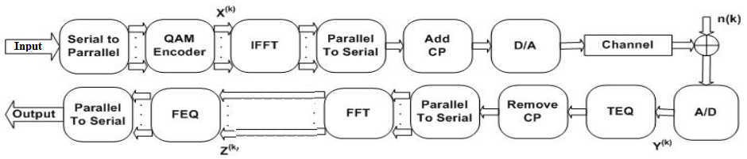
Typical DMT (baseband) System
DMT / OFDM ➔ use Fast Fourier Transform (FFT) for modulation

Slide 13
Slice the bitstream according to bitloading table
input bitstream: 010100011010110100001...
input bitstream: 01-010001-1010-1101-0...
Bitloading
k-th frame 01
010001
1010
1110
Tone
# bits
1
2
2
6
3
4
4
4

Slide 14
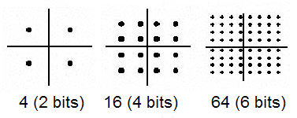
Mapping: from bits to symbols
01
010001
1010
1110
QAM symbols: 1+j8 4-j4 3+j3 1+j2

Slide 15
Inverse FFT
QAM symbols: X(0)=1, X(4)=8 X(1)=4-j4 X(2)=3+j3 X(3)=1+j2
Use 8-points FFT for this example
Need Hermitian symmetry to get real signal
X = [1 4-j4 3+j3 1+j2 8 1-j2 3-j3 4+j4]
x = ifft(X)‏
x = [25.0 -5.9 15.0 -2.4 5.0 -20.1 -9.0 0.4]
Add cyclic-prefix (example: CP with 3 samples)‏
x=[-20.1 -9.0 0.4 25.0 -5.9 15.0 -2.4 5.0 -20.1 -9.0 0.4]

Slide 16
Inverse FFT and add CP
QAM symbols: X(0)=1, X(4)=8 X(1)=4-j4 X(2)=3+j3 X(3)=1+j2
Use 8-points FFT for this example
Need Hermitian symmetry to get real signal
X = [1 4-j4 3+j3 1+j2 8 1-j2 3-j3 4+j4]
x = ifft(X)‏
x = [25.0 -5.9 15.0 -2.4 5.0 -20.1 -9.0 0.4]
Add cyclic-prefix (example: CP with 3 samples)‏
x=[-20.1 -9.0 0.4 25.0 -5.9 15.0 -2.4 5.0 -20.1 -9.0 0.4]

Slide 17
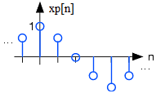
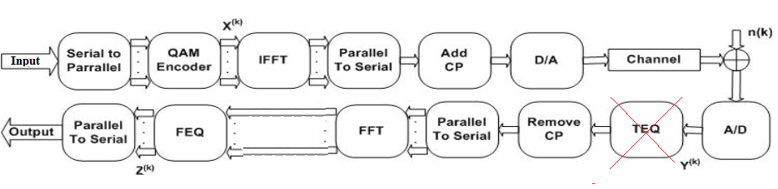
Typical DMT-based DSL System
QAM symbols: X(0)=1, X(4)=8 X(1)=4-j4 X(2)=3+j3 X(3)=1+j2
Symbols
Samples

Slide 18
Fundamental DMT Equation
Y_{k} = X_{k} H_{k}
H_{k} pode ser obtido da DTFT (discrete-time Fourier transform) da resposta ao impulso h[n] do canal na frequência correspondente
sub-carrier

Slide 19
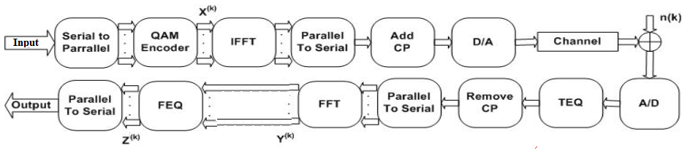
Vectors of interest in DMT simulation
Symbols
Samples

Slide 20
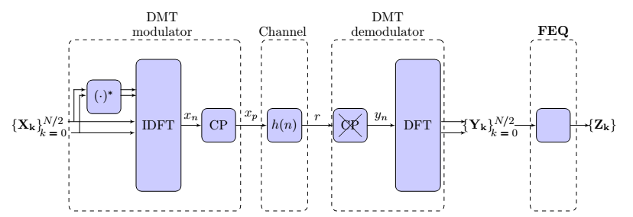
Vectors of interest in DMT simulation
Alternative view:

Slide 21
Simple DMT transmission example in Matlab

Slide 22
Step-by-step debugging of DMT in Matlab

