Slide 1
How to use a computer An introduction to engineering and computer science students on how to use computers more efficiently
Aldebaro Klautau
Federal University of Para (UFPA), Belém, Brazil
Sensors and Embedded Systems Laboratory (LASSE)
www.lasse.ufpa.br
github.com/aldebaro

Slide 2

Agenda
Motivation
stop mouse clicks and use a command line interpreter or script
CLI versus GUI
Learn Linux!
install virtual machines
Environment variables
Files & folders: organization and navigation
del, ren, rm, mv, pwd
File extensions
File attributes and permissions
What identifies an executable file? Script files
The PATH environment variable
File formats and headers
WAV header
ASCII text file versus other "text / doc" files
Line-ending: CR+LF on Windows versus only LF on Linux
Byte ordering: big or little endian?
Pipes on Linux
I/O Redirection

Slide 3
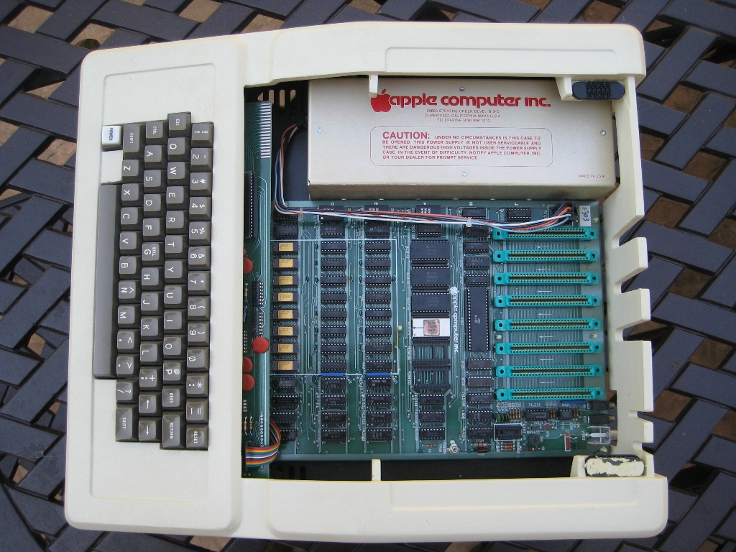
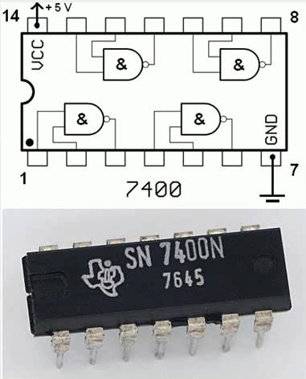
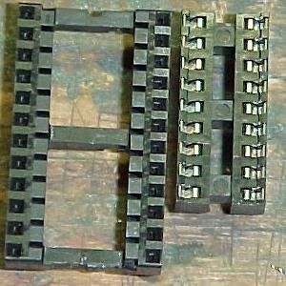
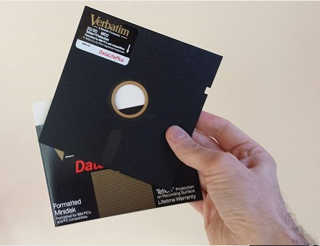
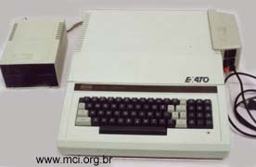
Motivation
We learn naturally when we have curiosity and manage to conquer basic understanding
In 1988: my first computer (Apple II)
64 KB of RAM, 8-bits CPU (6502 and Z80)
Hardware that I could understand, fix

Slide 4
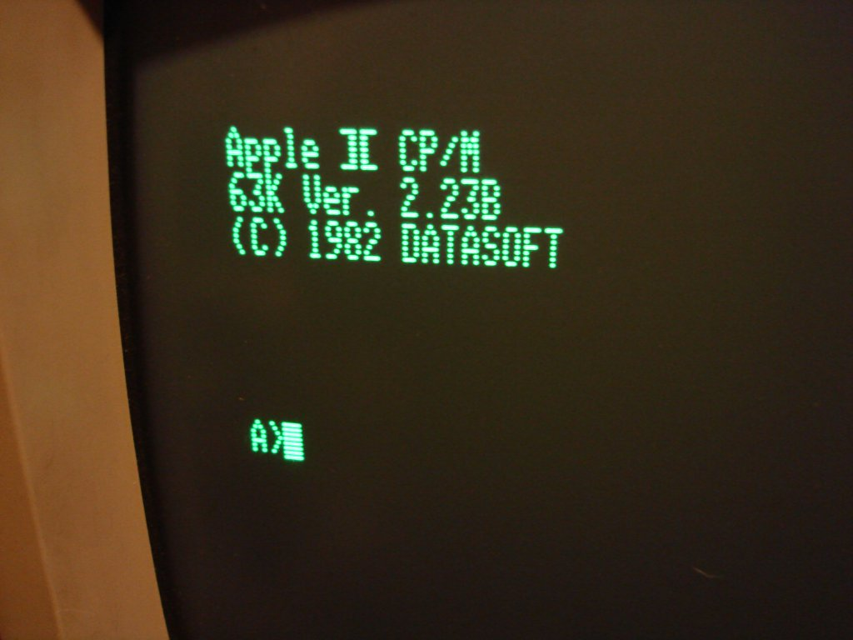
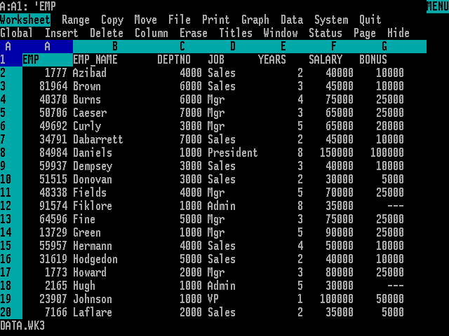

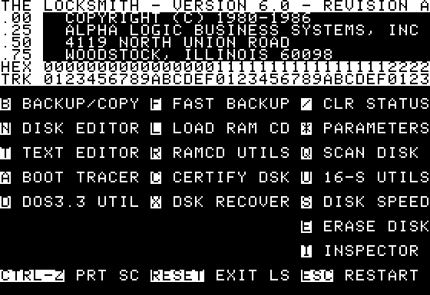
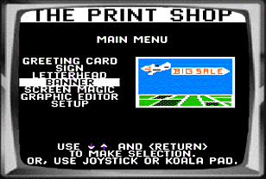
Plenty of software: the computer came with lots of 5 ¼” floppy disks
CP/M operating system prompt
(not friendly!)
Lotus 1 2 3: spreadsheet
desktop publishing
Locksmith: copy floppy disks

Slide 5
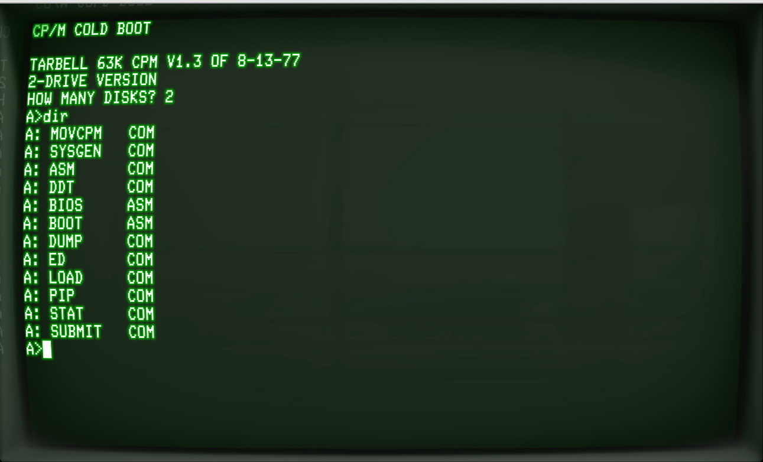
Let there be light: the dir command
“dir” lists all files in a disk
Extension “com” indicates executable files

Slide 6
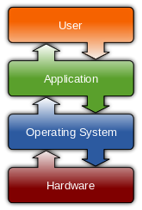


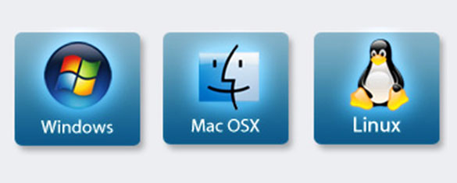
Operating system versus “application”

Slide 7
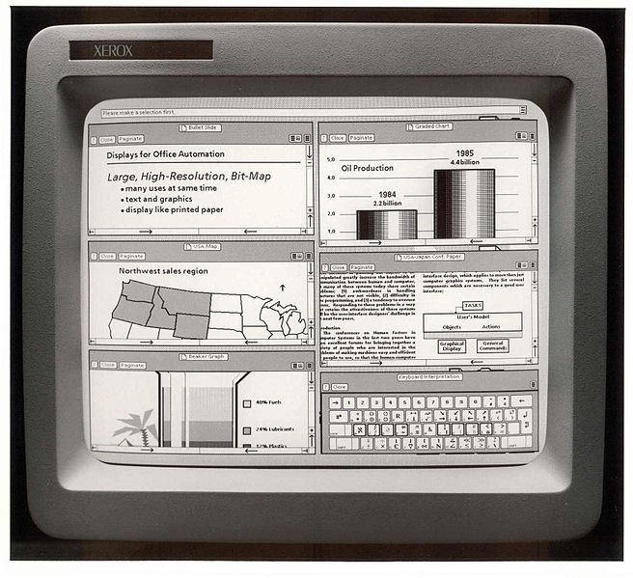
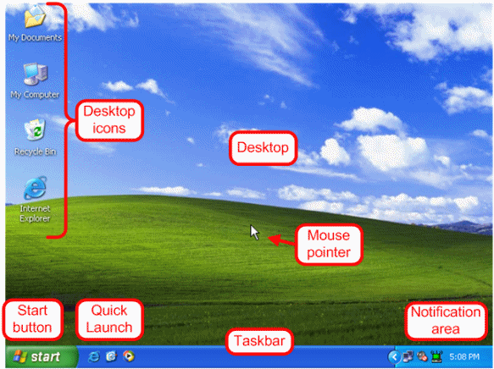
Graphical user interface (GUI):
computers more accessible to everyone (less training / technical skills required)
Xerox PARC in 1973: first mouse-driven GUI

Slide 8

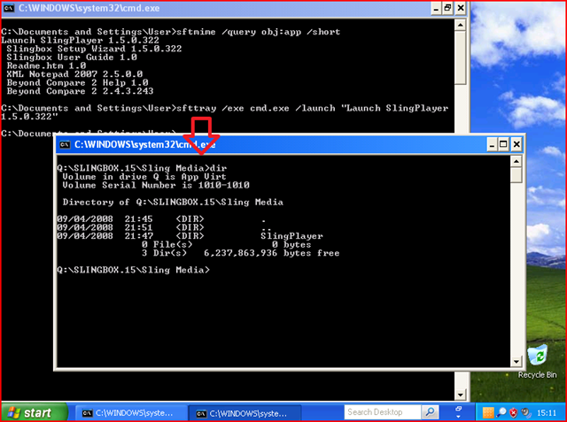
But we want to learn (sophisticated) computing skills!
Then we need to learn an alternative to using the GUI: the command-line interpreter (CLI) or “shell”
They are special applications that accept commands
The ones discussed here are the CMD.EXE and Bash. But there many! (see https://en.wikipedia.org/wiki/List_of_command-line_interpreters)
Mac OS X is based on Unix and its CLI is similar to Linux’s
CMD.EXE (Windows) Bash (Linux)
Obs: CMD.EXE is sometimes called DOS prompt

Slide 9
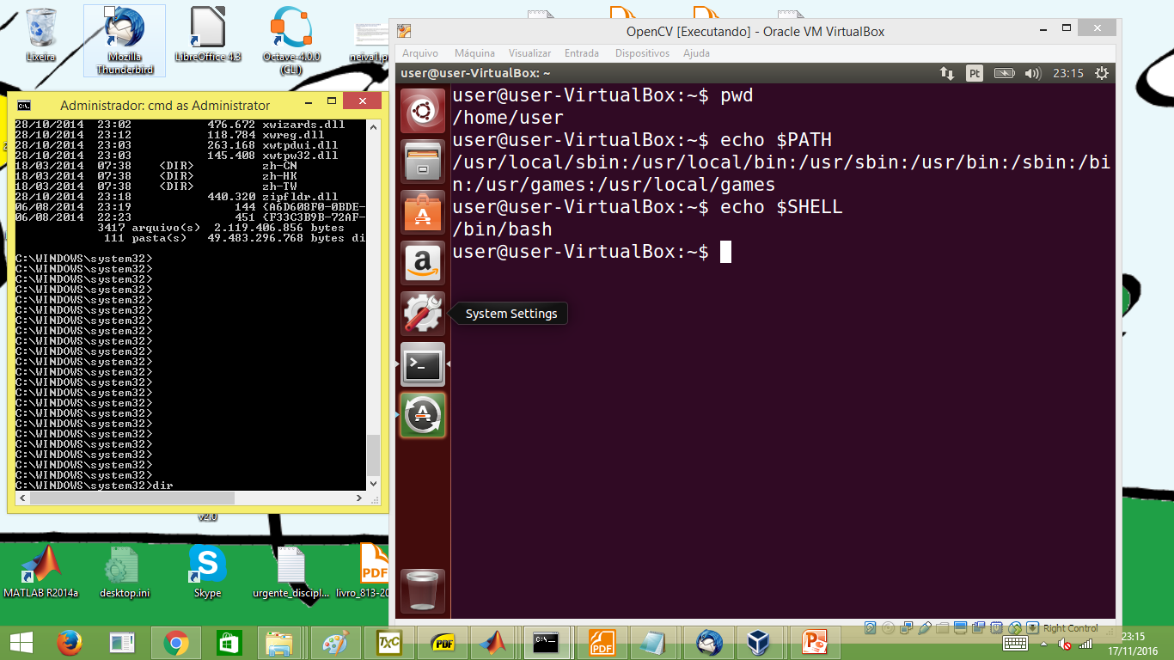
Why we emphasize Linux (or Unix-like)?
You learn more the operating system (OS) that you use everyday
If you are going to learn one OS:
Learn Windows if you plan to work for a company that does not have computing or engineering as its main business (e.g., lawyers office)
Learn Linux to work for a computing or engineering company
Besides, learn the shell to be more productive
Be aware: there are many Linux distributions. You may start with Ubuntu
If you share a Windows machine with other people, consider installing a virtual machine to run Linux on top of Windows or vice-versa. Check: https://www.virtualbox.org
CMD.EXE
Bash

Slide 10
Environment variables
Variables that help to determine how the program should behave, including a CLI
On Windows (cmd.exe), they can be found by typing “set” on the CLI
Some of them are:
PROMPT: defines the string that is shown by the CLI. Ex: PROMPT=$P$G
PATH: list of folder that should be searched when looking for an executable file
Linux also has environment variables
My environment variables obtained using “set”
ALLUSERSPROFILE=C:\ProgramData
APPDATA=C:\Users\pele\AppData\Roaming
CommonProgramFiles=C:\Program Files\Common Files
CommonProgramFiles(x86)=C:\Program Files (x86)\Common Files
CommonProgramW6432=C:\Program Files\Common Files
COMPUTERNAME=DELL-CNPQ
ComSpec=C:\WINDOWS\system32\cmd.exe
FP_NO_HOST_CHECK=NO
HOMEDRIVE=C:
HOMEPATH=\Users\pele
LOCALAPPDATA=C:\Users\pele\AppData\Local
NUMBER_OF_PROCESSORS=4
OS=Windows_NT
Path=C:\Program Files (x86)\Intel\iCLS Client\;C:\Program Files\Intel\iCLS Client\;C:\Windows\system32;C:\Windows;C:\Windows\System32\Wbem
PATHEXT=.COM;.EXE;.BAT;.CMD;.VBS;.VBE;.JS;.JSE;.WSF;.WSH;.MSC
PROCESSOR_ARCHITECTURE=AMD64
PROCESSOR_IDENTIFIER=Intel64 Family 6 Model 58 Stepping 9, GenuineIntel
PROCESSOR_LEVEL=6
PROCESSOR_REVISION=3a09
ProgramData=C:\ProgramData
ProgramFiles=C:\Program Files
ProgramFiles(x86)=C:\Program Files (x86)
ProgramW6432=C:\Program Files
PROMPT=$P$G
PSModulePath=C:\WINDOWS\system32\WindowsPowerShell\v1.0\Modules\
PUBLIC=C:\Users\Public
QUARTUS_ROOTDIR=C:\Programs\altera\13.0sp1\quartus
SESSIONNAME=Console
SOPC_KIT_NIOS2=C:\Programs\altera\13.0sp1\nios2eds
SystemDrive=C:
SystemRoot=C:\WINDOWS
TEMP=C:\Users\pele\AppData\Local\Temp
TMP=C:\Users\pele\AppData\Local\Temp
USERDOMAIN=dell-cnpq
USERDOMAIN_ROAMINGPROFILE=dell-cnpq
USERNAME=pele
USERPROFILE=C:\Users\pele
VBOX_MSI_INSTALL_PATH=C:\Program Files\Oracle\VirtualBox\
VS100COMNTOOLS=C:\Program Files (x86)\Microsoft Visual Studio 10.0\Common7\Tools\
windir=C:\WINDOWS

Slide 11
How to modify environment variables
On Windows CLI
set PROMPT=$P$G_BrazilRulzFootball_
On Linux bash, echo can be used to inspect a variable, and a $ is used before the variable name to recover what is currently stored
To inspect: echo $PATH
To modify: export PATH=$PATH:/myfolder/bin
Note, this change will be applied only to the current CLI session. To make it permanent, one needs to “save” it or include it on a configuration file
On Linux: modify.bashrc, which is a script ran by bash whenever bash is executed interactively
On Windows, it is possible to navigate via
right click My Computer icon ➔ Properties ➔ Advanced ➔ Environment Variables ➔ Edit

Slide 12
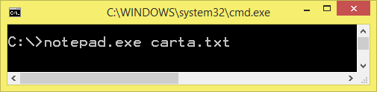
Files for applications and “documents”
Files are used to store the applications and the documents that these applications deal with. For example:
The file notepad.exe is a simple (ASCII) text editor for Windows that manipulates (create, edit, save) text files (with default extension txt)
3 files: cmd.exe is the CLI, notepad.exe is the application and carta.txt is the file that will be manipulated by the application

Slide 13
After few months of use, a computer has many files ➔ need organization
In my laptop, which has an almost full 920 GB harddisk, I found 1.8 million files, “organized” in 502 thousand folders:
Suggestion: put all your files in folders that start by your initials (Windows suggests C:\users\myname). When doing backup, you copy only these files
In the past, the name of a file or folder could not have a blank space. For compatibility with old programs, avoid it
For example, avoid using a folder called “My Documents” or naming a file “My letter.txt”
c:\> dir /s
...
Total of files in list:
1811336 arquivo(s) 912.326.915.243 bytes
502462 folders(s) 48.445.628.416 bytes available

Slide 14
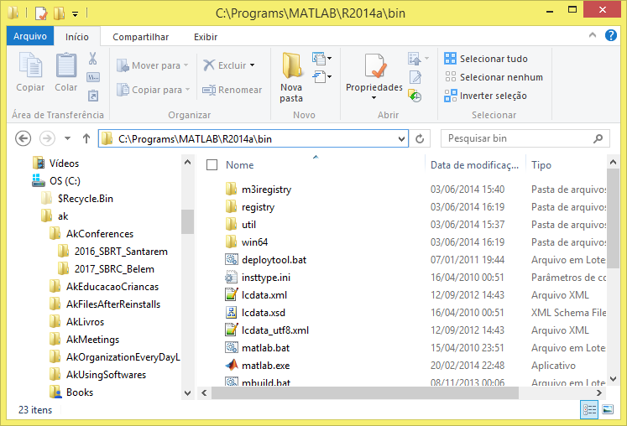
Organization of files in folders (or directories) and the full “path”
Full path of the current folder “bin”
Windows Explorer
Full “path” of folder 2016_SBRT_Santarem is
C:\ak\AkConferences\2016_SBRT_Santarem

Slide 15
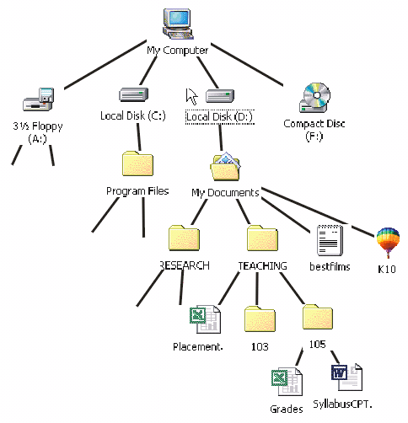
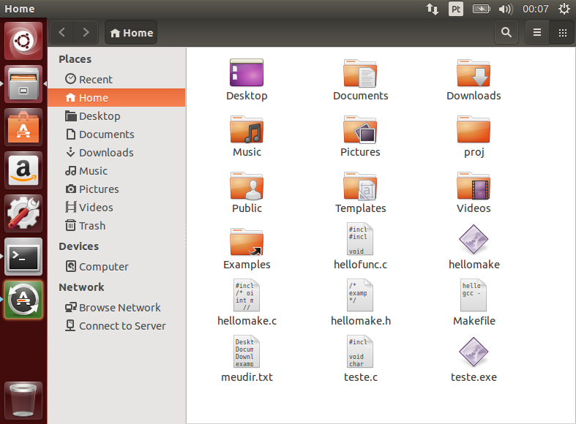
Navigating a folder / directory “tree”
You can navigate using a GUI or command-line (CLI)
Using a GUI “file explorer”
Windows Explorer
Ubuntu (Linux):
Files
Nautilus
Using CLI
cd command: change directory
For both Linux and Windows

Slide 16
Using the CLI to navigate folders
Important: pay attention where you saved a file (the full path)
Note the folder separator (the slash) is different (a first “battle”):
On Linux is / (slash). Example of full path: /home/myname/somefolder
On Windows is \ (backslash). Example: c:\Users\meunome
Examples that lead to the same result (assuming Windows)
1 command: cd c:\myfolder\otherfolder
2 commands: cd c:\myfolder and after that cd otherfolder
Special representations:
. is the current folder, .. is the parent folder
On Linux: ~ is the “home” folder (e.g. /home/myname)
Useful commands on Windows: mkdir (create directory), rmdir (remove / delete directory), del (delete file), ren (rename file or folder)
Useful commands on Linux: mkdir (create directory), rmdir (remove / delete directory), rm (delete file), mv (move / rename file or folder), pwd (print working directory, shows current folder)

Slide 17
Compiled versus interpreted languages
Matlab is interpreted
CLI waits for commands and executes them
A script is a file with a list of commands
C is a compiled language. Note very famous GNU C compiler gcc
The “source” code is processed by a compiler and becomes compiled as an “object” file. Then the linker merges the object with (eventually) required libraries and other objects to create the “executable”.
These two steps can be done at once with gcc laps_dump.c -o laps_dump.exe (because gcc invokes both the compiler and the linker)
Or explicitly done in two steps: gcc –c laps_dump.c gcc laps_dump.o -o laps_dump.exe

Slide 18
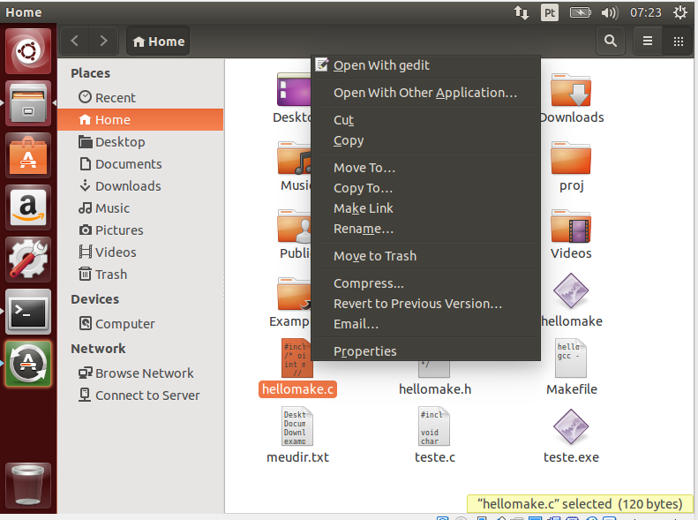
File extension tells the OS what application should be used
The file extension tells the operating system, to which application the given file should be associated and opened by
Example: select “hellomake.c” and right-clink ➔ “Open with...”

Slide 19
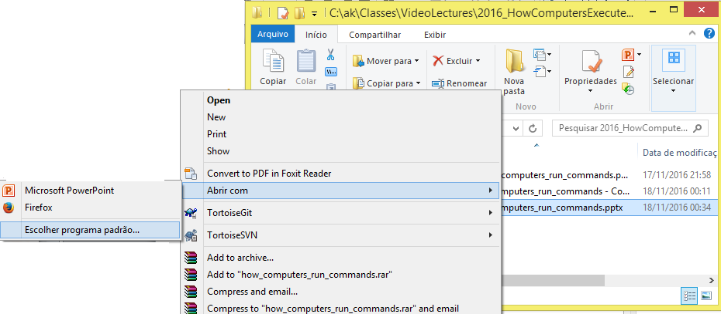
The importance of the file extension
“Open with” is similar on Windows (“Abrir com” in Portuguese):

Slide 20
Common file extensions
Extension | Application
DOCX | MS Word
TXT | ASCII text editor
PNG, JPG | Image editor (GIMP, Paint)
MP4 | Video editor
WAV | Audio editor (Audacity)
PDF | Adobe Reader
➔ Using a GUI, when one double-clicks a file, the OS can open the corresponding application by looking at the file extension
➔ Changing the file extension is “dangerous” and by default, Windows Explorer hides them from user! Need to customize it to see the extension.
The extension is the string after the last . (if it exists) in a file name
Example: for myfilename.oh.helpme the extension is helpme
Different from Windows, Linux does not enforce a file to have an extension
Example: README (no extension) is a common text file on Linux systems

Slide 21
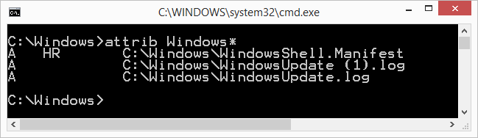
File attributes on Windows
A file has several binary attributes
On Windows, attrib can be used to inspect them:
In the example, the first file has attributes H and R, which mean
H: “hidden” from the user (it does not normally appear on folders) or not
R: “read/only”. If not, it is “read and write”, where the former indicates the file cannot be modified or deleted. Trying to modify returns message “Access denied”

Slide 22
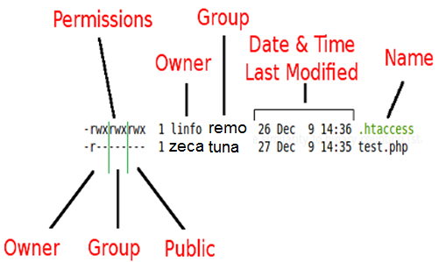
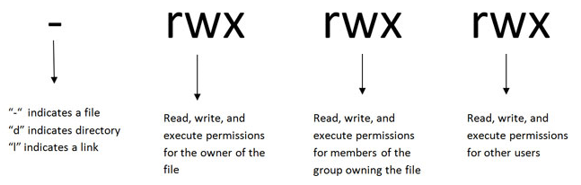
File permissions on Linux
A file has several “permissions” (or “attributes”)
Command ls –l (l standing for long listing) can be used
Command chmod can modify the permissions
Permission “x” to be “executable”
Owner Group Others

Slide 23
How the OS knows a file is executable?
Linux uses the “executable” permission
Windows uses the extension to identify an executable file
The environment variable PATHEXT informs the extensions:
PATHEXT=.COM;.EXE;.BAT;.CMD;.VBS;.VBE;.JS;.JSE;.WSF;.WSH;.MSC

Slide 24
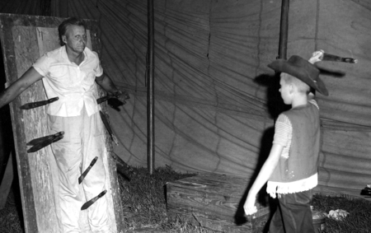
Know shortcuts ➔ Faster commander
If a computer will be your main tool for doing your job, learn how to be fast and productive while typing
Autocomplete (“TAB” on keyboard)
Most sheels and many softwares allow automatic word completion
Do not use only arrows to move cursor
Learn Home / End / Page Up / Page Down
For the software that you consider more important, look at the documentation and learn the shortcuts
“Control + S” to save a file, etc.

Slide 25
Script file: several commands together
As an example, create on Windows the file go.bat with contents:
cd c:\somefolder\otherfolder
.bat stands for a “batch” of commands and is executable. Now, type on a CLI
go
On Linux, a text file with any extension can be used, but needs permission to be “executable”
vi mycommands.txt ⬅ use text editor to create batch file
chmod u+x mycommands.txt ⬅ change the permission
./mycommands.txt ⬅ now the script can be executed

Slide 26
PATH environment variable: where to find executable files
The PATH variable stores a list of folders to be searched when the user wants to execute a program. To see the current PATH
On Windows: set PATH
On Linux: echo $PATH
Warning: on Linux, the current folder . may not be part of the PATH. This will require, for example:
./myprogram ⬅ in case myprogram is in the current folder and ...
myprogram ⬅ would fail if current folder is not in the PATH
Besides the operating system, other programs have their “PATHS”:
Matlab and Octave: try the command path
Java: CLASSPATH, and it can also be informed using java –cp myfolder MyClass

Slide 27
File formats
Extension | Application
DOCX | MS Word
TXT | ASCII text editor
PNG, JPG | Image editor (GIMP, Paint)
MP4 | Video editor
WAV | Audio editor (Audacity)
PDF | Adobe Reader
The file extension typically indicate the “file format”
Different applications need to save different kinds of data, and this leads to a large number of “file formats”
Most file “formats” have a header (bytes that provides information about the file)
With the exception of TXT, all file formats listed above have headers

Slide 28
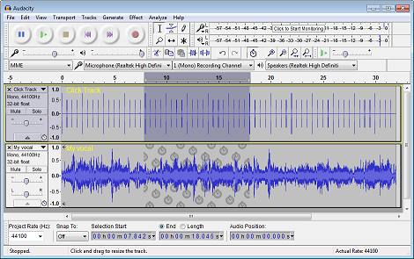

Example of file format / header: WAV
WAV or WAVE or RIFF is a fairly complex file format to store sound
Supports several “chunks” with distinct data
For simplicity, we will assume a “canonical” (simple) file with a single chunk
Will use open source Audacity to record sound http://www.audacityteam.org/ and take note of the sampling rate (or “project rate”)
Record file test.wav

Slide 29
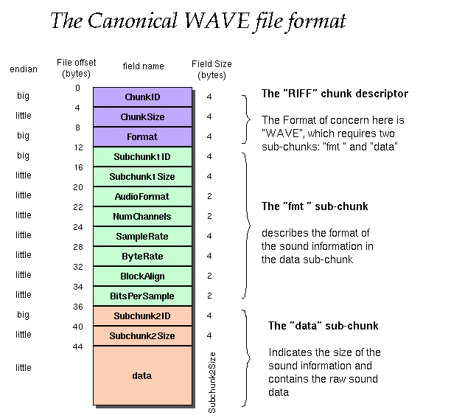
WAV header
(from http://soundfile.sapp.org/doc/WaveFormat/)
A simple header starts with two strings: “RIFF” and “WAVE”
Try to find the sample rate, which is specified as a 4-bytes integer from byte 25 to 28
Go to https://github.com/aldebaro/dsp-telecom-book-code/tree/master/C_Language and compile: inspectFile.c and laps_dump.c
Usage:
inpectFile test.wav 0 44
laps_dump test.wav not
Will talk about “endian” later

Slide 30
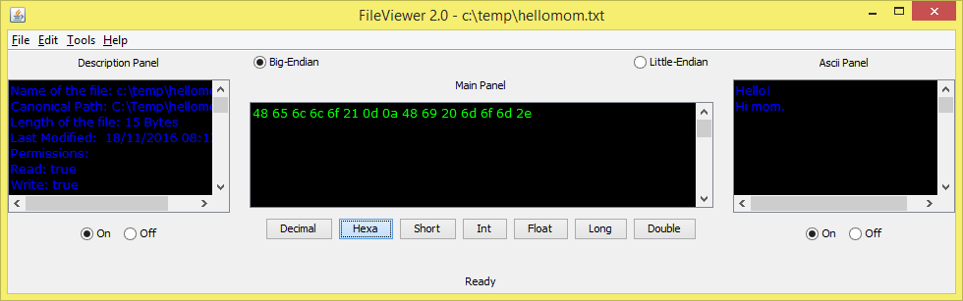
ASCII files: distinction from other text file formats
Let us use a software to inspect the bits/bytes of a file!
Download FileViewer.jar from https://github.com/aldebaro/dsp-telecom-book-code/tree/master/Applications/FileViewerAndSpeechFiles
Install Java on your computer. Using a shell, go to the folder where you saved FileViewer.jar and issue the command: “java –jar FileViewer.jar”

Slide 31
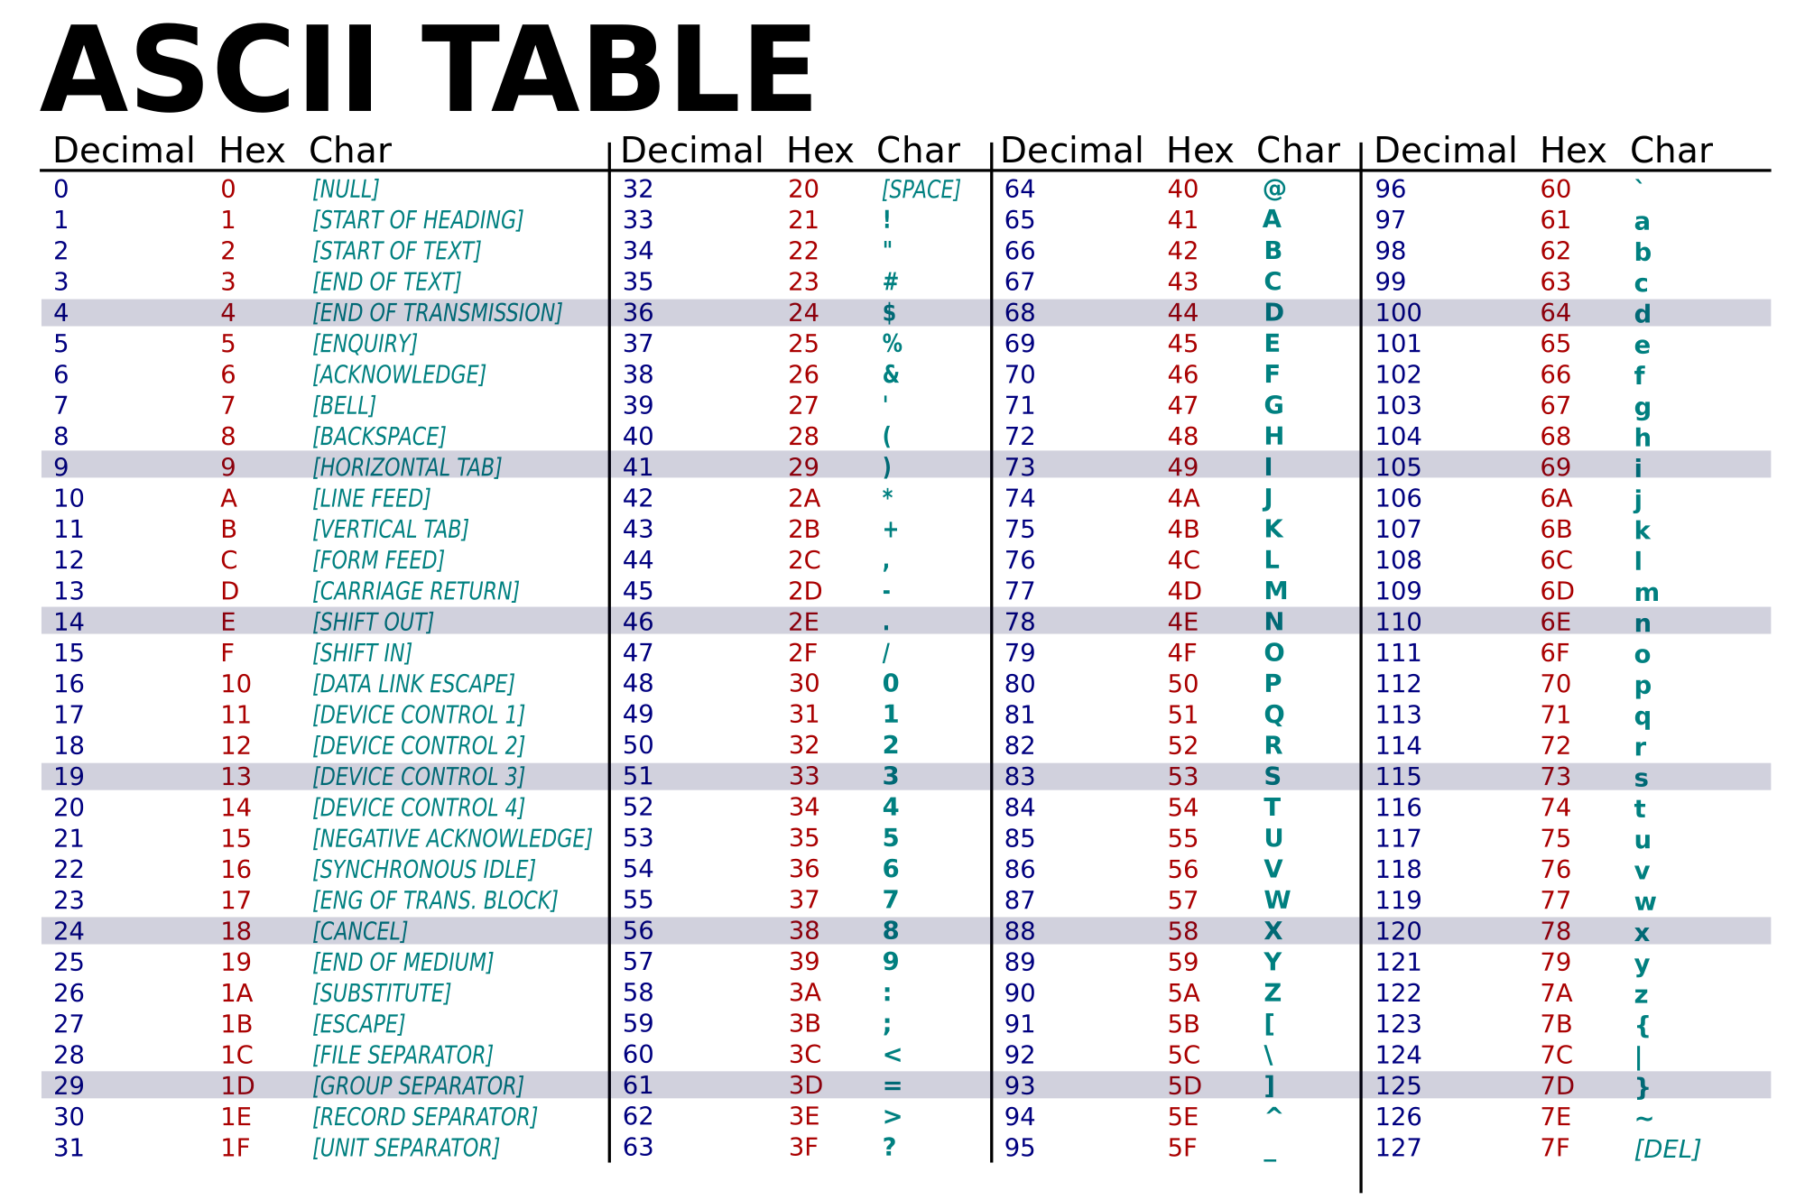
American Standard Code for Information Interchange (ASCII)

Slide 32
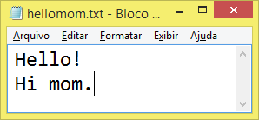
ASCII text files versus other text files (example: DOC, DOCX, RTF)
Using notepad create an ASCII text file (assuming Windows, on Linux use gedit, vim or equivalent). Inspect with FileViewer

Slide 33
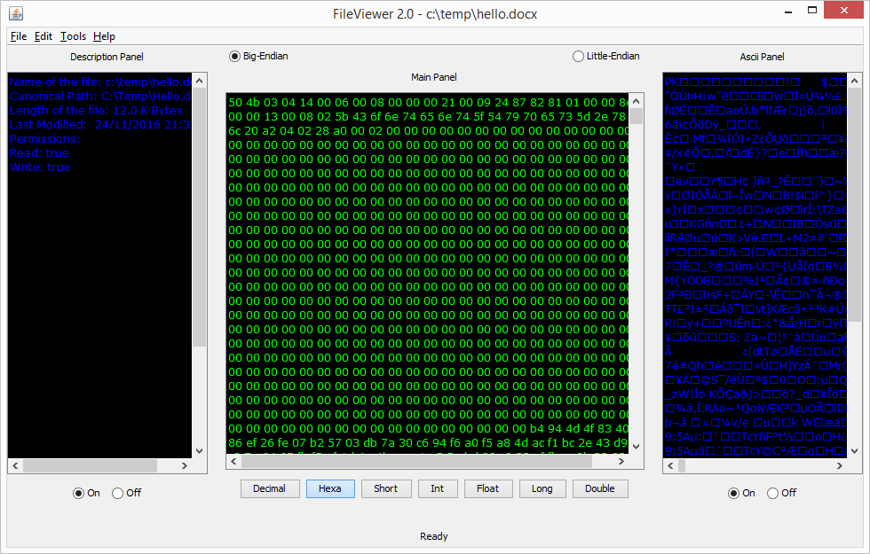
Same text as DOCX file
Cannot “find” the text Hello! Hi mom. Because DOCX is in fact compressed (ZIP) XML files
File has 12581 bytes!
It includes formatting information

Slide 34
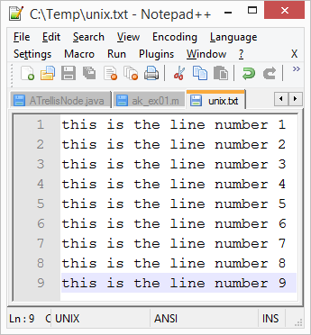
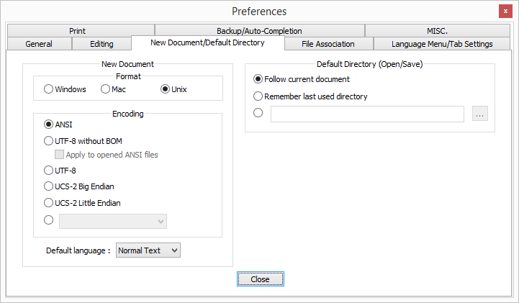
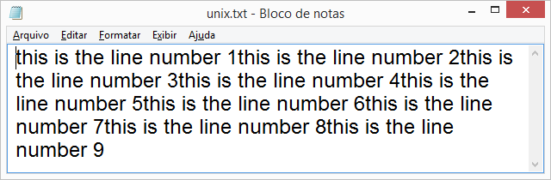
Line-ending battle: Windows vs. Unix/Linux
Text file created on Unix
At the end of each line:
Windows uses 2 characters: 0d 0a in hexa (CR LF, respectively)
Linux uses only 1 character: 0a (LF)
This text file opened on Windows, which cannot find 0d (CR)
Some ASCII text editors such as notepad++ allow support both Windows and Linux line-ending

Slide 35
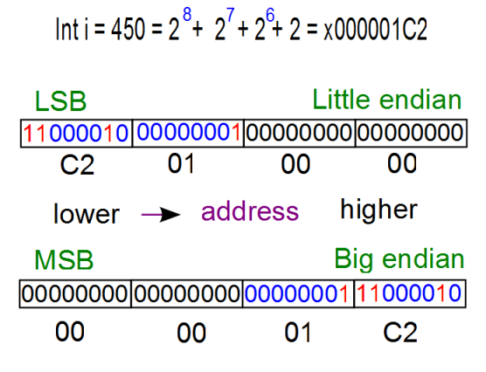
Another battle: Byte ordering or “endianness”
Chipset vendors did not agree on a convention to interpret data composed of multiple bytes:
The first byte in memory should be interpreted as the Most Significant (MSB) or Least Significant Byte (LSB)?
“Big-endian” or “little-endian”
Example: How to store the number 450 (decimal, or 1C2 in hexa) as a 4-bytes integer?

Slide 36
Yet the endianness battle
Intel adopts little-endian, while Motorola adopts big-endian
The endian issue happens not only when storing / reading data to / from memory, but also when dealing with files or even when using multiple programming Languages
Java adopts big-endian even when executing on a little-endian machine!
But C adopts by default the endianness of the machine it is running on
Example of trouble: using C program, save a file with “float” numbers on a little-endian machine, and read it (using C) on a big-endian machine. The byte ordering will be swapped and numbers wrongly interpreted
Example: Write “short” numbers (2 bytes per number) using C on a little-endian PC and read it using Java on the same machine
Will use: ak_write.c, ak_read.c, ReadShorts.java and ReadShortsSwapped.java

Slide 37
ak_write.c and ak_read.c
Write and then read
gcc ak_write.c -o ak_write.exe
gcc ak_read.c -o ak_read.exe
./ak_write (assuming Linux slash /)
./ak_read
#include <stdio.h>
int main() {
FILE *fp;
short x[3];
int i;
fp=fopen("shorts.bin","rb");
fread(x,sizeof(short),3,fp);
fclose(fp);
for (i=0;i<3;i++) {
printf("%d ",x[i]);
}
}
➔ Output:
1 2 3
#include <stdio.h>
int main() {
FILE *fp;
short x[]={1,2,3};
fp=fopen("shorts.bin","wb");
fwrite(x,sizeof(short),3,fp);
fclose(fp);
}

Slide 38
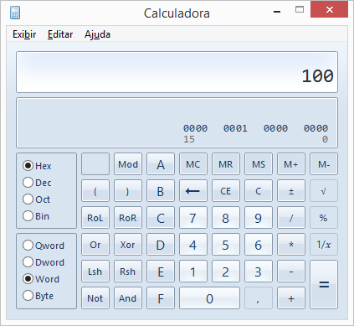
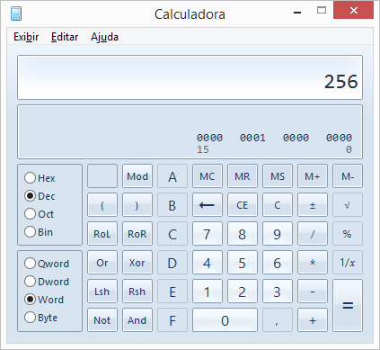
ReadShorts.java
import java.io.*;
public class ReadShorts {
public static void main(String[] args) {
short[] x = new short[3]; //array of shorts
String fileName="shorts.bin";
try {
File file = new File(fileName);
DataInputStream datainputstream = new DataInputStream(
new BufferedInputStream(new FileInputStream(file)));
for (int i = 0; i < 3; i++) {
x[i] = datainputstream.readShort(); // read from file
System.out.print(x[i] + " "); // show the value
}
System.out.println(""); // new line
}
catch (IOException e) {
e.printStackTrace();
throw new Error("Could not open file " + fileName);
}
}
}
Compile and execute
javac ReadShorts.java
java -cp . ReadShorts
➔ Output:
256 512 768

Slide 39
ReadShortsSwapped.java
import java.io.*;
public class ReadShortsSwapped {
public static void main(String[] args) {
short[] x = new short[3]; //array of shorts
String fileName="shorts.bin";
try {
File file = new File(fileName);
DataInputStream datainputstream = new DataInputStream(
new BufferedInputStream(new FileInputStream(file)));
for (int i = 0; i < 3; i++) {
x[i] = datainputstream.readShort(); // read from file
int LSB = x[i] & 255;
int MSB = (x[i] >> 8) & 255;
x[i] = (short) ( (LSB << 8) | MSB);
System.out.print(x[i] + " "); // show the value
}
System.out.println(""); // new line
}
catch (IOException e) {
}
}
}
Now, after reading two bytes, swap their position
Compile and execute
javac ReadShortsSwapped.java
java -cp . ReadShortsSwapped
➔ Output:
1 2 3

Slide 40
Pipe on Linux
Piping is to force the output of a program to be the input of another program. It can be done with the pipe character |
For example, on Linux:
find | more ➔ sends the output of find to be the input to more
find | wc ➔ sends the output of find to be the input to more
find . -name '*.c' | xargs cat | wc ➔ counts the number of lines / characters in all .c files in current folder and subfolders. In this case, the output of find is the input to xargs, which uses cat and their output is the input to wc

Slide 41
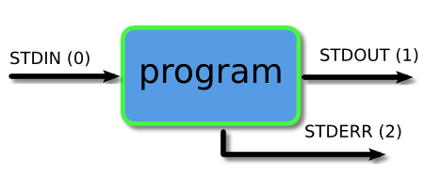
I/O Redirection
Input / Output (or I/O) operations are used to interface not only the CPU to peripherals, but also exchange data among programs
A program can have several inputs and outputs, but there are “standard” ones: stdin (input) and stdout (output)
It is useful to have an “error” output (stderr) that shows information that something is going wrong but not mixing with stdout data
Each standard I/O has a number from 0 to 2 and can be “redirected”
A program can read data from stdin
A program can write data to stdout and/or stderr

Slide 42
I/O redirection
Character > can be used to substitute stdout by a file that will be created. Example
ls –l > myfiles.txt
Instead of writing to stout, create (or overwrite) a file myfiles.txt
Character < can be used to substitute stdin by a file that already exists. Example
wc < myfiles.txt
The command wc processes the lines of myfiles.txt as input
The stderr can be replaced by using 2> such as in
gcc 2> error_message.txt
The gcc error message will be written to the file instead of console

