Slide 1
Digital Communications I:
Modulation and Coding Course
Term 3 - 2007
Catharina Logothetis
Lecture 10 – Textbook: B. Sklar, “Dig. Comm”
From http://www.signal.uu.se/Courses/CourseDirs/ModDemKod/2009X/main.html
Adapted by Aldebaro Klautau, UFPA, Brazil 2017

Slide 2
Today, we are going to talk about:
Another class of linear codes, known as Convolutional codes.
We study the structure of the encoder.
We study different ways for representing the encoder.
Lecture 10

Slide 3
Convolutional codes
Convolutional codes offer an approach to error control coding substantially different from that of block codes.
  A convolutional encoder:
    encodes the entire data stream, into a single codeword.
    does not need to segment the data stream into blocks of fixed size (Convolutional codes are often forced to have a block structure by periodic truncation).
    is a machine with memory.
This fundamental difference in approach imparts a different nature to the design and evaluation of the code.
  Block codes are based on algebraic/combinatorial techniques.
  Convolutional codes are based on construction techniques.
Lecture 10

Slide 4


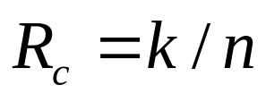
Convolutional codes-cont’d
A Convolutional code is specified by three parameters or where
  is the coding rate, determining the number of data bits per coded bit
    In practice, usually k=1 is chosen and we assume that from now on
  K is the constraint length: the encoder can store K vectors of k bits each, for the input and K-1 memory elements (k-tuple each)
    k and n are small numbers and K controls the capability and complexity of the code
    Note: there are different definitions for constraint length in the literature!
Lecture 10

Slide 5
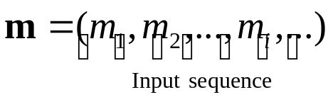
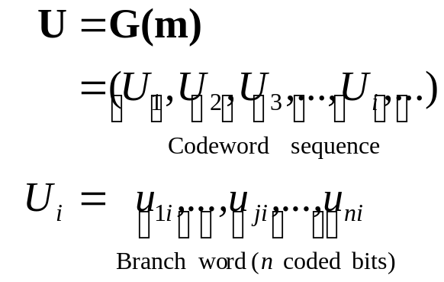

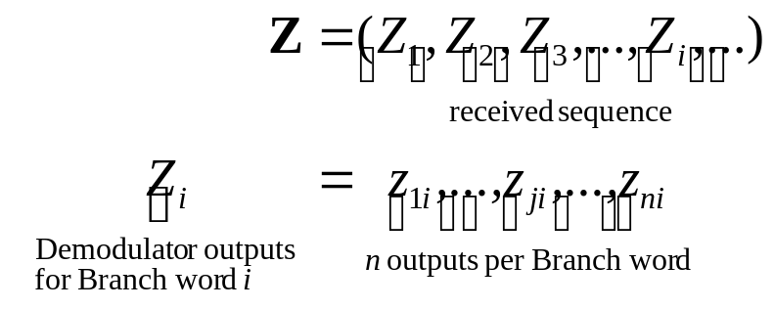
Block diagram of the DCS
Information
source
Rate 1/n
Conv. encoder
Modulator
Channel
Information
sink
Rate 1/n
Conv. decoder
Demodulator
Lecture 10

Slide 6
Note on nomenclature
An n-bits codeword is well-defined in block codes, but for convolutional encoders, we talk about “sequences”
  The encoder output sequence U is composed of “branch words” U₁, U₂, ...
  Each branch word U_{i} is composed of n code symbols, also called code bits or channel bits
  The demodulator generates another sequence Z

Slide 7




A Rate ½ Convolutional encoder
Convolutional encoder (rate ½, K=3)
  3 shift-registers where the first one takes the incoming data bit and the rest, form the memory of the encoder.
First coded bit
(Branch word)
Input data bits
Output coded bits
Second coded bit
Lecture 10

Slide 8








A Rate ½ Convolutional encoder (cont.)
Message sequence:
Time
Output
Time
Output
(Branch word)
(Branch word)
1
0
0
0
1
0
1
0
1
0
1
0
Lecture 10

Slide 9



A Rate ½ Convolutional encoder (cont. 2)
Time
Output
Time
Output
(Branch word)
(Branch word)
0
0
1
0
0
0
Encoder
Lecture 10

Slide 10
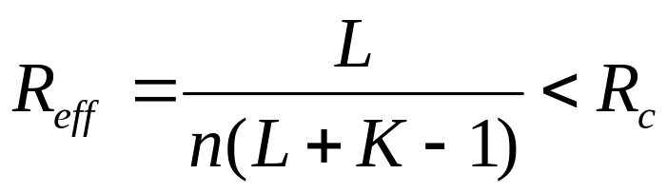
Periodic truncation and effective code rate
Periodic truncation is often used and imposes a “block” structure
  Initialize the memory before encoding the first bit (all-zero)
  clear out the memory after encoding the last bit (all-zero)
  Hence, a tail of K-1 zero-bits is appended to data bits.
Effective code rate (taking the tail bits in account):
  L is the number of data bits and k=1 is assumed
  Hence, the tail has K-1 bits such that L+K-1 bits are sent to the encoder and it outputs n(L+K-1) code bits:
data
tail
Encoder
code bits
Lecture 10

Slide 11
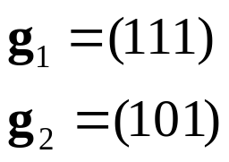

Encoder representation
Connection vector representation:
  We define n binary vectors with K elements (one vector for each modulo-2 adder). The i-th element in each vector, is “1” if the i-th stage in the shift register is connected to the corresponding modulo-2 adder, and “0” otherwise.
    Example:
Another alternative,
using D-transform:
1+D+D² and
1+D²
Lecture 10

Slide 12

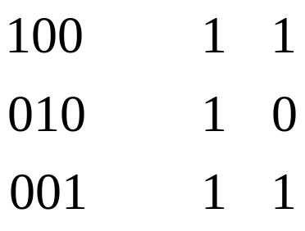
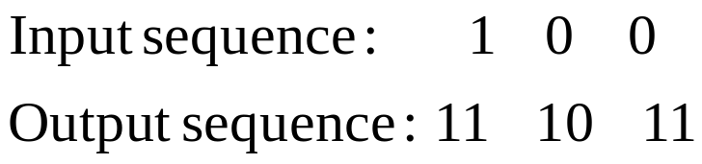
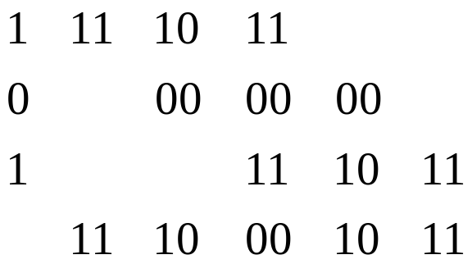
Encoder representation – cont’d
Impulse response representation:
  Encoder is a linear and time-invariant (LTI) system: The response to a single “one” bit (an impulse) allows to find output to any input
    Example:
Branch word
Register
contents
impulse
impulse
response
Input m
Output
⬅ Convolution
of a LTI system
for input 101
Modulo-2 sum:
Lecture 10

Slide 13
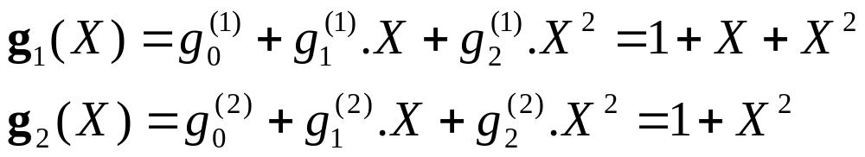
Encoder representation – cont’d 2
Polynomial representation:
  We define n generator polynomials, one for each modulo-2 adder. Each polynomial is of degree K-1 or less and describes the connection of the shift registers to the corresponding modulo-2 adder
    Example:
    The output sequence is found as follows:
Lecture 10

Slide 14
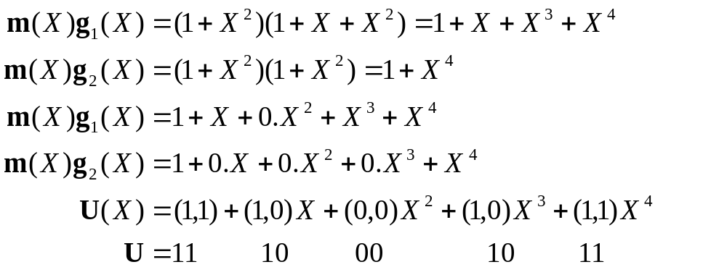
Encoder representation – cont’d 3
    In more details, assuming m=[1 0 1] and the implicit use of zeros to “flush” the register:
Lecture 10

Slide 15
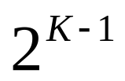
State diagram
A finite-state machine only encounters a finite number of states
State of a machine: the smallest amount of information that, together with the current input to the machine, can predict the output of the machine
In a convolutional encoder, the state is represented by the content of the memory
Hence, there are states
Lecture 10

Slide 16
State diagram – cont’d
A state diagram is a way to represent the encoder
A state diagram contains all the states and all possible transitions between them
Only two transitions initiating from a state
Only two transitions ending up in a state
Lecture 10

Slide 17




State diagram – cont’d 2
Obs: Solid line: when input is 0
Dashed: when input is 1
0/00
Current state
input
Next state
output
Output
(Branch word)
Input
00
0
00
00
1/11
0/11
1
11
1/00
01
0
11
10
01
1
00
0/10
10
0
10
1/01
1
01
11
0/01
11
0
01
1/10
1
10
Lecture 10

Slide 18






Trellis
Trellis diagram is an extension of the state diagram that shows the passage of time
  At each unit of time, 2^{K-1} nodes are required
  Example of a section of trellis for the rate ½ code
State
0/00
1/11
0/11
1/00
0/10
1/01
0/01
1/10
Time
Lecture 10

Slide 19
Trellis example
Input bits
Tail bits
1
0
1
0
0
Output bits
11
10
00
10
11
1/11
0/11
0/10
1/00
0/10
Note: Here we know the input bits, but in practice the receiver just
gets a (noisy) version of the “output” bits to find the “best path”
Lecture 10

Slide 20
Trellis example – cont’d
Assuming any state can be the starting state
Input bits
Tail bits
1
0
1
0
0
Output bits
11
10
00
10
11
0/00
0/00
0/00
0/00
0/00
1/11
1/11
1/11
1/11
1/11
0/11
0/11
0/11
0/11
0/11
1/00
1/00
1/00
1/00
1/00
0/10
0/10
0/10
0/10
0/10
1/01
1/01
1/01
1/01
1/01
0/01
0/01
0/01
0/01
0/01
Lecture 10

Slide 21
Trellis – cont’d 2
Assuming S₀ is the starting and tail bits are zero
Input bits
Tail bits
1
0
1
0
0
Output bits
11
10
00
10
11
0/00
0/00
0/00
0/00
0/00
1/11
1/11
1/11
0/11
0/11
0/11
0/10
1/00
0/10
0/10
1/01
1/01
0/01
0/01
Lecture 10

