Slide 1

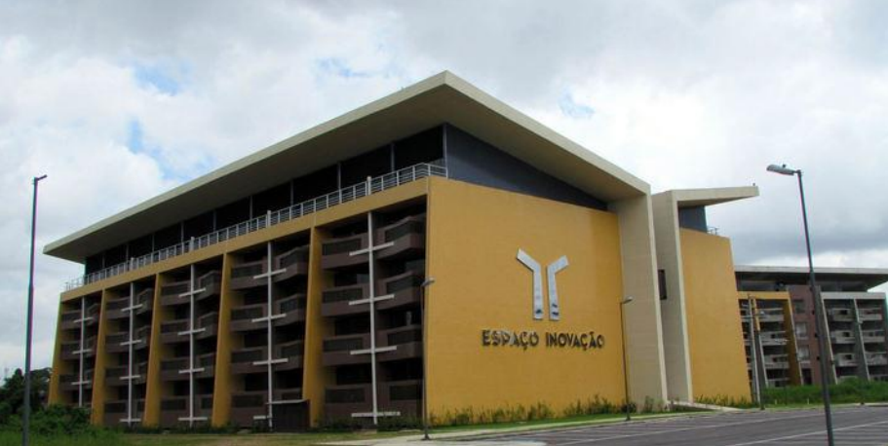
Maximum Likelihood (ML) and Maximum a Posteriori (MAP) Decision Criteria
Aldebaro Klautau
LASSE - Federal University of Pará (UFPA)
Brazil, Jun. 02, 2017

Slide 2
Agenda
What is “likelihood”?
Histogram of signal samples
Bayes’ rule: likelihood, prior, posterior and evidence
iid
MLE
Examples
Decision criteria for classifiers and digital communication receivers
ML
MAP

Slide 3
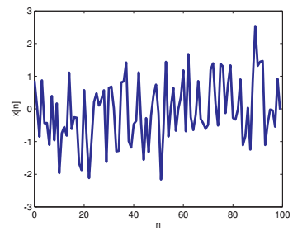
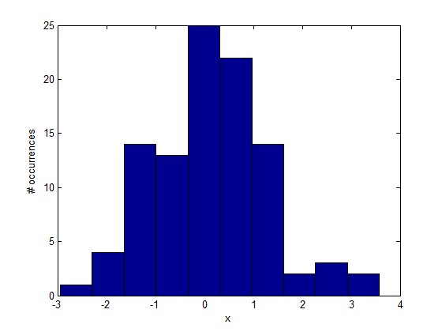
Histogram
Example: random signal (x=randn(1,100) using Matlab/Octave)
Time-domain waveform
plot(x) on Matlab/Octave
Histogram with 10 bins :
hist(x) on Matlab/Octave

Slide 4

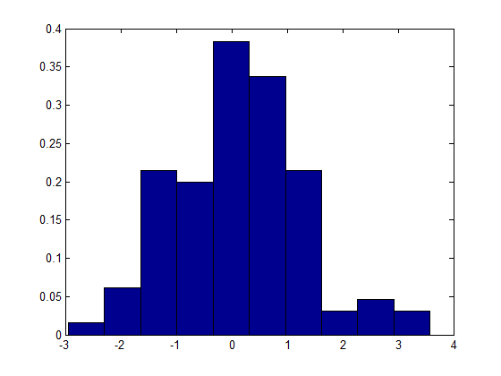
Estimation of PMF or PDF via normalized histograms
Normalizing the histogram by the total number of samples provides an estimate of the probability mass function (PMF). When this result is further normalized by the bin width, an estimate of the probability density function (PDF) is obtained.
[n,a]=hist(x)
bar(a,n/length(x) / ...
(a(2)-a(1)),'hist')
[n,a]=hist(x)
bar(a,n/length(x),'hist')

Slide 5
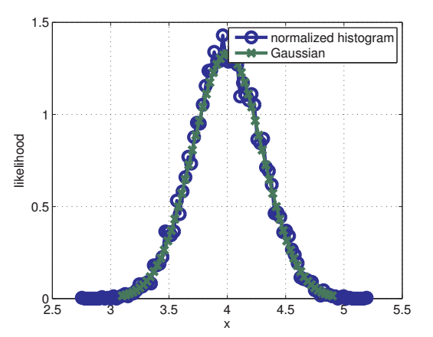
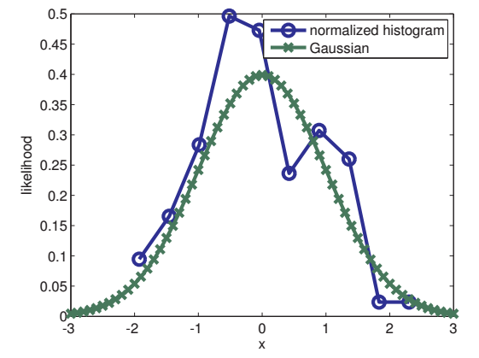
Likelihood
Likelihood is the actual value of a probability density function (PDF). It is not a probability and can be larger than 1. Superimposed PDFs and their estimation
Standard Gaussian with mean = 0 and variance = 1
100 examples
Gaussian with mean = 4 and variance = 0.09 10⁴ examples

Slide 6
Bayes’ rule
Based on the definition of conditional probability
P(A,B) = P(B,A) = P(B) P(A/B) = P(A) P(B/A)
Hence: P(B/A) = [P(B) P(A/B)] / P(A)
Used in many applications:
Digital communications: A is the received bit and B the hypothesized transmitted bit
Classification: A is the set of features and B the class
Note: “A” can be a continuous random variable (rv) while “B” is a discrete rv. In this case, P(A) and P(A/B) are likelihoods of two distinct PDFs, while P(B) and P(B/A) are distinct PMFs

Slide 7
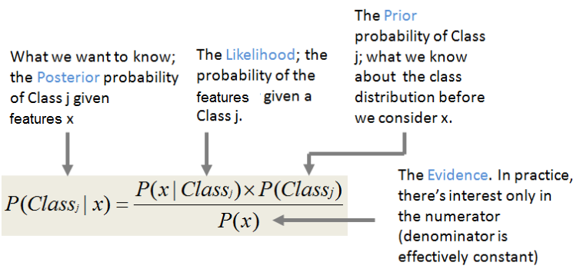
Bayes’ theorem (in the context of classification)
To apply Bayes’ theorem, typically one needs to estimate likelihoods and priors for each class:
x₁
classifier
x₂
Class
x_{N}
...
input features
http://shatterline.com/blog/2013/09/12/not-so-naive-classification-with-the-naive-bayes-classifier/

Slide 8
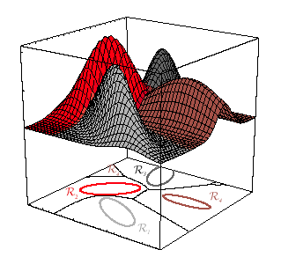


Example of Bayes classifier
Assume 4 classes and that each likelihood is a Gaussian distribution (dictated by “nature”)
Also assume the priors are uniformly distributed P(Class_{j})=1/4
Given a test vector x, calculate posteriors for j=1, 2, 3, 4 and choose the largest:
If the estimation of likelihoods and priors is perfect, the Bayes classifier is optimum and its error is the minimum possible, called “Bayes error”

Slide 9
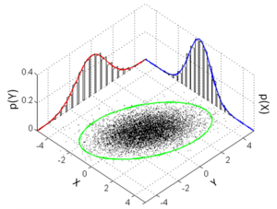
Naïve Bayes classifier
Use the naïve (ingenuous) assumption that the parameters of each class are statistically independent, such that all joint distributions are equivalent to the multiplication of the marginal distributions
Example, for a parameter vector z = [x, y] of a classe C, it corresponds to P(z|C) = P(x|C) P(y|C)

Slide 10
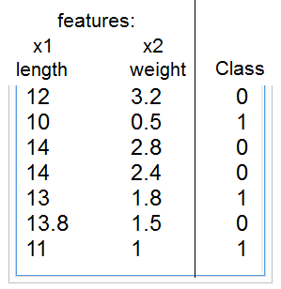
Naïve classifier using Gaussians for real-valued features
For each class, estimate the needed statistics, priors and likelihoods
Class 0:
prior0=4/7
m0l=mean([12 14 14 13.8]) %13.450
m0w=mean([3.2 2.8 2.4 1.5]) %2.4750
s0l=std([12 14 14 13.8]) %0.97125
s0w=std([3.2 2.8 2.4 1.5]) %0.72744
Class 1:
prior1=3/7
m1l=mean([10 13 11]) %11.333
m1w=mean([0.5 1.8 1]) %1.1000
s1l=std([10 13 11]) %1.5275
s1w=std([0.5 1.8 1]) %0.65574
Test example: x=[13 3.2]; xl=x(1); xw=x(2);
num0=normpdf(xl,m0l,s0l)*normpdf(xw,m0w,s0w)*prior0
num1=normpdf(xl,m1l,s1l)*normpdf(xw,m1w,s1w)*prior1
Px=num0+num1; %denominator, just a scale factor
posterior0=num0/Px %0.99685
posterior1=num1/Px %0.0031541

Slide 11
iid: independent and identically distributed
When a random vector X=[x₁, x₂, ..., x_{N}] is composed by statistically independente random variables (rv), the likelihood P(X) can be conveniently decomposed as
P(X) = P₁(x₁) P₂(x₂) ... P_{N}(x_{N})
If, besides independen, the rv’s are obtained from the same distribution, i. e., all distributions P₁(.), P₂(.), ..., P_{N}(.) are identical, then the rv’s are iid
When maximizing (or minimizing) P(X), it is convenient to use log P(X) instead because it allows the use of summations instead of products
The log is monotonic, so the arguments / parameters that maximize P(X) are the same ones that maximize log P(X)
We then often decide based on the log-likelihood function

Slide 12

Maximum likelihood estimation (MLE)
Several applications require “parameter estimation”
There are many methods (least-squares, MLE, etc.)
MLE: aims at finding the parameters that maximize a given likelihood of a given data. It is cast in a probabilistic framework
In telecom we want to find the transmitted bits (ML decoding) not model parameters but it has strong similarities with MLE
Examples of MLE:
MLE of a Bernoulli B(p) random variable (coin flips, p is the probability of “head”). Given N flips of the coin, the MLE of p is p= H / N, where H is the “number of heads” in the N flips.
MLE for univariate Gaussian mean of X₁, X₂, ..., X_{n} is the sample average:
For proofs of the two examples, see e.g. https://onlinecourses.science.psu.edu/stat414/node/191

Slide 13

Memoryless channels
AWGN, BSC and other memoryless channels simplify the math because the output at instant t depends only on the input at t
Assume the output of a memoryless channel is the sequence Y=y₁, y₂ when the input is X=x₁, x₂, the probability P(Y/X) can be written as
P(Y/X) = P(y₁ / x₁) P(y₂ / x₂) because the channel is memoryless
Note that P(Y) = P(y₁) P(y₂) ... P(y_{N}) requires y_{i} to be iid, but the equation P(Y/X) = P(y₁ / x₁) P(y₂ / x₂) is valid even if y_{i} are not independent, because given x_{i} and a memoryless channel, y_{i} does not depend on inputs and outputs at “time” different than i
Example, assume Z and U^{(m)} are the output and input sequences of a BSC, being composed by words Z_{i} and U_{i}^{(m)}, respectively, each with n bits z_{ji} and u_{ji}^{(m)}. The superscript m indicates the codeword U depends on information bits m. The convolutional code output U is not formed by iid codewords (hence, Z is not formed by iid words). In spite of not being iid, because the channel is memoryless, ML sequence decoding can use:

Slide 14
Two decision criteria for sequence detection
Maximum likelihood (ML): max P(Z / U)
Maximum a posteriori (MAP): max P(U / Z)
Information
source
Rate 1/n
Conv. encoder
Modulator
Channel
Information
sink
Rate 1/n
Conv. decoder
Demodulator

Slide 15
Decision criteria
In block coding there is a deterministic bijective mapping between the message m and its codeword U^{(m)} (or simply U) such that finding the codeword U allows to find m
In convolutional coding, the codeword U^{(m)} (or simply U) depends on the input and previous L input values (the current “state”). Hence, decoding is equivalent to finding the best state sequence over the trellis given the received symbols Z, which then enables estimating (uncovering) the hidden information m
Best path according to maximum likelihood (ML): max_{U} P(Z / U)
Recall that hypothesizing all codewords U (or U^{(m)}) requires trying all messages m
Likelihoods are often easier to calculate than posterior probabilities
Best path according to maximum a posteriori (MAP): max_{U} P(U / Z) = max_{U} P(Z / U) P(U)
The MAP criterion takes in account not only the likelihood but also the prior
Achieves the minimum probability of error (it is the optimum criterion)
ML and MAP lead to the same decision when all sequences U have the same probability, that is P(U) is a constant or “the prior is uniform”

Slide 16
Symbol-by-symbol versus sequence decisions
Given a sequence of received symbols Z, in general, the optimum decision needs to take in account the whole sequence but when the symbols are independent, a symbol-by-symbol decision (SbS) leads to the same (optimum) result and is often much simpler
In other words: we need to use sequence decision when the symbols are related, which happens at: 1) the transmitter (by a convolutional code, for example) , 2) the channel (by a LTI system with memory) and 3) both
Viterbi is an algorithm for ML sequence decision (MLSD) and can be used in any trellis: it finds the “best path” in ML sense over the trellis. It is often used in digital communications for:
convolutional decoding (case 1 above) and
combating intersymbol interference (ISI) caused by the signal dispersion in channels with memory (case 2 above)

Slide 17
General Viterbi setup
Many practical applications:
convolutional decoding and channel trellis decoding
fading communication channels
partial response channels in recording systems
optical character recognition
speech recognition
DNA sequence analysis
Find a path through any Markov graph, which is a sequence of states governed by a Markov chain
What is the best estimate for the information given the observation?
noise
information
x
n
Finite State Machine
observation
y = x + n

Slide 18
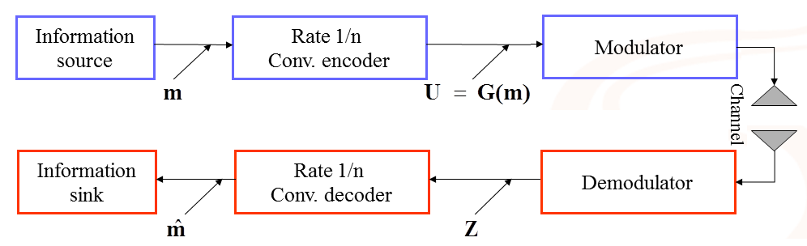
Sequence decision for convolutional decoding over memoryless channel
Has “memory”, creates “structure”
Memoryless
Sequence decision,
exploits the “structure”

Slide 19
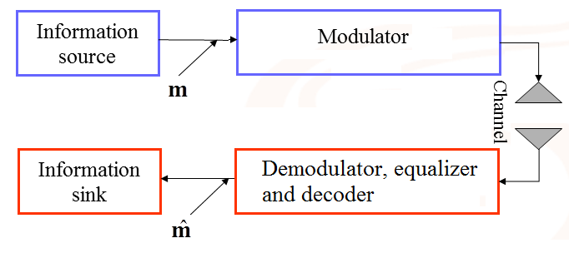
Sequence decision for uncoded information over channel with memory
Memoryless
Has “memory”, for
example with impulse response h(t) = δ(t) + 0.5 δ(t-3) It creates “structure”
Sequence decision,
exploits the “structure”

Slide 20
Distinguish: symbol-by-symbol, block-based and sequence decision
Make sure you distinguish the three cases. We assume (literature may use different definitions):
In symbol-by-symbol decision, the decoder operates on a single number
In block-based decision, the decoder operates on a block of N symbols and the blocks are statistically independent of each other
For example, the decision is made on the output of a memoryless channel whose input are the codewords of a block code (n, k). There is a sequence of N = n bits in this case, but the endpoints of the block limit the influence of a given symbol (it does not influence the next block)
In sequence decision, there is a continuous flow of symbols passing by a system with memory such that a symbol influences the following L, assuming a finite memory of L symbols
The L-symbols memory defines the states of a trellis that impose “structure” and the search can benefit from this structure
This is the situation that can be tackled with the Viterbi and similar MLSD algorithms

Slide 21
Block-based and sequence decision similarities
To restrict latency to reasonable values, convolutional decoding adopts truncation of a bitstream into “packets” and becomes more similar to block-based decoding
In fact, MLSD (Viterbi, etc.) can be used to decode block codes
See, e.g., [Lathi & Ding, 2010, 4th Ed.], Section 14.7 “Trellis diagram of block codes”
Makes more sense when the block is relatively large

Slide 22
Block-based decision for repetition code
Repeat each bit 3 times
Input bits
1
0
1
0
1
Coded (channel input) bits U
111
000
111
000
111
Channel output bits
101
110
110
100
111
Easier to make decisions for each three bits
No need for finding the best path over a trellis: the input bit is easily obtained from the estimated codeword

Slide 23
MLSD: Brute force versus Viterbi algorithm
For the example code:
Input bits m
Tail bits
1
0
1
0
0
Coded (channel input) bits U
11
10
00
10
11
Channel output bits Z
11
11
10
10
11
Number of possible sequences (two equivalent reasoning):
5 among the 4 possible codewords: 4⁵ = 1024 or sequences of 10 bits: 2¹⁰ = 1024
Brute force:
Enumerate all 1024 candidates U_{i} and calculate the likelihood P(Z / U_{i})
After choosing the best sequence of codewords U*, still needs to find the corresponding input m. Some codeword sequences may not be allowed
When Viterbi finds the best path, it helps in two aspects:
It saves computation and already informs the estimated input m taking in account all restrictions (“structure”) in the generation of U

Slide 24
Example of brute force
For the example code:
Channel output bits Z
11
11
10
10
11
List (hypothesize) all possibilities:
00
00
00
00
00
00
00
00
00
01
00
00
00
00
10
00
00
00
00
11
00
00
00
01
00
00
00
00
01
01
.
.
.
11
11
11
11
11

Slide 25
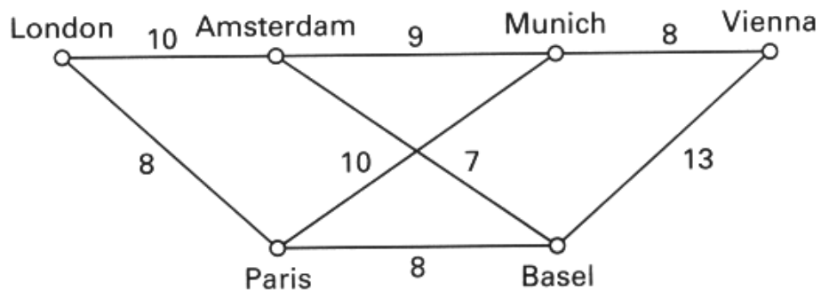
Dynamic programming
Viterbi is a “dynamic programming” algorithm
Find the quickest way from London to Vienna. The labels on each path are travel times (from [Sklar]).

Slide 26
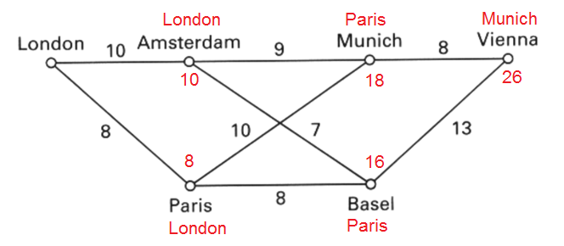
Viterbi / dynamic programming example
Collect metric and backtrace information
Best path, from last state to first: Vienna ⬅ Munich ⬅ Paris ⬅ London
Best path total time: 26

Slide 27
Thanks!
Contact: lasse@ufpa.br
www.lasse.ufpa.br

