Slide 1
Modulation, Demodulation and Coding Course
Term 3 - 2008
Catharina Logothetis
Lecture 11 – Textbook: B. Sklar, “Dig. Comm”
From http://www.signal.uu.se/Courses/CourseDirs/ModDemKod/2009X/main.html
Adapted by Aldebaro Klautau, UFPA, Brazil 2017

Slide 2
Last time, we talked about:
Another class of linear codes, known as Convolutional codes.
We studied the structure of the encoder and different ways for representing it.
Lecture 11

Slide 3
Today, we are going to talk about:
What are the state diagram and trellis representation of the code?
How the decoding is performed for Convolutional codes?
What is a Maximum likelihood decoder?
What are the soft decisions and hard decisions?
How does the Viterbi algorithm work?
Lecture 11

Slide 4
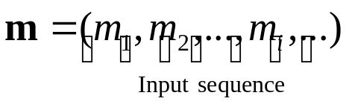
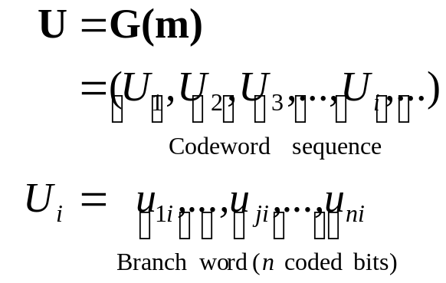

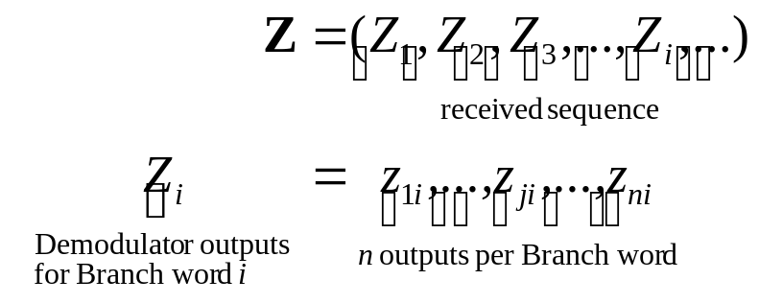
Block diagram of the DCS
Information
source
Rate 1/n
Conv. encoder
Modulator
Channel
Information
sink
Rate 1/n
Conv. decoder
Demodulator
Lecture 11

Slide 5
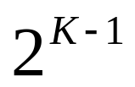
State diagram
A finite-state machine only encounters a finite number of states.
State of a machine: the smallest amount of information that, together with a current input to the machine, can predict the output of the machine.
In a Convolutional encoder, the state is represented by the content of the memory.
Hence, there are states.
Lecture 11

Slide 6
State diagram – cont’d
A state diagram is a way to represent the encoder.
A state diagram contains all the states and all possible transitions between them.
There can be only two transitions initiating from a state.
There can be only two transitions ending up in a state.
Lecture 11

Slide 7




State diagram – cont’d
0/00
Current state
input
Next state
output
Output
(Branch word)‏
Input
00
0
00
00
1/11
0/11
1
11
1/00
01
0
11
10
01
1
00
0/10
10
0
10
1/01
1
01
11
0/01
11
0
01
1/10
1
10
Lecture 11

Slide 8






Trellis – cont’d
The Trellis diagram is an extension of the state diagram that shows the passage of time.
  Example of a section of trellis for the rate ½ code
State
0/00
1/11
0/11
1/00
0/10
1/01
0/01
1/10
Time
Lecture 11

Slide 9






Trellis –cont’d
A trellis diagram for the example code
Input bits
Tail bits
1
0
1
0
0
Output bits
11
10
00
10
11
0/00
0/00
0/00
0/00
0/00
1/11
1/11
1/11
1/11
1/11
0/11
0/11
0/11
0/11
0/11
1/00
1/00
1/00
1/00
1/00
0/10
0/10
0/10
0/10
0/10
1/01
1/01
1/01
1/01
1/01
0/01
0/01
0/01
0/01
0/01
Lecture 11

Slide 10
Trellis – cont’d
Input bits
Tail bits
1
0
1
0
0
Output bits
11
10
00
10
11
0/00
0/00
0/00
0/00
0/00
1/11
1/11
1/11
0/11
0/11
0/11
0/10
1/00
0/10
0/10
1/01
1/01
0/01
0/01
Lecture 11

Slide 11
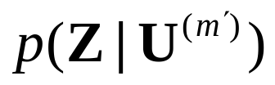



Optimum decoding
If the input sequence messages are equally likely, the optimum decoder which minimizes the probability of error is the Maximum likelihood decoder.
The ML decoder, selects a codeword among all the possible codewords which maximizes the likelihood function where is the received sequence and is one of the possible codewords:
codewords to search!!!
ML decoding rule:
Lecture 11

Slide 12
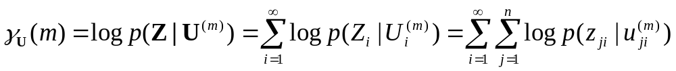

ML decoding for memory-less channels
Due to the independent channel statistics for memoryless channels, the likelihood function becomes
and equivalently, the log-likelihood function becomes
The path metric up to time index , is called the partial path metric.
Path metric
Branch metric
Bit metric
ML decoding rule:
Choose the path with maximum metric among
all the paths in the trellis.
This path is the “closest” path to the transmitted sequence.
Lecture 11

Slide 13
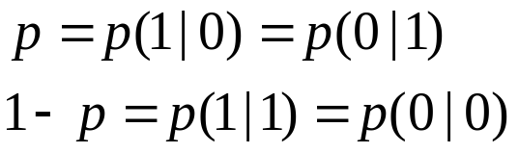

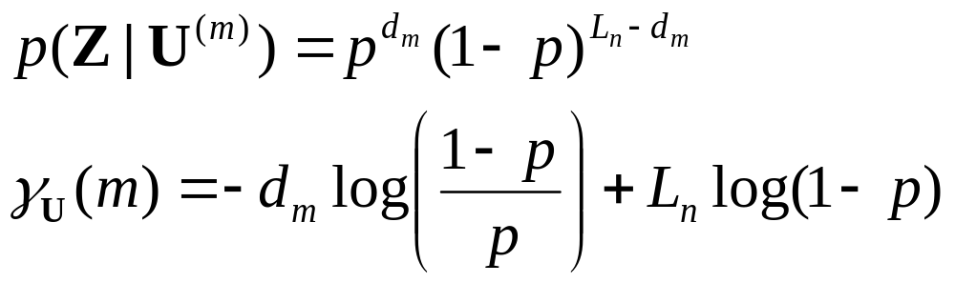
Binary symmetric channels (BSC)‏
1
1
If is the Hamming distance between Z and U, then
p
Modulator
input
Demodulator
output
p
0
1-p
0
Size of coded sequence
ML decoding rule:
Choose the path with minimum Hamming distance
from the received sequence.
Lecture 11

Slide 14


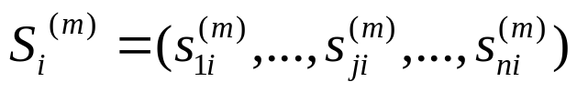

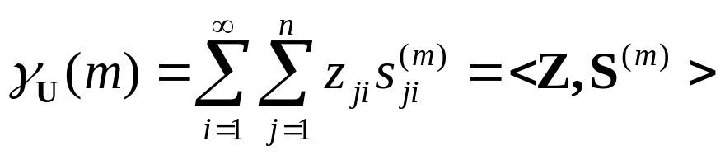
AWGN channels
For BPSK modulation the transmitted sequence corresponding to the codeword is denoted by where and
and .
The log-likelihood function becomes
  Maximizing the correlation is equivalent to minimizing the Euclidean distance.
Inner product or correlation
between Z and S
ML decoding rule:
Choose the path which with minimum Euclidean distance
to the received sequence.
Lecture 11

Slide 15
Soft and hard decisions
In hard decision:
  The demodulator makes a firm or hard decision whether a one or a zero was transmitted and provides no other information for the decoder such as how reliable the decision is.
  Hence, its output is only zero or one (the output is quantized only to two level) that are called “hard-bits”.
Decoding based on hard-bits is called the “hard-decision decoding”.
Lecture 11

Slide 16
Soft and hard decision-cont’d
In Soft decision:
  The demodulator provides the decoder with some side information together with the decision.
  The side information provides the decoder with a measure of confidence for the decision.
  The demodulator outputs which are called soft-bits, are quantized to more than two levels.
Decoding based on soft-bits, is called the “soft-decision decoding”.
On AWGN channels, a 2 dB and on fading channels a 6 dB gain are obtained by using soft-decoding instead of hard-decoding.
Lecture 11

Slide 17

The Viterbi algorithm
The Viterbi algorithm performs Maximum likelihood decoding.
It finds a path through the trellis with the largest metric (maximum correlation or minimum distance).
  It processes the demodulator outputs in an iterative manner.
  At each step in the trellis, it compares the metric of all paths entering each state, and keeps only the path with the smallest metric, called the survivor, together with its metric.
  It proceeds in the trellis by eliminating the least likely paths.
It reduces the decoding complexity to !
Lecture 11

Slide 18
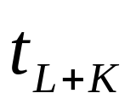


The Viterbi algorithm - cont’d
Viterbi algorithm:
Do the following set up:
  For a data block of L bits, form the trellis. The trellis has L+K-1 sections or levels and starts at time and ends up at time .
  Label all the branches in the trellis with their corresponding branch metric.
  For each state in the trellis at the time which is denoted by , define a parameter
Then, do the following:
Lecture 11

Slide 19




The Viterbi algorithm - cont’d 2
  Set and
  At time , compute the partial path metrics for all the paths entering each state.
  Set equal to the best partial path metric entering each state at time .
  Keep the survivor path and delete the dead paths from the trellis.
  If , increase by 1 and return to step 2.
Start at state zero at time . Follow the surviving branches backwards through the trellis. The path found is unique and corresponds to the ML codeword.
Lecture 11

Slide 20



Example of Hard decision Viterbi decoding
Assume BSC and Hamming distance as metric
0/00
0/00
0/00
0/00
0/00
1/11
1/11
1/11
0/11
0/11
0/11
0/10
1/00
0/10
0/10
1/01
1/01
0/01
0/01
Lecture 11

Slide 21
Example of Hard decision Viterbi decoding-cont’d
Label all the branches with the branch metric (Hamming distance)‏
Partial accumulated
metric
0
2
1
2
1
1
0
1
0
0
1
1
2
0
1
0
1
2
2
1
1
Lecture 11

Slide 22
Example of Hard decision Viterbi decoding-cont’d
i=2
0
2
2
1
2
1
1
0
1
0
0
0
1
1
2
0
1
0
1
2
2
1
1
Lecture 11

Slide 23
Example of Hard decision Viterbi decoding-cont’d
i=3
0
2
2
1
3
2
1
1
0
1
0
0
3
0
1
1
2
0
1
0
0
1
2
2
2
1
1
Lecture 11

Slide 24
Example of Hard decision Viterbi decoding-cont’d
i=4
0
2
2
1
3
2
0
1
1
0
1
0
0
3
2
0
1
1
1
2
0
0
0
3
1
2
2
2
1
3
1
Lecture 11

Slide 25
Example of Hard decision Viterbi decoding-cont’d
i=5
0
2
2
1
3
2
0
1
1
1
0
1
0
0
3
2
0
1
1
1
2
0
0
0
3
2
1
2
2
2
1
3
1
Lecture 11

Slide 26
Example of Hard decision Viterbi decoding-cont’d
i=6
0
2
2
1
3
2
0
1
1
1
2
0
1
0
0
3
2
0
1
1
1
2
0
0
0
3
2
1
2
2
2
1
3
1
Lecture 11

Slide 27


Example of Hard decision Viterbi decoding-trace back
Trace back and then:
0
2
2
1
3
2
0
1
1
1
2
0
1
0
0
3
2
0
1
1
1
2
0
0
0
3
2
1
2
2
2
1
3
1
Lecture 11

Slide 28
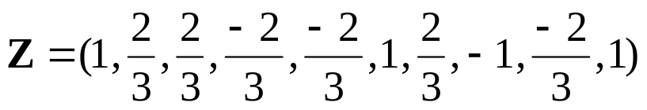


Example of soft-decision Viterbi decoding
0
-5/3
-5/3
0
-5/3
-1/3
10/3
1/3
1/3
-1/3
14/3
0
1/3
1/3
5/3
5/3
5/3
8/3
1/3
-5/3
-1/3
4/3
1/3
5/3
Partial metric
3
2
13/3
-4/3
5/3
5/3
-5/3
1/3
10/3
Branch metric
-5/3
Lecture 11

