Slide 1

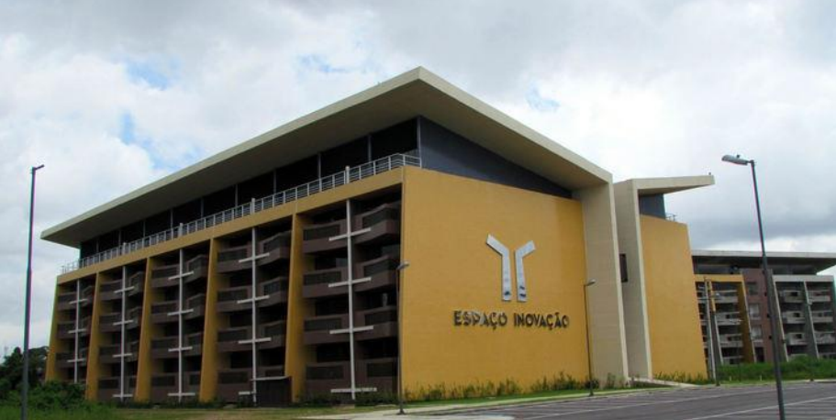
Face detection with boosted and cascaded Haar features Understanding UFPA’s code (Kroon’s) and Lienhart’s detector
Aldebaro Klautau
LASSE - UFPA
July 9, 2017

Slide 2
References for modifications / improvements on original Viola & Jones
[1] R. Lienhart and J. Maydt. An Extended Set of Haar-like Features for Rapid Object Detection. In Proceedings of the IEEE Conference on Image Processing (ICIP '02), pages 155 - 162, New York, USA, September 2002.
[2] Jian-qing Zhu and Can-hui Cai Real-time face detection using Gentle AdaBoost algorithm and nesting cascade structure, ISPACS 2012 http://ieeexplore.ieee.org/document/6473448/

Slide 3
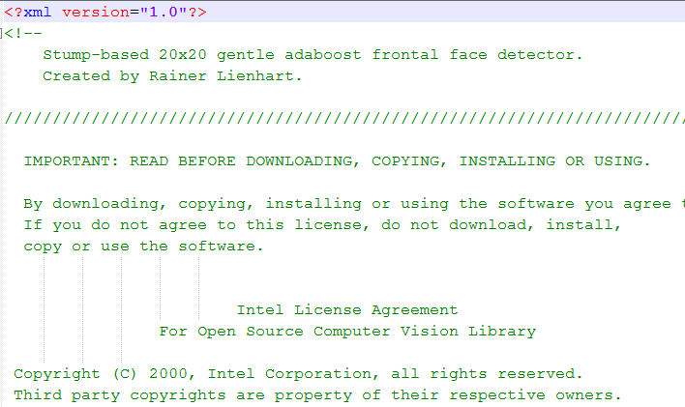
Detector created by Rainer Lienhart
OpenCV old format
Name: haarcascade_frontalface_alt.xml and size: 946.032 bytes
Gentle Adaboost
Available on Web, e.g., et:
https://github.com/aldebaro/ufpa-face-detection/tree/master/HaarCascades

Slide 4
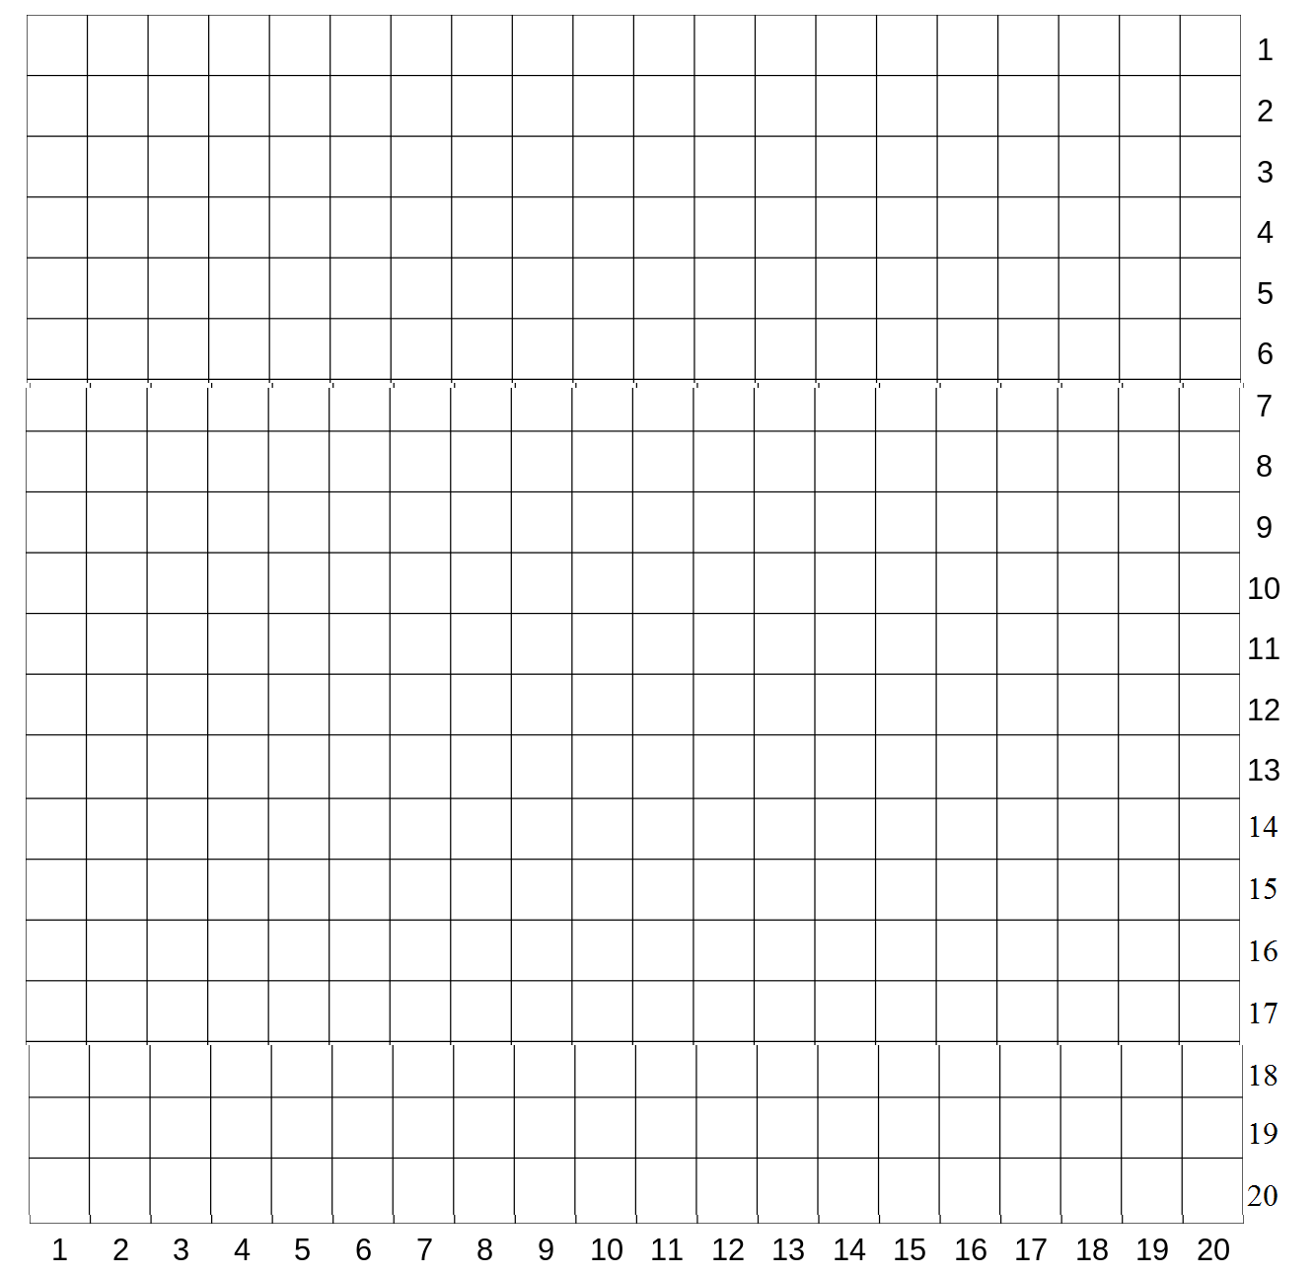
Rectangles in 20 x 20 pixels grid
Example: rectangle (3, 7, 14, 4) ⬅ (x, y, width, height)

Slide 5
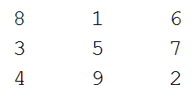
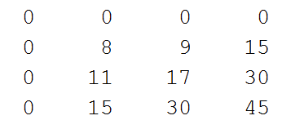
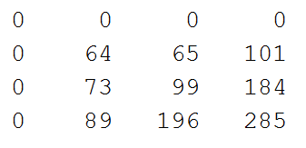
Convention in ufd_ code: extra row and column with zeros
Matrix
Integral (ii)
Squared integral (ii2)

Slide 6
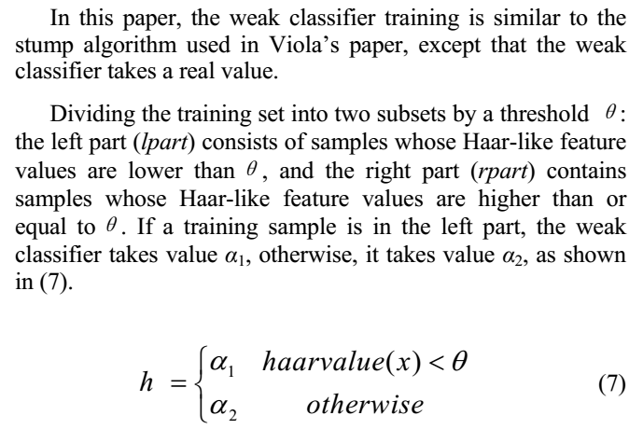
Weak classifier (stump) outputs one among two possible real values
From reference [2]:
Besides, adopting extended stumps, the paper does not use the “discrete” AdaBoost, but the Gentle AdaBoost
The strong classifier does not use α to weight each weak classifier, but it simply sums their outputs because these outputs already incorporate such weight

Slide 7
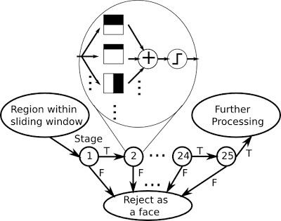
UFPA’s code (based on D. Kroon’s)
ufd_test (main script)
ufd_integralImage (pre-compute integral image)
ufd_multiScaleDetection (searches faces in all scales)
ufd_detectSingleScale (run the whole cascade detector for a given scale)
ufd_treeDetect (finds output of a given weak classifier)

Slide 8
Pseudocode for strongs classifiers and their respective weak classifiers
For a given scale
Find all possible (candidates to face) analysis windows and store them in an array
For all candidates (sliding windows)
For all stages, each one with a strong classifier
Find the “strongClassifierOutput”
Loop over all weak classifiers
Find the “response” of a weak classifier, which has a “Haar feature” composed of at most three rectangles
Find the output of a weak classifier by checking if its response is below or above its threshold
Sum all outputs to obtain “strongClassifierOutput”
Remove the current (windows) candidates that are below the strong classifier threshold: shouldRemoveBecauseBelowThreshold=strongClassifierOutput < stage.stage_threshold
Only the survivor candidates are passed to next stage
Regions

Slide 9
UFPA’s (from D. Kroon) implementation
All regions from a given scale and evaluated at once (arrays are used). In ufd_multiScaleDetection.m:
%create a grid with all possible analysis windows given the image size
%and the chosen "step“
[x,y]=ndgrid(0:step:(integralImages.width-w-1),0:step:(integralImages.height-h-1));
x=x(:); %make it a column vector
y=y(:); %make it a column vector
% input x,y are the starting positions of the analysis window
%input x,y are the rectangles top-left corners of the detected faces
%important: the function below will be called for each scale
[x,y] = ufd_detectSingleScale( x, y, Scale, integralImages, w, h, haarCascade);

Slide 10
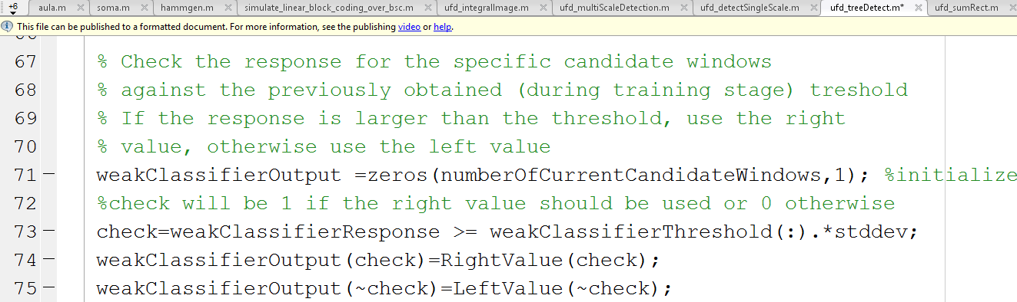
Output of a weak classifier is generated within ufd_treeDetect.m
Note how the two possible output values are implemented in the ufd code:

Slide 11
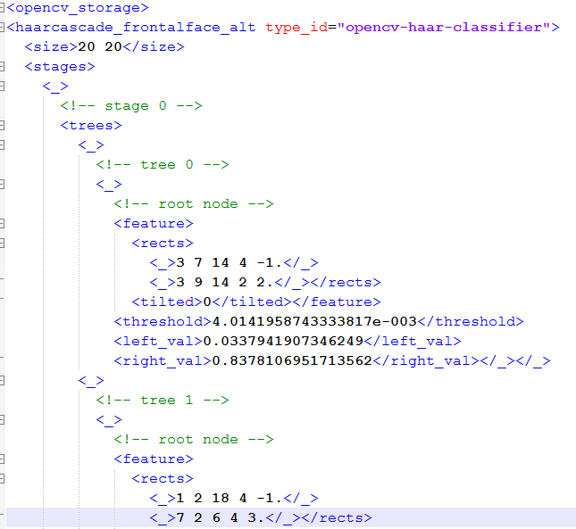
old format
Rectangles: (x, y) position, width, height, weight
0 means the feature is not tilted (rotated)
decision stump threshold, left and right values

Slide 12
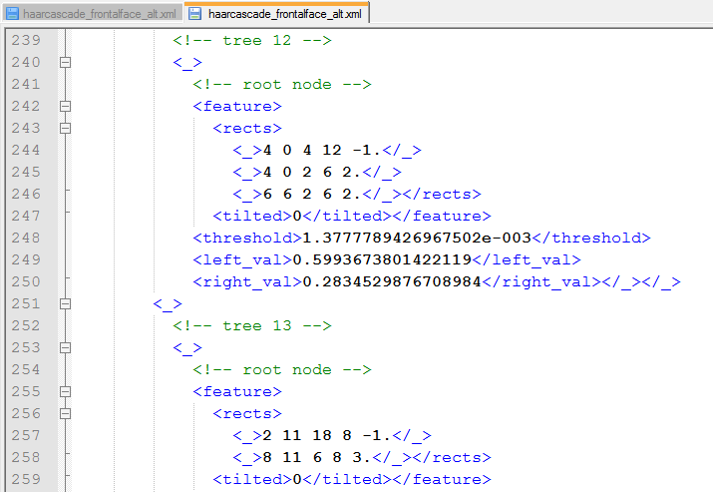
The features (for a weak classifier) can have at most 3 “rectangles”
3 rectangles
2 rectangles

Slide 13
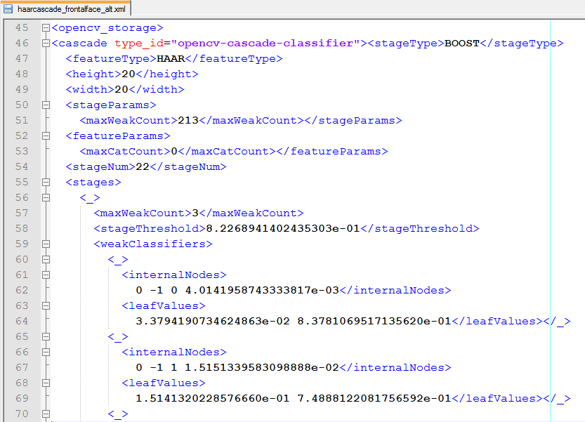
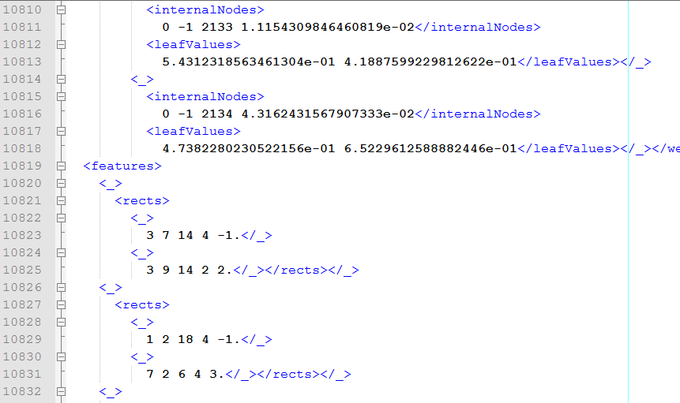
Detector created by Rainer Lienhart
OpenCV new format
Name: haarcascade_frontalface_alt.xml and size: 676.709 bytes
Available with OpenCV

Slide 14
Thanks!
Contact: lasse@ufpa.br
www.lasse.ufpa.br

