Slide 1
Digital Communications I:
Modulation and Coding Course
Term 3 - 2008
Catharina Logothetis
Lecture 9 – Textbook: B. Sklar, “Dig. Comm”
From http://www.signal.uu.se/Courses/CourseDirs/ModDemKod/2009X/main.html
Adapted by Aldebaro Klautau, UFPA, Brazil 2017

Slide 2
Last time we talked about:
Evaluating the average probability of symbol error for different bandpass modulation schemes
Comparing different modulation schemes based on their error performances.
Lecture 9

Slide 3
Today, we are going to talk about:
Channel coding
Linear block codes
  The error detection and correction capability
  Encoding and decoding
  Hamming codes
  Cyclic codes
Lecture 9

Slide 4
Block diagram of a DCS
Source
encode
Channel
encode
Pulse
modulate
Bandpass
modulate
Format
Digital modulation
Channel
Digital demodulation
Source
decode
Channel
decode
Demod.
Sample
Format
Detect
Lecture 9

Slide 5
What is channel coding?
Channel coding:
  Transforming signals to improve communications performance by increasing the robustness against channel impairments (noise, interference, fading, ...)‏
    Waveform coding: Transforming waveforms to better waveforms
    Structured sequences: Transforming data sequences into better sequences, having structured redundancy.
      -“Better” in the sense of making the decision process less subject to errors.
Lecture 9

Slide 6
Error control techniques
Automatic Repeat reQuest (ARQ)‏
  Half or full-duplex connection, error detection
  The receiver sends feedback to the transmitter, saying that if any error is detected in the received packet or not (Not-Acknowledgement (NACK) and Acknowledgement (ACK), respectively).
  The transmitter retransmits the previously sent packet if it receives NACK.
Forward Error Correction (FEC)‏
  Simplex connection, error correction codes
  The receiver tries to correct some errors
Hybrid ARQ (ARQ+FEC)‏
  Full-duplex, error detection and correction codes
Lecture 9

Slide 7

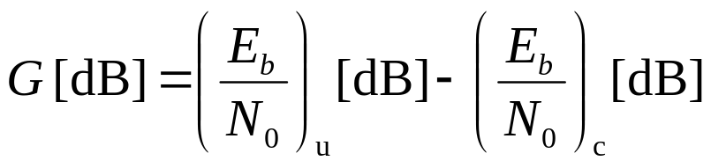

Why using error correction coding?
  Error performance vs. bandwidth
  Power vs. bandwidth
  Data rate vs. bandwidth
  Capacity vs. bandwidth
➔ Point A to C
➔ D to E
➔ D/F to E
D/E (less interference,
e.g. CDMA)
Coded
Coding gain:
For a given bit-error probability,
the reduction in the Eb/N0 that can be
realized through the use of code:
A
F
C
B
D
E
Uncoded
Lecture 9

Slide 8
Channel models
Discrete memoryless channels
  Discrete input, discrete output
Binary Symmetric channels
  Binary input, binary output
Gaussian channels
  Discrete input, continuous output
  Digital communication models adopt various forms for the
  demodulator output: for example, the demodulator can deliver
  to the decoder bits or real values
Lecture 9

Slide 9
Demodulator’s hard or soft decision
Source
encode
Channel
encode
Pulse
modulate
Bandpass
modulate
Format
Digital modulation
Hard decision: bits
Soft decisions: real values
Channel
Digital demodulation
Source
decode
Channel
decode
Demod.
Sample
Format
Detect
Lecture 9

Slide 10
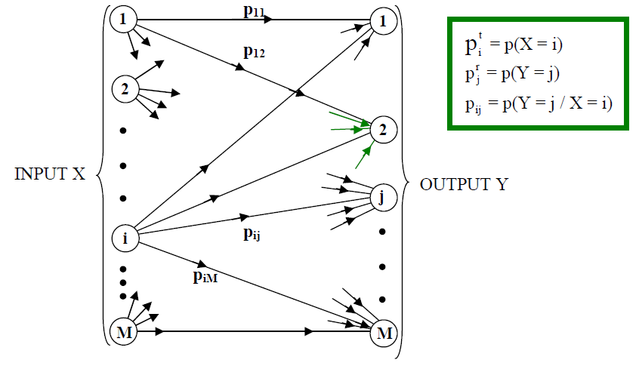
Discrete memoryless channels (DMC)
Discrete input, discrete output
Conditional probability of sequences
  Input U=u₁,u₂,u₃ and output Z=z₁,z₂,z₃
  P(Z/U) = P(z₁/u₁) P(z₂/u₂) P(z₃/u₃)
Lecture 9

Slide 11
Binary Symmetric Channels (BSC)
Special example of the DMC channel model:
  discrete and memoryless, and also:
  binary (alphabet) and symmetric (probabilities)
    completely characterized by the bit error probability p
  Example: input U=0110 and output Z=0011
  P(Z/U)=P(0/0) P(0/1) P(1/1) P(1/0)
  P(Z/U)=(1-p) p (1-p) p = (1-p)² p²
1
1-p
1
p
Tx. bits
Rx. bits
p
0
1-p
0
Lecture 9

Slide 12
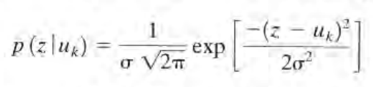
Gaussian channel
Given input U, the output is Z = U + N, where N is AWGN
  Discrete input, real-valued output
The likelihood is
Conditional probability
  Example: input U=(3,-5,1,3) and output Z=(2.9,-5.2, 1.4, 2.1), assuming the noise has variance 0.8 and zero mean
  P(Z/U)=0.4433 x 0.4350 x 0.4036 x 0.2688 = 0.0209

Slide 13
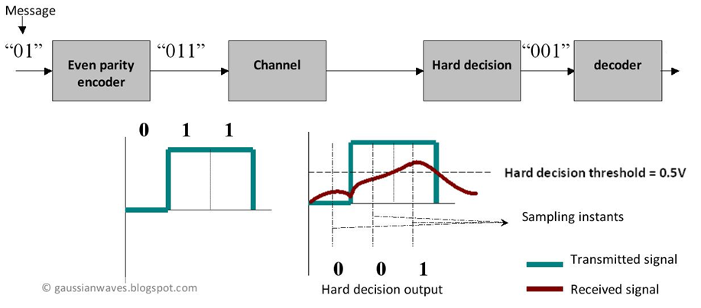
Hard-decision decoding
In hard-decision (or simply “hard”) decoding, the demodulator delivers bits

Slide 14
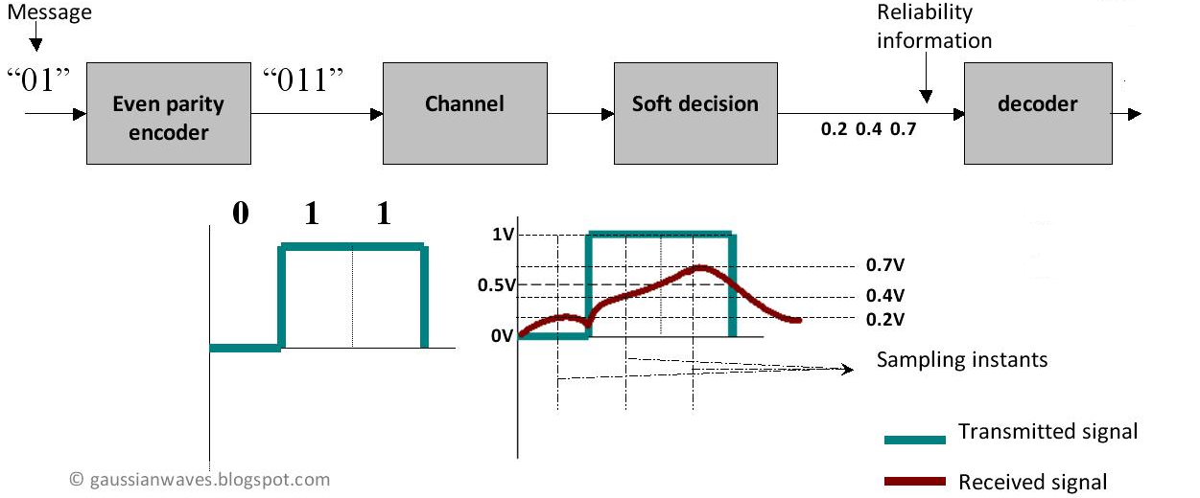
Soft-decision (or “soft”) decoding
Demodulator delivers real “reliability” values
  For simplicity, voltage values are used in the example below, but in practice log-likelihood ratios (LLR) are adopted

Slide 15
On the use of soft or hard-decision
Decoders using soft decisions typically have better performance but are more complex than hard-decision decoders
  Block codes are usually implemented with hard-decision
For convolutional codes, both hard- and soft-decision are equally popular

Slide 16

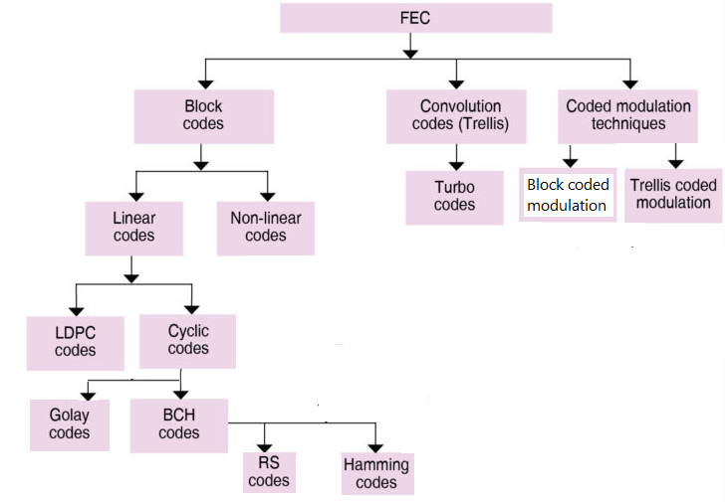
A Simplified Taxonomy of FEC

Slide 17
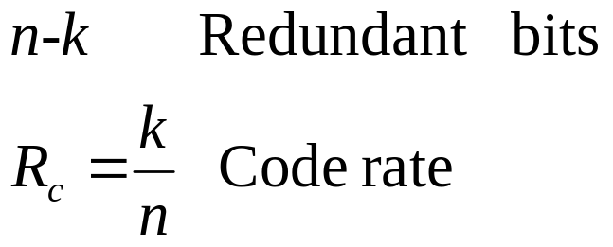
Linear block codes
The information bit stream is chopped into blocks of k bits.
Each block is encoded to a larger block of n bits.
The coded bits are modulated and sent over the channel.
The reverse procedure is done at the receiver.
Channel
encoder
Data block
Codeword
k bits
n bits
Lecture 9

Slide 18

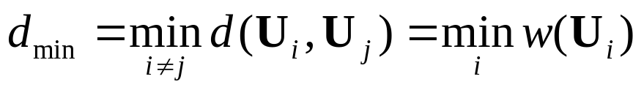
Linear block codes – cont’d
The Hamming weight of the vector U, denoted by w(U), is the number of non-zero elements in U.
The Hamming distance between two vectors U and V, is the number of elements in which they differ.
The minimum distance of a block code is
Reason is: codewords compose a subspace (closure), and the sum of a pair of codewords x,y is another codeword z=x+y, and Hamming distance between x,y is the Hamming weight of z
Lecture 9

Slide 19

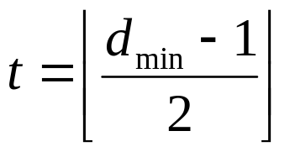
Linear block codes – cont’d
Error detection capability is given by
Error correcting-capability t of a code is defined as the maximum number of guaranteed correctable errors per codeword, that is
Lecture 9

Slide 20

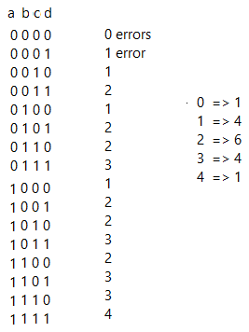
Recall “Combination”
Good review: http://www.mathsisfun.com/combinatorics/combinations-permutations.html
Matlab: nchoosek(['a','b','c','d'],2)
output:
ab
ac
ad
bc
bd
cd
How many n-bits vectors have r errors (bits 1)?

Slide 21
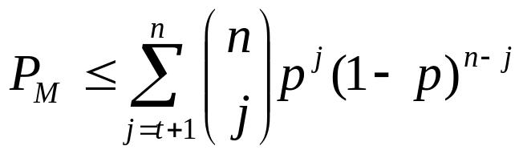

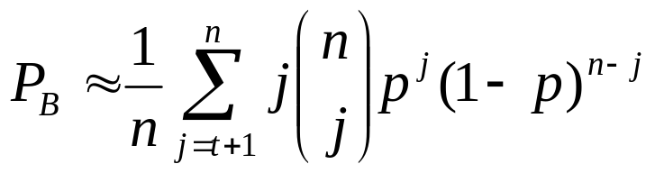
Linear block codes – cont’d
For memory less channels, the probability that the decoder commits an erroneous decoding is
  is the transition probability or bit error probability over channel.
The decoded bit error probability is
Lecture 9
Notes:
http://www.mathsisfun.com/combinatorics/combinations-permutations.html

Slide 22
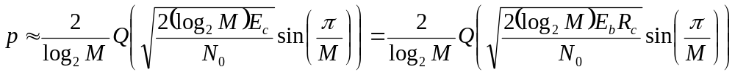


Uncoded vs coded transmission
Note that for coded systems, the coded bits are modulated and transmitted over the channel. For example, for M-PSK modulation on AWGN channels (M>2):
  where is energy per coded bit, given by
Lecture 9

Slide 23
Linear block codes
Let us first review some basic definitions that are useful in understanding Linear block codes.
Lecture 9

Slide 24
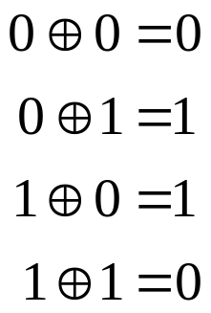
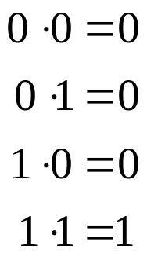
Some definitions
Binary field:
  The set {0,1}, under modulo 2 binary addition and multiplication forms a field.
  Binary field is also called Galois field, GF(2)
  Note in GF(2) that for any vector x, the sum x+x leads to an all-zero vector
Addition
Multiplication
Lecture 9

Slide 25



Some definitions…
Fields:
  Let F be a set of objects on which two operations ‘+’ and ‘.’ are defined.
  F is said to be a field if and only if
    F forms a commutative group under + operation. The additive identity element is labeled “0”.
    F-{0} forms a commutative group under . operation. The multiplicative identity element is labeled “1”.
    The operations “+” and “.” are distributive:
Lecture 9

Slide 26



Some definitions…
Vector space:
  Let V be a set of vectors and F a field of elements called scalars. V forms a vector space over field F if the properties are obeyed:
    1. Commutative:
    2.
    3. Distributive:
    4. Associative:
    5.
Lecture 9

Slide 27

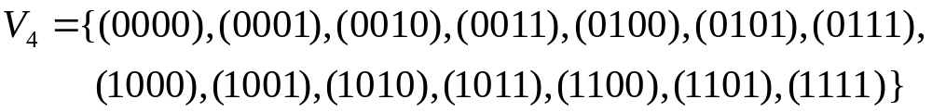
Some definitions…
Example of a vector space
    The set of binary n-tuples, denoted by
Vector subspace:
  A subset S of the vector space is called a subspace if:
    The all-zero vector is in S.
    The sum of any two vectors in S is also in S.
    Example:
Lecture 9

Slide 28
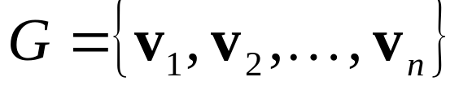
Some definitions…
Spanning set:
  A collection of vectors , is said to be a spanning set for V or to span V if
  linear combinations of the vectors in G include all vectors in the vector space V,
    Example:
Bases:
  The spanning set of V (of basis vectors) that has minimal cardinality is called the bases for V.
    Cardinality of a set is the number of objects in the set.
    Example:
Lecture 9

Slide 29

Linear algebra in GF(2): a warning
Be careful when working in GF(2) and making analogies to real vector spaces:
  Strictly, an inner product is a mapping with 3 properties: bilinear (also called linear), symmetric and positive definitive.
  Inner product spaces are defined over a field of scalars that are real or complex-valued. You can then “order” elements and define a set of “positive” numbers
  But there is no useful notion of positive elements in finite fields and, consequently, of “length”. Example, in GF(2) let us say that 1 is “positive”. Then the sum of two positives 1+1 should also be positive, but it is 0 in GF(2)
  But the “conventional” inner product is still useful in GF(2). It is bilinear and symmetric:
See: http://math.stackexchange.com/questions/1346664/how-to-find-orthogonal-vectors-in-gf2
http://math.stackexchange.com/questions/49348/inner-product-spaces-over-finite-fields
http://everything2.com/title/inner+product
http://math.stackexchange.com/questions/185403/do-there-exist-vector-spaces-over-a-finite-field-that-have-a-dot-product
Notes:
See: http://math.stackexchange.com/questions/1346664/how-to-find-orthogonal-vectors-in-gf2
http://math.stackexchange.com/questions/49348/inner-product-spaces-over-finite-fields
http://everything2.com/title/inner+product
http://math.stackexchange.com/questions/185403/do-there-exist-vector-spaces-over-a-finite-field-that-have-a-dot-product

Slide 30
An issue: “inner product” in GF(2)
The “regular” inner product
is useful but has an issue in GF(2):
  Nonnegativity fails: <x,x> ≥ 0, and 0 iif x=0.
    Example <(1,1); (1,1)> = 1+1 = 0
In summary:
  Inner product spaces are defined over a field which is either R or C, not a finite field.
  GF(2) does not lead to inner product space
  Orthogonality concept is used but Gram-Schmidt procedure does not apply in GF(2)
    Ex: (1100) and (0011) are “orthogonal” to each other, but also “orthogonal” to themselves!

Slide 31
Orthogonality in GF(2)
Similar to what is used for inner product spaces, also in GF(2), orthogonality implies the inner product is zero
  But the geometrical interpretation of “orthogonality” as a generalization of “perpendicular” is not valid!
  For example, note that any vector x with an even number of 1’s will have <x,x>=0. And such vector is not (geometrically) perpendicularity to itself!
  Assume 3-tuples of elements in GF(2). The dimension of the space is 3. Find the subspace orthogonal to (1,1,1). In this case, this subspace has dimension 2 and consists of the elements (0,0,0), (1,1,0), (1,0,1), (0,1,1). There is no pair of these 4 vectors that form an orthogonal basis for the subspace

Slide 32
Recollecting
Vector space: set of binary n-tuples
Vector subspace (closure property):
Spanning set:
Bases (spans and has minimum # basis vectors):
Lecture 9

Slide 33
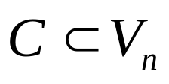

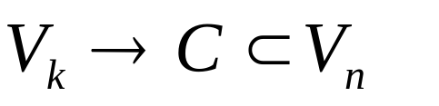
Linear block codes
Linear block code (n,k)‏
  A set with cardinality is called a linear block code if, and only if, it is a subspace of the vector space .
    Members of C are called codewords.
    The all-zero codeword is a codeword.
    Any linear combination of codewords is a codeword.
Lecture 9

Slide 34


Linear block codes – cont’d
mapping
Bases of C
Lecture 9

Slide 35

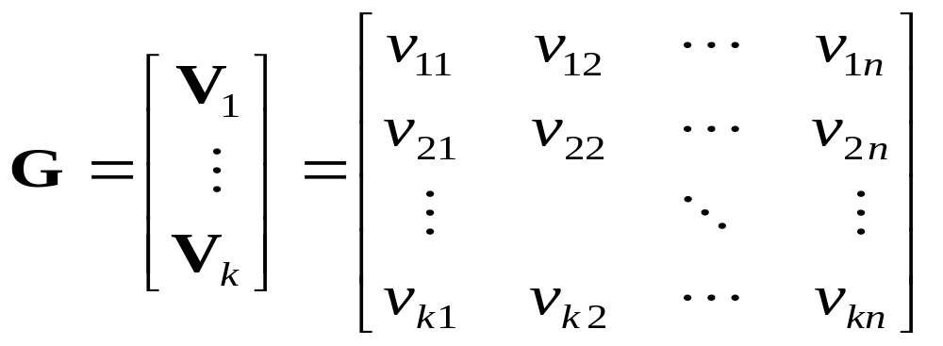
Linear block codes –cont’d
  A matrix G is constructed by taking as its rows the vectors of the basis, .
mapping
Bases of C
Lecture 9

Slide 36

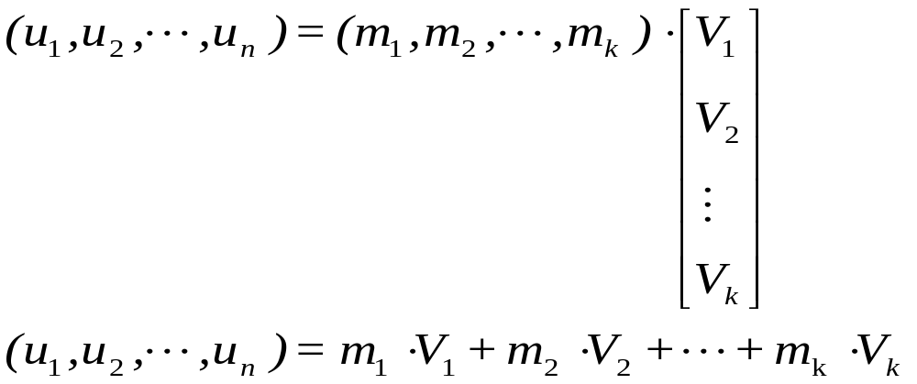
Linear block codes – cont’d
Encoding in (n,k) block code
  The rows of G are linearly independent.
Lecture 9

Slide 37
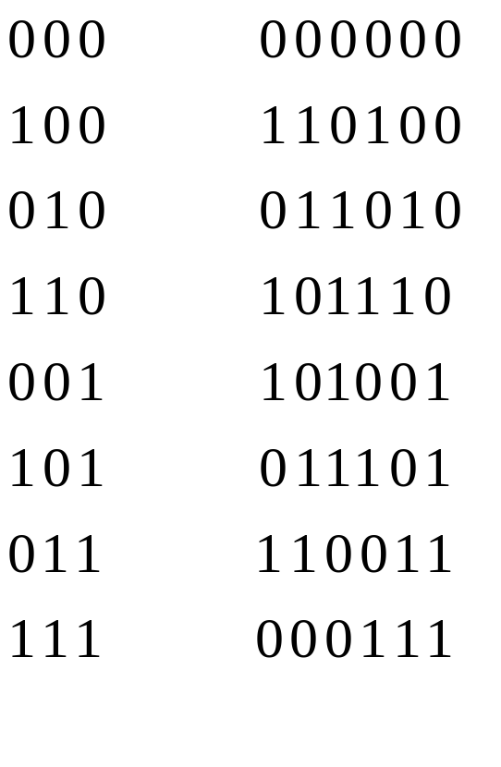
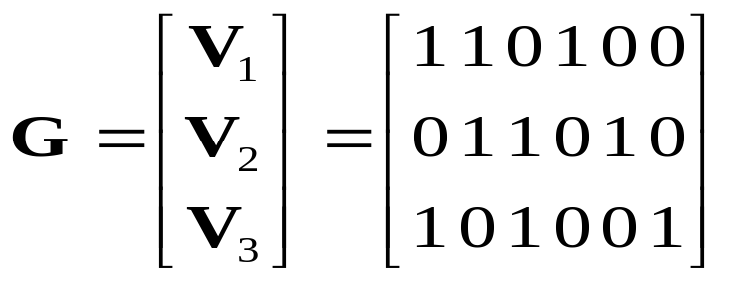
Linear block codes – cont’d
Example: Block code (6,3)‏
Message vector
Codeword
mapping
Bases of C
Lecture 9

Slide 38
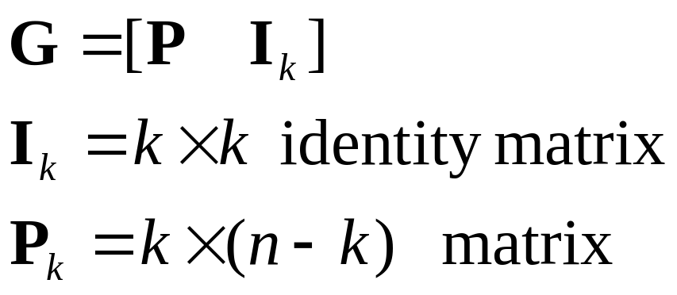
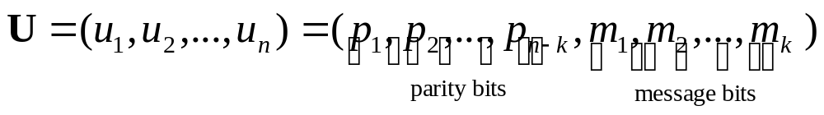
Linear block codes – cont’d
Systematic block code (n,k)‏
  For a systematic code, the first (or last) k elements in the codeword are information bits.
Lecture 9

Slide 39
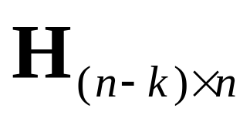

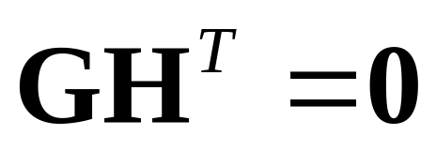
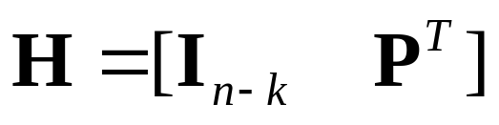
Linear block codes – cont’d
For any linear code we can find a matrix , such that its rows are orthogonal to the rows of :
H is called the parity check matrix and its rows are linearly independent.
For systematic linear block codes:
Lecture 9

Slide 40
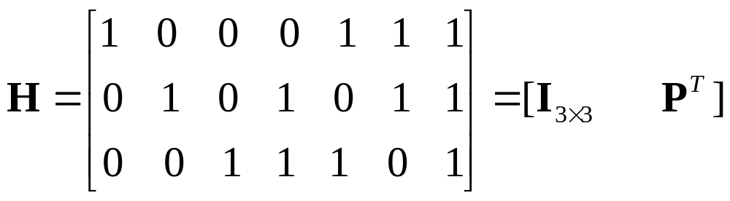
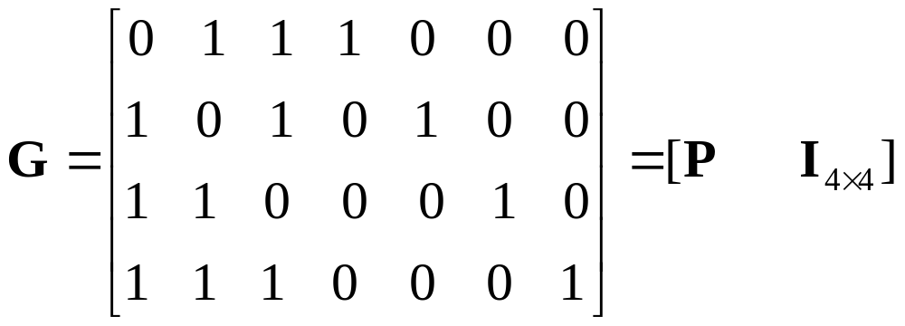
Systematic (Hamming) code (7,4)‏
Lecture 9

Slide 41
Systematic block code (6,3) in Matlab
n=6; %number of bits in codeword
k=3; %number of information bits
Ik=eye(k); %identity matrix of dimension k x k
P=[1 1 0; 0 1 1; 1 0 1];
G=[P Ik];
%% Codeword for specific message
m=[1 1 1];
U=mod(m*G, 2)
%% To find all codewords
messages=de2bi(0:(2^k - 1), k)
U=mod(messages*G, 2)

Slide 42




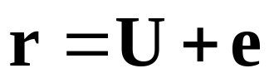
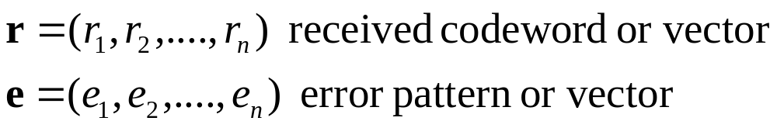

Linear block codes – cont’d
Syndrome testing:
  S is the syndrome of r, corresponding to the error pattern e.
Data source
Format
Channel
encoding
Modulation
channel
Data sink
Format
Channel
decoding
Demodulation
Detection
Lecture 9

Slide 43
Decoding systematic block code (6,3)
n=6; %number of bits in codeword
k=3; %number of information bits
Ik=eye(k); %identity matrix of dimension k x k
P=[1 1 0; 0 1 1; 1 0 1];
G=[P Ik];
%% Decode received codeword
Ink=eye(n-k); %identity matrix (n-k) x (n-k)
H=[Ink transpose(P)];
r=[0 0 1 1 1 0];
S=mod(r*transpose(H),2)
S=[1 0 0]

Slide 44
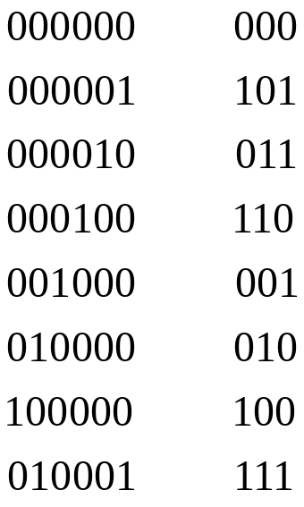
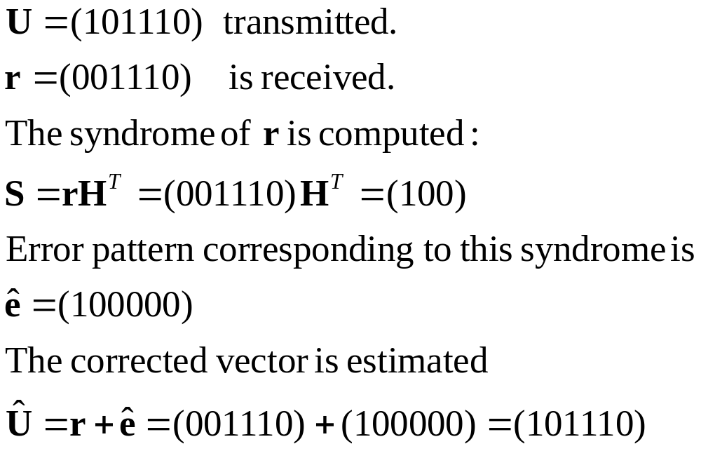
Linear block codes – cont’d
Example 6.4 in Sklar’s textbook
Error pattern
Syndrome
Lecture 9

Slide 45
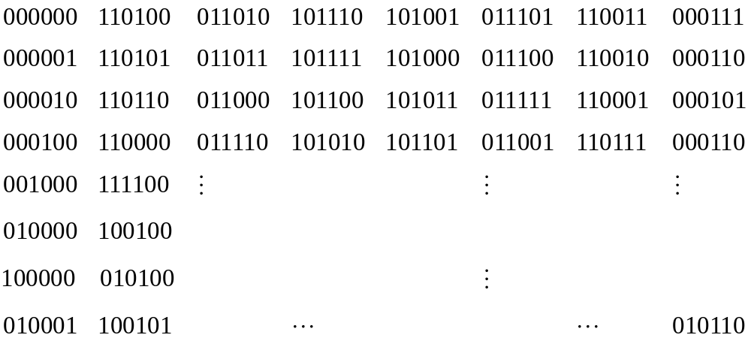
Linear block codes – cont’d
Example: Standard array for the (6,3) code
codewords
coset
Coset leaders
Lecture 9

Slide 46



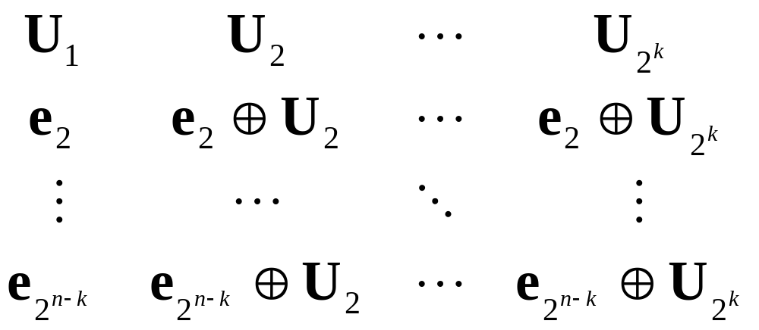
Linear block codes – cont’d
Standard array
  For row find a vector in of minimum weight that is not already listed in the array.
  Call this pattern and form the row as the corresponding coset
zero
codeword
coset
coset leaders
Lecture 9

Slide 47




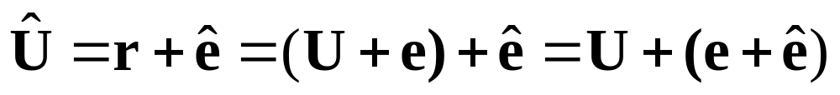


Linear block codes – cont’d
Standard array and syndrome table decoding
  Calculate
  Find the coset leader, , corresponding to .
  Calculate and the corresponding .
  Note that
    If , the error is corrected.
    If , undetectable decoding error occurs.
Lecture 9

Slide 48
Linear block codes – cont’d
Example: Standard array for the (6,3) code
codewords
coset
Coset leaders
Lecture 9

Slide 49
Linear block codes – cont’d
Error pattern
Syndrome
Lecture 9

Slide 50

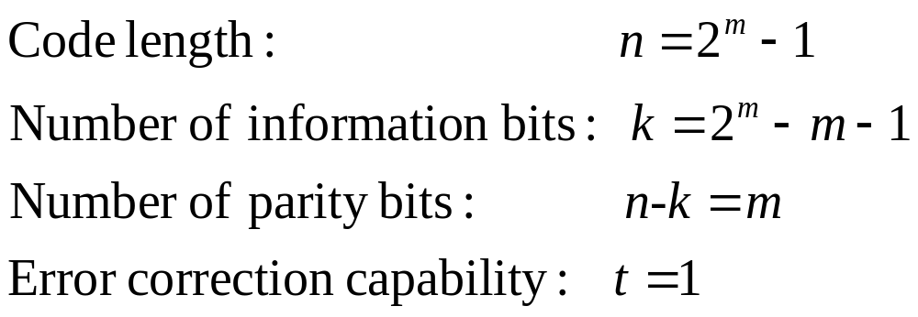
Hamming codes
Hamming codes
  Hamming codes are a subclass of linear block codes and belong to the category of perfect codes.
  Hamming codes are expressed as a function of a single integer .
  The columns of the parity-check matrix, H, consist of all non-zero binary m-tuples.
Lecture 9

Slide 51
Hamming codes
Example: Systematic Hamming code (7,4)‏
Lecture 9

Slide 52
Cyclic block codes
Cyclic codes are a subclass of linear block codes.
Encoding and syndrome calculation are easily performed using feedback shift-registers.
  Hence, relatively long block codes can be implemented with a reasonable complexity.
BCH and Reed-Solomon codes are cyclic codes.
Lecture 9

Slide 53
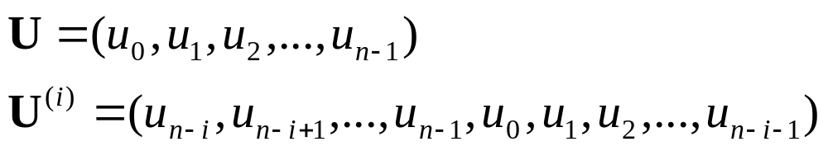
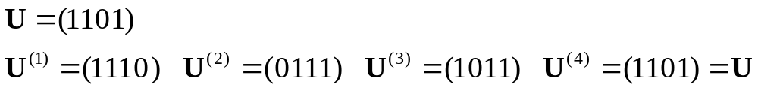
Cyclic block codes
A linear (n,k) code is called a Cyclic code if all cyclic shifts of a codeword are also codewords.
  Example:
“i” cyclic shifts of U
Lecture 9

Slide 54
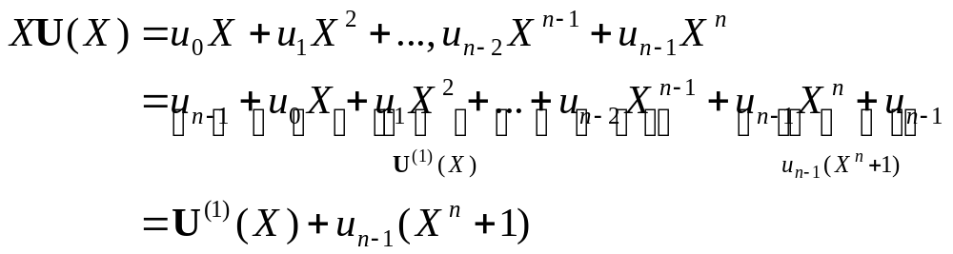


Cyclic block codes
Algebraic structure of Cyclic codes, implies expressing codewords in polynomial form
Relationship between a codeword and its cyclic shifts:
  Hence:
By extension
Lecture 9

Slide 55


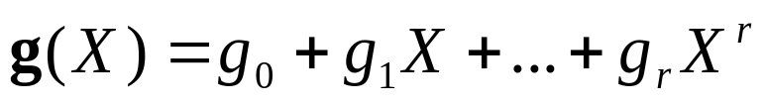



Cyclic block codes
Basic properties of Cyclic codes:
  Let C be a binary (n,k) linear cyclic code
    Within the set of code polynomials in C, there is a unique monic polynomial with minimal degree is called the generator polynomial.
    Every code polynomial in C can be expressed uniquely as
    The generator polynomial is a factor of
Lecture 9

Slide 56
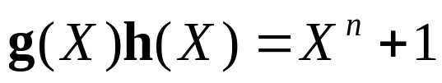



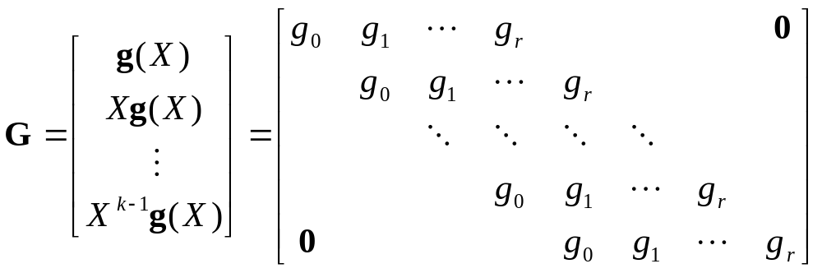
Cyclic block codes
    The orthogonality of G and H in polynomial form is expressed as . This means is also a factor of
    The row , of the generator matrix is formed by the coefficients of the cyclic shift of the generator polynomial.
Lecture 9

Slide 57



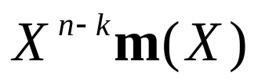
Cyclic block codes
Systematic encoding algorithm for an (n,k) Cyclic code:
  Multiply the message polynomial by
  Divide the result of Step 1 by the generator polynomial . Let be the reminder.
  Add to to form the codeword
Lecture 9

Slide 58


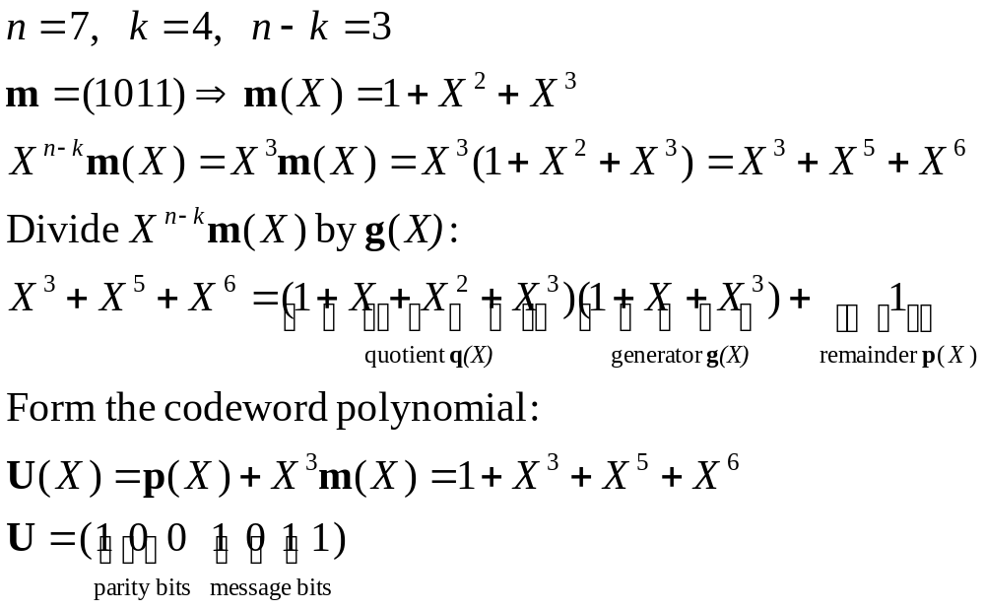
Cyclic block codes
Example: For the systematic (7,4) Cyclic code with generator polynomial
  Find the codeword for the message
Lecture 9

Slide 59
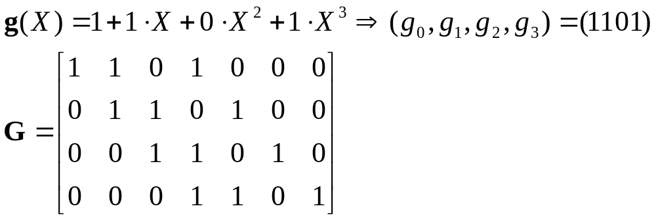
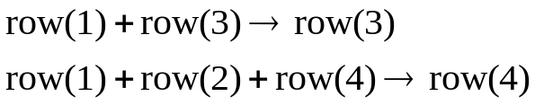
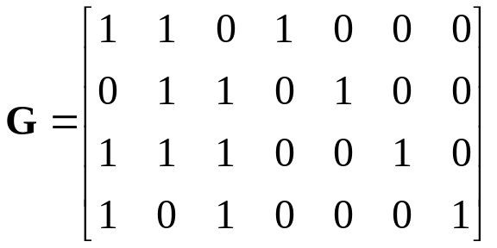
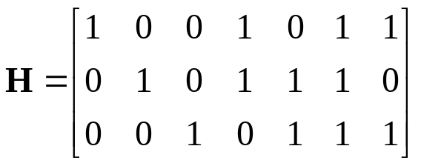




Cyclic block codes
  Find the generator and parity check matrices, G and H, respectively.
Not in systematic form.
We do the following:
Lecture 9

Slide 60


Cyclic block codes
Syndrome decoding for Cyclic codes:
  Received codeword in polynomial form is given by
  The syndrome is the remainder obtained by dividing the received polynomial by the generator polynomial.
  With syndrome and Standard array, the error is estimated.
    In Cyclic codes, the size of standard array is considerably reduced.
Received codeword
Error pattern
Syndrome
Lecture 9

Slide 61



Example of the block codes
8PSK
QPSK
Lecture 9

