Slide 1





QSFP loopback with UART

Slide 2
Concept
The design is built using the PolarFire SoC high-speed transceiver block and the LiteFast IP core. It operates in loopback mode, because the TX and RX transceiver lanes are manually looped back on the board.
Data is transmitted via UART, processed by the LiteFast IP core, sent through the transceiver and QSFP port, looped back, and then returned via LiteFast and UART to the console.
The project supports two UART data transmission modes:
- simulation-based
- FPGA-based
In both modes, the received data is identical.
<number>2

Slide 3
UART Communication in Simulation
In this mode, communication is performed via a Pseudo-Terminal (PTY). This is possible thanks to a C implementation that creates a PTY handle, and implements read and write operations on it. The testbench interfaces with these C functions using DPI.
<number>2

Slide 4
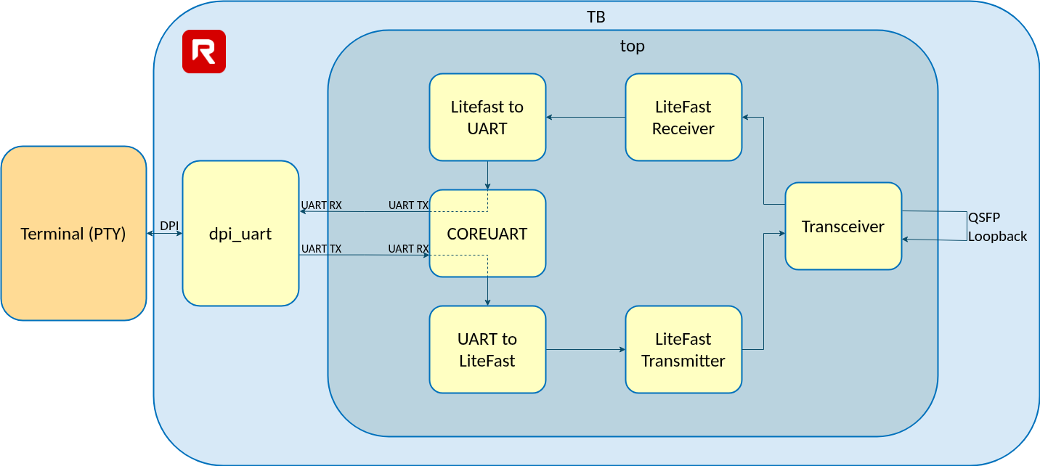
UART Communication in Simulation
9

Slide 5
UART Communication in FPGA
In this mode, communication is performed using a standard terminal via the available UART ports on the board. The QSFP ports must be connected in loopback.
The project is implemented on the TySOM-M-MPFS250 development board, which is equipped with a PolarFire SoC device.
https://www.aldec.com/en/products/emulation/tysom_boards/polarfire_microchip/tysom_m_mpfs250
<number>2

Slide 6
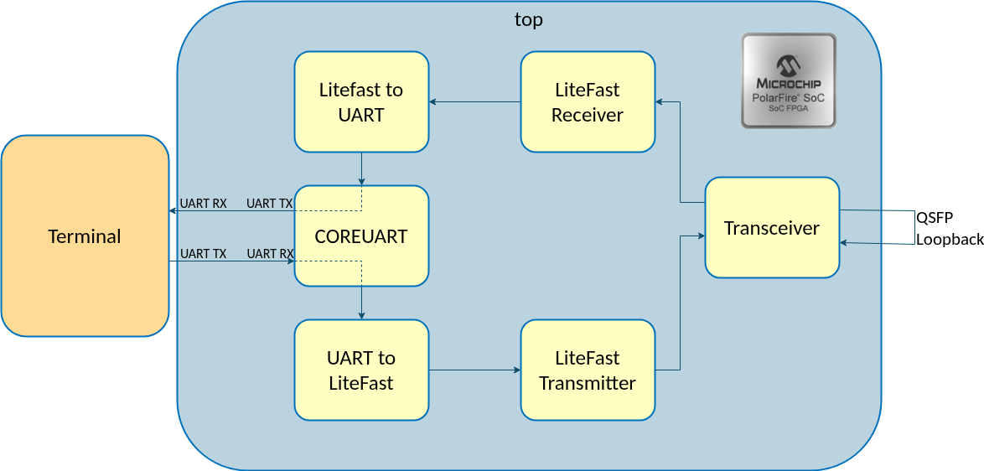
UART Communication in FPGA
9

Slide 7

Solutions
Riviera-PRO™
Advanced Verification Platform
Active-HDL™
FPGA Design and Simulation
ALINT-PRO™
Design Rule Checking
HES-DVM™
HW/SW Validation Platform
TySOM™
High Performance Embedded Development
DO-254/CTS™
FPGA Level In-Target Testing
HES™
SoC/ASIC Prototyping
RTAX/RTSX
Prototyping Microchip™ Rad-Tolerant Devices
Corp. Headquarters
2260 Corporate Circle , Suite 400
Henderson, NV 89074
Ph +1.702.852.4000
Fax +1.702.990.4414
sales@aldec.com
Training https://www.aldec.com/training
Support https://www.aldec.com/support
Blog https://www.aldec.com/company/blog

