Slide 1
Module 1
Introduction to version control with Git
Notes:
20762C
1: An Introduction to Database Development

Slide 2
Module Overview
Learn what version control is Understand distributed version control systems, like Git
Recognize the differences between Git and GitHub and the roles they play in the software development lifecycle.
Notes:
20762C
1: An Introduction to Database Development

Slide 3
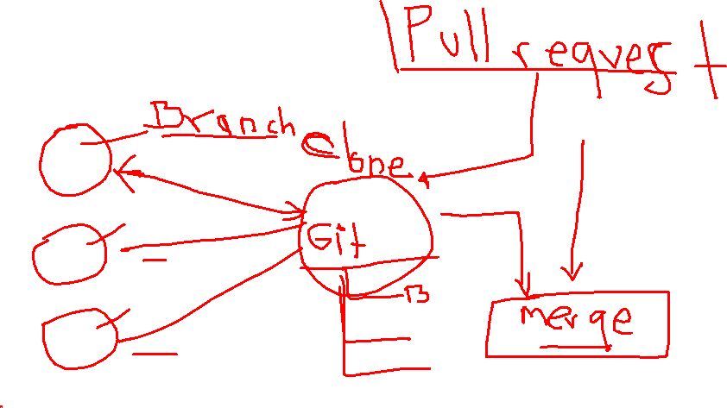
Lesson 1:What is version control?
Distributed version control Git terminology The Git command line Git and GitHub.
Notes:
20762C
1: An Introduction to Database Development

Slide 4
What is version control?
A version control system (VCS) is a program or set of programs that tracks changes to a collection of files.
One goal of a VCS is to easily recall earlier versions of individual files or of the entire project.
With a VCS, you can:
See all the changes made to your project, when the changes were made, and who made them.
Include a message with each change to explain the reasoning behind it.
Retrieve past versions of the entire project or of individual files.
Create branches, where changes can be made experimentally. This feature allows several different sets of changes (for example, features or bug fixes) to be worked on at the same time, possibly by different people, without affecting the main branch. Later, you can merge the changes you want to keep back into the main branch.
Attach a tag to a version—for example, to mark a new release.
Notes:
20762C
1: An Introduction to Database Development

Slide 5
Distributed version control
Git is distributed, which means that a project's complete history is stored both on the client and on the server. You can edit files without a network connection, check them in locally, and sync with the server when a connection becomes available. If a server goes down, you still have a local copy of the project. Technically, you don't even have to have a server. Changes could be passed around in e-mail or shared by using removable media, but no one uses Git this way in practice.
Notes:
20762C
1: An Introduction to Database Development

Slide 6

Git terminology
Working tree
Repository (repo)
Hash
Object
Commit
Branch
Remote
Commands, subcommands, and options
Notes:
20762C
1: An Introduction to Database Development

Slide 7
The Git command line
Several different GUIs are available for Git, including GitHub Desktop.
Notes:
20762C
1: An Introduction to Database Development

Slide 8

Git and GitHub
Several different GUIs are available for Git, including GitHub Desktop.
GitHub is a cloud platform that uses Git as its core technology. GitHub simplifies the process of collaborating on projects and provides a website.
Key features provided by GitHub include:
Issues
Discussions
Pull requests
Notifications
Labels
Actions
Forks
Projects
Notes:
Categorize Activity
Place each item into the appropriate category. Indicate your answer by writing the category number to the right of each item.
Component
(1)Database Engine
(2)Master Data Services
(3)Replication
(4)Integration Services
Tool
(1)Data Quality Services Client
(2)Connectivity
(3)Profiler
(4)SQL Server Management Studio
(5)SQL Server Data Tools
Edition
(1)Enterprise
(2)Developer
(3)Web
(4)Standard
20762C
1: An Introduction to Database Development

Slide 9
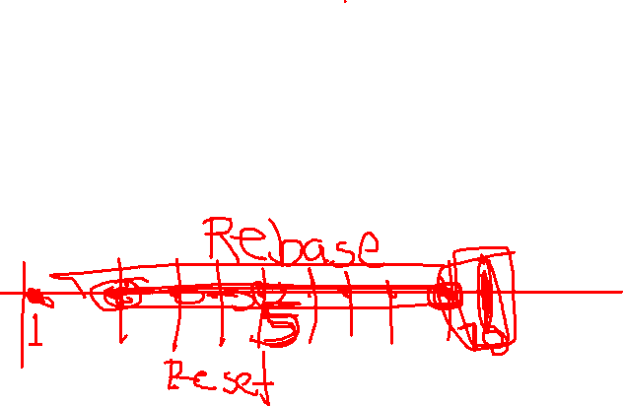
Lesson 2: Basic Git commands
git status: displays the state of the working tree git add: is the command you use to tell Git to start keeping track of changes in certain files git commit: After you've staged some changes for commit, you can save your work to a snapshot.
git log: allows you to see information about previous commits.
git help: for example: git commit –help
Notes:
20762C
1: An Introduction to Database Development

Slide 10

Knowledge check
What’s the difference between Git and GitHub?
Git lets you work with one or more local branches and push changes to a remote repository. GitHub acts as the remote repository, which is accessed through a website or command-line tools.
Git is a distributed version control system (DVCS) that runs in the cloud. GitHub is an interface layer that provides access to Git technology.
Git is used by an individual contributor. GitHub is used by multiple contributors to simplify group development work.
Notes:
20762C
1: An Introduction to Database Development

Slide 11
Lesson 2:How to create and modify a Git project
Learn how to create a new Git Project
Understand how to track changes in Git
Know how to fix simple mistakes in Git
Recover deleted files in Git
Notes:
SQL Operations Studio is in public preview at time of writing.
20762C
1: An Introduction to Database Development

Slide 12
Exercise - Start a project
Learn how to create a new Git Project
Understand how to track changes in Git
Know how to fix simple mistakes in Git
Recover deleted files in Git
Notes:
SQL Operations Studio is in public preview at time of writing.
20762C
1: An Introduction to Database Development

Slide 13
Exercise - Make changes and track them with Git
Most development projects are iterative. You write some code, and then you test the code and make sure it works. Then, you write more code and invite other people to contribute code. Iteration means many changes: code additions, bug fixes, deletions, and replacements.
As you work on your project, Git helps keep track of the changes you make. It also lets you undo mistakes. In the next exercises, you continue building out the website you're working on and learn some important new commands, like git diff.
Notes:
SQL Operations Studio is in public preview at time of writing.
20762C
1: An Introduction to Database Development

Slide 14
Exercise -Fix simple mistakes
Sometimes, things go wrong. You might forget to add a new file, or maybe you add a file by mistake. Perhaps you made a spelling error in your latest commit or you committed something you didn't intend to. Perhaps you accidentally deleted a file.
Git lets you make changes fearlessly, because it always offers a way to get back to where you were. You can even change Git's commit history as long as you only change commits that haven't been shared.
Notes:
SQL Operations Studio is in public preview at time of writing.
20762C
1: An Introduction to Database Development

Slide 15
Exercise -Fix simple mistakes
Sometimes, things go wrong. You might forget to add a new file, or maybe you add a file by mistake. Perhaps you made a spelling error in your latest commit or you committed something you didn't intend to. Perhaps you accidentally deleted a file.
Git lets you make changes fearlessly, because it always offers a way to get back to where you were. You can even change Git's commit history as long as you only change commits that haven't been shared.
Notes:
SQL Operations Studio is in public preview at time of writing.
20762C
1: An Introduction to Database Development

Slide 16
Exercise -Use Git to fix mistakes
Now, let's get some hands-on practice fixing our mistakes!
Notes:
SQL Operations Studio is in public preview at time of writing.
20762C
1: An Introduction to Database Development

Slide 17
Knowledge Check
What does the -m tag do to your commit?
The -m tag isn't a valid tag in git
The tag modifies your commit if you forgot to add something
This tag allows you to add a message to your commit
Notes:
SQL Operations Studio is in public preview at time of writing.
20762C
1: An Introduction to Database Development

Slide 18
Notes:
In the Save File As dialog box, navigate to D:\Demofiles\Mod01, and then click Save. Note that this saves the query to a file.
On the Results tab, right-click the cell for ProductID 1 (first row and first cell), and then click Save Results As.
In the Save Grid Results dialog box, navigate to the D:\Demofiles\Mod01 folder.
In the File name box, type Demonstration2AResults, and then click Save. Note that this saves the query results to a file.
On the Query menu, click Display Estimated Execution Plan. Note that SSMS can do more than just execute queries.
On the Tools menu, click Options.
In the Options dialog box, expand Query Results, expand SQL Server, and then click General. Review the available configuration options, and then click Cancel.
On the File menu, click Close.
Open a SQL Server Management Studio Project
On the File menu, point to Open, and then click Project/Solution.
In the Open Project dialog box, open the D:\Demofiles\Mod01\Demo01.ssmssln project.
In Solution Explorer, note the contents of Solution Explorer, and that by using a project or solution you can save the state of the IDE. This means that any open connections, query windows, or Solution Explorer panes will reopen in the state they were saved in.
On the File menu, click Close Solution.
(More notes on the next slide)
20762C
1: An Introduction to Database Development

Slide 19
Notes:
Connect to Servers and Databases
In Object Explorer, click Connect and note the other SQL Server components to which connections can be made.
On the File menu, point to New, and then click Database Engine Query to open a new connection.
In the Connect to Database Engine dialog box, in the Server name box, type MIA-SQL.
In the Authentication drop-down list, select Windows Authentication, and then click Connect.
In the Available Databases drop-down list on the toolbar, click tempdb. Note that this changes the database against which the query is executed.
Right-click in the query window, point to Connection, and then click Change Connection. This will reconnect the query to another instance of SQL Server.
In the Connect to Database Engine dialog box, click Cancel.
Close SSMS.
Use SSDT to Run a Transact-SQL Script
On the taskbar, click Visual Studio 2015.
On the Tools menu, click Connect to Database.
In the Choose Data Source dialog box, in the Data source list, click Microsoft SQL Server, and then click Continue.
In the Add Connection dialog box, in the Server name box, type MIA-SQL.
In the Select or enter a database name drop-down list, click AdventureWorks, and then click OK.
In Server Explorer, expand Data Connections.
Right-click mia-sql.AdventureWorks.dbo, and then click New Query.
In the SQLQuery1.sql pane, type:
SELECT * FROM Production.Product ORDER BY ProductID;
On the toolbar, click Execute.
(More notes on the next slide)
20762C
1: An Introduction to Database Development

Slide 20
Notes:
Note that you can view results, just as you can in SSMS.
Close Visual Studio 2015 without saving any changes.
Question
Which one of the following tools can you use to create and deploy SSIS packages?
( )Option 1: SQL Server Management Studio.
( )Option 2: SQL Server Profiler.
( )Option 3: Database Engine Tuning Advisor.
( )Option 4: SQL Server Data Tools.
( )Option 5: SQL Server Configuration Manager.
Answer
(√) Option 4: SQL Server Data Tools.
20762C
1: An Introduction to Database Development

Slide 21
Module Review and Takeaways
Review Question(s)
Notes:
Review Question(s)
Question
Which IDE do you think you will use to develop on SQL Server, SSMS or SSDT?
Answer
Answers will vary, depending on which tools students feel most comfortable using. Developers can manage and develop SQL code with both tools.
20762C
1: An Introduction to Database Development

