Slide 1
Azure KB Agent Architecture
PDF/PPTX Conversion Quality Spike
March 2026
Notes:
Welcome to the architecture overview for the Azure KB Agent. This presentation covers the key components, deployment strategy, and performance characteristics of the system. IMPORTANT: Mention that we use managed identity everywhere — no secrets in code.

Slide 2
System Components
Core Services
Azure AI Search — hybrid vector + keyword retrieval
Azure OpenAI — GPT-4.1 for generation and vision
Azure Blob Storage — KB article staging and serving
Azure Container Apps — serverless hosting
Azure Cosmos DB — conversation memory
Documentation: Azure AI Search docs
Notes:
Emphasize that all services communicate via managed identity. No connection strings or API keys are stored in application code. The Container Apps use DefaultAzureCredential for authentication. Cosmos DB uses native RBAC with Built-in Data Contributor role.

Slide 3
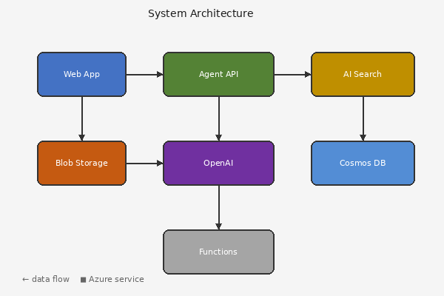
Architecture Diagram
Notes:
This diagram shows the data flow from HTML ingestion through conversion (MarkItDown), indexing (AI Search), to the agent query path. Key point: the conversion pipeline supports three backends — Content Understanding, Mistral Document AI, and MarkItDown.

Slide 4
Conversion Backend Comparison
Backend | API Calls | Image Handling | Cost
Content Understanding | CU API | CU Analyzer | CU + GPT-4.1
Mistral Document AI | Mistral OCR | GPT-4.1 Vision | Mistral + GPT-4.1
MarkItDown | None (local) | GPT-4.1 Vision | GPT-4.1 only
MarkItDown + PDF | TBD | TBD | TBD
Notes:
The MarkItDown backend is the most cost-effective option. The PDF row is for this spike — we are evaluating whether MarkItDown can handle PDF input directly with acceptable quality.

Slide 5
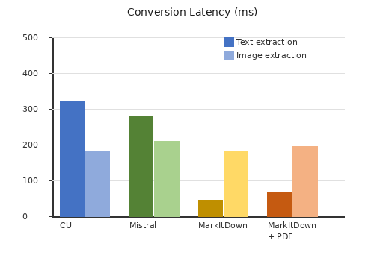
Performance Results
Notes:
Performance chart shows that MarkItDown is 10x faster than cloud-based alternatives for text extraction. Image description time is the same across all backends since they all use GPT-4.1 vision.

Slide 6

Photo Extraction Test
Notes:
This slide tests extraction of a photo-like image with complex color gradients and organic shapes. The image simulates a landscape photograph to verify that color fidelity and detail are preserved during extraction.

Slide 7
Azure Resource Inventory (Long Table)
# | Resource Name | Type | Region | Status | Monthly Cost
1 | kb-agent-container-app-01 | Container App | East US 2 | Running | $45.00
2 | kb-agent-cosmos-db-02 | Cosmos DB | West US 3 | Provisioned | $120.50
3 | kb-agent-ai-search-03 | AI Search | Central US | Scaling | $89.99
4 | kb-agent-openai-04 | OpenAI | North Europe | Updating | $210.00
5 | kb-agent-blob-storage-05 | Blob Storage | West Europe | Healthy | $15.75
6 | kb-agent-key-vault-06 | Key Vault | East US 2 | Running | $32.40
7 | kb-agent-app-insights-07 | App Insights | West US 3 | Provisioned | $8.50
8 | kb-agent-log-analytics-08 | Log Analytics | Central US | Scaling | $55.20
9 | kb-agent-container-registry-09 | Container Registry | North Europe | Updating | $178.00
10 | kb-agent-virtual-network-10 | Virtual Network | West Europe | Healthy | $0.00
11 | kb-agent-container-app-11 | Container App | East US 2 | Running | $45.00
12 | kb-agent-cosmos-db-12 | Cosmos DB | West US 3 | Provisioned | $120.50
13 | kb-agent-ai-search-13 | AI Search | Central US | Scaling | $89.99
14 | kb-agent-openai-14 | OpenAI | North Europe | Updating | $210.00
15 | kb-agent-blob-storage-15 | Blob Storage | West Europe | Healthy | $15.75
16 | kb-agent-key-vault-16 | Key Vault | East US 2 | Running | $32.40
17 | kb-agent-app-insights-17 | App Insights | West US 3 | Provisioned | $8.50
18 | kb-agent-log-analytics-18 | Log Analytics | Central US | Scaling | $55.20
19 | kb-agent-container-registry-19 | Container Registry | North Europe | Updating | $178.00
20 | kb-agent-virtual-network-20 | Virtual Network | West Europe | Healthy | $0.00
21 | kb-agent-container-app-21 | Container App | East US 2 | Running | $45.00
22 | kb-agent-cosmos-db-22 | Cosmos DB | West US 3 | Provisioned | $120.50
23 | kb-agent-ai-search-23 | AI Search | Central US | Scaling | $89.99
24 | kb-agent-openai-24 | OpenAI | North Europe | Updating | $210.00
25 | kb-agent-blob-storage-25 | Blob Storage | West Europe | Healthy | $15.75
26 | kb-agent-key-vault-26 | Key Vault | East US 2 | Running | $32.40
27 | kb-agent-app-insights-27 | App Insights | West US 3 | Provisioned | $8.50
28 | kb-agent-log-analytics-28 | Log Analytics | Central US | Scaling | $55.20
29 | kb-agent-container-registry-29 | Container Registry | North Europe | Updating | $178.00
30 | kb-agent-virtual-network-30 | Virtual Network | West Europe | Healthy | $0.00
Notes:
This table has 30 data rows plus a header to test whether the converter handles large tables that might overflow a single slide. In a real presentation this table would typically be split across slides.

Slide 8
References & Links
Key Resources
Azure AI Search documentation
Azure OpenAI Service
MarkItDown on GitHub
Azure Container Apps
Bicep documentation
Notes:
Share these links with the team for further reading. The MarkItDown repository is the most relevant for this spike.

