Slide 1

Baldwin Museum

Slide 2
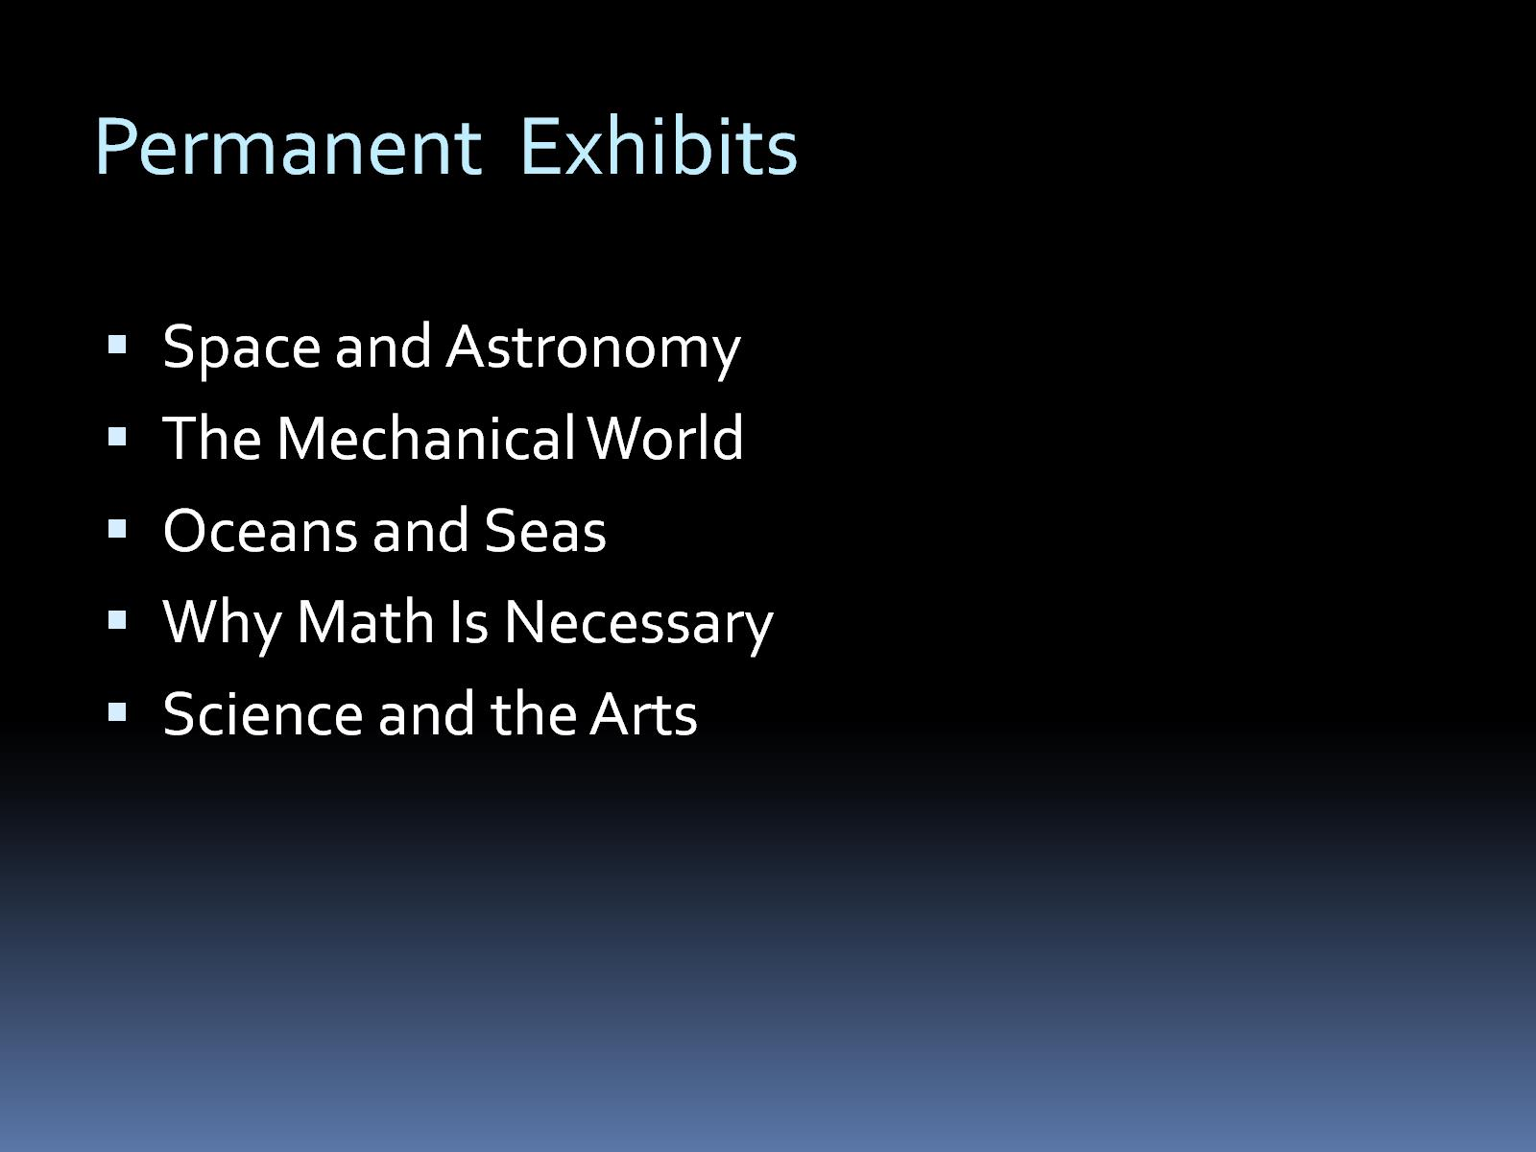
Permanent Exhibits

Slide 3
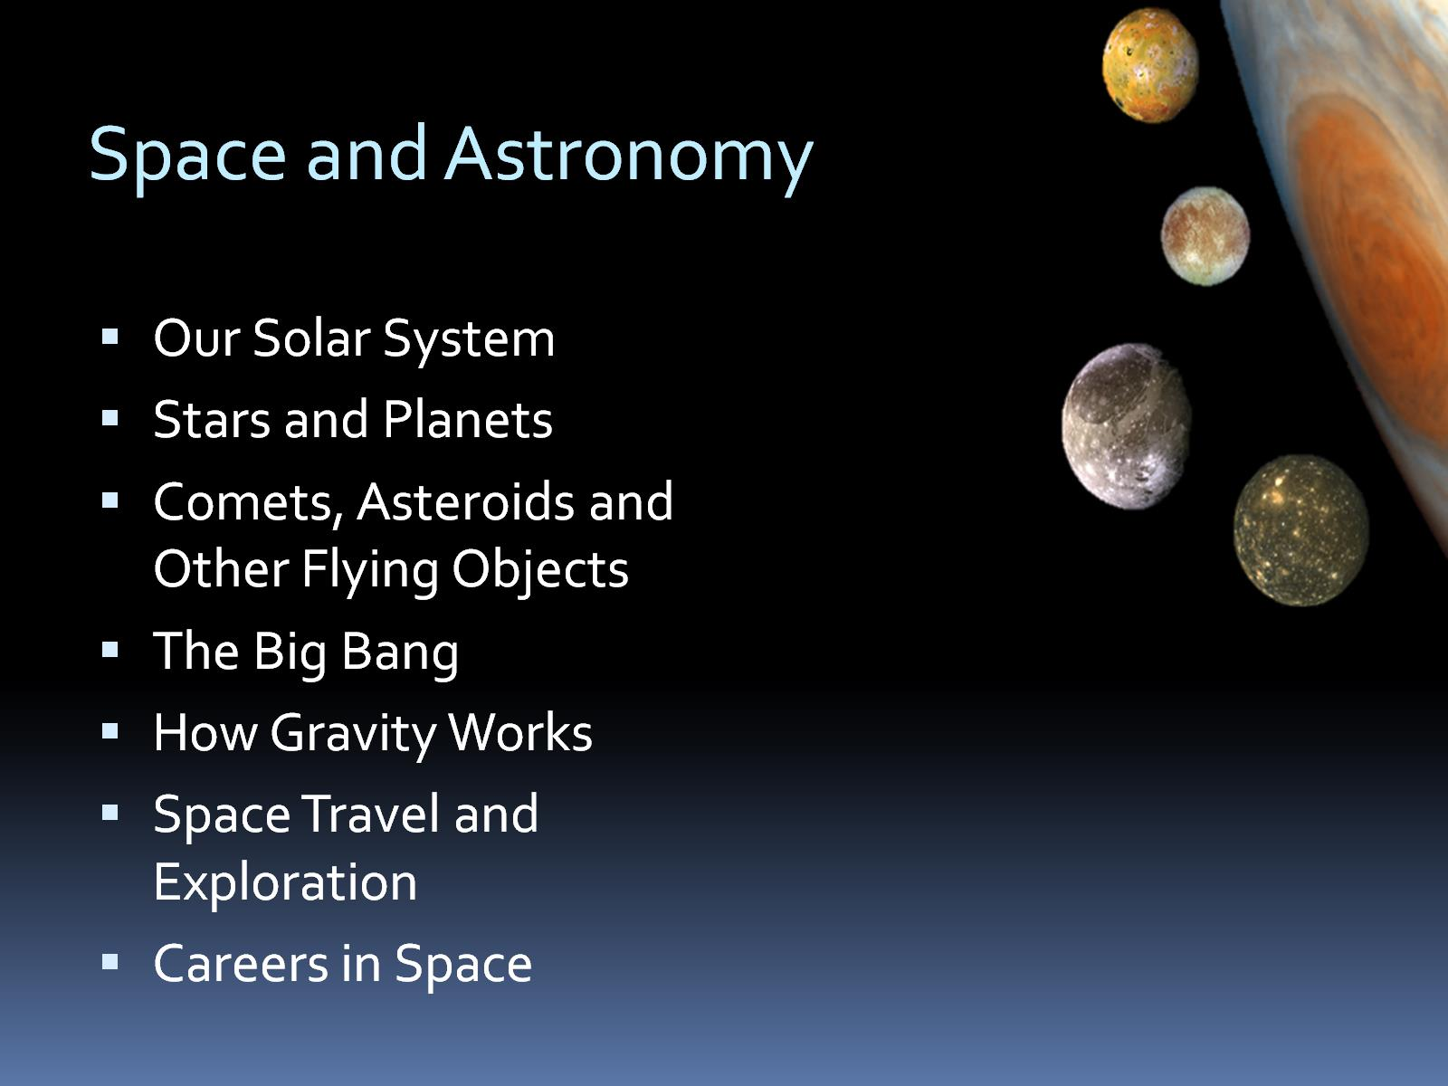
Space and Astronomy

Slide 4
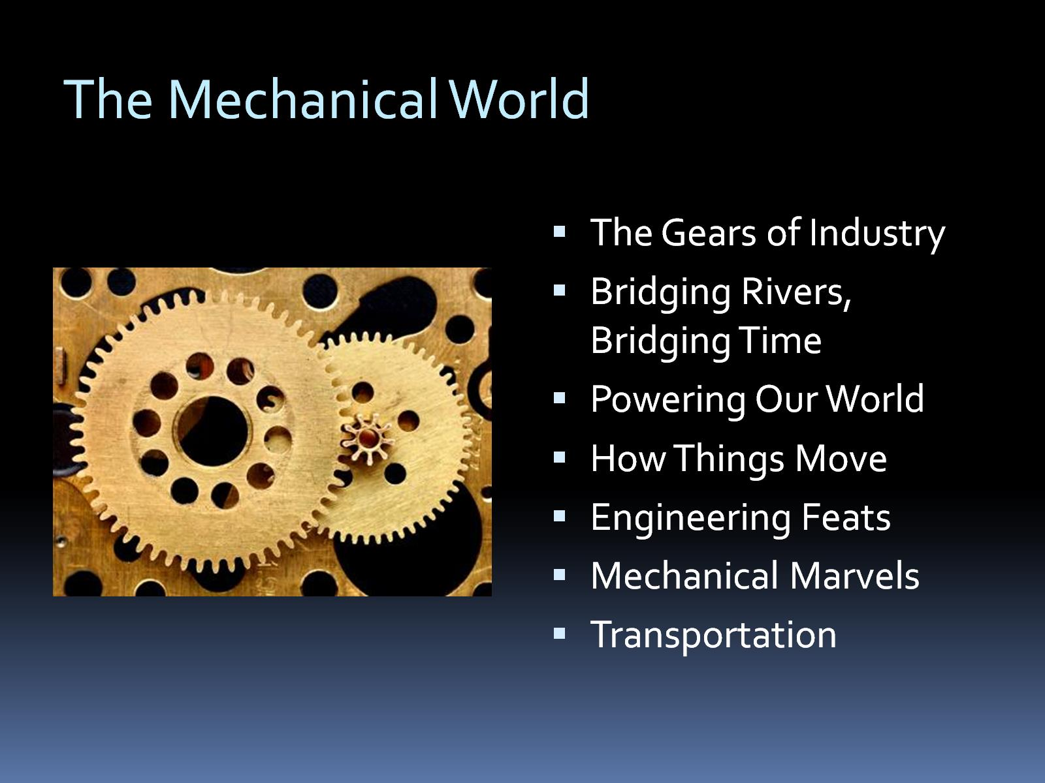
The Mechanical World

Slide 5
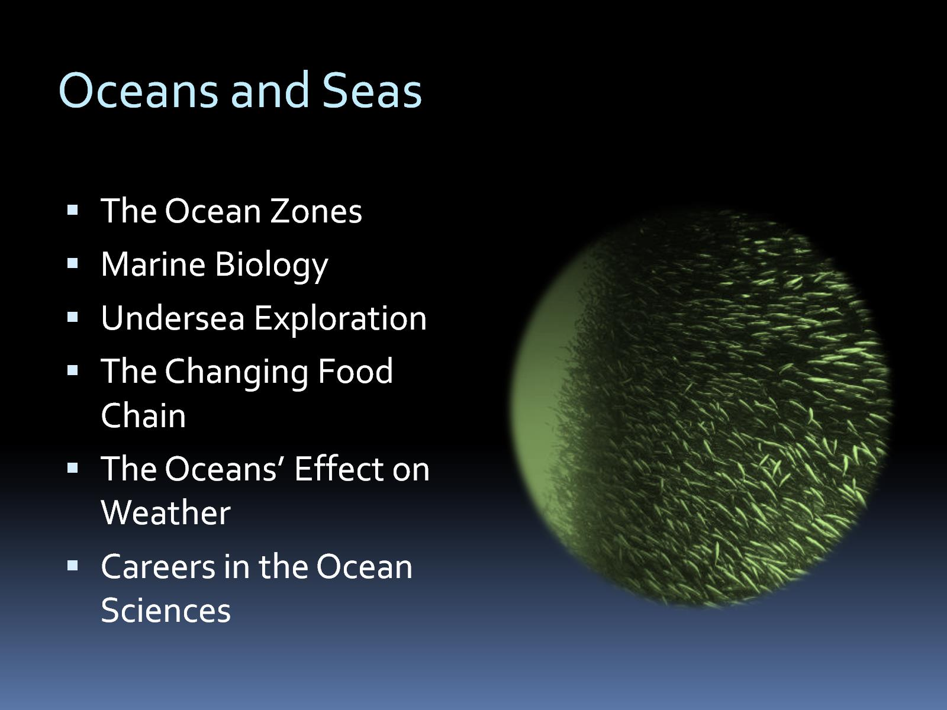
Oceans and Seas

Slide 6
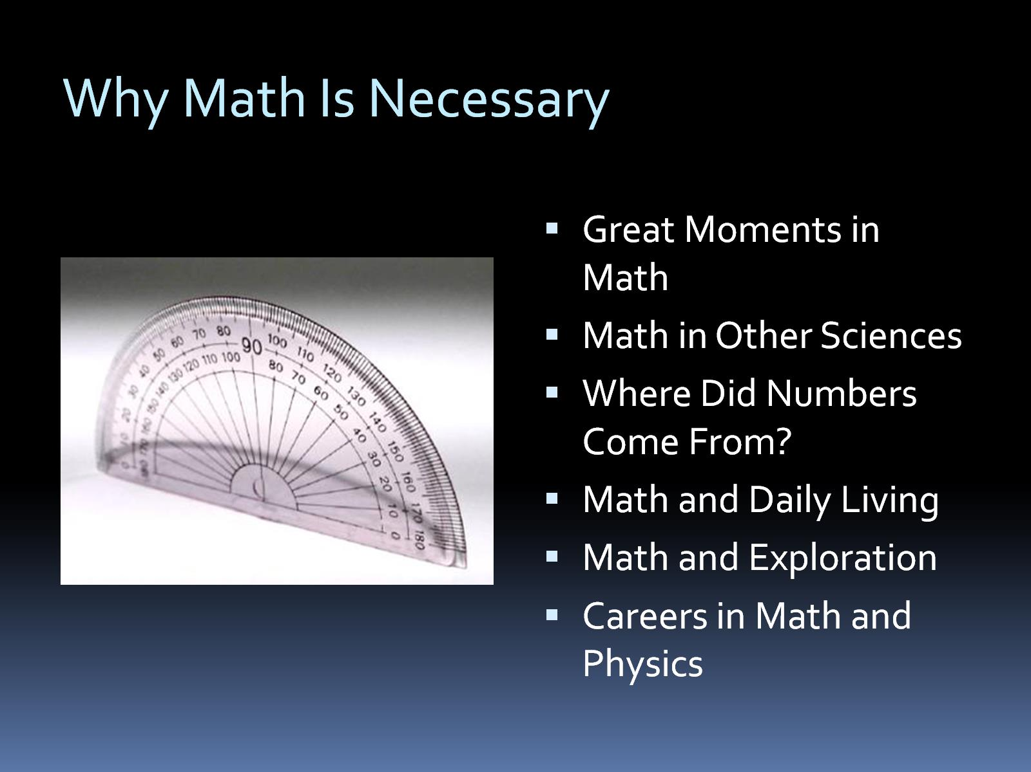
Why Math Is Necessary

Slide 7
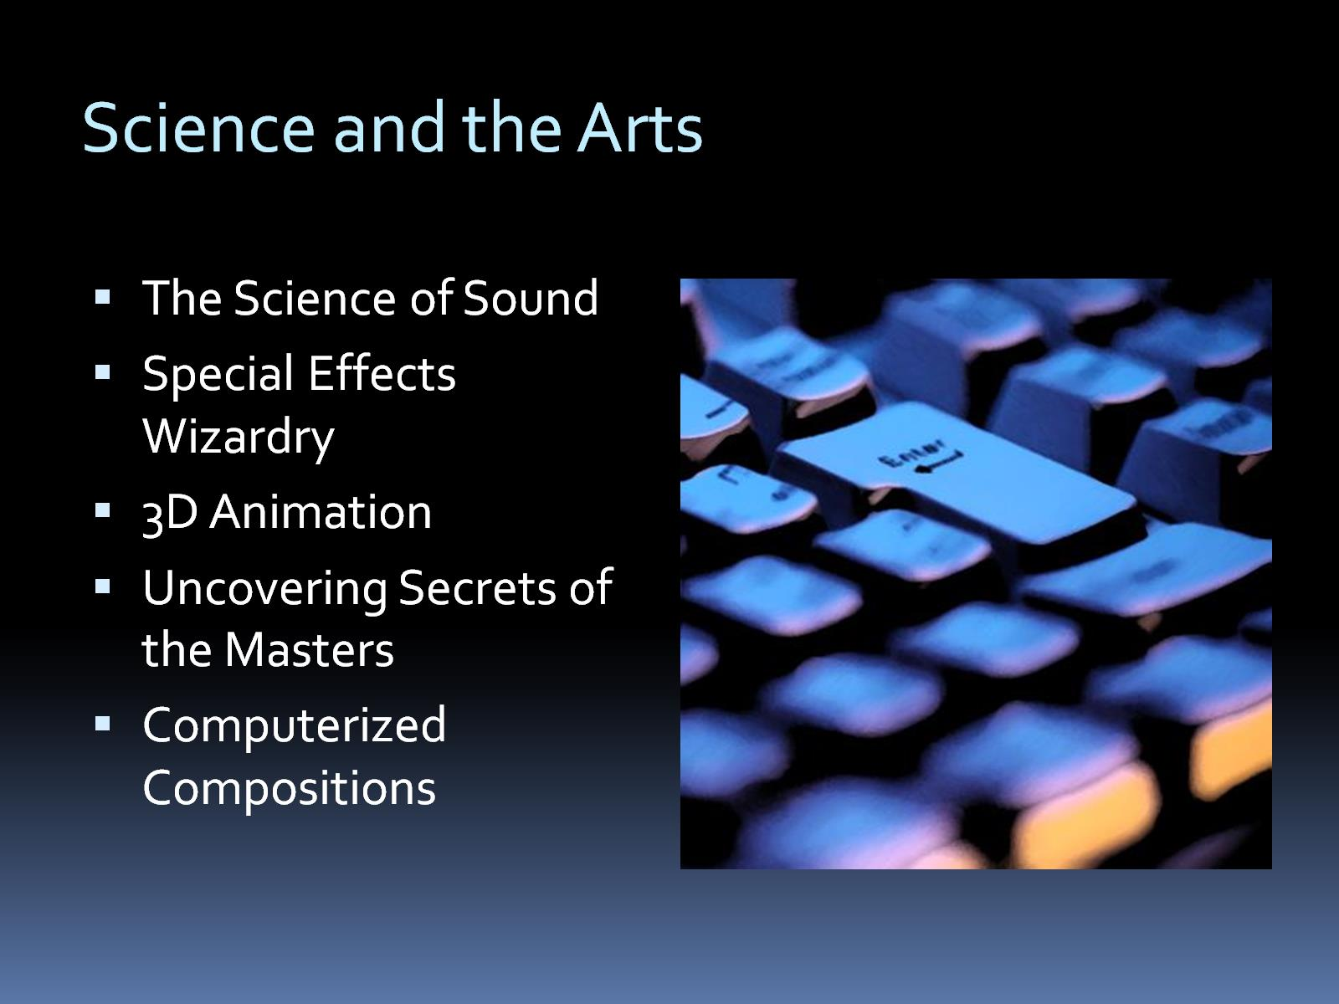
Science and the Arts

Slide 8
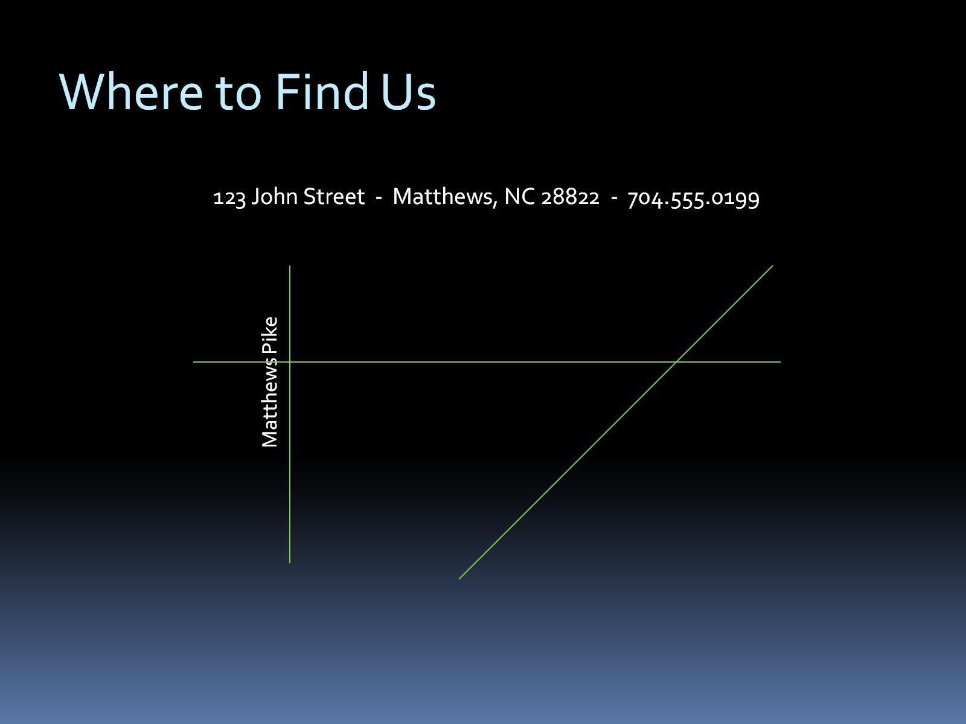
Where to Find Us

