Slide 1
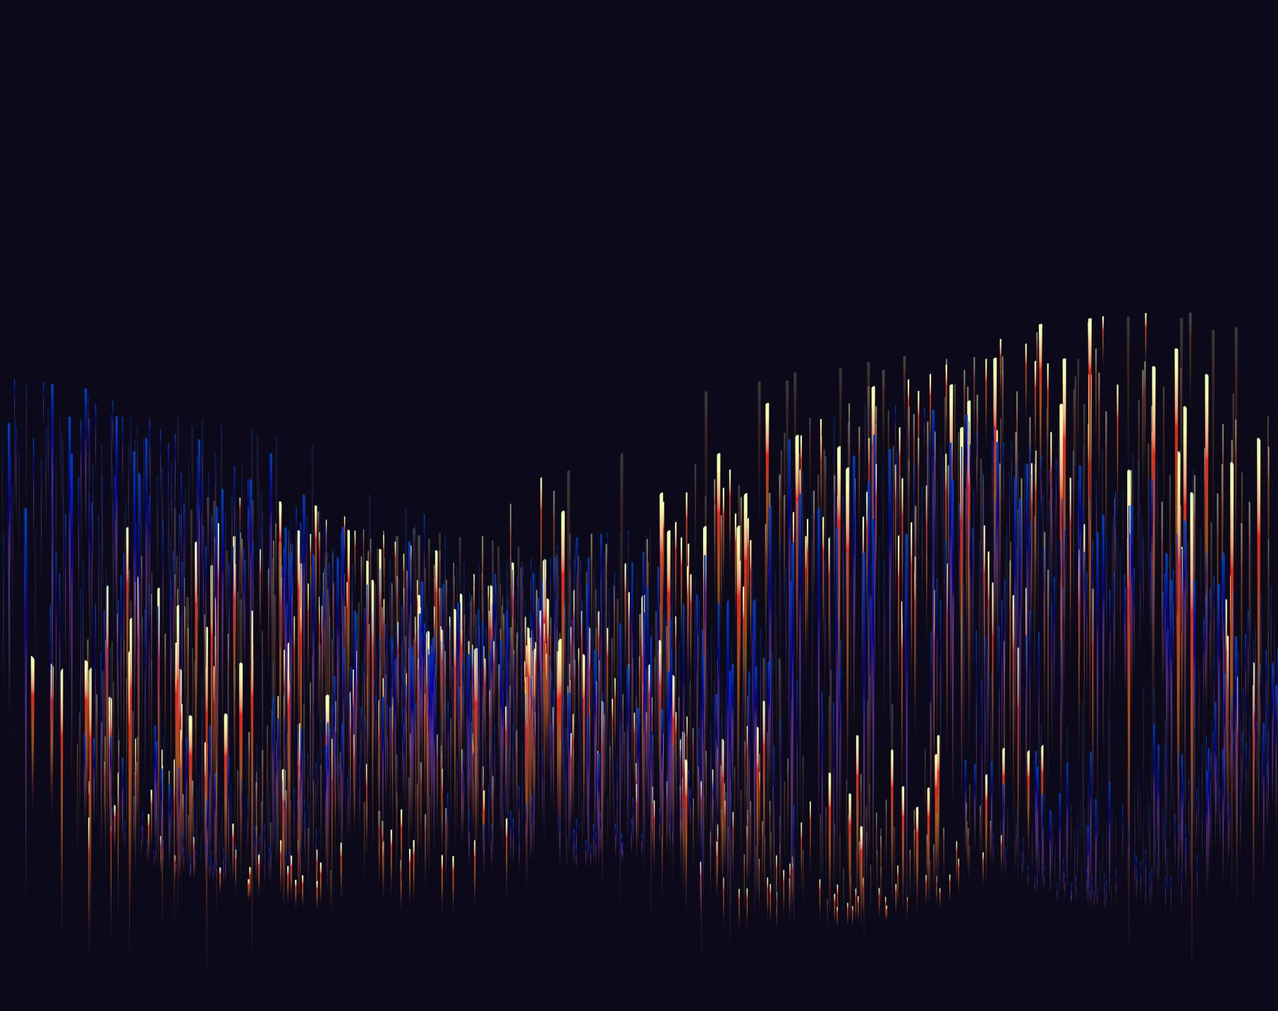
Exploring the Effect of the COVID-19 Pandemic on Mental Health through Tweets
Alden Felix
EPPS 6355

Slide 2
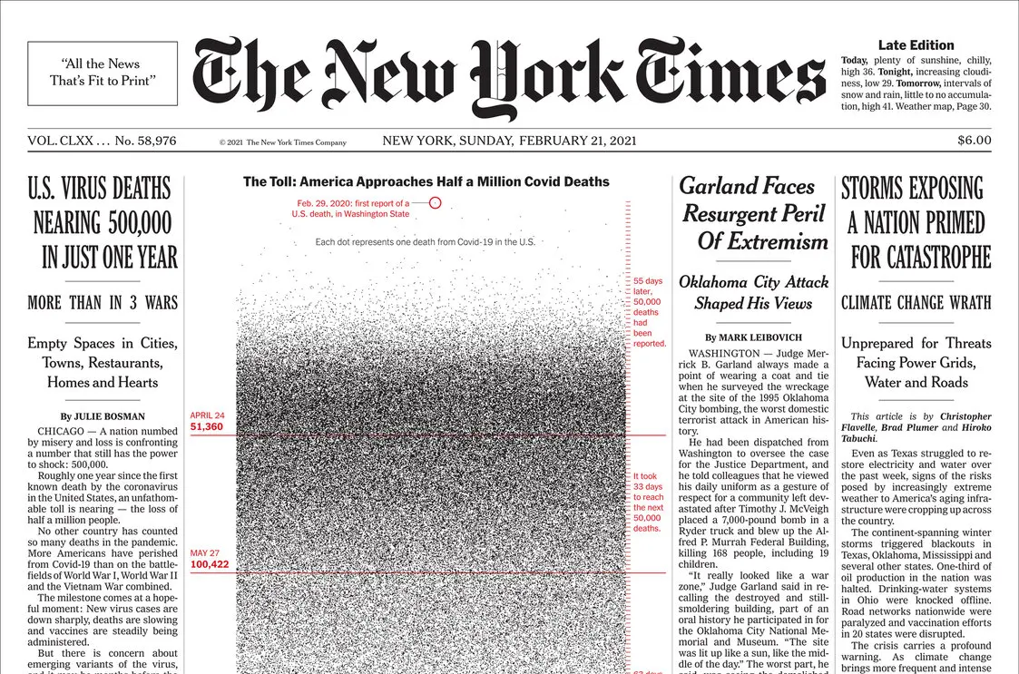
Background
COVID-19 Pandemic introduced conditions that increased anxiety for many people
Social Isolation
Health concerns
Uncertainty
Affected people in different ways, different intensities
How can we understand its impact?
Source: Brooks et al., (2020), Cowan (2020)
Source: New York Times (2021)

Slide 3
Twitter (X)
Alternative to traditional survey methods
Feasible as a tool for public survey?
Insight into thoughts, concerns, actions
Short answer survey with no questions – Gold Mine or Random Mess?
Use in public health studies: surveillance, event detection, pharmacovigilance, forecasting, disease tracking
Source: Edo-Osagie et al., (2020)

Slide 4
Research Question
Methodology: How effective is Twitter as a form of public survey?
Area of application: How well can tweets communicate the effect of the COVID-19 pandemic on mental health?

Slide 5
Data
Self collected from a previous project
480,000 tweets from users in the Dallas Fort Worth Metroplex
3 periods
March 2018 to October 2018
September 2019 to July 2020
September 2021 to July 2022

Slide 6
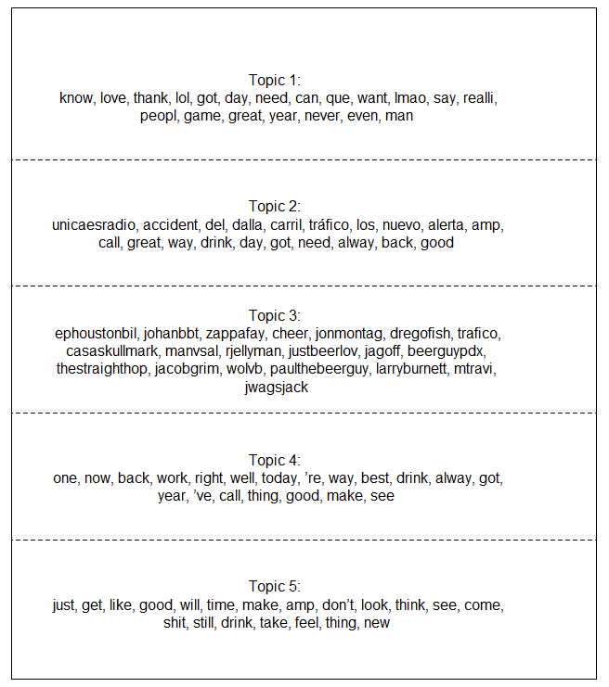
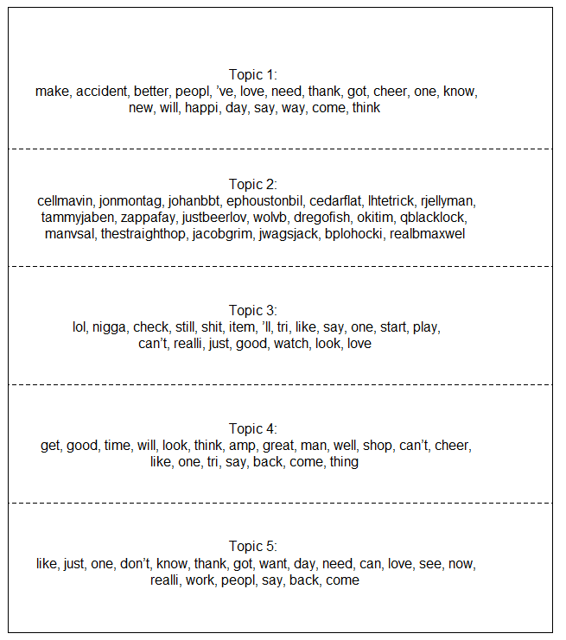
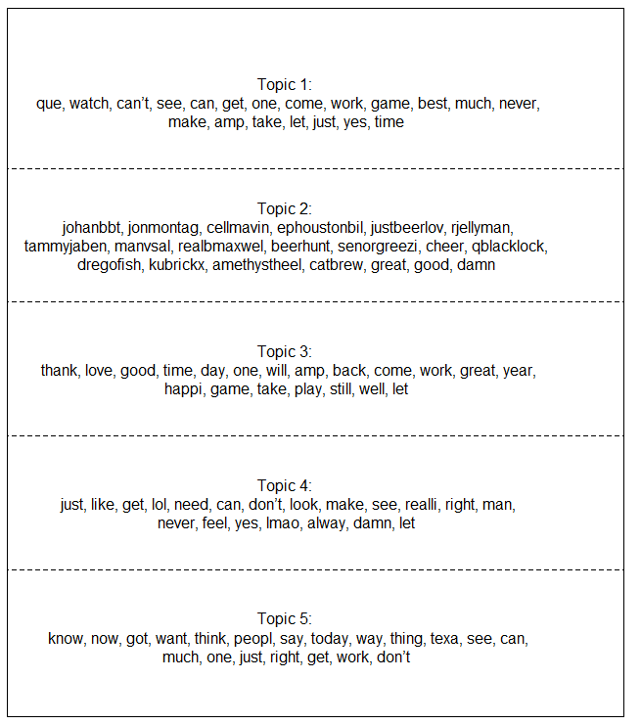
Topic Modeling
Random sample of 10,000 tweets from each period
Period 1
Period 2
Period 3

Slide 7
Dictionary Method
Mental Health Dictionary | depress, anxiety, anxious, stress, strain, frustrat, fear, frighten, alone, lone, scari, scare, scared, scary, danger, racist, racism, mental

Slide 8
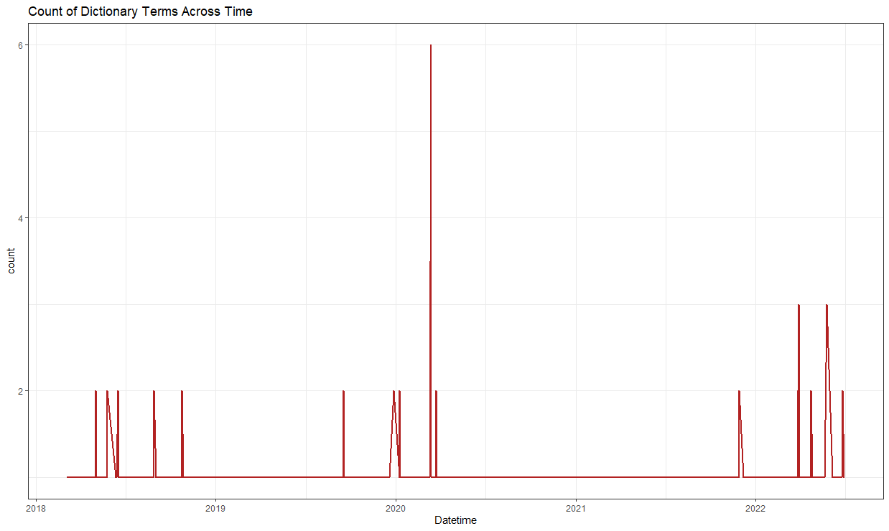

Slide 9
So…Gold Mine or Random Mess
Could not effectively explore the effect of COVID-19 on mental health
Problem with methodology employed in this case
Filter pulled tweets using dictionary terms (with API)
Other issues
Generalizability of Twitter users
Hardware limitations
Source: Junjun et al., (2018)

Slide 10
References
Brooks, S. K., Webster, R. K., Smith, L. E., Woodland, L., Wessely, S., Greenberg, N., & Rubin, G. J. (2020). The psychological impact of quarantine and how to reduce it: rapid review of the evidence. The lancet, 395(10227), 912-920.
Cowan, K. (2020). Survey results: Understanding people’s concerns about the mental health impacts of the COVID-19 pandemic. MQ: Transforming mental health and the academy of medical Sciences, 2020.
Edo-Osagie, O., De La Iglesia, B., Lake, I., & Edeghere, O. (2020). A scoping review of the use of Twitter for public health research. Computers in biology and medicine, 122, 103770. https://doi.org/10.1016/j.compbiomed.2020.103770
Junjun Yin, Guangqing Chi, and Jennifer Van Hook. (2018). Evaluating the Representativeness in the Geographic Distribution of Twitter User Population. https://doi.org/10.1145/3281354.3281360

