Slide 1
Conjugate Logical Bases
A lateral attack on the quantum measurement problem
Allan Goff
paradigmsage.com
vs 1.9
Notes:
Presented at the LOF2026 conference at Cambridge University, UK, 8/12/2026.

Slide 2
Argument
Argument
Observation:
Logical self-reference requires imaginary truthvalues.
The Imaginaries are conjugate to the Booleans.
A form paradoxical in one basis will be indeterminate in the other.
Speculation:
A self-referential quantum system can self-collapse in the one basis in which it is indeterminate.
No ambiguous divide between environment and system.
No change in the Hilbert spaces.
No change in unitary evolution.
Just a global consistency constraint.
Objective:
To make the theory falsifiable.
To devise an experimental test demonstrating that an isolated cyclically entangled quantum system can self-collapse.
Dashboard
Notes:
This presentation is a stepwise argument from math to physics ending in an experimental test.
Its inspiration is the unavoidability of self-reference in complex systems building upon the seminal work of G. Spencer-Brown in Laws of Form.
The introduction of imaginary truthvalues leads to the epiphany that Imaginary truthvalues form a conjugate basis to the Boolean truthvalues.
Thus, the speculation: will an isolated cyclically entangled closed loop in spacetime self-collapse?
Supposition: if there is one and only one basis in which the loop is self-consistent.
No ambiguous divide between the environment (treated at the classical level) and the system (treated at the quantum level).
Just one level – quantum all the way up.
A global consistency constraint is built upon the foundation of Hilbert spaces and unitary evolution.
QM is not wrong, relativity is not wrong, but both were incomplete, each containing part of the solution.

Slide 3
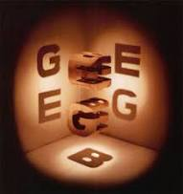

Self-Reference is Unavoidable
R = { x | x ∉ x∉ }
n = 1 – n
n = 2÷n
z = –1/z
z = +1/z
$A :\sim A$
$A :\text{≈}A$
function P(program):
if Halts(program, program):
loop forever
else:
halt
P(P)
Dashboard
Notes:
Russell
Gödel
Use/Mention
Liar’s Paradox
Ontological Indeterminism
Sequential circuits
Halting problem
Spencer-Brown
Self-reference breaks closure.
It has been at the heart of all the major limit theorems of the last century.

Slide 4
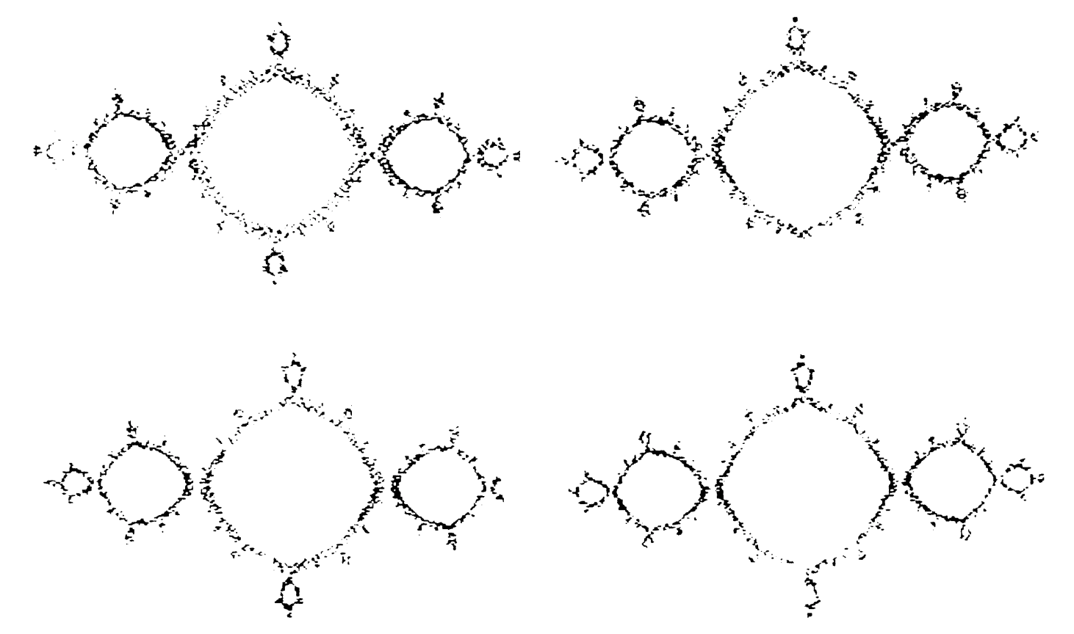
Oscillation (in spacetime?)
Dashboard
Notes:
Spencer-Brown was ambiguous whether reentrance was in space or time – pick your distinction.
Kauffman has deeply explored reentrance in space.
Reentrance in time is arguably easier
Hellerstein’s Diamond logic, Bricken, Shoup, Goff.
The notation of digital schematics makes it trivial to recognize the symmetry between the Liar’s Paradox and the Circular Argument.

Slide 5
Frequency?
Dashboard
Notes:
If we model SR as an oscillation in time, then the question is whether there is an upper limit to its frequency.
If so, call it the paradox frequency.
This can be modeled with clocked gates.
A NOT gate feeding back on itself has a paradox frequency half the clock frequency.
Its phase determines is imaginary truthvalue.
Its arbitrary which phase is mapped to which truthvalue.
Does that rankle?
We forget that Boolean truthvalues are also arbitrary.
Does zero map to T or to F?
A standard must be picked.

Slide 6
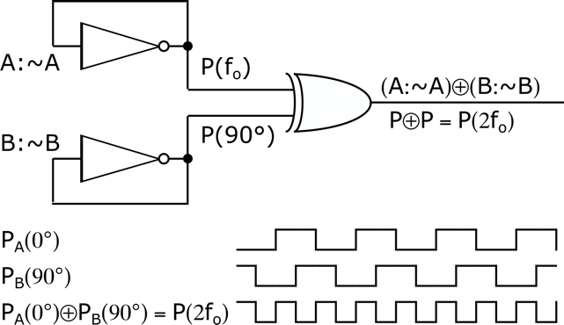
Quantization
Dashboard
Notes:
Assume a maximum frequency, call it the paradox frequency.
Let two paradoxes feed an XOR gate but with a 90° phase shift.
Out comes an oscillation at twice the paradox frequency, assumption invalidated.
Thus, either there is no upper limit, or the phase must be quantized.
Thus, there are two imaginary truthvalues, call the imaginary true and imaginary false, and label them ’i’ and ‘j’.
Portent #1: A maximum allowed frequency (the Planck frequency, the paradox frequency).
Portent #2: Quantization (allowed phases: 0° and 180°).

Slide 7
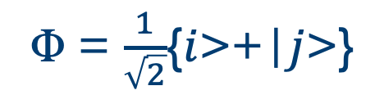
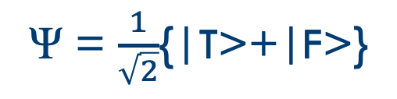
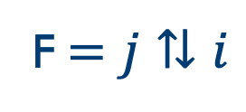



Conjugate Logical Bases
$$i=T⇅F$$
$$j=F⇅T$$
T$=i⇅j$
F$=j⇅i$
Ψ = $\frac{1}{\sqrt{2}}${|T>+|F>}
Φ = $\frac{1}{\sqrt{2}}${$i$>+|$j$>}
Dashboard
Notes:
The Imaginary truthvalues can be represented as alternating Boolean truthvalues.
In perfect symmetry, the Boolean truthvalues can be represented as alternating Imaginary truthvalues.
They form a pair of conjugate bases for truthvalues.
Echoes (portent) of quantum physics.
Portent #3: Conjugate Bases

Slide 8
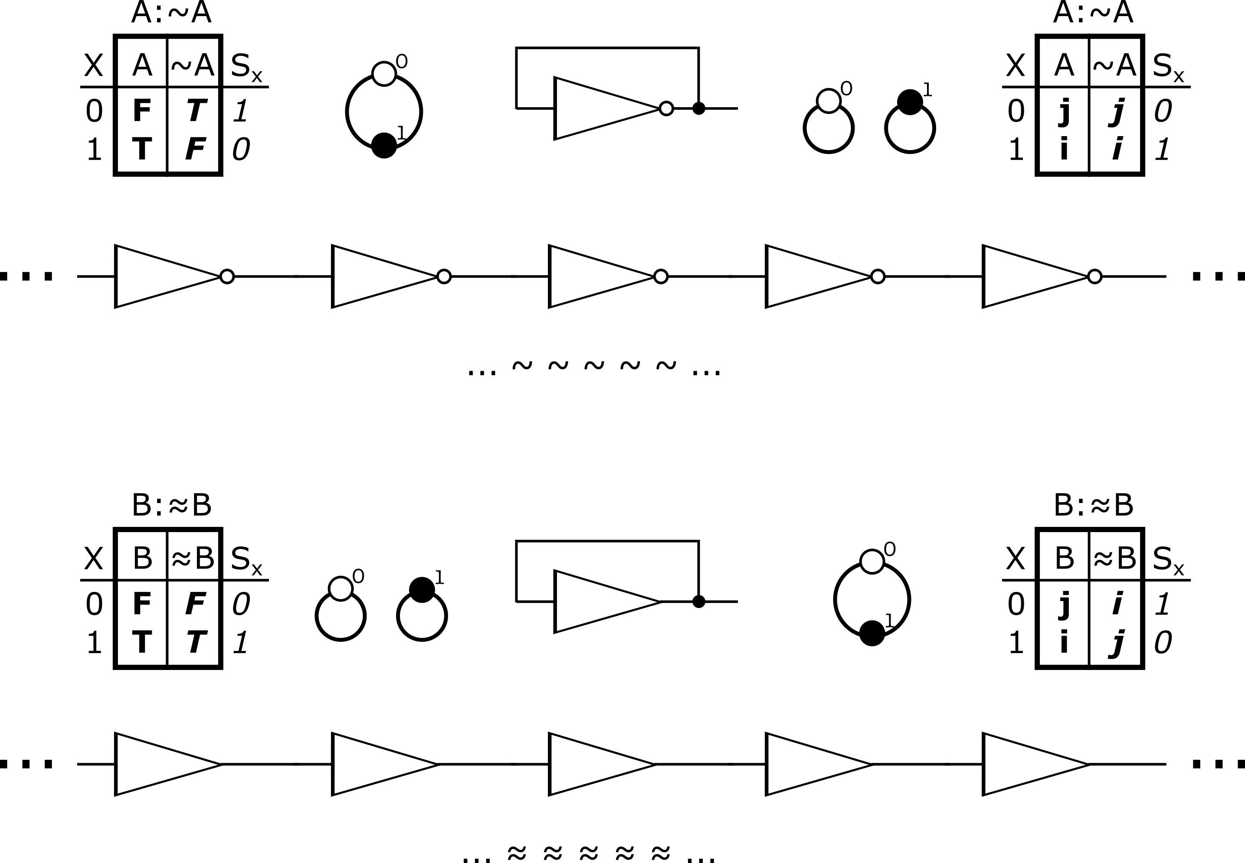
Six Representations
Dashboard
Notes:
Six representations
Typographic
Truth tables
Successor vector
Attractor structures
Digital circuits
Infinite expansion
Hypothetical: a self-referential form is never paradoxical in all bases.
There is always at least one in which it is indeterminate.
Consider a unary gate whose output feeds back to its input.
It is fully self-referential, no inputs at all.
If it is a NOT gate, the circuit is paradoxical in the Boolean basis but indeterminate in the Imaginary basis.
If it is a BUF gate, the circuit is paradoxical in the Imaginary basis but indeterminate in the Boolean basis.
There are two theoretical branches here:
Keep the indeterminacy throughout some ‘proof’.
Randomly pick one value and use it throughout the ’proof’.

Slide 9
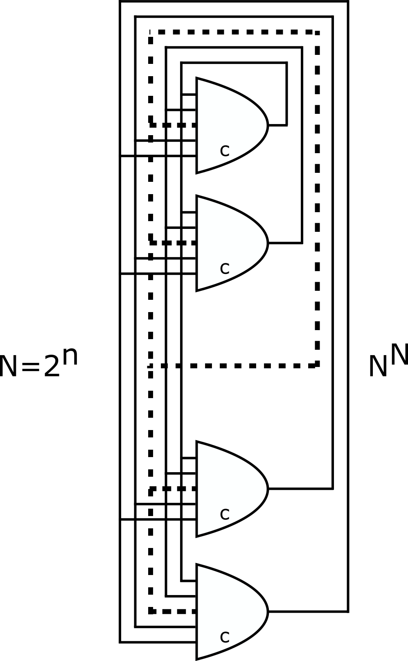
Scaling Law
There are n gate complexes:
Each with n inputs.
Every output is an input.
Every complex is clocked.
Each implements a truth table.
Each has 2^{n} rows.
There are 2^(2^{n}) possible output columns.
Thus, (2^(2^{n}))^n sequential circuits.
Thus, N^{N} sequential circuits.
N = 2^{n}.
Only N! combinatorial circuits.
Avoiding self-reference has denied logicians access to most logical forms, N! versus N^{N}.
Dashboard
Notes:
Combinatorial circuits (linear forms) only scale as N!.
Sequential circuits (nonlinear forms) scale as N^{N}.
Logicians in their misguided attempt to prevent self-reference have cut themselves off from the vast majority of logical forms.
The conventional interpretations of Gödel’s theorems may be off base.
Perhaps they do not prove that truth supersedes proof, but merely that some truths cannot be reached without going through imaginary truthvalues.
The ancient Euclidean ideal of neatly stepping from truth to truth as the ultimate recipe to uncover all truths may not be possible.
Perhaps that ideal should be given a name, the Euclidean Proof Paradigm (EPP).
It has reigned supreme as the core of human reasoning for more than 2,000 years – perhaps self-reference reveals its limits.
Like imaginary numbers in math, some proofs require them.

Slide 10
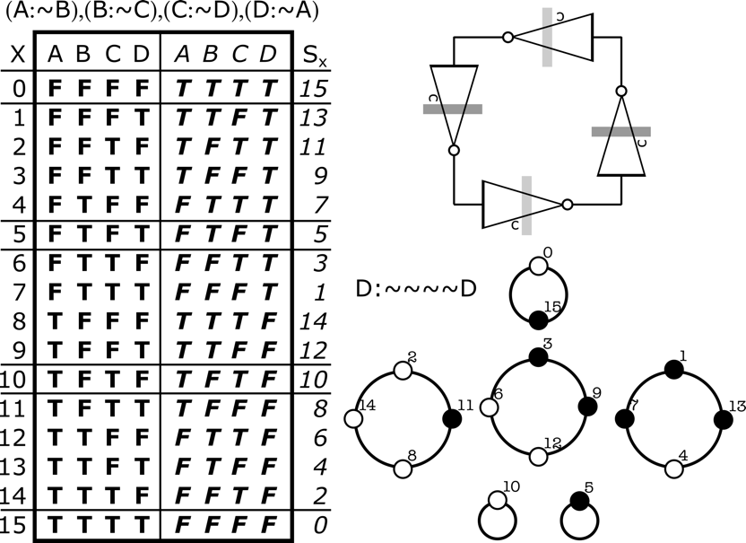
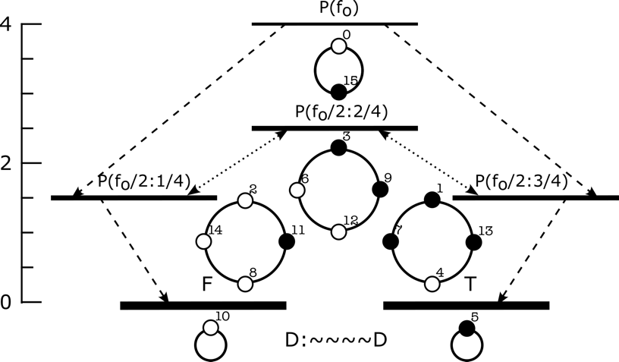
Relaxation
Overclocking produces noise.
Evaluation no longer deterministic.
Contradictions can cancel.
Irreversible state transitions.
Contradictions can drift.
Reversible state transitions.
Looks a lot like excited states.
Four NOT gates in a loop.
Six attractors.
Loop can contain 4, 2, or 0 contradictions.
1 at the paradox frequency
3 at half that
Different duty cycles
2 fixed points
Dashboard
Notes:
In a sequential form, any contradictions propagate around the loops.
Here we have a simple 4 stage loop of NOT gates.
The attractor structure has 6 pure attractors, no stems (no transient states).
All the representational forms are evident here.
The attractor structure makes it clear that this form is indeterminate between Boolean and Imaginary bases, and at least one other basis conjugate to both.
If evaluation is strictly generational, then the truth table is predictive, and the form is stuck in whatever attractor it starts in.
The contradictions stately advance around the loop.
However, if a signal arrives early or late, or a logical computation rushes or gets delayed, then the contradictions can shift relative positions.
Overclocking does just this in real circuits.
A simple shift is just a phase shift, a reversible transition between similar attractors.
But if two contradictions meet, they cancel, and the system can transition, irreversibly, between attractors.
Thus the ‘values’ of this form can be organized into a contradiction diagram (energy diagram) with various excited states and, significantly, a ground state.
Portent #4: Excited states.
Take a page out of Dirac.
If scalars don’t work, try vectors, if vectors don’t work try matrices – viola, antimatter.

Slide 11
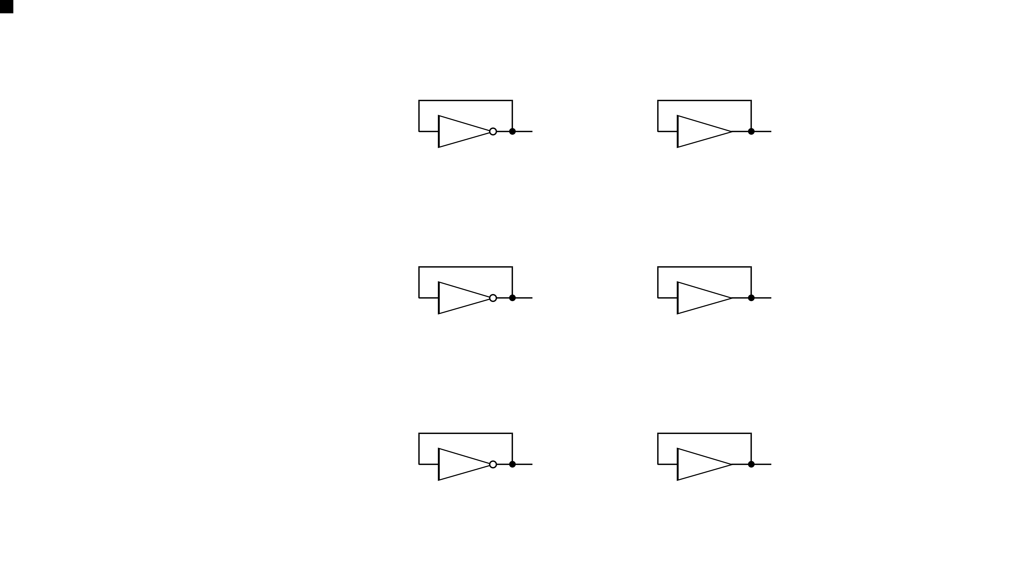
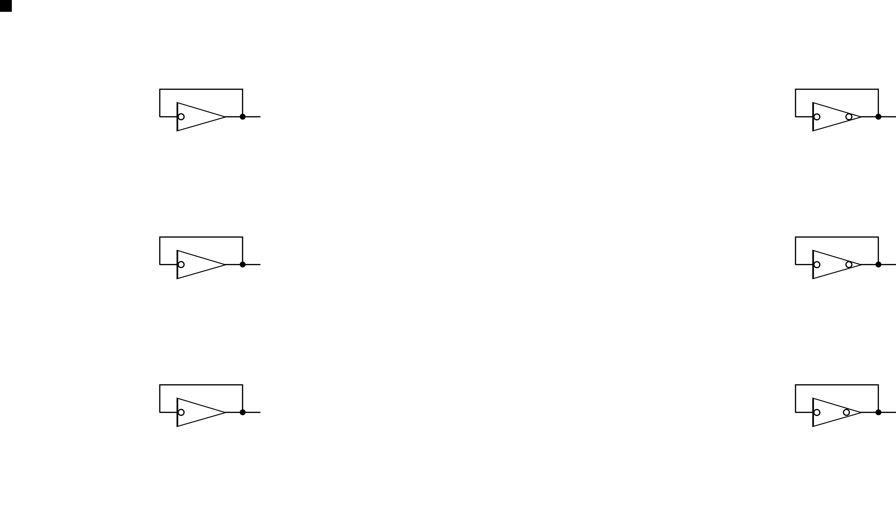
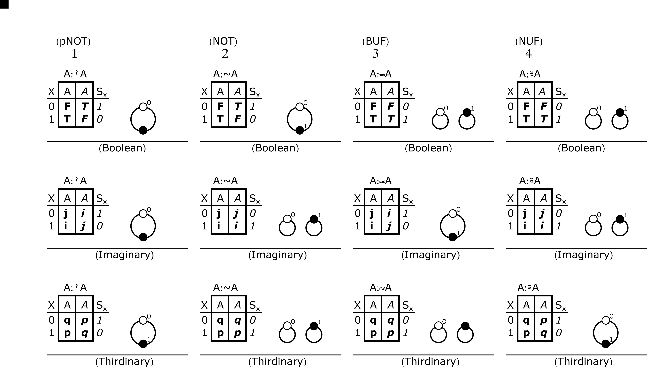
Tri Conjugate Logic (TCL)
Dashboard
Notes:
Deeper analysis has been slow – could this be a dead end?
Why should there be only two mutually conjugate logical bases?
Could there be three?
Now we add two more ‘imaginary’ truthvalues, call them p & q.
(If there is room for three standards, there is certainly room for four.)
Three bases:
Boolean (T/F)
Imaginary (i/j)
Thirdinary (p/q)
Four unary operators:
pNOT
NOT
BUF
NUF
Try Conjugate Logic, (TCL – tickle).

Slide 12
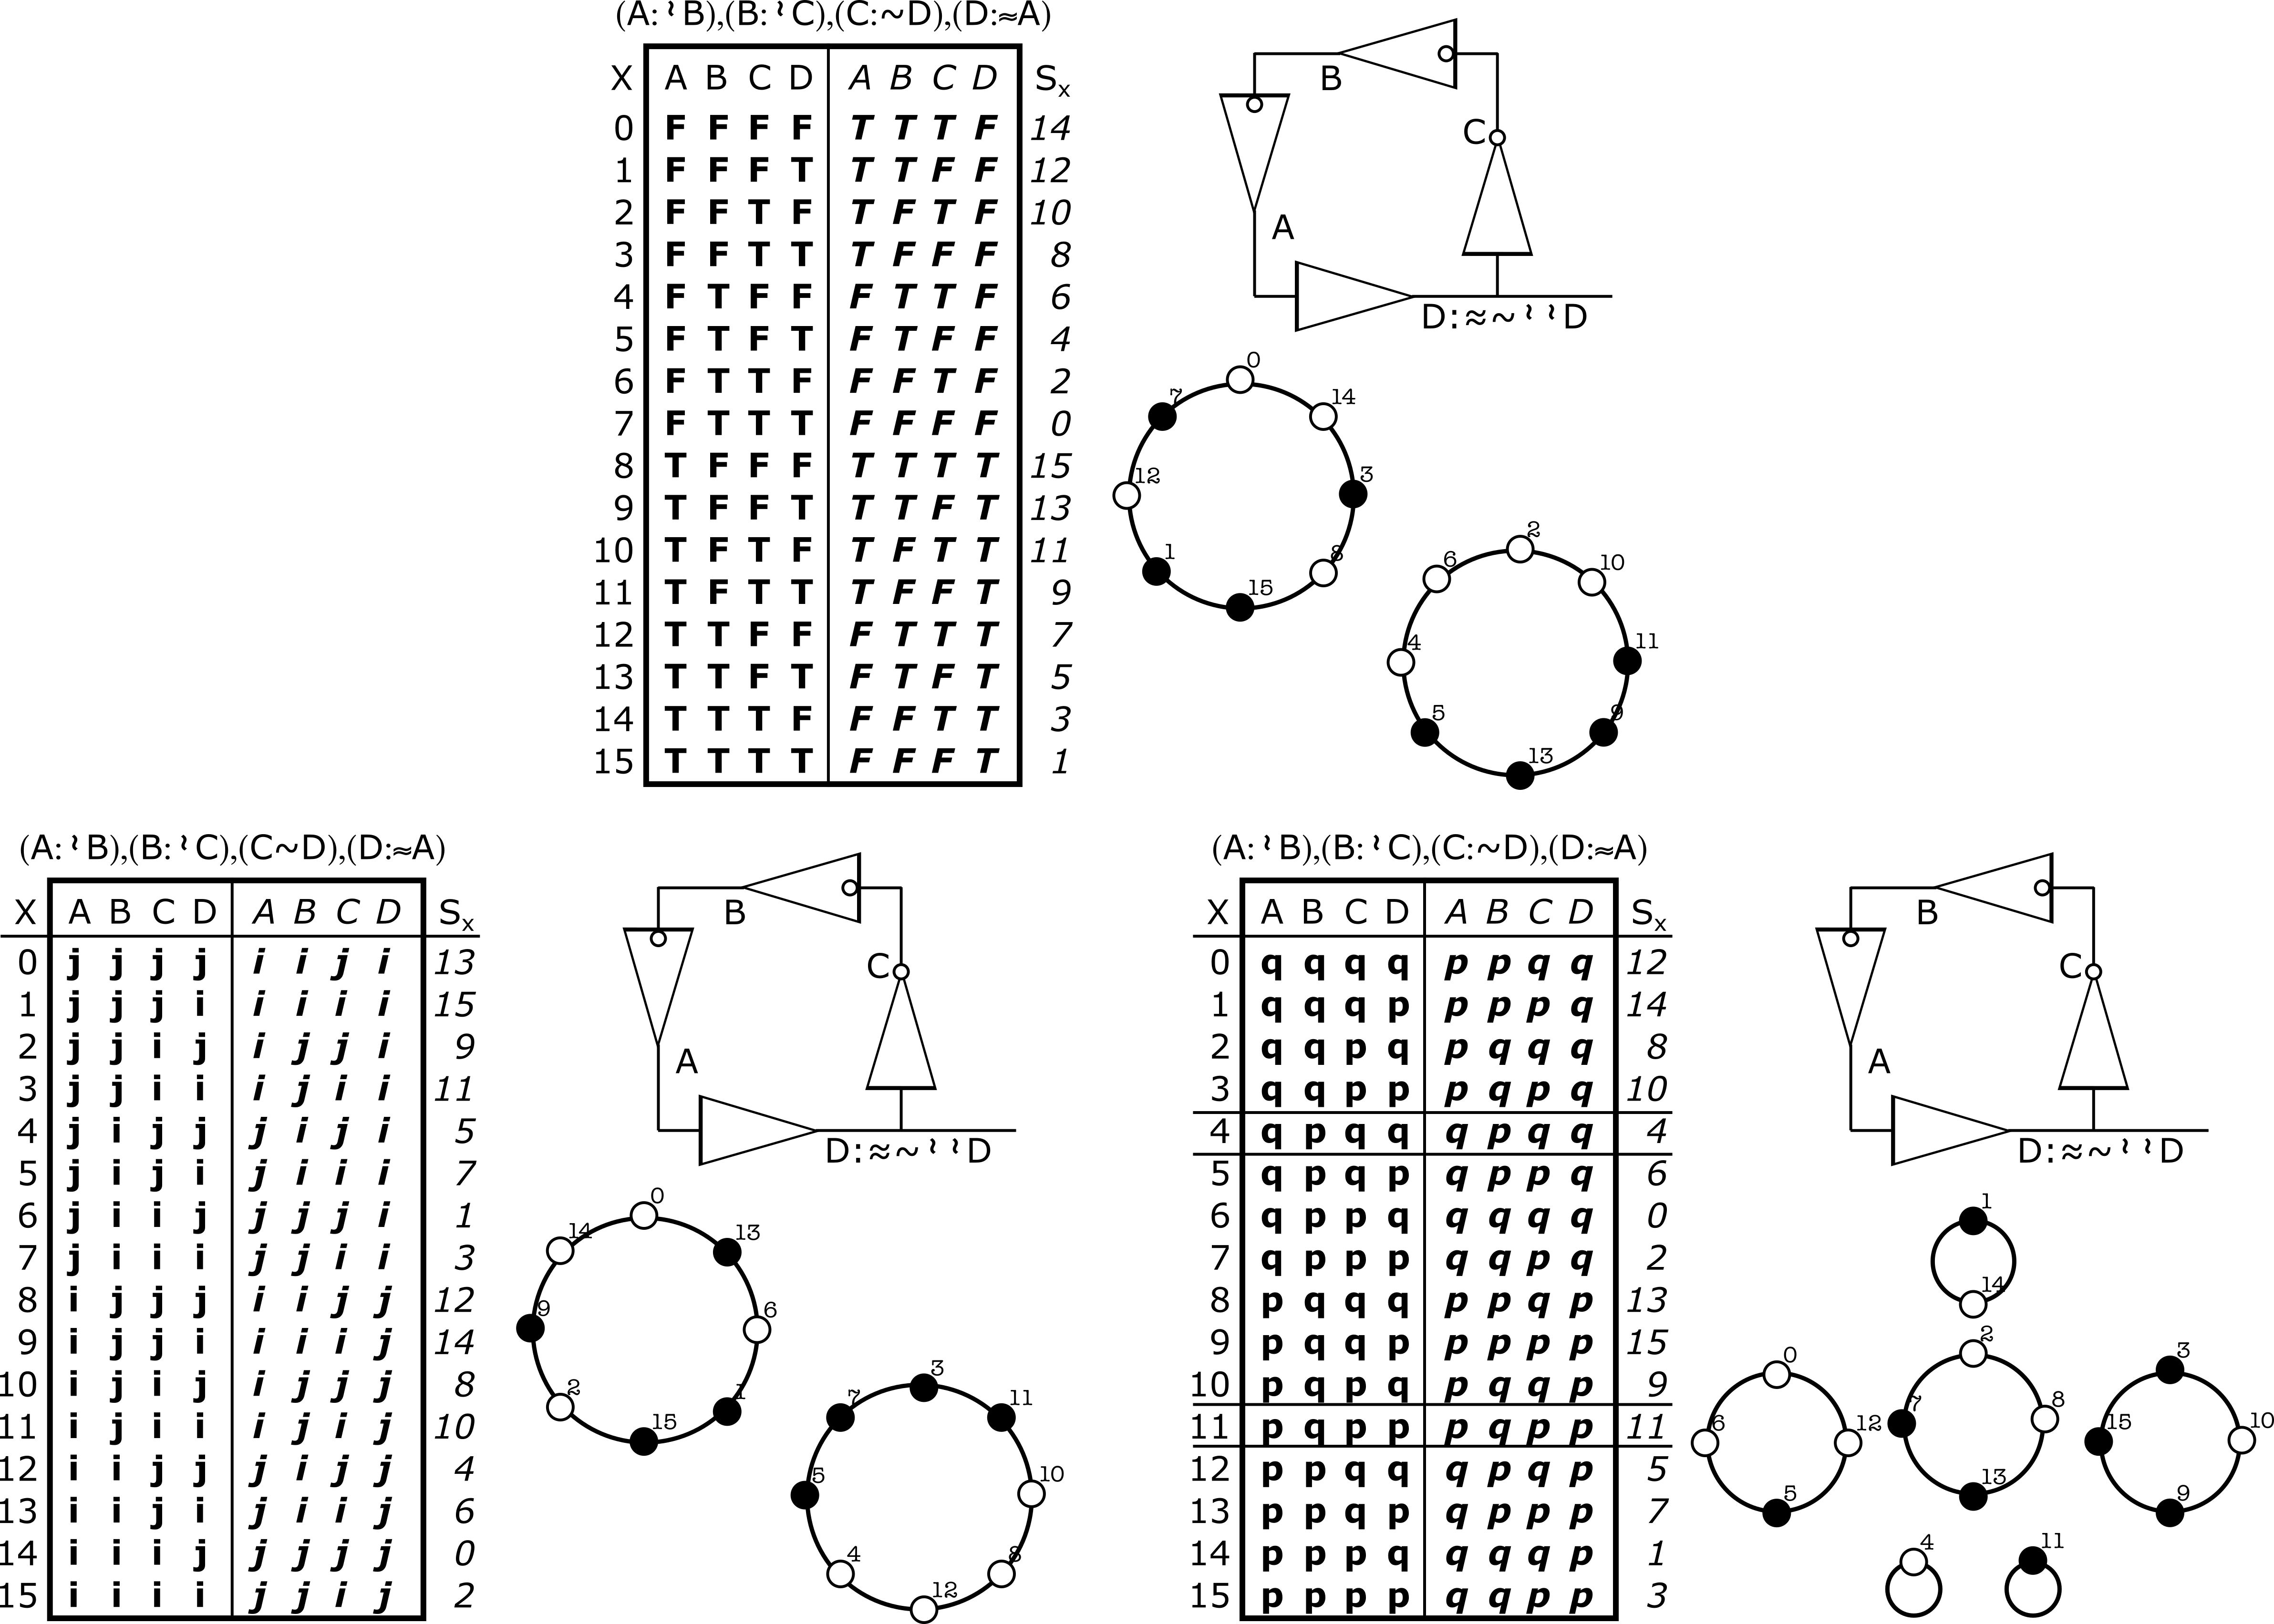
Logical Consistency
4 locations
4 operators
2 paradoxes
1 indeterminacy
Dashboard
Notes:
In a sequential form, any contradictions propagate around the loops.
Here we have a simple 4 stage loop of unary gates – pNOT, pNOT, NOT, BUF.
The attractor structure is basis dependent.
This form is inconsistent in the Boolean and Imaginary bases but has a fixed-point ground state in the Thirdinary basis.

Slide 13
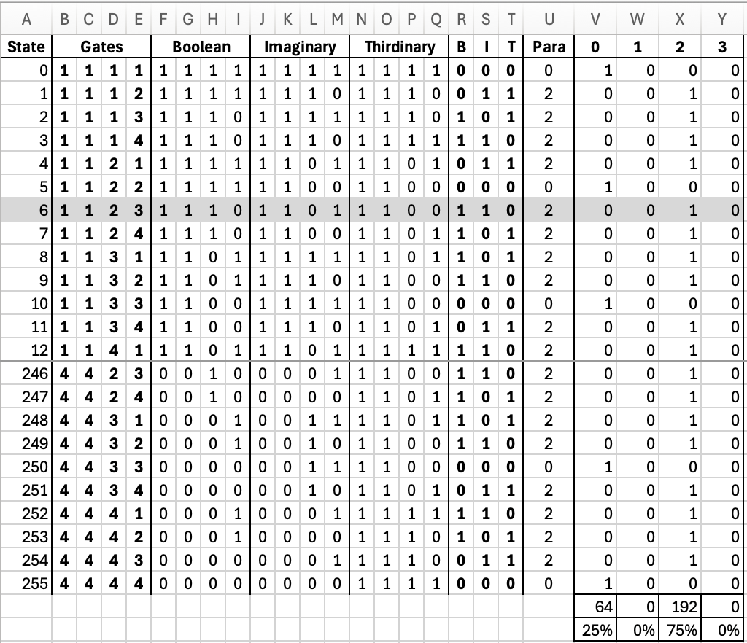
An Unexpected Invariant
Dashboard
Notes:
Four possible operators, four possible locations.
256 permutations - shown is the partial spreadsheet, middle rows suppressed.
The number of phase inversions for each gate is computed.
Odd number is a paradox, even number is an indeterminacy.
Tallied by basis, then summed for the entire table.
Permutation 6 is highlighted as an example – pNOT, pNOT, NOT, BUF.
In no case is there a permutation where only one basis is paradoxical, and none where every basis is paradoxical.
In 192 cases the loop is paradoxical in exactly two bases and indeterminate in precisely one.
in 64 cases, the loop is indeterminate in all three bases.

Slide 14
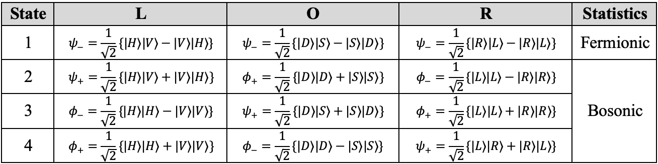
The Bell States in Three Bases
The Bell states have the same structure as the operators of TCL.
Dashboard
Notes:
Now for the transition from logic to physics.
Consider the Bell states but represent them in all three mutually independent bases.
Four states, each represented in each of the three basis.
The antisymmetric state (state 1, $ψ_{−}$) has the same mathematical form in every basis, the rest do not.
This asymmetry is going to have consequences.
It is exactly the same structure as in TCL.
Do the consequences follow?

Slide 15
World Ribbons
World lines
are a classical
abstraction –
infinitely thin.
Wrong abstraction
for quantum particles.
World ribbons
are a quantum
abstraction –
increasing width.
Upon a measurement, what
does the top edge look like?
Dashboard
Notes:
The uncertainty principle is at odds with the concept of a world line.
A particle does not follow an infinitely thin trajectory.
Its path into the future has breadth, which generally increases.
Call this a world ribbon.
Collapse of the wave function is envisioned as something that happens instantaneously.
But instantaneous is not a relativistic invariant – it is a classical abstraction.
Collapse cannot be instantaneous in all reference frames, only in one.
Thus, the question – when collapse happens, what is the shape of the top edge of a world ribbon?
If objective collapse is relativistically meaningful, the collapse hypersurface should itself be spacelike.

Slide 16
A Lorentz Invariant Top Edge
It’s called a symmetric spacetime interval.
There are invariants associated with symmetric intervals – there is a firm mathematical foundation underpinning them.
Their development is an entire presentation.
So, for the purposes of this talk, we simply assume them.
Outside of self-reference, they are not testable.
Assume that EPR pairs are coupled along symmetric intervals.
They Lorentz transform like any other spacetime interval.
For equal frequency pairs, the SSI is horizontal in the lab frame.
Placing an EPR source in motion produces a Poincare rotation.
For unequal pairs (3rd harmonic), they are steeply rotated (~0.3c).
Apologies for the implied “Trust Me.”
Dashboard
Notes:
Recall that before and after are invariants for timelike intervals.
Recall that left and right are invariants for spacelike intervals.
That symmetry is crucial; before and after are frame independent for timelike intervals, left and right are frame independent for spacelike intervals.
If there is any frame in which it can be decided the slope of the collapse edge (spacelike), then all observers will agree.
Nature gifted us an arrow of time, we get before and after for free.
For spacelike intervals we shall have to dig a little deeper.
Quantum teleportation via entanglement provides another hint – half the information arrives from the quantum channel.
Claiming this is ”instantaneous” is not consistent with relativity, but a Lorentz invariant spacelike interval would be.
The symmetric interval provides a specification for the top edge of a world ribbon, but some other specification might be the case.
See the references for a detailed derivation.

Slide 17
Natural Nonlinearity
A closed loop in spacetime, consisting of four spacelike intervals.
Agnostic to spacelike causality or just spacelike correlations.
Proper Lorentz transformation plus Minkowski invariants.
Dashboard
Notes:
Consider four EPR pairs, 8 particles in all.
Assume the photons in each pair are connected by symmetric intervals.
Place each EPR source be placed in relative motion which imposes Poincare rotations.
Let the direction, timing, and Poincare rotations be chosen with such care that the symmetric intervals form a closed loop in space time, in this example, a simple diamond.
We have a closed loop in spacetime, the EPR pairs are correlated by the Bell states, the cross pairs are correlated by becoming indistinguishable and thus must have the same polarization.
The presumption has long been that solving the quantum measurement problem requires introducing nonlinearity into quantum mechanics.
Existing collapse models introduce new nonlinear physics.
Self-reference offers a possible source of nonlinearity without introducing a new universal constant.

Slide 18
Unitary Evolution Remains Timelike
( ( (
( ( (
( ( (
( ( (
( ( (
( ( (
( ( (
( ( (
4 EPR pairs advance into the future under standard unitary evolution.
Carefully timed to create a global consistency situation.
Dashboard
Notes:
No changes to the evolution of the wave function are required.
Hilbert spaces still work, the Schrodinger equation still applies.
The EPR photons follow their lightlike world lines.
Entanglement remains spacelike.
Poincare rotations are achieved by simply placing the EPR sources in motion.
But that means the entangled photon pairs no longer have the same frequencies.
How do you convince a pair of photons to behave like bosons, to be in the same state, if their frequencies are different?

Slide 19
Bosons in the Same State
( ( (
( ( (
( ( (
( ( (
( ( (
( ( (
( ( (
( ( (
To complete the loop the cross-pair photons must be indistinguishable.
Requires they have the same frequency.
Easy to achieve by tuning the pump frequency.
Dashboard
Notes:
The pump photons must be in different frequencies.
Indistinguishability of the cross-pair photons complete the loop.
This creates a global consistency constraint – the polarizations of the photons must be consistent around the loop.
Turns out that this constraint is NOT basis agnostic.

Slide 20
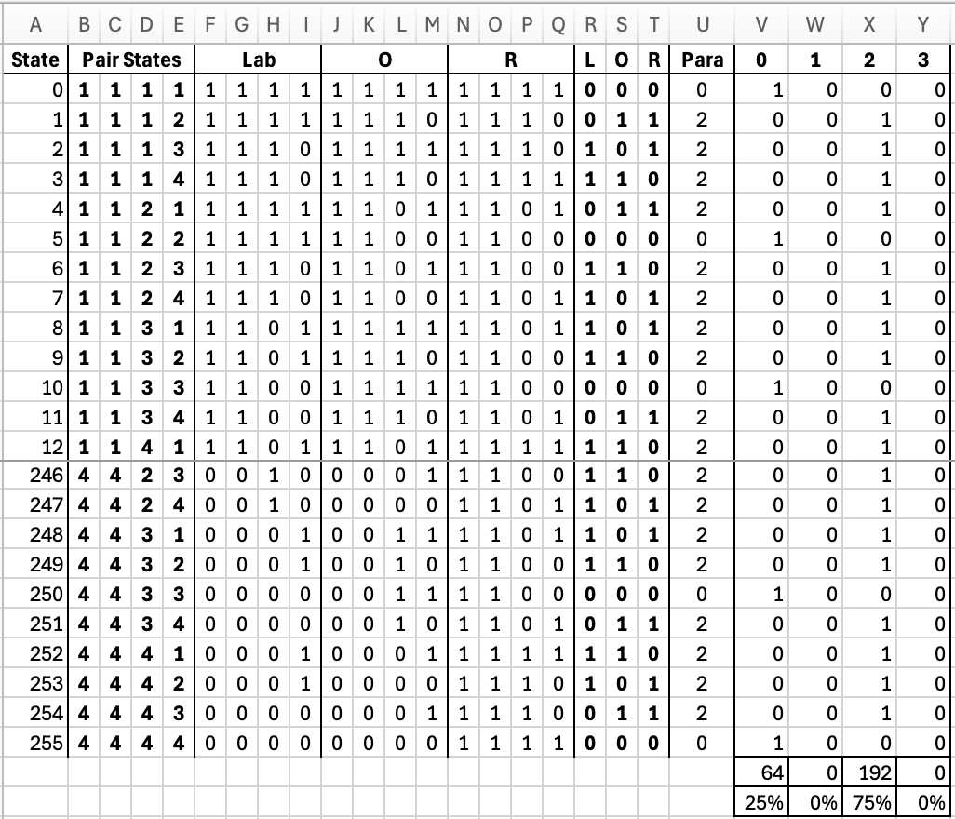
An Unexpected Invariant
Dashboard
Notes:
4 sides to the diamond loop, 4 Bell states => 256 possible cyclic entanglements.
Each Bell state can be represented in each of the three Dirac bases.
Which cycles are self-consistent when represented in each of the three Dirac bases.
64 are paradoxical in none of the bases, they are indeterminate in all three.
0 are paradoxical in one basis.
192 are paradoxical in two bases, but indeterminate in the third.
0 are paradoxical in all three bases.
The observation motivates the conjecture that recursive entanglement possesses a topological consistency invariant.
This may turn out to be merely a finite combinatorial curiosity—or it may reflect a deeper property of recursively entangled systems.
The Bell-state basis transformations exhibit the same combinatorial classification as TCL.
Speculation: an isolated quantum system which becomes cyclically entangled, will be paradoxical in all bases except one.
In that one unique basis, the quantum state is indeterminate.
The conjecture is that the unique indeterminate basis is the attractor selected by global consistency – self-collapse w/o an external observer.

Slide 21
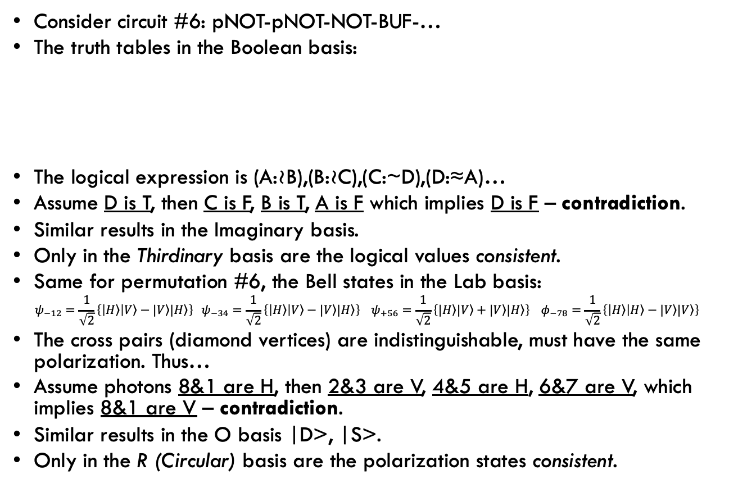
Global Self-Consistency
Consider circuit #6: pNOT-pNOT-NOT-BUF-…
The truth tables in the Boolean basis:
The logical expression is (A:≀B),(B:≀C),(C:~D),(D:≈A)…
Assume D is T, then C is F, B is T, A is F which implies D is F – contradiction.
Similar results in the Imaginary basis.
Only in the Thirdinary basis are the logical values consistent.
Same for permutation #6, the Bell states in the Lab basis:
$$ψ_{−12}=\frac{1}{\sqrt{2}}\left\{\left|\left.H\right\rangle \right|\left.V\right\rangle −|\left.V\right\rangle |\left.H\right\rangle \right\} ψ_{−34}=\frac{1}{\sqrt{2}}\left\{\left|\left.H\right\rangle \right|\left.V\right\rangle −|\left.V\right\rangle |\left.H\right\rangle \right\} ψ_{+56}=\frac{1}{\sqrt{2}}\left\{|\left.H\right\rangle |\left.V\right\rangle +|\left.V\right\rangle |\left.H\right\rangle \right\} φ_{−78}=\frac{1}{\sqrt{2}}\left\{\left|\left.H\right\rangle \right|\left.H\right\rangle −|\left.V\right\rangle |\left.V\right\rangle \right\}$$
The cross pairs (diamond vertices) are indistinguishable, must have the same polarization. Thus…
Assume photons 8&1 are H, then 2&3 are V, 4&5 are H, 6&7 are V, which implies 8&1 are V – contradiction.
Similar results in the O basis |D>, |S>.
Only in the R (Circular) basis are the polarization states consistent.
B | A:≀B
F | T
T | F
C | B:≀C
F | T
T | F
D | C:~D
F | T
T | F
A | D:≈A
F | F
T | T
Dashboard
Notes:
The bits around a self-referential form must be consistent.
Logical reasoning in combinatorial circuits is basis agnostic.
But in sequential circuits (self-reference), they are not basis agnostic.
The re-entrance constrains the globally self-consistent basis.
The polarization states around a self-referential form must be consistent.
Unitary evolution is basis agnostic.
But a closed loop in spacetime is not basis agnostic.
The re-entrance constrains the globally self-consistent basis.

Slide 22
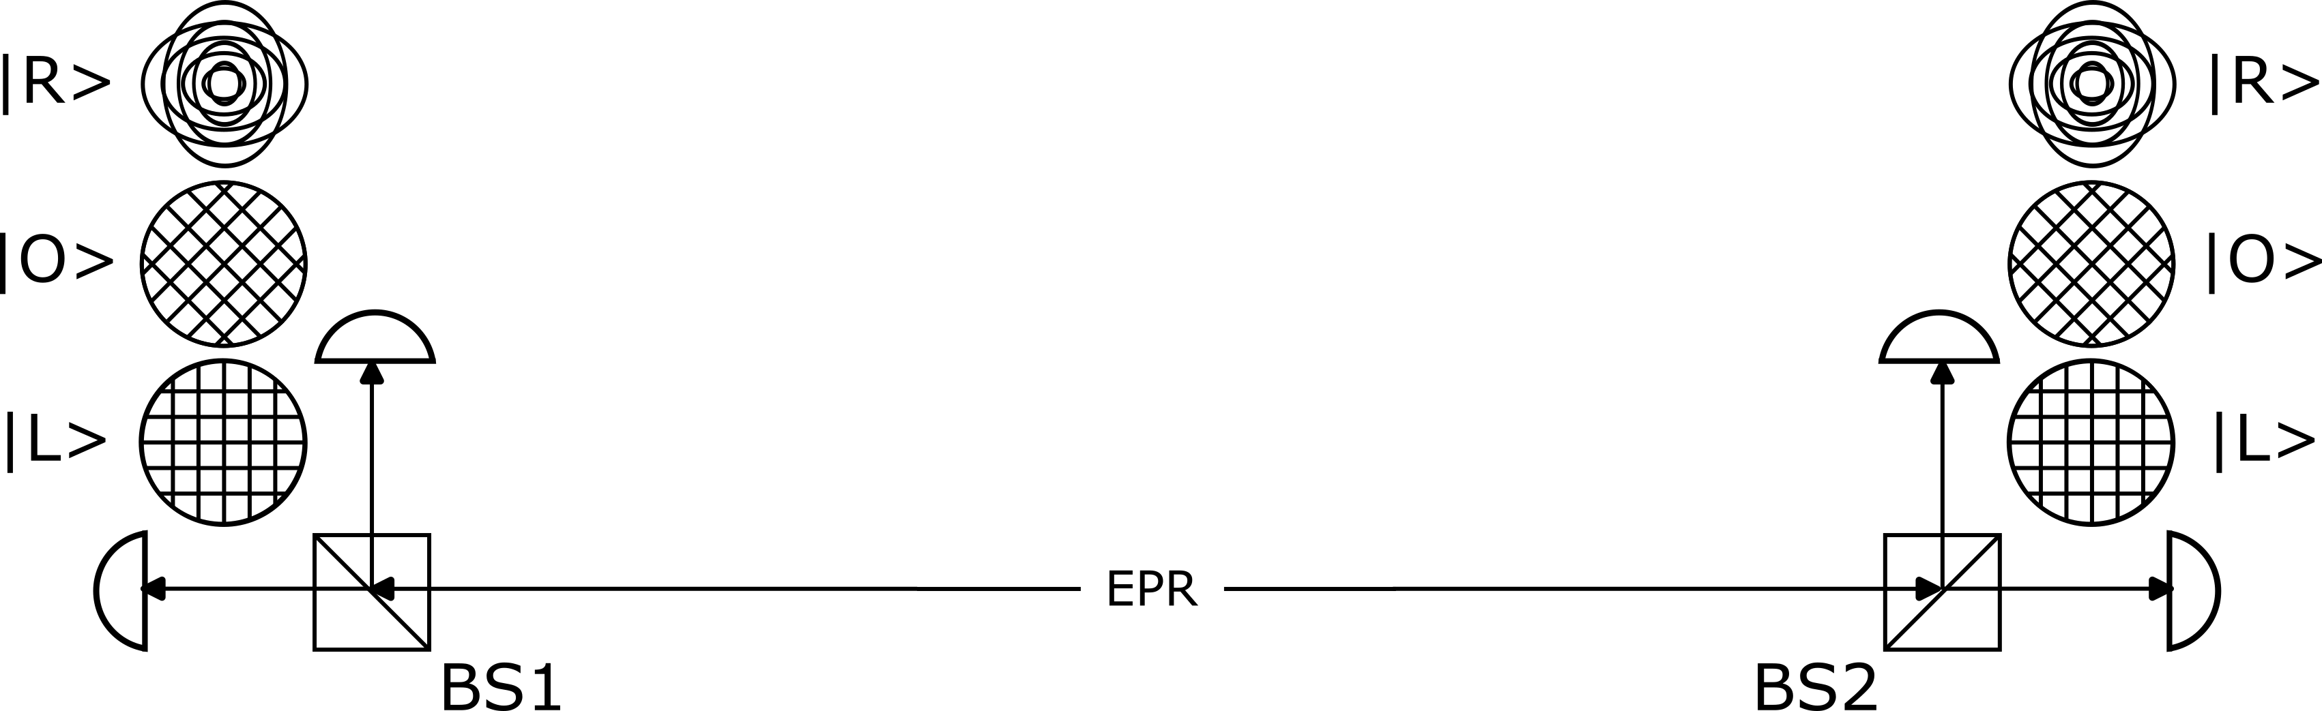
EPR Entanglement
Collapse is in the measurement basis.
Correlations only if the bases match.
Ambiguous Collapse Paradigm (ACP) applies.
The Environment specifies all the information that determines the collapse basis.
Dashboard
Notes:
ACP: current dogma about nonlocal collapse should be given a name.
Given two spacelike separated observers, Alice and Bob, which measurement is the ‘cause’ of the collapse is ambiguous.
Each is free to assume that it is their measurement which collapses the wave function from entangled in a single Hilbert space into two separated Hilbert spaces,
where each beliefs (claims) the other observer’s measurement merely reveals which eigenvector was the result of the random collapse.

Slide 23
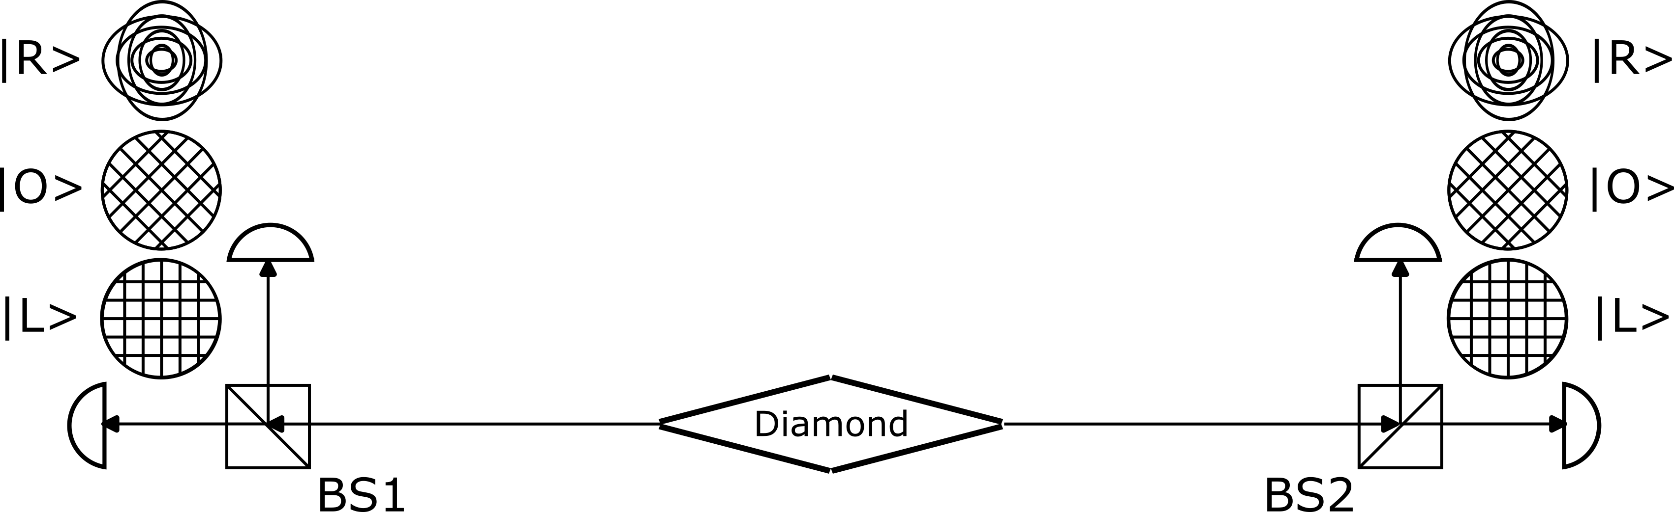
Diamond Paradox
Either collapse is open or occurred in the self-collapse basis.
If collapse is open, correlations whenever the bases match.
If self-collapse, correlations only if the bases match the self-collapse basis.
The quantum system specifies all the information that determines the collapse basis.
Dashboard

Slide 24
Experimental Predictions
Collapse Measurement | Uncollapsed 25% | Lab (|H>, |V>) | Ortho (|D>, |S>) | Circular (|L>, |R>)
Lab (|H>, |V>) | Correlated | Correlated | Random | Random
Ortho (|D>, |S>) | Correlated | Random | Correlated | Random
Circular (|L>, |R>) | Correlated | Random | Random | Correlated
Falsifiable
A speculative hypothesis deserves a good name.
Quantum Temporal Paradox (QTP).
Dashboard
Notes:
Measure opposite ends of a diamond paradox in any of the three bases.
If it has not collapsed, the results will be correlated in every basis.
If it has collapsed, the results will be correlated only when measured in the collapse basis.
Quantum Temporal Paradox (QTP) makes very specific predictions.
It is falsifiable.
“I know, I know, Quantum Temporal Indeterminacy (QTI) would be more accurate, but no scientist in his right mind is going to propose a speculative theory that would be pronounced ‘cutie’, I’d never hear the end of it.”

Slide 25
An Objective Measurement Mechanism
Laws of Form led to formal self-reference which led to conjugate bases.
Self-referential loops in logic can be inconsistent in some bases.
Tri-conjugate logic (TCL) displays the same homology as the Bell states.
Conjecture: quantum systems evolve until global consistency forces collapse.
Spacelike connections can be arranged to be self-referential.
Compatible with either spacelike causality or spacelike correlations.
Diamond paradox is testable (falsifiable); makes very specific predictions.
And it is a test of the symmetric spacetime interval.
Candidate spec for the top edge of a world ribbon.
Satisfies Hawking’s Chronological Protection Conjecture (CPC).
The measurement mechanism is how Nature avoids temporal paradox.
Dashboard
Notes:
The challenge for World Ribbons is specifying the top edge when a measurement occurs.
The Symmetric Spacetime Interval (SSI) was a good answer for light but was not testable.
The Diamond Paradox provides a test which current tech is, or is close to, being able to resolve.

Slide 26
QTP Ambitions
QTP provides a unified candidate explanation for several open questions in quantum measurement:
No ambiguous divide between environment and quantum system.
Collapse basis uniquely determined by particulars of the quantum system.
Self-collapse, no classical environment at all – its quantum all the way down.
Introduces nonlinearity naturally through self-reference.
Hilbert spaces still apply.
Evolution remains unitary.
QM machinery untouched.
Indeterminacy provides a foundation for quantum randomness.
Next steps.
Publish a paper on world ribbons and SSI – it is finally testable.
Publish a paper on TCL.
Dashboard
Notes:
QTP may, of course, turn out to be wrong, but the logic behind it is well grounded.
It should provide impetus to consider self-reference as a viable avenue from which to attack the quantum measurement problem.
As a tease, should spacelike causality be allowed by Nature within the guardrails of self-collapse…
Prediction is forecasting the future using data, laws, and computation.
Postdiction is knowing the future, having witnessed it.

Slide 27
Q&A
Dashboard

Slide 28
Dashboard
Intro
Argument
Logic
Self-Reference is Unavoidable
Oscillation
Frequency?
Quantization
Conjugate Logical Bases
Six Representations
Scaling Law
Relaxation
Tri Conjugate Logic (TLC)
Logical Consistency
An Unexpected Invariant
Quantum Physics
The Bell States in Three Basis
World Ribbons
A Lorentz Invariant Top Edge
Natural Nonlinearity
Unitary Evolution Remains Timelike
Bosons in the Same State
An Unexpected Invariant
Global Self-Consistency
EPR Entanglement
Diamond Paradox
Experimental Predictions
Objective Measurement Mechanism
QTP Ambitions
Q&A
References
paradigmsage.com
Notes:
Links to sections and individual slides.

Slide 29
Dashboard
Notes:
Side by side comparison of the homology of TCL and the Bell states.

Slide 30
References
Spencer-Brown, G., Laws of Form, Julian Press, 1972.
Hofstadter, Douglas, Gödel, Escher, Bach: An Eternal Golden Braid, Vintage Books, New York, NY, 1979.
Hellerstein, Nathaniel S., Diamond, A Paradox Logic, World Scientific Publishing Co., Singapore, 1997.
Copi, Irving, Introduction to Logic, 4th Ed., Macmillan Co., New York, NY, 1972.
Gleick, James, Chaos, Making a New Science, Viking, New York, NY, 1987.
Kline, Morris, Mathematics: The Loss of Certainty, Oxford University Press, New York, NY, 1980.
de Bono, Edward, Lateral Thinking, Harper and Row, New York, NY, 1990.
Khun, Thomas, The Structure of Scientific Revolutions, University of Chicago Press, Chicago, IL, 1970.
Harel, David, Algorithmics, the Spirit of Computing, Addison-Wesley, Menlo Park, CA, 1987.
Knuth, Donald, The Art of Computer Programming, 2nd Ed, Vol. 2, Addison-Wesley Publishing Co., Reading, Massachusetts, 1981.
Bell, John S., Speakable and Unspeakable in Quantum Mechanics, Cambridge University Press, Cambridge CB2 2RU, United Kingdom, 1993.
Albert, David Z., Quantum Mechanics and Experience, Harvard University Press, Cambridge, MA, 1992, pp. 61-72.
Penrose, Roger, The Emperor’s New Mind, Oxford University Press, New York, NY, 1989.
Herbert, Nick, Faster Than Light, Superluminal Loopholes in Physics, Plume, New York, NY, 1989.
Taylor, Edwin, John Wheeler, Spacetime Physics, Freeman, San Francisco, 1963.
Feynman, Richard, “The Feynman Lecture on Physics, Vol. III, Chs. 3-4, Addison-Wesley, Cal Tech, 1965.
Davies, Paul,, How to Build a Time Machine, Viking Penguin, New York, NY, 2002.
Mandel, Leonard, Emil Wolf, Optical Coherence and Quantum Optics, Cambridge University Press, New York, NY, 1995.
Omnés, Roland, The Interpretation of Quantum Mechanics, Princeton University Press, Princeton, NJ, 1994.
Hughes, R. I. G., The Structure and Interpretation of Quantum Mechanics, Harvard University Press, Cambridge, MA, 1989.
Shankar, R., Principles of Quantum Mechanics, Plenum, New York, NY, 1994.
Lee Smolin, The Trouble with Physics, Houghton Mifflin, NY, NY, 2006.
Maudlin, Tim, Quantum Non-Locality and Relativity, 2nd ed., Blackwell Publishing, Oxford, UK, 2002.
French, S.; Krause, D., Identity in Physics: A Historical, Philosophical and Formal Analysis, Oxford University Press, Oxford, UK, 2006.
Coveney, Peter, R. Highfield, The Arrow of Time, Fawcett Columbine, New York, NY, 1990.
Bertrand Russel, The Principles of Mathematics, Appendix B: The Doctrine of Types, Cambridge University Press, Cambridge, 1903.
Dashboard
Notes:
Books.

Slide 31
References
Kauffman, Louis H., “Knot Automata”, IEEE, The 24th International Symposium on Multiple-Valued Logic, Boston, MA, May 25-27, 1994.
Shoup, Richard G., “A Complex Logic for Computation with Simple Interpretations for Physics”, Phys. Comp., 1992.
Kauffman, Louis, “Self-Reference and Recursive Forms”, J. Social Biol. Struct. , 1987, 10, 53-72.
Kauffman, Varela, “Form Dynamics”, J. Soc. Bio. Struct., 1980, 3, pp.171-206.
Smullyan, Raymond, “Brain Bogglers”, Discover Magazine, August 1995, pp 84.
Kauffman, Louis, “Imaginary Values in Mathematical Logic”, ISML, 1987.
Fleming, Gordan. Hyperplane Dependence in Relativistic Quantum Mechanics. Foundations of Physics, Vol. 19, No. 3, 1989.
Einstein A, Rosen, N., and Podolsky, B., “Can Quantum-Mechanical Description of Physical Reality Be Considered Complete?” Physical Review 47 777 (1935).
Bell, John S., “On the Einstein-Podolsky-Rosen Paradox,” Physics 1 (1964), 195-200.
Clauser, John F. and Abner Shimony, “Bell’s Theorem: Experimental Test and Implications”, Reports on Progress in Physics 41 1881 (1978).
Aspect, Alain, J. Dalibard, G. Roger, “Experimental Test of Bell’s Inequalities Using Time-varying Analyzers”, Physical Review Letters 49 1804 (1982).
Zukowski, M., A. Zeilinger, M. A. Horne, H. Weinfurter, “Independent Photons and Entanglement. A Short Overview” ,Int. J. of Theoretical Physics, Vol. 38, No. 1, 1999.
McCall, S., “QM and STR. The combining of quantum mechanics and relativity theory”, Unpublished, McGill University, 1998?
Pan, J., D. Bouwmeester, J. Weinfurter, A. Zeilinger, “Experimental Entanglement Swapping: Entangling Photons that Never Interacted”, Phys Rev, Vol. 80, No. 18, pgs. 3891-3894, 1998.
Clauser, J. F., R. A. Holt, A. Shimony, and M. A. Horne. “Proposed Experiment to Test Local Hidden-Variable Theories”, Physics Review Letters, 23, 880-884 (1969).
Walborn, Stephen, Marcelo Cunha, Sebastiao Padua, Carlos Monken, “Quantum Erasure”, American Scientist, 91, No. 4, pp. 336, 2003.
Gisin, Nicolas, G. Ribordy, W. Tittel, H. Zbinden, “Quantum Cryptography”, Rev. of Modern Phys., 74, 2002.
Bennett, C., G. Brassard, C. Crepeau, R. Jozsa, A. Peres, W. Wootters, “Teleporting an Unknown Quantum State via Dual Classical and EPR Channels”, Phys. Rev. Ltrs., 70, No. 13, 1993.
A. Stefanov, A. Suarez, H. Zbinden, N. Gisin, Physical Review Letters (2002) 88, 120404.
Eberhard, Phillippe, Ronald Ross, “Quantum Field Theory Cannot Provide Faster-Than-Light Communication”, Found. of Physics Ltrs, 2, No. 2, 1989.
Dashboard
Notes:
Papers.

Slide 32
References
Goff, A., D. Lehmann, J. Siegel, “Quantum Tic-Tac-Toe, Spooky-Coins & Magic-Envelopes, as Metaphors for Relativistic Quantum Physics”, AIAA Paper 2002-3763, 38th Joint Propulsion Conference, Indianapolis, IN, July 7-10, 2002.
Goff, Allan, “The Fast Hierarchy”, CMC3 6th Annual Recreational Mathematics Conference, Stateline, NV, 2002.
A. Goff, J. Levine, “Quantum Tic-Tac-Toe, a Refereed Game Board”, http://www.paradigmpuzzles.com/, Novatia Labs, 2002.
Goff, A., “Temporal Paradox”, AIAA Popular Talk, 39th Joint Propulsion Conference, Huntsville AL July 20-23 2003.
Goff, A., D. Lehmann, J. Siegel, “Quantum Tic-Tac-Toe as Metaphor for Quantum Physics”, Space Technology & Applications International Forum (STAIF 2004), edited by M. El-Genk, AIP Conference Proceedings, F08-199, Melville, NY, Feb 8-11, 2004.
Goff, A., D. Lehmann, J. Siegel, “Can Conventional Warp Drive Avoid Temporal Paradox”, AIAA Paper 2004-3699 40th Joint Propulsion Conference, Fort Lauderdale FL July 11-14 2004.
Goff, Allan, “Practical Time Travel – Entangling the Near Future with the Recent Past”, AIAA Paper 2005-3820, 41st Joint Propulsion Conference, Tucson, AZ, July 10-13, 2005.
Goff, Allan, “Quantum Entanglement – Can Reality Really be this Weird?”, AIAA Paper 2006-4609, 42nd Joint Propulsion Conference, Sacramento, CA, July 9-12, 2006.
Goff, Allan, “Nonlinear Logic (NLL) – Making Sense out of Logical Self-Reference”, AIAA Paper 2006-4726, 42nd Joint Propulsion Conference, Sacramento, CA, July 9-12, 2006.
Goff, A., D. Lehmann, J. Siegel, “Relativistically Consistent Collapse of the Wave Function Along Symmetric Spacetime Intervals”, AIAA Paper 2006-4727, 42nd Joint Propulsion Conference, Sacramento, CA, July 9-12, 2006.
Goff, A., D. Lehmann, J. Siegel, “Derivation of the Symmetric Spacetime Interval – A formulation for Relativistically Consistent Wave Function Collapse”, AIAA Paper 2006-4728, 42nd Joint Propulsion Conference, Sacramento, CA, July 9-12, 2006.
Goff, A., D. Lehmann, J. Siegel, “Implications of Relativistically Consistent Wave Function Collapse – Expanding the Definition of Causality”, AIAA Paper 2006-4729, 42nd Joint Propulsion Conference, Sacramento, CA, July 9-12, 2006.
Goff, Allan, “Cyclic Entanglements for Complex Superpositions”, AIAA Paper 2006-4732, 42nd Joint Propulsion Conference, Sacramento, CA, July 9-12, 2006.
Goff, Allan, “A Potential Self-Collapse Experiment Using Quantum Dots”, AIAA Paper 2006-4733, 42nd Joint Propulsion Conference, Sacramento, CA, July 9-12, 2006.
Goff, A., D. Lehmann, J. Siegel, “Abstract Quantum Systems and the Possibility for Paradox-Free Backwards-in-Time Causality”, AIAA Paper 2006-4730, 42nd Joint Propulsion Conference, Sacramento, CA, July 9-12, 2006.
Dashboard
Notes:
Curriculum Vitae.

Slide 33
Bio – Allan Goff
Allan Goff served as a nuclear officer in the US Air Force. He has taught 50 university classes, presented 18 papers at international propulsion conferences, is the author of Quantum Tic-Tac-Toe and Discovering the Rules to 3D Chess: an Unexpected Excursion into the Quantum Realm. As an entrepreneur, he ran a placement agency for software engineers and won a two-year contract with the state of California removing 11 megawatts of demand off the electric grid. His day jobs have included software engineering and project management gigs in government, business, and academia. He is married with two children, two grandchildren…and counting.

Slide 34
Backup Slides
tbd
Dashboard
Notes:
Curriculum Vitae.

Slide 35
Another Invariant
Symmetric Intervals
Source to detector:
Color different
Spacing different
Count different
Detector to detector:
Count invariant
Assume SSI is the top
edge of a world ribbon.
(12, 12)
n = n_{r} + n_{b} = 12
(
s = 12 ls
)
(
(
(
(
(
)
)
)
)
)
(
)
d = 1 ls
β = 0.6
(-3, 3)
L = 9.6 ls
Dashboard
Notes:
Spacelike causes are verboten in physics because of the specter of temporal paradox.
Spacelike causality is more than just FTL it is also time travel.
But if conjugate bases remove that objection, then the challenge of spacelike causality becomes much simpler.
Recall that left and right are invariants in spacelike causes.
In timelike causes it is before and after that are the invariants.
That symmetry is crucial; before and after are frame dependent in spacelike causes, left and right are frame dependent in timelike causes.
If there is any frame in which it can be decided whether it is the left event of the right event that is the cause, then all observers will agree.
Nature gifted us an arrow of time, we get before and after for free.
For spacelike causality we shall have to dig a little deeper.
We already have a hint that spacelike causality is in fact allowed in physics, entanglement supported teleportation. Half the information travels by the quantum channel.
If the symmetric interval idea is correct, then we have a specification for the top edge of a world ribbon.

Slide 36
Global Self-Consistency - TCL
Consider circuit #6: pNOT-pNOT-NOT-BUF-…
The truth tables in the Boolean basis:
The logical expression is (A:≀B),(B:≀C),(C:~D),(D:≈A)…
Assume D is T, then C is F, B is T, A is F which implies D is F – contradiction.
Similar results in the Imaginary basis.
Only in the Thirdinary basis are the logical values consistent.
B | A:≀B
F | T
T | F
C | B:≀C
F | T
T | F
D | C:~D
F | T
T | F
A | D:≈A
F | F
T | T
Dashboard
Notes:
The bits around a self-referential form must be consistent.
Logical reasoning in combinatorial circuits is basis agnostic.
But in sequential circuits (self-reference), they are not basis agnostic.
The re-entrance forces a global consistency condition which selects a preferred basis.

Slide 37
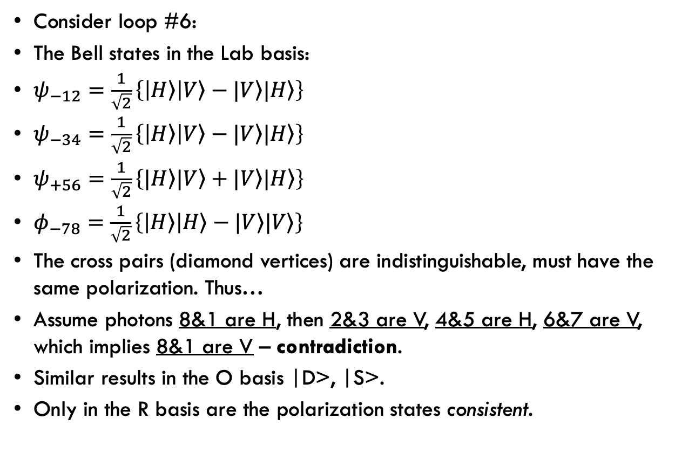
Global Self-Consistency – Bell
Consider loop #6:
The Bell states in the Lab basis:
$ψ_{−12}=\frac{1}{\sqrt{2}}\left\{\left|\left.H\right\rangle \right|\left.V\right\rangle −|\left.V\right\rangle |\left.H\right\rangle \right\}$
$ψ_{−34}=\frac{1}{\sqrt{2}}\left\{\left|\left.H\right\rangle \right|\left.V\right\rangle −|\left.V\right\rangle |\left.H\right\rangle \right\}$
$ψ_{+56}=\frac{1}{\sqrt{2}}\left\{|\left.H\right\rangle |\left.V\right\rangle +|\left.V\right\rangle |\left.H\right\rangle \right\}$
$φ_{−78}=\frac{1}{\sqrt{2}}\left\{\left|\left.H\right\rangle \right|\left.H\right\rangle −|\left.V\right\rangle |\left.V\right\rangle \right\}$
The cross pairs (diamond vertices) are indistinguishable, must have the same polarization. Thus…
Assume photons 8&1 are H, then 2&3 are V, 4&5 are H, 6&7 are V, which implies 8&1 are V – contradiction.
Similar results in the O basis |D>, |S>.
Only in the R basis are the polarization states consistent.
Dashboard
Notes:
The polarization states around a self-referential form must be consistent.
Unitary evolution is basis agnostic.
But a closed loop in spacetime is not basis agnostic.
The re-entrance forces a global consistency condition which selects a preferred basis.

Slide 38
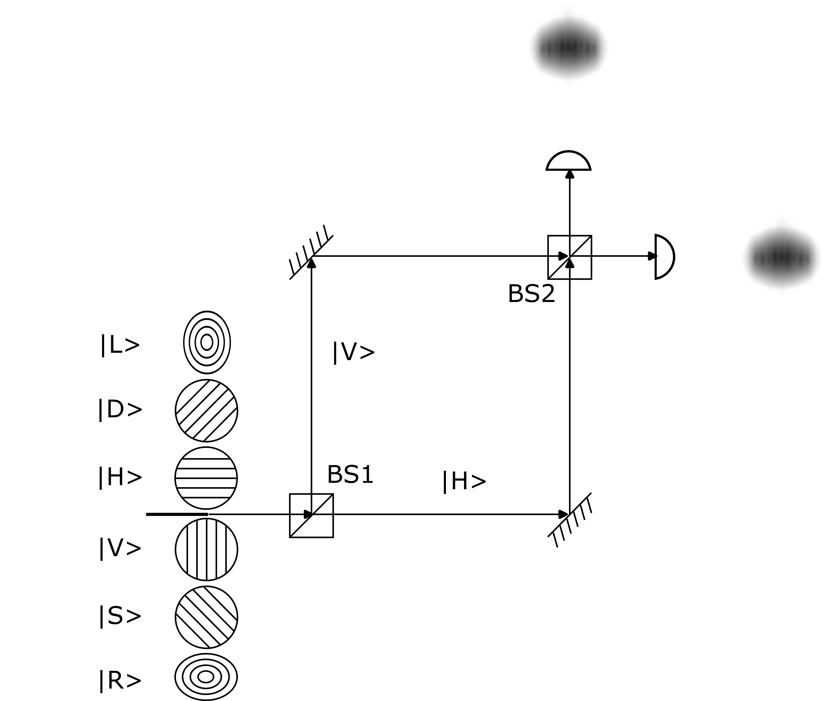
Diffraction
Mach-Zehnder interferometer in the lab basis.
One arm is |H>, one is |V>.
Measure in a basis.
Diffraction patterns only.
Dashboard
Notes:
Consider a Mach-Zehnder interferometer with the polarizing beam splitters set up so horizontally polarized photons go down one arm, while vertically polarized photons go down the other.
Random insertion of photons will reveal only diffraction patterns.
In the lab basis, every photon travels along only one arm.
In the bases conjugate to the lab bases, the interference patterns for each eigenvector are phase inverted, so their sum is still just a diffraction pattern.
Without post-selection, single-photon detections produce only the diffraction distributions associated with each arm.
There are three bases: the lab basis (|H>, |V>), the linear basis orthogonal to it (|D>, |S>), and the circular basis (|L>, |R>).

Slide 39
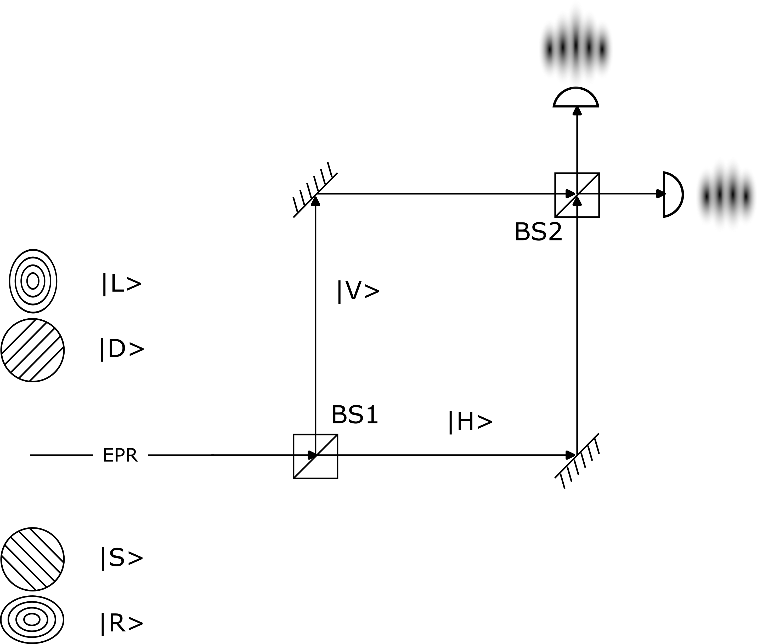
Interference
Use entanglement.
Orthogonal bases.
Post-select to see interference patterns.
Dashboard
Notes:
Entanglement can be used to tease out the interference patterns by post-selecting events in the bases conjugate to the laboratory basis.
This is basically quantum erasure.

Slide 40
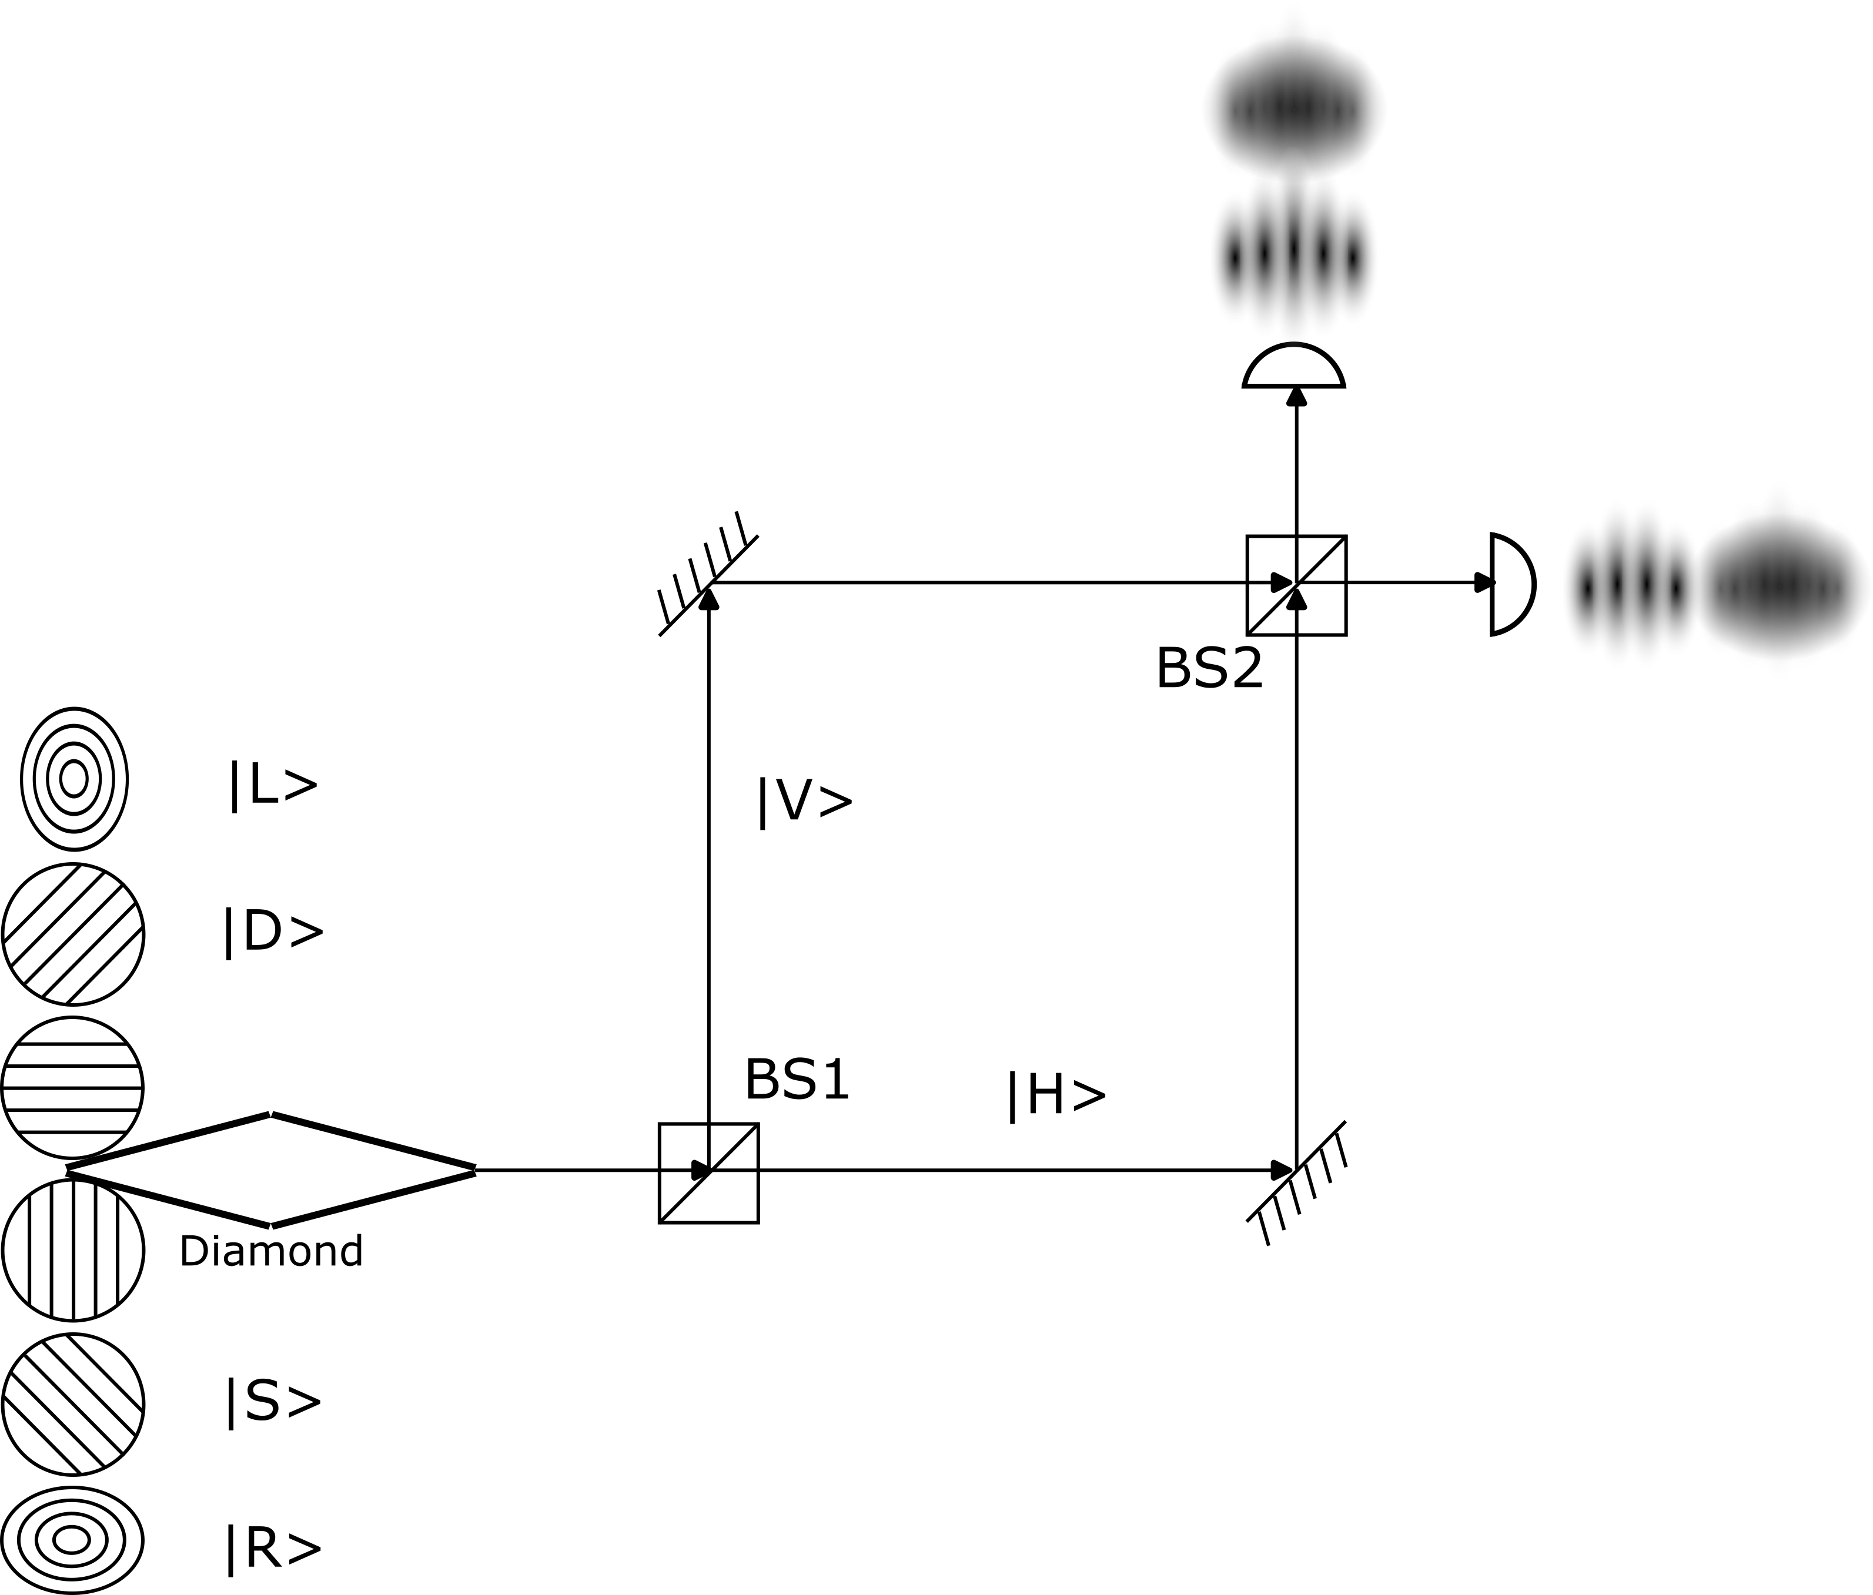
An Experimental Prediction
Test diamond loop.
Interference only for indeterminate loops in the matching basis.
The claim of self-collapse is testable.
Dashboard
Notes:
Replace the EPR source with the diamond loop.
There are 256 possible loops.
Quantum Temporal Paradox (QTP) is the hypothesis that this loop has a very specific collapse profile, depending on which Bell state each EPR arm of the diamond is in.
One quarter of cyclic configurations are predicted to remain uncollapsed.
In the other cases, 25% will collapse in the lab basis, 25% in the ortho basis, and 25% in the circular basis.
This global consistency constraint, that an isolated quantum system may self-collapse into a specific basis, is falsifiable.

Slide 41
Experimental Permutations
Collapse Measurement | Uncollapsed 25% | Lab (|H>, |V>) | Ortho (|D>, |S>) | Circular (|L>, |R>)
Lab (|H>, |V>) | Diffraction | Diffraction | Diffraction | Diffraction
Ortho (|D>, |S>) | Interference | Diffraction | Interference | Diffraction
Circular (|L>, |R>) | Interference | Diffraction | Diffraction | Interference
Falsifiable
QTP creates tension with our classical notion of linear time.
The present as an infinitely thin interface between past and future.
The diamond loop is a static structure in spacetime.
Any photon prior to encountering the loop is indeterminate.
After a collapsed loop, every photon’s state is fixed.
Have entangled the near future with the recent past into an expanded present.
Within this window around now, past, present, and future become ambiguous.
The present has a thickness – call it a chronoblock.
Dashboard
Notes:
If the loop is in a configuration that does not collapse, any measurement in a basis orthogonal to the lab basis can be used to post select, revealing interference patterns.
If the loop self-collapses into the lab basis, every photon goes down only one arm of the interferometer, diffraction patterns only.
If the measurement of the left pair of photons in the diamond loop is in the lab basis, again every photon goes down only one arm of the interferometer, diffraction patterns only.
However, if the diamond loop self-collapses in a basis conjugate to the lab basis, then a measurement in that basis can be used to post select, revealing interference patterns.
The signature of this theory is the quad of yellow/green cells – no self-collapse, all green; self-collapse, two green, two yellow.

Slide 42
An Objective Measurement Mechanism?
Laws of Form led to formal self-reference which led to conjugate bases.
Self-referential loops in logic can be inconsistent in some bases.
Tri-conjugate logic (TCL) displays the same homology as the Bell states.
Conjecture: quantum systems evolve until global consistency forces collapse.
Spacelike connections can be arranged to be self-referential.
Compatible with either spacelike causality or spacelike correlations.
Diamond paradox is testable (falsifiable); makes very specific predictions.
However, it falls short of QTP ambitions.
The MZI provides symmetry breaking, the basis of the arms.
In an EPR experiment, the environment fully defines the collapse basis.
In the diamond paradox the MZI is not sufficient, the loop provides part of the specification.
A step closer to self-collapse – quantum level only.
But it is a test of the symmetric spacetime interval.
Candidate spec for the top edge of a world ribbon.
Dashboard
Notes:
The challenge for World Ribbons is specifying the top edge when a measurement occurs.
The Symmetric Spacetime Interval (SSI) was a good answer for light but was not testable.
The Diamond Paradox provides a test which current tech is, or is close to, being able to resolve.

Slide 43
Section
Dashboard
Notes:
If retro-causal information is physically possible, thermodynamics must be reformulated in terms of causal order rather than temporal order.

Slide 44
Section
Dashboard

Slide 45
Section
Dashboard

Slide 46
Section
Dashboard

Slide 47
Section
Dashboard

Slide 48
Section
Next
next
Dashboard

