Slide 1
Interoperability Simulator for Data Spaces
Faculty of Electrical Engineering, Mathematics and Computer Science (EEMCS)
Master Project
Aldi Doanta Kurnia
Master Computer Science - Software Technology
University of Twente

Slide 2
Interoperability Challenges: General Context
Data incompatibility often happens in real-life scenarios, where an organization needs to exchange data with the other organization.
Examples of incompatibility factors: different file formats, different data schemas, different meaning of data instances.
Data space is one of the proposed approaches to create an interoperable data-sharing ecosystem. International Data Spaces (IDS) from IDSA (International Data Space Association) is one of the examples of data space.
IDS is working on the latest version of the IDS Reference Architecture Model (IDS-RAM) that uses five layers to describe the IDS architecture, from the high-level Business Layer to the lower-level System Layer. https://github.com/International-Data-Spaces-Association/IDS-RAM_4_0

Slide 3
Interoperability Challenges: Interoperability Simulator
There was a research project named CLiCKS (Connecting Logistics interfaces, Converters, Knowledge, and Standards), proposing two additional components for IDS: IDS Connector Store and Interoperability Simulator. https://www.nwo.nl/en/projects/43919633-0
There was a research about IDS Connector Store that was part of an EngD Thesis at UT. https://doi.org/10.3990/1.9789036557177
Currently there are no clear design and prototype implementation of the Interoperability Simulator.

Slide 4
Goals
1
Design an architecture of Interoperability Simulator
2
Implement a prototype of Interoperability Simulator
that can help IDS participants in solving their interoperability problems
that shows how it works in an interoperability scenario between two data participants

Slide 5
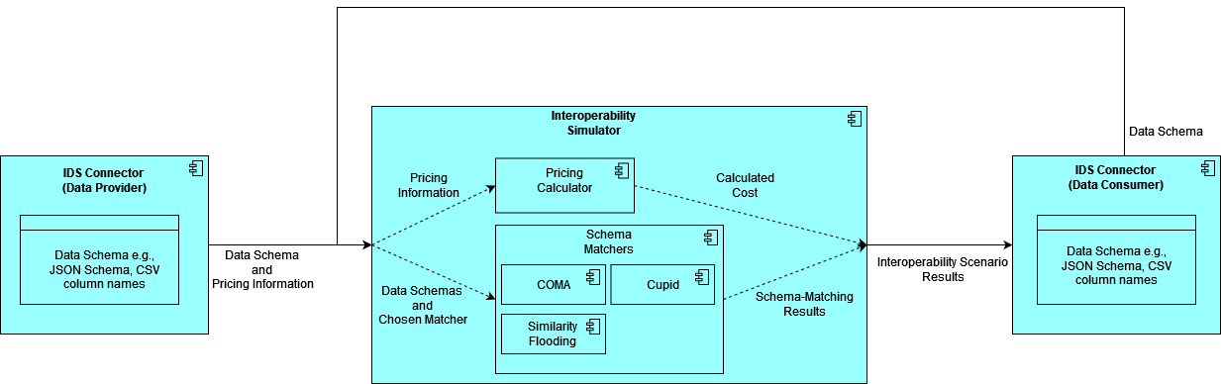
Interoperability simulator

Slide 6
Interoperability simulator: Input
The schemas from Data Provider and Data Consumer are used as inputs for the Schema Matcher module.
Data Provider might charge the Data Consumer for accessing the data. In this case, the pricing information (such as the payment model and the amount) is also sent to the Interoperability Simulator.
Sample Input
dataprovider_schema.csv: EID,Authors,Cited by,Title,Year,Source title,DOI
dataconsumer_schema.csv:
EID,cited-by,Auteurs,Country,Document Type,City
pricing information:
Recurring payment, €50 per month for 12 months

Slide 7
Interoperability simulator: Process
The Schema Matcher module performs schema matching from Data Provider’s schema to Data Consumer’s schema.
The Pricing Calculator module calculates the total cost based on the provided pricing information.
dataprovider_schema.csv EID,Authors,Cited by,Title,Year,Source title,DOI
EID,cited-by,Auteurs,Country,Document Type,City dataconsumer_schema.csv
cost calculation: €50/month x 12 months = €600

Slide 8
Interoperability simulator: Output
The Schema Matcher module outputs the schema mapping, along with the similarity score.
The Pricing Calculator module gives the total cost that needs to be paid by Data Consumer to use the provided data.
mat
matches:
(('table_1', 'Authors'), ('table_2', 'Auteurs')): 0.5838747
(('table_1', 'Cited by'), ('table_2', 'cited-by')): 0.66644174
(('table_1', 'EID'), ('table_2', 'EID')): 0.83644176
total cost: €600

Slide 9
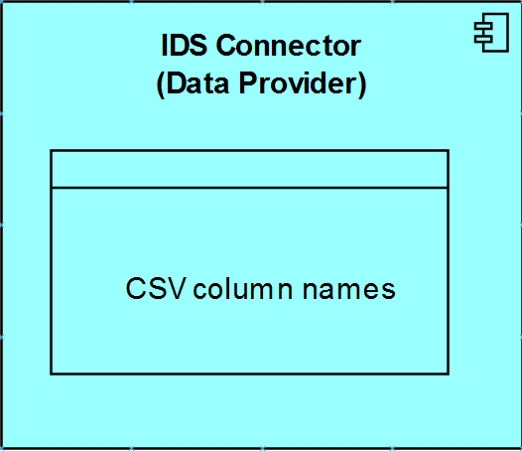
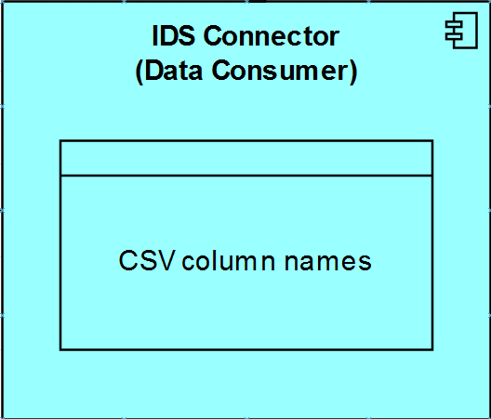
Example Interoperability Scenario
Source Schema trip_id
companies.id
companies.name
companies.description
companies.role,
status
Target Schema
id
status
actors.entity.id
actors.entity.name
actors.roles
actors.associationType
Example scenario: match an arbitrary schema with a simplified Open Trip Model (OTM) schema.
Current prototype only supports CSV column names as input.
Workaround for JSON schemas: flatten the nested JSON objects using delimiter such as dots ‘.’

Slide 10
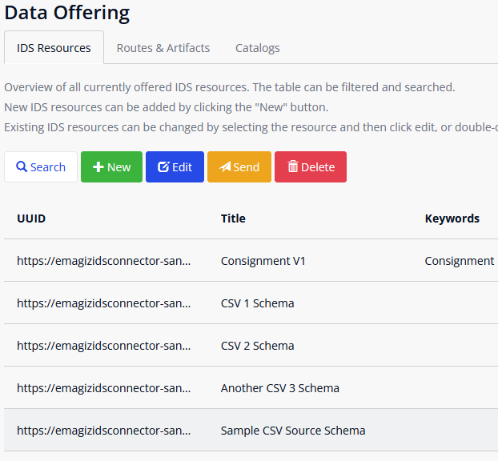
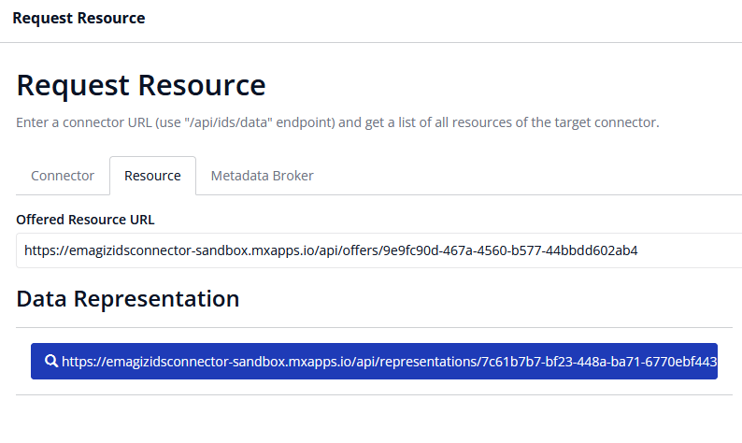
IDS Data Offering and Data Consumption
Source Schema as an offered IDS Resource by the Data Provider
Data Consumer requests access to the Source Schema

Slide 11
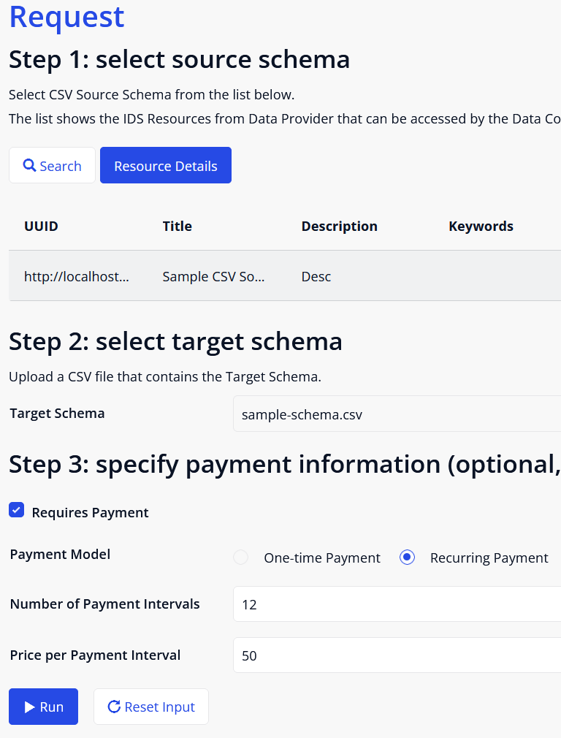
Inputs of Interoperability Simulator
Source Schema as consumed IDS Resource from the Data Provider
Target Schema uploaded by user
Optional pricing information if the Data Provider sets the data as commercial data

Slide 12
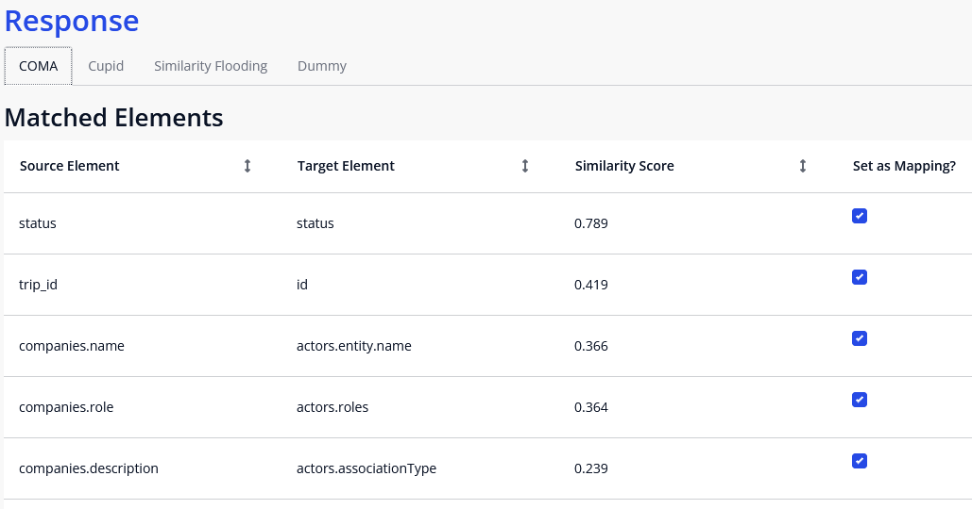
Output – Matched Elements
Shows matched elements from every Schema Matchers.
Each matched pair is provided with a similarity score, ranging from 0 to 1.

Slide 13
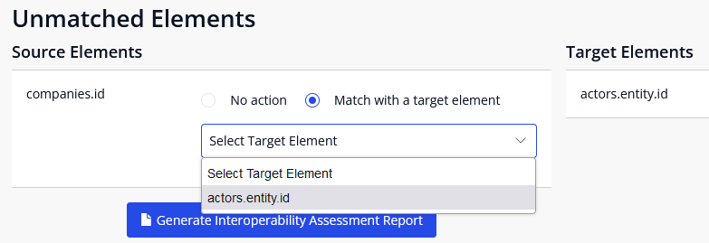
Output – Unmatched Elements
User can decide what to do with unmatched elements.

Slide 14
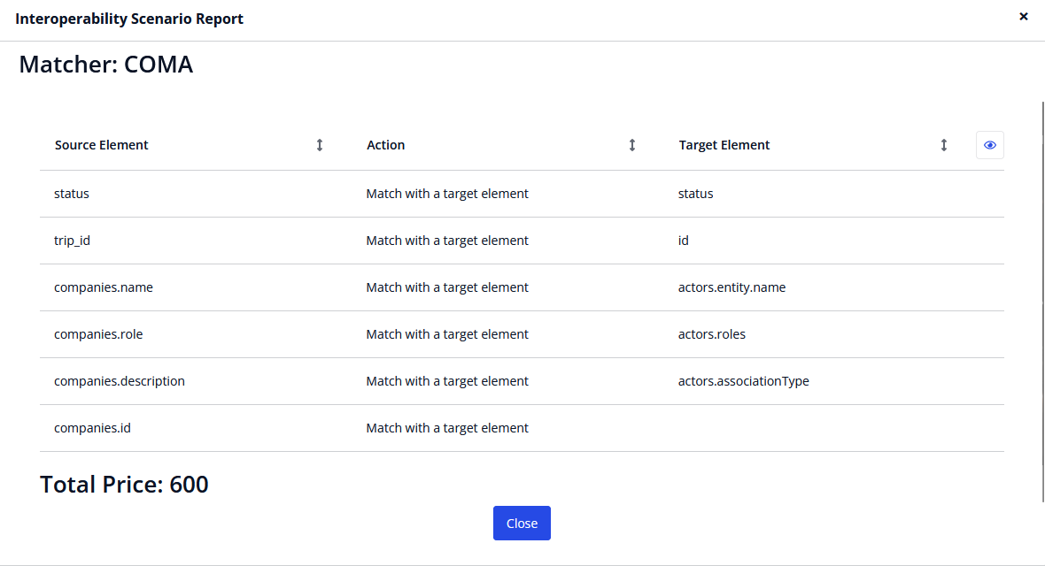
Interoperability Scenario report
A report can be generated to show a summary of the interoperability scenario.

Slide 15
Thank You for Your Feedback and Suggestions!
Backend source code is available on GitHub. Feel free to submit an Issue. https://github.com/aldidoanta/mp-isim
Any general questions or feedback? Email me at aldidoantakurnia@student.utwente.nl

