Slide 1
ATTESTIA
01 / PROBLEM
Every new community asks contributors
to prove themselves again
Work is scattered.
Review starts over.
Repositories, research documents and bounty submissions rarely carry the full review context.
Organizers reconstruct who did the work, whether it met the brief and who accepted it.
Portable evidence could make the next evaluation easier.
Build-ready product plan • Investment thesis to validate
Notes:
Useful work already exists, but the context needed to evaluate it is fragmented. Attestia’s starting hypothesis is that a structured review becomes more valuable when another community can inspect and reuse it.
Source: Attestia — Product Requirements Document, v1.1, supplied by user. Sections 1–3, 5. Product capabilities are planned unless explicitly identified otherwise. Concept UI and worked examples are illustrative. No independent market research added.

Slide 2
ATTESTIA
02 / INITIAL CUSTOMER
Start where reviewing contributions
is already part of the job
Role | Job to be done | Value hypothesis
DAO / hackathon admin | Coordinate contribution reviews | Less repeated review coordination
Contributor | Show accepted work | Reusable proof of contribution
Reviewer | Assess a specific claim | Clear evidence and criteria
External verifier | Inspect prior work | Public access without a wallet
First pilot: one community, one contribution type, credible reviewers.
Initial buyer hypothesis: DAO administrators and hackathon organizers
Notes:
We begin with organizations that already coordinate reviews, giving Attestia a specific operational entry point. Human and AI collaboration adds a provenance question, but adoption and willingness to pay still need validation.
Source: Attestia — Product Requirements Document, v1.1, supplied by user. Sections 2.3, 5, 17, 20. Product capabilities are planned unless explicitly identified otherwise. Concept UI and worked examples are illustrative. No independent market research added.

Slide 3
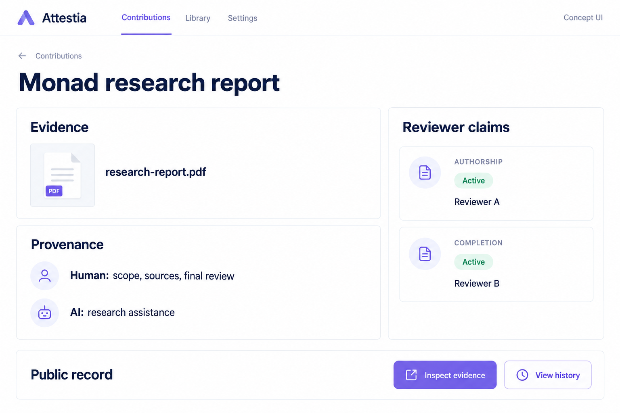
ATTESTIA
03 / SOLUTION
One reviewed contribution becomes
a reusable work credential
Submit evidence
Artifact, sources and disclosed AI involvement.
Review specific claims
Preserve the decision and its supporting context.
Reuse the record
Public page, export or API.
MVP portability: shared reads and verification of a Monad-anchored record
Notes:
Attestia preserves evidence and reviewer context that often disappear after a submission is accepted. The value proposition becomes stronger when a second organization uses the same record to inform its own decision.
Visual: AI-generated illustrative product concept, not a shipped interface. Portability does not include cross-chain writes in the MVP.
Source: Attestia — Product Requirements Document, v1.1, supplied by user. Sections 3–4, 6. Product capabilities are planned unless explicitly identified otherwise. Concept UI and worked examples are illustrative. No independent market research added.

Slide 4
ATTESTIA
04 / PRODUCT / CLAIMS
Specific claims make work history
easier to evaluate
Claim | What the reviewer assesses
Authorship | Who created the work
Completion | Whether the requested scope was delivered
Quality | Whether the work meets a versioned rubric
Usage | Whether someone accepted, merged or used the work
Provenance | Whether disclosures align with available evidence
Every claim retains its reviewer, evidence reference and lifecycle state
Notes:
A specific claim gives the next evaluator more useful information than a generic endorsement. It also defines the reviewer’s responsibility: assess a stated claim against evidence and, where relevant, a documented rubric. Attestations represent reviewer claims, not guarantees of objective truth.
Source: Attestia — Product Requirements Document, v1.1, supplied by user. Sections 7, Epic 4; 8. Product capabilities are planned unless explicitly identified otherwise. Concept UI and worked examples are illustrative. No independent market research added.

Slide 5
ATTESTIA
05 / PRODUCT / HISTORY
A work record stays useful
when its status can change
2
1
History remains visible
Active counts update after processing. Revoked claims remain inspectable.
active claims
active claim
After one reviewer revokes a claim
Explainable categories
Counts, evidence coverage and unique reviewers.
Illustrative example. Agent permissions in the MVP are declarations, without enforcement.
Notes:
Work history needs to reflect corrections without losing accountability for earlier decisions. Attestia makes changes visible and leaves the ultimate judgment with the organization consuming the evidence. The two-to-one example is illustrative, not a measured product result. Agent identity can link to contributions, while policy enforcement is outside MVP scope.
Source: Attestia — Product Requirements Document, v1.1, supplied by user. Sections 7, Epics 5 and 7; 10–12. Product capabilities are planned unless explicitly identified otherwise. Concept UI and worked examples are illustrative. No independent market research added.

Slide 6
ATTESTIA
06 / DIFFERENTIATION
The potential advantage lies in
the review workflow and its context
Ecosystem layer | Attestia’s proposed focus
Generic attestation infrastructure | Contribution-specific review coordination
Personhood signals | Evidence about completed work
Reputation systems | Explicit, claim-specific reviewer decisions
Agent identity standards | Linked work and provenance
Defensibility to prove
Repeat use, reviewer relationships, rubric history and integrations.
Custom MVP registry. EAS integration remains an option. Network effects are unproven.
Notes:
Attestia’s case depends on solving the review workflow well enough for organizations to adopt it. Repeated use could create valuable context and integrations, but that defensibility hypothesis needs evidence of retention and cross-community reuse. This table describes product focus rather than an independently verified competitor feature audit.
Source: Attestia — Product Requirements Document, v1.1, supplied by user. Sections 2.4, 3, 10.4. Product capabilities are planned unless explicitly identified otherwise. Concept UI and worked examples are illustrative. No independent market research added.

Slide 7
ATTESTIA
07 / MARKET
Size the market around organizations
that will pay to verify work
BEACHHEAD
Measure | Bottom-up input
TAM | Relevant buyers × annual spend
SAM | Supported buyer subset × spend
SOM | Reachable, convertible buyers within a stated period × spend
DAOs and hackathon operators
with recurring review workflows
Expansion hypotheses
Grant programs, open-source communities and verification API consumers.
Market size: research required
No validated TAM, SAM or SOM in the PRD. Adjacent segments are strategic hypotheses.
Notes:
The initial market should be measured through identifiable buyers and their existing review workload. A defensible dollar opportunity requires a verified account universe and willingness-to-pay evidence. Separately assess API demand to avoid double counting subscription buyers. No market-size figures are supplied by the PRD.
Source: Attestia — Product Requirements Document, v1.1, supplied by user. Sections 20. Product capabilities are planned unless explicitly identified otherwise. Concept UI and worked examples are illustrative. No independent market research added.

Slide 8
ATTESTIA
08 / BUSINESS MODEL
Free profiles support
paid organizational workflows
Offering | Proposed price | Value
Individual | Free | Public work history and export
Community | $29–$99 / month | Review queues, roles and rubrics
Organization | $199–$499 / month | Multiple workspaces and private evidence
API | Usage-based, TBD | Verification queries and webhooks
Enterprise | Custom, TBD | Dedicated indexing and tailored controls
Pricing hypotheses. Validate willingness to pay and delivery costs before building billing.
Notes:
Free profiles give contributors a reason to participate, while organizational workflow needs provide the proposed revenue model. Pricing becomes credible when buyers confirm the value and pilot costs show the model can support healthy margins. Costs include RPC and indexing, storage, sponsored gas and support. Charge for workflow and service reliability rather than positive attestation outcomes.
Source: Attestia — Product Requirements Document, v1.1, supplied by user. Sections 9.4, 20. Product capabilities are planned unless explicitly identified otherwise. Concept UI and worked examples are illustrative. No independent market research added.

Slide 9
ATTESTIA
09 / GO-TO-MARKET
The decisive signal is another
community using the record
1 pilot community
Pilot metric | Target hypothesis
New users publishing | ≥40%
Reviewer decision rate | ≥50%
First attestation, median | <48 hours
Accessible evidence | ≥90%
Required claims in 7 days | North star: baseline TBD
10–20 credible reviewers
One contribution type
Track repeat contribution or second-workspace verification within 60 days.
Targets are hypotheses, not traction. Second-workspace use tests the portability proposition.
Notes:
A populated profile proves that someone created a record. The stronger signal is repeat contribution activity and another organization choosing to inspect or rely on that history, alongside willingness to pay. Verified Contribution Completion Rate is the percentage of submissions receiving required structured attestations within seven days, with the target still to establish. Metrics are independent and should not be read as one conversion funnel.
Source: Attestia — Product Requirements Document, v1.1, supplied by user. Sections 4.3–4.4, 19–20. Product capabilities are planned unless explicitly identified otherwise. Concept UI and worked examples are illustrative. No independent market research added.

Slide 10
ATTESTIA
10 / EXECUTION
The next milestone is a secure pilot
with evidence of repeat use
Timing | Milestone | Decision gate
Week 1 | Discovery and pricing tests | One partner commitment
Weeks 2–5 | Build the verification loop | Two-wallet end-to-end flow
Weeks 6–8 | Context and hardening | Independent review; pilot readiness
Weeks 9–10 | Capped mainnet pilot | Stable operations; zero critical/high issues
Post-pilot | Retention and monetization | 60-day reuse and willingness to pay
Funding priorities
Engineering capacity, independent review and pilot validation.
Solo-builder plan. Raise and runway remain to be defined. Timeline is provisional.
Notes:
The plan converts the product thesis into measurable adoption and reliability milestones. The investment ask should fund enough execution capacity and observation time to establish whether communities repeatedly use these records and will pay for the workflow. The PRD assigns delivery to one builder, so independent contract review, a second multisig signer and a documented handoff are pre-mainnet requirements. Complete privacy, moderation and legal readiness gates before relevant public claims. The 60-day retention result extends beyond Week 10. Raise amount and runway are not supplied.
Source: Attestia — Product Requirements Document, v1.1, supplied by user. Sections 17–18, 20–23. Product capabilities are planned unless explicitly identified otherwise. Concept UI and worked examples are illustrative. No independent market research added.

