Slide 1

UI Kit/Style Guide
Color
Primary
Baground
Text
Mix Color
#ff0000
#F3F3F3
#000000
#00a859
#8979ff
2. Typography
1) App
Font Type : Poppins
Size & Font Weight:
a. Tittle : 24 px (Semi Bold)
b. Section Tittle : 20 px (Semi Bold)
c. Item Tittle : 16 px (Medium)
d. Body Text : 12 px (Reguler)
e. Button Text : 14 px (Medium)
2) Web
Font Type : Poppins
Size & Font Weight:
a. Tittle : 32 px (Semi Bold)
b. Section Tittle : 32 px (Semi Bold)
c. Item Tittle : 20 px (Medium)
d. Body Text : 20 px (Reguler)
e. Button Text : 20 px (Medium)

Slide 2


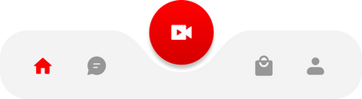
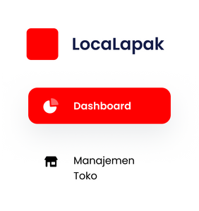
3. Button
Primary Button
Secondary Button
Disabled Button
4. Component
Form
Masukkan Username
Checkbox
Radio Button
Bottom Navigation
Side Bar

