Slide 1
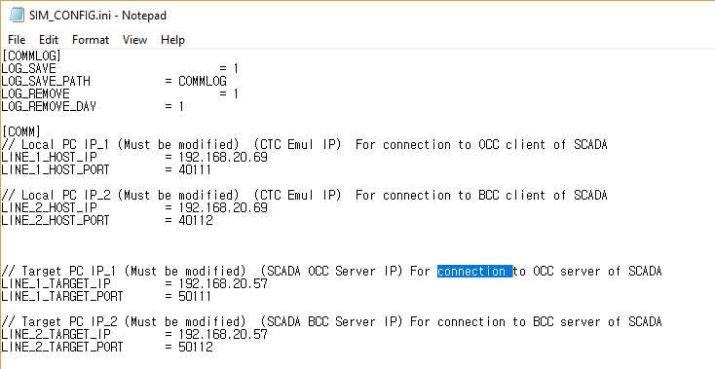
Program Configuration Guide
1. Open file 'SIM_CONFIG.ini'
The following screen will be displayed
2. Change the following items.
LOG_SAVE : If the value is 1, the log is saved. If the value is 0, the log is not saved.
LOG_SAVE_PATH : Set the folder where log files are saved.(It is created as a subfolder with the executable file.)
LOG_REMOVE : If the value is 1, the log is automatically deleted. If the value is 0, the log is not automatically deleted.
LOG_REMOVE_DAY : Log deletion cycle (unit is one day).
LINE_1_HOST_IP : IP Address of Line1 (IP address of network card 1 of the PC where the program is installed)
LINE_1_HOST_PORT : Fixed network port '40111’ - Connect to OCC
LINE_2_HOST_IP : IP Address of Line2 (IP address of network card 2 of the PC where the program is installed)
LINE_2_HOST_PORT : Fixed network port '40112’ - Connect to BCC

Slide 2
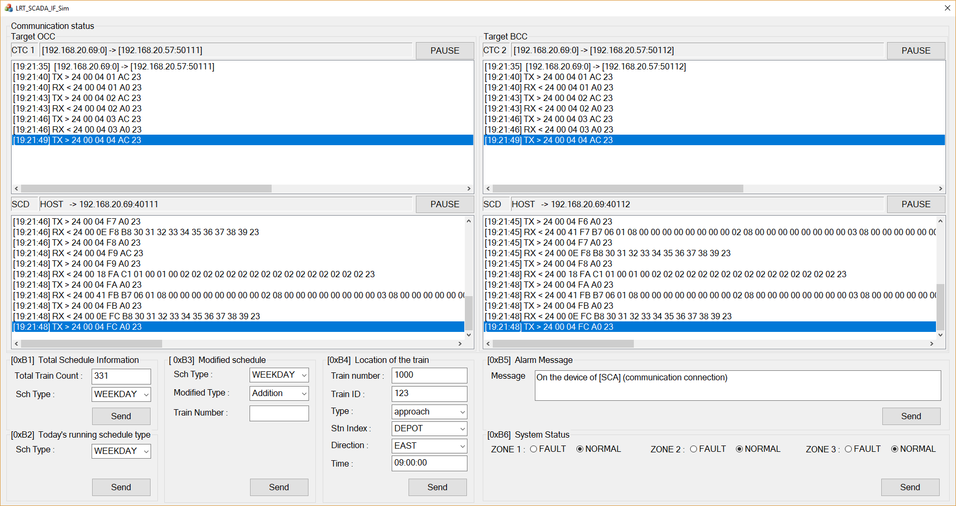
How to use the program
1. Main screen
①
②
③
④
① : Comm Log(OCC)
The top screen is the transfer log of the CTC simulator.
The bottom screen is the log received from SCADA.
② : Comm Log(BCC)
The top screen is the transfer log of the CTC simulator.
The bottom screen is the log received from SCADA
③ : Stop display of Log(OCC)
④ : Stop display of Log(BCC)
③
④
⑤ : Send Message (0xB1)
⑥ : Send Message (0xB2)
⑦ : Send Message (0xB3)
⑧ : Send Message (0xB4)
⑨ : Send Message (0xB5)
⑩ : Send Message (0xB6)
⑤
⑦
⑧
⑨
⑥
⑩

Slide 3
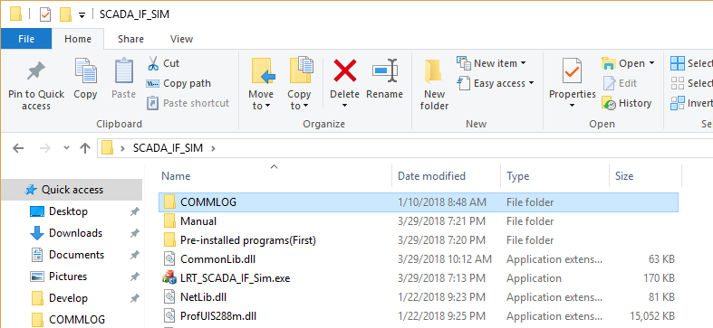
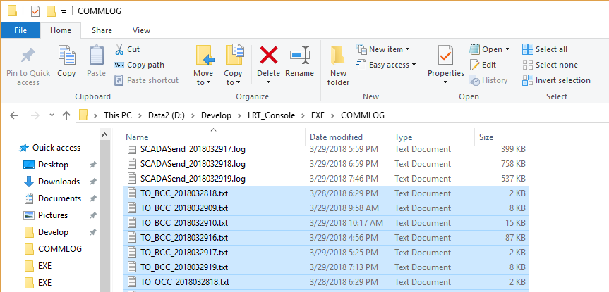
The Timetable log sent by the CTC simulator is stored in the storage folder
The schedule data sent to the CTC simulator is stored in the COMMLOG folder, which is a subfolder of the folder where the executable file is located.
The file name is in the form 'TO_BCC_DATA.txt', and the file name with 'BCC' is the log sent to the BCC server.

