Slide 1
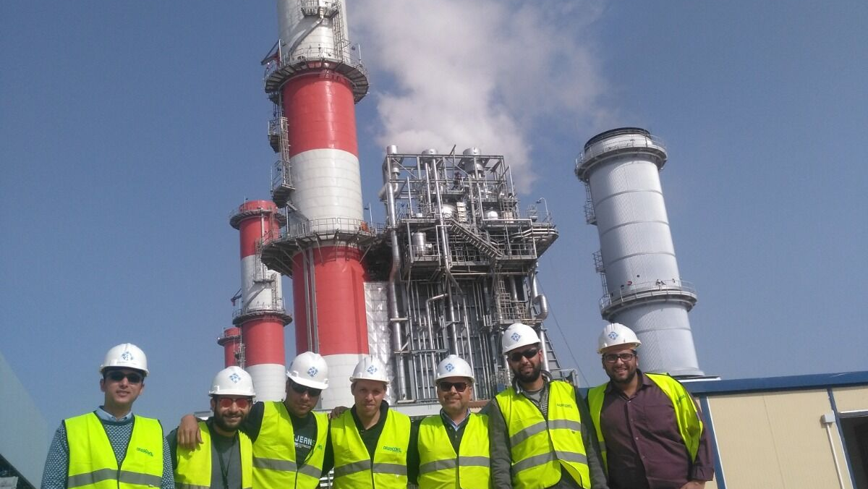


COMPANY PRESENTATION · 2026
SUCCESS STORIES
28 reference projects in Egypt, Saudi Arabia and Oman — DCS commissioning, loop checks, start-up and training since 1991.
patdcs.com · +20 109 991 2020 · info@patdcs.com
Notes:
Cover photo: PAT team on site (PAT photo).

Slide 2






















TRUSTED BY
CONTRACTORS, VENDORS AND PLANT OWNERS
Companies PAT engineers and technicians have delivered for since 1991.
EPC CONTRACTORS & SYSTEM VENDORS
PLANT OWNERS & END USERS
POWER AUTOMATION TEAM · SUCCESS STORIES
02
Notes:
Logos are trademarks of their owners and are shown to identify companies PAT has worked for. Check each company's policy before external use — Saudi Aramco in particular requires written approval to reference its name or logo in marketing material. Name tiles are used where no logo file is available.

Slide 3
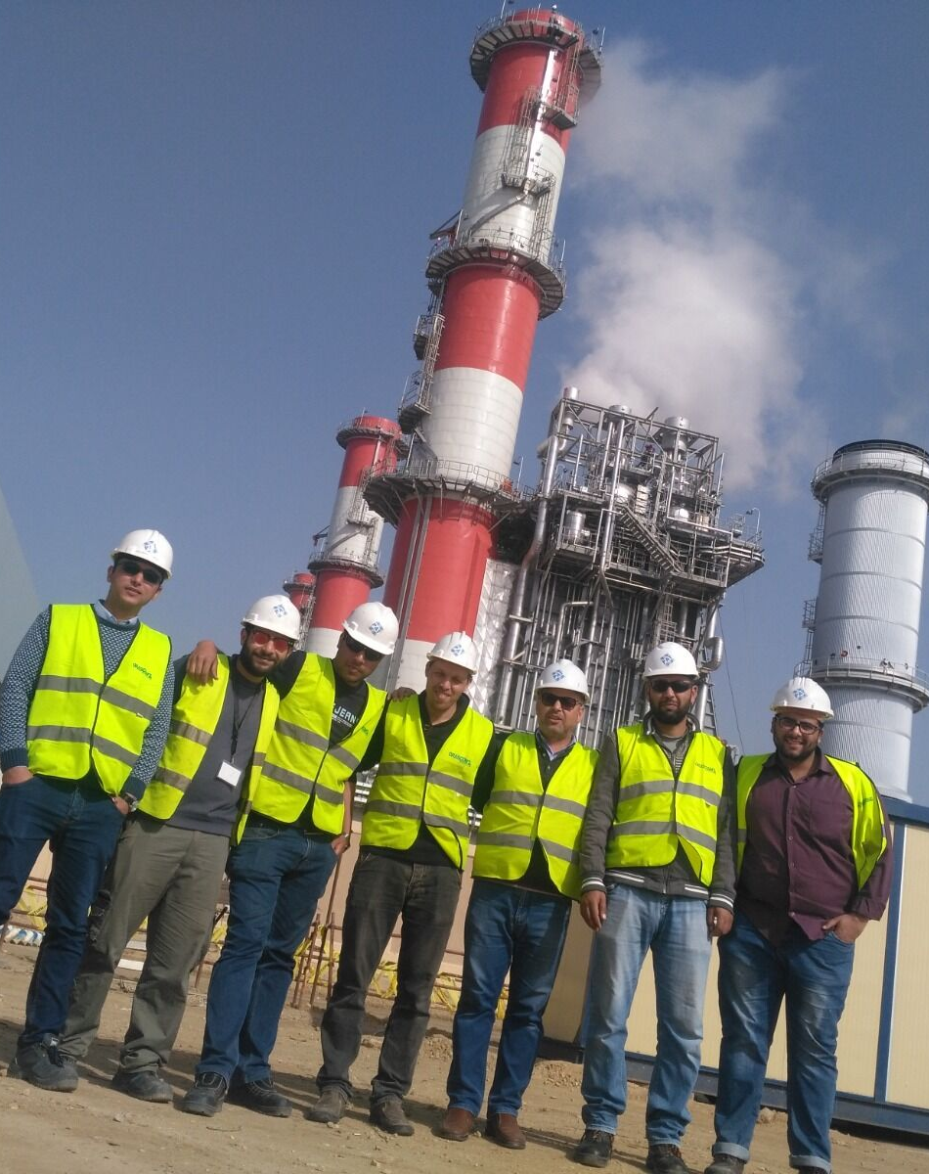
PAT IN NUMBERS
THE COMMISSIONING SPECIALISTS
1991
Established in Egypt
28
Reference projects
3
Countries: Egypt, Saudi Arabia, Oman
12 GW+
Combined capacity of the plants we worked on
24/7
Support for our clients
POWER AUTOMATION TEAM · SUCCESS STORIES
03
Notes:
12 GW+: sum of the plant capacities in the reference list, counting each plant once (Rabigh II and Shoaiba Stage I not counted). Photo: PAT team on site.

Slide 4
SECTORS WE SERVE
INDUSTRIES WE COMMISSION
8
8
5
3
STEAM POWER PLANTS
COMBINED-CYCLE POWER PLANTS
GAS-TURBINE POWER PLANTS
WATER & UTILITIES
Ataka Power Plant 2×300 + 2×150 MW, Shoaiba ST Power Plant 3×250 MW, Rabigh Power Plant 4×300 MW
Damietta CCPP 1,230 MW, New Talkha & El Kurimat II CCPP, New Talkha CCPP 750 MW
PP4 Riyadh Power Plant, SEC4A Al Jouf, SEC4A Al Quryat
Shoaiba lime water plant, Marafiq Yanbu II 3×270 MW, Yanbu I & II
1
1
2
Counted by reference project.
Most of our work is DCS commissioning on power plants — and the same procedures carry over to water, oil & gas and industrial sites.
OIL & GAS PROCESSING
SOLAR (ISCC)
INDUSTRIAL & MARINE
Abqaiq plants
Solar Energy Kurimat Power Plant
Suez Sokhna Port United Sugar Project, El Esraa petroleum tanker ship, Alexandria
POWER AUTOMATION TEAM · SUCCESS STORIES
04

Slide 5
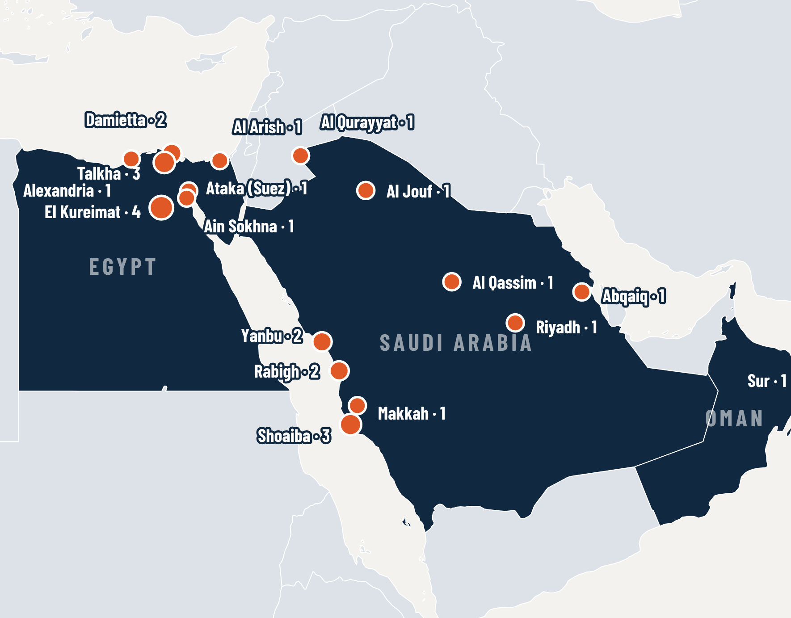

WHERE WE HAVE WORKED
THREE COUNTRIES, ONE TEAM
14
EGYPT
reference projects
13
SAUDI ARABIA
reference projects
1
OMAN
reference projects
Pins show plant locations; numbers are projects per site.
POWER AUTOMATION TEAM · SUCCESS STORIES
05
Notes:
Map: Natural Earth (public domain). Site locations are approximate (city level).

Slide 6
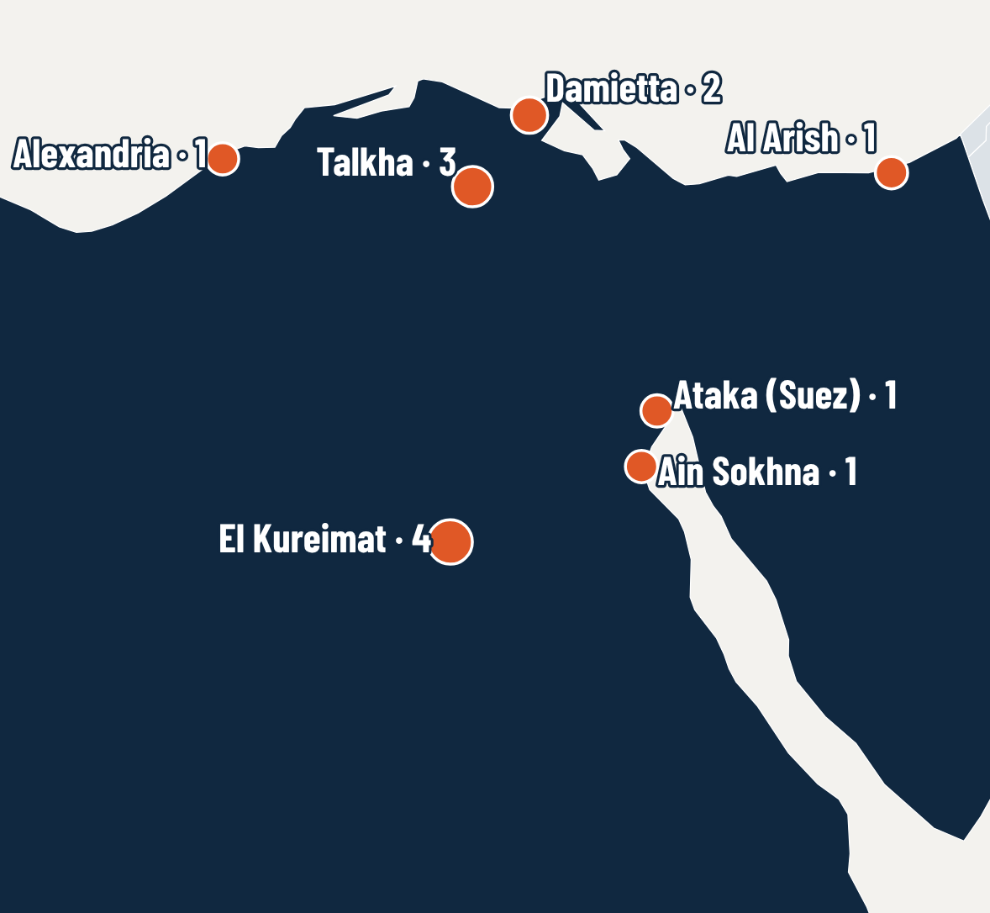
2004–2020
EGYPT
14 REFERENCE PROJECTS
Damietta · Talkha · El Kureimat · Ataka (Suez) · Ain Sokhna · Al Arish · Alexandria
Steam and combined-cycle power plants, solar ISCC, industrial and marine.
POWER AUTOMATION TEAM · SUCCESS STORIES
06

Slide 7
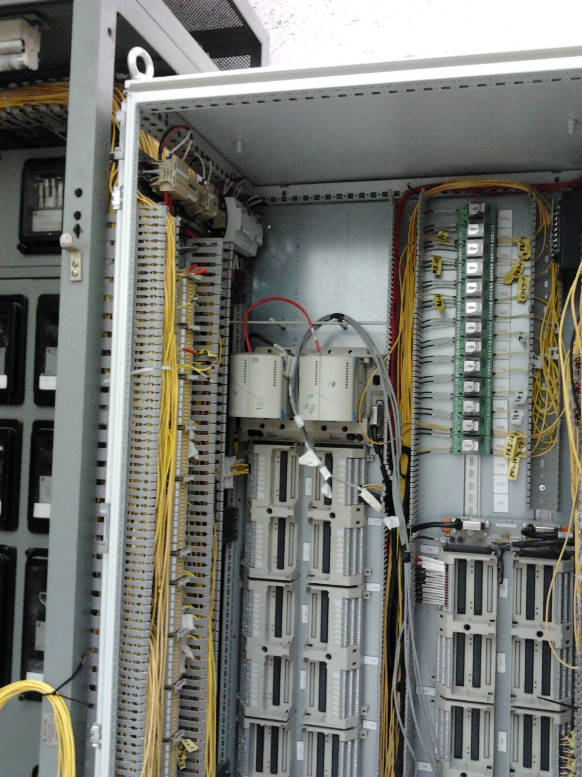
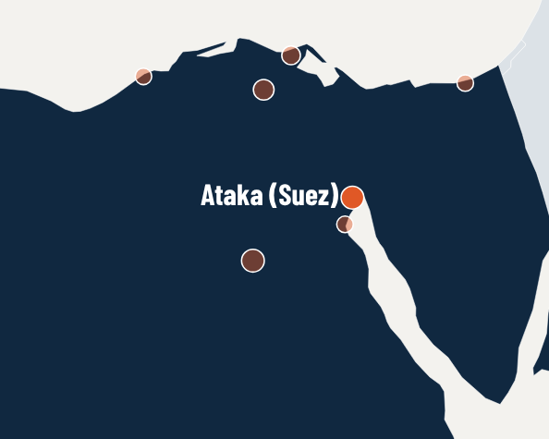
EGYPT · 2004 · EMERSON OVATION
900
ATAKA POWER PLANT 2×300 + 2×150 MW
MW
DCS retrofit
CONTRACTOR
END USER
Emerson
Egyptian Electricity Holding Co.
THE PROJECT
DCS retrofit of a steam power plant: old panels removed, new DCS installed and units returned to commercial operation.
PAT SCOPE
• Removal of the old panels and supervision of the new DCS installation and replacement
• Commissioning and start-up, returning the DCS units to commercial operation
• Owner staff training courses on DCS plant operation and maintenance
RESULT DCS units returned to commercial operation; owner staff trained.
POWER AUTOMATION TEAM · SUCCESS STORIES
PAT on site — illustrative photo
07
Notes:
Reference no. 01.
Contractor(s): Emerson — from the PAT reference list.
End user: Egyptian Electricity Holding Co. — TO CONFIRM (not in the reference list).
Photo: PAT photo (illustrative, not from this site)

Slide 8
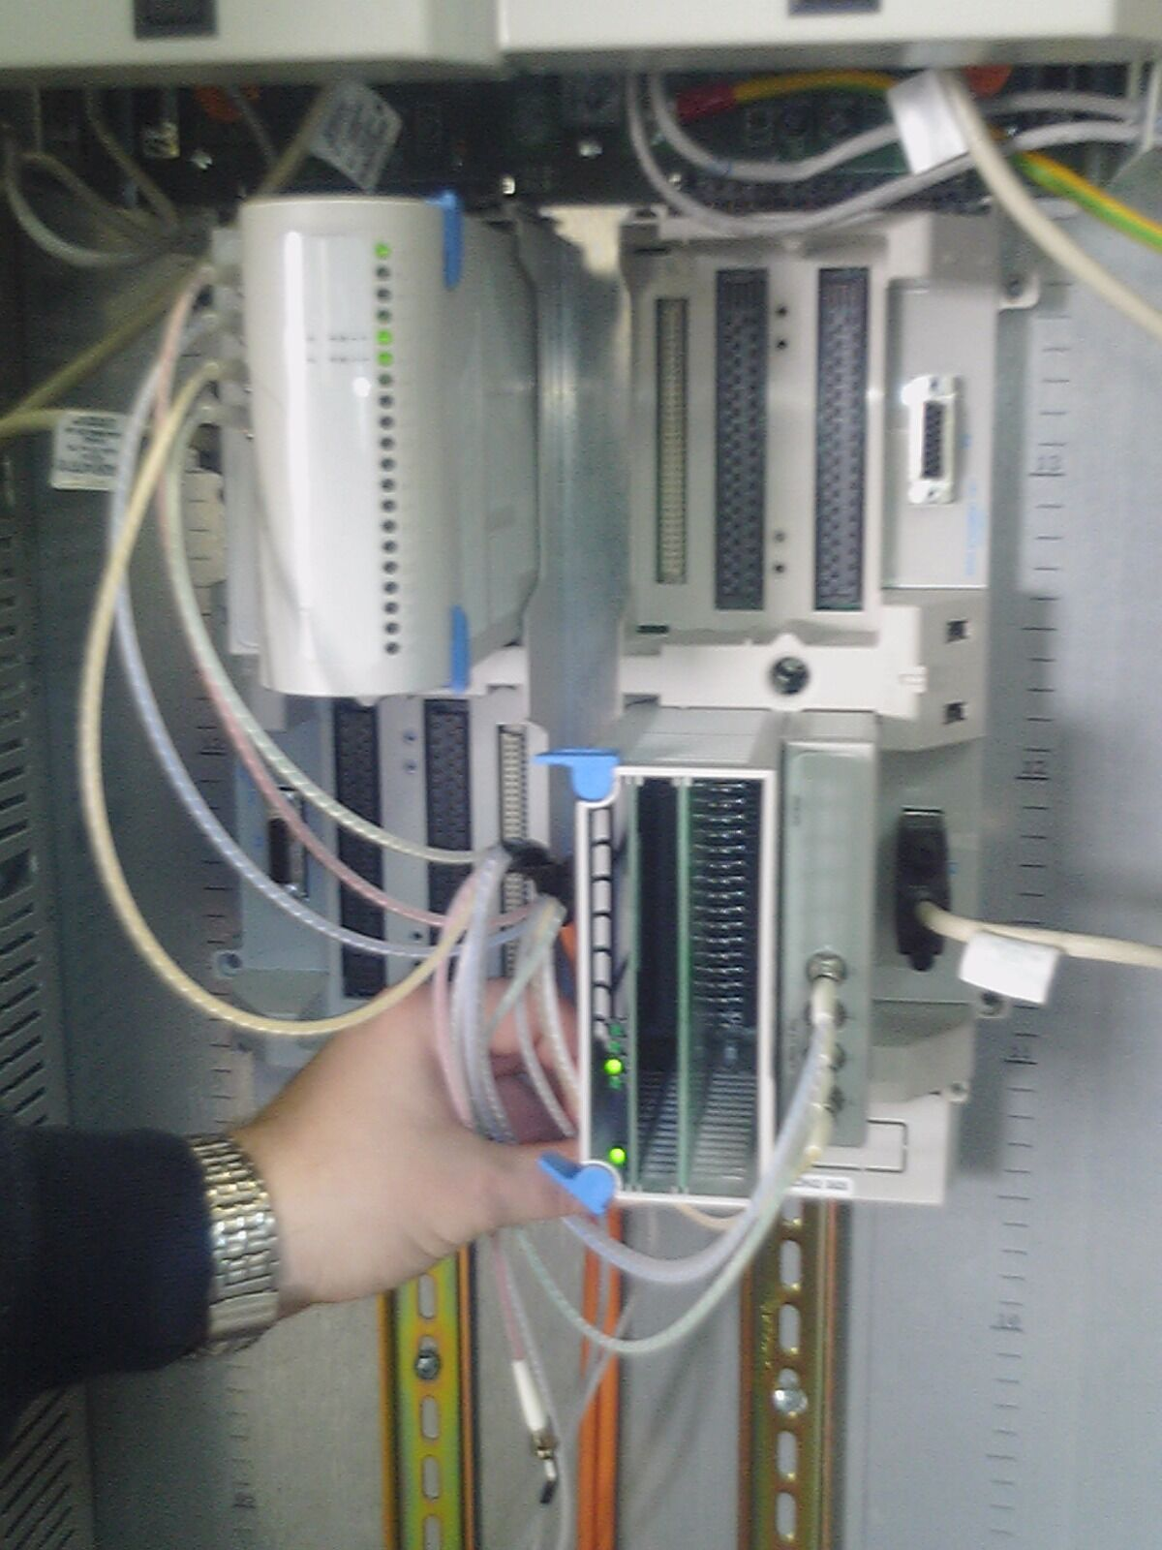
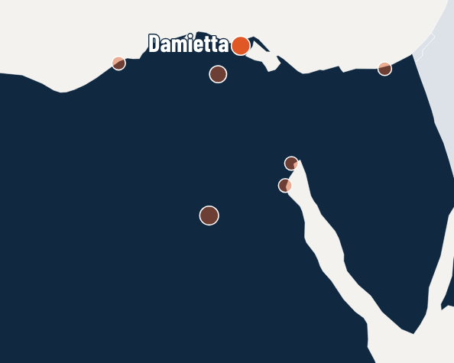
EGYPT · 2006 · EMERSON OVATION
1,230
DAMIETTA CCPP 1,230 MW
MW
DCS migration
CONTRACTOR
END USER
Emerson
Egyptian Electricity Holding Co.
THE PROJECT
Migration of the plant DCS from Westinghouse WDPF to Emerson Ovation, with commissioning, start-up and owner training.
PAT SCOPE
• Installation and commissioning of the new DCS parts
• Commissioning and start-up, returning the DCS units to commercial operation
• Owner staff training courses on DCS plant operation and maintenance
RESULT Units returned to commercial operation on Ovation; owner staff trained.
POWER AUTOMATION TEAM · SUCCESS STORIES
PAT on site — illustrative photo
08
Notes:
Reference no. 02.
Contractor(s): Emerson — from the PAT reference list.
End user: Egyptian Electricity Holding Co. — TO CONFIRM (not in the reference list).
Photo: PAT photo (illustrative, not from this site)
Recognised by Emerson: DCS Lead Engineer, Damietta 1,230 MW WDPF to Ovation Migration.

Slide 9
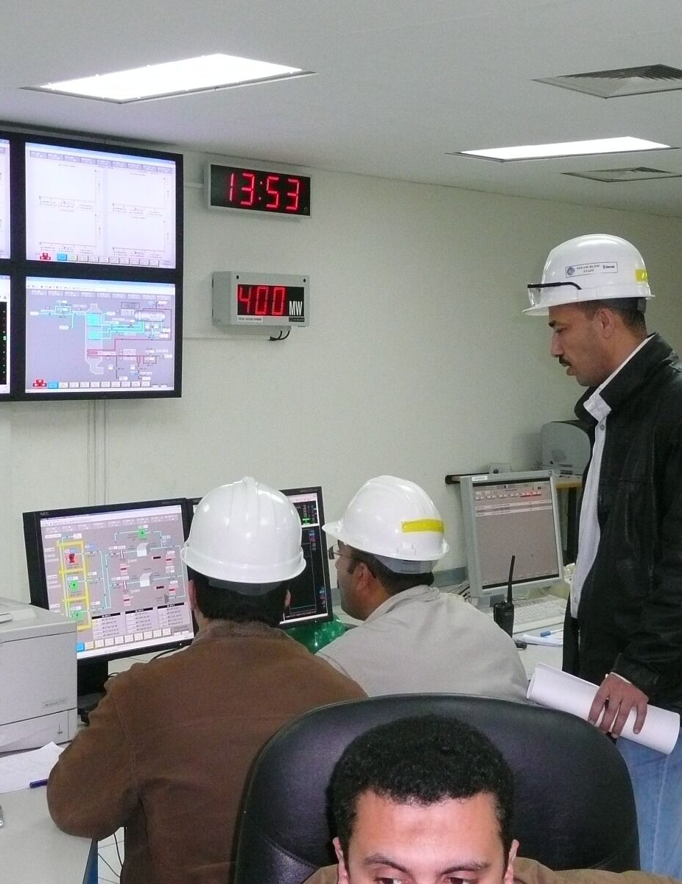
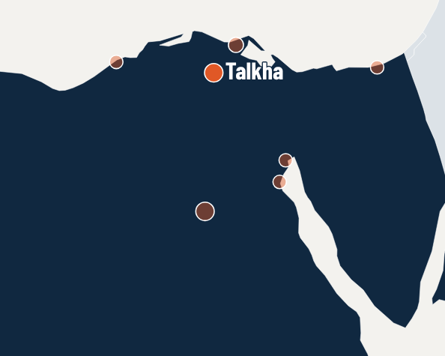
EGYPT · 2007–2009 · EMERSON OVATION
750
NEW TALKHA & EL KURIMAT II CCPP — 2 × 750 MW
MW
DCS installation & commissioning
CONTRACTOR
END USER
Emerson · SKODA Power (now Doosan Skoda Power) · CMI (now John Cockerill)
Egyptian Electricity Holding Co.
THE PROJECT
DCS installation, hardware and software modifications and configuration for normal operation on two 750 MW combined-cycle plants.
PAT SCOPE
• Emerson — DCS installation & start-up
• SKODA Power — BOP commissioning
• CMI — HRSG commissioning
RESULT Both plants powered up and configured for normal operation; owner staff trained.
POWER AUTOMATION TEAM · SUCCESS STORIES
PAT on site — illustrative photo
09
Notes:
Reference no. 03 (+ 4, 5).
Contractor(s): Emerson, SKODA Power (now Doosan Skoda Power), CMI (now John Cockerill) — from the PAT reference list.
End user: Egyptian Electricity Holding Co. — TO CONFIRM (not in the reference list).
Photo: PAT photo (illustrative, not from this site)
Recognised by Emerson: DCS Lead Engineer on both plants.

Slide 10
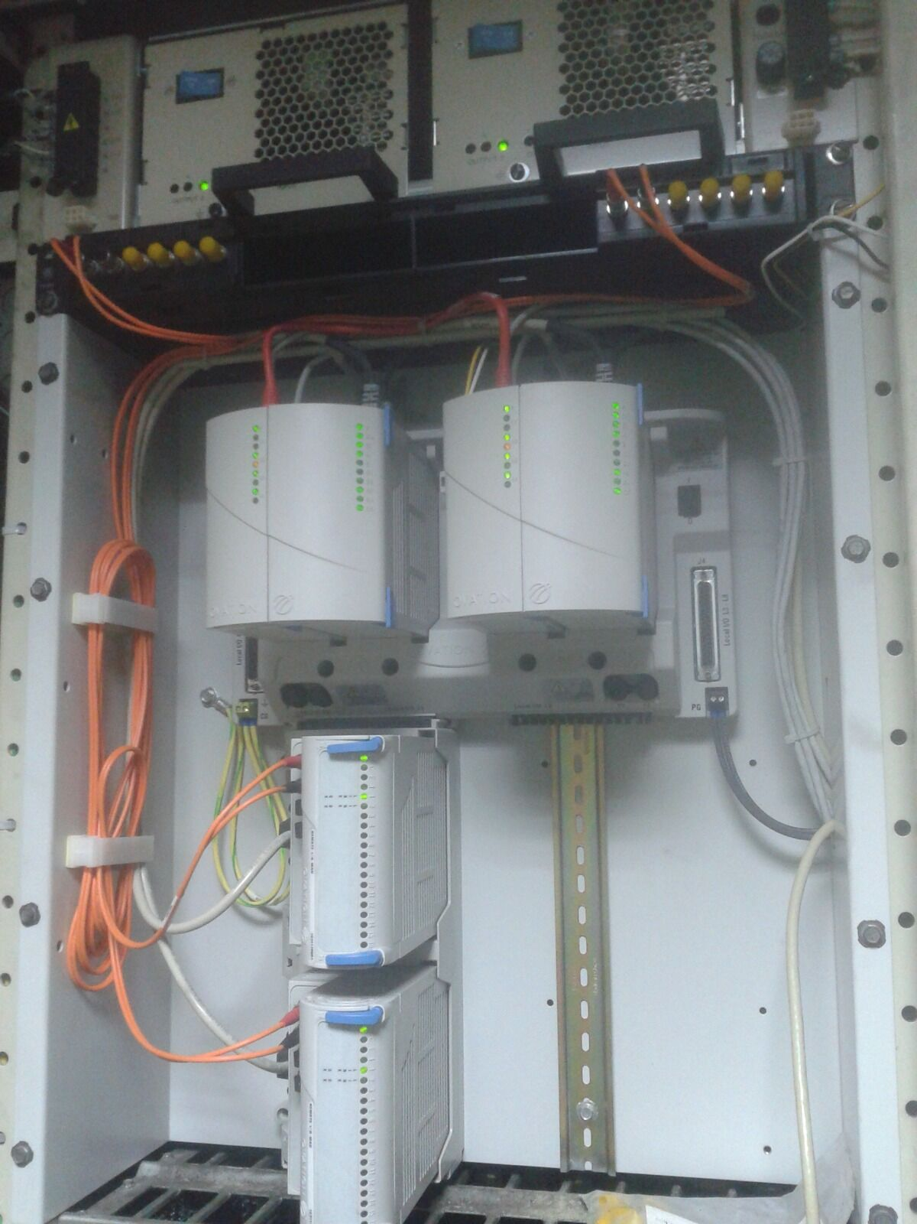

EGYPT · 2009 · SIEMENS S7 PLC
S7
SUEZ SOKHNA PORT UNITED SUGAR PROJECT
SIEMENS PLC
PLC commissioning
CONTRACTOR
END USER
Savola Group
United Sugar Company of Egypt
THE PROJECT
IO loop and device checks and commissioning of a Siemens S7 PLC system for Savola (Saudi Arabia).
PAT SCOPE
• Siemens S7 PLC IO loop and device checks and commissioning
POWER AUTOMATION TEAM · SUCCESS STORIES
PAT on site — illustrative photo
10
Notes:
Reference no. 06.
Contractor(s): Savola Group — from the PAT reference list.
End user: United Sugar Company of Egypt — TO CONFIRM (not in the reference list).
Photo: PAT photo (illustrative, not from this site)

Slide 11
EGYPT · 2009
750
NEW TALKHA CCPP 750 MW — CWP
MW
CWP commissioning & start-up
CONTRACTOR
END USER
INITEC Energia (Tecnicas Reunidas group)
Egyptian Electricity Holding Co.
THE PROJECT
CWP commissioning, start-up and operation scope for INITEC (Spain) at the New Talkha combined-cycle plant.
PAT SCOPE
• CWP commissioning, start-up and operation scope
POWER AUTOMATION TEAM · SUCCESS STORIES
PAT on site — illustrative photo
11
Notes:
Reference no. 07.
Contractor(s): INITEC Energia (Tecnicas Reunidas group) — from the PAT reference list.
End user: Egyptian Electricity Holding Co. — TO CONFIRM (not in the reference list).
Photo: PAT photo (illustrative, not from this site)

Slide 12
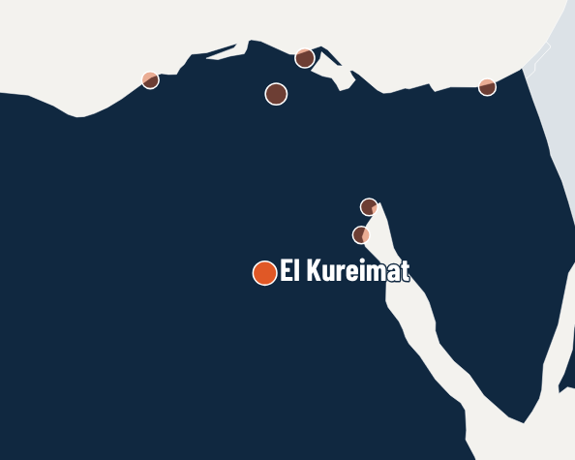
EGYPT · 2010 · ALSTOM DCS
750
EL KURIMAT III 750 MW
MW
I&C commissioning
CONTRACTOR
END USER
INITEC Energia (Tecnicas Reunidas group)
Egyptian Electricity Holding Co.
THE PROJECT
IO loop and I&C device commissioning team for the Alstom DCS, working for INITEC (Spain).
PAT SCOPE
• Alstom DCS IO loop and I&C device commissioning team
POWER AUTOMATION TEAM · SUCCESS STORIES
PAT on site — illustrative photo
12
Notes:
Reference no. 10.
Contractor(s): INITEC Energia (Tecnicas Reunidas group) — from the PAT reference list.
End user: Egyptian Electricity Holding Co. — TO CONFIRM (not in the reference list).
Photo: PAT photo (illustrative, not from this site)

Slide 13
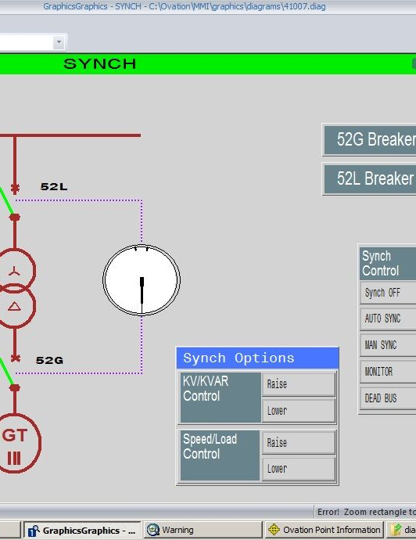
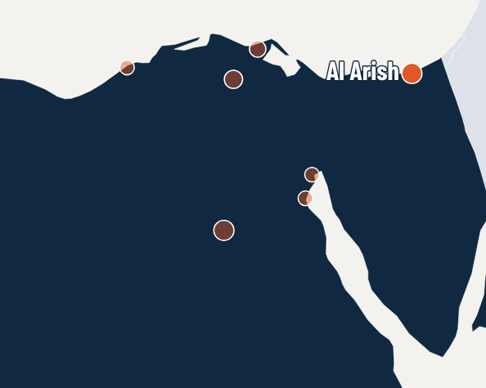
EGYPT · 2011–2012 · EMERSON DCS
60
AL ARISH STPP 2×30 MW
MW
DCS migration
CONTRACTOR
END USER
Emerson
Egyptian Electricity Holding Co.
THE PROJECT
Complete DCS removal and installation scope and migration activities on a steam power plant.
PAT SCOPE
• Complete DCS removal and installation scope and migration activities
• Plant device check and test, commissioning of plant systems and return to normal operation
• Owner staff training courses on DCS plant operation and maintenance
RESULT Plant systems back to normal operation; owner staff trained.
POWER AUTOMATION TEAM · SUCCESS STORIES
Ovation operator graphics at Al Arish — PAT photo
13
Notes:
Reference no. 13.
Contractor(s): Emerson — from the PAT reference list.
End user: Egyptian Electricity Holding Co. — TO CONFIRM (not in the reference list).
Photo: PAT photo

Slide 14
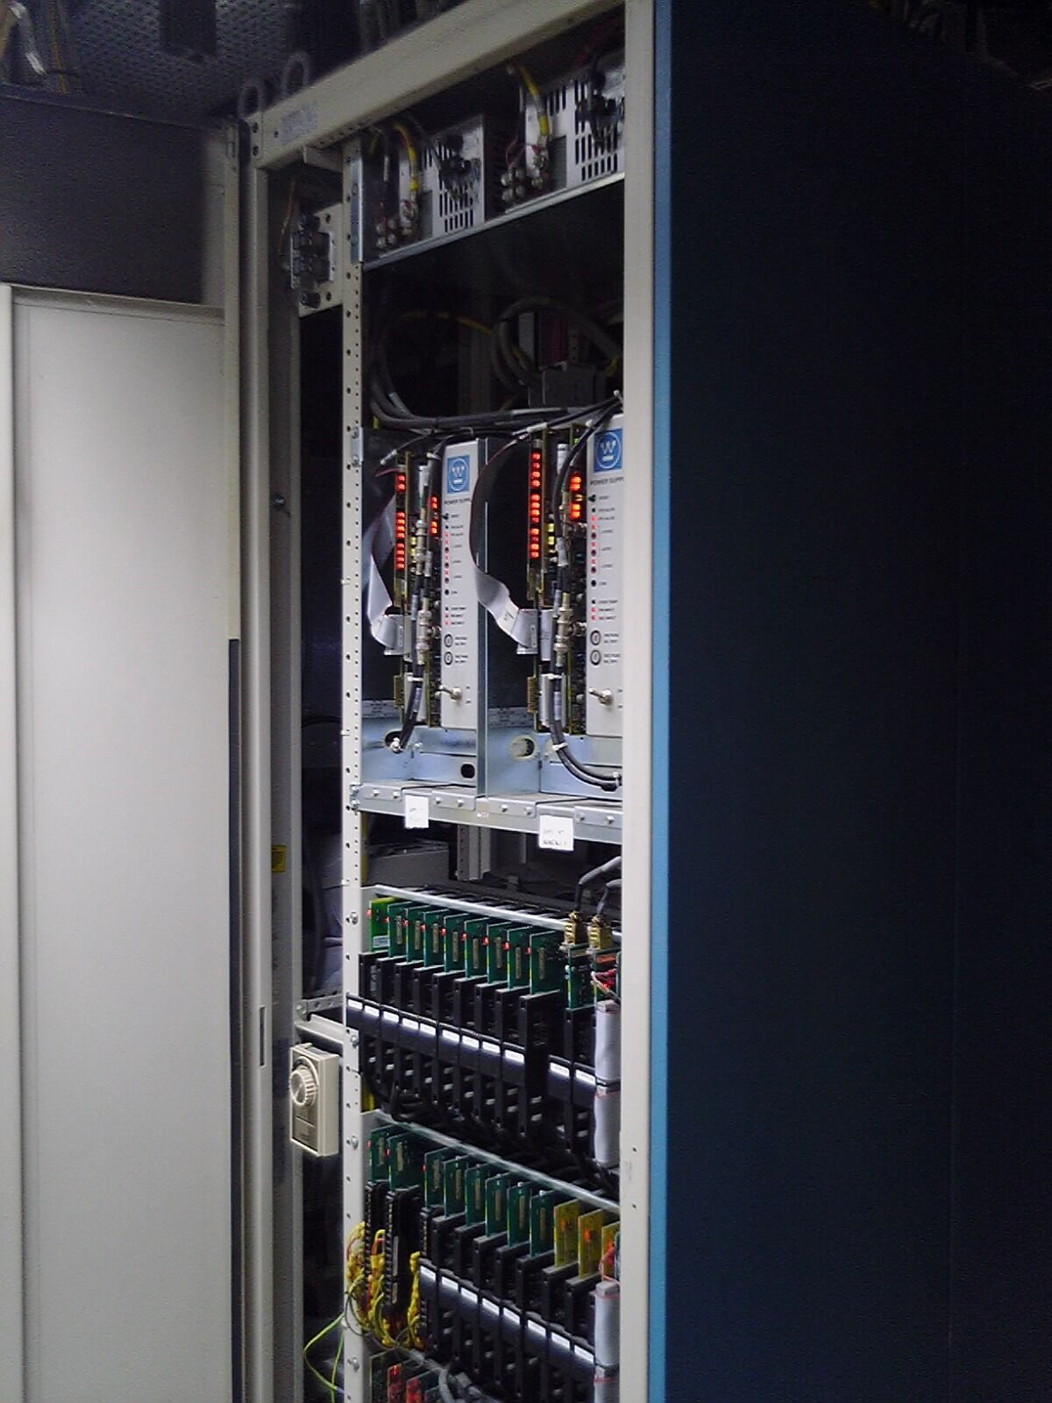
EGYPT · 2011 · EMERSON OVATION
210
OLD TALKHA 210 MW — TCS UNIT 2
MW
DCS retrofit
CONTRACTOR
END USER
Emerson
Egyptian Electricity Holding Co.
THE PROJECT
Removal of the old TCS control cabinets and complete installation of a new Ovation DCS on Unit 2.
PAT SCOPE
• Removal of the old TCS control cabinets and complete installation scope of the new Ovation DCS
RESULT New Ovation DCS installed on Unit 2.
POWER AUTOMATION TEAM · SUCCESS STORIES
PAT on site — illustrative photo
14
Notes:
Reference no. 14.
Contractor(s): Emerson — from the PAT reference list.
End user: Egyptian Electricity Holding Co. — TO CONFIRM (not in the reference list).
Photo: PAT photo (illustrative, not from this site)

Slide 15
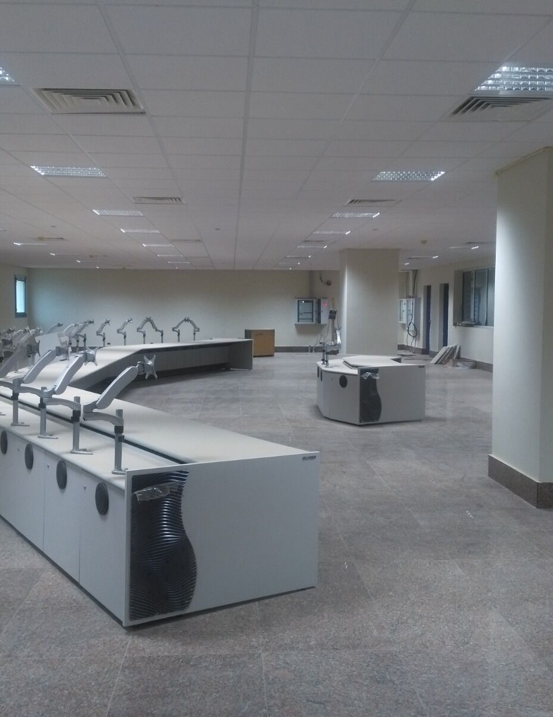
EGYPT · 2011
Solar
SOLAR ENERGY KURIMAT POWER PLANT
COMMISSIONING
Plant commissioning & start-up
CONTRACTOR
END USER
Iberdrola
NREA — New & Renewable Energy Authority
THE PROJECT
Plant commissioning, start-up and operation within Iberdrola's scope.
PAT SCOPE
• Plant commissioning, start-up and operation within the Iberdrola scope
POWER AUTOMATION TEAM · SUCCESS STORIES
PAT on site — illustrative photo
15
Notes:
Reference no. 15.
Contractor(s): Iberdrola — from the PAT reference list.
End user: NREA — New & Renewable Energy Authority — TO CONFIRM (not in the reference list).
Photo: PAT photo (illustrative, not from this site)

Slide 16
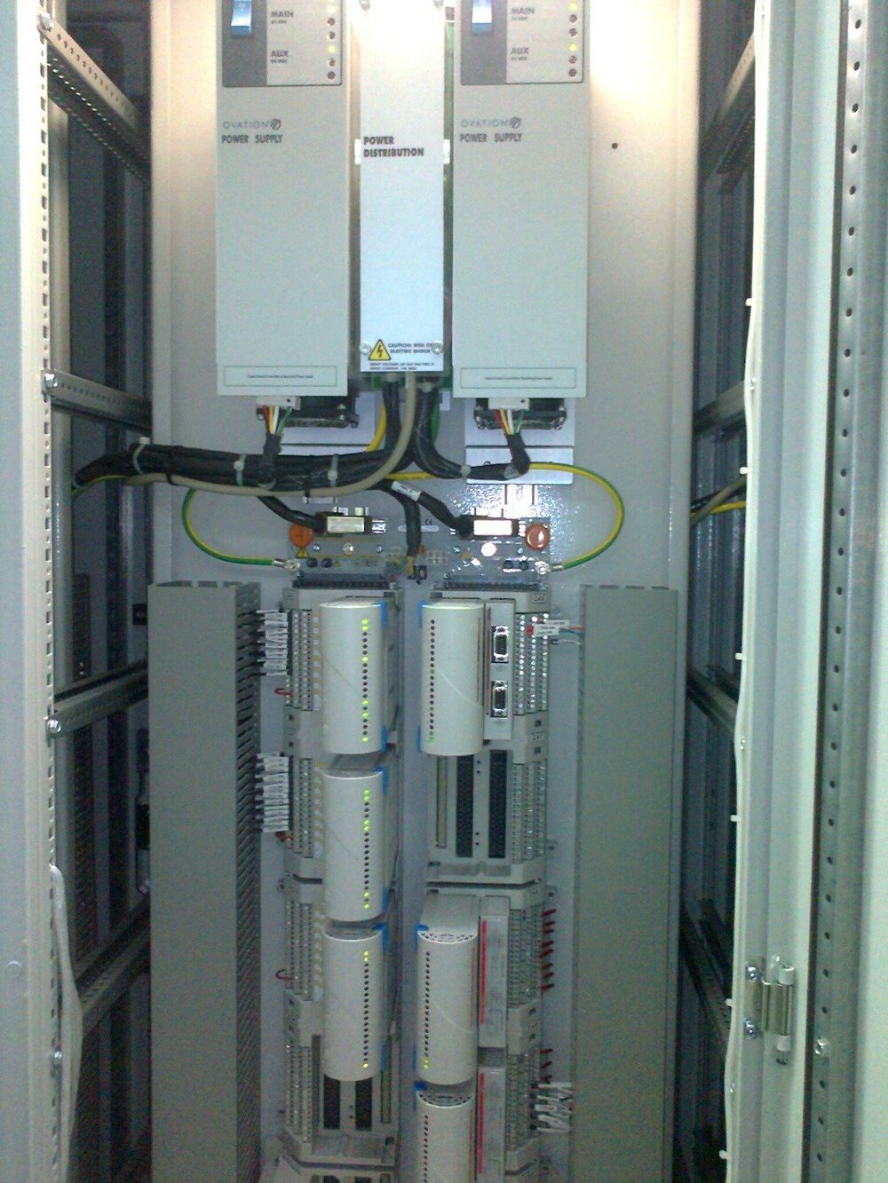
EGYPT · 2015–2016 · EMERSON DCS
1,300
EL KURIMAT I 2×650 MW
MW
DCS migration
CONTRACTOR
END USER
Emerson
Egyptian Electricity Holding Co.
THE PROJECT
Site management and supervision of the DCS replacement on a very tight schedule, through start-up and return to commercial operation.
PAT SCOPE
• Site management and supervision, inspecting and checking out the removal of the old DCS parts and the installation of the new DCS, on a very tight schedule
• Start-up and commissioning of the new DCS, powering up and configuring it for normal operation
• Plant device checks and tests (database, graphics, logic) and hardware and software modifications
RESULT DCS back in normal commercial operation on a very tight schedule.
POWER AUTOMATION TEAM · SUCCESS STORIES
PAT on site — illustrative photo
16
Notes:
Reference no. 21.
Contractor(s): Emerson — from the PAT reference list.
End user: Egyptian Electricity Holding Co. — TO CONFIRM (not in the reference list).
Photo: PAT photo (illustrative, not from this site)

Slide 17
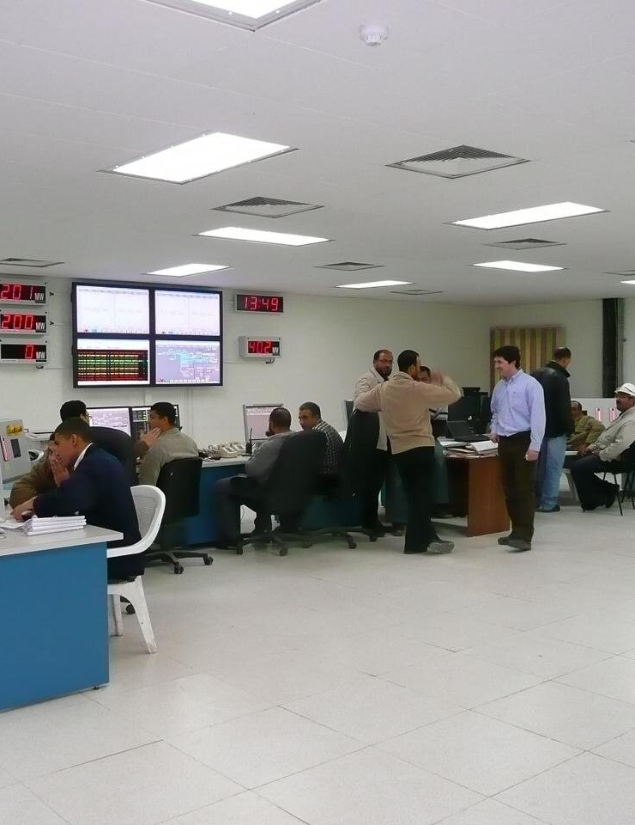
EGYPT · 2017
750
WEST DAMIETTA POWER STATION CCPP — GT 4×125 + 1×250 MW
MW
I&C commissioning
CONTRACTOR
END USER
GE · Orascom Construction
Egyptian Electricity Holding Co.
THE PROJECT
I&C commissioning scope for four HRSGs, BOP, STG and ACC plants: cold and hot IO loop tests and plant device functional tests.
PAT SCOPE
• I&C commissioning scope for 4 HRSG, BOP, STG and ACC plants
• IO cold and hot loop tests
• Plant device functional tests
POWER AUTOMATION TEAM · SUCCESS STORIES
PAT on site — illustrative photo
17
Notes:
Reference no. 24.
Contractor(s): GE, Orascom Construction — from the PAT reference list.
End user: Egyptian Electricity Holding Co. — TO CONFIRM (not in the reference list).
Photo: PAT photo (illustrative, not from this site)

Slide 18
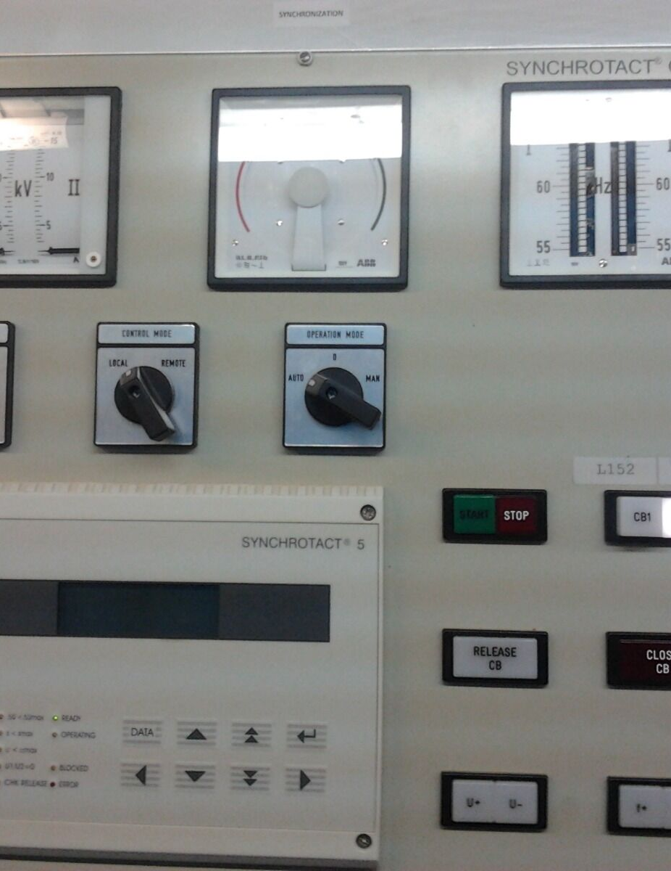


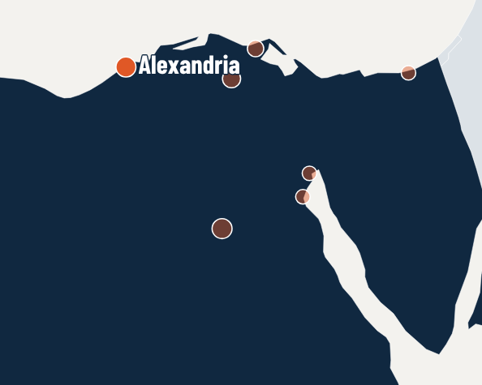
EGYPT · 2020
10
EL ESRAA PETROLEUM TANKER SHIP, ALEXANDRIA
DAYS
Electrical & PLC troubleshooting
CONTRACTOR
END USER
Direct contract
El Esraa Co.
THE PROJECT
Troubleshooting of generator systems, switchgear, emergency systems and PLCs; the ship was handed over to the first engineer within 10 days after standing idle for years.
PAT SCOPE
• Troubleshooting of the electrical generator systems, switchgear, emergency systems and PLCs
• Task completed and the ship handed over to the first engineer within 10 days, after being stopped for years
RESULT Ship handed over to the first engineer within 10 days after standing idle for years.
POWER AUTOMATION TEAM · SUCCESS STORIES
PAT on site — illustrative photo
18
Notes:
Reference no. 26.
Contractor(s): Direct contract — from the PAT reference list.
End user: El Esraa Co..
Photo: PAT photo (illustrative, not from this site)

Slide 19
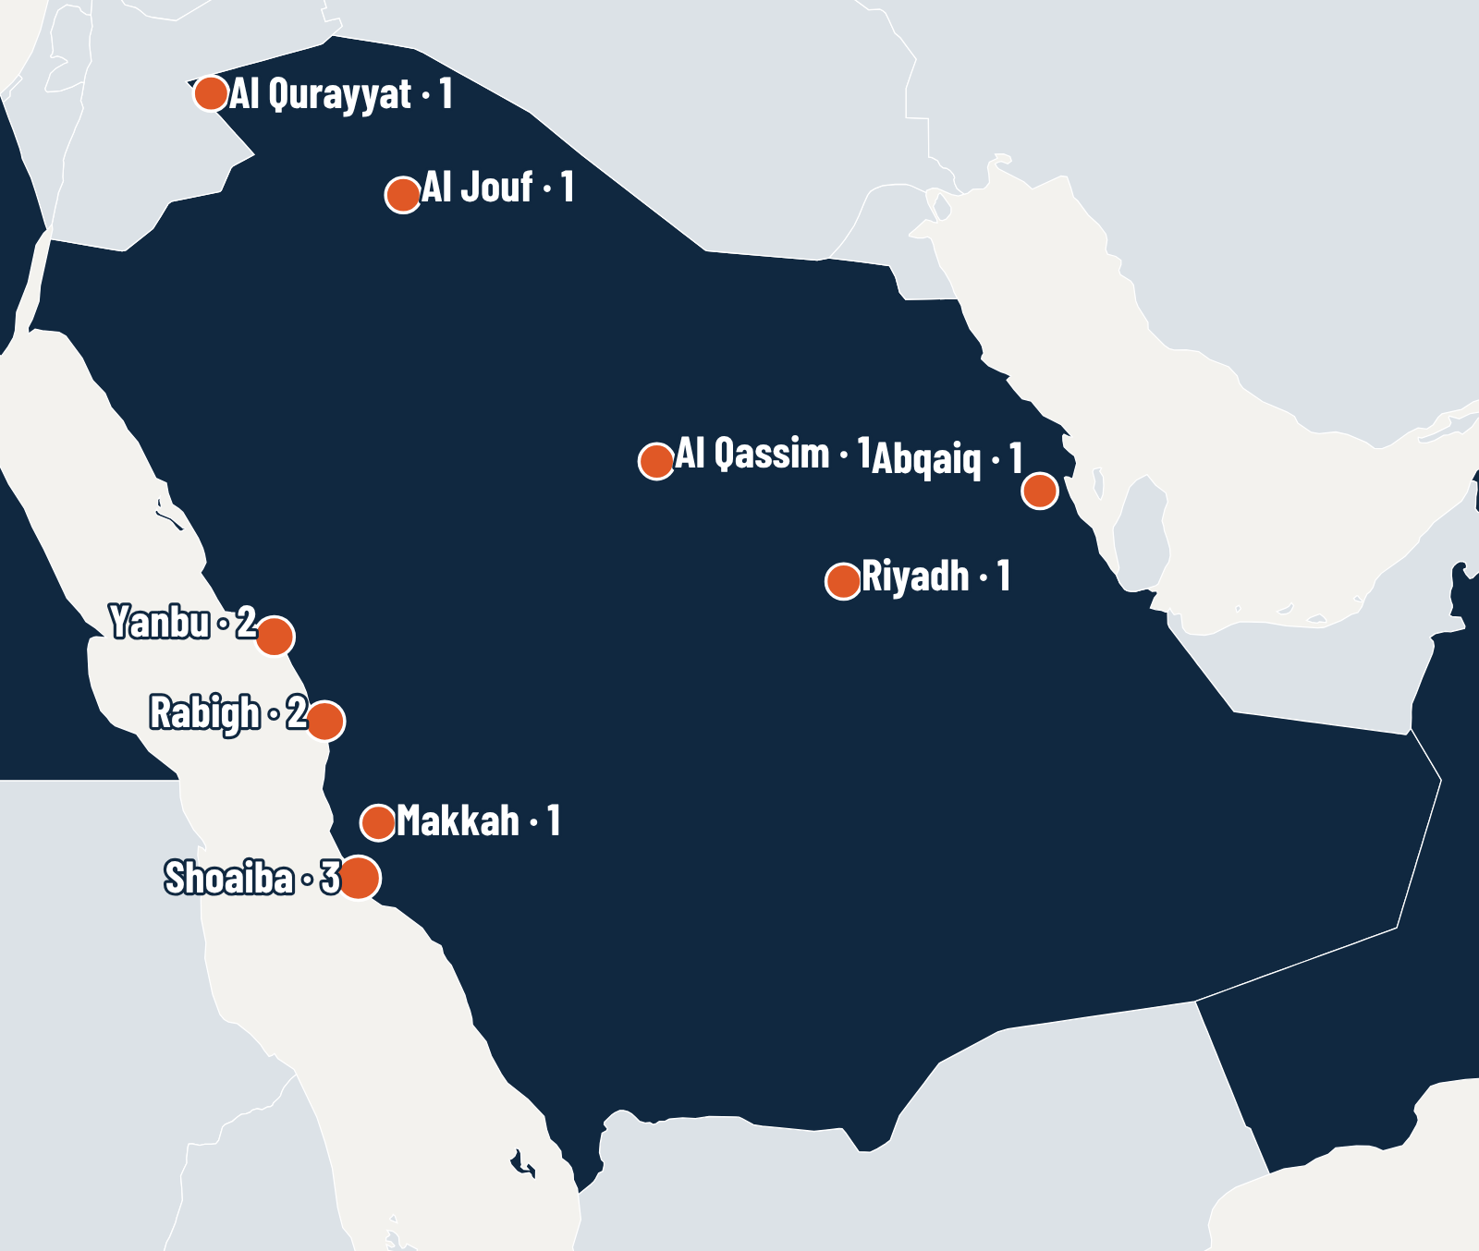
2009–2023
SAUDI ARABIA
13 REFERENCE PROJECTS
Shoaiba · Rabigh · Yanbu · Makkah · Riyadh · Al Qassim · Al Jouf · Al Qurayyat · Abqaiq
Steam and gas-turbine power plants, utilities, desalination and oil & gas processing.
POWER AUTOMATION TEAM · SUCCESS STORIES
19

Slide 20
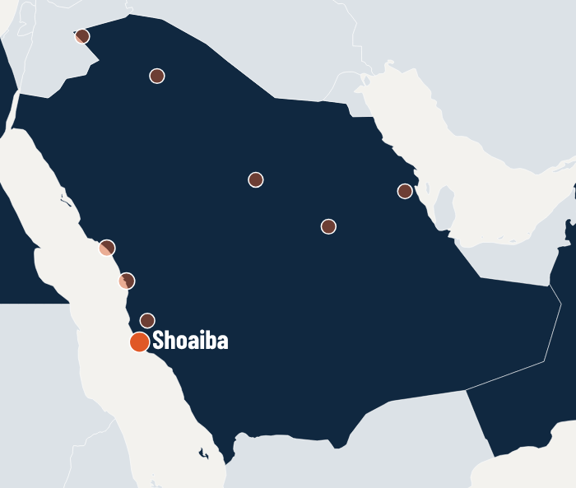
SAUDI ARABIA · 2009–2010 · EMERSON DCS
750
SHOAIBA ST POWER PLANT 3×250 MW
MW
DCS retrofit
CONTRACTOR
END USER
Emerson
Saudi Electricity Company
THE PROJECT
DCS retrofit of a steam power plant: IO loop and device checks, commissioning and start-up, returning the units to commercial operation.
PAT SCOPE
• Plant IO loop and device checks
• Commissioning and start-up, normalizing the system and returning to commercial operation
RESULT System normalised and units returned to commercial operation.
POWER AUTOMATION TEAM · SUCCESS STORIES
PAT on site — illustrative photo
20
Notes:
Reference no. 08.
Contractor(s): Emerson — from the PAT reference list.
End user: Saudi Electricity Company — TO CONFIRM (not in the reference list).
Photo: PAT photo (illustrative, not from this site)

Slide 21
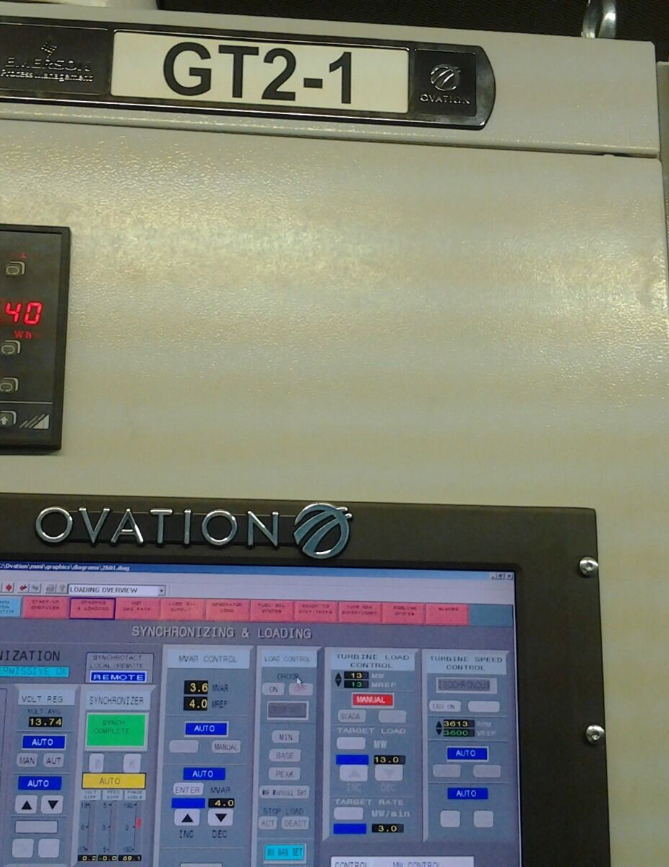
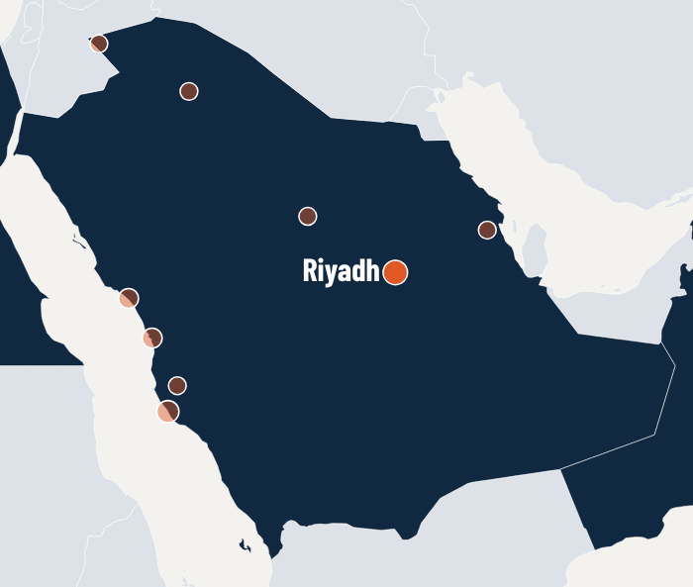
SAUDI ARABIA · 2009 · EMERSON OVATION
50
PP4 RIYADH POWER PLANT — GE GAS TURBINES 2×25 MW
MW
DCS retrofit
CONTRACTOR
END USER
Emerson
Saudi Electricity Company
THE PROJECT
GE gas turbine loop and device checks, commissioning and start-up, plus DCS Ovation operation training for owner staff.
PAT SCOPE
• GE gas turbine loop and device checks, commissioning and start-up
• DCS Ovation operation training for owner staff
• Owner staff training courses on DCS plant operation and maintenance
RESULT Gas turbines commissioned and started up; owner operators trained on Ovation.
POWER AUTOMATION TEAM · SUCCESS STORIES
PAT on site — illustrative photo
21
Notes:
Reference no. 09.
Contractor(s): Emerson — from the PAT reference list.
End user: Saudi Electricity Company — TO CONFIRM (not in the reference list).
Photo: PAT photo (illustrative, not from this site)

Slide 22
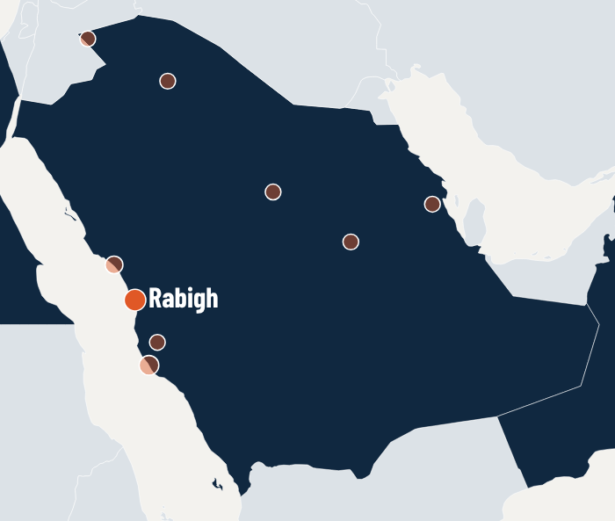
SAUDI ARABIA · 2009–2011 · EMERSON DCS
1,200
RABIGH POWER PLANT 4×300 MW
MW
DCS upgrade
CONTRACTOR
END USER
Emerson
Saudi Electricity Company
THE PROJECT
DCS software and hardware installation and programming, commissioning and start-up, ending with hand-over to the owner's staff.
PAT SCOPE
• DCS software and hardware installation and programming, commissioning, start-up and powering up
• Plant IO loop and device checks, commissioning and start-up, units normalized and handed over to the owner for commercial operation
• Owner staff training courses on DCS plant operation and maintenance
RESULT Units normalised and handed over to the owner for commercial operation.
POWER AUTOMATION TEAM · SUCCESS STORIES
PAT on site — illustrative photo
22
Notes:
Reference no. 12.
Contractor(s): Emerson — from the PAT reference list.
End user: Saudi Electricity Company.
Photo: PAT photo (illustrative, not from this site)

Slide 23
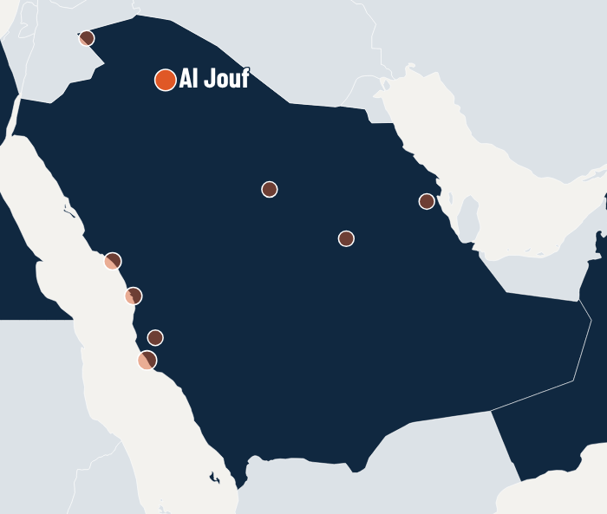
SAUDI ARABIA · 2009–2012 · EMERSON DCS
245
SEC4A AL JOUF — FIAT GAS TURBINES 7×35 MW
MW
DCS upgrade
CONTRACTOR
END USER
Emerson
Saudi Electricity Company
THE PROJECT
New DCS installation supervision and software installation, then gas turbine IO loop checks, commissioning and a guarantee-period scope.
PAT SCOPE
• Supervision of the new DCS installation and software installation
• Powering up the DCS and making it ready for gas turbine commissioning and start-up
• Gas turbine IO loop and device checks, plant commissioning and normalizing the units after the reliability test
RESULT Units back to commercial operation after the reliability test; guarantee period covered.
POWER AUTOMATION TEAM · SUCCESS STORIES
PAT on site — illustrative photo
23
Notes:
Reference no. 16.
Contractor(s): Emerson — from the PAT reference list.
End user: Saudi Electricity Company.
Photo: PAT photo (illustrative, not from this site)

Slide 24
SAUDI ARABIA · 2010 · EMERSON DCS
FAT
SHOAIBA LIME WATER PLANT
ENGINEERING
DCS engineering for FAT
CONTRACTOR
END USER
Owner to be confirmed
Emerson
THE PROJECT
Engineering of the database, logic and graphics software, ready for the factory acceptance test.
PAT SCOPE
• Engineering of database, logic and graphics software ready for FAT
RESULT Database, logic and graphics delivered ready for FAT.
POWER AUTOMATION TEAM · SUCCESS STORIES
PAT on site — illustrative photo
24
Notes:
Reference no. 11.
Contractor(s): Emerson — from the PAT reference list.
End user: not stated.
Photo: PAT photo (illustrative, not from this site)

Slide 25
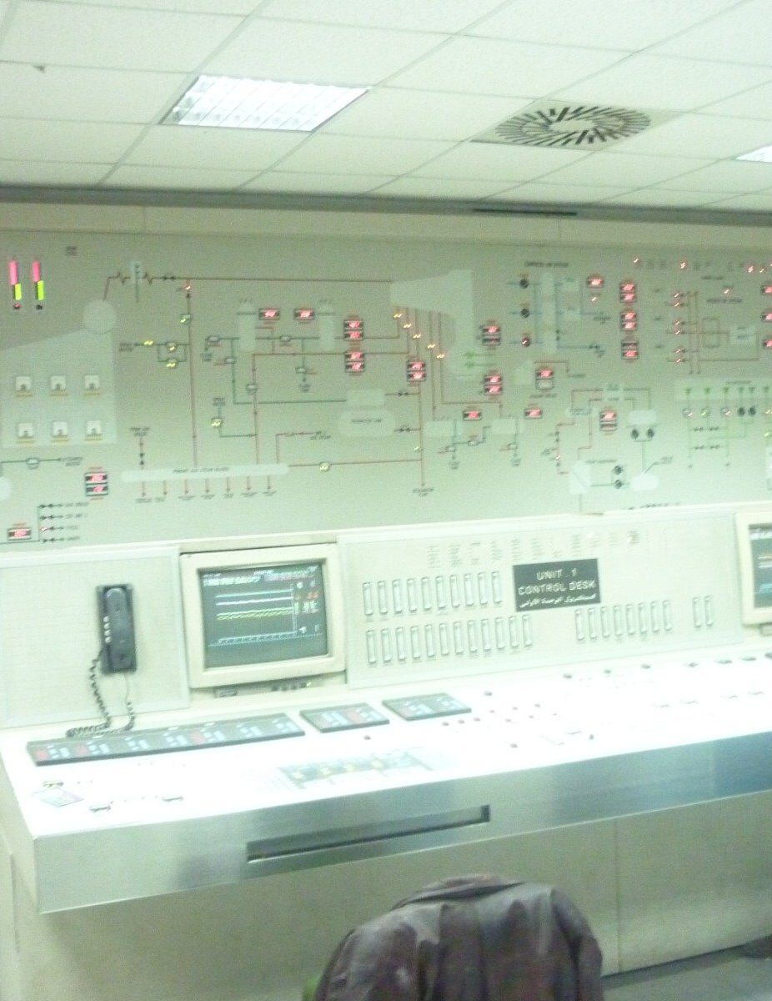
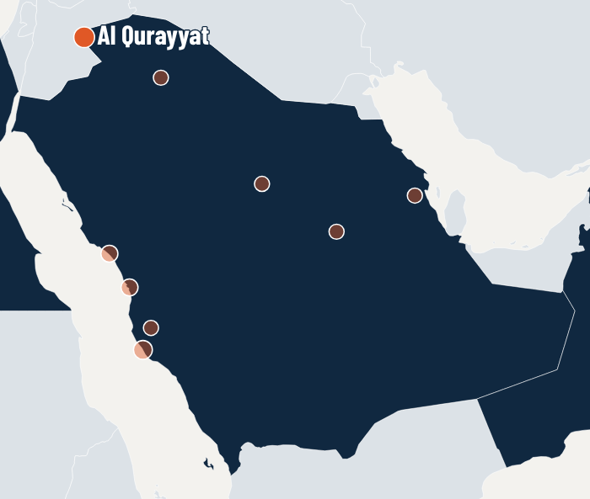
SAUDI ARABIA · 2013 · EMERSON DCS
44
SEC4A AL QURYAT — BBC GAS TURBINES 2×22 MW
MW
DCS upgrade
CONTRACTOR
END USER
Emerson
Saudi Electricity Company
THE PROJECT
New DCS installation supervision and software installation, then gas turbine IO loop checks and commissioning.
PAT SCOPE
• Supervision of the new DCS installation and software installation
• Powering up the DCS and making it ready for gas turbine commissioning and start-up
• Gas turbine IO loop and device checks, plant commissioning and normalizing the units after the reliability test
RESULT Units back to commercial operation after the reliability test.
POWER AUTOMATION TEAM · SUCCESS STORIES
PAT on site — illustrative photo
25
Notes:
Reference no. 17.
Contractor(s): Emerson — from the PAT reference list.
End user: Saudi Electricity Company.
Photo: PAT photo (illustrative, not from this site)

Slide 26
SAUDI ARABIA · 2014 · EMERSON DCS
600
RABIGH II 2×300 MW
MW
DCS modernization
CONTRACTOR
END USER
Emerson
Saudi Electricity Company
THE PROJECT
IO loop and device checks, commissioning and start-up after the DCS modernization, ending with hand-over to the owner.
PAT SCOPE
• Plant IO loop and device checks
• Commissioning and start-up, units normalized and returned to commercial operation by the owner (Saudi Electricity)
RESULT Units returned to commercial operation by the owner.
POWER AUTOMATION TEAM · SUCCESS STORIES
PAT on site — illustrative photo
26
Notes:
Reference no. 19.
Contractor(s): Emerson — from the PAT reference list.
End user: Saudi Electricity Company.
Photo: PAT photo (illustrative, not from this site)

Slide 27
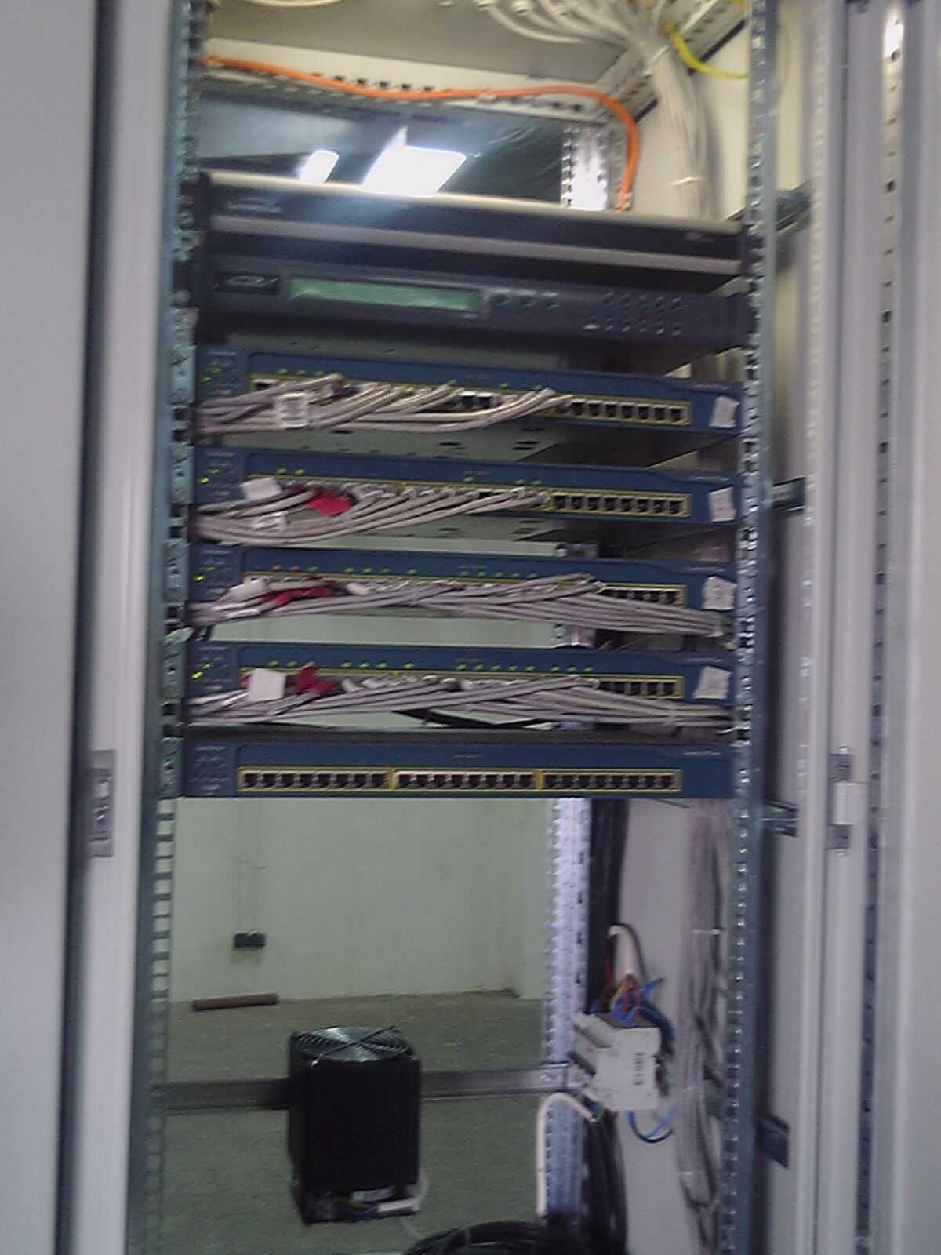
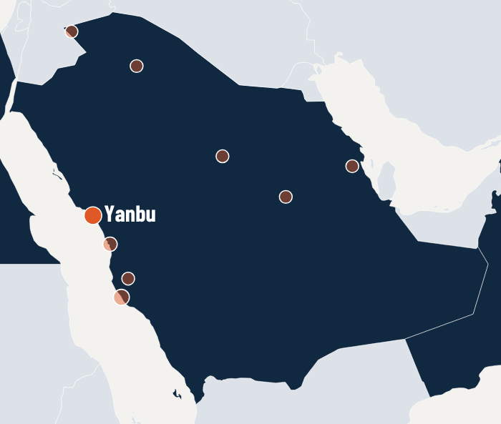
SAUDI ARABIA · 2014–2017 · EMERSON DCS
810
MARAFIQ YANBU II 3×270 MW
MW
New DCS
CONTRACTOR
END USER
Emerson · Hanwha
Marafiq
THE PROJECT
DCS hardware and software modifications and system configuration, IO loop and device checks, commissioning and start-up, with warranty-period coverage by a PAT engineer.
PAT SCOPE
• DCS hardware and software modifications and system configuration
• Plant IO loop and device checks, commissioning and start-up
• Warranty period covered by a PAT engineer
RESULT New DCS commissioned; warranty period covered by a PAT engineer.
POWER AUTOMATION TEAM · SUCCESS STORIES
PAT on site — illustrative photo
27
Notes:
Reference no. 20.
Contractor(s): Emerson, Hanwha — from the PAT reference list.
End user: Marafiq.
Photo: PAT photo (illustrative, not from this site)

Slide 28
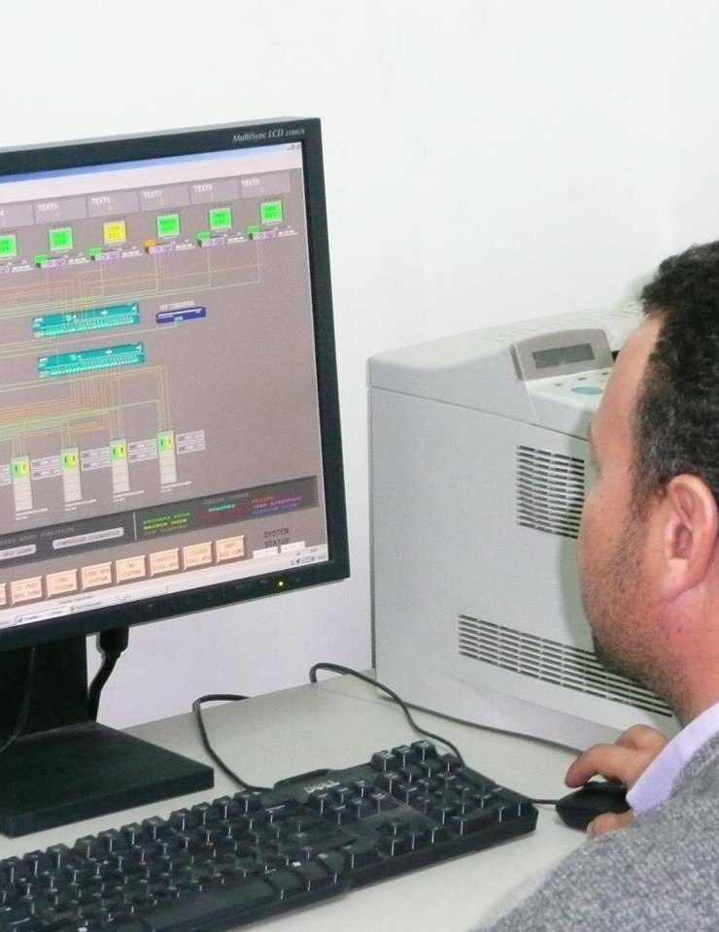

SAUDI ARABIA · 2016 · EMERSON DCS
390
MAKKAH POWER PLANT — GE GAS TURBINES 6×65 MW
MW
DCS upgrade — GT3 troubleshooting
CONTRACTOR
END USER
Emerson
Saudi Electricity Company
THE PROJECT
GT3 start-up, operation troubleshooting and solution during the DCS upgrade of a GE gas turbine plant.
PAT SCOPE
• GT3 start-up, operation troubleshooting and solution
RESULT GT3 start-up and operation problems solved.
POWER AUTOMATION TEAM · SUCCESS STORIES
PAT on site — illustrative photo
28
Notes:
Reference no. 22.
Contractor(s): Emerson — from the PAT reference list.
End user: Saudi Electricity Company — TO CONFIRM (not in the reference list).
Photo: PAT photo (illustrative, not from this site)

Slide 29

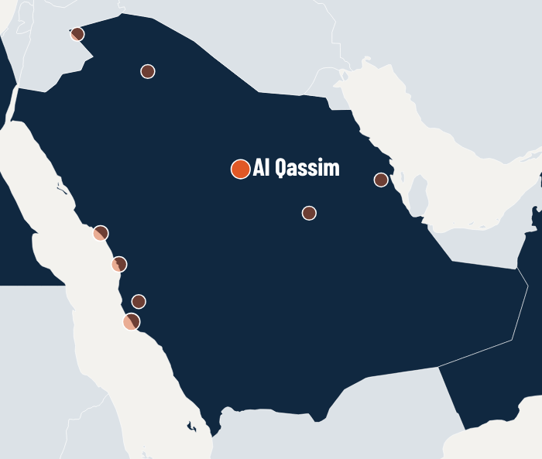
SAUDI ARABIA · 2017
GT9
AL QASEEM POWER STATION — WESTINGHOUSE GAS TURBINES 9×50 MW
VALVE UPGRADE
GT9 valve replacement & commissioning
CONTRACTOR
END USER
Saudi FAL
Saudi Electricity Company
THE PROJECT
Supervision of the new FCV installation (GT9 FCV, OST and HP/LP valves replaced with new REGZA valves), software installation and commissioning.
PAT SCOPE
• Supervision of the new FCV installation and software installation, ready for gas turbine commissioning and start-up
• GT9 IO loop and device checks, plant commissioning and normalizing the unit after the reliability test
RESULT GT9 back to commercial operation after the reliability test.
POWER AUTOMATION TEAM · SUCCESS STORIES
PAT on site — illustrative photo
29
Notes:
Reference no. 23.
Contractor(s): Saudi FAL — from the PAT reference list.
End user: Saudi Electricity Company.
Photo: PAT photo (illustrative, not from this site)

Slide 30

SAUDI ARABIA · 2019
HCD
YANBU I & II — MARAFIQ TRAINING ACADEMY
CONSULTING
Consulting & training
CONTRACTOR
END USER
Leoron
Marafiq
THE PROJECT
HCD senior consultant for Marafiq's utility and engineering practice: improved work-flow procedures and established a training academy.
PAT SCOPE
• Work-flow procedure improvements
• Established an academy for the Marafiq training center
• Created training course material for engineers, supervisors and technicians on operation and maintenance
RESULT Training academy established for Marafiq's training centre.
POWER AUTOMATION TEAM · SUCCESS STORIES
PAT on site — illustrative photo
30
Notes:
Reference no. 25.
Contractor(s): Leoron — from the PAT reference list.
End user: Marafiq.
Photo: PAT photo (illustrative, not from this site)

Slide 31
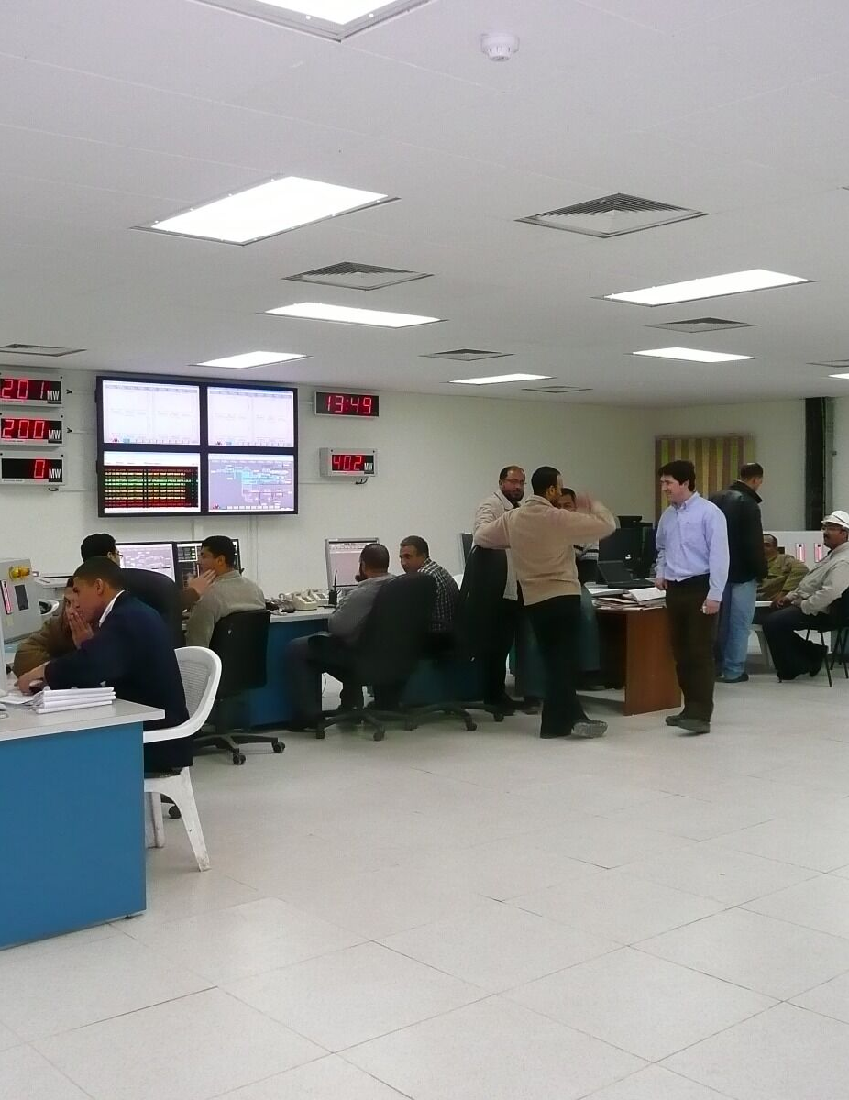
SAUDI ARABIA · 2021–2022 · EMERSON OVATION
Ovation
SHOAIBA POWER PLANT, STAGE I PHASE 1
FROM ABB
DCS rehabilitation — ABB to Emerson Ovation
CONTRACTOR
END USER
Emerson · Giza Systems
Saudi Electricity Company
THE PROJECT
DCS rehabilitation from ABB to Emerson Ovation on a very tight schedule: IO loop checks, device tests and commissioning of boiler, turbine, BOP, desalination and demi water.
PAT SCOPE
• IO loop checks, device tests and commissioning of the boiler, turbine, BOP, desalination and demi water systems
• Troubleshooting of the Ovation DCS together with the Emerson team
• Comprehensive support throughout the project on a tight construction schedule to return the plant to commercial operation
RESULT Delivered on a very tight schedule to return the plant to commercial operation.
POWER AUTOMATION TEAM · SUCCESS STORIES
PAT on site — illustrative photo
31
Notes:
Reference no. 27.
Contractor(s): Emerson, Giza Systems — from the PAT reference list.
End user: Saudi Electricity Company — TO CONFIRM (not in the reference list).
Photo: PAT photo (illustrative, not from this site)

Slide 32
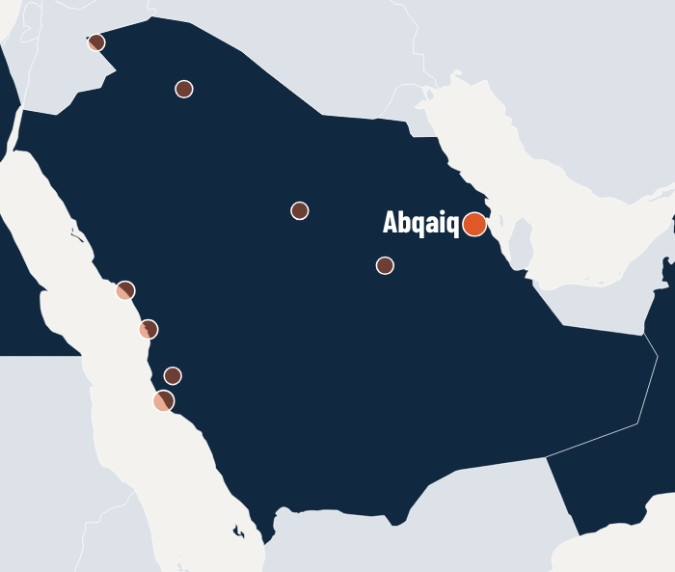
SAUDI ARABIA · 2022–2023 · EMERSON DELTAV
12
ABQAIQ PLANTS — DCS UPGRADE, PIB-2 TO PIB-18 (ARAMCO)
PIBS
DCS upgrade — DeltaV
CONTRACTOR
END USER
Emerson · Saudi FAL · KBR (design)
Saudi Aramco
THE PROJECT
DCS upgrade across twelve PIBs: document review, cabinet staging checks before FAT, construction supervision and hot and cold tests for each PIB shutdown.
PAT SCOPE
• Engineering document review and verification of cabinet and marshalling staging before FAT
• Supervision of construction activities
• Hot and cold test commissioning for each PIB shutdown
RESULT Hot and cold tests completed for each of the twelve PIB shutdowns.
POWER AUTOMATION TEAM · SUCCESS STORIES
PAT on site — illustrative photo
32
Notes:
Reference no. 28.
Contractor(s): Emerson, Saudi FAL, KBR (design) — from the PAT reference list.
End user: Saudi Aramco.
Photo: PAT photo (illustrative, not from this site)

Slide 33
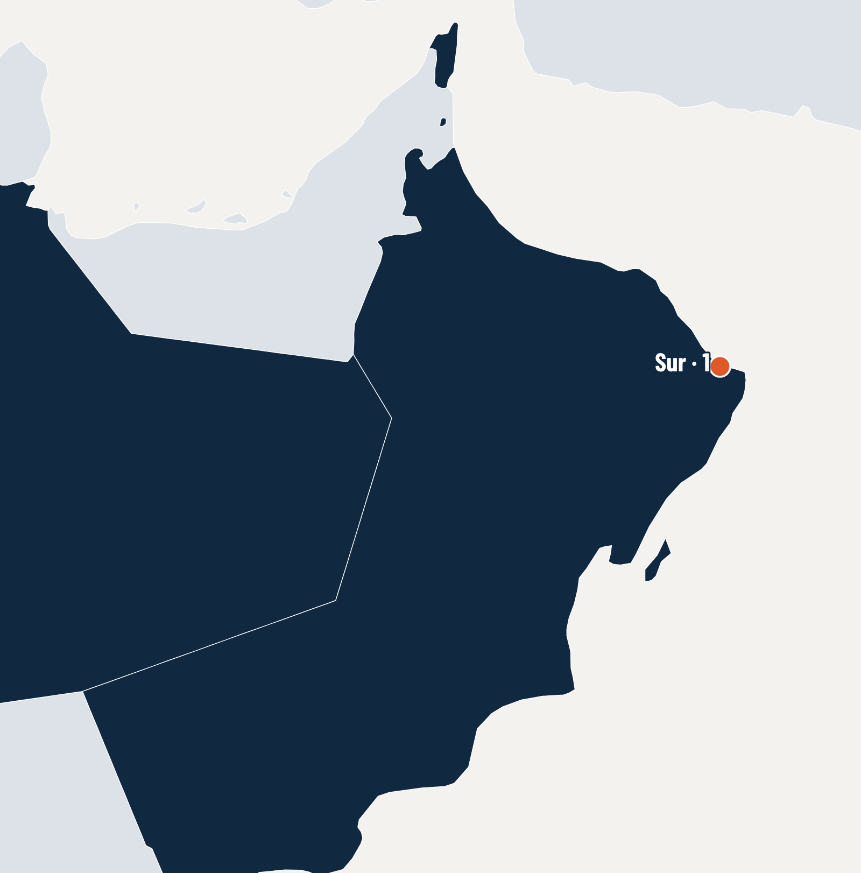
2014
OMAN
1 REFERENCE PROJECT
Sur
A 2,000 MW combined-cycle IPP — Ovation DCS and Automatic Plant Start.
POWER AUTOMATION TEAM · SUCCESS STORIES
33

Slide 34

OMAN · 2014 · EMERSON OVATION
2,000
SUR IPP-CCPP 2,000 MW
MW
Ovation DCS — APS check & commissioning
CONTRACTOR
END USER
Emerson · Daewoo E&C
Phoenix Power Company
THE PROJECT
Check and modification of the Automatic Plant Start (APS) software on the new Ovation DCS so the plant starts as one power block.
PAT SCOPE
• Check, troubleshooting and modification of the APS (Automatic Plant Start) software so it works as one power block plant start
• Plant systems commissioning and start-up
RESULT Automatic Plant Start working as one power-block start; plant systems commissioned.
POWER AUTOMATION TEAM · SUCCESS STORIES
PAT on site — illustrative photo
34
Notes:
Reference no. 18.
Contractor(s): Emerson, Daewoo E&C — from the PAT reference list.
End user: Phoenix Power Company — TO CONFIRM (not in the reference list).
Photo: PAT photo (illustrative, not from this site)

Slide 35
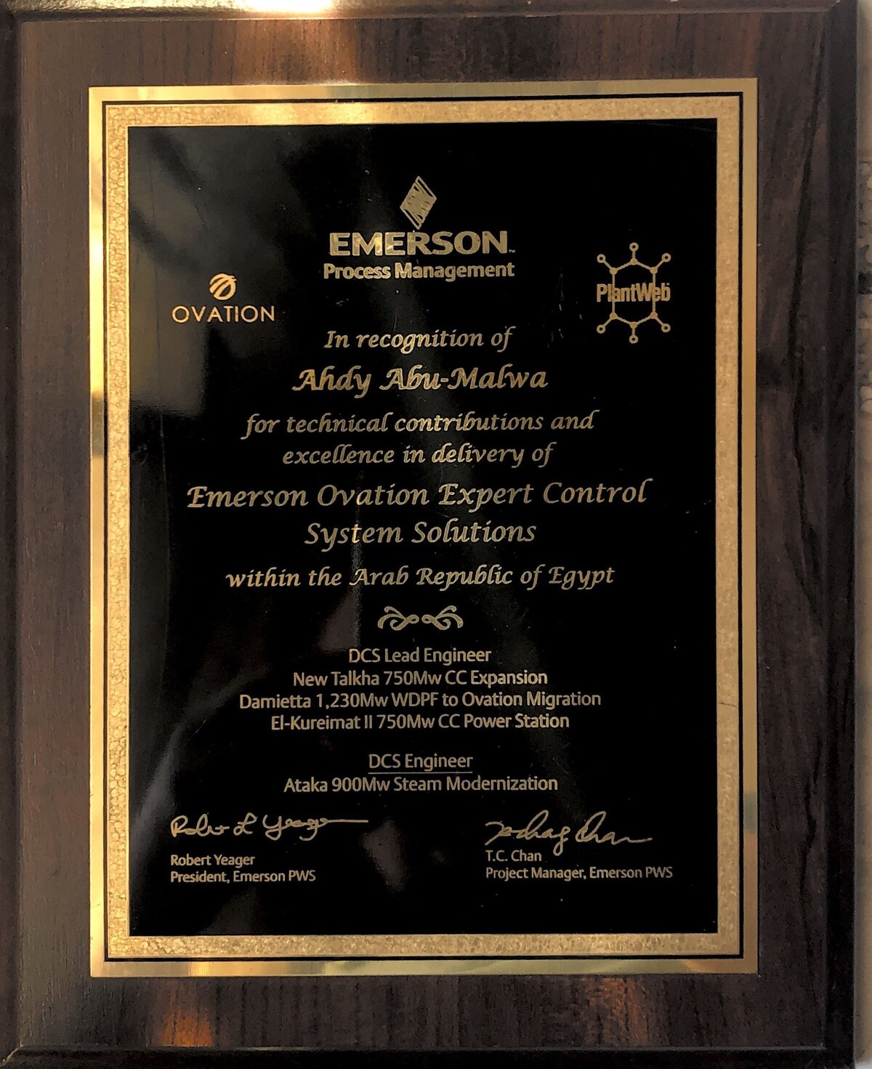
RECOGNITION
RECOGNISED BY EMERSON PROCESS MANAGEMENT
“In recognition of Ahdy Abu-Malwa for technical contributions and excellence in delivery of Emerson Ovation Expert Control System Solutions within the Arab Republic of Egypt.”
DCS LEAD ENGINEER
New Talkha 750 MW CC Expansion
Damietta 1,230 MW WDPF to Ovation Migration
El-Kureimat II 750 MW CC Power Station
DCS ENGINEER
Ataka 900 MW Steam Modernization
Signed by Robert Yeager, President, Emerson PWS, and T.C. Chan, Project Manager, Emerson PWS. Emerson and Ovation are trademarks of Emerson Electric Co.
POWER AUTOMATION TEAM · SUCCESS STORIES
35

Slide 36
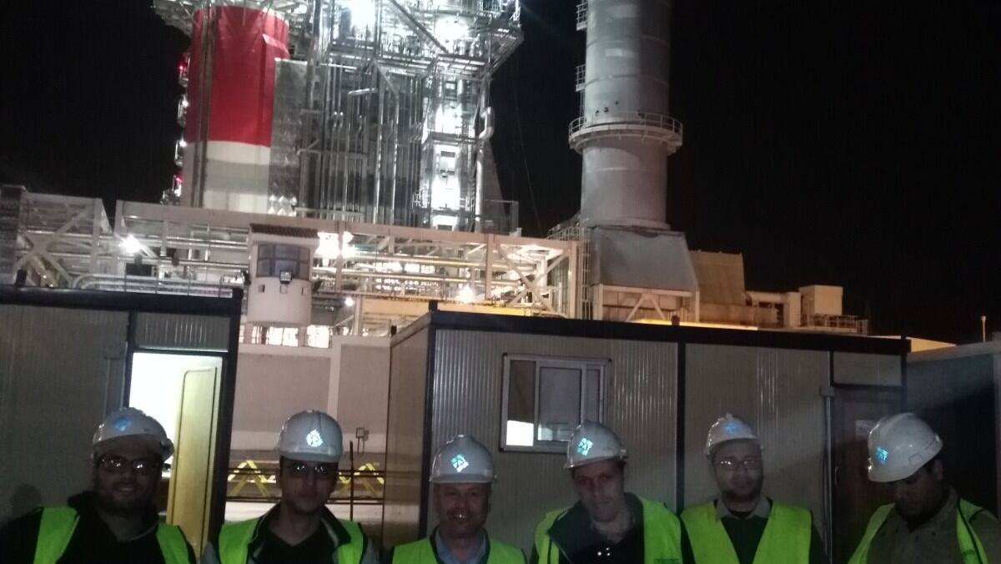

YOUR NEXT OUTAGE OR START-UP
LET’S BRING YOUR CONTROL SYSTEM ONLINE
PHONE
+20 109 991 2020 (24/7)
E-MAIL
info@patdcs.com · sales@patdcs.com
WEB
patdcs.com
OFFICE
New Damietta, Egypt
Scan for the full project list

