Slide 1
Nebula Warehouse Management.
Sprint Two
Diego Corzo #2212441
Aldo Lozano Villarreal #2132725
Juan Diego Corzo Sanchez #2212636

Slide 2
Table of contents
01
02
03
04
05
06
07
08
Project Identity.
List of features
User stories
2nd Sprint Goal
Tasks Distribution
Time Distribution
Database Design
Next Sprint Vision
little demo at the end….

Slide 3

Project Identity
“Nebula Warehouse Management.”
Title
Nebula evokes images of stars and galaxies, suggesting a powerful and expansive software solution. This can communicate that the company's software is innovative, cutting-edge, and capable of handling complex tasks.
Logo

Slide 4

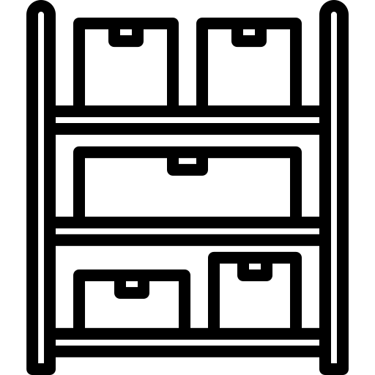

List of features:
Access Management
Product Management
Storage Management
Transaction Management

Slide 5
Access Management
Ability to create user accounts and assign roles/permissions.
Authentication (login/logout) for users.
Access control to restrict users from certain features or data.

Slide 6
Product Management
Ability to create products
Manage products.
Ability to set prices, descriptions, and images for products

Slide 7
Storage Management
Ability to track inventory levels and locations
Alerting and reporting on low stock levels
Barcode number integration for easy product tracking

Slide 8
Transaction Management
Ability to approve or denied transactions automatically.
Ability to record sales.
Reporting on sales by salesman.

Slide 9
User stories

Slide 10
Access Management
As an administrator, I want to be able to create new user accounts and assign roles so that I can control who has access to certain features and data.
As an employee, I want to be able to log in with my credentials so that I can access the features I'm authorized to use.

Slide 11
Product Management
As a manager, I want to be able to add new products to the system.
As an manager, I want to be able to set low-stock alerts so that I can restock items before we run out.

Slide 12
Storage Management
As an employee, I want to be record to scan a barcode number to track inventory levels so that I can quickly find products.
As a manager, I want to be able to view inventory reports so that I can see which products are selling well and which aren't.

Slide 13
Transaction Management
As an employee, I want to be able to view orders history so that I can track my purchases.
As an manager, I want to be able to view sales reports so that I can see how the business is performing over time.

Slide 14
2nd Sprint Goal
Implement session, adapt user authentication, implementation of objects and interfaces, database design and construction, connection between database and web page, general functionality of ALL FEATURES

Slide 15
Tasks Distribution
Diego Corzo | UI design and basic functionality.
Aldo Lozano | Page functionality between frontend and backend.
Juan Diego | Database design and functions.

Slide 16
1 Meeting per week for 14 weeks
Objects: Product, and Transaction.
Objects: Stock, and Users.
Css file and Bootstrap.
Login.
Navigation Bar.
Database design.
Interfaces: Product, and Transaction.
Interfaces: Stock, and Users.
Add classes: Product, and Transaction.
Add classes: Stock, and Users.
Edit classes: Product, and Transaction.
Edit classes: Stock, and Users.
Session implementation.
Start implementation.

Slide 17
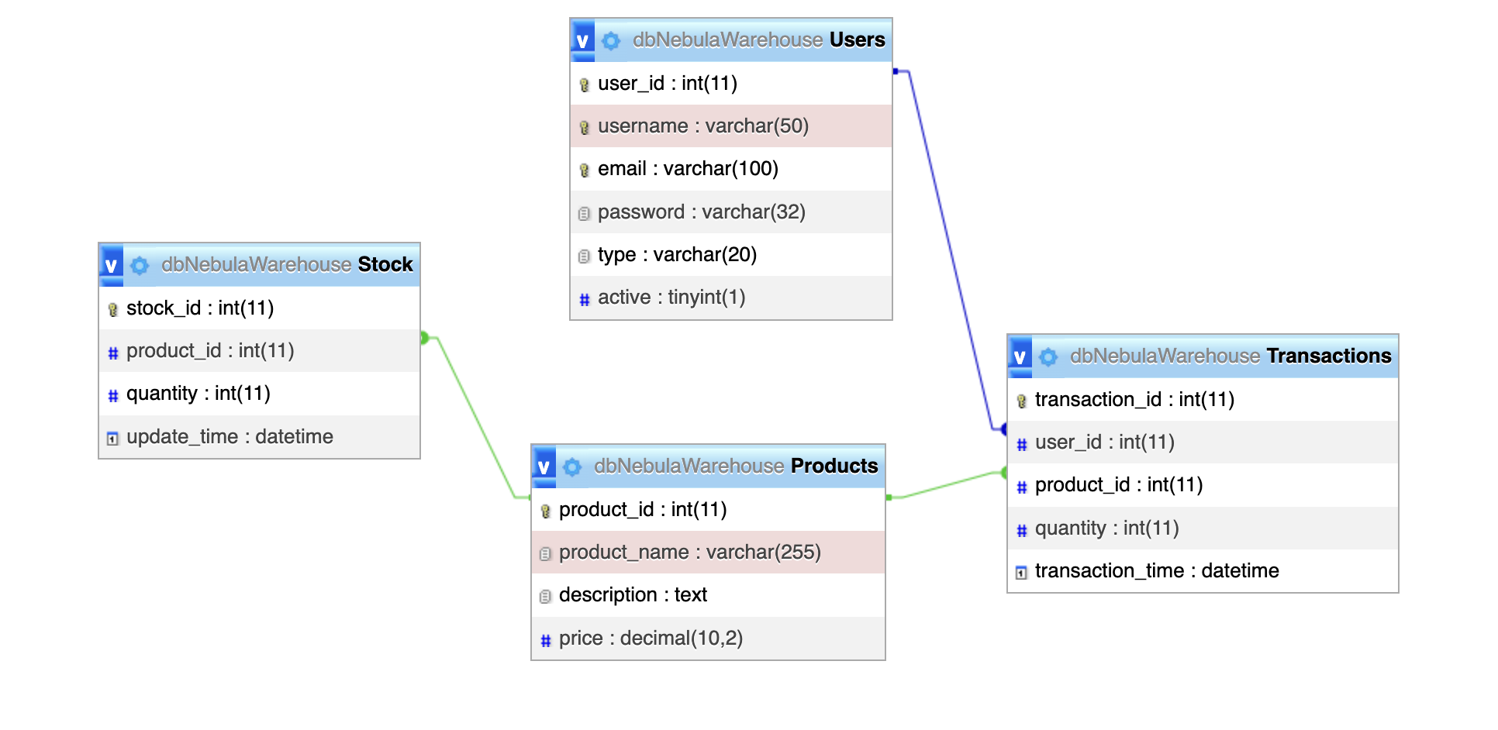
ERD

Slide 18
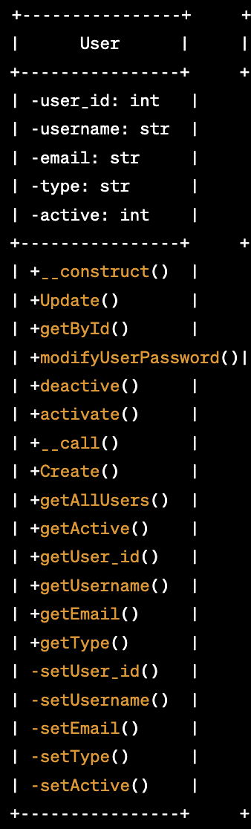
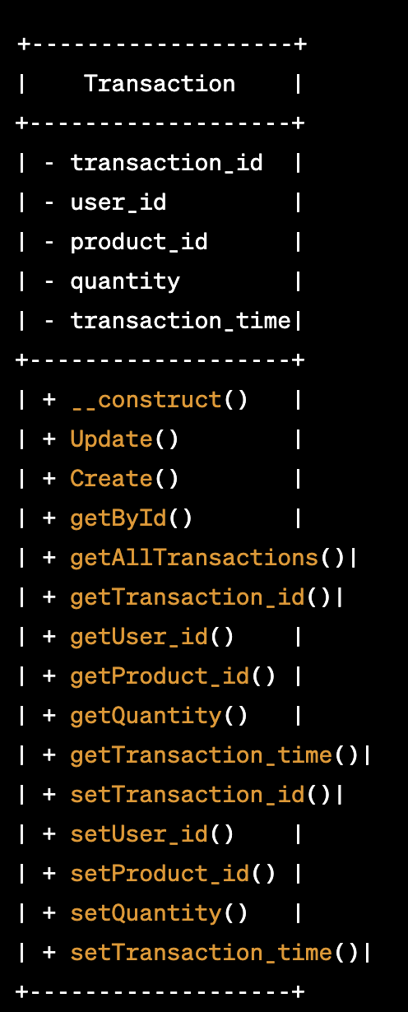
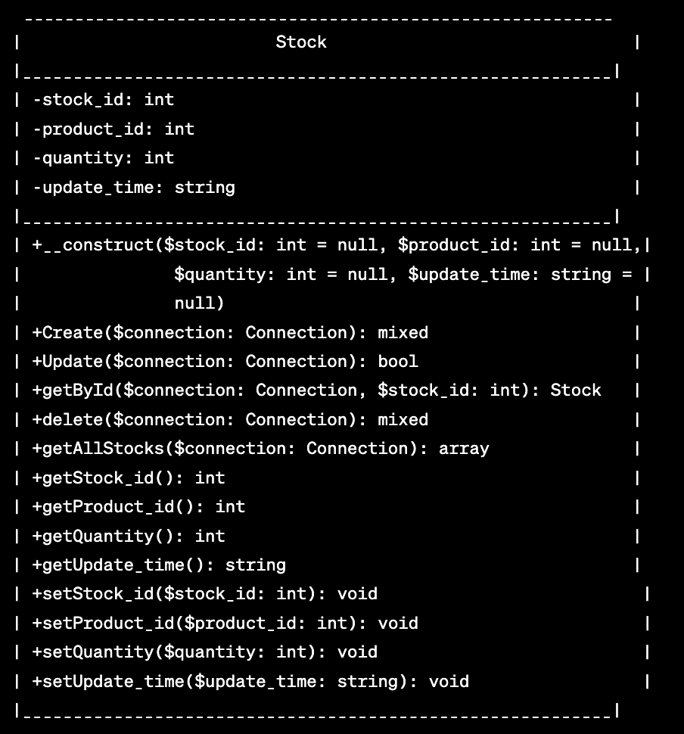
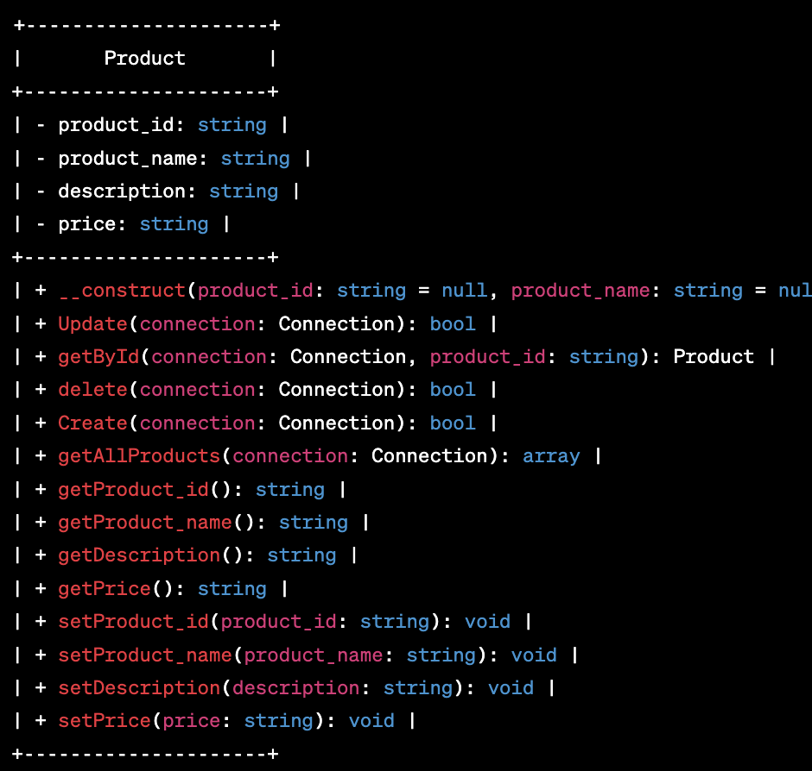
UML Diagrams

Slide 19
Next Sprint View
Barcode functionality, optimization of the code, pop-up warnings when low levels of stock, increase in UI and UX design, and images for the products.

Slide 20
Highlights
Bootstrap, jquery, basic js, and phpMyAdmin.

Slide 21
THE END

