Slide 1
Smart Piggybank
Internet of things
A.a. 2019/20
Professor
Dr. P. Ritrovato
Students
Emilio Schiavo
Matricola 0512105201
Aldo Claudini
Matricola 0512105486

Slide 2
TABLE OF CONTENTS
01
02
Project in a nutshell
Components
03
04
protocols
Tech Stack

Slide 3
TABLE OF CONTENTS
05
06
Code
Client app
07
08
Test
Zerynth Advanced device manager

Slide 4
PROJECT IN A NUTSHELL
Smart PiggyBank
Self opening and closure
Opening protected by password
Remote control from android native app
Trigger alarm on overturn

Slide 5
COMPONENTS
Development board
Gyroscope & Thermometer sensor
Servo motor
AZ-delivery ESP32 NodeMCu
TowerPro SG90
MPU6050 on GY-521 module
Passive piezoelectic buzzer
Led on opening

Slide 6
PROTOCOLS
I2C
MQTT
Communication between the board and the mpu6050
Connection between the board and the client app

Slide 7
Tech stack
Zerynth framework
Python programming language
Zerynth Advance device manager
Html & Javascript templates
Android native client app
Java programming language

Slide 8
Code on the board
Definition of gloabl variables
Definition of different functions for interaction between components, carefully not hard-coded
Initialization of zap & mqtt connection
Definition of callbacks and handling of data reception
Handling of exceptions

Slide 9
Code for client app
MainActivity for connection to the broker using Eclipse paho
Design pattern Singleton for instance of MqttAndroidClient
ConnectedActivity for interaction
Subscription to the broker incoming message appears on dialog panel
Handling of pwd change

Slide 10
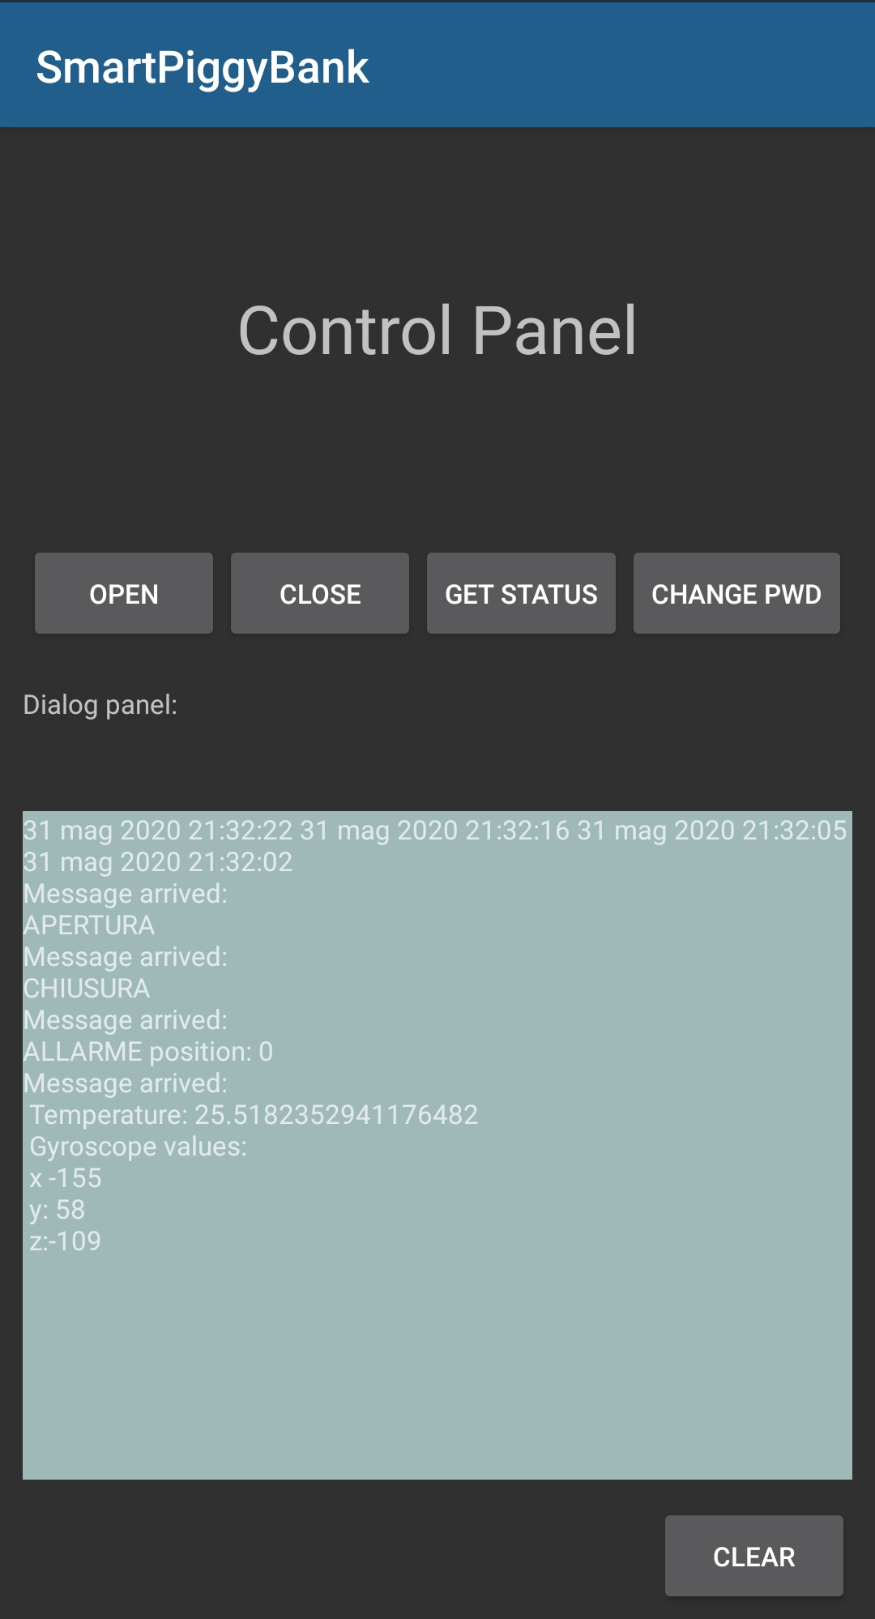
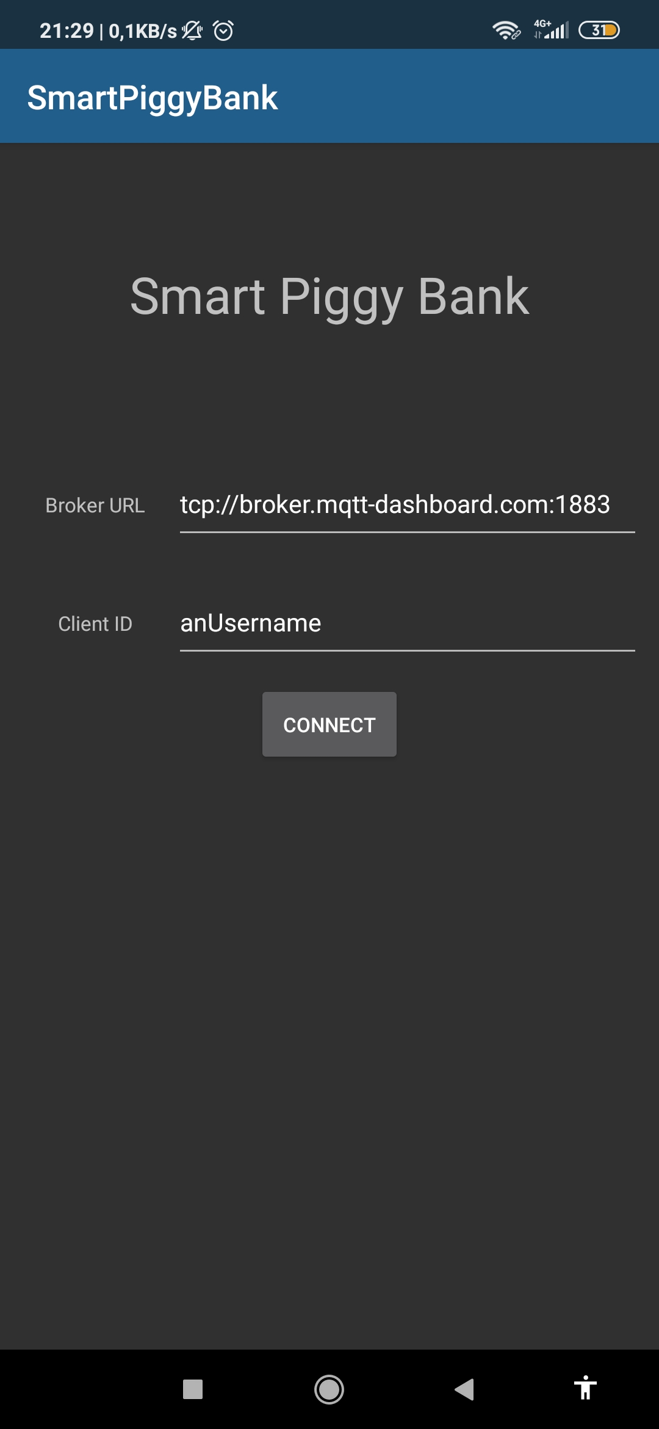
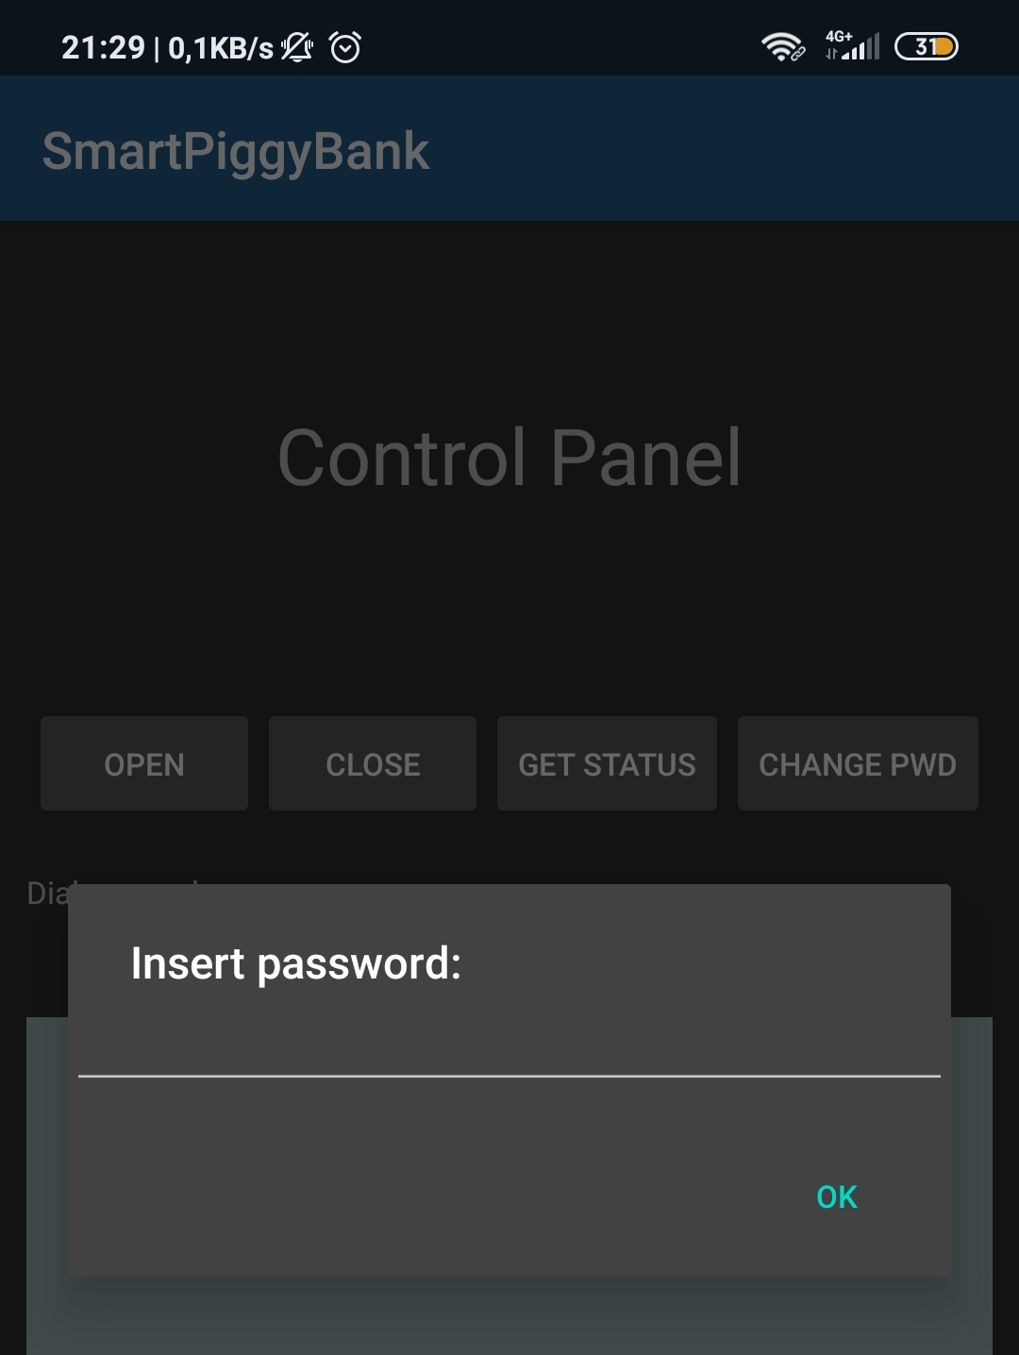
Client app screenshots
Homepage
Opening request

Slide 11
Zerynth advanced device manager
WebApp desktop for log files

Slide 12
DEMO

Slide 13
Thank you

