Slide 1
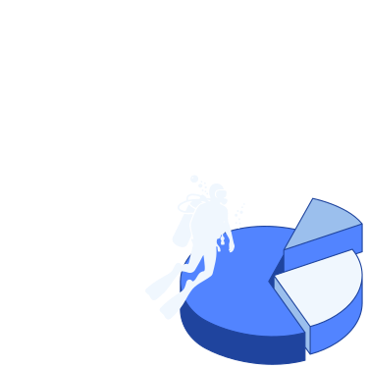
GENDER PAY GAP IN ‘UK’

Slide 2


Slide 3
Agenda
1
Main findings
6
Companies with the largest pay gaps
2
Pay gap for companies across the UK
7
pay gap based on the numbers of employees within the company
3
Pay gap across industries
8
Average pay gaps over the years
4
Pay gaps across different regions of the UK
9
Summary
5
10
Recommendation
Gender bonus gap

Slide 4
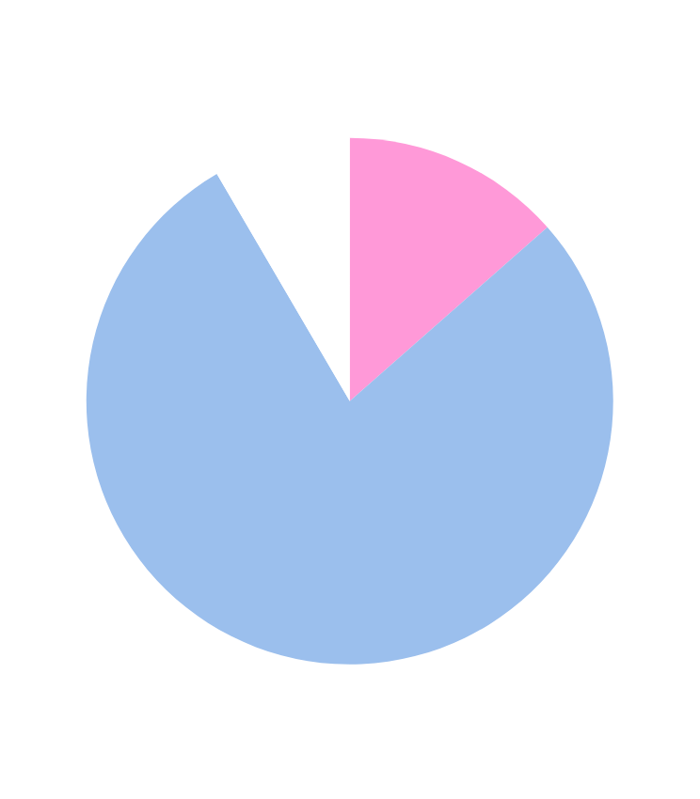
MAIN FINDINGS
Companies | Avg Median Hourly Percent
13378 | 11.925

Slide 5
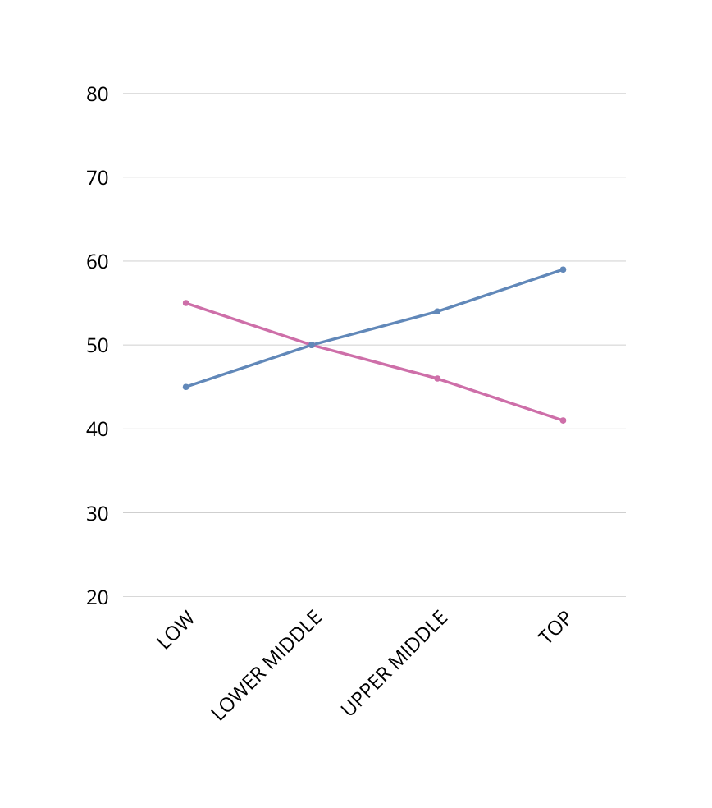
AVERAGE PAY GAP FOR COMPANIES ACROSS THE UK
LOW QUARTILE: MORE WOMEN THAN MEN
LOWER MIDDLE QUARTILE: BALANCE BEGINS SHIFTING
UPPER MIDDLE QUARTILE: MORE MEN THAN WOMEN
TOP QUARTILE: MEN DOMINATE

Slide 6

AVERAGE PAY GAPS ACROSS INDUSTRIES
Men consistently earn more than women
Most notably in banking and education

Slide 7
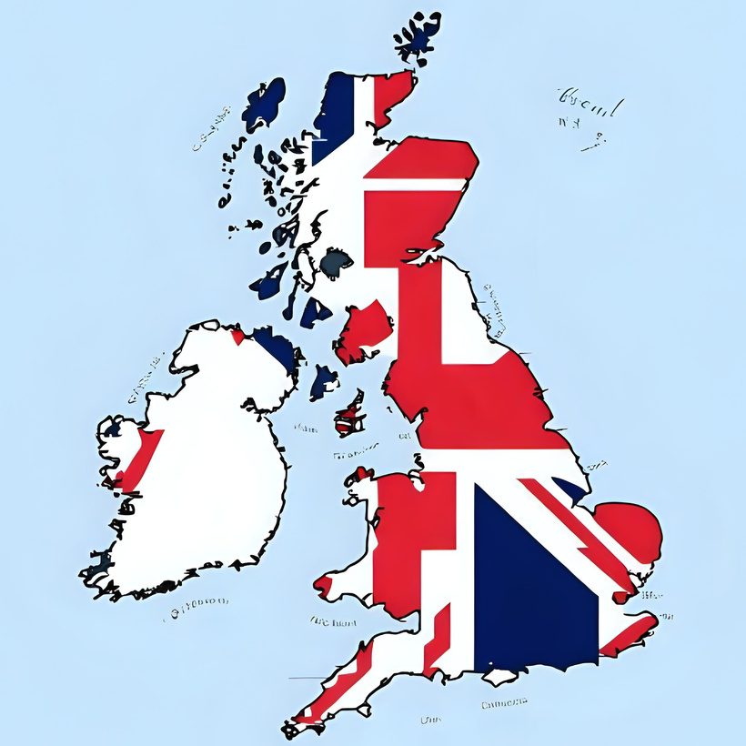
AVERAGE PAY GAPS ACROSS DIFFERENT REGIONS OF THE UK
Region | AVG Diff Median Pay
South West | 13.85
Yorkshire and the Humber | 13.62
London | 12.75
South East | 12.44
North East | 12.33
East of England | 12.26
“The gap in South West and Yorkshire
exceeds 13%”

Slide 8
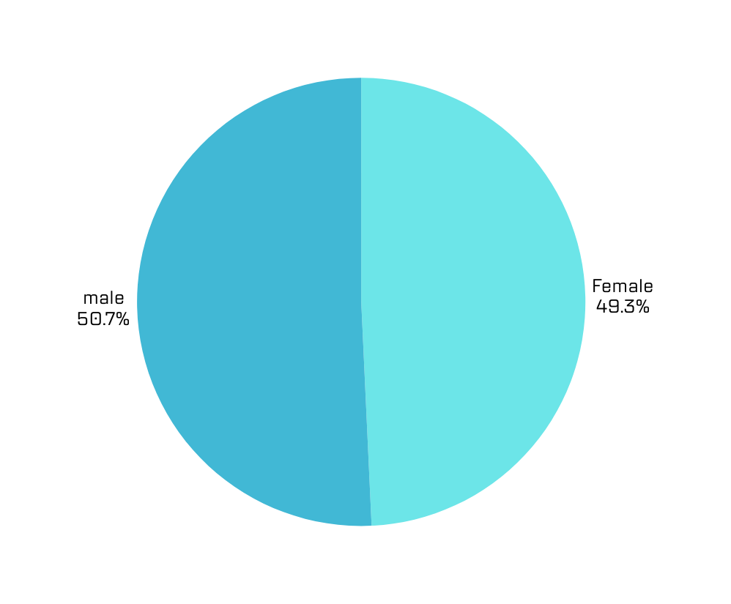



AVERAGE BONUS GAP
“A subtle but persistent gap in reward structures”

Slide 9
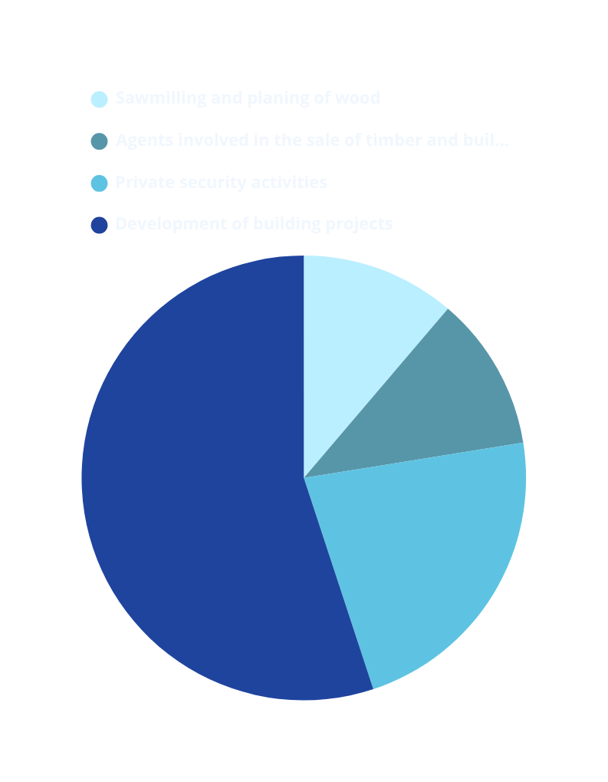

COMPANIES WITH THE LARGEST PAY GAPS

Slide 10
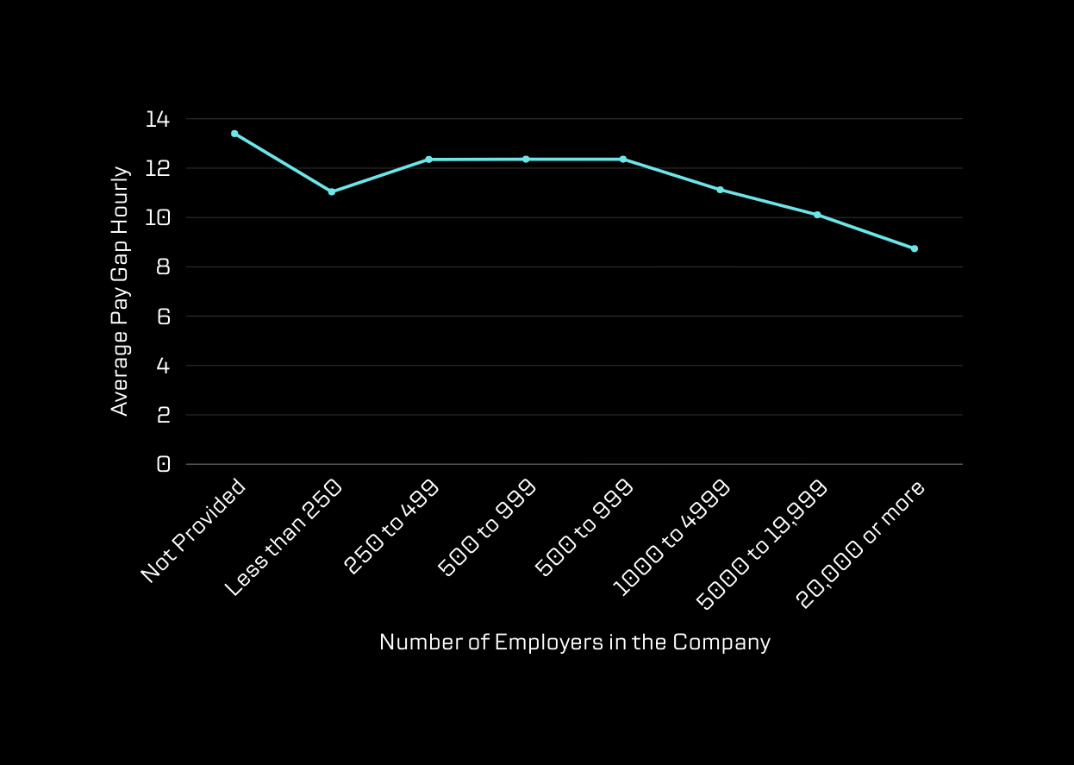

THE AVERAGE PAY GAP BASED ON THE NUMBERS OF EMPLOYEES WITHIN THE COMPANY

Slide 11

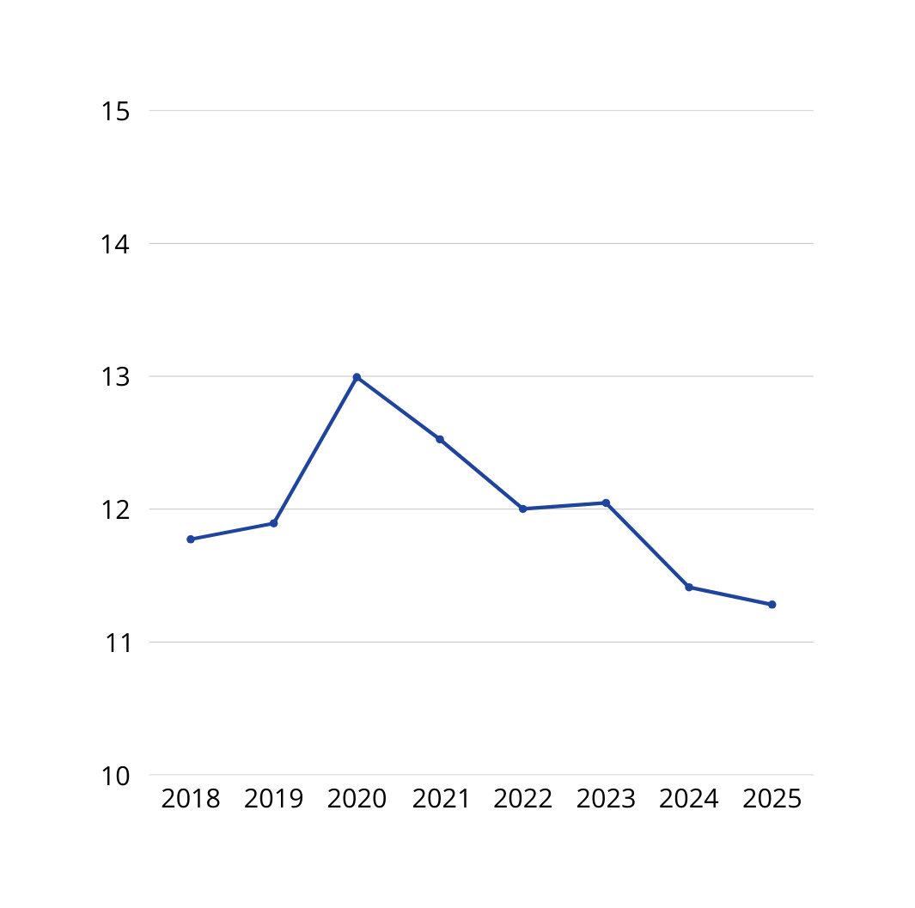
AVERAGE PAY GAPS OVER THE YEARS
TREND: SLIGHT BUT STEADY DECREASE IN PAY GAP OVER THE YEARS.
MAKE SALARIES OPEN AND CLEAR
2020 SPIKE: NOTICEABLE DISRUPTION DURING COVID-19.
CURRENT SITUATION: GAP REMAINS, IMPROVEMENTS ARE SLOW.
CALL TO ACTION: MORE EFFORT NEEDED FOR FASTER, REAL EQUALITY.

Slide 12
SUMMARY
• BASED ON THE MEDIAN AVERAGE OF MORE THAN 13,000 COMPANIES, THE GAP IS 11.6% IN FAVOR OF MEN.
AS SALARIES RISE, THE QUARTILE FOR MEN INCREASES.
THE INDUSTRIES WITH THE HIGHEST AVERAGE INEQUALITY ARE BANKS AND SCHOOLS.
THE AVERAGE PAY GAP DOES NOT VARY SIGNIFICANTLY BETWEEN REGIONS.
COMPANIES THAT DO NOT PROVIDE THE NUMBER OF EMPLOYEES TEND TO HAVE A HIGHER AVERAGE GAP.
THERE IS A DECREASE IN THE AVERAGE PAY GAP OVERALL, BUT NOT A SHARP ONE.

Slide 13
RECOMMENDATION
MAKE SALARIES OPEN AND CLEAR
USE A FAIR SYSTEM TO SET PAY
GIVE WOMEN MORE PROMOTION CHANCES
OFFER FLEXIBLE WORK AND EQUAL PARENTAL LEAVE
REVIEW PAY GAPS EVERY YEAR
GIVE BONUSES FAIRLY BASED ON PERFORMANCE

Slide 14
CLOSE THE GAP, OPEN THE FUTURE

