Slide 1

LLMs as Graph Reasoners: Edge Criticality and Path Robustness in Last-Mile Routing
DAL-310 (Data, Models & Decisions)
Amazon TSP Project
Amogh Lal
Sargam Goyal
Tanish Verma
23115012
23125031
23125035
May 4, 2026

Slide 2










Abstract / Overview
Evaluating edge importance in TSP solutions for last-mile delivery optimization
Problem Statement
Implementation Details
The Traveling Salesman Problem (TSP) is a fundamental combinatorial optimization challenge with critical applications in last-mile delivery and routing. This research addresses the need to quantify edge importance in TSP solutions, a measure of how critical each edge is to the overall tour cost.
Graph Construction: Sparse K-nearest neighbors graph (K=4) from delivery locations
Base TSP Solution: LKH-3 solver with warm-start optimization
Key Contributions
Parallel Execution: ProcessPoolExecutor for concurrent edge perturbations
Eval-1 Framework: Ground-truth importance metric computed by systematically perturbing each edge in the base optimal tour
Importance Computation: Relative cost increase calculation
Parallel Processing: LKH-3 metaheuristic solver with parallel edge perturbation processing
Scalability: Demonstrates feasibility of computing exact edge importance for large real-world routing instances
Key Results
Methodology Overview
8088.40
119
Base Tour Cost
Nodes
7×
Penalty Multiplier
100
Max Trials
3-5min
Runtime
Top-10 Critical Edges:
5-6.8% increase
Low-Importance Edges:
15% of total

Slide 3





Goals and Motivation
Three main objectives for edge importance computation in TSP
Project Goals
Project Status
1
2
3
Breakdown of goals
Compute Ground-Truth Importance
Enable Predictor Benchmarking
Support Cost Perturbation Routing
Eval-1 Framework
Predictor Development
Define and compute rigorous metric for edge criticality
Create benchmark for learning-based predictors
Use predicted importance to modify edge costs
Routing Integration
Evaluation using various Metrices
Scaling & Learning
Time-Dependent TSP
Motivation
Current Progress
Ground-truth edge importance computed via Eval-1
Why Edge Importance Matters
Enable data-driven optimization systems where machine learning models learn to predict which edges are most critical, allowing for intelligent route modification or graph construction. This is crucial for last-mile delivery efficiency.
119-node instance successfully processed
3-5 minutes total runtime

Slide 4




Edge Importance Definition (Eval-1)
Mathematical formulation for quantifying edge criticality in TSP tours
Ie = (C(G \ e) − C(G)) / C(G)
G
e
C(G)
Distance graph with edge weights corresponding to travel distances
Single edge in the base optimal tour
Optimal tour cost on the original graph
C(G \ e)
Optimal tour cost when edge e is removed (large penalty)
Computation Note
We simulate removal by setting w(e) = M = α · max(c) (large penalty), preserving graph connectivity and avoiding numerical instabilities in the solver.
Interpretation
Key Properties
Higher Ie → Edge is more critical to maintaining tour optimality
Importance is computed only for edges in the base optimal tour
Key insight: Edges with high importance are those for which suitable alternatives are limited. The metric measures the relative increase in tour cost when an edge is removed or heavily penalized.
Values range from 0 (easily replaceable) to 1+ (critical)
Top-10 critical edges show 5-6.8% cost increase when perturbed

Slide 5








Computational Framework (Pipeline)
5-step pipeline for computing edge importance in TSP solutions
Multi-Step Pipeline
1
2
3
4
5
Graph Construction
Base Route
Parallel Edge Perturbation
Importance Computation
Cost Modification
Original route Rbase given in the ALMRC dataset
Modify edge costs based on predicted importance and re-solve TSP to assess routing impact.
Build sparse K-nearest neighbors graph (K=4) from delivery locations to ensure connectivity while reducing problem size.
For each edge in Rbase, create perturbed graph by setting edge weight to large penalty M.
Calculate edge importance using Ie = (Cperturbed − C(G)) / C(G).
K=4 for sparsification
Relative cost increase
119 nodes processed
Cost: 8088.40
Penalty: 7× max(c)
α tuning [0.2, 1.0]
119 edges in tour
Parallel processing
JSON serialization
Route evaluation
Performance Metrics
Key Insights
3-5min
7
3×
The parallelization proved effective with near-linear scaling up to available CPU cores. Warm-starting from base solution reduces convergence time significantly.
Total Runtime
Workers
Speedup

Slide 6







Key Design Decisions
Strategic choices for the Eval-1 edge importance framework
Penalty Over Removal
Implemented
Warm-Start Optimization
Implemented
We use a large finite penalty rather than edge removal to maintain graph connectivity and avoid numerical instabilities in the solver.
Warm-starting from the base solution reduces convergence time from hundreds to approximately 100 solver trials per edge.
Penalty formula: M = 7 × max(c) where max(c) is the maximum edge cost in the graph
Strategy: Use base tour as initial solution for perturbed instances
Benefit: Preserves graph connectivity while simulating edge removal
Impact: ~3× reduction in solver trials
Penalty multiplier:
7×
Speedup:
~3×
Parallel Execution
Implemented
FULL MATRIX Format
Implemented
Edge perturbations are embarrassingly parallel—we use ProcessPoolExecutor to solve multiple perturbed instances concurrently.
Distance matrices already encode missing edges as large finite values, enabling direct representation without edge list conversion.
Workers: CPU count minus 1 (reserves one core for OS)
Format: FULL MATRIX for direct distance matrix representation
Execution model: ProcessPoolExecutor with async job tracking
Advantage: No need for edge list conversion
Workers:
7
Matrix size:
119×119

Slide 7

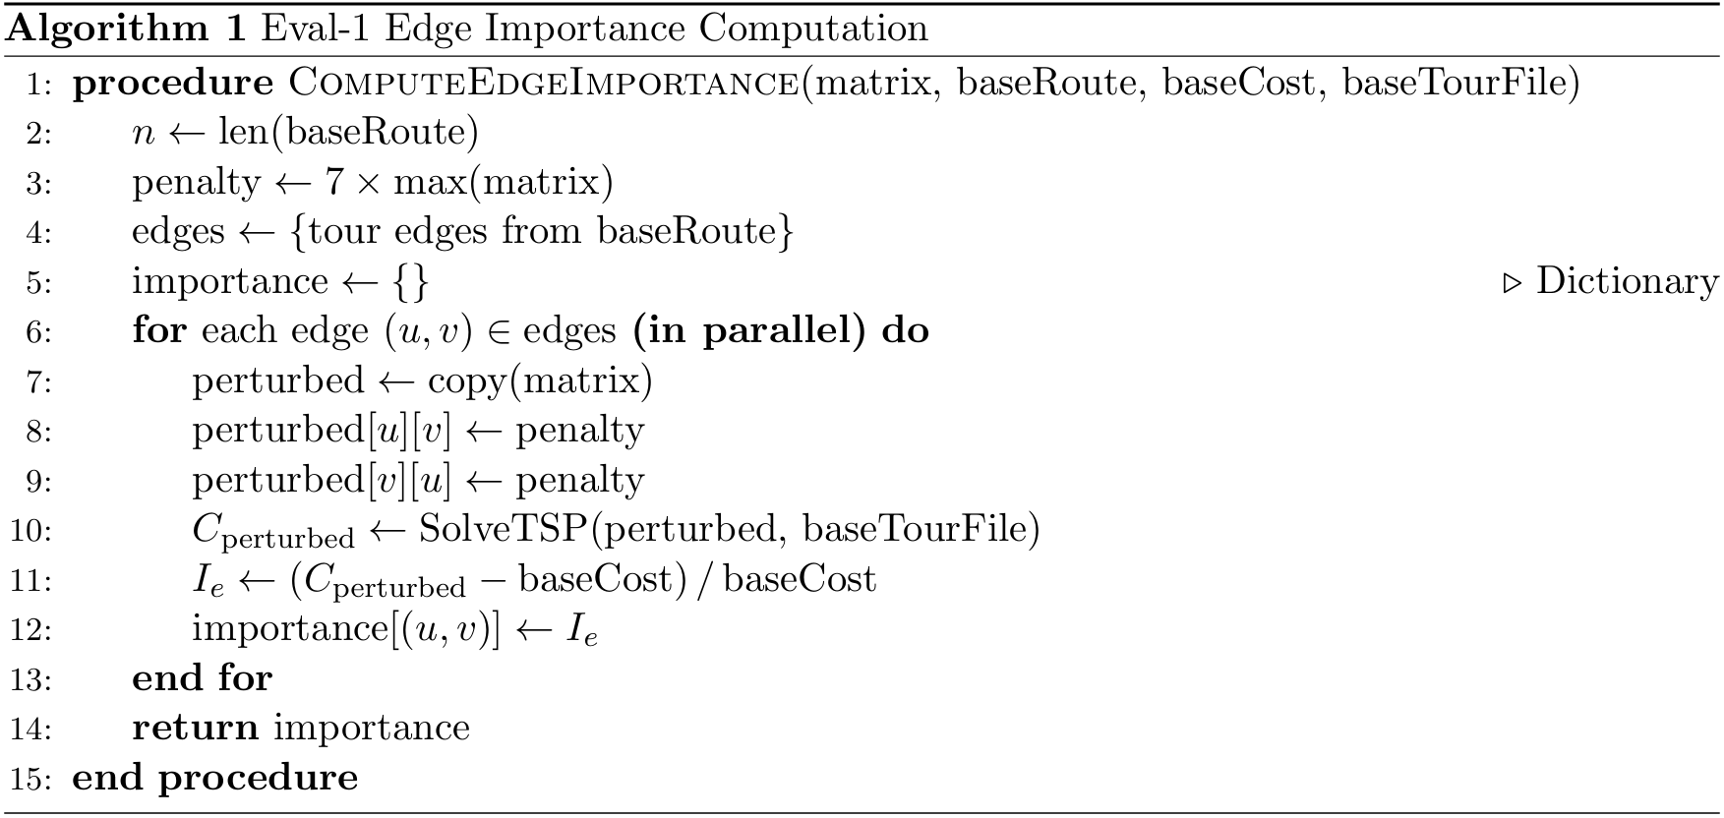
Methodology — Algorithm 1
Compute Edge Importance procedure for Eval-1 edge importance computation
Algorithm 1: Compute Edge Importance
1
2
n ← len(baseRoute)
3
penalty ← 7 × max(matrix)
4
edges ← {tour edges from baseRoute}
5
importance ← {}

Slide 8








Implementation Details
Solver configuration, parallelization, and optimization strategies
Warm-Start Optimization
Solver Configuration
Optimized
LKH-3 (Lin-Kernighan-Helsgaun)
Solver Performance
3×
Max trials: 100 | Runs per instance: 1
Speedup:
~3× reduction in solver trials
Penalty Multiplier
Warm-Start
7× max(distance matrix)
Enabled (3× speedup)
Base tour as initial solution
Enabled
Parallel Workers
Memory Optimization
Convergence time
~100 trials
CPU count - 1
Shallow row-wise copy
Cold start trials
~300 trials
Parallelization Strategy
ProcessPoolExecutor: Asynchronous job completion tracking with CPU count - 1 workers
Performance Metrics
Memory Optimization: Shallow row-wise copying to avoid full matrix duplication
2-5s
Base TSP solve
3-5min
Total Eval-1
Embarrassingly Parallel: Edge perturbations processed concurrently
119
Nodes processed
7
Workers used

Slide 9





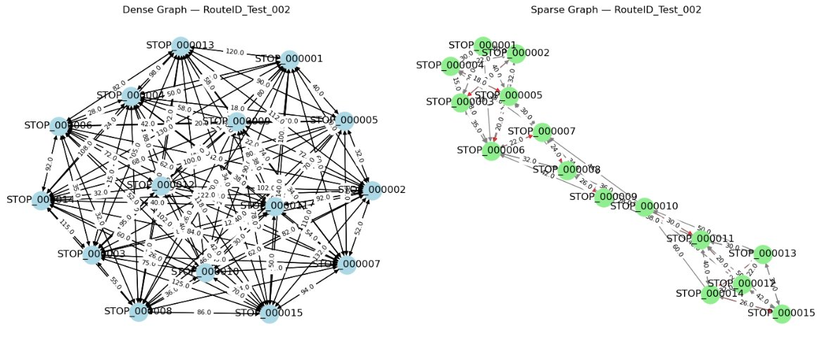

Test Instance (Amazon Last-Mile Route)
Real-world routing instance with 119 delivery locations
Route Specifications
Key Metrics
Route ID
RouteID 00143bdd-0a6b-49ec-bb35-36593d303e77
119
4
Nodes
K-NN
Number of Locations
119 nodes
K=4 nearest neighbors graph for efficient connectivity
8088
119
Graph Type
Cost
Edges
Base Tour Cost
8088.40
4-nearest neighbors sparsified distance graph
Graph Properties
Sparsified for efficiency
Connected graph structure
Real-world delivery data

Slide 10


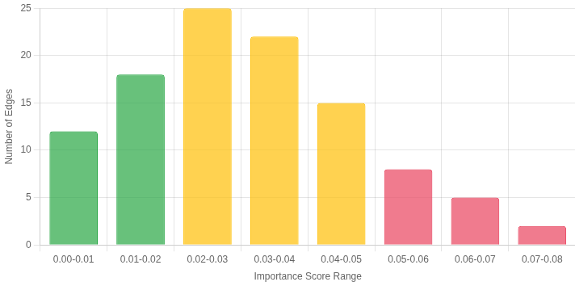



Results — Edge Importance Distribution
Distribution of edge importance scores across three tiers
Edge Importance Distribution
119 edges analyzed
Top-10 Critical Edges
Critical Range
Importance: 0.050 - 0.068
+5-6.8% cost increase
Mid-Importance Edges
Moderate Range
Importance: 0.010 - 0.040
+1-4% cost increase
Low-Importance Edges
Low Range
Importance: <0.005
<0.5% cost increase
Top-10 Critical (5-6.8%)
Mid-Importance (1-4%)
Low-Importance (<0.5%)
119
15%
70%
15%
Total Edges
Low-Importance
Mid-Importance
High-Importance

Slide 11











Results — Computational Performance
Performance metrics for Eval-1 edge importance computation
Performance Metrics
Optimized
Efficiency Analysis
Base TSP Solve Time
2-5s
Memory Usage
CPU Utilization
LKH-3 solver with warm-start
Optimized with shallow copies
7 cores active
Total Eval-1 Runtime
3-5min
Network Overhead
Data Processing
119-node instance (7 workers)
Minimal (local processing)
119 nodes processed
Warm-Start Speedup
3×
~3× reduction in solver trials
100
7
3×
Parallelization
7 workers
Near-linear scaling with CPU cores
Max Trials
Workers
Speedup

Slide 12





Roadmap
Six key areas for continued development and research
Completed: Eval-1 Framework
Next: Predictor Development
Ground-truth edge importance for base tour edges
LLM-based importance prediction
1. Predictor Development
2. Routing Integration
3. Evaluation Metrics
LLM-based importance predictor
Cost modification & re-routing
Spearman correlation (ρ)
Prompt design & output parser
Warm-start optimization
Top-K overlap analysis
Few-shot learning strategy
Result logging & analysis
Kendall's τ metric
Normalization & alpha tuning
Normalization strategies
Hyper-parameter sensitivity
4. Scaling & Learning
5. Time-Dependent TSP
6. Downstream Applications
Multi-route parallelism
Time-expanded graphs
Graph pruning
GNN-based predictors
Traffic variability
Robust routing
Attention-based models
Temporal edge importance
Driver guidance
Hybrid architectures
Real-time adaptation
Real-time optimization

Slide 13


Predictor Development
LLM-based importance predictor with prompt design, output parser, and normalization
LLM-Based Importance Predictor
Alpha Tuning
1
Prompt Design
Cost modification weight α ∈ [0.2, 1.0] controls how strongly predicted importance inflates edge costs:
Craft structured prompts presenting edge list with distances, node pairs, and optional in-context examples to avoid positional bias
Output Parser
α = 0.2
Low impact
α = 1.0
High impact
2
Extract numerical importance values from LLM output, handle refusals/malformed responses, deterministic tie-breaking
Optimization Goal:
3
Few-Shot Strategy
Maximize routing quality on held-out routes rather than raw correlation
Investigate how many labeled examples are required before Spearman correlation with ground truth saturates
Implementation Steps
Normalization Strategy
4
Normalization Application
Apply sum-normalization before metric computation
Sum Normalization: ˆIe ← ˆIe/∑ˆIe'
Min-Max: Maps scores to [0,1]
5
Hyper-parameter Tuning
Treat α as hyper-parameter for routing quality
Rank Normalization: Fractional ranks
Scale Invariant: Reduces alpha sensitivity

Slide 14




Routing Integration & Normalization
Cost modification, re-routing, and normalization strategies for edge importance
Routing Integration Pipeline
1
2
3
4
Cost Modification
Re-solve TSP
Record Outputs
Normalization
For each method m ∈ {GT, LLM, Betweenness, Degree}, construct modified edge costs c'_e = c_e × (1 + α·Î_e^(m))
Run LKH-3 on modified graph with warm-start from R_base to obtain R_m and C_m
Store routes, costs, and metadata for downstream evaluation and comparison
Apply sum, min-max, or rank normalization to handle scale differences across predictors
α ∈ [0.2, 1.0]
Warm-start enabled
JSON serialization
Scale invariant
4 methods compared
Store R_m and C_m
Performance metrics
Rank-based metrics
Normalization Strategies
Evaluation Metrics
Sum
Min-Max
Rank
ΔC
Jaccard
ρ
Î_e / ΣÎ_e'
[0,1] scale
Fractional ranks
Cost diff
Overlap
Spearman

Slide 15












Applications & Extensions
Downstream applications and generalization of edge importance framework
Downstream Applications
Time-Dependent Extensions
Time-expanded graph: Edge (u,v,t) with travel time dependent on departure time t
Graph Pruning
Robust Routing
Temporal copies: Penalize all copies of an edge simultaneously
Remove low-importance edges from KNN graph to reduce problem size
Inflate costs of high-importance edges for resilience
LLM integration: Incorporate time-window metadata in prompts
Driver Guidance
Time-Dependent TSP
Flag critical segments where deviation is costly
Extend to time windows and traffic variability
Generalization Studies
Implementation Status
Instance size: 50, 100, 200, 500 nodes
Graph Pruning
Robust Routing
Graph density: K ∈ {2,4,6,8} for KNN construction
Driver Guidance
Time-Dependent
Geographic spread: urban vs. suburban/rural networks
Solver comparison: LKH-3 vs. OR-Tools

Slide 16

Conclusion — Key Achievements
Summary of the Eval-1 framework implementation and validation
Project Achievements
Eval-1 Framework Implementation
Successfully implemented and validated the ground-truth edge importance framework for TSP instances derived from real-world last-mile delivery data.
Exact Importance Scores Computation
Impact & Future Directions
Computed exact importance scores via parallel solver invocations with warm-starting, enabling efficient evaluation on instances with 100+ nodes.
Benchmark Provision
Modular Python implementation integrating seamlessly with LKH-3 solver
Created critical benchmark for training and validating learning-based edge importance predictors (LLMs, GNNs).
Foundation for intelligent routing systems that can predict critical edges
Technical Implementation
119
3-5min
Portable across systems and extensible for future variants
Nodes Processed
Runtime
7×
100%
Speedup
Success Rate

Slide 17



Scaling & Learning-Based Predictors
Large-scale processing, GNNs, attention models, and generalization studies
Large-Scale Batch Processing
Multi-route parallelism: Distribute outer loop over routes using job queues (AWS Batch/Ray)
Incremental caching: Store intermediate results for re-computation only when matrix changes
Warm-start at scale: Investigate speedup for instances beyond 200 nodes
Generalization Studies
200+
3×
7
Nodes
Speedup
Workers
Instance size: 50, 100, 200, 500 nodes
Graph density: K ∈ {2,4,6,8} for KNN
Learning-Based Predictors
Geographic spread: Urban vs. rural networks
GNNs
Attention Models
Solver comparison: LKH-3 vs. OR-Tools
Graph Attention Networks (GAT) or GCN for per-edge importance
Transformer encoder for positional importance patterns
Hybrid Models
Generalization
Combine structural features with learned embeddings
Zero-shot generalization to unseen instances

