Slide 1
FINAL PROJECT • WEEKS 14–17
LifeLink
♥
Blood Donation
Management System
Reports • integration • testing • finalization
LIFELINK
PROJECT OVERVIEW
A donor-to-donation workflow built around shared records and role-based access

Slide 2
LIFELINK • FINAL SYSTEM REVIEW
Why LifeLink exists
Blood donation work crosses people, screening, appointments, records, and stock. LifeLink gives donors and administrators one connected place to manage that journey.
The coordination gap
The system response
The outcome
Scattered donor details and manual follow-up make it harder to see a donor’s status, keep a reliable history, and act on available blood stock.
A shared database links donor profiles with assessments, appointments, donations, requests, and inventory. Role checks separate donor and admin work.
Staff can review operational records in one place, while donors can manage their own profile, screening, appointment requests, and history.
LifeLink • Blood Donation Management System
02

Slide 3
LIFELINK • FINAL SYSTEM REVIEW
Objectives and user roles
Donor
Administrator
• Create an account and sign in
• Maintain a donor profile
• Submit a preliminary health assessment
• Request an appointment
• View donation history and blood requests
• Manage donor records and archives
• Review assessments and appointments
• Record donations and track requests
• Maintain blood inventory
• Open protected, database-backed reports
PUBLIC VISITOR
Public Home, About, Features, Contact, registration, and login routes.
LifeLink • Blood Donation Management System
03

Slide 4
LIFELINK • FINAL SYSTEM REVIEW
Core modules and connected workflow
Registration & access
1
Donor profile
2
Health assessment
3
Accounts, password checks, sessions, role redirects
Contact, blood type, demographic details
Answers, score, eligibility result and reasons
Appointments
4
Donation tracking
5
Inventory & requests
6
Request, review, status, rescheduling
Donation date, status, bags and donor link
Stock adjustments and blood request workflow
Assessment results are preliminary screening; they do not replace clinical judgment.
LifeLink • Blood Donation Management System
04

Slide 5
LIFELINK • FINAL SYSTEM REVIEW
Application architecture
Browser
Spring Boot
Persistence
HTML + CSS + JavaScript
Thymeleaf-rendered views
Form validation and report filters
›
Spring MVC controllers
Session role checks
Eligibility service and business rules
›
Spring Data JPA repositories
Hibernate entity mapping
MySQL database
Configuration
Database URL, username, and password can be supplied through LIFELINK_DB_URL, LIFELINK_DB_USERNAME, and LIFELINK_DB_PASSWORD; local defaults preserve existing setup.
LifeLink • Blood Donation Management System
05

Slide 6
LIFELINK • FINAL SYSTEM REVIEW
Donor journey and dashboard
01
02
03
04
Account
›
Screen
›
Schedule
›
History
Registration
and login
Health assessment
and result
Appointment
request and status
Donation history
and requests
Dashboard data
Empty and missing values
Dashboard sections load the signed-in donor’s real profile, latest assessment, appointments, donation records, and requests.
No-record states are handled; a regression test covers an upcoming appointment whose status is missing.
LifeLink • Blood Donation Management System
06

Slide 7
LIFELINK • FINAL SYSTEM REVIEW
Administrator operations
1
Donors
2
Assessments
3
Appointments
Search and manage donor profiles
Review eligibility status and reasons
Review requests and update status
4
Donations
5
Requests
6
Inventory
Record donations and bag counts
Review and process blood requests
Track stock by blood type
LifeLink • Blood Donation Management System
07

Slide 8
LIFELINK • FINAL SYSTEM REVIEW
Reports use real records and independent filters
DONORS
ID • name • contact • blood type • archive status
DONATIONS
Date • donor • type • bags • status
ELIGIBILITY
Date • donor • score • result • reasons
APPOINTMENTS
Time • donor • center • city • status
INVENTORY
Blood type • available bags • low-stock flag
Search and filters are scoped per report. Applicable blood type, status, and date criteria combine; invalid date ranges and no-match results show feedback.
LifeLink • Blood Donation Management System
08

Slide 9
LIFELINK • FINAL SYSTEM REVIEW
Database records and business rules
Donor-linked records
Assessment
Screening • score • result
User
1:1
Donor
Identity • email • role
Profile • blood type • archive
Appointment
Center • time • status
Donation
1:N requests
Date • bags • status
Blood request
Requester • urgency • status
Completing a donation applies inventory once; approved requests deduct stock once.
Inventory
Blood type • bag count
Current donor schema has no registration timestamp; reports do not invent one.
LifeLink • Blood Donation Management System
09

Slide 10
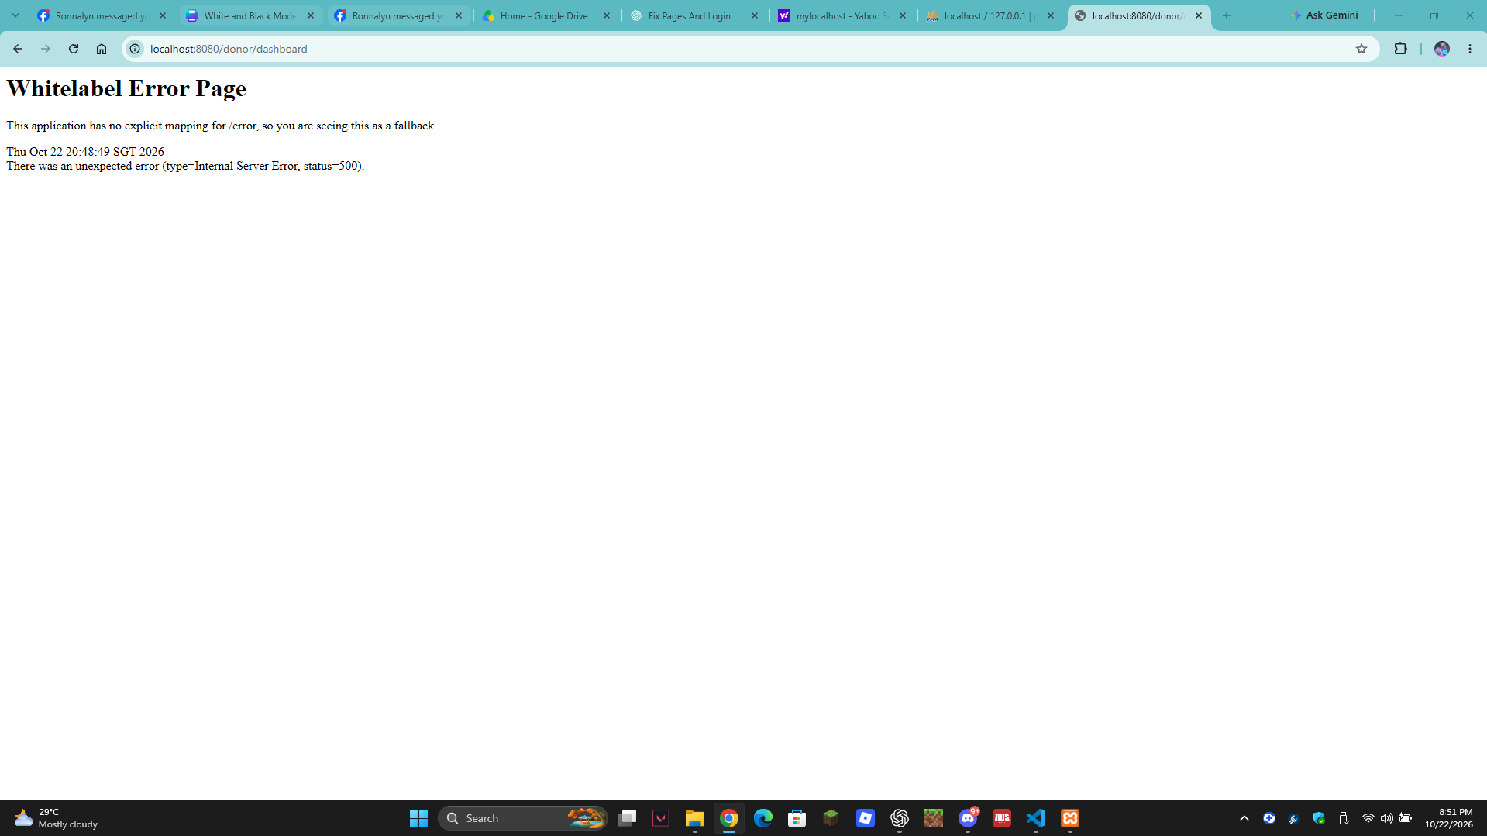
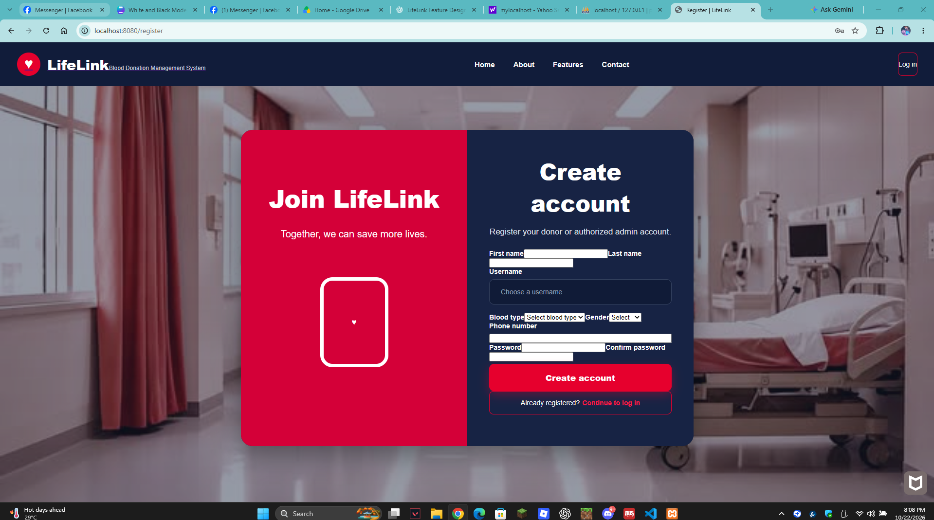
LIFELINK • FINAL SYSTEM REVIEW
Reported integration defects and fixes
The supplied captures document the earlier report: a donor dashboard HTTP 500 and an unstructured registration form. They are historical issue evidence, not screenshots of the final UI.
DONOR DASHBOARD • HTTP 500
REGISTRATION • LAYOUT DEFECT
Implemented fixes
Null-safe appointment status filtering; isolated report filters; database-backed data and regression coverage.
LifeLink • Blood Donation Management System
10

Slide 11
LIFELINK • FINAL SYSTEM REVIEW
Testing evidence and current verification limits
11 / 11
Java tests passed
1 / 1
Node report-filter test passed
6 routes
Public route smoke checks returned 200
2 routes
Unauthenticated admin/donor access redirected to login
Java coverage: startup, role redirects, registration/login, donor views, assessment and donation persistence, report content, and the null appointment-status regression.
Live HTTP smoke checks used an already-running listener; the process serving it could not be tied to the final compiled build. Fresh Tomcat startup was blocked by a Windows loopback selector error and an occupied port. Automated MockMvc tests validate current source behavior.
LifeLink • Blood Donation Management System
11

Slide 12
LIFELINK • FINAL SYSTEM REVIEW
Integration fixes and remaining work
Null appointment status
Cross-report filtering
Before public demo
List.of(...).contains(null) threw for a missing appointment status. Replaced with null-safe comparisons; regression covered by MockMvc.
A shared filter could hide unrelated report rows. Each section now combines its own search, blood type, status, and date filters; Node test verifies isolation.
Confirm the current app process and database, then capture fresh authenticated donor and admin screens. Use sanitized accounts; keep MySQL and app logs available.
Known limitations: report filters run in the browser after records load; eligibility is preliminary; MySQL reports legacy server version; live authenticated browser verification remains part of the demo checklist.
LifeLink • Blood Donation Management System
12

Slide 13
LIFELINK • FINAL SYSTEM REVIEW
Demonstration sequence and conclusion
1 Register or sign in
2 Donor dashboard + assessment
3 Request an appointment
4 Admin review and donor management
5 Record donation + verify stock
6 Reports: search, filters, empty state
LifeLink links donor-facing actions with administrator review and shared operational records.
Backup plan: if the local service or database is unavailable, use the architecture, module, and test-result slides. Identify any displayed records as fixtures; do not claim a live database update.
LifeLink • Blood Donation Management System
13

