Slide 2







Analysis of Technologies
Ralph Mendoza
14-15-2021

Slide 3



OUTLINE
Executive Summary
Introduction
Methodology
Results
Visualization – Charts
Dashboard
Discussion
Findings & Implications
Conclusion
Appendix

Slide 4

EXECUTIVE SUMMARY
Introduction to Various Trending Technologies
Methodology
Data Sources
Plan Outline
Report
Result
Data
Charts
Graphs
Discussion
Findings
Implications
Conclusion
Appendix and References

Slide 5

INTRODUCTION
The World is changing Day by Day
New Technologies Emerge and Outdates the Older One
Here Is Analytics over
1. What Technologies are Prevalent Now?
2. What Shall Constitute the Future?

Slide 6

METHODOLOGY
Data Collection and Wrangling
Exploratory Data Analysis
Data Visualization
Dashboard Creation

Slide 7
Action Plan
04
2
03
Data Visualization
Relation
Composition
Comparison
Data Dashboards
IBM Cognos
02
Data Collection and Wrangling
Collecting Data Using APIs
Collecting Data Using WebScraping
Exploring Data
Exploratory Data Analysis
Distribution
Outliers
Correlation
01
www.yourwebsite.com

Slide 8
RESULTS
Data is Organized in the Following Manner
→ Data Collection using GitHub API and even StackOverflow Survey
Data Wrangling removing Duplicates, Finding and Imputing Missing Values and Normalized Values
Exploratory Data Analysis peeking into the Distribution and Composition of the Data
Data Visualization Relation, Composition and Correlation

Slide 9
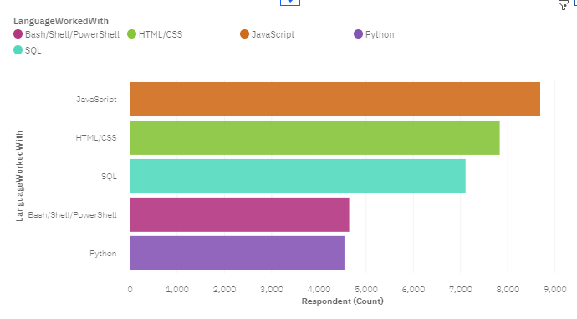
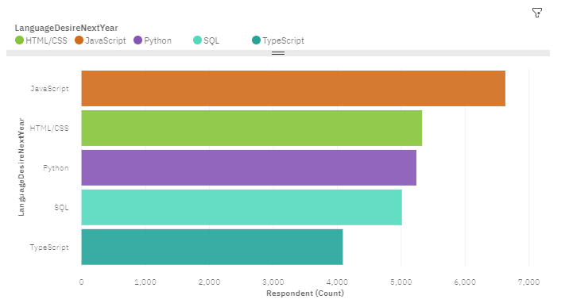
PROGRAMMING LANGUAGE TRENDS
Current Year
Next Year
<Bar chart of top 5 programming languages for the current year goes here.>
< Bar chart of top 5 programming languages for the next year goes here.>

Slide 10
PROGRAMMING LANGUAGE TRENDS - FINDINGS & IMPLICATIONS
Findings
Java Script Leads
HTML/CSS follows..
Python is at Number 5
Implications
Java Script Maintains the Crown
Python Pops in Top 3
TypeScript Emerges in Top 5

Slide 11
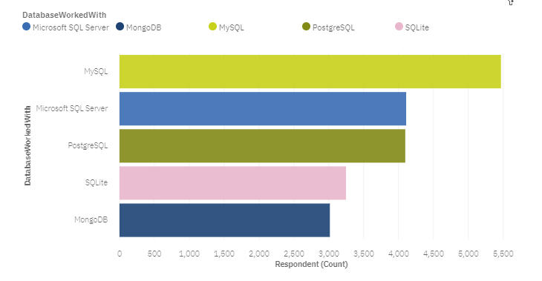
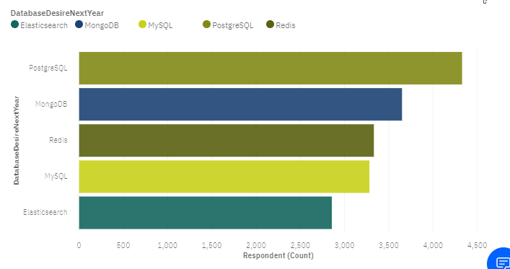
DATABASE TRENDS
Current Year
Next Year

Slide 12
DATABASE TRENDS - FINDINGS & IMPLICATIONS
Findings
MySQL Leads the Pact
Microsoft SQL in Top 3
PostgreSQL and Mongo DB Pops in Top 5
Implications
PostgreSQL Emerges as Leader
Demand for Mongo DB Rises
MySQL maintains in Top 5

Slide 13

DASHBOARD
Click The Link : My Dashboard

Slide 14
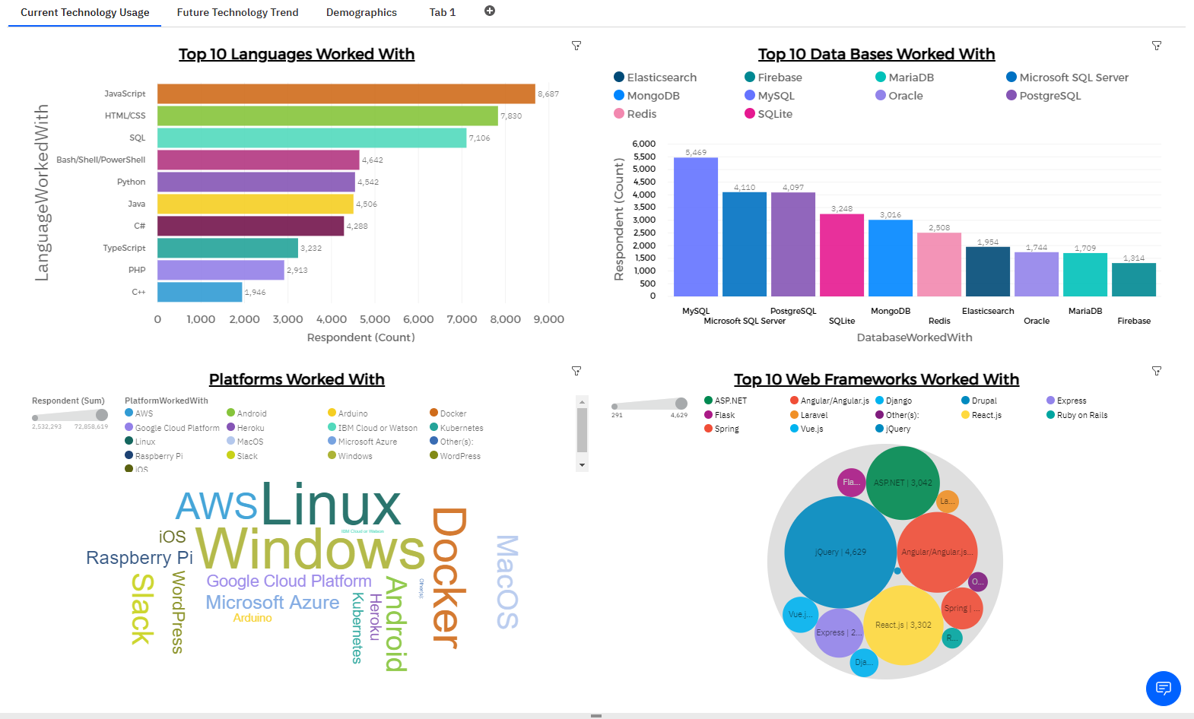
DASHBOARD TAB 1

Slide 15
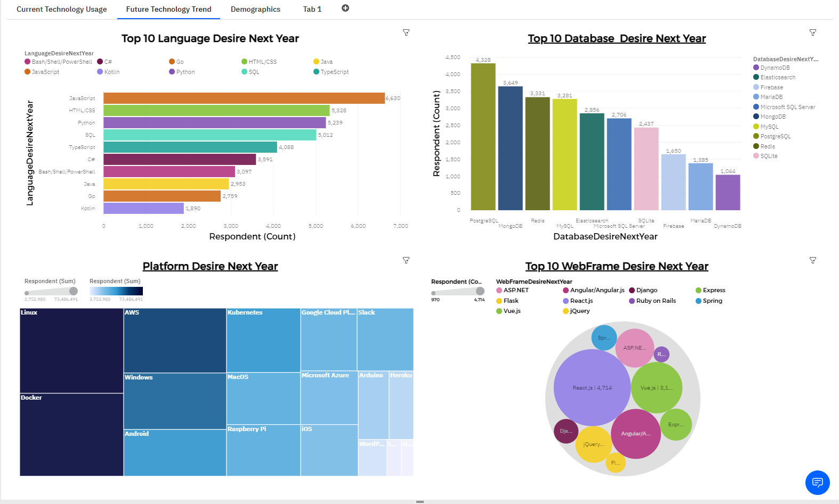
DASHBOARD TAB 2

Slide 16
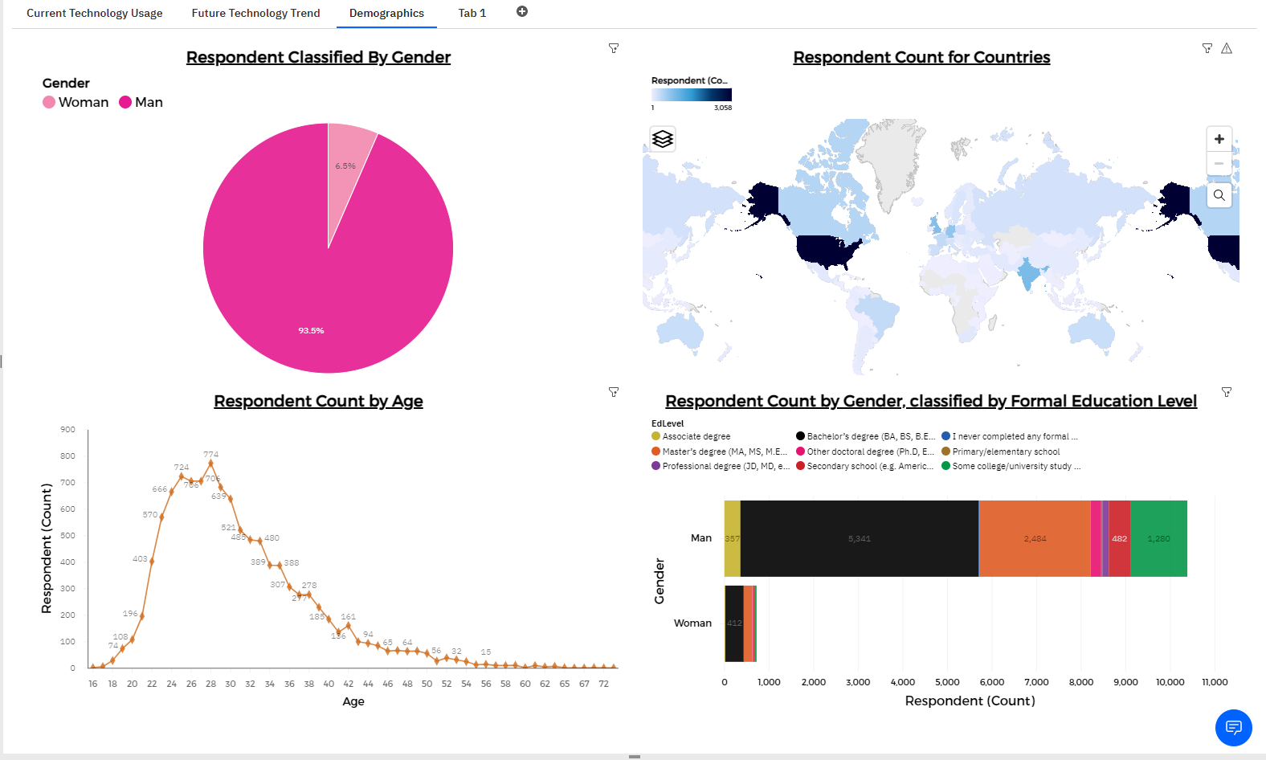
DASHBOARD TAB 3

Slide 17
DISCUSSION
Overall Findings
Implication

Slide 18
OVERALL FINDINGS & IMPLICATIONS
Findings
JavaScript Highly Used Language
PostGre SQL and MongoDb are Emerging Databases
Linux and Docker are extremely used Platforms
JQuery and React JS is the Popular WebFrame Work
Implications
Although JavaScript Dominates Python Emerges Faster
MySQL looks to be diminishing but still maintains in TOP 5
Man comprises of majority of Respondents

Slide 19

CONCLUSION
One must invest in Python and JavaScript.
MySQL, PostGre SQL and Mongo DB should be taken into account.
Linux, Windows, Docker and AWS are rich Platforms.
jQuery, React JS ASP. Net and Angular are Popular WebFrame Works to Learn.

Slide 20
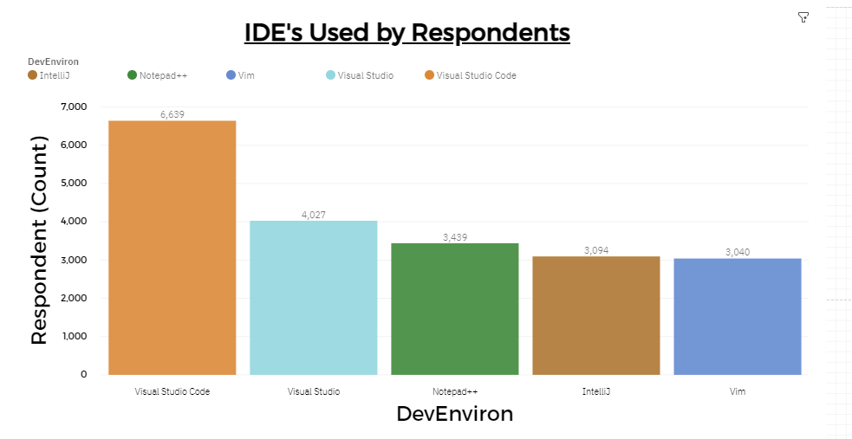

APPENDIX

Slide 21
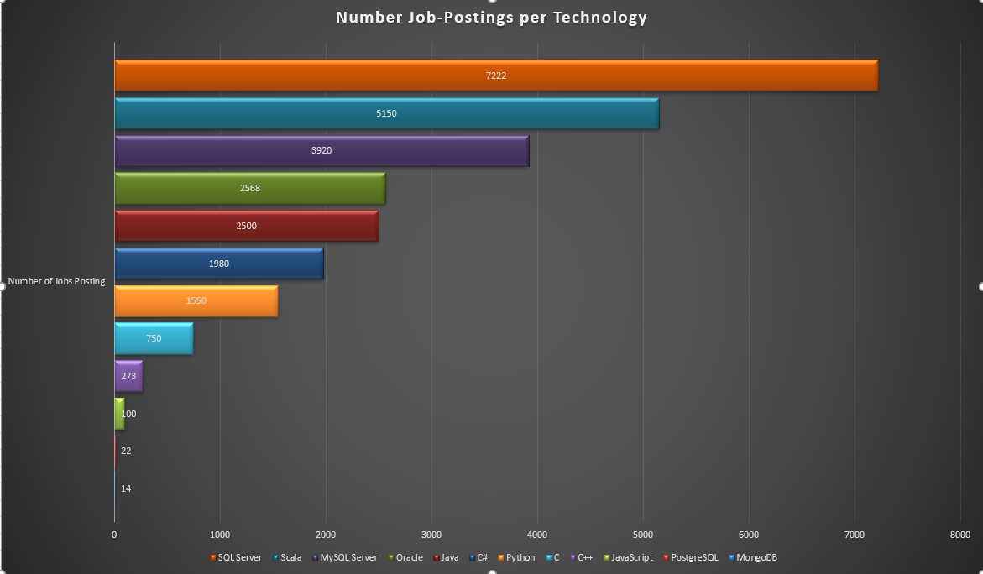
GITHUB JOB POSTINGS

Slide 22
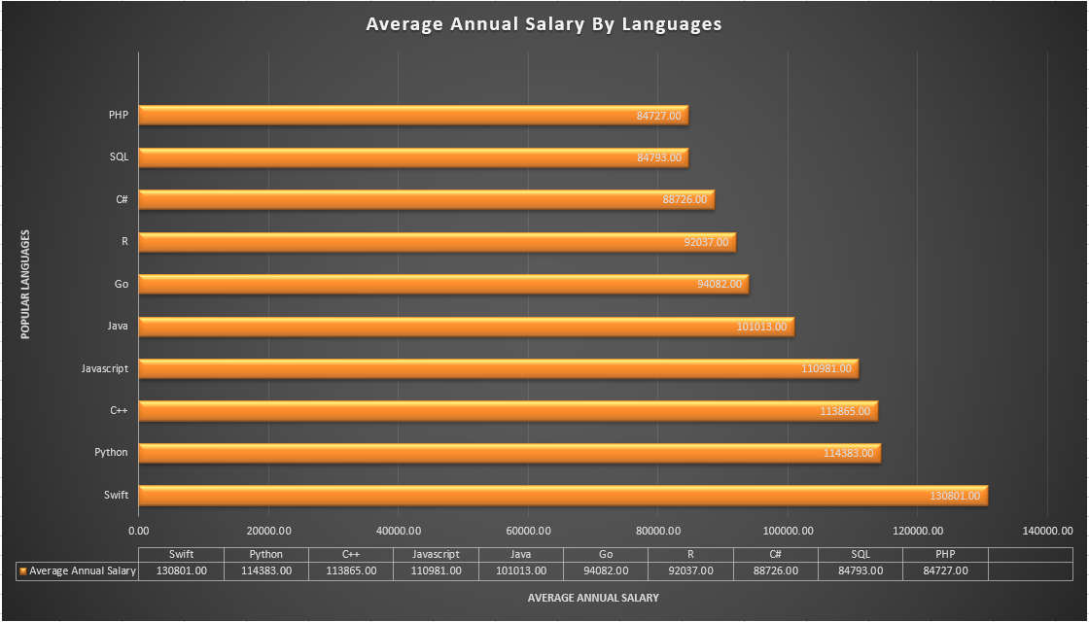
POPULAR LANGUAGES

