Slide 1
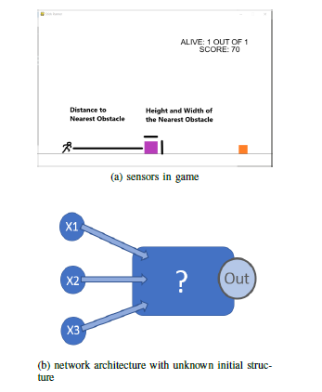
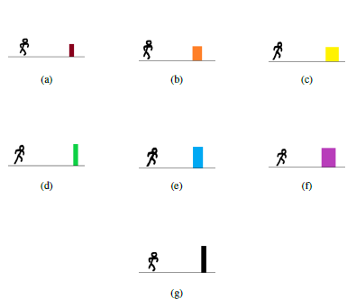
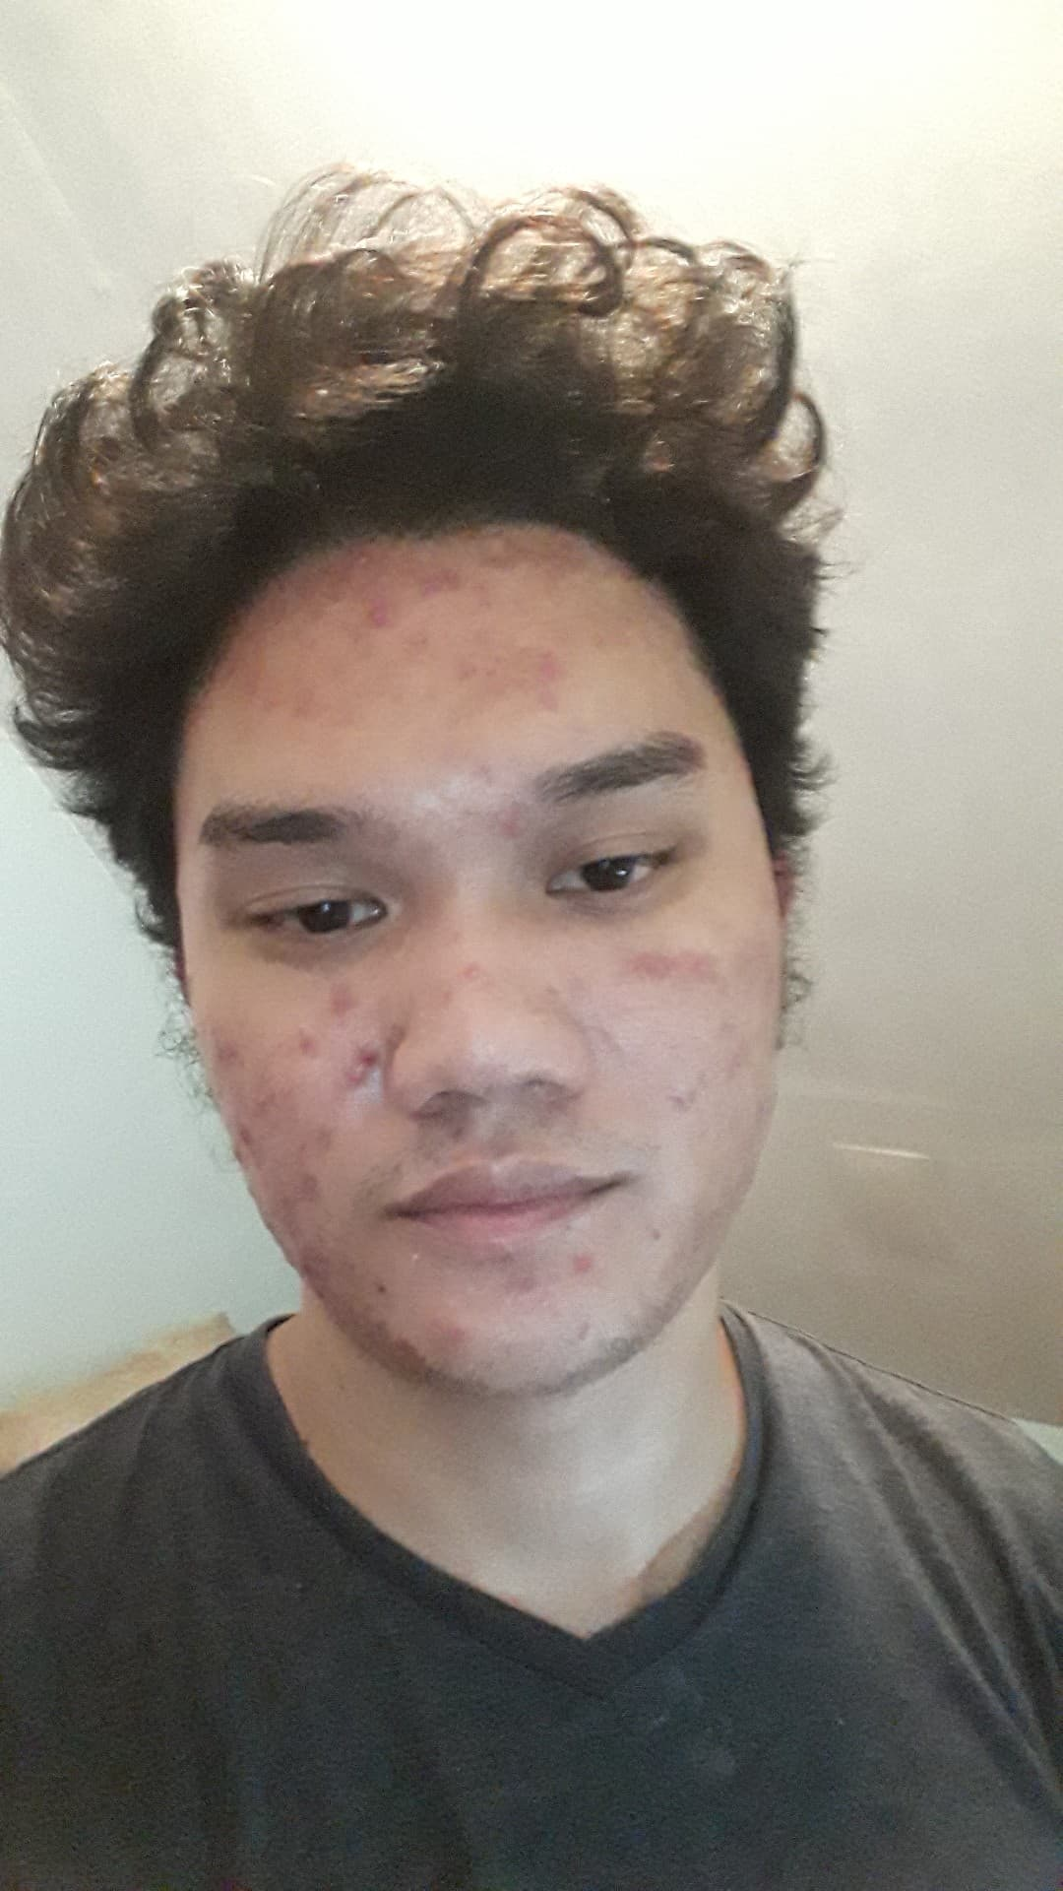
CREATING AN ARTIFICIAL GAME PLAYER FOR MODIFIED STICK RUNNING USING NEURO EVOLUTION OF AUGMENTING TOPOLOGIES (NEAT)
Aldrich S. Goco and Rozano S. Maniaol
2020 ICS University of the Philippines Los Bańos
Abstract
Result and Discussion
An artificial game player for the Modified Stick Running was created using the NeuroEvolution of Augmenting Topologies (NEAT) algorithm.
NEAT was used to evolve the neural network of the game agent to play the game indefinitely
Game states are represented using three features including the height and width of the nearest obstacle and also its distance to the game agent.
The fitness of the agent is the combination of its score and traveled distance.
The Algorithm was run for 30 trials with a maximum allowable generation of 30 and a maximum scoring of 50 points.
The experiment has shown that the NEAT algorithm has a success rate of 83.33 percent and an average of breakthrough at 16.8 generations.
In 25 runs out of 30 runs, the NEAT algorithm has successfully produced an game agent that has breached 50 obstacles.
The experiment has shown a success rate of about 83.33 percentage.
The generations in which the breakthrough has occurred and its frequency can be seen on the graph.
The average generation wherein a successful game agent can be produced is at 16.8 generation.
Introduction
After every experiment runs the final 30 individuals are recorded, which would total to 900 individuals documented after 30 trial runs.
Each individual has 3 inputs which means there are a total of 900 average weights for each of the 3 types of input.
zero average input weights indicates that the respective input type it belongs to is currently inactive, or in other words they are unimportant.
764 activated average weight input for the distanceInput
322 activated average weight input for the widthInput.
237 activated avg weight input for the heightInput.
NEAT algorithm has decided that the distanceInput is the most important input for all the genomes while the widthInput follows behind with the heightInput taking the last.
Stick Running is an endless running platform game wherein the goal is to survive for as long as possible by jumping though varying obstacles .
It is easy for a human to learn how to play the Stick Running, while it might be hard to be learned by an Artificial Intelligence (AI).
The issue is that it is a challenge for a person to describe precisely their playing strategy.
Machine Learning (ML) is one of the existing methods that could address the issue.
One example of Machine Learning (ML) is the Neuroevolution of augmenting topologies (NEAT) which isused in to develop an artificial agent that plays the Modified Stick Running.
Objectives
The general objective of this study is to develop an agent
capable of learning to play the game Modified Stick Running
and survive indefinitely. Specifically, it aims to:
Implement an Artificial Neural Network (ANN) to act as
the brain of the game agent.
Implement the NeuroEvolution of Augmenting Topologies
(NEAT) system for the training of the game agent.
Develop an evolved Game Agent that could survive fifty
obstacles of seven variations by jumping over them
Methodology
Only 28 out of 900 individuals recorded after has managed to transpose 50 obstacles
There are 28 activated distanceInput with 26 are on negative scale while 2 are on positive scale.
There are 7 activated widthInput with all on positive scale.
There are 6 activated heightInput with 1 on negative scale while 5 are on positive scale.
The distanceInput is still more
influential compared to the other two input type.
The Artificial Neural Network (ANN) would initially start from 3 input node, 1 output node with no hidden node.
The input layer or the sensors that were used were made up of the following 3 nodes: A: Distance of player to nearest obstacle
H: Height of the nearest obstacle
W: Width of the nearest obstacle
To supply the controller with information about game states, internal game state variables were directly accessed and fed as inputs to the neural network.
When the agent receives the information given by the environment (A, H and W), it is processed by the network, generating a probability of executing a jump.
If the output is greater than 0.5 then the agent will jump, otherwise none will happen.
The dominant negative polarity of the average weight input of distanceInput indicates that it is inversely proportionate to the output of the topology.
This implies that the agent will tend to not jump when the obstacle is still far.
Inversely, it will lead the agent to jump up when the obstacles are near.
Conclusion
There are seven types of land obstacles that the player will encounter while running the game.
These seven obstacles then are randomly generated with a minimum gap of 300 pixels to one another.
The obstacles and the players are moving at the same speed which were determined in the Game attributes.
By using only 30 individuals, the NEAT algorithm was run for 30 trials with a maximum of 30 generations per trial. The NEAT algorithm was able to produce an individual that has breached the maximum specified score of 50 with a success rate of 83.33 percentage and an average of breakthrough at 16.8 generations. After the experiment, the NEAT algorithm has designated
that the distanceInput as the most important input amongst the other which included the widthInput and heightInput. Additionally, the NEAT algorithm has put heavy importance
on designating negative weight inputs for the distanceInput to ensure inverse proportionality to the output.It ensures that the game agent will jump much proficiently whenever an obstacle
is near it. Overall, this shows that the NEAT algorithm can be used to create an artificial game agent capable of playing the Modified Stick Running.
Author
Flowchart for NEAT
The NEAT algorithm using sigmoid as an activation function was run for 30 times in which the maximum generation allowed is set to 30 and the maximum fitness cap of about 50 scores or 50 obstacles to be transposed.
Aldrich S. Goco son of Helen S.Goco
and Leo P. Goco is a BS Computer Science
undergraduate student of the University
of the Philippines Los Banos. He
loves to spend most of his time on reading
light novels and watching youtube recommendations
varying from war history,
conspiracy theories, video games, bodybuilding
and much more

