Slide 1
Ethical Hacking
Internship
TASK 2

Slide 2
FOUND OUT 3 CRITICAL VULNERABILITIES

Slide 3
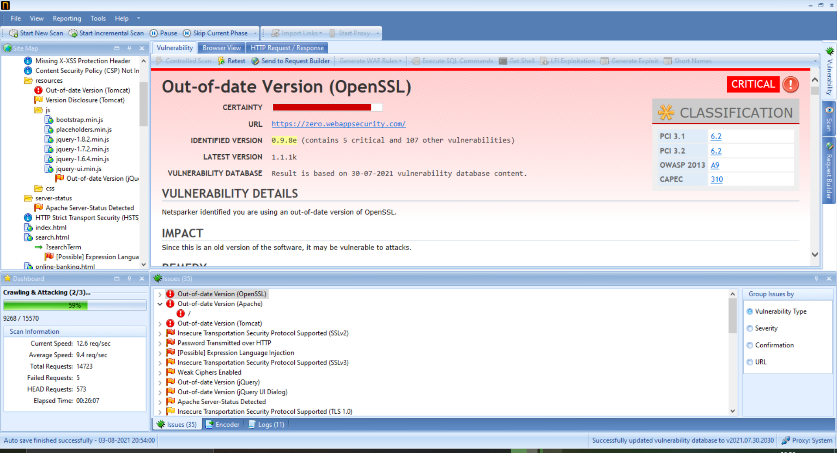

Slide 4


Slide 5
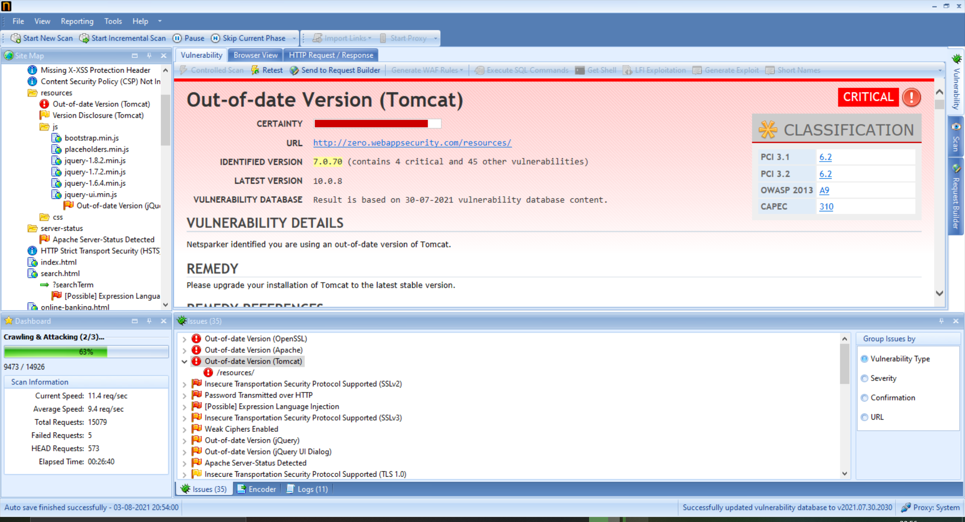

Slide 6
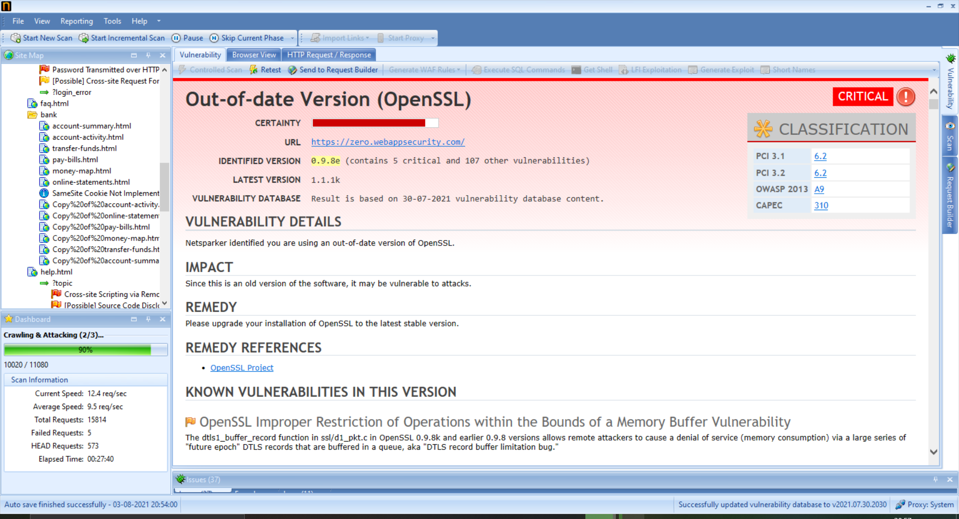

Slide 7
