Slide 1

Machine learning on MNIST dataset

Slide 2

AGENDA
The goal
MNIST Dataset
Exploratory data analysis (Eda)
Ml models
Streamlit app
conclusions

Slide 3

The goal
Create at least tree models
Compare which model is best
Create an app that lets user write numbers. The model will then predict the written number
Present the finding and solution for the class

Slide 4
mnist dataset
Modified National Institute of Standards and Technology
70.000 handwritten numbers from 0 to 9
Grayscale images
Each picture is 28x28 pixels (784 total pixels)
Each picture is labeled
Commonly used for classification models

Slide 5
EDA
Dataset info/Classes/Null values/Data type
Class distribution
Samples
Pixel intensity distribution
Pixel statistics
Correlation heatmap

Slide 6
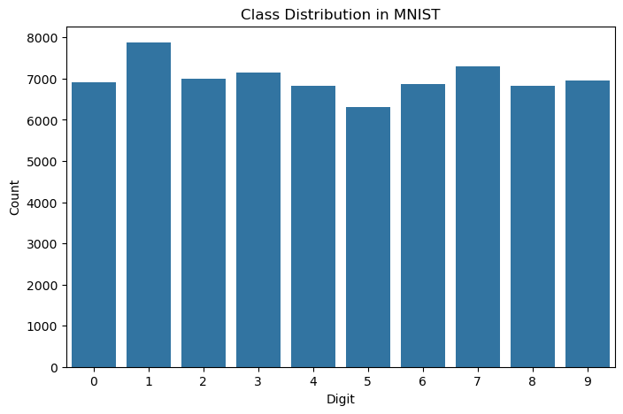
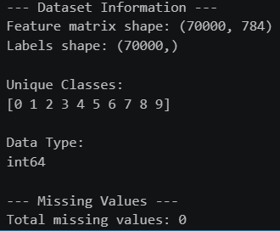
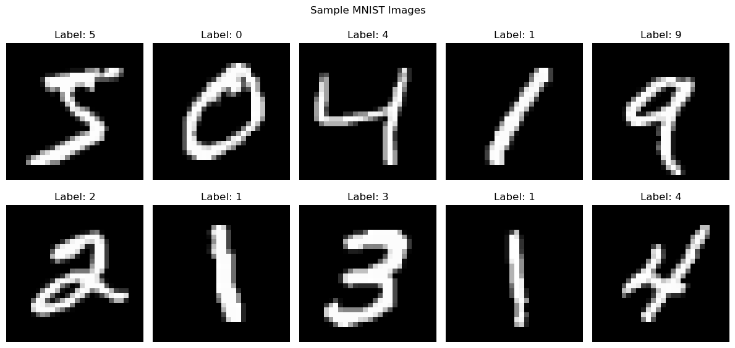
EDA – some findings

Slide 7
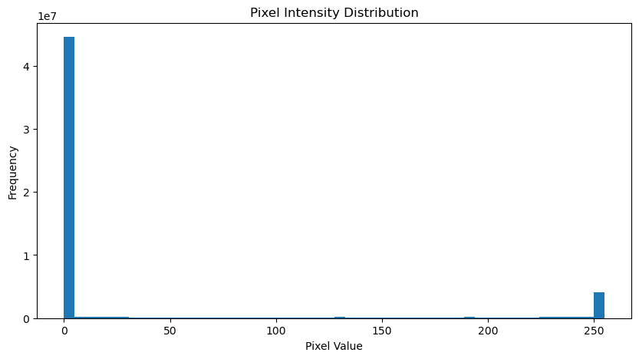
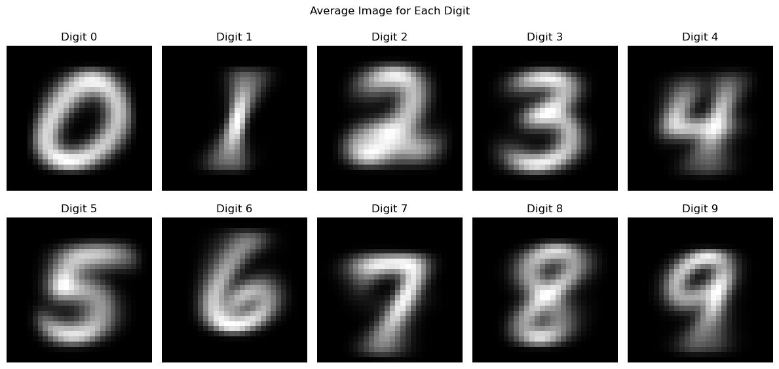
EDA – some findings

Slide 8
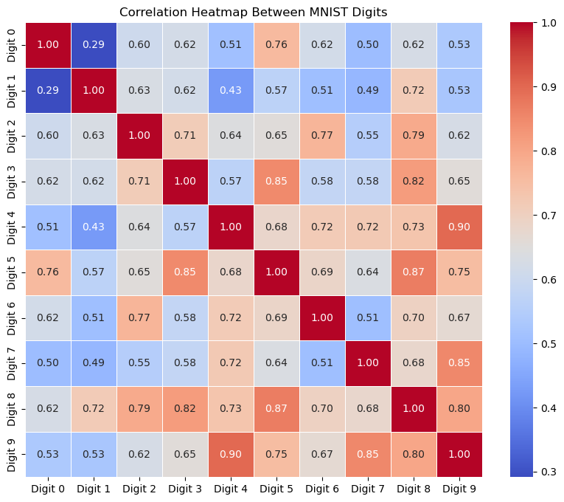
EDA – some findings

Slide 9
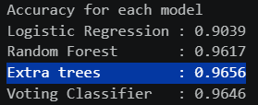
ML models – first solution
Different models
LogisticRegression
RandomForestClassifier
ExtraTreesClassifier
Voting Classifier

Slide 10

ML models – Second solution
CNN model
Adam as optimizer
10 epochs
10% for validation split

Slide 11
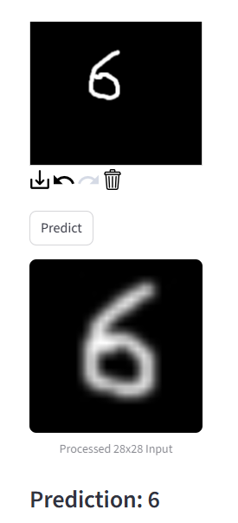
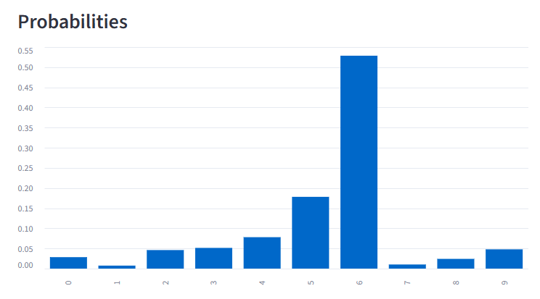
Streamlit app 1
Based on extra tree model
New separated model – only extra tree
With pre-processing and augmentation
Smaller model to meet github upload demands
-> Less accuracy (92%)

Slide 12
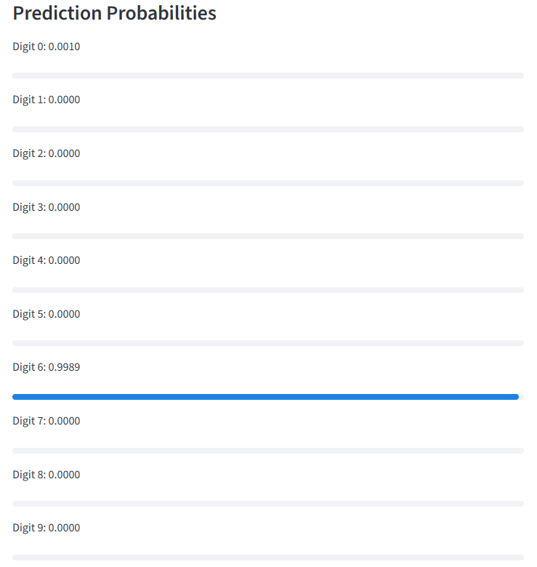
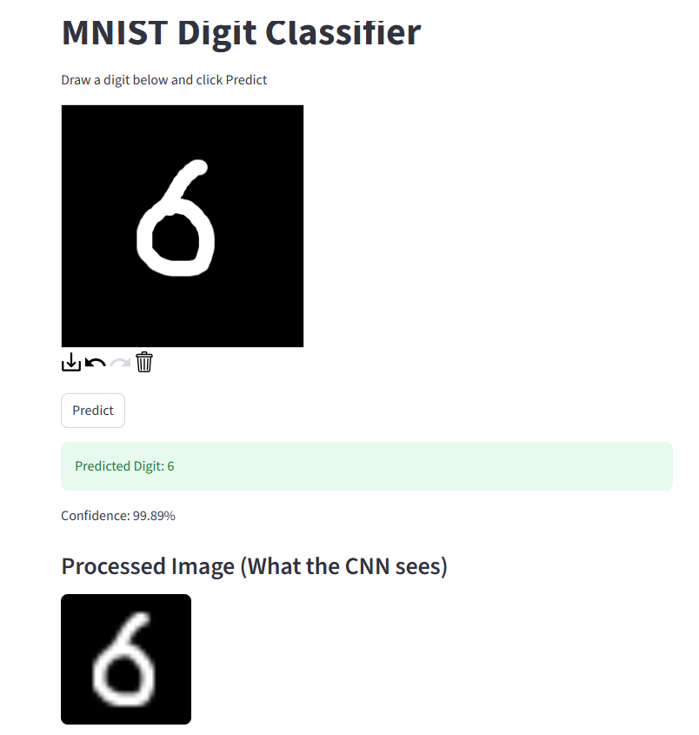
Streamlit app 2
Based on CNN

Slide 13

Conclusions
The CNN model does not require same amount of pre-processing to predict “hard numbers” as 6, 7, 8 and 9
CNN is better for images
CNN gives better accuracy
The model “extra tree” require depth to give high accuracy. Makes the .pkl file large

Slide 14

THANK YOU
Questions?

