Slide 1
ACTIVITY 3 - NAME IT DRAW IT
ALRRIN R. ESCAPE
CHEMICAL ENGINEERING 2-A

Slide 2
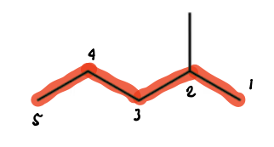
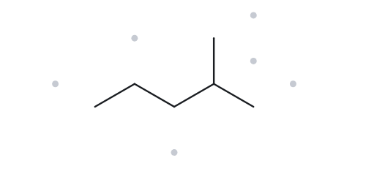




CARD A01 - 2-methylpentane
Level: Foundation Molecular Formula:C6H14
  Numbered Parent
  Naming Trail
Parent chain: the longest chain is 5 C, so the root is pentane. The methyl branch is on a top corner, so it is not part of the longest horizontal run. The path methyl–C2–C3–C4–C5 is also 5 C and leads to the same name.
Numbering: left to right puts the methyl on C4, and right to left puts it on C2. The first point of difference is 2 < 4, so number from the right.
Substituents: methyl on C2, so 2-methyl.
  My Name
  The Alkane Check
2-methylpentane
Returned name: 2-methylpentane
Match
VERIFICATION STRIP
longest chain confirmed
lowest locants
alphabetical order
punctuation
formula counted

Slide 3
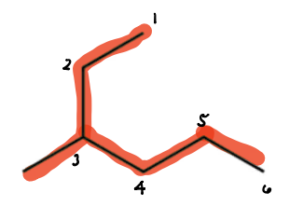
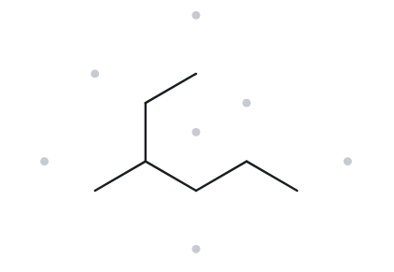

CARD A02 - 3-methylhexane
Level: Foundation Molecular Formula:C7H16
  Numbered Parent
  Naming Trail
Parent chain: the longest chain is 6 C, so the root is hexane. It starts at the end of the upward arm, passes through the branch carbon, and continues along the lower zigzag. The path through the short down-left arm is only 5 C, so that arm is a substituent.
Numbering: numbering from the upper-left end puts the methyl on C3, and numbering from the right end puts it on C4. The first point of difference is 3 < 4, so number from the upper-left end.
Substituents: methyl on C3, so 3-methyl.
  My Name
  The Alkane Check
3-methylhexane
Returned name: 3-methylhexane
Match
VERIFICATION STRIP
longest chain confirmed
lowest locants
alphabetical order
punctuation
formula counted

Slide 4
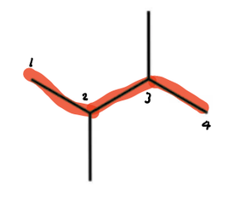
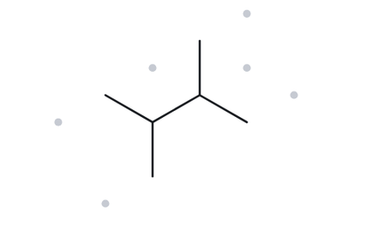

CARD A03 - 2,3-dimethylbutane
Level: Foundation Molecular Formula:C6H14
  Numbered Parent
  Naming Trail
Parent chain: the longest chain is 4 C, so the root is butane. Several 4-C paths exist, but each one carries two methyl groups, so they all lead to the same name.
Numbering: left to right gives 2,3 and right to left also gives 2,3. The sets tie. There is only one kind of substituent, so no alphabetical tie-break is needed, and the name is the same either way.
Substituents: methyl on C2 and C3, so 2,3-dimethyl. Use the di- prefix with a comma between the numbers and a hyphen before the letters.
  My Name
  The Alkane Check
2,3-dimethylbutane
Returned name: 2,3-dimethylbutane
Match
VERIFICATION STRIP
longest chain confirmed
lowest locants
alphabetical order
punctuation
formula counted

Slide 5
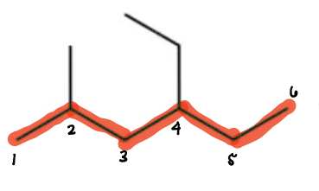
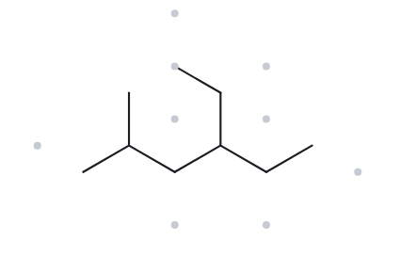

CARD A04 - 4-ethyl-2-methylhexane
Level: Developing Molecular Formula:C9H20
  Numbered Parent
  Naming Trail
Parent chain: the longest chain is 6 C, so the root is hexane. Chains through the upward ethyl arm also reach 6 C, but they carry the same two substituents, so they lead to the same name. No chain reaches 7 C.
Numbering: left to right gives locants 2,4 (methyl on C2, ethyl on C4), and right to left gives 3,5. The first point of difference is 2 < 3, so number from the left.
Substituents: ethyl on C4, then methyl on C2. E comes before M, so ethyl is cited first even though its locant is higher.
  My Name
  The Alkane Check
4-ethyl-2-methylhexane
Returned name: 4-ethyl-2-methylhexane
Match
VERIFICATION STRIP
longest chain confirmed
lowest locants
alphabetical order
punctuation
formula counted

Slide 6
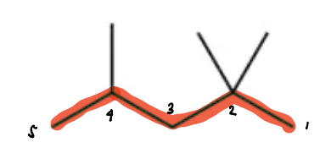
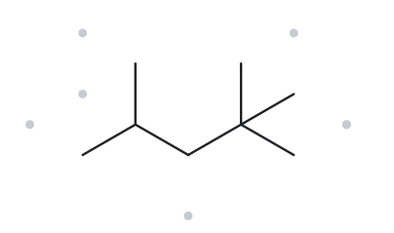

CARD A05 - 2,2,4-trimethylpentane
Level: Developing Molecular Formula:C8H18
  Numbered Parent
  Naming Trail
Parent chain: the longest chain is 5 C, so the root is pentane. Several 5-C paths exist because of the two methyls on the same carbon, but each carries three methyl groups, so they lead to the same name. No chain reaches 6 C.
Numbering: left to right gives locants 2,4,4 and right to left gives 2,2,4. The first locants are both 2, so compare the next term: 2 < 4. The right-to-left set 2,2,4 wins at the second term, so number from the right.
Substituents: methyl on C2, C2 and C4, so 2,2,4-trimethyl. Use the tri- prefix, with one locant for each methyl (so 2 appears twice), commas between the numbers and a hyphen before the letters.
  My Name
  The Alkane Check
2,2,4-trimethylpentane
Returned name: 2,2,4-trimethylpentane
Match
VERIFICATION STRIP
longest chain confirmed
lowest locants
alphabetical order
punctuation
formula counted

Slide 7
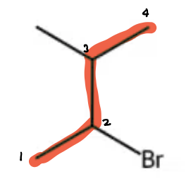
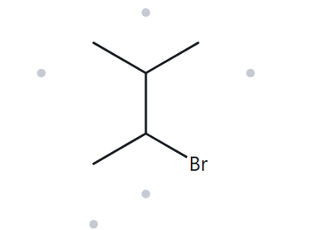

CARD A06 - 2-bromo-3-methylbutane
Level: Developing Molecular Formula:C5H11Br
  Numbered Parent
  Naming Trail
Parent chain: the longest chain is 4 C, so the root is butane. Several 4-C paths exist because of the two methyl arms on the branch carbon, but each carries one bromo and one methyl, so they lead to the same name. No chain reaches 5 C.
Numbering: left to right puts Br on C2 and methyl on C3, giving {2,3}. Right to left puts methyl on C2 and Br on C3, also {2,3}. The locant sets tie, so the substituent cited first alphabetically gets the lower number. Bromo (b) comes before methyl (m), so Br gets C2 and numbering runs from the left.
Substituents: bromo on C2, then methyl on C3. The halogen is a prefix here, named bromo.
  My Name
  The Alkane Check
2-bromo-3-methylbutane
Returned name: 2-bromo-3-methylbutane
Match
VERIFICATION STRIP
longest chain confirmed
lowest locants
alphabetical order
punctuation
formula counted

Slide 8
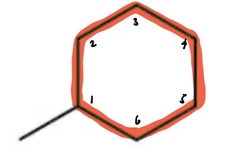
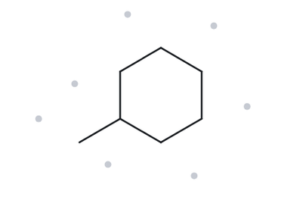

CARD A07- methylcyclohexane
Level: Developing Molecular Formula:C7H14
  Numbered Parent
  Naming Trail
Parent chain: the ring has 6 C and the only chain is a 1-C methyl, so the ring is the parent (this activity’s rule: a ring present is the parent). The root is cyclohexane.
Numbering: with only one substituent, the ring carbon bearing it is C1 by default. Either direction round the ring gives the same single locant, so there is nothing to compare.
Substituents: methyl on C1. A ring with one substituent needs no locant, so the 1 is left out, as in the activity’s quick reference.
  My Name
  The Alkane Check
methylcyclohexane
Returned name: methylcyclohexane
Match
VERIFICATION STRIP
longest chain confirmed
lowest locants
alphabetical order
punctuation
formula counted

Slide 9
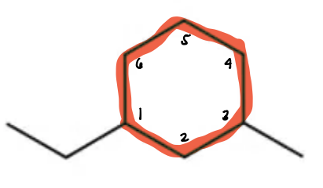
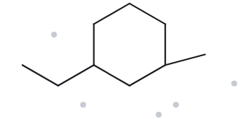

CARD A08- 1-ethyl-3-methylcyclohexane
Level: Challenge Molecular Formula:C9H18
  Numbered Parent
  Naming Trail
Parent chain: the ring has 6 C and the longest chain is only the 2-C ethyl, so the ring is the parent. The root is cyclohexane.
Numbering: on a ring, start at a substituent and go the shorter way round to the other one. The two substituents are separated by one ring carbon. Starting at the ethyl carbon gives {1,3}, and starting at the methyl carbon also gives {1,3}. The locant sets tie, so the substituent cited first alphabetically gets the lower number. Ethyl (e) comes before methyl (m), so ethyl is on C1 and methyl on C3.
Substituents: ethyl on C1, then methyl on C3.
  My Name
  The Alkane Check
1-ethyl-3-methylcyclohexane
Returned name: 1-ethyl-3-methylcyclohexane
Match
VERIFICATION STRIP
longest chain confirmed
lowest locants
alphabetical order
punctuation
formula counted

Slide 10
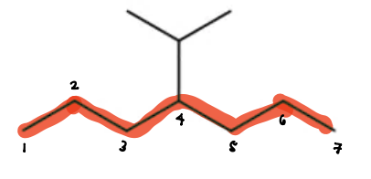
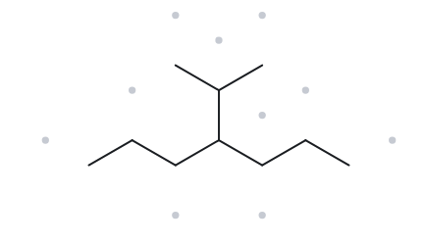


CARD A09- 4-(1-methylethyl)heptane
Level: Challenge Molecular Formula: C10H22
  Numbered Parent
  Naming Trail
Parent chain: the longest chain is 7 C, so the root is heptane. It runs along the horizontal zigzag through the branch carbon, with three carbons on each side. The path that goes up through the branch is only 6 C (3 + the branch carbon + 2), so it isn’t the parent even though it looks like a straight line in the drawing.
Numbering: left to right puts the branch on C4, and right to left also puts it on C4. The locants tie. With only one kind of substituent, no alphabetical tie-break is needed.
Substituents: the three-carbon branched group on C4 is isopropyl, written systematically as (1-methylethyl). Complex substituents go in parentheses, so the name is 4-(1-methylethyl).
  My Name
  The Alkane Check
4-(1-methylethyl)heptane
Returned name: 2-methyl-3-propylhexane
Mismatch
VERIFICATION STRIP
longest chain confirmed
lowest locants
alphabetical order
punctuation
formula counted

Slide 11
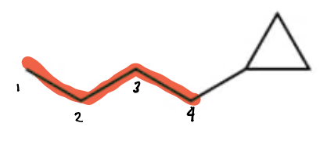
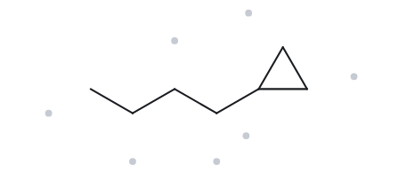

CARD A10- butylcyclopropane
Level: Challenge Molecular Formula: C7H14
  Numbered Parent
  Naming Trail
Parent chain: the ring has 3 C and the chain has 4 C. In older textbooks the longer chain would win, but this activity uses the current IUPAC rule: when a ring is present, the ring is the parent. So the root is cyclopropane, and the 4-C chain is a substituent.
Numbering: there is only one substituent, so the ring carbon bearing it is C1. Either direction round the ring gives the same result, so there is nothing to compare.
Substituents: a four-carbon straight chain, which is butyl, on C1. A ring with one substituent needs no locant, so no “1-” is written.
  My Name
  The Alkane Check
butylcyclopropane
Returned name: butylcyclopropane
Match
VERIFICATION STRIP
longest chain confirmed
lowest locants
alphabetical order
punctuation
formula counted

Slide 12
ACTIVITY 3 - NAME IT DRAW IT
PART B

Slide 13
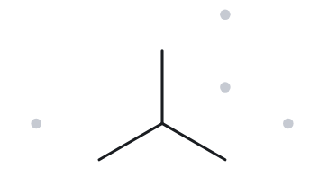
CARD B01 - Given name: 2-methylpropane
Level: Foundation
  Name Decoded
  Bond-line Structure
Parent chain: propane, a 3-carbon chain.
Substituents: methyl on C2
Expected Formula: : 3 + 1 = 4 C. An open chain is CₙH₂ₙ₊₂, so n = 4 gives C₄H₁₀.
  Formula Check
  Back Check
Returned by The Alkane: 2-methylpropane
Counted from the drawing: C4H10
Open chain: CₙH₂ₙ₊₂ = C₄H₁₀. No halogens, so nothing is subtracted.
Same as the given name
VERIFICATION STRIP
Parent length matches
Substituent positions match
Formula agrees
Back-check record

Slide 14
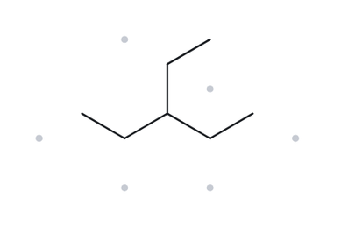
CARD B02 - Given name: 3-ethylpentane
Level: Foundation
  Name Decoded
  Bond-line Structure
Parent chain: pentane, a 5-carbon chain.
Substituents: ethyl on C3, the middle carbon.
Expected Formula: : 5 + 2 = 7 C. An open chain is CₙH₂ₙ₊₂, so n = 7 gives C₇H₁₆.
  Formula Check
  Back Check
Returned by The Alkane: 3-ethylpentane
Counted from the drawing: C7H16
Open chain: CₙH₂ₙ₊₂ = C₇H₁₆. No halogens, so nothing is subtracted.
Same as the given name
VERIFICATION STRIP
Parent length matches
Substituent positions match
Formula agrees
Back-check record

Slide 15
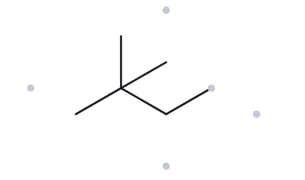
CARD B03 - Given name: 2,2-dimethylbutane
Level: Foundation
  Name Decoded
  Bond-line Structure
Parent chain: butane, a 4-carbon chain.
Substituents: two methyl groups, both on C2 (the “2,2” and the di- prefix).
Expected Formula: : 4 + 2 = 6 C. An open chain is CₙH₂ₙ₊₂, so n = 6 gives C₆H₁₄.
  Formula Check
  Back Check
Returned by The Alkane: 2,2-dimethylbutane
Counted from the drawing: C6H14
Open chain: CₙH₂ₙ₊₂ = C₆H₁₄. No halogens, so nothing is subtracted.
Same as the given name
VERIFICATION STRIP
Parent length matches
Substituent positions match
Formula agrees
Back-check record

Slide 16
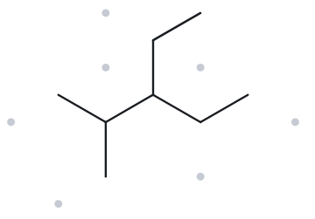
CARD B04 - Given name: 3-ethyl-2-methylpentane
Level: Developing
  Name Decoded
  Bond-line Structure
Parent chain: pentane, a 5-carbon chain.
Substituents: methyl on C2 and ethyl on C3. They are on neighboring carbons.
Expected Formula: : 5 + 1 + 2 = 8 C. An open chain is CₙH₂ₙ₊₂, so n = 8 gives C₈H₁₈.
  Formula Check
  Back Check
Returned by The Alkane: 3-ethyl-2methylpentane
Counted from the drawing: C8H18
Open chain: CₙH₂ₙ₊₂ = C₈H₁₈. No halogens, so nothing is subtracted.
Same as the given name
VERIFICATION STRIP
Parent length matches
Substituent positions match
Formula agrees
Back-check record

Slide 17
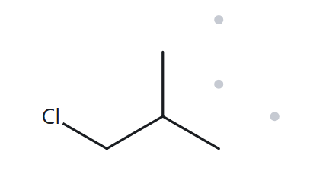
CARD B05 - Given name: 1-chloro-2-methylpropane
Level: Developing
  Name Decoded
  Bond-line Structure
Parent chain: propane, a 3-carbon chain.
Substituents: chloro on C1 and methyl on C2.
Expected Formula: : 3 + 1 = 4 C. An open chain is CₙH₂ₙ₊₂, so n = 4 gives C₄H₁₀. Cl replaces one H, so the formula is C₄H₉Cl.
  Formula Check
  Back Check
Returned by The Alkane: 1-chloro-2-methylpropane
Counted from the drawing: C4H9Cl
Open chain: CₙH₂ₙ₊₂ = C₄H₁₀; minus one H for Cl = C₄H₉Cl
Same as the given name
VERIFICATION STRIP
Parent length matches
Substituent positions match
Formula agrees
Back-check record

Slide 18
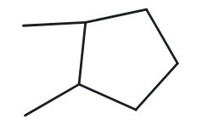
CARD B06 - Given name: 1,2-dimethylcyclopentane
Level: Developing
  Name Decoded
  Bond-line Structure
Parent chain: cyclopentane, a 5-carbon ring.
Substituents: two methyl groups, on C1 and C2. These are adjacent ring carbons.
Expected Formula: : 5 + 2 = 7 C. One ring is CₙH₂ₙ, so n = 7 gives C₇H₁₄.
  Formula Check
  Back Check
Returned by The Alkane: 1,2-dimethylcyclopentane
Counted from the drawing: C7H14
Open chain: CₙH₂ₙ = C₇H₁₄, no halogens, so nothing is subtracted.
Same as the given name
VERIFICATION STRIP
Parent length matches
Substituent positions match
Formula agrees
Back-check record

Slide 19
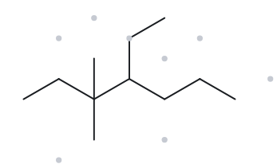
CARD B07- Given name: 4-ethyl-3,3-dimethylheptane
Level: Developing
  Name Decoded
  Bond-line Structure
Parent chain: heptane, a 7-carbon chain.
Substituents: ethyl on C4, and two methyl groups, both on C3 (the “3,3” and the di- prefix).
Expected Formula: : 7 + 2 + 2 = 11 C. An open chain is CₙH₂ₙ₊₂, so n = 11 gives C₁₁H₂₄.
  Formula Check
  Back Check
Returned by The Alkane: 4-ethyl-3,3-dimethylheptane
Counted from the drawing: C11H24
Open chain: CₙH₂ₙ₊₂ = C₁₁H₂₄. No halogens, so nothing is subtracted.
Same as the given name
VERIFICATION STRIP
Parent length matches
Substituent positions match
Formula agrees
Back-check record

Slide 20
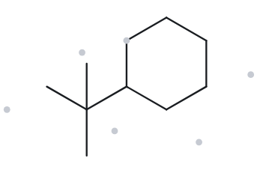
CARD B08 - Given name: tert-butylcyclohexane
Level: Developing
  Name Decoded
  Bond-line Structure
Parent chain: cyclohexane, a 6-carbon ring.
Substituents: tert-butyl on the ring. It is a 4-carbon group with one central carbon bonded to three methyl groups, written (CH₃)₃C–. With a single substituent on a ring, no locant is needed.
Expected Formula: : 6 + 4 = 10 C. One ring is CₙH₂ₙ, so n = 10 gives C₁₀H₂₀.
  Formula Check
  Back Check
Returned by The Alkane: (1,1-dimethylethyl)cyclohexane
Counted from the drawing: C10H20
Open chain: CₙH₂ₙ₊₂ = C10H20. No halogens, so nothing is subtracted.
The returned name is just the systematic IUPAC name of tert-butylcyclohexane
Same as the given name
VERIFICATION STRIP
Parent length matches
Substituent positions match
Formula agrees
Back-check record

Slide 21
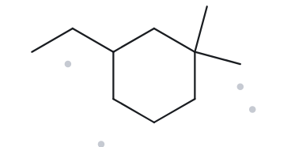
CARD B09 - Given name: 3-ethyl-1,1-dimethylcyclohexane
Level: Developing
  Name Decoded
  Bond-line Structure
Parent chain: cyclohexane, a 6-carbon ring.
Substituents: two methyl groups, both on C1 (the “1,1” and the di- prefix), and an ethyl on C3.
Expected Formula: : 6 + 2 + 2 = 10 C. One ring is CₙH₂ₙ, so n = 10 gives C₁₀H₂₀.
  Formula Check
  Back Check
Returned by The Alkane: 3-ethyl-1,1-dimethylcyclohexane
Counted from the drawing: C10H20
Open chain: CₙH₂ₙ₊₂ = C10H20. No halogens, so nothing is subtracted.
Same as the given name
VERIFICATION STRIP
Parent length matches
Substituent positions match
Formula agrees
Back-check record

Slide 22
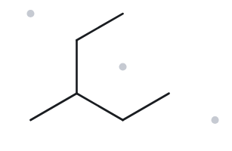
CARD B10 - Given name: 2-ethylbutane
Level: Developing
  Name Decoded
  Bond-line Structure
Parent chain: pentane, a 5-carbon chain. The longest continuous chain runs through the ethyl group: CH₃–CH₂–CH–CH₂–CH
Substituents: methyl on C3.
Expected Formula: : 5 + 1 = 6 C. An open chain is CₙH₂ₙ₊₂, so n = 6 gives C₆H₁₄.
  Formula Check
  Back Check
Returned by The Alkane: 3-methylpentane
Counted from the drawing: C6H14
Open chain: CₙH₂ₙ₊₂ = C10H20. No halogens, so nothing is subtracted.
Not the same as the given name
VERIFICATION STRIP
Parent length matches
Substituent positions match
Formula agrees
Back-check record

