Slide 1
ACTIVITY 2 ORGANIC CHEMISTRY
ALRRIN R. ESCAPE
CHEMICAL ENGINEERING 2A

Slide 2
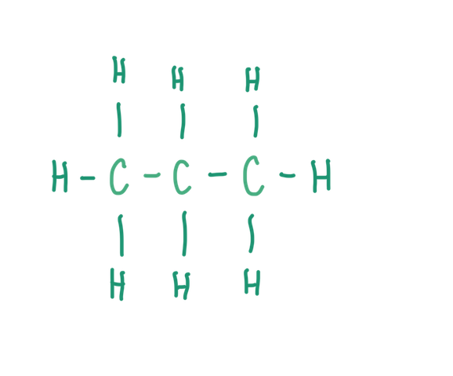
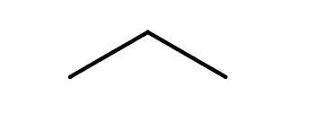


CARD 01 - Propane
Molecular Formula: C₃H₈
  Molecular Formula
  Lewis Structure
C₃H₈
  Condensed Structural Formula
  Bond-Line Formula (Ketcher)
CH₃CH₂CH₃
VERIFICATION STRIP
atom count verified
valence checked
bond order checked
same connectivity confirmed

Slide 3
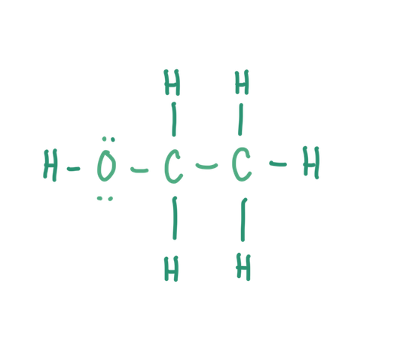
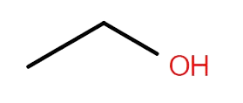
CARD 02 - Ethanol
Molecular Formula: C₂H₆O
  Molecular Formula
  Lewis Structure
C₂H₆O
  Condensed Structural Formula
  Bond-Line Formula (Ketcher)
CH₃CH₂OH
VERIFICATION STRIP
atom count verified
valence checked
bond order checked
same connectivity confirmed

Slide 4
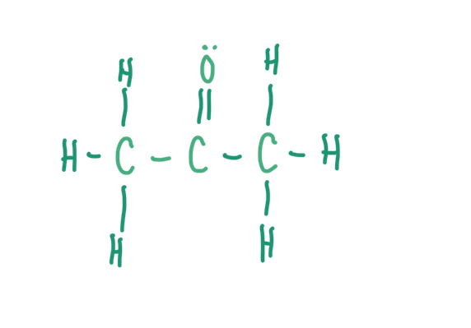
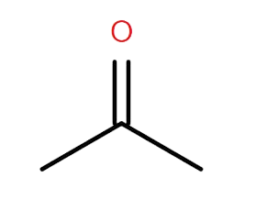
CARD 03 - Acetone (propan-2-one)
Molecular Formula: C₃H₆O
  Molecular Formula
  Lewis Structure
C₃H₆O
  Condensed Structural Formula
  Bond-Line Formula (Ketcher)
CH₃COCH₃
VERIFICATION STRIP
atom count verified
valence checked
bond order checked
same connectivity confirmed

Slide 5
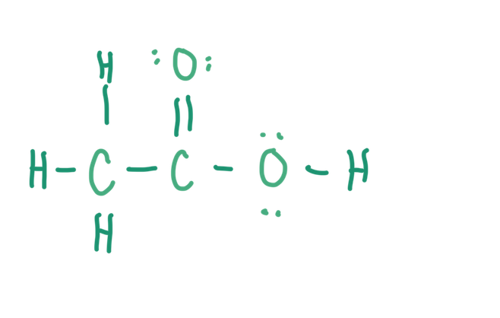
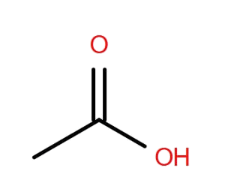
CARD 04 - Acetic Acid (ethanoic acid)
Molecular Formula: C₂H₄O₂
  Molecular Formula
  Lewis Structure
C₂H₄O₂
  Condensed Structural Formula
  Bond-Line Formula (Ketcher)
CH₃COOH
VERIFICATION STRIP
atom count verified
valence checked
bond order checked
same connectivity confirmed

Slide 6
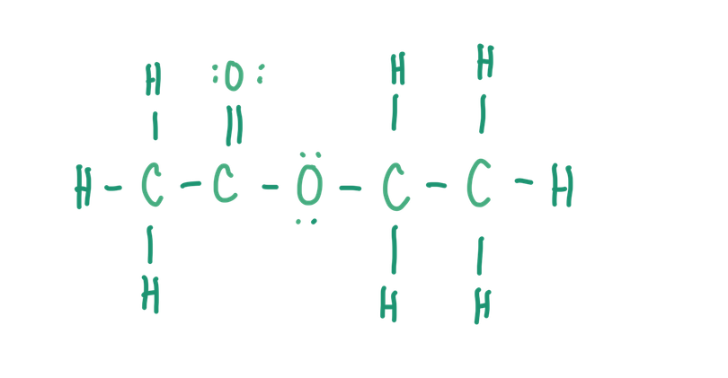
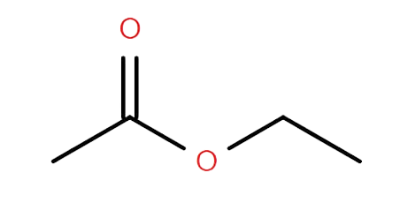
CARD 05 - Ethyl acetate (ethyl ethanoate)
Molecular Formula: C₄H₈O₂
  Molecular Formula
  Lewis Structure
C₄H₈O₂
  Condensed Structural Formula
  Bond-Line Formula (Ketcher)
CH₃COOCH₂CH₃
VERIFICATION STRIP
atom count verified
valence checked
bond order checked
same connectivity confirmed

Slide 7
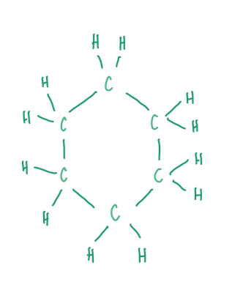
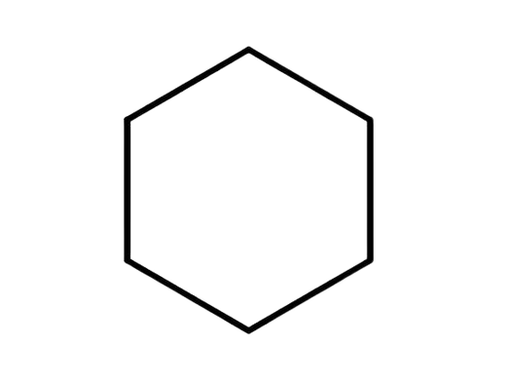
CARD 06 - Cyclohexane
Molecular Formula: C₆H₁₂
  Molecular Formula
  Lewis Structure
C₆H₁₂
  Condensed Structural Formula
  Bond-Line Formula (Ketcher)
(CH₂)₆
VERIFICATION STRIP
atom count verified
valence checked
bond order checked
same connectivity confirmed

Slide 8
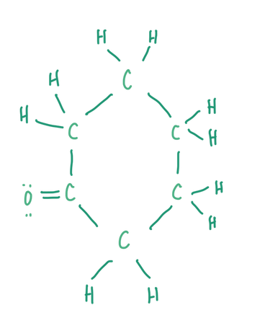
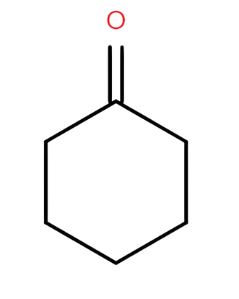
CARD 07 - Cyclohexanone
Molecular Formula: C₆H₁₀O
  Molecular Formula
  Lewis Structure
C₆H₁₀O
  Condensed Structural Formula
  Bond-Line Formula (Ketcher)
(CH₂)₅CO
VERIFICATION STRIP
atom count verified
valence checked
bond order checked
same connectivity confirmed

Slide 9
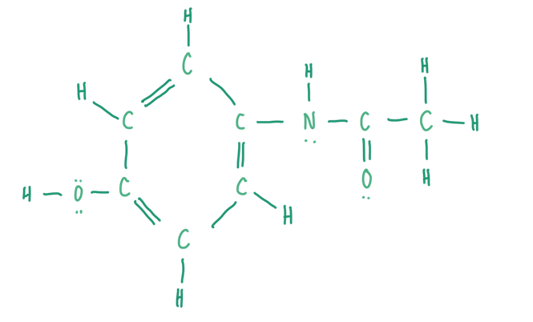
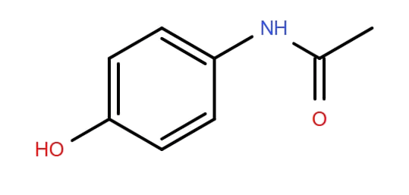
CARD 08 - Acetaminophen (paracetamol)
Molecular Formula: C₈H₉NO₂
  Molecular Formula
  Lewis Structure
C₈H₉NO₂
  Condensed Structural Formula
  Bond-Line Formula (Ketcher)
HOC₆H₄NHCOCH₃
VERIFICATION STRIP
atom count verified
valence checked
bond order checked
same connectivity confirmed

Slide 10
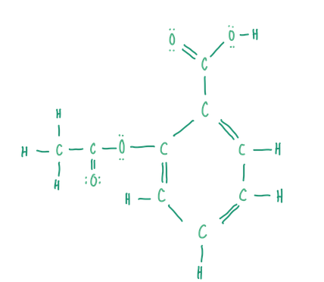
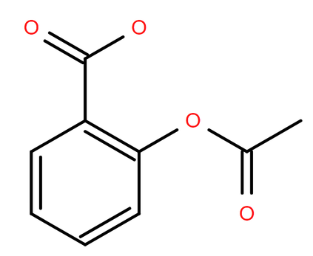
CARD 09 - Aspirin (acetylsalicylicacid)
Molecular Formula: C₉H₈O₄
  Molecular Formula
  Lewis Structure
C₉H₈O₄
  Condensed Structural Formula
  Bond-Line Formula (Ketcher)
CH₃COOC₆H₄COOH
VERIFICATION STRIP
atom count verified
valence checked
bond order checked
same connectivity confirmed

Slide 11
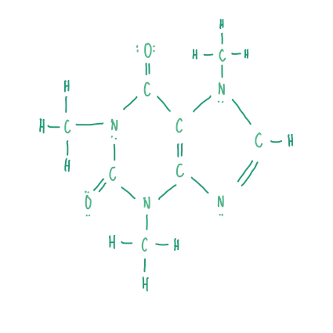
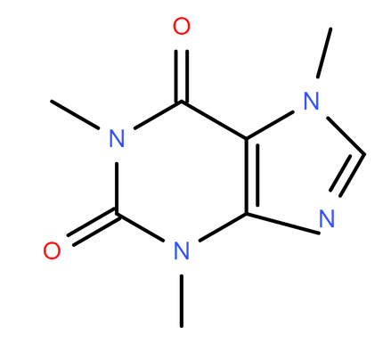
CARD 10 - Caffeine
Molecular Formula: C₈H₁₀N₄O₂
  Molecular Formula
  Lewis Structure
C₈H₁₀N₄O₂
  Condensed Structural Formula
  Bond-Line Formula (Ketcher)
C₈H₁₀N₄O₂
VERIFICATION STRIP
atom count verified
valence checked
bond order checked
same connectivity confirmed

