Slide 1
BREAKOUT
De La Salle University-Manila
College of Computer Studies

Slide 2
BREAKOUT is a text-based game.
What this means is that you type in commands.
The game commands take the form of simple verb-noun phrases such as “call ghostbusters”; however, nothing’s really stopping you from typing in a long sentence. What matters is that the first and last words (if any) must follow that verb-noun form.
Have fun! 頑張って！

Slide 3


You wake up in total darkness.
What do you do?
>

Slide 4


As you inch forward, you bump into a flashlight.
What now?
>

Slide 5
You pick up the flashlight.
>

Slide 6




You turn on the flashlight and are startled to discover a dead body.
>

Slide 7

The man has a note on his person.
>

Slide 8




You pick up the note.
>

Slide 9
The note reveals that the man was severely depressed.
He hung himself in this freezer because no one checks here.
He also reveals that the freezer can only be opened from the outside.
>

Slide 10
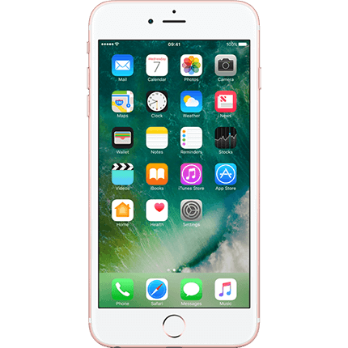
It eluded your notice earlier, but the man has a phone in one of his pockets.
>

Slide 11
You retrieve the man’s phone.
It’s currently turned off.
>

Slide 12

The phone has no battery.
There must be a charger around here somewhere…
>

Slide 13



There it is.
>

Slide 14
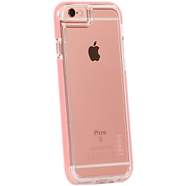
You pick up the charger.
The charger and the phone seem to be compatible…
>

Slide 15

The phone and the charger are now connected.
Now you just have to plug it in somewhere…
>

Slide 16
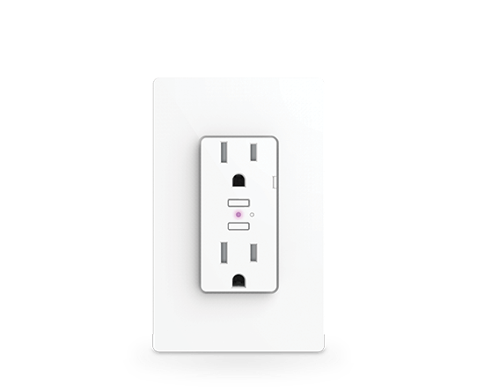
In another stroke of luck, you find a wall socket.
>

Slide 17
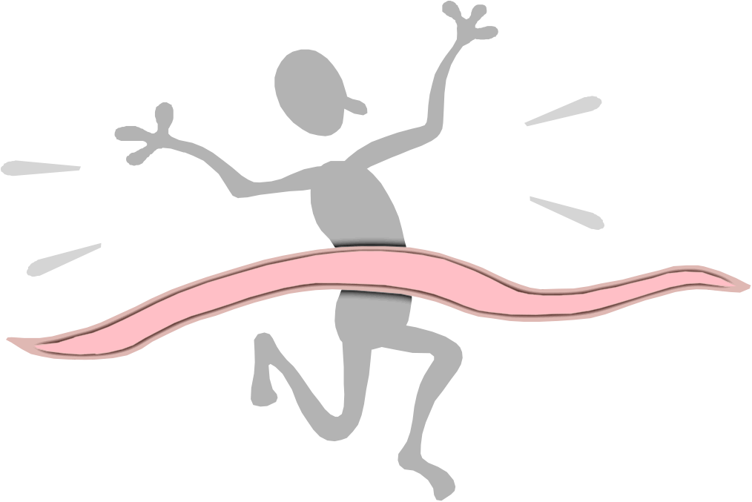
You reach the wall socket.
>

Slide 18
You plug in the phone, making it spring to life.
You’ll have to wait before you can use it, though.
>

Slide 19

There. Luckily, the phone seems to have enough load to make a call.
>

Slide 20

Who you gonna call?
>

Slide 21
The police are asking for your location!
This phone should have GPS, right?
>

Slide 22
The Lasallian student community was taken by surprise recently as dozens, if not hundreds, of students from De La Salle University-Manila have been reported missing as of 06:00pm this past Friday, February 9, 2017.
By 08:15pm that night, people claiming to be connected to the missing students have reported receiving an email containing a file. The file contains a text-based game, simply titled “BREAKOUT.” Recipients of the email who have successfully finished the game have reported that their relatives have been returned to them unharmed.
Whoever sent the email remains a mystery to this day.

