Slide 1
Data warehouse and data modelling I
Relation Data Model

Slide 2
Relational model concepts
Data Modeling is the process of determining and analyzing data requirements needed to support business processes.
Relational Model describes data, relationships between data, semantic data and constraints data in relational databases.
Relation Data structure:
Name | Description
Relation | Table consisting of columns and rows
Tuple | Relation row
Attribute | Relation column

Slide 3
Relational integrity constraints
Attributes constraints / column constraints using data type as a limitation. Example: Column "name" has data type "string”.
Key constraints to give identity to each record or rows in a table using the primary key.
Referential integrity constraints to maintain data consistency on one table against another table using foreign keys.

Slide 4
Operation in relational database
Insert is used to insert data into a table
Delete and Truncate are used to delete rows from table
Update is used to change the value of a column in a row which has existed
Select is used to select specific data
GROUP BY: It clause groups the resulting data rows into groups
COUNT: It returns the number of rows in each group.
MIN, MAX and AVG: It returns the minimum, maximum and average values

Slide 5
GROUP_CONCAT: It concatenates all values inside the group into a single string, with a given separator.
SUM: It will summaries numerical values.
IF: This is a function that takes three arguments. First argument is the condition, second argument is used if the condition is true and the third argument is used if the condition is false.
CASE: This works similar to the switch-case statements you might be familiar with from programming
IN: If we want to use multiple results returned by the inner query.
UNION: It will combine the results of multiple SELECT queries.

Slide 6
join
Join is a way to connect data taken from tables through connecting column (this is the meaning of relational from relational database).
Join allows us to retrieve data from multiple tables via one query.

Slide 7
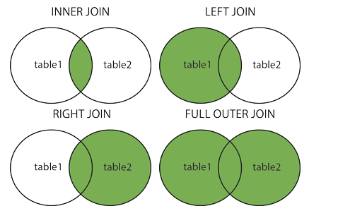
Different Types of SQL JOIN
(INNER) JOIN: Returns records that have matching values in both tables
LEFT (OUTER) JOIN: Returns all records from the left table, and the matched records from the right table
RIGHT (OUTER) JOIN: Returns all records from the right table, and the matched records from the left table
FULL (OUTER) JOIN: Returns all records when there is a match in either left or right table

