Slide 1
Data mining – a.Y. 22/23
Analysis
Cellular Traffic Dataset
Alessio Chiodin

Slide 2
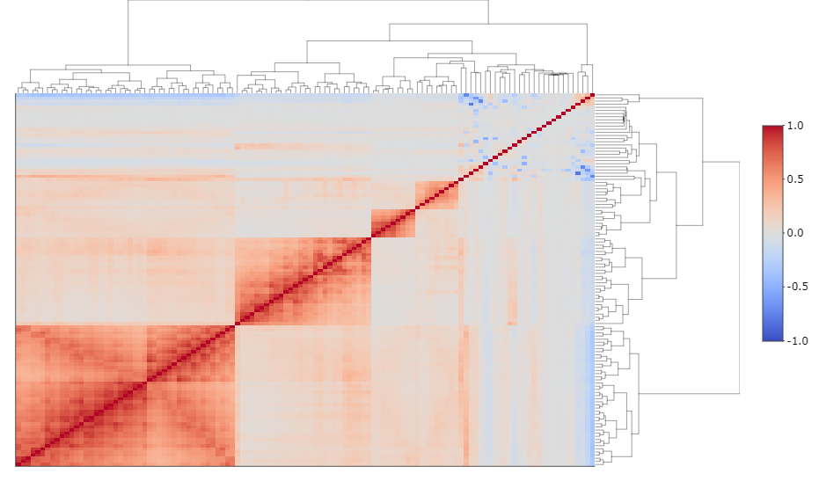
Introduction
Context: The marketing department of a telecommunications company wants to better understand the consumption patterns of its customers. Objective: Predict the telephone traffic for the next month based on the available data, expressed as the total number of seconds of outgoing calls made.
Objective: predict telephone traffic for the following month based on the available data, expressed as the total number of seconds of outgoing calls made.

Slide 3
E.D.A

Slide 4
Dataset
Observations | 15310
Predictors | 91 numeric | 8 categorical
NA | 0
The variables are listed by month.
The chosen enumeration does not necessarily correspond to that of the calendar (e.g., X_01 does not indicate that the data was recorded in January).
Limited number of temporal observations (9 months, 1 monthly observation for each variable for each user) -> time series approach excluded.
Hypothesis: relatively stable traffic in nearby months (e.g., month 9 is more relevant than month 5 in predicting traffic for month 10).

Slide 5
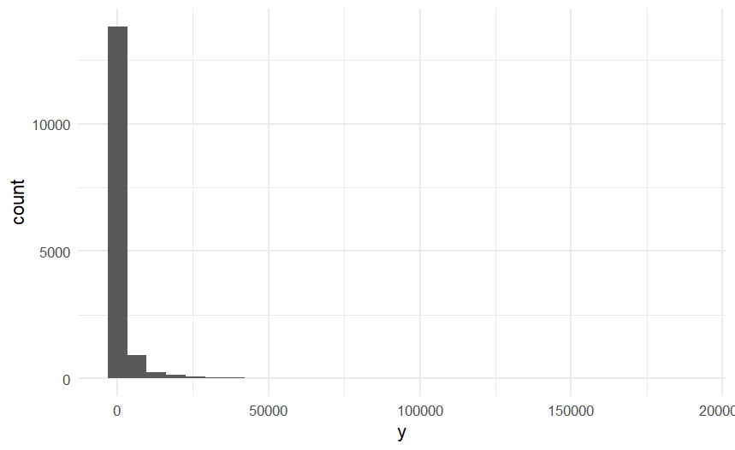
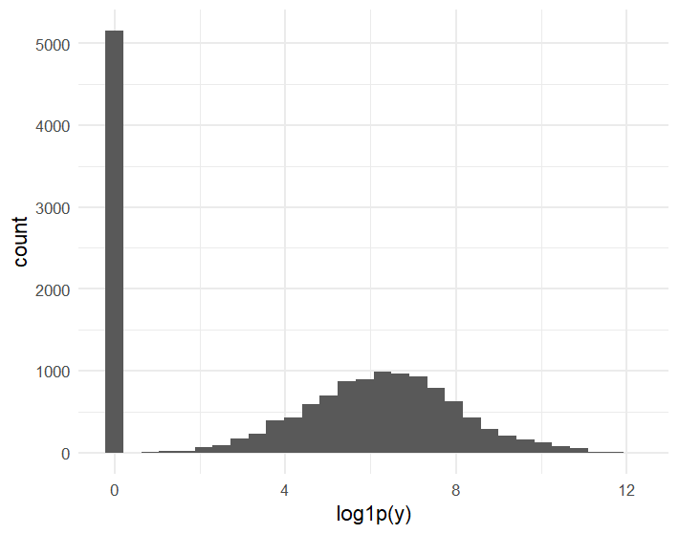
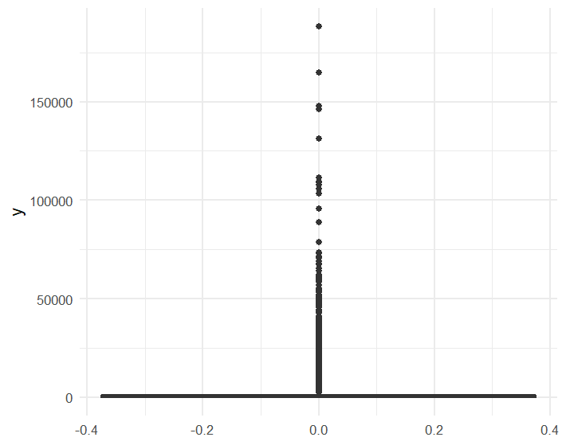
Response
High percentage of observations equal to 0 (33.6%) -> asymmetry in the distribution
Symmetric distribution with log1p(x) = log(1+x) transformation and conditioning on y > 0 (figure on the right)
Presence of outliers
Mean 1666.86
SD 6360.201
Range [0, 188035]
# 0 5151

Slide 6
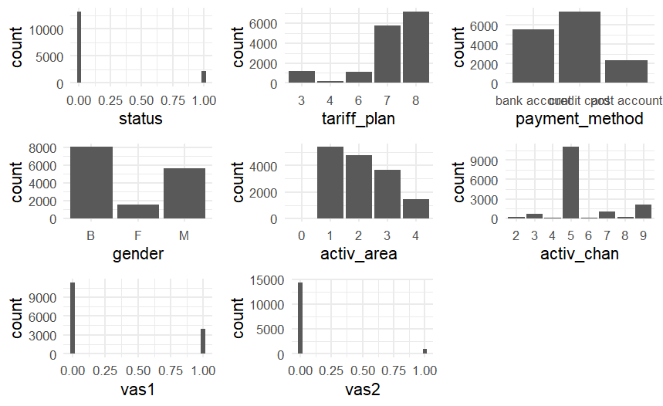
Categorical predictors
Some categorical variables are highly imbalanced

Slide 7
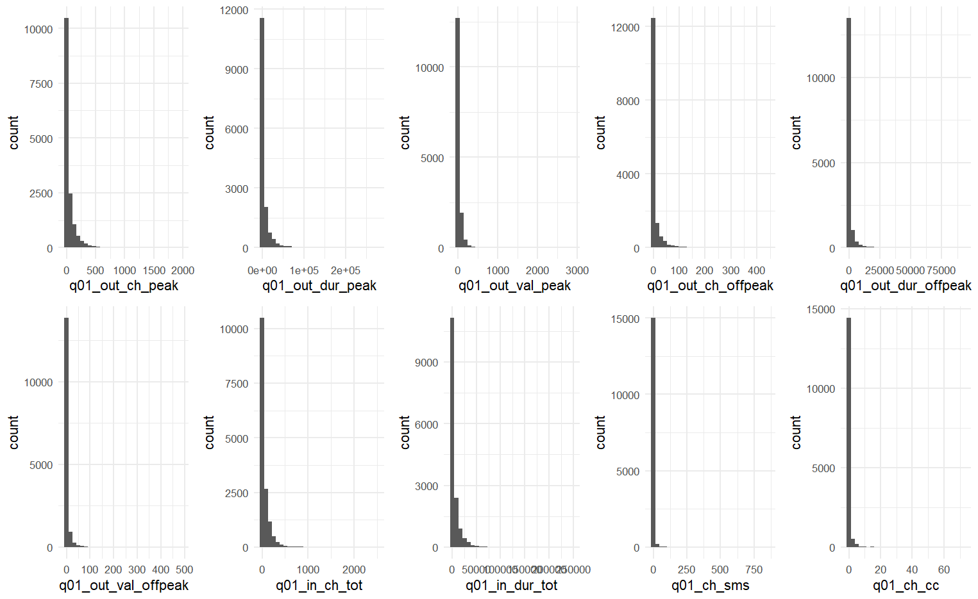
Numeric predictors
Grafico
predittori numerici riferiti al mese 1.
Caratteristiche
High percentage of 0 (often higher than 80%)
Variables on different scales
Correlation (next slide)

Slide 8
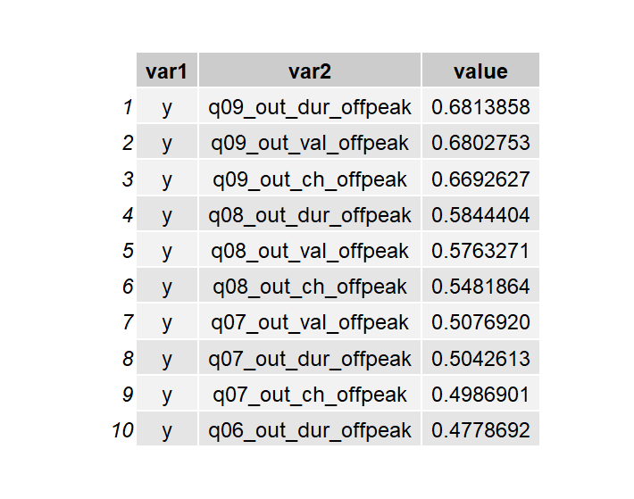
Correlations
10 most correlated* predictors with y
* Correlation values in absolute value
Strong multicollinearity

Slide 9
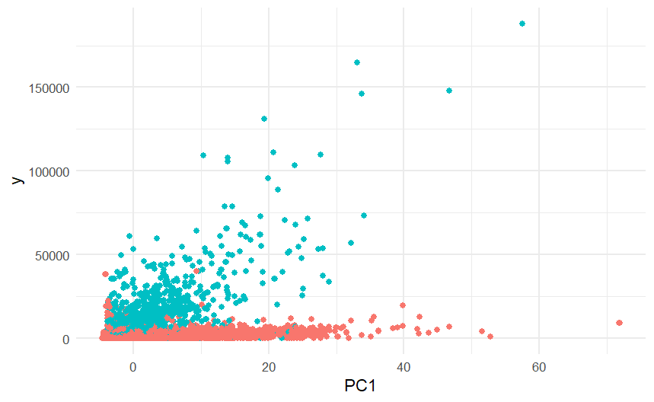
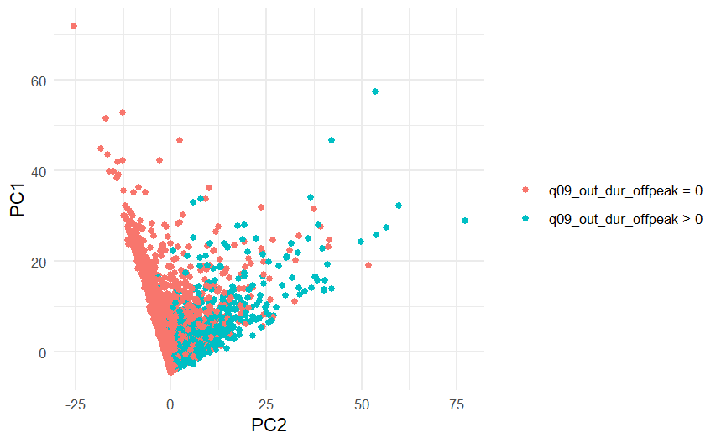
Relazioni tra predittori e risposta
Grafici
PC1 and PC2 are the first two components of PCA on the predictors alone.
Observations appear to belong to two main classes:
active and inactive users on the month before the response variable.
The separation is not clear-cut. Some inactive users appear to behave as active users and viceversa.
Linear relationship masked by the zero-inflation issue → nonlinear approach

Slide 10
Modeling

Slide 11
Modeling Approach
Characteristics of the data
Strong asymmetry
Presence of outliers
Different scales
Multicollinearity
Presence of nonlinear relations
These discoveries suggest a Random Forest model:
No distributional assumptions
Bootstraping at each tree
Scale-invariant partition rules
Combination of multiple decision trees

Slide 12
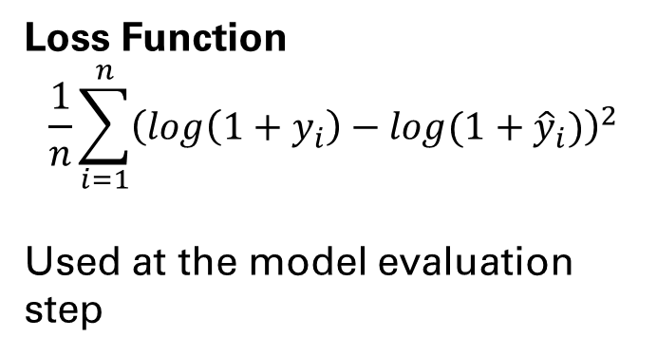

Approccio al modello
Loss Function
$$\frac{1}{n}\sum_{i=1}^{n}{{\left(log\left({1+y}_{i}\right)−log(1+{\hat{y}}_{i})\right)}^{2}}$$
Used at the model evaluation step
Models trained on transformed response $\log\left(1+y\right)$
Split
Train 80% (12248 obs)
Validation 20% (3062 obs)
Validation set only used after the analysis and modeling steps (avoid biases)

Slide 13
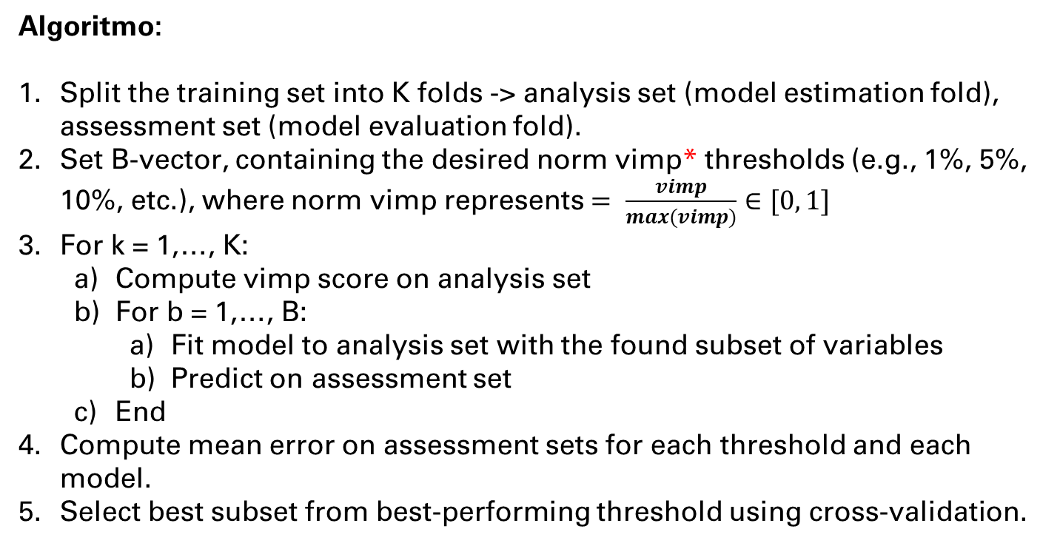
Recursive Feature Elimination (RFE)
Algoritmo:
Split the training set into K folds -> analysis set (model estimation fold), assessment set (model evaluation fold).
Set B-vector, containing the desired norm vimp* thresholds (e.g., 1%, 5%, 10%, etc.), where norm vimp represents $= \frac{vimp}{max(vimp)}$ $∈[0, 1]$
For k = 1,…, K:
Compute vimp score on analysis set
For b = 1,…, B:
Fit model to analysis set with the found subset of variables
Predict on assessment set
End
Compute mean error on assessment sets for each threshold and each model.
Select best subset from best-performing threshold using cross-validation.
*variable importance
Taken and adapted from «Feature Engineering and Selection - A Practical Approach for Predictive Models », Kuhn, Johnson, 2020, p. 237

Slide 14
Results
rf_all: no tuning, no variable selection;
rf_RFE: no tuning, variable selection with RFE
rf_RFE_tune: model 2 with hyperparameter tuning
rf_RF_cor_filter: random forest with default hyperparameters, correlation filter* (> 90%) and variable selection with RFE
*Recommended step by Kuhn e Johnson (2020, p. 249), to avoid “dilution” of importance scores
model | mean_cv_tr_loss | mean_cv_val_loss | train_loss | valid_loss
rf_all | 0.9777069 | 3.947162 | 0.9760795 | 3.948121
rf_RFE_cor_filter | 1.0286464 | 3.627720 | 1.0138438 | 3.925720
rf_RFE | 0.9742796 | 3.595058 | 0.9550966 | 3.904771
rf_RFE_tune | 0.8936597 | 3.907697 | 0.8934876 | 3.881156

Slide 15
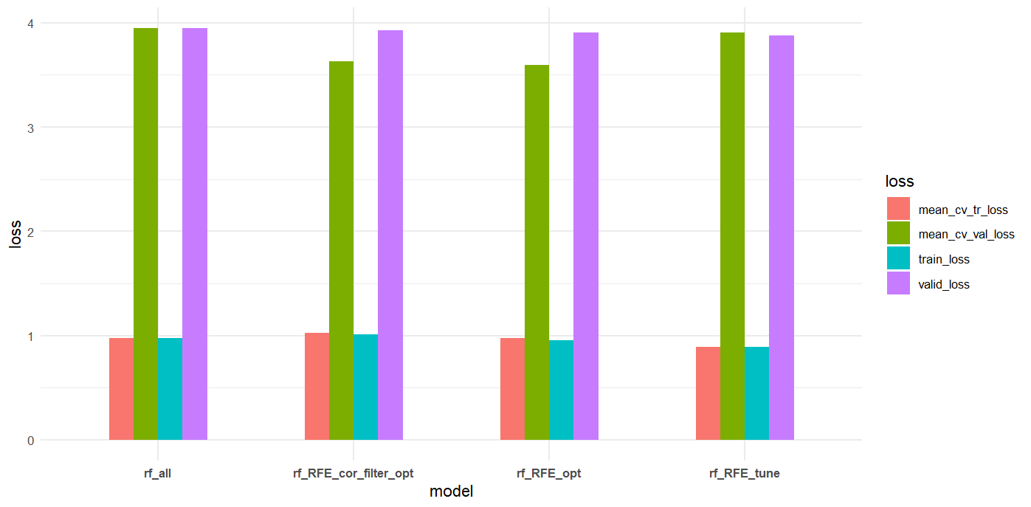
Results

Slide 16
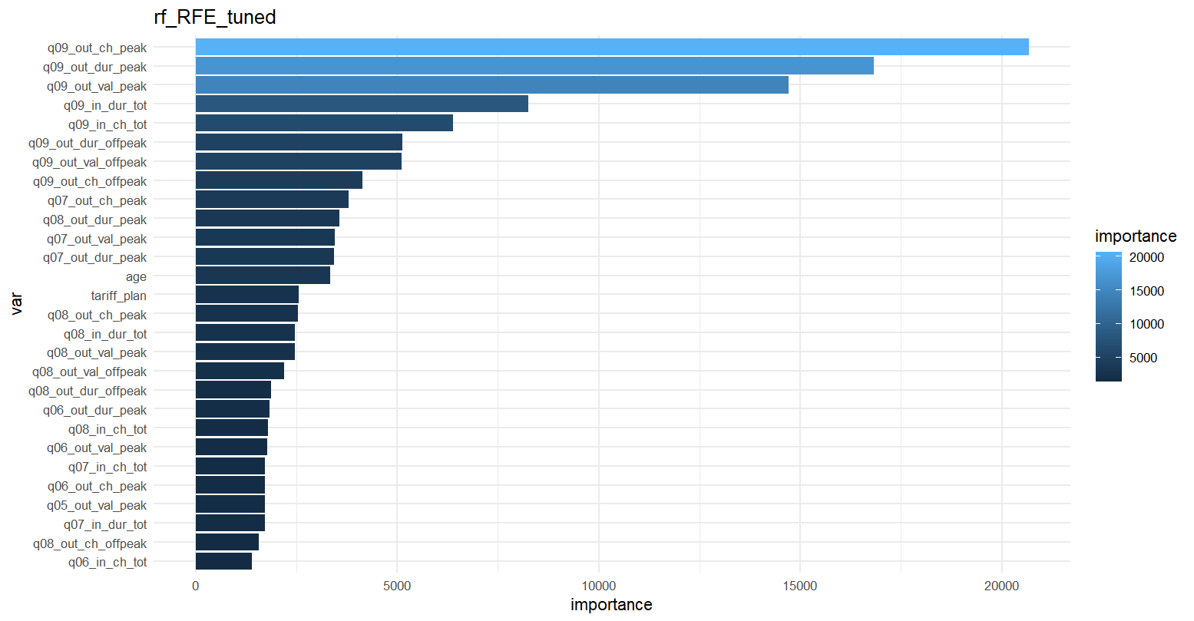
Results
Selezionate variabili con norm vimp > 10%
28 variabili predittive (nel grafico)
Supporto a favore di ipotesi iniziale (variabili osservate nei mesi vicini a quello della risposta sono più rilevanti)

Slide 17
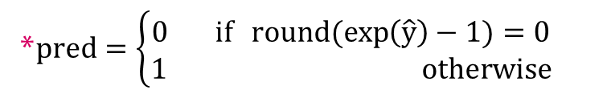
Observations
High % of «false positives»
Users with null traffic on the response predicted as active
Training set
Actual / Pred* | 0 | 1
0 | 1679 | 2479
1 | 3 | 8087
Possible cause: predictors limited to traffic alone might be insufficient to anticipate an "unpredictable" behavior.
Possible solutions
Enrich the dataset with
Variables related to customer history (ad es. subscription date, past churn etc.)
Market related variables (ad es. prices of similar products)
Periodically investigate customer satisfaction
Idea: prevent customer churn
*$pred=\left\{\begin{aligned}0 if round(exp\left(\hat{y}\right)−1)=0 \\ 1 otherwise\end{aligned}\right.$
17

Slide 18



ConclusionS
Tree-based models show good performance in predicting the traffic of active customers, but fail to identify customers who suddenly cease their activity.
Proposed solution: include more predictors related to the customer's history with the phone provider, their satisfaction with the service, and competition during the dataset creation phase.

