Slide 1
Homelessness in the US
- Alejandra Soriano

Slide 2
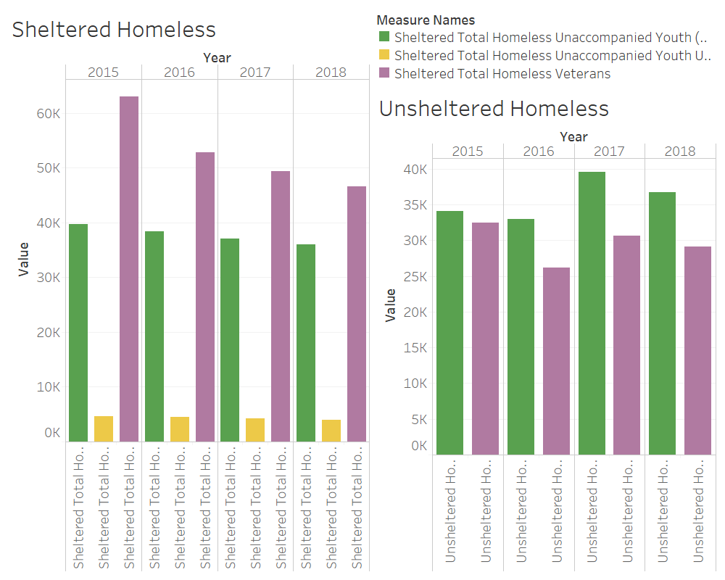
39522
39676

Slide 3
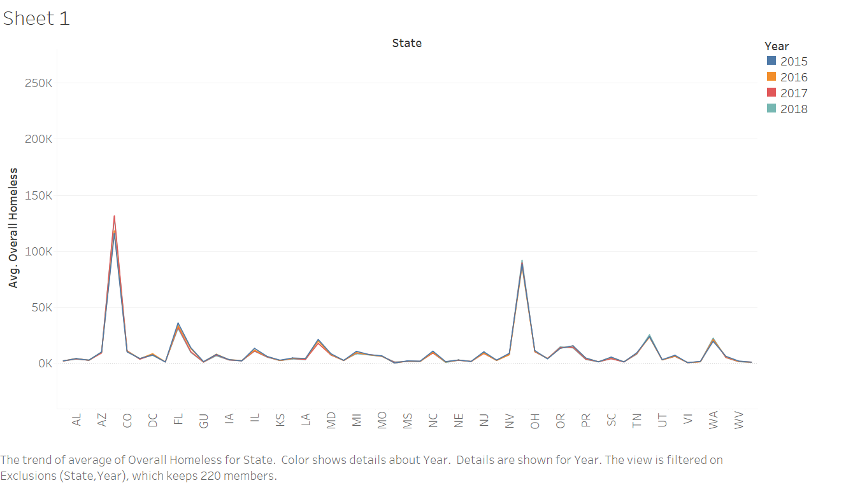

Slide 4
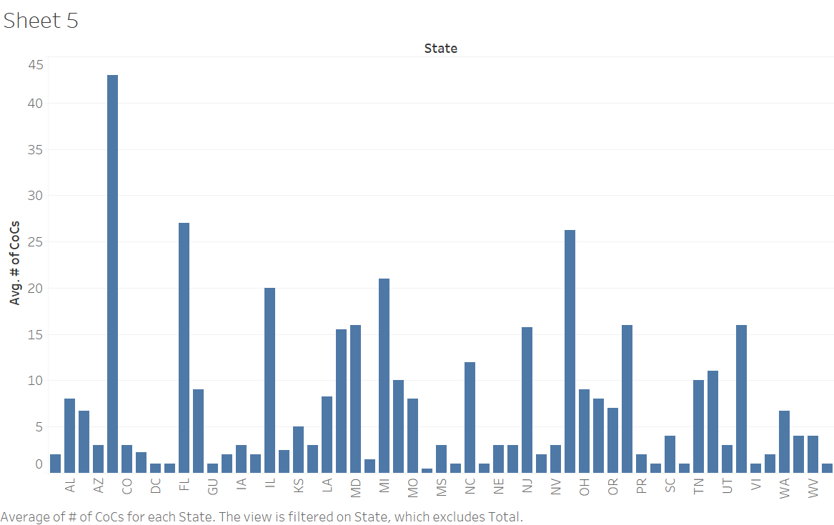

Slide 5
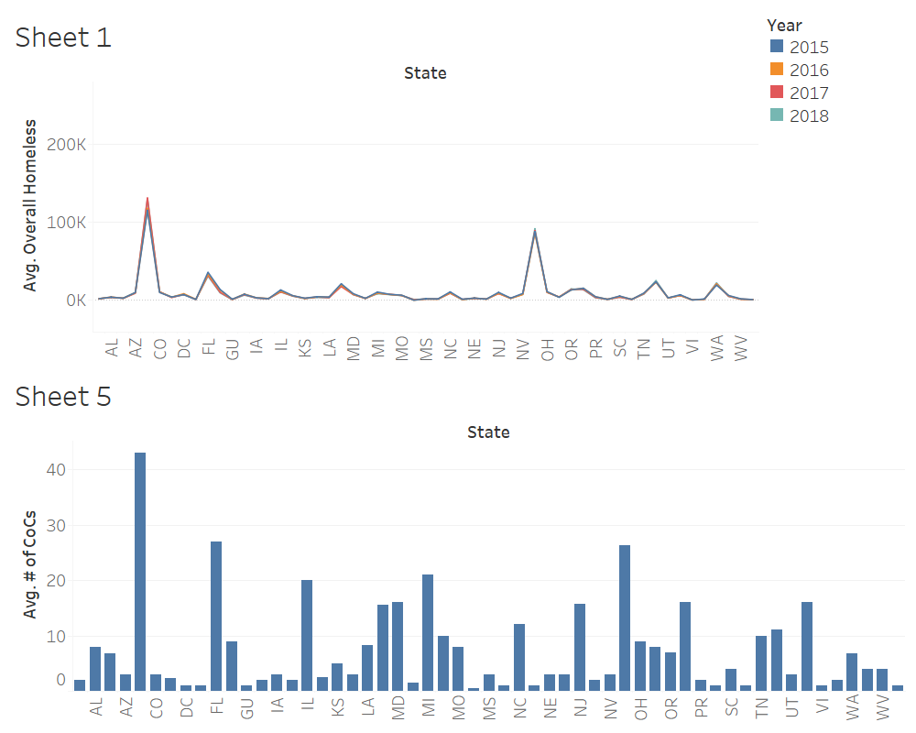

Slide 6
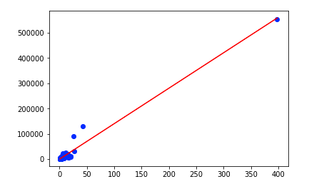
Linear Regression

Slide 7


What I Would Do Next?
Include shelter data
Major events for impact
More models ML

Slide 8


Slide 9



Thank you!

Slide 10
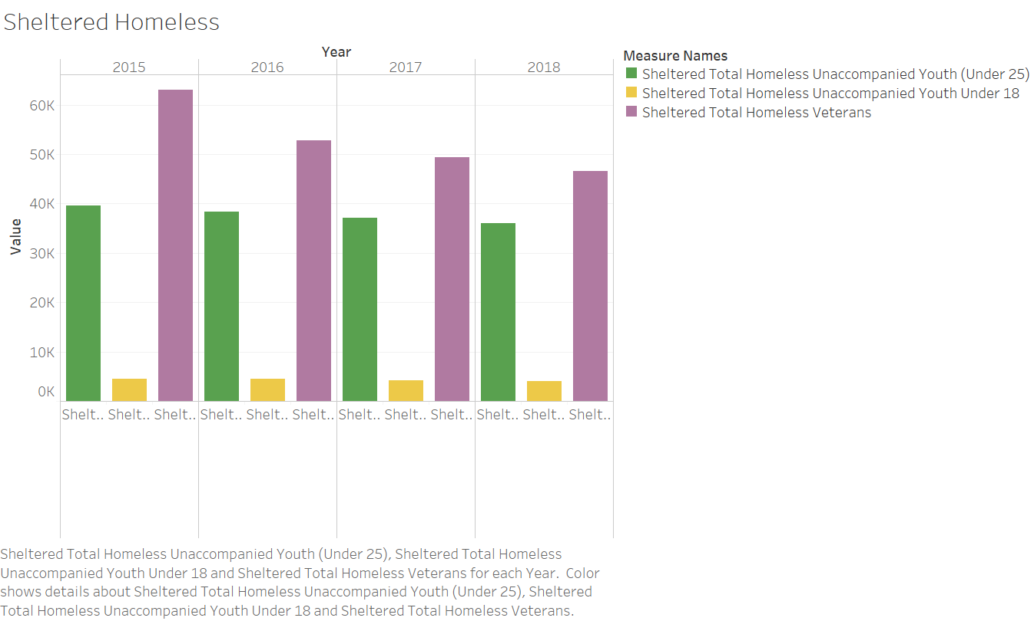

Slide 11
