Slide 1

Exactly Once Streaming and why Microseconds Matter
…An Ad Bidding Case Study
May 5, 2017
Colin MacNaughton and Igor Mihaljevic

Slide 2


Introductions
Colin MacNaughton
Head of Engineering at Neeve Research, the creators of the X Platform: a platform for building In Memory enterprise applications that are high performance, easy to author, and easy to maintain.
Igor Mihaljevic Lead Engineer a Kode41, a services firm specializing in high performance system design and development. Igor's professional focus is software architecture of Ad Bidding, Online Games, and Social Network analysis with BigData.

Slide 3
Agenda
X-Once Steaming Challenges
Case Study – An Ad Exchange
DEMO

Slide 4
Streaming App Characteristics
What do they do?
Receive Inbound Messages
Process / Update State
… and Emit Outbound Messages
Inbound Message Stream
Outbound Message Stream(s)
App
Business Logic
State CRUD
Notes:
Ordering Matters

Slide 5
Why Do Microseconds Matter?
A processing time of 1ms limits your throughput to 1000 messages / sec
Same applies to any synchronous callouts in the stream
…when ordered processing matters this is a problem
Notes:
This is mostly a function of cost and operation complexity. How wide do you have to scale?

Slide 6
Exactly Once Challenges
The Speed Bumps:
Synchronous Messaging
Storage and Access to fault tolerant State
Atomicity between Message Stream and State Updates

Slide 7
X-Once Messaging Challenges
Guaranteed messaging implies acks
Performance
Synchronous delivery modes kill throughput
Choose a messaging provider with windowed acks (pipelining)
Message session based transactions (batching) can improve throughput, but is costly for latency
Avoiding Redeliveries
Sender must hold un-acked messages to redeliver after failure
Receiver must track received messages to prevent reprocessing after a failure

Slide 8
X Once State Challenges
Disk Based Storage
Can be slow (1-4ms) commodity SSDs
Doesn’t provide HA for machine failure
Remote Storage
Provides HA for application failure, but…
RDBMS – too slow to read / commit
Data Grids – Better, but still slow update times
Data Consistency and Contention
Distributed locking and write contention quickly become the bottleneck
Problematic when multiple threads/processes update the same state
Notes:
-Von Neumman Bottleneck and Data Gravity
-Single Writer Principle
Source: http://www.legitreviews.com/limited-edition-750gb-crucial-mx300-ssd-review_182310/8

Slide 9
Message / State Atomicity
State and Message processing must be atomic
Updates to state should be consistent with outbound messages emitted
In an Ad Exchange, “If I send an ad to a user, but fail before I record the winning bidder, I’m not getting paid for an ad I served.”
Coordination between Message Streams and State Updates is the hardest challenge to solve for streaming applications.

Slide 10
The Solution
“Micro Apps” – streaming micro services
Like Micro Services, app state is private and single threaded.
Keep all state In-Memory
Pipeline State Changes to Hot Backup
Pipelined Guaranteed Messaging
Atomic Message / State Processing, message doubt is part of state
Uncontended, Consistent
Data Access Times
High Availability
Asynchronous
Exactly Once, Atomic

Slide 11
Micro Apps with the X Platform
Application Handler(s)
Inbound Message Stream
Outbound Message Stream(s)
1
2
Primary
4
4
5
3
State as Java
State 100% In Memory
Zero Loss or Duplication
Pipelined Replication
Async Journaling
Messages as Java
Pipelined Messaging
Pooling for Zero Garbage
Simple
Receive
Process
Replicate
Send Out / Ack
Outbound Acks
Backup
1
2
3
4
5
Notes:
Encourage follow up.

Slide 12
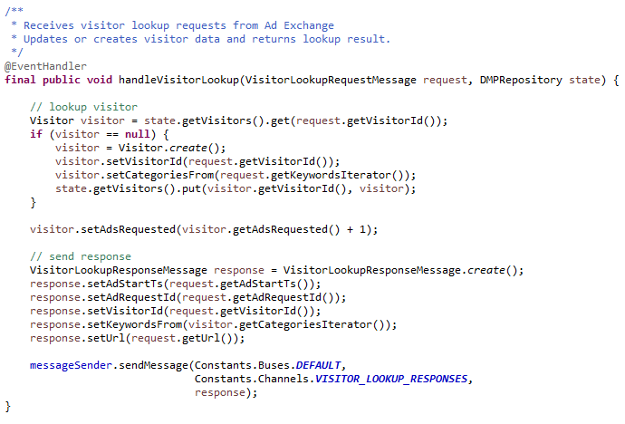
Simple Programming Model
“Plumbing” Free Code!
Modeled State and Messages as POJOs
Single Threaded
=
No State Contention CPU cache friendly
State In Memory = Fast!
Exactly Once / Atomic: Inbound Message State Updates and
Outbound Message(s)
Pooled Messages / Preallocated State = Zero Garbage

Slide 13
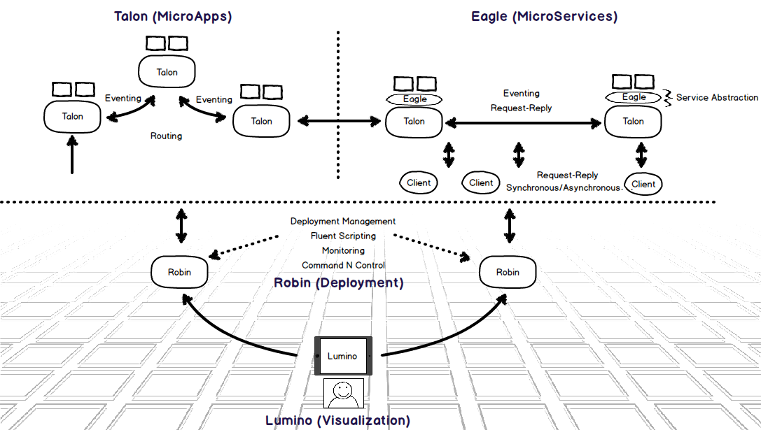
The X Platform

Slide 14
Build + Run
Build Time
Run Time
Build Time
Application Data Modeler
(ADM)
Repository
State CRUD
@EventHandler
final public void onNewOrder(final NewOrderMessage message) {
// instantiate a new order
final Order order = orderPool.get(null);
// extract from into the order
NewOrderMessageExtractor.extract(message, order);
// initialize order state
order.setState(OrderState.New);
// add to the application's order collection
orders.put(order.getOrderId(), order);
// create a new order event
final OrderEvent event = OrderEvent.create();
// populate the event
OrderEventPopulator.populate(event, order);
// send the event
sendMessage(event);
}
Application Data Modeler
(ADM)
Map
Set
XML
Generate State Classes
(optional)
Entity
Entity
Entity
Entity
Generate Message Classes
XML
Queue
Queue
Outbound Messages
Inbound Messages
State Modeling
Persistence
X Platform
Message Modeling
Connection Management
Subscription Management
Serialization/Deserialization
Send/Receive
ACIDity
High Availability
Exactly Once Delivery
Lifecycle Management
Command and Control
Alerts
Statistics
Configuration Repository
Messaging Fabric
(Solace, JMS, Falcon, …)

Slide 15
Diving Under
Application Data Modeler
(ADM)
Application Data Modeler
(ADM)
Repository
State CRUD
@EventHandler
final public void onNewOrder(final NewOrderMessage message) {
// instantiate a new order
final Order order = orderPool.get(null);
// extract from into the order
NewOrderMessageExtractor.extract(message, order);
// initialize order state
order.setState(OrderState.New);
// add to the application's order collection
orders.put(order.getOrderId(), order);
// create a new order event
final OrderEvent event = OrderEvent.create();
// populate the event
OrderEventPopulator.populate(event, order);
// send the event
sendMessage(event);
}
XML
Generate State Classes
(build time)
(optional)
Generate Message Classes
(build time)
XML
Map
Set
Entity
Entity
Entity
Entity
Queue
Queue
State Management
Send, Receive Messages
Transaction Processing
State Modeling
Persistence
ACID
High Availability
Exactly Once Delivery
Operational Data Store (ODS)
Atomic Event Processor
(AEP)
Messaging
Cluster Persistence
X Platform
Message Modeling
Connection Management
Subscription Management
Serialization/Deserialization
Send/Receive
Deployment Management
Lifecycle Management
Command and Control
Alerts
Statistics
Talon Server (XVM)
Transaction Log
Simple Messaging Abstraction (SMA)
Enterprise Integration
Messaging Fabric
(Solace, JMS, Falcon, …)
Configuration Repository
CDC (Change Data Capture)
ICR (Inter-Cluster Replication)

Slide 16
The X Architecture Pattern
Backup
@EventHandler
final public void onNewOrder(final NewOrderMessage message) {
// instantiate a new order
final Order order = orderPool.get(null);
// extract from into the order
NewOrderMessageExtractor.extract(message, order);
// initialize order state
order.setState(OrderState.New);
// add to the application's order collection
orders.put(order.getOrderId(), order);
// create a new order event
final OrderEvent event = OrderEvent.create();
// populate the event
OrderEventPopulator.populate(event, order);
// send the event
sendMessage(event);
}
Repository
Repository
3
Update application state
Map
Set
Map
Set
Entity
Entity
Entity
Entity
Entity
Entity
Entity
Entity
Queue
Queue
Queue
Queue
2
Dispatch to application for processing
4
Send outbound messages
Stabilize
(Replicate/Persist)
X Platform
X Platform
Start Transaction
2
5
1
Inbound message
6
Send outbound messages
Receive stability notification
Acknowledge inbound message
(Complete Transaction)
TLOG
TLOG
7
8

Slide 17
About Kode41 Projects
We develop custom solutions focused on:
Stream processing
Targeted advertising
Soft real-time solutions
Based on our past experiences, we partnered up with Neeve Research to build ad serving solutions on X Platform

Slide 18
Introduction to Real-Time Ad Bidding

Slide 19
Introduction to Real-Time Ad Bidding

Slide 20
Introduction to Real-Time Ad Bidding

Slide 21
Introduction to Real-Time Ad Bidding

Slide 22
Introduction to Real-Time Ad Bidding

Slide 23
Introduction to Real-Time Ad Bidding

Slide 24
Introduction to Real-Time Ad Bidding

Slide 25
Introduction to Real-Time Ad Bidding

Slide 26
Introduction to Real-Time Ad Bidding

Slide 27
Introduction to Real-Time Ad Bidding

Slide 28
Introduction to Real-Time Ad Bidding

Slide 29
Introduction to Real-Time Ad Bidding

Slide 30
Introduction to Real-Time Ad Bidding

Slide 31
Problems we Encountered
Problems encountered with several projects we’ve done:
Build everything from scratch
Difficult to design for concurrency
Difficult to achieve scaling
Difficult to achieve reliability
Storage is the bottleneck

Slide 32
Problems we Encountered
Real-time computing with VMs and garbage collection
Complicated setup for development
Complicated DevOps
Complicated HW and network topology from start

Slide 33
The Case Study with X Platform

Slide 34
The Case Study with X Platform

Slide 35
X Platform: High Availability, and Guaranteed, X-Once Delivery
Some amount of errors in ad serving can be tolerated, but they bear high financial cost
Every ad request involves financial transaction
If there is a winning bid, but no delivery to user, someone is getting paid for work not done, and someone else is being charged for it.
Handling same messages multiple times complicates tracing and discarding duplicate ad requests (someone is being double-charged, or possibly multiple ad buyers are being charged)

Slide 36
Extending the Product

Slide 37
Problems Revisited
Focus is on business logic.
Concurrency model is built-in
Simple horizontal scaling
Fast persistent storage, enabled by configuration, not coding
No remote cache

Slide 38
Problems Revisited
No issues with GC pauses
Easier setup for development
Simplified DevOps
Simplified Hardware and Network Topology
Increased productivity

Slide 39
Demo
Deploying and Running the Ad Serving System

Slide 40
Questions
?

