Slide 1

Module administration

Slide 2
C4CSS: Demystifying Computing with Python
introduce coding and Python
focus on simple ways to develop software autonomously
We will learn programming with Python!
If time allows: basic Data Science methods

Slide 3
Keywords
Data types and data structures
Conditional and loops
User input output
Text files
Functions
Data cleaning
Basic stats
Relational databases and their Structured query language (SQL)

Slide 4
On module completion you will be able to:
Write Python programs
Feel confident to develop personal projects
Understand the basics of algorithms and coding
Use different data sources
Visualize data
use the SQL language to query relational databases; set up and run simple databases

Slide 5
Syllabus
Quick, hands-on introduction to programming with python
The triad prolem/algorithm/implementation
basic structures, iterations & functions
List, Dictionaries, Sets and Tuples
Numerical functions: numpy
Data visualisation: Matplotlib
Data ingestion, tables and time series: Pandas
7. Introduction to Structured the Query Language (SQL)
8. Creating simple SQL databases
9. writing SQL queries to extract data
10. embed SQL in Python
11. Developing a Case Study with Python

Slide 6
Class activities
Laptops on, smartphones off
Lectures and labs mix up seamlessly
use the the Teams channel for quick questions

Slide 7
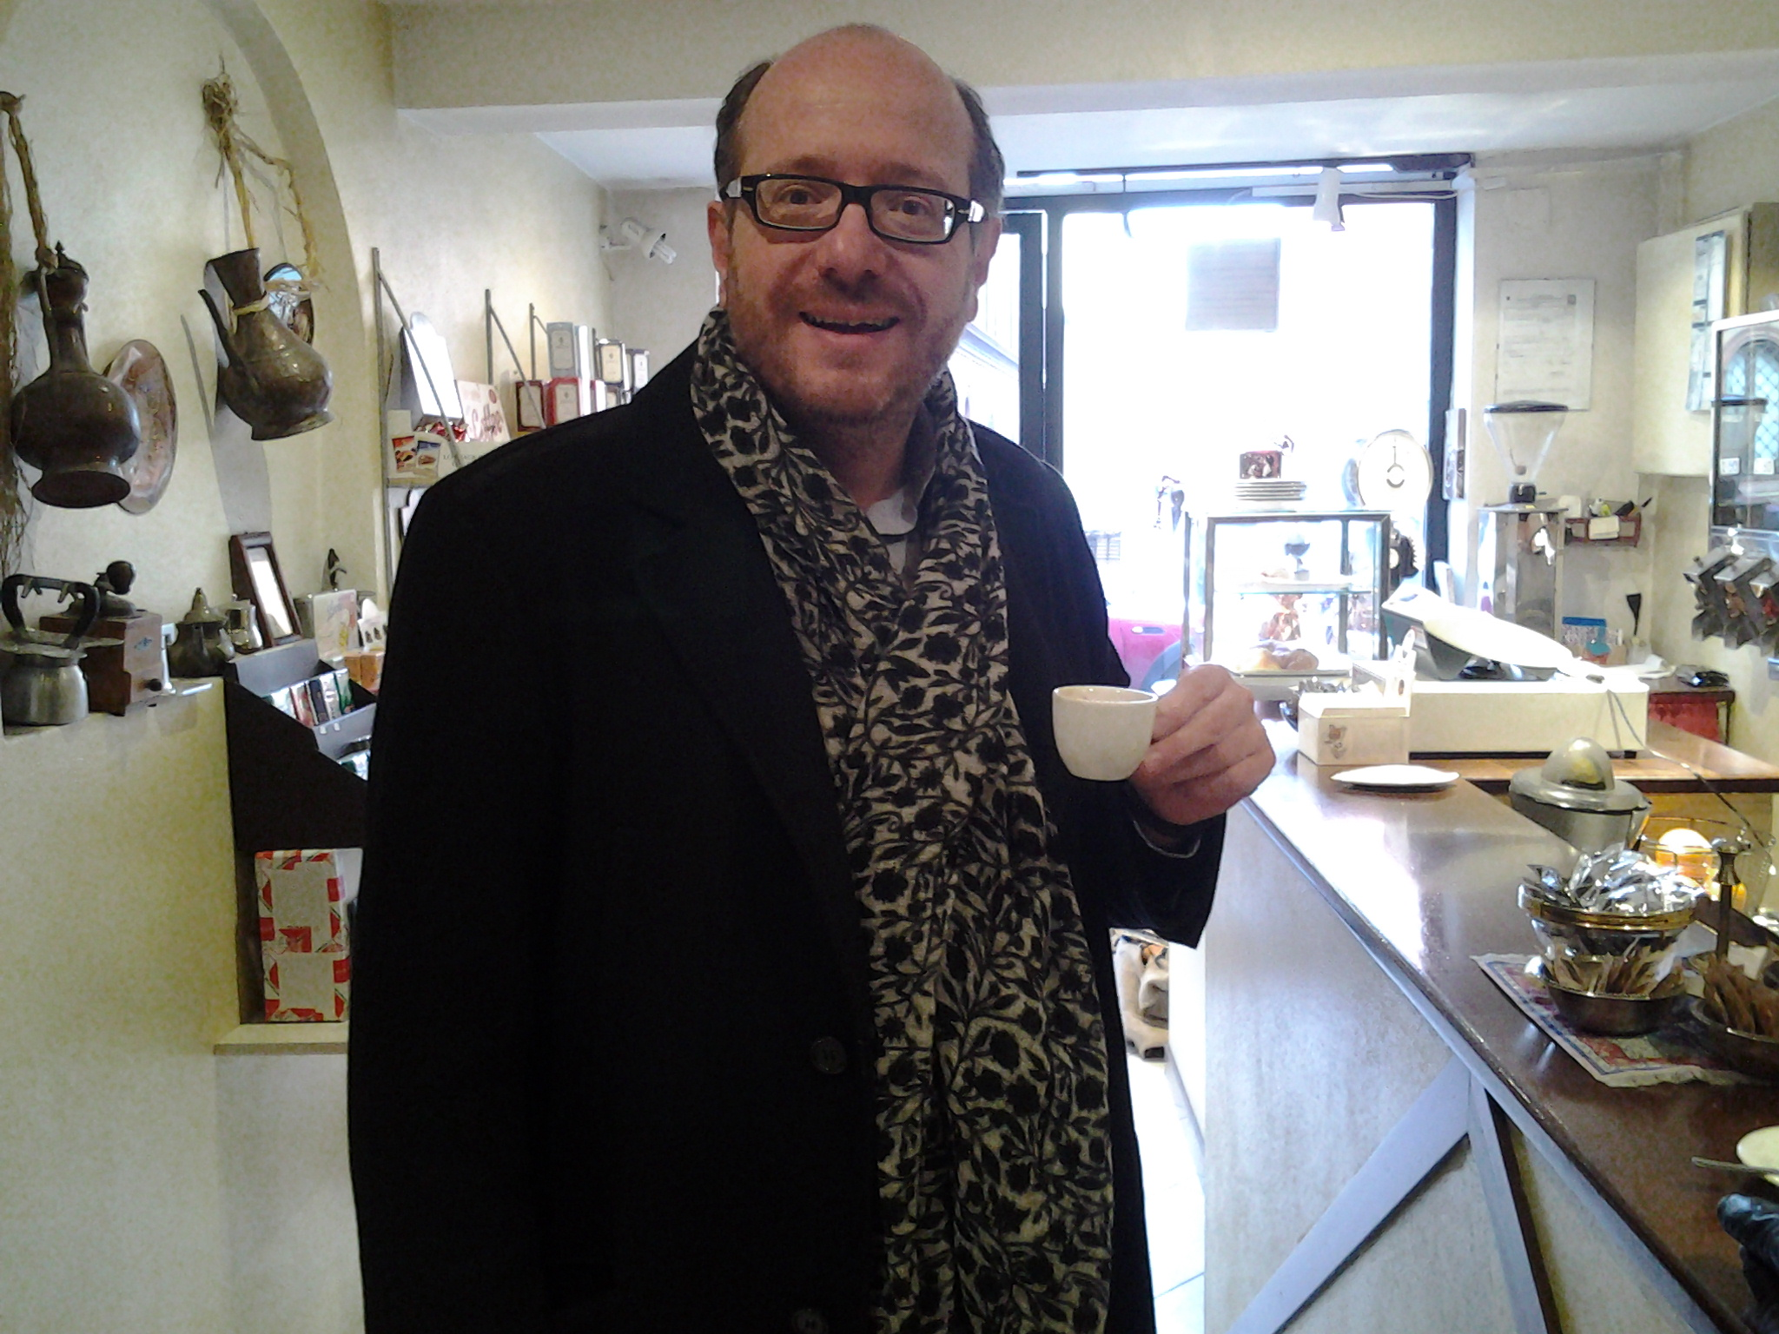
instructor:
Dr Alessandro Provetti
PhD on AI for simplifying programming languages
Research on understanding user data in “Social web” platforms.
I founded of the Birkbeck Institute for Data Analytics
office: virtual (MS Teams) mostly
email: alessandro.provetti@unimi.it
7
Notes:
7

Slide 8

Guest lecturer: Dr Federico Pilati
PhD in Computational Social sciences at IULM, IT
Post-doc at Université de Genève, CH
Research on the emergence of online communities within digital platforms (e.g. Wikipedia, Twitter, TikTok, Twitch).
office: virtual (MS Teams) mostly
email: federico.pilati2@unibo.it
8
Notes:
8

