Slide 1
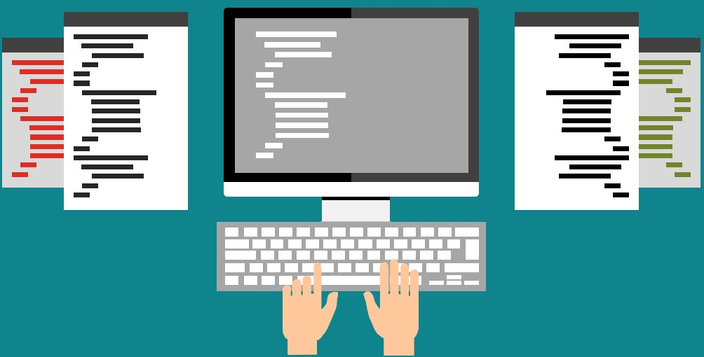
B: variables and types

Slide 2
Programming with Python
Simple and minimal-chic programming language
Easy to learn and use: reading code is almost like reading English
Simplicity as a result of design:
focus on the problem and not on the language/the data representation in memory
a way to represent an easy-to-read program
Python is free, open source well-supported and well-maintaned:
VS Code, Jupyter, PIP, PyPi, Anaconda, Docker...
Comes from “Monty Python”

Slide 3
Programming in Python
Sequence of one or more instructions
A fixed alphabet, strict syntactical rules and notations
high-level computer language
The Python interpreter maps Py. commands, one after the other, into low-level commands
Computer hardware understands and executes the low-level commands
Even adding two numbers requires a certain visibility of RAM and CPU
load the number from memory location 2001 into the CPU
load the number from memory location 2002 into the CPU
add the two numbers in the CPU
Store the result into location 2003

Slide 4
Programming
Python is easy to understand
interpreters translate high-level Py. to machine language
Two ways to do it, using:
Compiler or
Interpreter
grand_total = price + vat
print(“Welcome to Python”)

Slide 5
Simple Python commands
Comments!
Use of hashtag #
Print command print
Prints on screen!
Numbers and operations
# Command to print number 10!
print(10)
# More commands...
print(10+20)
print(10+2*20)
print((2*4)+6)
print(2**2)
Notes:
5

Slide 6
Simple Python commands
print()
Prints on screen!
Text is containerized by means of single (‘’) or double (“”) quotes
# prints on the screen:
print(‘Have a nice Autumn term!’)

Slide 7
Simple Python commands
# Let’s print two names
print(“Stelios”)
print(“Sotiriadis”)
print()
Prints on screen!
Text is containerized by means of single (‘’) or double (“”) quotes
# Or
print(“Stelios”, “Sotiriadis”)
# Or
print(‘Stelios’, ‘Sotiriadis’)
# Or
print(‘Stelios ’+‘Sotiriadis’)

Slide 8
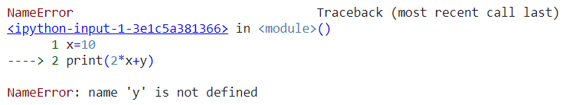
Variables
print(name)
Programs manipulate data that sits in the computer memory.
Variables are generic names for the container of some value
Computer variables are akin to both parameters and variables of mathematics
A funny ‘=’ symbol to assign value to a variable
name = `Nik`
age = 10
x = age + 10
print(x)
print(10/x) # beware division by 0!
print(2*x + y) # What does it print?

Slide 9
Variables can change their content
Assignment statement
fahrenheit = 9/5 * celsius + 32
# This is an assignment expression!
myvar = 10
print(myvar)
myvar = 20 # Assign a new value
print(myvar)
myvar = myvar+1
print(myvar) # Prints 21

Slide 10
How memory looks like!
Variables can change!
myvar
10
# This is an assignment expression!
myvar = 10
print(myvar)
myvar = 20 # Assign a new value
print(myvar)
myvar = myvar+1
print(myvar) # Prints 21
10
myvar
20
10
myvar
20
21
Notes:
10

Slide 11
Programming is about input/output
Input from the keyboard:
‘enter’/’return’ to end the input.
input()
Assign the input to a variable
<variable> = input(<prompt>)
# This is an input example
name = input("Please enter a name: ")
print(name)
# This is another input example
my_fav_num = input(“What is your favourite number? ”)
print(“Your favourite number is ”, my_fav_num)

Slide 12
Programming is about input/output
Input from the keyboard:
‘enter’/’return’ to end the input.
input()
Assign the input to a variable
<variable> = input(<prompt>)
# This is another input example
fName = input(“Give first name: ”)
lName = input(“Give surname: ”)
print(fName, lName)

Slide 13
Quiz 2: Fill the gaps
a) ________________ # Write a statement to print your name
b) ________________ # Write a statement to print number 10
c) ________________ # Write a statement to print the sum of 1 and 2

Slide 14
Quiz 2 Solution
a) print(“Stelios”) # Write a statement to print your name
b) print(10) # Write a statement to print number 10
c) print(1+2) Write a statement to print the sum of 1 and 2

Slide 15
Quiz 3: Fill the gaps
# Provide the command to prompt the user to enter a name
my_input = d) ________________(“Enter your name: “)
# Provide the command to print the variable my_input
e) ________________ (my_input)

Slide 16
Quiz 3 Solution
# Provide the command to prompt user to enter a name
my_input = d) __ input__(“Enter your name: “)
# Provide the command to print the variable my_input
e) __print__(my_input)

Slide 17
Data types
Integers
x=10, y=100 …
Floats
pi=3.14, a=10.10, rate=0.0992929
Strings (text)
name=“Stelios”, age=“32”
Boolean (True or False, 1 or 0)
headphones=True

Slide 18
Working with numbers!
Everything that the user inputs from the keyboard Python assumes that it is a TEXT!
We need to transform text to numbers to make operations
Text to integer
Text to float
# The input is 10
x = input(“Give a number”)
print(x)
# x is a text, even if it looks like a number
# This will print 10!
# This is another input
x = input(“Give a number”)
print(x+20)
# Python does not know that x is a numbers...
# This will cause an error

Slide 19
What is the output?
# This is an input
x = input(“Give a number”)
print(x * 2)
# This is how you comment multiple lines...
“““
What does it print if the user enters 10?
20
An error ...
1010
”””
The correct answer is 1010

Slide 20
Data types conversions
String to Integer
use int(<value>)
# This is another input example
x = input(“Give a number”)
print(int(x) * 2)
“““ What does it print if the user enters 10?
20
An error ...
1010
”””
The correct answer is 20

Slide 21
Data types conversions
String to Integer
use int(<value>)
# Hint
# If you except an integer, convert the input to integer directly
x = int(input(“Give an integer number”))
print(x * 2) # Will print 20!

Slide 22
Data types conversions
String to Float
use float(<value>)
# This is another input example
x = input(“Give a number”)
print(float(x) + 2)
# What does it print if the user enters 10.5?
The correct answer is 12.5

Slide 23
Data types conversions
Int to String
use str(<value>)
x = 10
# What does it print?
print(“ID” + x)
The correct answer is error
# What does it print?
print(“a” + str(x))
The correct answer is a10

Slide 24
Recap
Data types:
Integers: x=10, y=100 …
Floats: pi=3.14, a=10.10, rate=0.0992929
Strings (text): name=“Stelios”, age=“32”
Boolean (True or False, 1 or 0): headphones=True
Converting types:
int(<value>), float(<value>), str(<value>)

Slide 25
Quiz 4
What is the output of the following script?
a = input("give a number")
# The user enters 10
b = input("give a second number")
# The user enters 20
print(a+b)

Slide 26
Quiz 4 Solution
What is the output of the following script?
a = input("give a number") # The user enters 10
b = input("give a second number") # The user enters 20
print(a+b)
If input is 10 and then 20 this will print 1020!
a = int(input("give a number"))
b = int(input("give a second number"))
print(a+b)
This will print 30!

