Slide 1
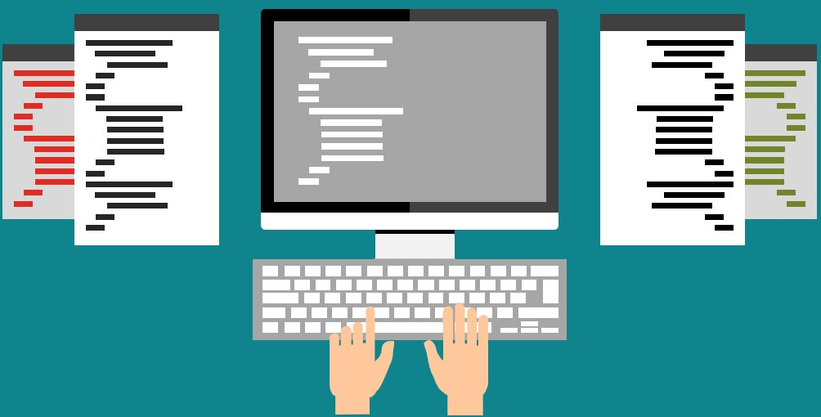
C: types

Slide 2
Data types
Integers
x=10, y=100 …
Floats
pi=3.14, a=10.10, rate=0.0992929
Strings (text)
name=“Stelios”, age=“32”
Boolean (True or False, 1 or 0)
headphones=True

Slide 3
Working with numbers!
Everything that the user inputs from the keyboard Python assumes that it is a TEXT!
We need to transform text to numbers to make operations
Text to integer
Text to float
# The input is 10
x = input(“Give a number”)
print(x)
# x is a text, even if it looks like a number
# This will print 10!
# This is another input
x = input(“Give a number”)
print(x+20)
# Python does not know that x is a numbers...
# This will cause an error

Slide 4
What is the output?
# This is an input
x = input(“Give a number”)
print(x * 2)
# This is how you comment multiple lines...
“““
What does it print if the user enters 10?
20
An error ...
1010
”””
The correct answer is 1010

Slide 5
Data types conversions
String to Integer
use int(<value>)
# This is another input example
x = input(“Give a number”)
print(int(x) * 2)
“““ What does it print if the user enters 10?
20
An error ...
1010
”””
The correct answer is 20

Slide 6
Data types conversions
String to Integer
use int(<value>)
# Hint
# If you except an integer, convert the input to integer directly
x = int(input(“Give an integer number”))
print(x * 2) # Will print 20!

Slide 7
Data types conversions
String to Float
use float(<value>)
# This is another input example
x = input(“Give a number”)
print(float(x) + 2)
# What does it print if the user enters 10.5?
The correct answer is 12.5

Slide 8
Data types conversions
Int to String
use str(<value>)
x = 10
# What does it print?
print(“ID” + x)
The correct answer is error
# What does it print?
print(“a” + str(x))
The correct answer is a10

Slide 9
Recap
Data types:
Integers: x=10, y=100 …
Floats: pi=3.14, a=10.10, rate=0.0992929
Strings (text): name=“Stelios”, age=“32”
Boolean (True or False, 1 or 0): headphones=True
Converting types:
int(<value>), float(<value>), str(<value>)

Slide 10
Quiz 4
What is the output of the following script?
a = input("give a number")
# The user enters 10
b = input("give a second number")
# The user enters 20
print(a+b)

Slide 11
Quiz 4 Solution
What is the output of the following script?
a = input("give a number") # The user enters 10
b = input("give a second number") # The user enters 20
print(a+b)
If input is 10 and then 20 this will print 1020!
a = int(input("give a number"))
b = int(input("give a second number"))
print(a+b)
This will print 30!

