Slide 1

E: expressions

Slide 2
Recap quiz
# 1
a = input("give a number")
# user inputs 10
b = input("give a number")
# user inputs 10
print(a+b)
# What does it print?
# 2
a = input("give a number")
# user inputs 10
b = input("give a number")
# user inputs 10
print(int(a)+b)
# What does it print?

Slide 3
Solutions
# 1
a = input("give a number")
# user inputs 10
b = input("give a number")
# user inputs 10
print(a+b)
# What does it print?
1010
# 2
a = input("give a number")
# user inputs 10
b = input("give a number")
# user inputs 10
print(int(a)+b)
# What does it print?
ERROR!
TypeError: unsupported operand type(s) for +: 'int' and 'str'

Slide 4
Logical operators
Equal
10 == 10 -> This expression is True!
if (a==10) … If the condition is True…
a=10 is a value assignment not a condition
Not equal
5!=5 -> This expression is False!
if (a!=0): print(10/a)
if (temp>30) and (distance_to_beach<50):
print(“Let’s go to the beach!”)
if(raining==True) or (day==“Sunday”):
tea==True
Notes:
<number>

Slide 5
Booleans
x = int(input(“Give a num: ”))
enterTheIf= False
if(x == 10):
print(“This is true!”)
enterTheIf = True
print(enterTheIf)
# Another example!
a = int(input(“Give a num: ”)
isZero = False
if(a==0):
isZero = True
if (isZero == False):
print(100/a)
A Boolean expression (or logical expression) evaluates to one of two states true or false.
Python provides the Boolean type that can be either set to False or True.

Slide 6
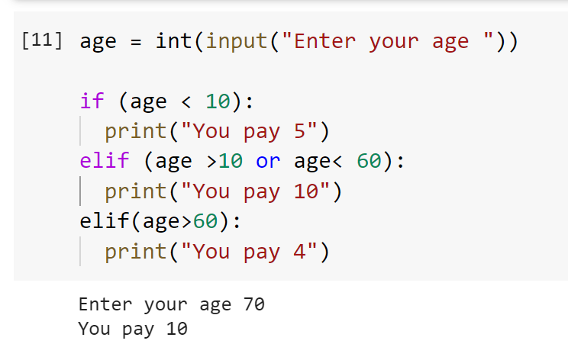
Awkward run 1! What’s wrong?
Do not post your solution in the chat yet…
Wait for the timer to complete…
Notes:
<number>

Slide 7
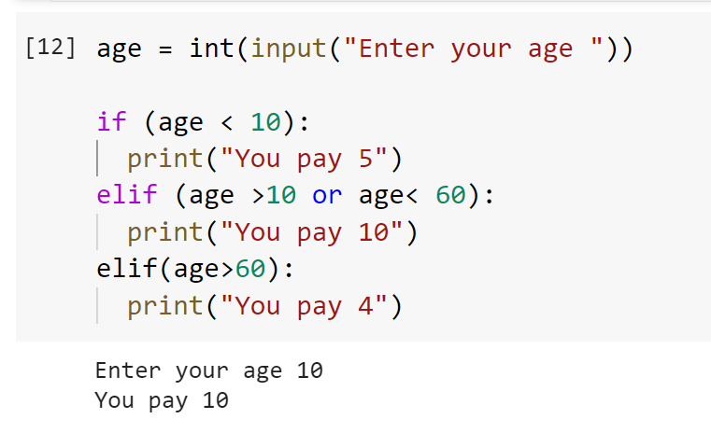
Awkward run 2! What’s wrong?
Do not post your solution in the chat yet…
Wait for the timer to complete…
Notes:
<number>

Slide 8
Solution
age = int(input("Enter your age "))
if (age <= 10):
print("You pay 5")
elif (age >10 and age<= 60):
print("You pay 10")
elif(age>60):
print("You pay 4")

