Slide 1
Predicting Seriousness of Injury in a Traffic Accident: A New Imbalanced Dataset and Benchmark Paschalis Lagias, George D. Magoulas, Ylli Prifti, and Alessandro Provetti
Birkbeck College, University of London, UK

Slide 2
UK Department for Transport Road Safety Data
Available to the public via UK Government Open Data webpage: Road Safety Data link
Records available since 1979.
3 datasets published per year:
Accidents: Incident conditions.
Vehicles: Vehicle characteristics, driver details, action before the incident.
Casualties: Details about injured individuals.
STATS 20: Associated Documentation

Slide 3
UK Department for Transport Road Safety Data
Accidents ID: Accident Index
Accident
Vehicles ID: Vehicle Reference Foreign Key: Accident Index
Vehicle 1
Vehicle 2
Casualties ID: Casualty Reference Foreign Key: Accident Index Foreign Key: Vehicle Reference
Casualty 1 (Driver)
Casualty 2 (Passenger)
Casualty 3 (Pedestrian)

Slide 4
UK Department for Transport Road Safety Data
Accident / Casualty Severity:
Slight: E.g., collisions in parking lots or with very low speed. About 89% of all records.
Serious: Incidents where hospitalization is required. About 10% of all records.
Fatal: About 1% of all records.
Most data variables are nominal and encoded with integers that represent a category.
Missing values are encoded with -1.

Slide 5
Past Work with UK Road Safety Data
Research Focus:
Exploratory data analysis
Prediction of Accident Severity
Features derived mostly from Accidents dataset
Challenges:
Class distribution for Accident Severity is heavily imbalanced
Low accuracy achieved for minority classes (serious, fatal)
Missing values

Slide 6
Project Overview
Dataset Merging (2005 – 2018)
Exploratory Analysis
Data Correction
Data Imputation: MissForest
Multi-layered Perceptron
Casualties
Vehicles
Accidents
Feature correlation
Missing values
Corrections based on DfT documentation
Fields with missing values more than 50% were dropped
Reinforcement Learning
Training / Validation data (2005 – 2018) imputed
Test data (2019) imputed
Double Q network deployed
Architecture from network sensitive to fatal casualties during supervised learning.
Empirical feature selection
Class weights used in loss function
Predictions from an ensemble of neural networks

Slide 7
Data Preparation Data merging
Merging Accidents, Vehicles and Casualties
Stage 1:
Vehicles + Casualties join on Vehicle Reference.
Vehicles not matched with a casualty were removed.
Stage 2:
Stage 1 + Accidents join on Accident Index.
Output:
2,915,883 rows and 66 features.
Casualty severity class distribution heavily imbalanced.

Slide 8
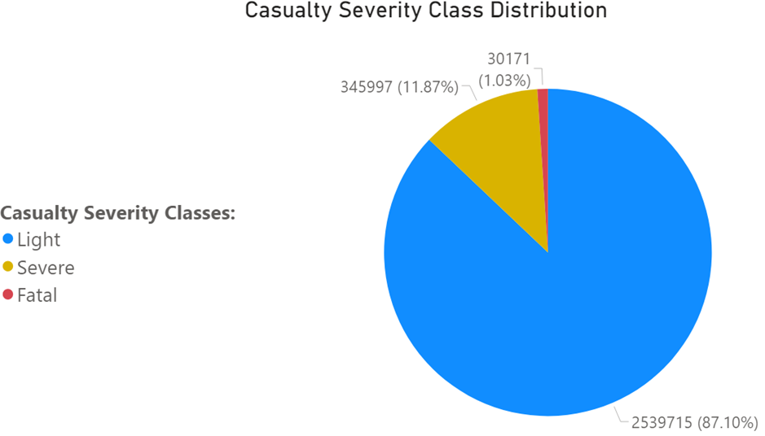
Data Preparation Casualty Severity imbalanced distribution

Slide 9
Data Preparation Missing values after merging
Total rows | 2,915,883
Total columns | 66
Number of full rows | 411,158
Number of rows where at least one value is missing | 2,504,725
Percentage of rows with missing values (%) | 85.9

Slide 10
Data Preparation Features dropped
Accident Index, Vehicle Ref. and Casualty Ref:
Features used only for data joins.
Age Band of Driver and Age Band of Casualty:
Data already include ages for casualties and drivers.
Latitude, Longitude and LSOA of Accident Location:
Data already include Eastings and Northings.
Did Police attend Accident Scene, Accident Severity and No of Casualties:
Post-accident information was removed from the research.
Road Maintenance Worker, Journey Purpose of Driver and Engine Capacity:
Excessive number of missing values, “unknown” and “not applicable”. Engine Capacity data inconsistent with Vehicle Types.

Slide 11
Data Preparation Correction for “unknown” values
Values for “unknown” were re-encoded as missing with -1:
Urban or Rural Area
Sex of Casualty
Sex of Driver
Pedestrian Location
Pedestrian Movement
Light Conditions

Slide 12
Data Preparation Missing value imputation based on domain knowledge
Car Passenger:
Missing values for buses and vans were replaced with “Not car passenger”.
Towing or Articulation:
It was assumed that bicycles, motorcycles and mobility scooters do not have such.
Left / Right Hand Drive Vehicles:
A new category for “unknown” was created for bicycles, horses, motorcycles and trams.
Junction Location, Junction Detail, Junction Control and 2nd Road Class:
Many missing values were corrected as they referred to accidents not near to a junction.

Slide 13
Data Preparation Missing value imputation based on domain knowledge
Age of Driver, Age of Casualty, Casualty Home Area Type and Driver Home Area Type:
Corrected for samples where the casualty was the driver.
Light Conditions:
Set to “Daylight” after checking Time.
Eastings, Northings, Time:
Data points dropped (very small amount).

Slide 14
Data Preparation Missing values after manual imputation
Total rows | 2,915,387
Total columns | 53
Number of full rows | 1,443,492
Number of rows where at least one value is missing | 1,471,895
Percentage of rows with missing values (%) | 50.49

Slide 15
Data Preparation Time processing
2 variables denoting incident time:
Date
Time
New categorical variables:
Hour
Month
Year
Date and Time were discarded

Slide 16
Data Preparation Feature correlation and importance
Variables treated as numerical:
Number of Vehicles
Speed Limit
Age of Casualty
Age of Vehicle
Age of Driver
Eastings and Northings (British National Grid)
All remaining variables were nominal:
Discrete values (integers) without any intrinsic ranking
Target variable:
Casualty Severity

Slide 17
Data Preparation Feature importance with respect to Casualty Severity
Numerical variables
ANOVA F – statistic
Categorical variables
X² – squared statistic
Correlation ratio
Mutual information (based on entropy)
Cramer’s V coefficient
Theil’s U coefficient (anti-symmetrical)

Slide 18
Data Preparation Feature correlation between pairs of data variables
Categorical - Categorical
Mutual information
Cramer’s V coefficient
Categorical – Numerical
Correlation ratio coefficient
Numerical – Numerical
Pearson’s correlation coefficient
Theil’s U coefficient

Slide 19
Data Preparation Feature correlation results
Categorical variables:
Important features: Casualty Type, Vehicle Type and Vehicle Maneuver.
Least important features: Carriageway Hazards, Was Vehicle Left Hand Drive and Pedestrian Crossing-Human Control.
Numerical variables:
Important features: Number of Vehicles and Speed Limit.
Least important features: Eastings and Northings.

Slide 20
Data Preparation Imputation with MissForest
Algorithm suitable for high dimensional data with mixed data types.
Challenges
Data size.
Memory capacity.
Speed Limit and Weather Conditions:
Features with minimal percentage of missing values.
Imputed first to expand the number of complete features.
The rest of the variables divided in thematic groups.
Imputation pipeline can be reviewed if larger memory is available.

Slide 21
Data Preparation Imputation with MissForest – thematic groups
Junctions and Road Classes
Pedestrians
Vehicle-Site Interaction
Drivers-Vehicles
Age of Vehicle
Driver IMD Decile

Slide 22
Data Preparation More features dropped
Location related variables:
Police Force, Local Authority (District), Local Authority (Highway), Eastings and Northings were highly correlated.
Only Local Authority (District) was kept.
1st Road Number and 2nd Road Number were dropped due to high cardinality.
Casualty, driver and vehicle related variables:
Casualty Type dropped: Highly correlated with Casualty Class and Vehicle Type.
Casualty Home Area Type dropped: Highly correlated with Driver Home Area Type.

Slide 23
Baseline Models Multi-layered Perceptron
Merging Accidents, Vehicles and Casualties
Stage 1:
Vehicles + Casualties join on Vehicle Reference.
Vehicles not matched with a casualty were removed.
Stage 2:
Stage 1 + Accidents join on Accident Index.
Output:
2,915,883 rows and 66 features.
Casualty severity class distribution heavily imbalanced.

Slide 24
Baseline Models Reinforcement Learning Deep Q Network
Merging Accidents, Vehicles and Casualties
Stage 1:
Vehicles + Casualties join on Vehicle Reference.
Vehicles not matched with a casualty were removed.
Stage 2:
Stage 1 + Accidents join on Accident Index.
Output:
2,915,883 rows and 66 features.
Casualty severity class distribution heavily imbalanced.

Slide 25
UK Department for Transport Traffic Accident Data
Available to the public

